Slide 1
ALD alumina protection layer
Effect on Vπ·L and insertion loss in the Cordoba and buffered Lisbon lifted designs
1575 nm · 550 nm LN film, 275 nm etch · rib top width 1.4 µm · full LN slab (no slab etch)

Slide 2
What we studied
A thin alumina film covers every exposed surface after the electrodes are made
The layer
Cordoba
Lisbon lifted, buffered
ALD Al₂O₃, conformal on all surfaces.
Nominal thickness 40 nm, swept from 0 to 100 nm.
Optical index 1.74, RF permittivity 9.8.
Gold electrodes directly on the LN slab.
Electrode gap 4.2 µm.
Reference: 0.43 dB/cm and 2.17 V·cm.
Gold on a 200 nm SiO₂ buffer.
Bottom gap 3.4 µm.
Very low loss: 0.03 dB/cm.
Questions: how much does the layer lower Vπ·L, how much loss does it add, and can it let us widen the Lisbon gap?

Slide 3
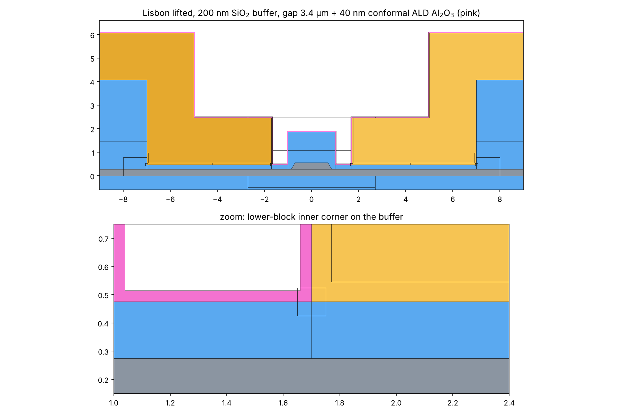
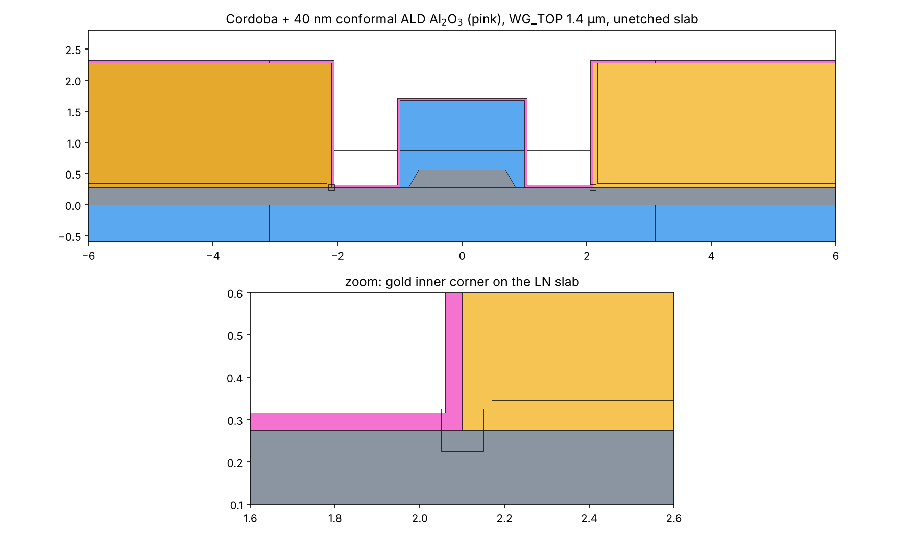
The two cross-sections with 40 nm of alumina
Alumina shown in pink; the bottom panels zoom on the electrode corner
Cordoba
Lisbon lifted with 200 nm SiO₂ buffer

Slide 4
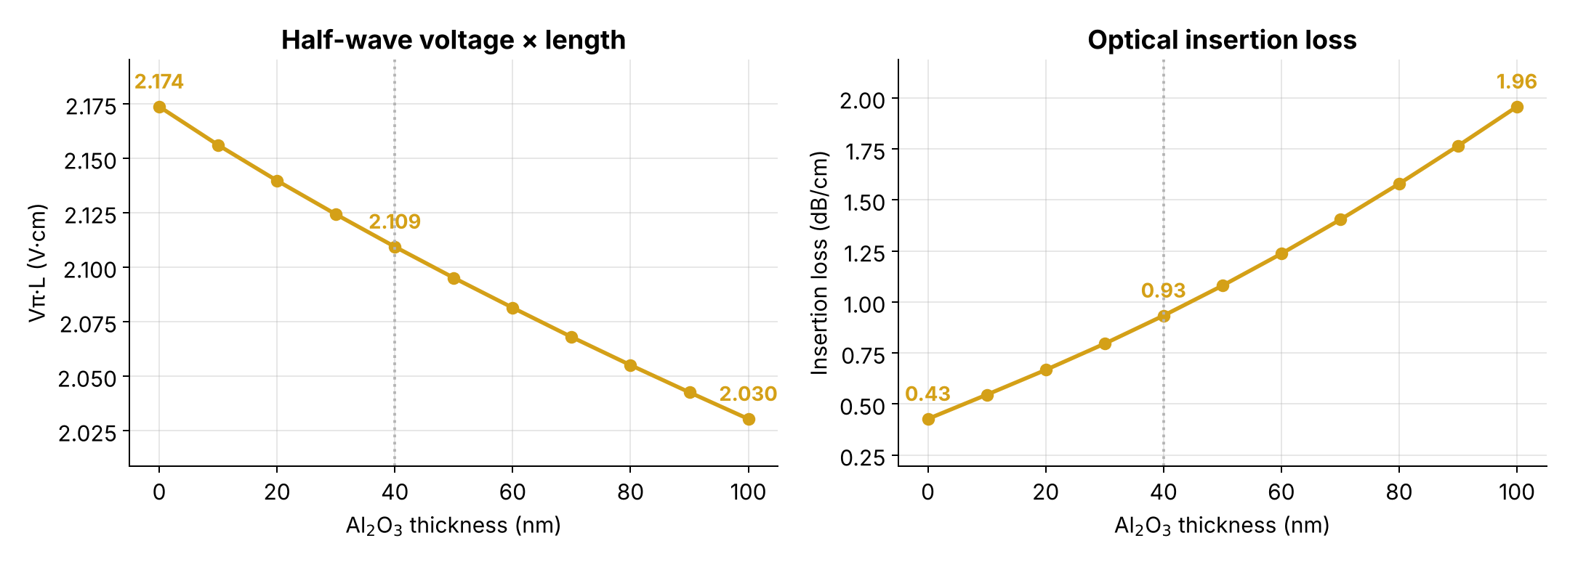
Cordoba: alumina lowers Vπ·L but doubles the loss at 40 nm
Gap 4.2 µm
−3 %
×2.2
Vπ·L at 40 nm (2.174 → 2.109 V·cm)
loss at 40 nm (0.43 → 0.93 dB/cm)
Notes:
Validated against COMSOL: the Vpi*L change matches point by point; the IL increase factor matches within about 3 %. Absolute IL differs by a constant ~25 % ratio, most likely gold permittivity or mesh at the metal in COMSOL.

Slide 5
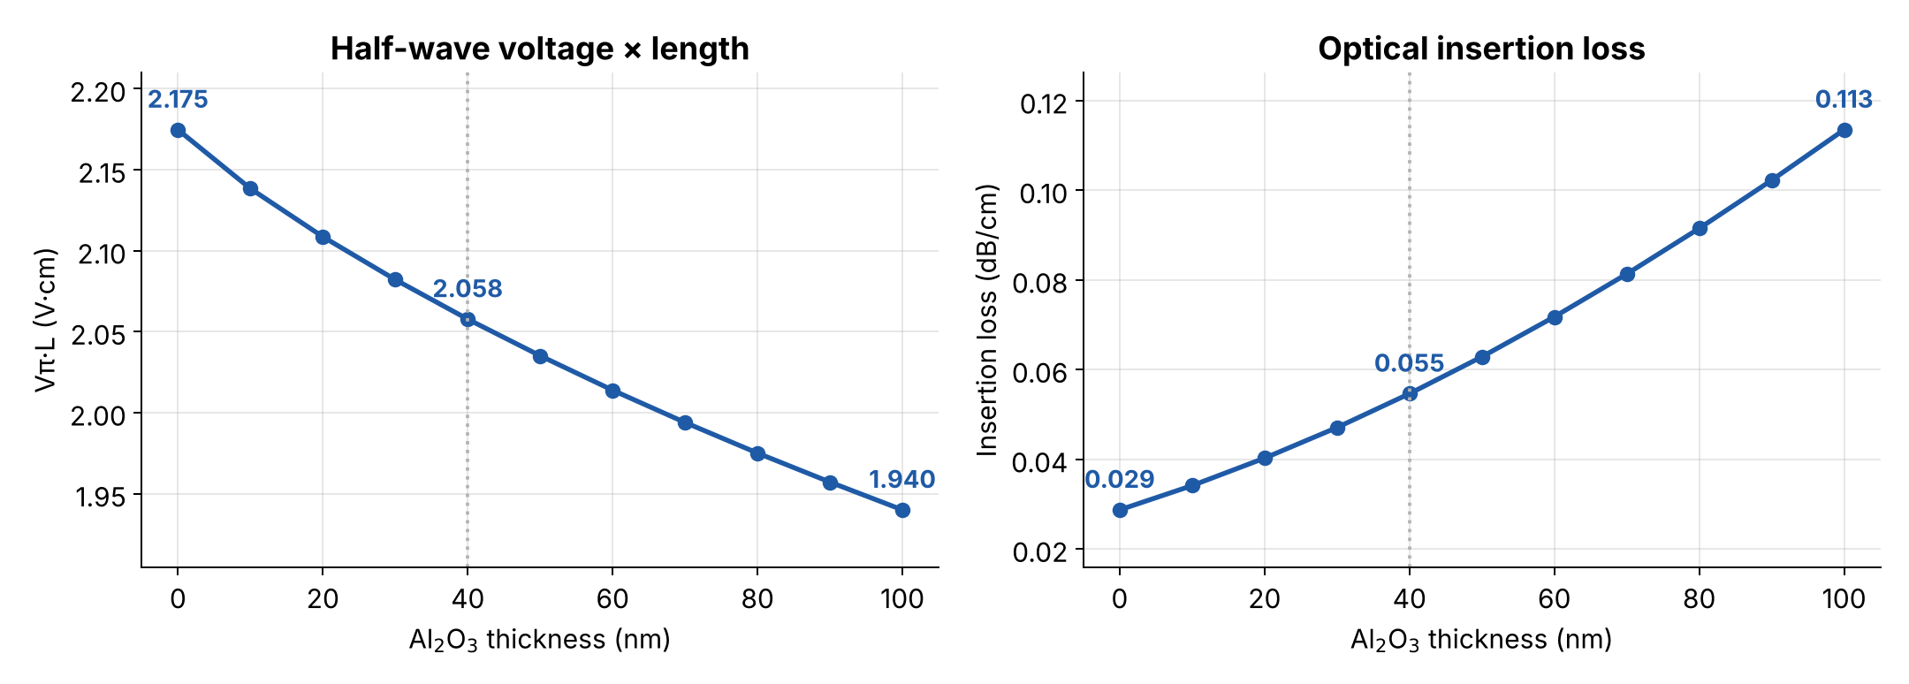
Lisbon buffered: a larger Vπ·L gain, loss stays very low
Bottom gap 3.4 µm
−5.4 %
0.055 dB/cm
Vπ·L at 40 nm (2.175 → 2.058 V·cm)
loss at 40 nm, still 8× below bare Cordoba

Slide 6
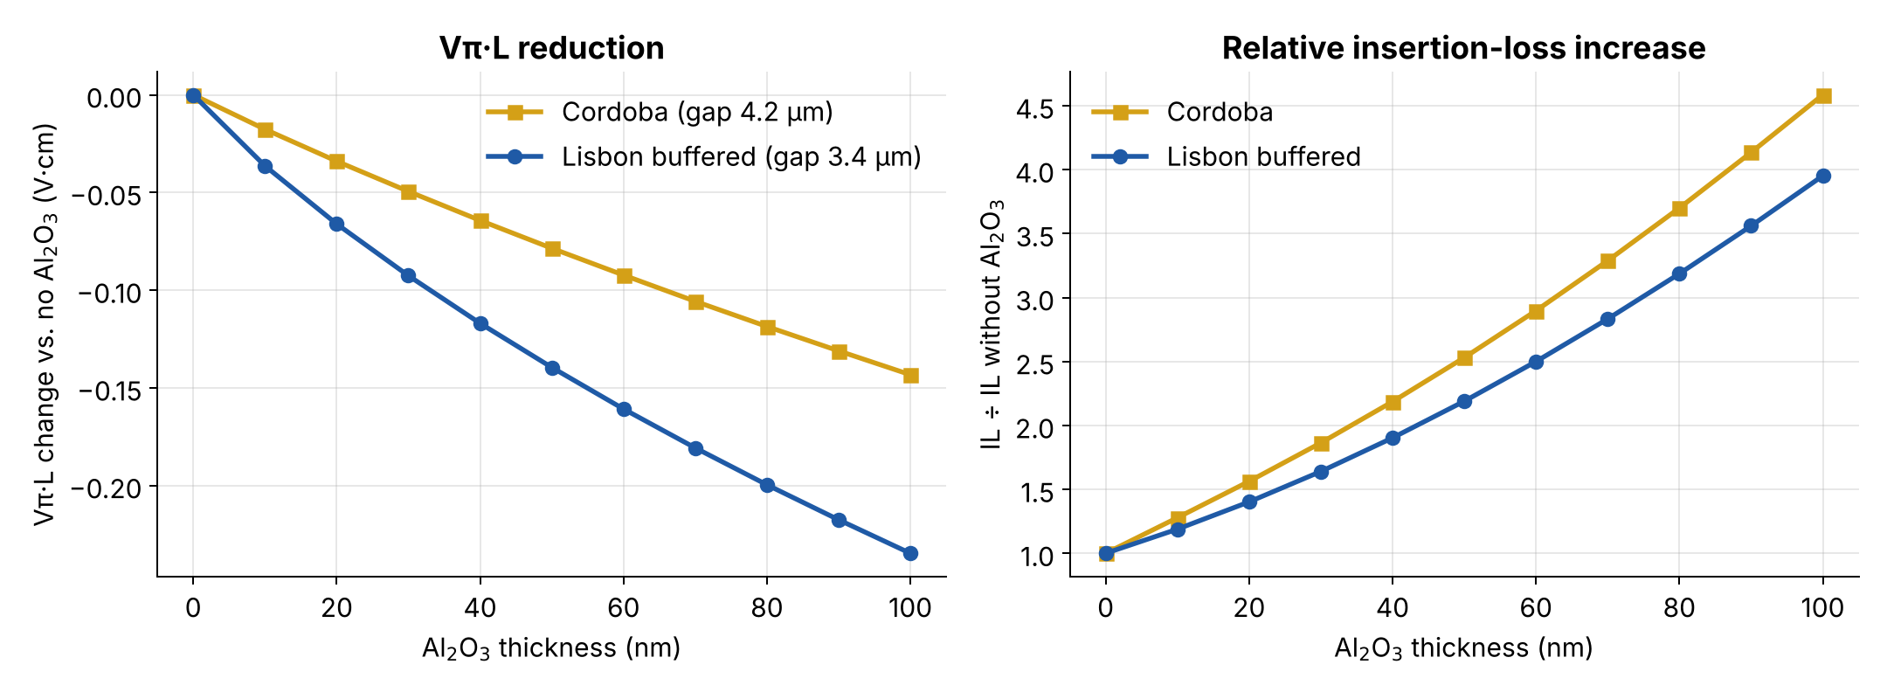
Side by side: same trend, different strength
Changes are measured from each design without alumina
Both designs start from the same Vπ·L (2.17 V·cm), but Lisbon gains almost twice as much
Loss grows by a similar factor in both, yet Lisbon starts about 15 times lower

Slide 7
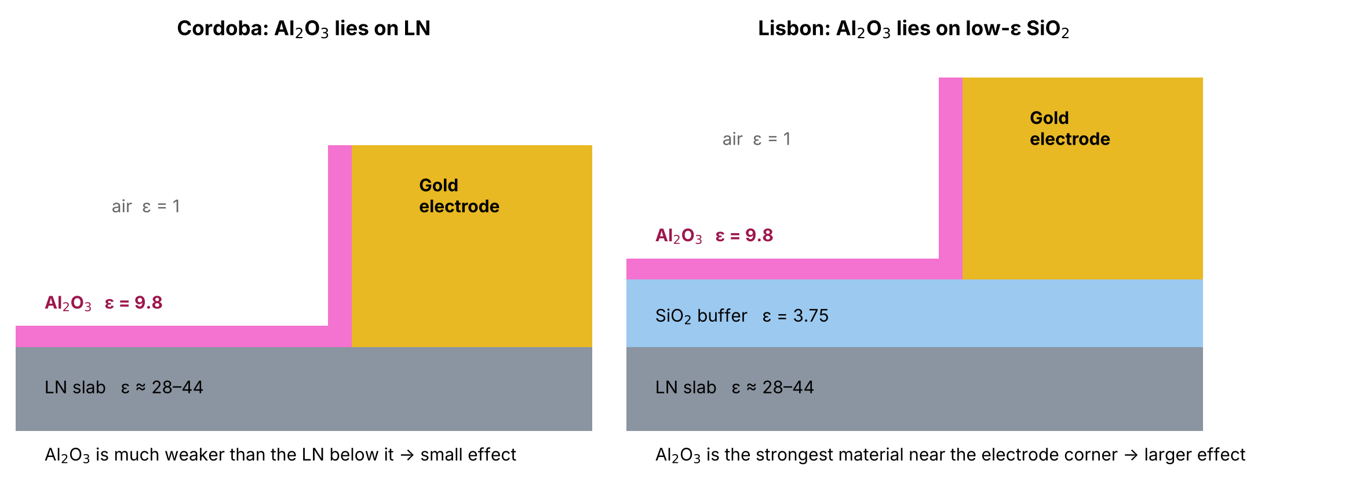
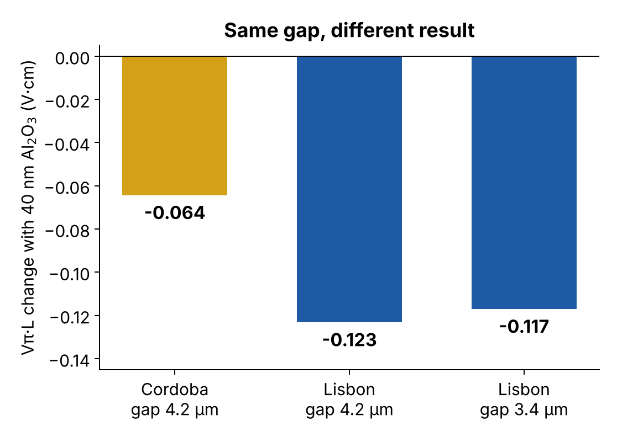
Why Lisbon gains more: what the alumina sits on
Simplified drawing, not to scale
In Cordoba, the electric field already prefers the LN, which is far more polarisable than alumina
In Lisbon, alumina is the most polarisable material at the electrode level. It acts like a small extension of the electrode toward the waveguide
Test: at the same 4.2 µm gap, Lisbon still gains twice as much (right). The buffer, not the narrower gap, causes the difference

Slide 8
Is it the mesh? No
Repeating the 40 nm case with a much finer mesh barely changes the results
Check (40 nm alumina) | Mesh | Vπ·L change | Loss change
Lisbon, gap 3.4 µm | 30 % finer everywhere | +0.01 % | −0.8 %
Lisbon, gap 3.4 µm | 5 elements across the alumina (instead of 3) | < 0.01 % | −0.2 %
Lisbon, gap 4.2 µm | 30 % finer everywhere | +0.01 % | −0.8 %
Cordoba, gap 4.2 µm | 30 % finer everywhere | +0.02 % | −0.6 %
Cordoba, gap 4.2 µm | 5 elements across the alumina (instead of 3) | 0.00 % | +0.03 %
0.05 V·cm
the Lisbon–Cordoba difference at 40 nm: 100× larger than any mesh effect

Slide 9
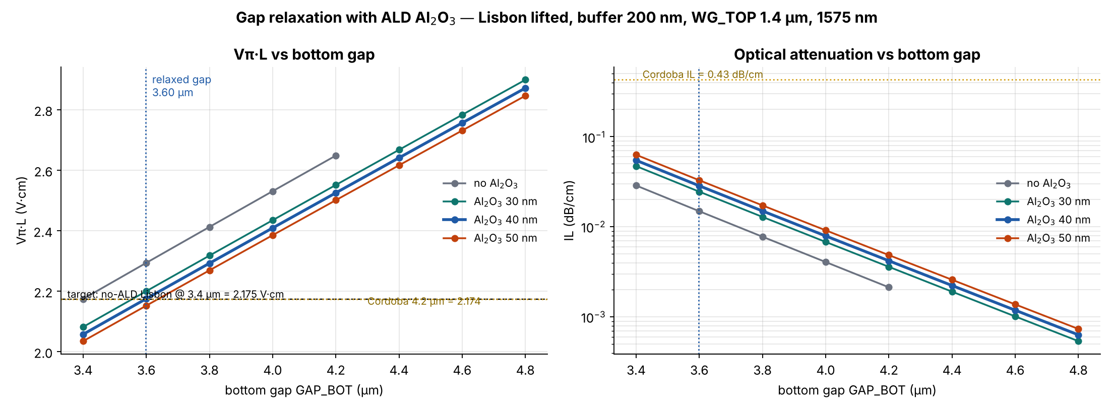
Gap relaxation: from 3.4 µm to 3.6 µm
Target: the Vπ·L of Lisbon without alumina at 3.4 µm (2.175 V·cm, same as Cordoba)
3.60 µm
0.029 dB/cm
+0.58 V·cm / µm
relaxed bottom gap with 40 nm alumina
loss at 3.60 µm: 15× below Cordoba
Vπ·L cost of widening the gap
Notes:
Vpi*L grows steeply with the gap, so the 0.12 V*cm gained from the alumina buys only about 0.2 um. Loss is never the limit: it falls with the gap and stays below 0.001 dB/cm at 4.8 um.

Slide 10
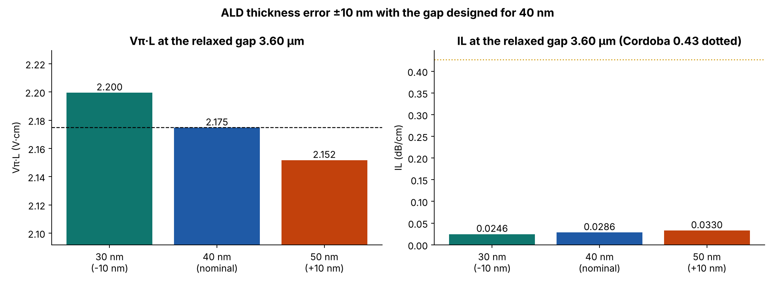
Robustness: alumina thickness ±10 nm
The gap is fixed at 3.60 µm, designed for 40 nm
A ±10 nm error moves Vπ·L by only ±1.1 % (2.200 to 2.152 V·cm)
That equals a gap error of about 40 nm: the gap lithography matters more than the alumina control
Loss stays between 0.025 and 0.033 dB/cm in all cases

Slide 11
Conclusions
1
Alumina lowers Vπ·L in both designs
by 3 % in Cordoba and 5.4 % in Lisbon at 40 nm
2
The difference is physical
the buffer makes the alumina more effective; the mesh is not the cause
3
Loss is not a concern for Lisbon
below 0.06 dB/cm at the original gap, below 0.03 dB/cm at 3.6 µm
4
Gap gain is modest: 3.4 → 3.6 µm
a wider gap is possible only by accepting a higher Vπ·L
5
Process tolerance is comfortable
±10 nm of alumina changes Vπ·L by about ±1 %

