Slide 1
Arm imbalances in a push-pull TW-MZM
Effect on EO bandwidth and eye diagram, and how each is represented in Lumerical INTERCONNECT

Slide 2
Overview
0
Framework
1
The six imbalances
2
INTERCONNECT representation
How the EO bandwidth and the eye are computed
The eye features and how they are measured
The INTERCONNECT schematic, block by block
The two-arm model every imbalance enters
Eye diagrams computed by the code, per value
Equations linking the imbalance to the eye / EO BW
Range, typical value, physical and fabrication cause
Which block or property carries each imbalance
Summary matrix
Reference device for every number and plot in this deck
Measured line “Jerez” (Touchstone, L_{meas} = 2.5 mm) scaled to L = 16.5 mm · R_{S} = 50 Ω, R_{T} = 53 Ω · n_{g} = 2.27 · V_{π} = 4 V per arm (2 V push-pull) · 1550 nm, 13 dBm laser (19.95 mW), responsivity 1 A/W
100 Gb/s NRZ, PRBS-9, 2.0 V_{pp} drive, driver 70 GHz / receiver 75 GHz (4th-order Bessel), 32 samples per bit, receiver noise OFF (so every change seen is caused by the imbalance). Balanced EO BW = 84.47 GHz.

Slide 3
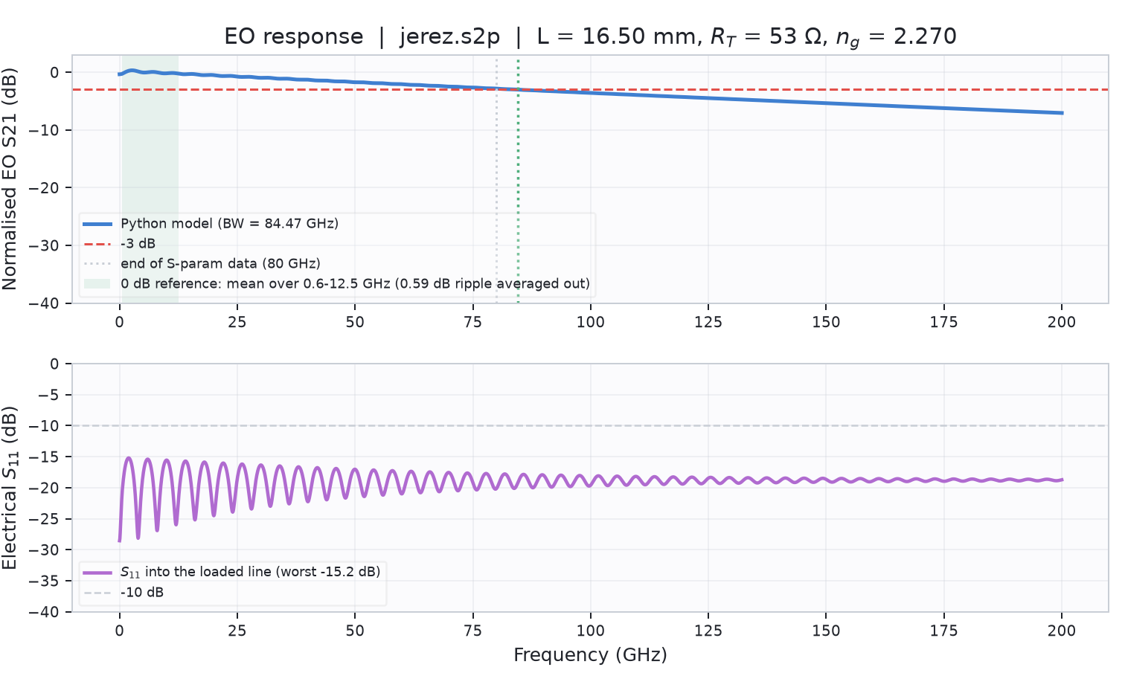
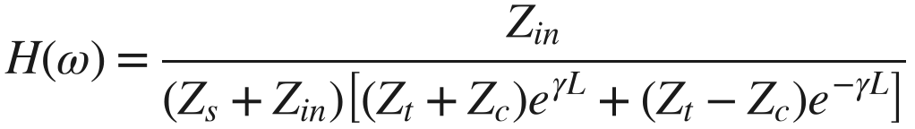
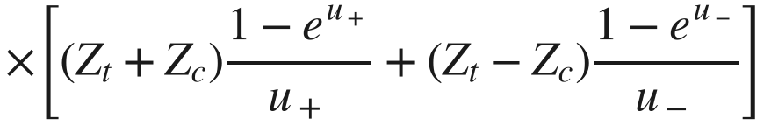
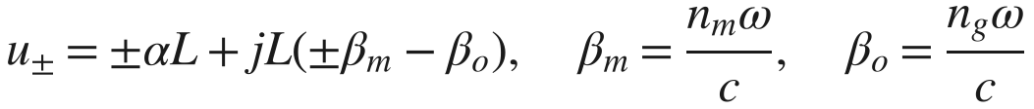

0.1 How the EO bandwidth is computed
Travelling-wave transfer function of one electrode, then the two-arm combination
Electrode transfer function (per arm, n_{g} of that arm)
$$H(ω)=\frac{Z_{in}}{(Z_{s}+Z_{in})\left[(Z_{t}+Z_{c})e^{γL}+(Z_{t}−Z_{c})e^{−γL}\right]}$$
$$×\left[(Z_{t}+Z_{c})\frac{1−e^{u_{+}}}{u_{+}}+(Z_{t}−Z_{c})\frac{1−e^{u_{−}}}{u_{−}}\right]$$
$$u_{±}=±αL+jL\left(±β_{m}−β_{o}\right), β_{m}=\frac{n_{m}ω}{c}, β_{o}=\frac{n_{g}ω}{c}$$
Whole modulator, normalisation, bandwidth
$$ΔP(f)∝−2a_{1}a_{2}sinΔφ_{0}\left[g_{1}H_{1}(f)−g_{2}H_{2}(f)\right]V(f)$$
$$S_{21}(f)=20\log_{10}|H_{dev}(f)|−⟨20\log_{10}|H_{dev}|⟩_{f_{lo}..f_{hi}}$$
$$BW: S_{21}(f_{3dB})=−3 dB$$
α(f), n_{m}(f), Z_{c}(f): fitted to the de-embedded Touchstone, then scaled to L
Plateau window f_{lo}..f_{hi} averages the low-frequency ripple; INTERCONNECT’s read-back uses the same window
The prefactor before the bracket is frequency-flat: it cancels on normalisation
Right: normalised EO S₂₁ (top) and electrical S₁₁ (bottom) of the balanced reference device; BW = 84.47 GHz.

Slide 4
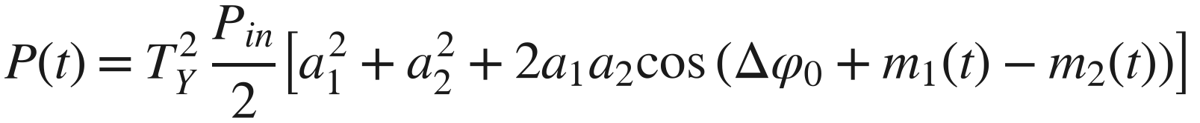
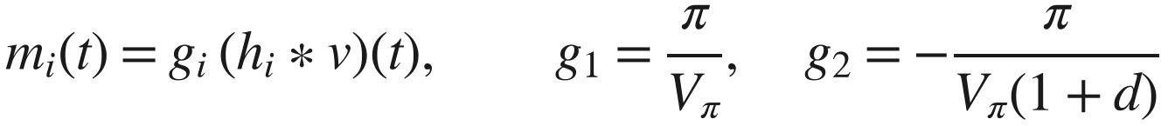
0.2 How the eye diagram is computed
Time-domain simulation of the same device, folded on two unit intervals (UI = 1 / bit rate = 10 ps)
PRBS-9
NRZ driver
Electrode
Arm phases
Interferometer
Photodiode + Rx
Fold + measure
511-bit pattern,
100 Gb/s
±V_{pp}/2 = ±1 V
Bessel-4, 70 GHz
H₁(f), H₂(f)
one per arm
m_{i} = g_{i}(h_{i} ∗ v)
g_{i} = ±π/V_{π,i}
Y branch → arms →
Y branch, bias 90°
1 A/W, Bessel-4,
75 GHz, noise off
2-UI traces, labelled
by transmitted bit
Output power: two-beam interference of the arm fields
$$P(t)=T_{Y}^{2} \frac{P_{in}}{2}\left[a_{1}^{2}+a_{2}^{2}+2a_{1}a_{2}cos\left(Δφ_{0}+m_{1}(t)−m_{2}(t)\right)\right]$$
$$m_{i}(t)=g_{i} (h_{i}*v)(t), g_{1}=\frac{π}{V_{π}}, g_{2}=−\frac{π}{V_{π}(1+d)}$$
Symbols
a₁, a₂: arm field amplitudes after the input Y branch · Δφ₀: static phase (bias + error) · T_{Y}: power transmission of one Y branch · h_{i}: impulse response of H_{i}
Why it agrees with the EO BW
The eye uses the same electrode function H_{i}(f) as the bandwidth, evaluated on the FFT grid. The whole PRBS period is one FFT period, so filtering is exact (no edge effects). Delay is removed by cross-correlation.

Slide 5
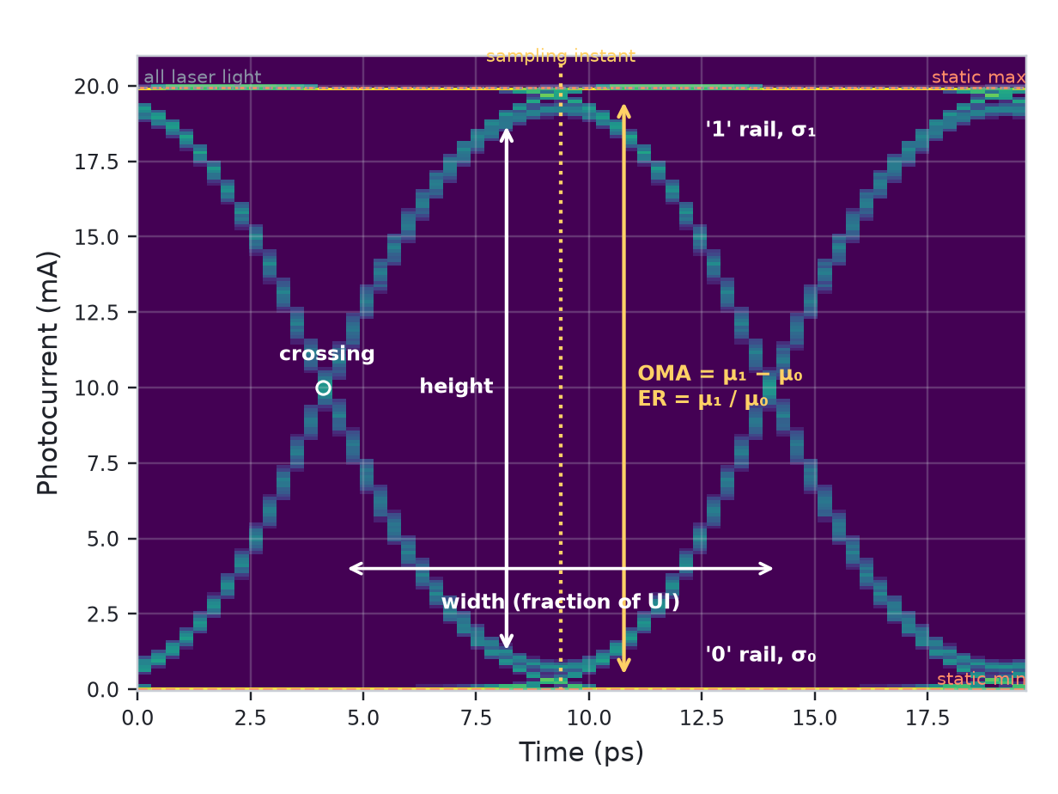
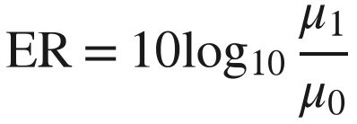

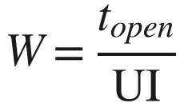

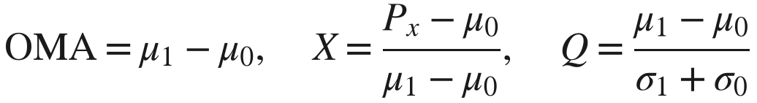
0.3 The eye features and how they are measured
The four features
Extinction ratio (aperture)
$$ER=10\log_{10}\frac{μ_{1}}{μ_{0}}$$
Height (vertical margin)
$$H=(μ_{1}−3σ_{1})−(μ_{0}+3σ_{0})$$
Width (timing margin): fraction of UI where worst 1 > worst 0
$$W=\frac{t_{open}}{UI}$$
Rail thickness (cleanness)
$$σ_{1}, σ_{0}=std of each level$$
Also reported
How they are set: μ and σ are taken at the sampling instant of maximum opening; every trace is labelled by the bit that was sent (no threshold).
Standard instruments (IEEE 802.3) average over the central ~20 % of the UI; identical for flat rails.
$$OMA=μ_{1}−μ_{0}, X=\frac{P_{x}−μ_{0}}{μ_{1}−μ_{0}}, Q=\frac{μ_{1}−μ_{0}}{σ_{1}+σ_{0}}$$
Notes:
OMA: optical modulation amplitude. X: crossing percentage. Q: quality factor. mu/sigma: mean and standard deviation of the photocurrent of each level at the sampling instant. Dashed lines on the code plots: static maximum/minimum of the transfer curve (infinite bandwidth); dotted: all laser light reaching the detector.

Slide 6
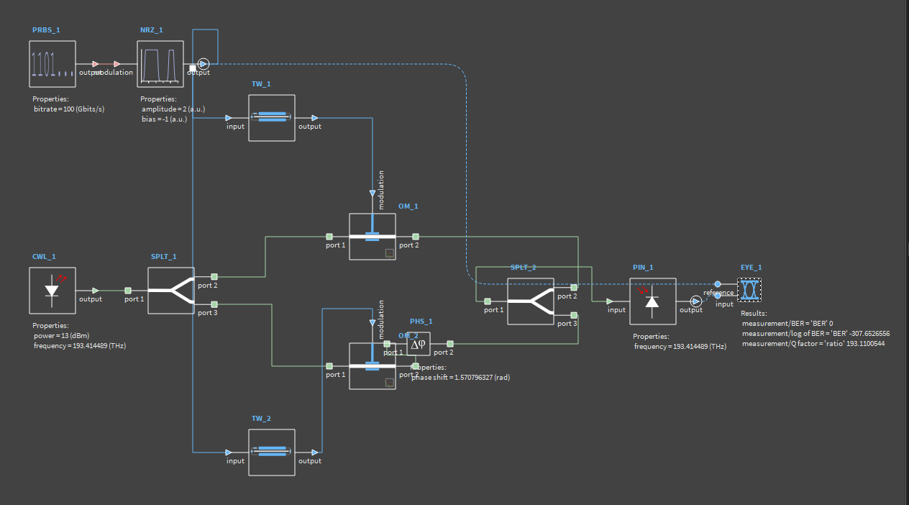
0.4 The MZM schematic in INTERCONNECT
Built by the API (eye mode). For the EO bandwidth, PRBS/NRZ/EYE are replaced by a network analyser (ENA)
Reading the schematic
Green: optical path
CWL → SPLT_1 → OM_1 / OM_2 (+PHS_1) → SPLT_2 → PIN
Blue: electrical path
PRBS → NRZ → TW_1 / TW_2 → OM modulation ports
Dashed: timing reference
NRZ output → EYE reference (without it no eye is computed)
Why not the built-in MZM element?
It is lumped (π dc/rf voltage, ER, insertion loss): no travelling-wave electrode, so no measured α(f), n_{m}(f), Z_{c}(f).

Slide 7
0.5 Blocks and the parameters that matter here
Block | INTERCONNECT element | Function | Relevant parameters (reference value)
CWL_1 | CW Laser | Optical carrier | power 13 dBm · frequency 193.414 THz (1550 nm) · linewidth 0
SPLT_1 | Waveguide Y Branch | Input splitter | coupling coefficient 0.5 (→ split error) · insertion loss (→ Y loss)
TW_1, TW_2 | Traveling Wave Electrode | Microwave line, one per arm | length 16.5 mm · optical index n_{g} per arm · loss / Z_{c} / n_{m} tables · R_{S} 50 Ω, R_{T} 53 Ω
OM_1, OM_2 | Optical Modulator Measured | Phase modulation of each arm | input parameter = coefficients · phase coefficient c = ∓π/(V_{π,i}·L) · length L = 1 µm · lumped
PHS_1 | Optical Phase Shift | Bias of the interferometer | phase shift = 90° + static phase error (1.5708 rad at quadrature)
ATT_1 | Optical Attenuator | Extra loss in arm 2 (only if ≠ 0) | attenuation = arm loss imbalance (dB)
SPLT_2 | Waveguide Y Branch | Output combiner | coupling coefficient 0.5 · insertion loss (→ Y loss)
PIN_1 | PIN Photodetector | Optical → electrical | responsivity 1 A/W · noise sources off
PRBS_1 / NRZ_1 | PRBS / NRZ Pulse Generator | Drive signal | bitrate 100 Gb/s · order 9 · amplitude 2 · bias −1 (→ ±1 V) · rise/fall period
EYE_1 | Eye Diagram | Eye and its measurements | bitrate 100 Gb/s · input ← PIN · reference ← NRZ · calculate measurements
ENA_1 | Network Analyzer | EO bandwidth mode only | sweep to f_{max} · output → TW inputs · input ← PIN → normalised S₂₁

Slide 8






The two-arm model: where each imbalance enters
One equation, six knobs. Only n_{g} changes the frequency dependence, so only it can move the EO bandwidth
$$P(t)=T_{Y}^{2} \frac{P_{in}}{2}\left[a_{1}^{2}+a_{2}^{2}+2a_{1}a_{2}cos\left(Δφ_{0}+g_{1}(h_{1}*v)−g_{2}(h_{2}*v)\right)\right]$$
1 Arm loss imbalance
2 Splitter imbalance
3 Static phase error
$$a_{2}=\sqrt{1−ρ} {10}^{−ΔL/20}$$
$$a_{1}=\sqrt{ρ}, a_{2}=\sqrt{1−ρ}, ρ=0.5+ε$$
$$Δφ_{0}={90}^{∘}+φ$$
changes: amplitude of arm 2
changes: both amplitudes
changes: operating point
4 V_{π} imbalance
5 n_{g} imbalance
6 Y-branch excess loss
$$g_{2}=−\frac{π}{V_{π}(1+d)}$$
$$h_{1,2} from n_{g}(1±dn/2)$$
$$T_{Y}={10}^{−IL/10}$$
changes: modulation efficiency
changes: frequency response
changes: common-mode scale

Slide 9
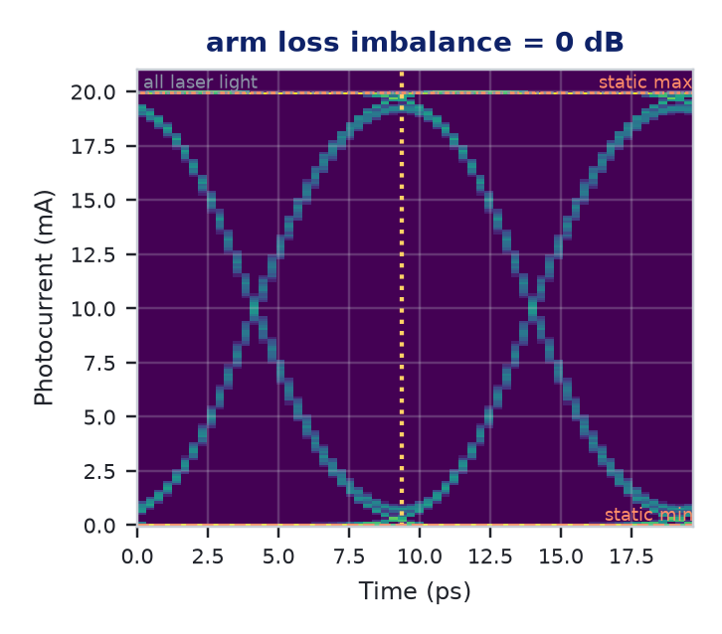
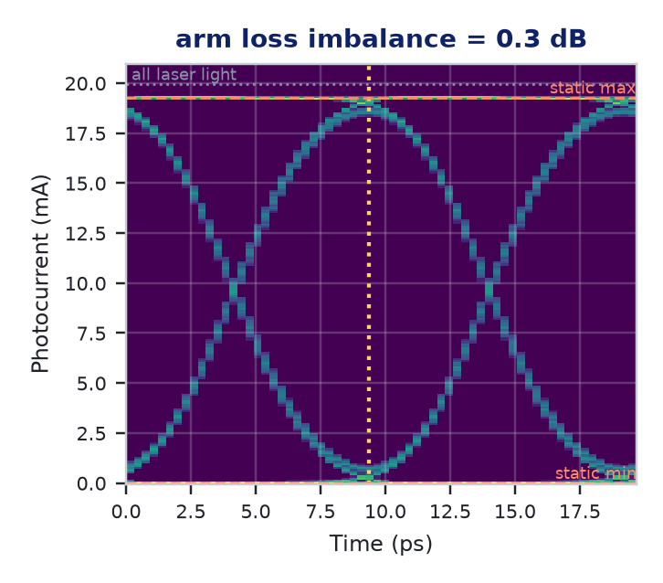
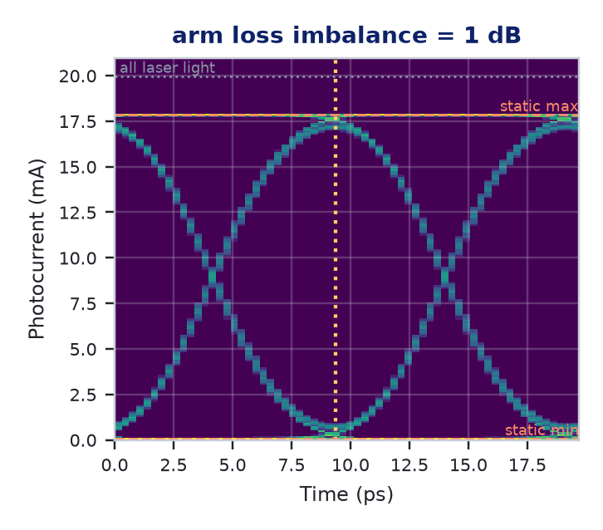
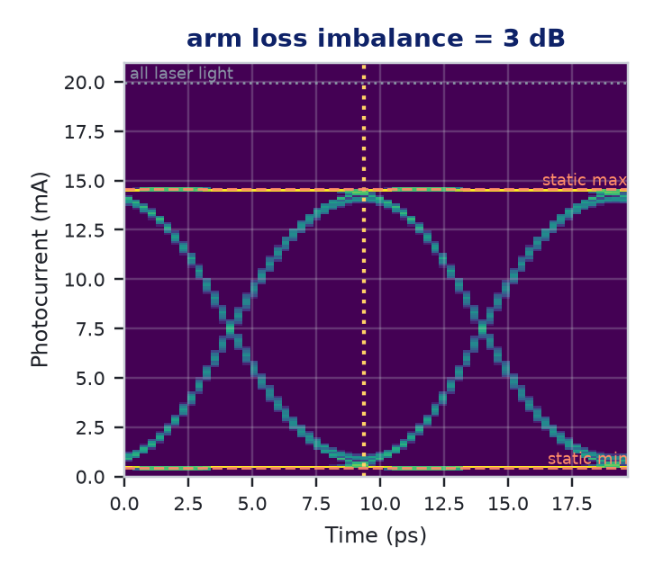
1 Arm loss imbalance: effect on the eye
The '0' rail lifts off zero and the top drops: extinction ratio falls; timing is untouched
ΔL (dB) | ER static | ER eye | 1/ER rule | μ₁ (mA) | μ₀ (mA) | Height (mA) | Mean P (mW) | EO BW (GHz)
0 | ∞ | 17.86 | 17.86 | 19.63 | 0.321 | 17.71 | 10.00 | 84.47
0.3 | 35.26 | 17.79 | 17.78 | 18.97 | 0.316 | 17.11 | 9.66 | 84.47
1 | 24.81 | 17.06 | 17.06 | 17.55 | 0.345 | 15.79 | 8.97 | 84.47
3 | 15.34 | 13.41 | 13.41 | 14.32 | 0.653 | 12.54 | 7.50 | 84.47
Reading it
ER falls: 17.86 → 13.41 dB at 3 dB
Width 0.969 UI and crossing 50 % unchanged
Rails get thinner: the swing is smaller, so is the ISI
“1/ER rule” column: predicted eye ER, matches the code to 0.01 dB
Eyes computed by mzm_interconnect.eye on the reference device. Dashed: static max/min of the transfer curve (infinite bandwidth); dotted: all laser light; vertical dotted: sampling instant.

Slide 10
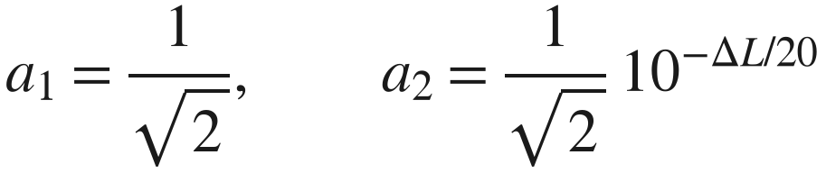
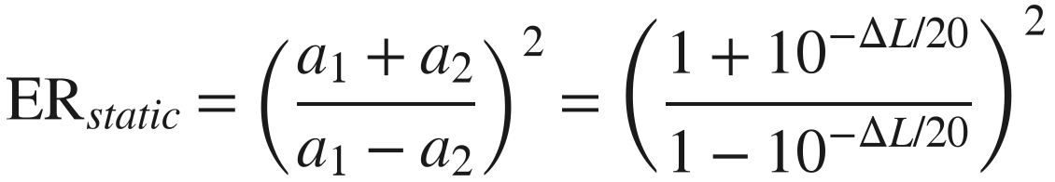
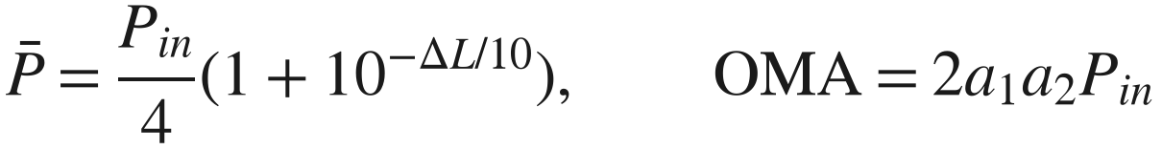
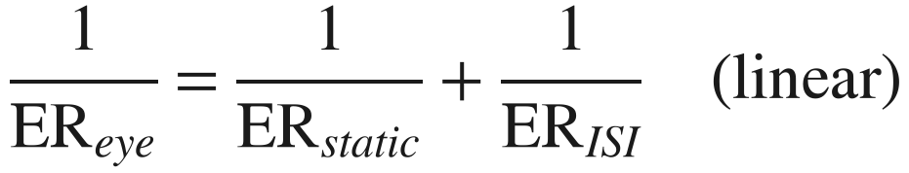
1 Arm loss imbalance: mechanism
How it enters the equations
Range
0 – 3 dB in the GUI. Typical 0 – 0.3 dB: 5 % loss-coefficient difference at 0.2 dB/cm over 16.5 mm is only 0.017 dB; above ~1 dB suspect a localised defect.
$$a_{1}=\frac{1}{\sqrt{2}}, a_{2}=\frac{1}{\sqrt{2}} {10}^{−ΔL/20}$$
$${ER}_{static}={\left(\frac{a_{1}+a_{2}}{a_{1}−a_{2}}\right)}^{2}={\left(\frac{1+{10}^{−ΔL/20}}{1−{10}^{−ΔL/20}}\right)}^{2}$$
Physical / fabrication cause
Different propagation loss in the two arms: sidewall-roughness scattering after an asymmetric over-etch, a mode pushed closer to the metal (absorption), a particle or local defect, unequal bends.
$$\overset{‾}{P}=\frac{P_{in}}{4}\left(1+{10}^{−ΔL/10}\right), OMA=2a_{1}a_{2}P_{in}$$
Eye ER = static ceiling combined with the balanced eye's ISI floor (ER_ISI = 17.86 dB):
$$\frac{1}{{ER}_{eye}}=\frac{1}{{ER}_{static}}+\frac{1}{{ER}_{ISI}} (linear)$$
In INTERCONNECT
Optical Attenuator ATT_1 in arm 2, property attenuation = ΔL (dB). Alternative: OM_2 absorption coefficient a. A negative value is modelled by swapping the arms.
EO bandwidth
Unchanged (84.47 GHz at every value): a₁a₂ is a flat factor.

Slide 11
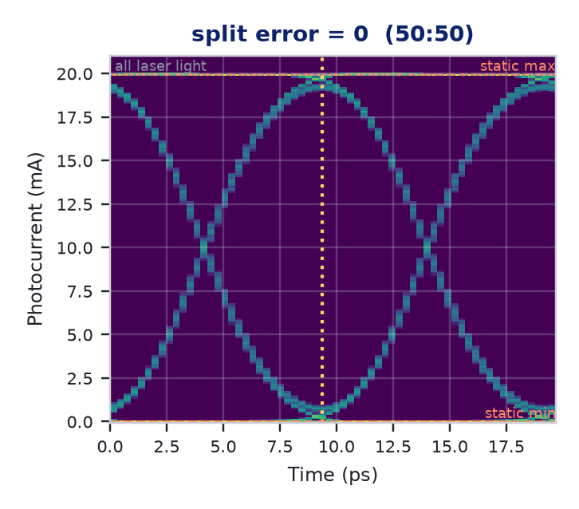
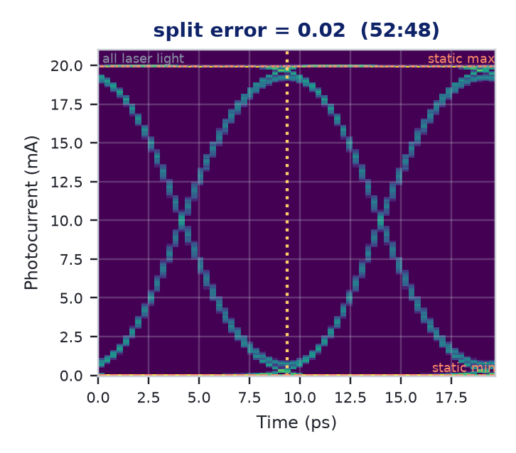

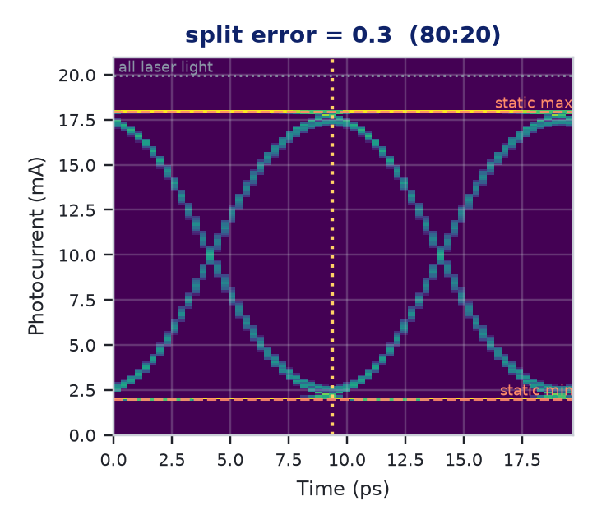
2 Splitter imbalance: effect on the eye
Same signature as arm loss, but the mean power stays constant: light is redistributed, not lost
ε (split) | ER static | ER eye | 1/ER rule | μ₁ (mA) | μ₀ (mA) | Height (mA) | Mean P (mW) | EO BW (GHz)
0 | ∞ | 17.86 | 17.86 | 19.63 | 0.321 | 17.71 | 10.00 | 84.47
0.02 | 33.98 | 17.76 | 17.76 | 19.62 | 0.329 | 17.70 | 10.00 | 84.47
0.1 | 19.91 | 15.76 | 15.76 | 19.44 | 0.516 | 17.36 | 10.00 | 84.47
0.3 | 9.54 | 8.95 | 8.95 | 17.70 | 2.252 | 14.17 | 9.99 | 84.47
Reading it
ER falls smoothly: 17.86 → 15.76 → 8.95 dB
Mean power fixed at 10.0 mW
Width and crossing unchanged
No threshold: at ε = 0.5 all light is in one arm and the interferometer is gone
Eyes computed by mzm_interconnect.eye on the reference device. Dashed: static max/min of the transfer curve (infinite bandwidth); dotted: all laser light; vertical dotted: sampling instant.

Slide 12
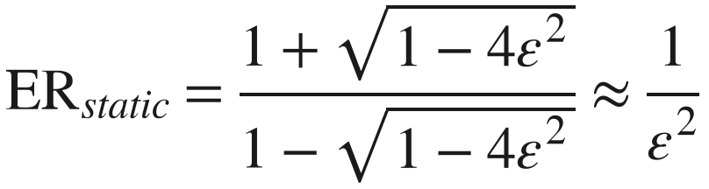
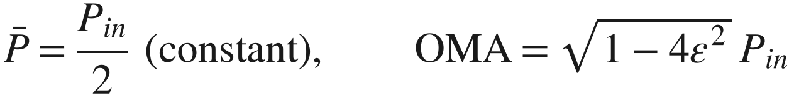
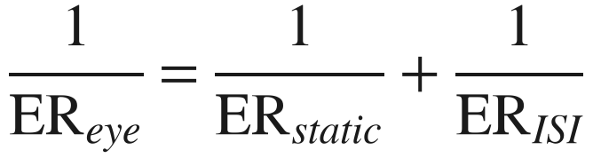
2 Splitter imbalance: mechanism
How it enters the equations
Range
0 – 0.45 in the GUI (deviation of the power fraction from 0.5). Typical 0.005 – 0.02 (50.5:49.5 to 52:48) for a good Y branch or MMI.
$$ρ=0.5+ε, a_{1}=\sqrt{0.5+ε}, a_{2}=\sqrt{0.5−ε}$$
$${ER}_{static}=\frac{1+\sqrt{1−4ε^{2}}}{1−\sqrt{1−4ε^{2}}}≈\frac{1}{ε^{2}}$$
Physical / fabrication cause
Geometric asymmetry at the junction: unequal branch widths (lithography / etch bias), unequal branch angles, tip rounding offset, asymmetric over-etch.
$$\overset{‾}{P}=\frac{P_{in}}{2} (constant), OMA=\sqrt{1−4ε^{2}} P_{in}$$
$$\frac{1}{{ER}_{eye}}=\frac{1}{{ER}_{static}}+\frac{1}{{ER}_{ISI}}$$
In INTERCONNECT
Waveguide Y Branch SPLT_1, coupling coefficient = 1 − ρ = 0.5 − ε (power to port 3 / arm 2). SPLT_2 stays 0.5. No extra block.
ε = 0.02 → ER_static ≈ 34 dB; ε = 0.1 → 19.9 dB; ε = 0.3 → 9.5 dB
EO bandwidth
Unchanged (84.47 GHz): a₁a₂ is a flat factor.

Slide 13
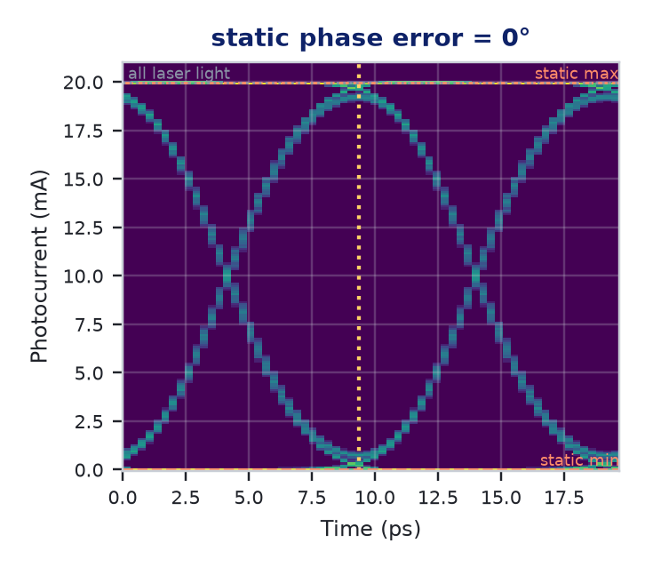
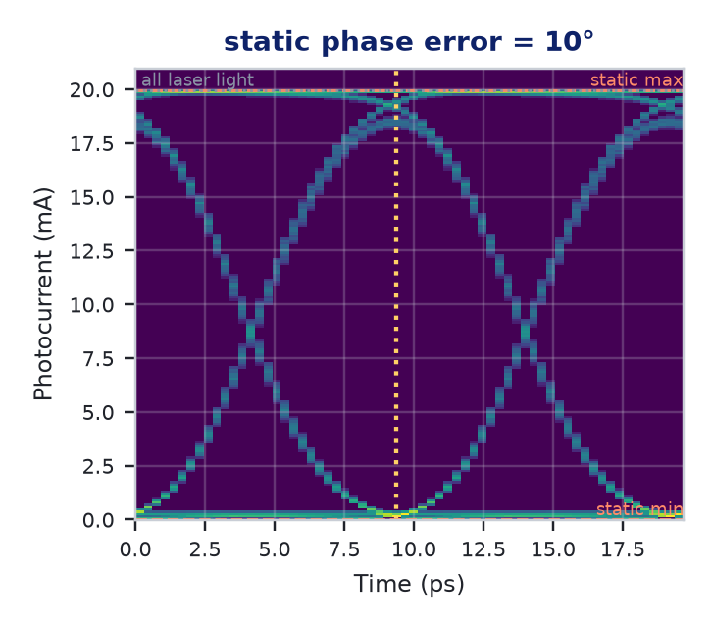
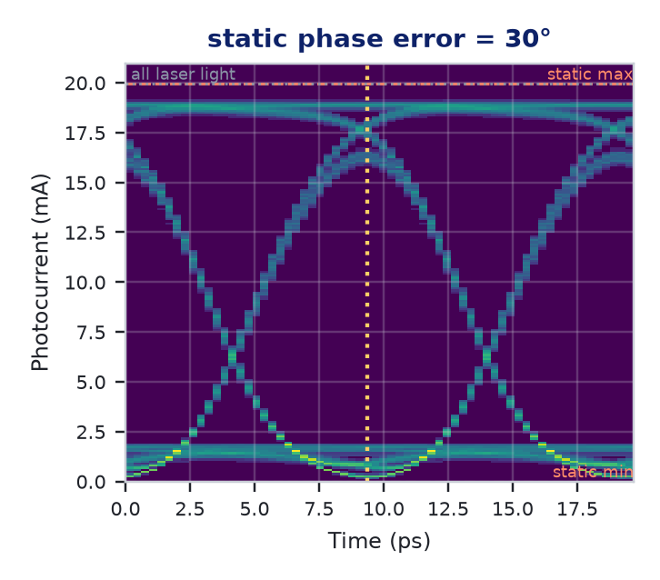
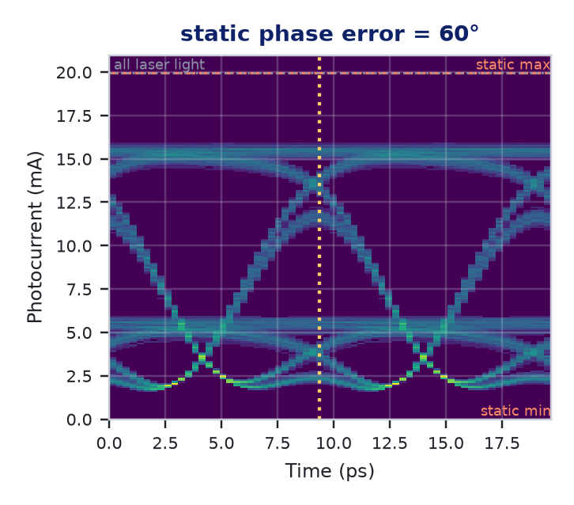
3 Static phase error: effect on the eye
The operating point leaves quadrature: rails become asymmetric, the crossing drops, the eye closes past ~60°
φ (deg) | μ₁ th / eye | μ₀ th / eye | ER static | ER eye | Height (mA) | Rails σ₁ / σ₀ | Crossing | Width (UI)
0 | 19.95 / 19.63 | 0.00 / 0.32 | ∞ | 17.86 | 17.71 | 0.27 / 0.27 | 50.0 % | 0.969
10 | 19.80 / 19.23 | 0.15 / 0.21 | 21.16 | 19.55 | 17.29 | 0.51 / 0.07 | 41.6 % | 0.969
30 | 18.62 / 17.60 | 1.34 / 0.88 | 11.44 | 13.00 | 12.37 | 0.94 / 0.50 | 19.1 % | 0.969
60 | 14.96 / 13.53 | 4.99 / 3.88 | 4.77 | 5.42 | 2.15 | 1.38 / 1.12 | 20.8 % | 0.719
Reading it
Crossing 50 → 41.6 → 19 %: the eye leans
'1' rail thickens (0.27 → 1.38 mA), '0' rail thins then thickens
μ₀ below theory at 30°: the '0' swings past the null and ISI pulls it back toward it (curve folding)
Eyes computed by mzm_interconnect.eye on the reference device. Dashed: static max/min of the transfer curve (infinite bandwidth); dotted: all laser light; vertical dotted: sampling instant.

Slide 14
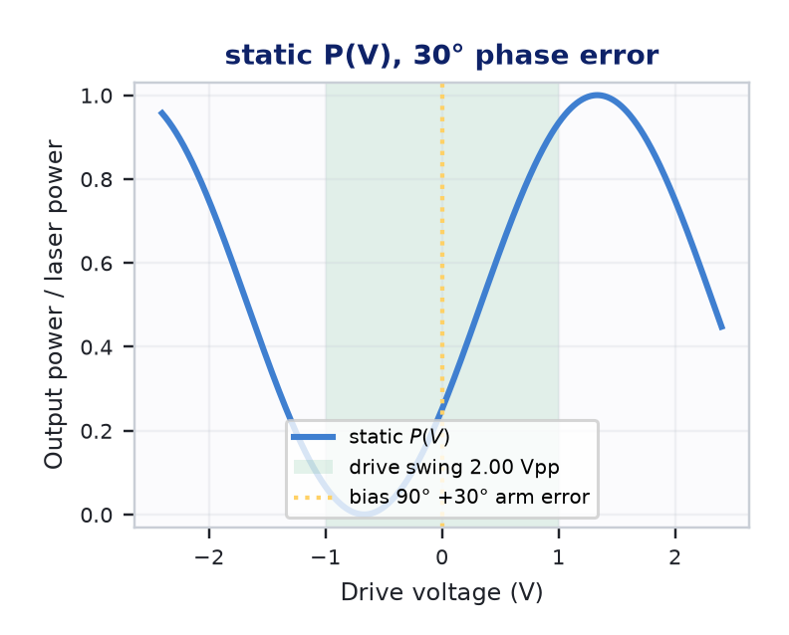
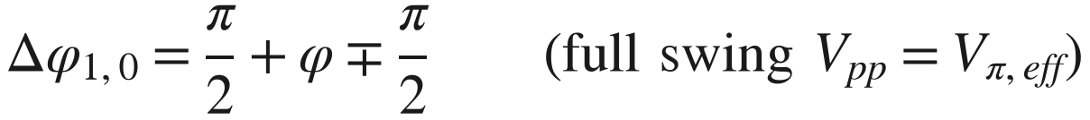
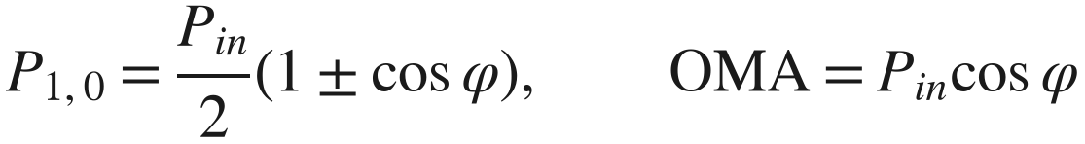
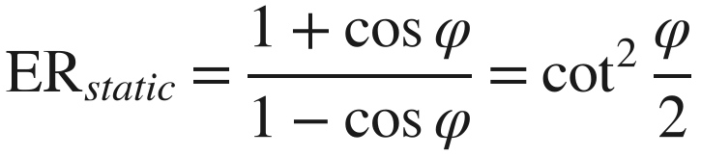
3 Static phase error: mechanism
How it enters the equations
Range
±180° in the GUI. Any value occurs; a bias controller nulls it continuously, so it is a demand on control range, not a performance limit. Uncontrolled beyond ~60° the eye closes.
$$Δφ_{1,0}=\frac{π}{2}+φ∓\frac{π}{2} (full swing V_{pp}=V_{π,eff})$$
$$P_{1,0}=\frac{P_{in}}{2}\left(1±cosφ\right), OMA=P_{in}cosφ$$
Physical / fabrication cause
Optical path difference between the arms: width difference (Δn_{eff}), film-thickness gradient, stress, temperature gradient, DC / photorefractive drift in LiNbO₃.
$${ER}_{static}=\frac{1+cosφ}{1−cosφ}=\cot^{2}\frac{φ}{2}$$
10° → 21.2 dB · 30° → 11.4 dB · 60° → 4.8 dB. The '0' sits past the null (π), so the curve folds:
In INTERCONNECT
Optical Phase Shift PHS_1 (already present), phase shift = 90° + φ in radians. Wavelength-independent: a real length difference would need two waveguide elements.
EO bandwidth
Unchanged (84.47 GHz): sin Δφ₀ is a flat factor (it only scales the slope).

Slide 15


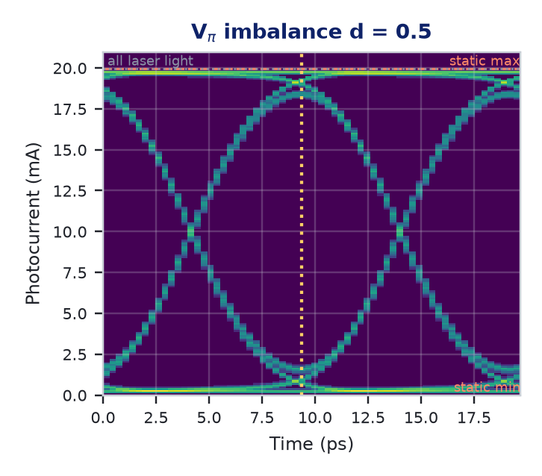

4 V_{π} imbalance: effect on the eye
At a fixed 2.0 V_{pp} drive the swing falls short of a full V_{π,eff}: eye shrinks. Re-set the drive and it is identical to balanced
d | V_{π,eff} (V) | ER static @2 V | ER eye @2 V | Height @2 V | Rails σ @2 V | ER eye @V_{π,eff} | Height @V_{π,eff} | Chirp α
0 | 2.000 | ∞ | 17.86 | 17.71 | 0.266 | 17.86 | 17.71 | 0.000
0.05 | 2.049 | 34.56 | 17.30 | 17.40 | 0.304 | 17.86 | 17.71 | 0.024
0.2 | 2.182 | 23.67 | 15.68 | 16.56 | 0.390 | 17.86 | 17.71 | 0.091
0.5 | 2.400 | 17.61 | 13.42 | 15.30 | 0.485 | 17.86 | 17.71 | 0.200
Reading it
Fixed drive: ER 17.86 → 13.42 dB, rails 0.27 → 0.49 mA (levels leave the flat top/bottom of the cosine)
Drive = V_{π,eff}: every metric equals the balanced one
What remains is chirp α = d/(2+d): visible only after fibre
Eyes computed by mzm_interconnect.eye on the reference device. Dashed: static max/min of the transfer curve (infinite bandwidth); dotted: all laser light; vertical dotted: sampling instant. Fourth eye: d = 0.5 with the drive re-set to V_{π,eff} = 2.40 V.

Slide 16
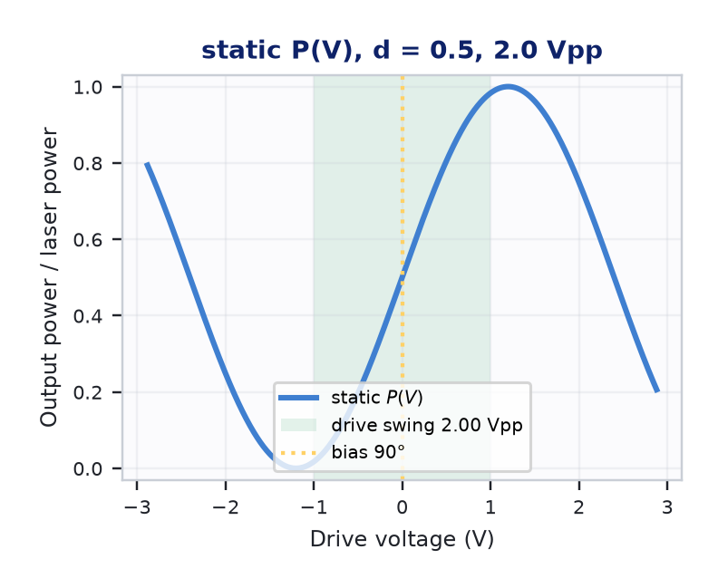
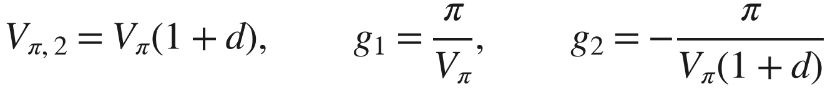
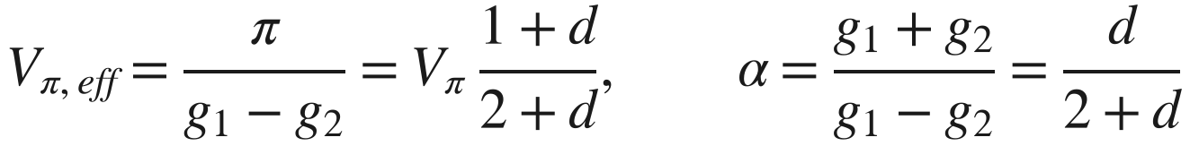
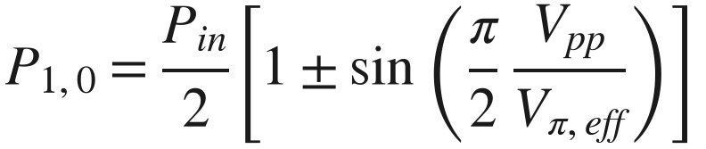
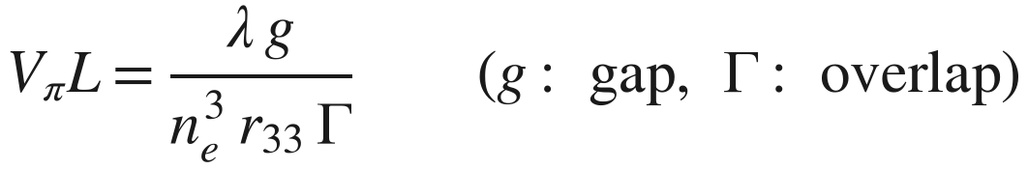
4 V_{π} imbalance: mechanism
How it enters the equations
Range
±0.5 in the GUI. Typical 0.01 – 0.05. A 100 nm gap difference on a 5 µm gap is 0.02.
$$V_{π,2}=V_{π}(1+d), g_{1}=\frac{π}{V_{π}}, g_{2}=−\frac{π}{V_{π}(1+d)}$$
$$V_{π,eff}=\frac{π}{g_{1}−g_{2}}=V_{π} \frac{1+d}{2+d}, α=\frac{g_{1}+g_{2}}{g_{1}−g_{2}}=\frac{d}{2+d}$$
Physical / fabrication cause
Different overlap Γ or gap g per arm: overlay error between the waveguide and electrode masks (waveguides off-centre in the gaps), gap asymmetry, asymmetric rib over-etch changing confinement.
$$P_{1,0}=\frac{P_{in}}{2}\left[1±sin\left(\frac{π}{2} \frac{V_{pp}}{V_{π,eff}}\right)\right]$$
$$V_{π}L=\frac{λ g}{n_{e}^{3} r_{33} Γ} (g: gap, Γ: overlap)$$
In INTERCONNECT
OM_1 / OM_2 (already present): phase coefficient c = −π/(V_{π}L) and +π/(V_{π}(1+d)L), L = 1 µm. Equivalently vary length.
EO bandwidth
Unchanged (84.47 GHz): g₁, g₂ are flat weights on the same H(f).

Slide 17
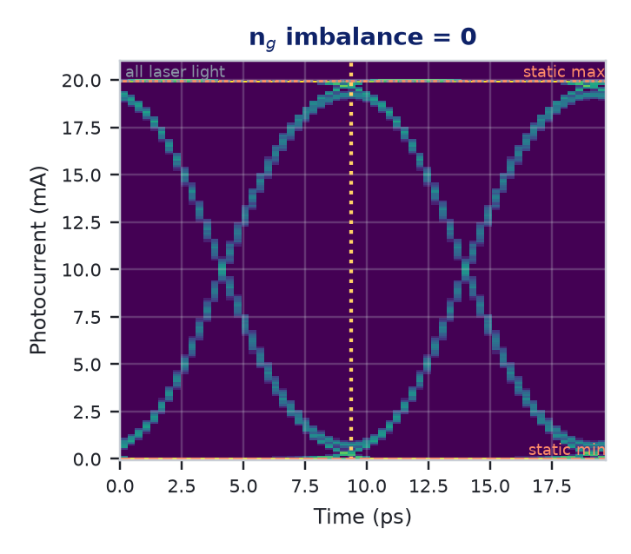

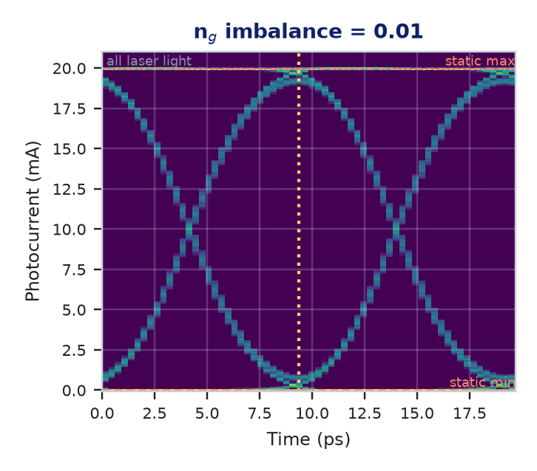

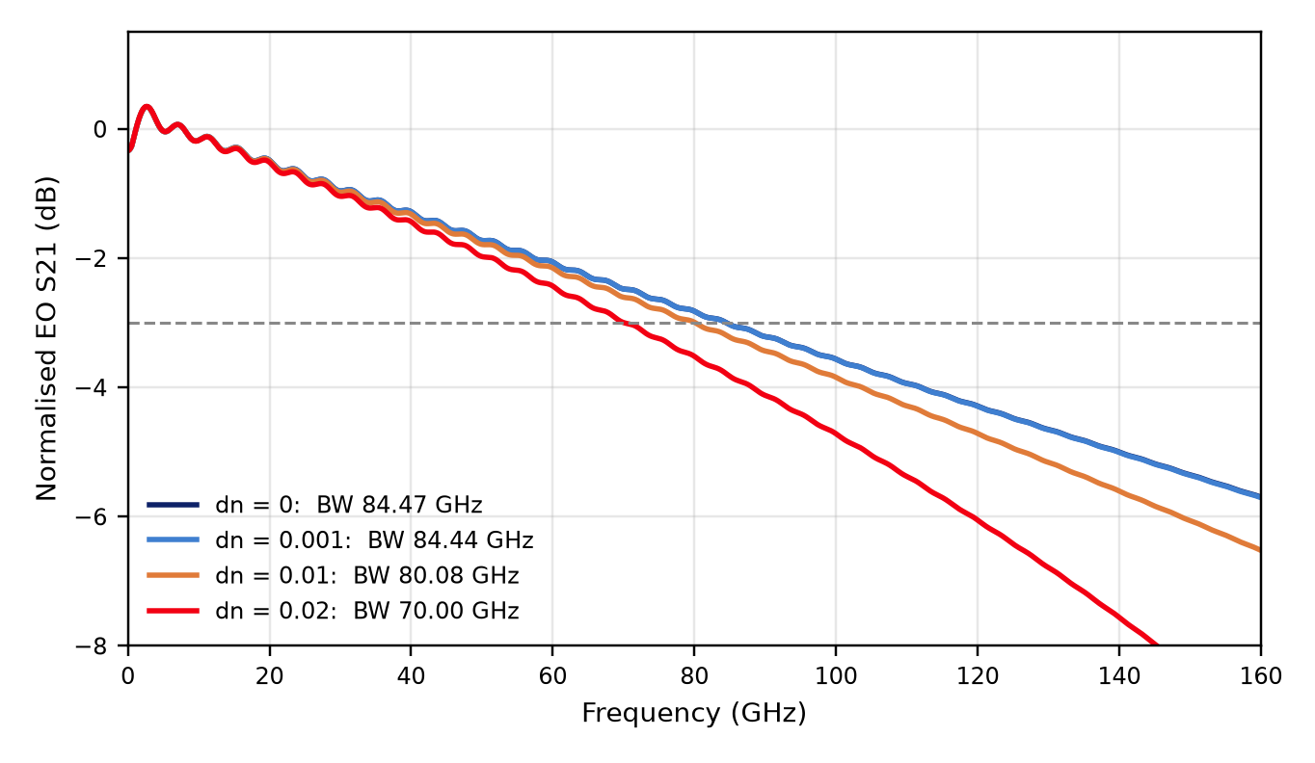
5 Group-index imbalance: EO bandwidth and eye
The only imbalance that reshapes the frequency response. Effect grows with dn²: invisible at realistic values
dn | EO BW (GHz) | Shift | ER eye | Height | Rails σ
0 | 84.47 | +0.00 | 17.86 | 17.71 | 0.266
0.001 | 84.44 | -0.03 | 17.86 | 17.71 | 0.266
0.01 | 80.08 | -4.40 | 17.67 | 17.62 | 0.278
0.02 | 70.00 | -14.48 | 17.13 | 17.31 | 0.313
Reading it
dn = 0.001: −0.03 GHz
dn = 0.01: −4.40 GHz
Eye: slightly thicker rails from the extra ISI; ER −0.7 dB at 0.02
Eyes computed by mzm_interconnect.eye on the reference device. Dashed: static max/min of the transfer curve (infinite bandwidth); dotted: all laser light; vertical dotted: sampling instant.

Slide 18
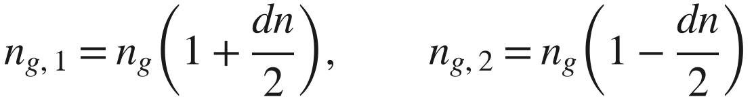
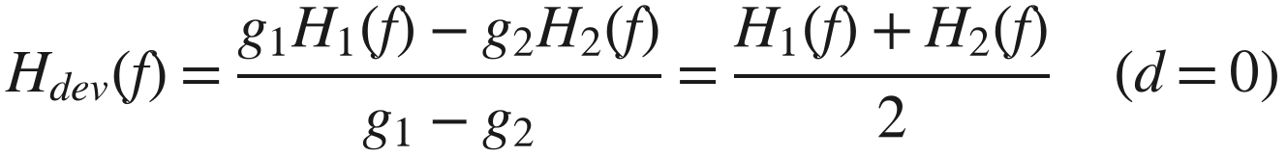
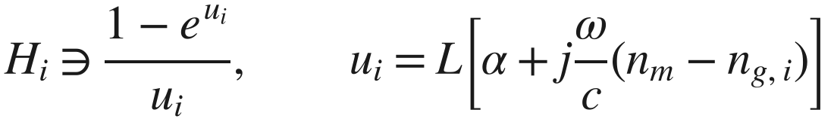
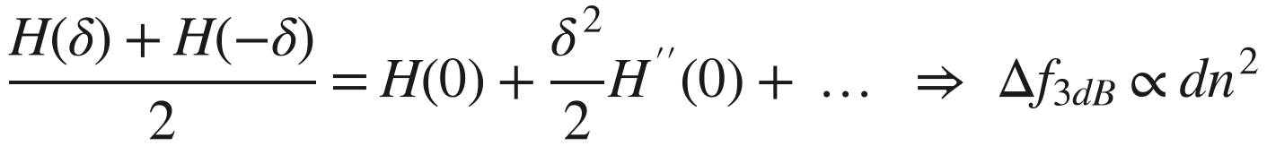
5 Group-index imbalance: mechanism
How it enters the equations
Range
0 – 0.02 in the GUI (to show the mechanism). Typical below 0.001 between two arms on the same die.
$$n_{g,1}=n_{g}\left(1+\frac{dn}{2}\right), n_{g,2}=n_{g}\left(1−\frac{dn}{2}\right)$$
$$H_{dev}(f)=\frac{g_{1}H_{1}(f)−g_{2}H_{2}(f)}{g_{1}−g_{2}}=\frac{H_{1}(f)+H_{2}(f)}{2} (d=0)$$
Physical / fabrication cause
Different waveguide cross-section per arm: width or etch-depth difference (lithography, asymmetric over-etch), film-thickness gradient across the chip — all change the group index.
$$H_{i}∋\frac{1−e^{u_{i}}}{u_{i}}, u_{i}=L\left[α+j\frac{ω}{c}\left(n_{m}−n_{g,i}\right)\right]$$
The ± split is symmetric, so the first-order change cancels between the arms:
$$\frac{H(δ)+H(−δ)}{2}=H(0)+\frac{δ^{2}}{2}H^{″}(0)+… ⇒ Δf_{3dB}∝dn^{2}$$
In INTERCONNECT
Two Traveling Wave Electrode elements, TW_1 → OM_1 and TW_2 → OM_2, same tables and drive; optical index = n_{g}(1 ± dn/2).
EO bandwidth
Moves: 84.47 → 84.44 → 80.08 → 70.00 GHz for dn = 0, 0.001, 0.01, 0.02.

Slide 19

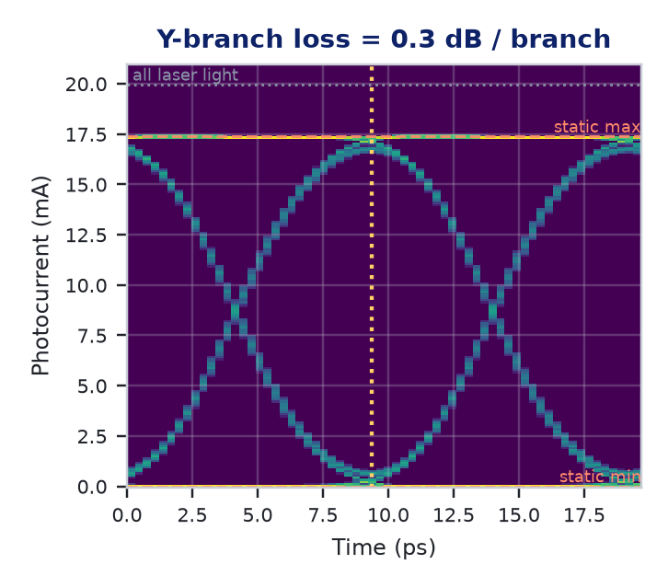
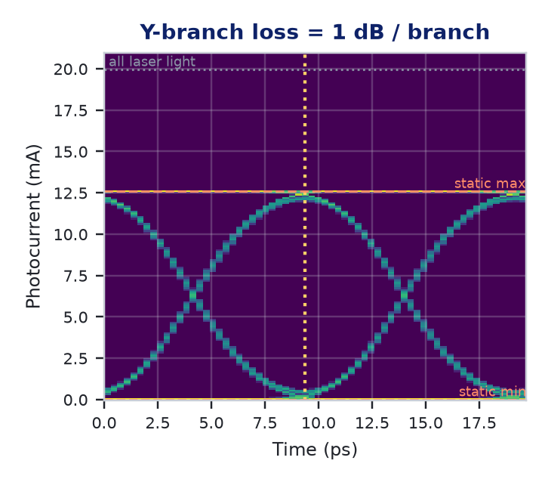
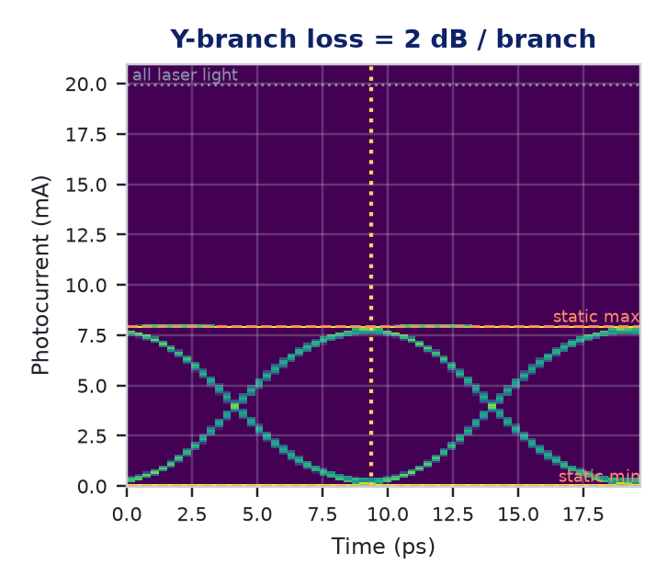
6 Y-branch excess loss: effect on the eye
Common-mode: the whole eye shrinks toward zero by one factor. Not an imbalance, but it sets the received power
IL / branch (dB) | T_{Y}² (theory) | μ₁ (mA) | μ₁ / μ_{1,0} | Height (mA) | ER eye | Width | Mean P (mW) | EO BW
0 | 1.000 | 19.63 | 1.000 | 17.71 | 17.86 | 0.969 | 10.00 | 84.47
0.3 | 0.871 | 17.10 | 0.871 | 15.43 | 17.86 | 0.969 | 8.71 | 84.47
1 | 0.631 | 12.39 | 0.631 | 11.18 | 17.86 | 0.969 | 6.31 | 84.47
2 | 0.398 | 7.82 | 0.398 | 7.05 | 17.86 | 0.969 | 3.98 | 84.47
Reading it
μ₁ ratio equals T_{Y}² to 3 digits
ER 17.86 dB, width, crossing: unchanged
Matters once noise is on: less signal, same noise floor → lower Q
Eyes computed by mzm_interconnect.eye on the reference device. Dashed: static max/min of the transfer curve (infinite bandwidth); dotted: all laser light; vertical dotted: sampling instant.

Slide 20

6 Y-branch excess loss: mechanism
How it enters the equations
Range
0 – 2 dB per branch in the GUI. Typical 0.1 – 0.3 dB per branch for thin-film LiNbO₃, counted twice (input splitter and output combiner).
$$T_{Y}={10}^{−IL/10} (power transmission of one Y branch)$$
$$P(t) → T_{Y}^{2} P(t) (input splitter×output combiner)$$
$$ER=\frac{T_{Y}^{2}μ_{1}}{T_{Y}^{2}μ_{0}}=\frac{μ_{1}}{μ_{0}}, H, OMA, σ ∝ T_{Y}^{2}$$
Physical / fabrication cause
Light scattered out where the waveguide divides or merges: blunt junction tip (finite lithographic resolution), mode mismatch at the branching angle, radiation in the S-bends, sidewall roughness.
“Counted twice”: 0.3 dB per branch = 0.6 dB in the link.
In INTERCONNECT
The Y branch itself is enough: insertion loss = IL on both SPLT_1 and SPLT_2. No extra block. (The plain Optical Splitter has no such property.)
EO bandwidth
Unchanged (84.47 GHz): same fraction lost at every frequency, in both arms.

Slide 21
Summary: effects and INTERCONNECT representation
Imbalance | Enters as | ER | Height | Width | Rails | Crossing | Mean power | EO BW | INTERCONNECT
1 Arm loss | a₂ | ↓ ceiling | ↓ | — | thinner | — | ↓ | — | ATT_1: attenuation
2 Splitter | a₁, a₂ | ↓ ceiling | ↓ | — | thinner | — | — | — | SPLT_1: coupling coefficient
3 Static phase | Δφ₀ | ↓ (folds) | ↓↓ | ↓ >60° | asymmetric | ↓ (leans) | ↓ | — | PHS_1: phase shift
4 V_{π} (fixed drive) | g₂ | ↓ | ↓ | — | thicker | — | — | — | OM_2: phase coefficient c
4 V_{π} (drive = V_{π,eff}) | g₂ | — | — | — | — | — | — | — | + chirp α = d/(2+d)
5 Group index | h₁, h₂ | ↓ slightly | ↓ slightly | — | thicker | — | — | ↓ ∝ dn² | TW_1 / TW_2: optical index
6 Y-branch loss | T_{Y}² | — | ↓ ×T_{Y}² | — | ×T_{Y}² | — | ↓ ×T_{Y}² | — | SPLT_1, SPLT_2: insertion loss
Take-away
Five differential imbalances close or distort the eye; only the group-index one can move the EO bandwidth, and only quadratically. Y-branch loss is common-mode: it never touches ER or bandwidth, only the absolute power (and so the noise-limited Q).

