Slide 1
Jerez lifted (O band)
Standing wave under the lifted electrodes and the SiO₂ buffer
400 nm LN film, 1310 and 1360 nm: x_lift sweeps, Fabry-Perot fits, buffer cutoff and gap relaxation

Slide 2
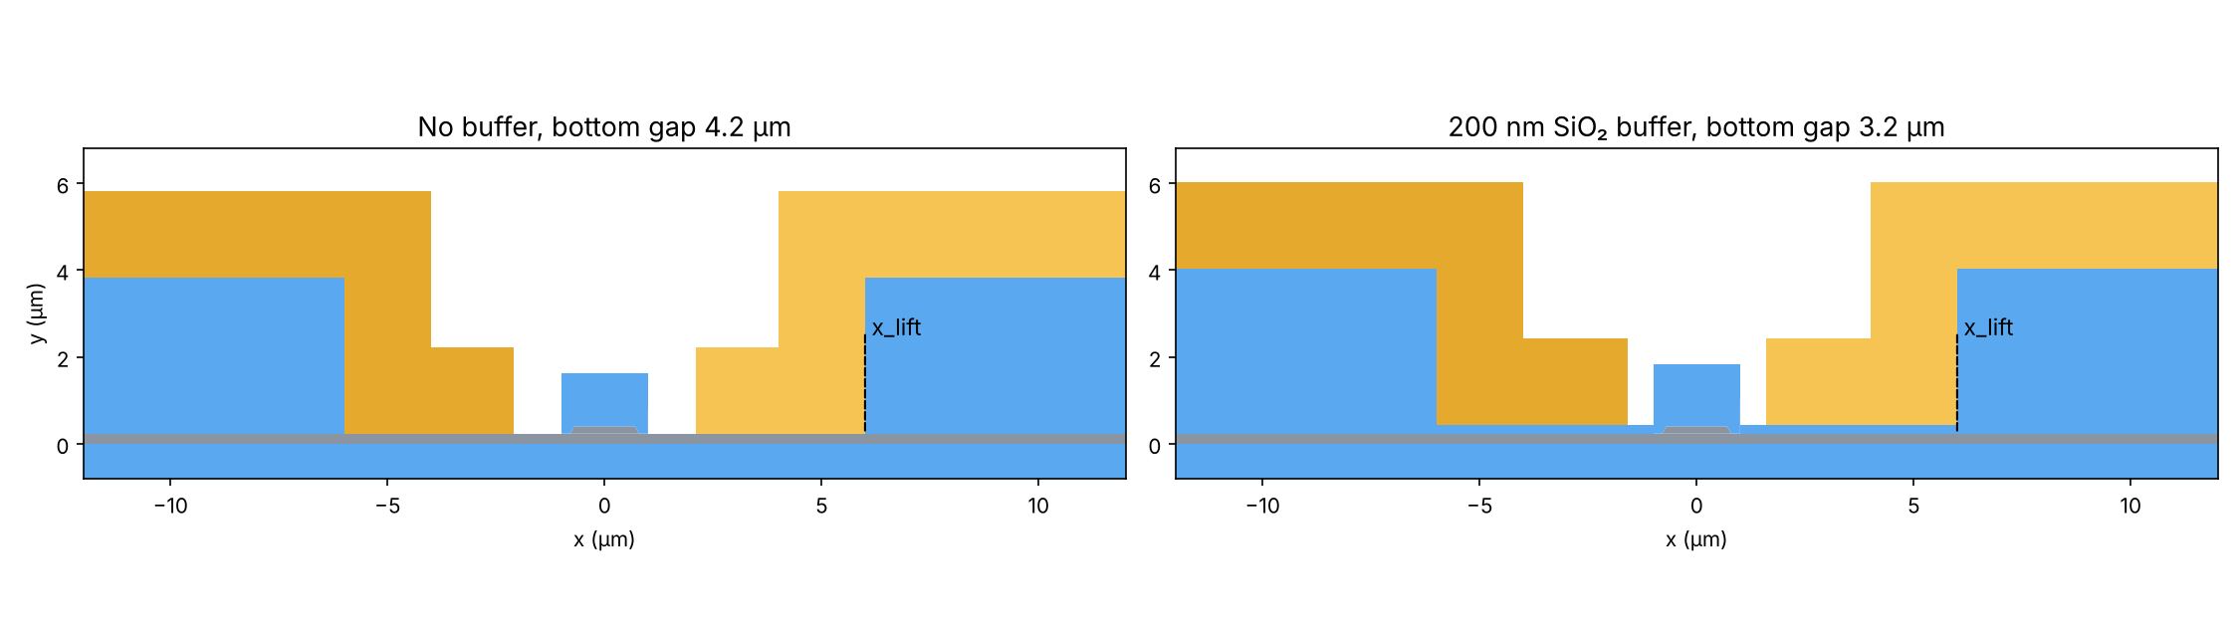
Jerez lifted: the two designs
Lisbon-lifted electrodes on a 400 nm LN film (170 nm etch, 230 nm slab), rib top 1.0 µm
The question
Does the standing wave seen in Lisbon lifted (C band) also appear in the O band, and does the 200 nm buffer remove it?
x_lift
Where the gold leaves the slab and climbs onto the SiO₂ lift: the far mirror of the cavity. Swept 6.5 → 11 µm (0.1 µm step).

Slide 3
x_lift sweep: ripple without buffer, flat with buffer
Bottom gap 4.2 µm (no buffer) / 3.2 µm (200 nm buffer); 184 runs, no failures
 | 1310 nm | 1360 nm
No buffer: IL range | 0.043–0.158 | 0.075–0.269
Ripple period | 0.634 µm | 0.675 µm
Buffer: IL (flat) | 0.0179 | 0.0284
Buffer: spread | < 0.01 % | 0.35 %
IL in dB/cm
The ripple is present in the O band too: up to ×3.7 between trough and peak. With the buffer IL is flat and 2–10× lower.

Slide 4
Vπ·L, and the O band against the C band
Same lifted design; O band on 400 nm film, C band on 550 nm film
λ (nm) | film (nm) | no buffer IL range | IL∞ (Fabry-Perot) | period (µm) | Vπ·L no buffer | buffer IL | Vπ·L buffer
1310 | 400 | 0.043–0.158 | 0.084 | 0.634 | 1.812 | 0.0179 | 1.683
1360 | 400 | 0.075–0.269 | 0.147 | 0.675 | 1.915 | 0.0284 | 1.779
1525 | 550 | 0.112–0.550 | 0.265 | 0.849 | 2.167 | 0.0333 | 2.054
1550 | 550 | 0.142–0.683 | 0.331 | 0.872 | 2.215 | 0.0401 | 2.101
1575 | 550 | 0.181–0.883 | 0.412 | 0.895 | 2.265 | 0.0481 | 2.148
Vπ·L
Independent of x_lift (< 0.1 %)
Buffer at gap 3.2 µm: −7 % vs no buffer at 4.2 µm (1.81 → 1.68 V·cm at 1310 nm)
O band vs C band
Shorter period (0.63–0.67 vs 0.85–0.90 µm) and lower loss level
IL in dB/cm; same physics: the buffer removes the ripple in both bands

Slide 5
Why the buffer removes the ripple
The slab wave under the gold, and the buffer thickness that cuts it off
Cavity
The rib mode leaks into the slab wave guided under the gold (index above the rib mode)
That wave is reflected where the gold climbs onto the lift (x_lift) → Fabry-Perot cavity
Fabry-Perot fit (no buffer)
1310 nm: mirror ρ₀ 0.93, round-trip decay 0.23 µm⁻¹, rms 0.0004 dB/cm
1360 nm: mirror ρ₀ 0.94, round-trip decay 0.22 µm⁻¹, rms 0.0010 dB/cm
Cutoff of the slab wave
Buffer between gold and slab lowers the slab-wave index; above a critical thickness it can no longer be guided
1D cutoff: 45.7 nm (1310) and 46.5 nm (1360); C band ≈ 38 nm
2D check of the 1D model
Ripple period at 0 and 25 nm: within 0.5–2.2 %
200 nm is ≈ 4× the cutoff: the ripple is suppressed with a large margin

Slide 6
Buffered Jerez lifted: how far can the gap be relaxed?
1360 nm, 200 nm buffer, bottom gap 3.2 → 4.0 µm; target = unbuffered Vπ·L at gap 4.2 µm
Cap / rib (µm) | unbuffered Vπ·L at 4.2 | matching buffered gap | buffered IL there | unbuffered IL (x_lift 6)
1.4 / 1.0 | 1.915 V·cm | 3.46 µm | 0.0124 dB/cm | 0.313 dB/cm
1.4 / 1.4 | 1.840 V·cm | 3.47 µm | 0.0130 dB/cm | 0.188 dB/cm
0.5 / 1.0 | 1.837 V·cm | 3.41 µm | 0.0147 dB/cm | 0.311 dB/cm
0.5 / 1.4 | 1.768 V·cm | 3.42 µm | 0.0155 dB/cm | 0.196 dB/cm

Slide 7
Cap height and buffer: how they interact
Rib 1.0 µm, 1360 nm; Vπ·L (V·cm) at gaps 3.4 and 4.2 µm
 | gap 4.2, no buffer | gap 3.4, no buffer | gap 4.2, buffer | gap 3.4, buffer
Cap 1.4 µm | 1.915 | 1.499 | 2.287 | 1.883
Cap 0.5 µm | 1.837 | 1.449 | 2.214 | 1.833
Cap 1.4 → 0.5 | -4.1 % | -3.4 % | -3.2 % | -2.7 %
Cap acts electrostatically
n_eff changes by only 4·10⁻⁴; a lower SiO₂ cap leaves more air next to the rib, so more of the gap voltage drops across it (DC field in the rib +3–5 %)
Smaller with the buffer
The buffer fills the gap at rib level whatever the cap height, so the cap only changes the dielectric above it
Buffer penalty at fixed gap: +19–21 % (4.2 µm), +26 % (3.4 µm), the same for both caps

Slide 8
Conclusions
1
The standing wave exists in Jerez lifted in the O band: IL varies up to ×3.7 with x_lift (period 0.63–0.67 µm)
2
The 200 nm SiO₂ buffer removes it: IL flat (0.018 / 0.028 dB/cm at 1310 / 1360 nm), ≈ 4× above the 46 nm cutoff
3
With the buffer the bottom gap can be relaxed to ≈ 3.4–3.5 µm at equal Vπ·L, with IL ≈ 0.012–0.016 dB/cm
4
Cap height acts only electrostatically: a lower cap lowers Vπ·L by 3–4 %, less with the buffer
5
Same physics as Lisbon lifted in the C band, with a shorter ripple period and lower loss

