Slide 1
Electrode bends in Lumerical INTERCONNECT
From the built-in traveling-wave block to a scripted transmission-line electrode
TW-MZM modelling toolkit · Jerez line, 14 mm, push-pull
Notes:
Goal of the talk: show how electrode bends were brought into the INTERCONNECT model of the traveling-wave Mach-Zehnder modulator, why the first approach was replaced, how the new scripted electrode works, and how it compares with the Python model that the GUI uses. No INTERCONNECT background is assumed.

Slide 2
Roadmap
0
1
2
3
Starting point
Why bends
TW blocks + drive files
Why that is not enough
4
5
6
7
Scripted electrode
TW block vs scripted
EO bandwidth with bends
Eye with bends
Notes:
Eight steps. 0: what the INTERCONNECT model looked like before bends. 1: why bends matter. 2-3: the first implementation and its limits. 4: the scripted electrode, the core of the work (red). 5: how it compares with the built-in block. 6-7: the final schematics for the EO bandwidth and the eye, validated against the Python model.

Slide 3
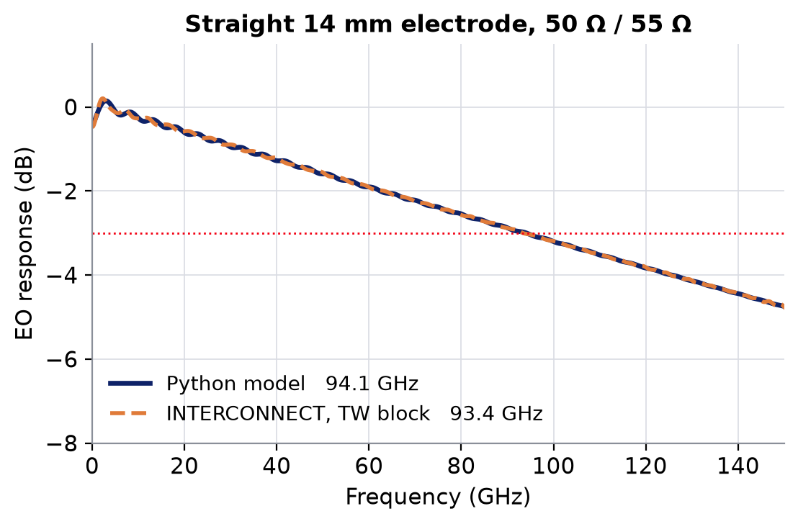
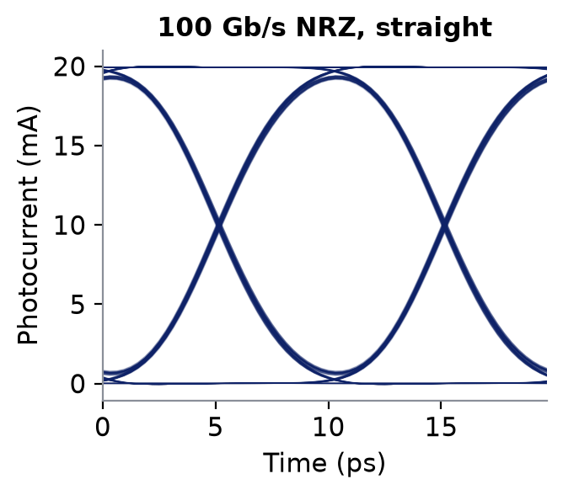
INTERCONNECT in one slide
A circuit simulator for photonics: blocks, wires, analysers
1 Blocks and wires
2 Every block is a digital filter
Laser
Modulator
Detector
filter
h(f)
analyser
Drive
samples in
samples out, delayed
optical
electrical
3 Two ways to read the result
Network analyser
sweeps frequency → EO bandwidth
Eye analyser
PRBS in time → eye diagram
Notes:
INTERCONNECT is a circuit simulator for photonic links. You place blocks (laser, modulator, detector, sources, analysers) and wire them: optical wires carry light, electrical wires carry voltages. Internally every block is turned into a digital filter acting on sampled signals: samples go in, filtered samples come out, a little later. Two kinds of analyser are used here: a network analyser, which sweeps frequency and gives the EO response and its -3 dB bandwidth, and an eye analyser, which runs a PRBS pattern in time and folds the detected signal into an eye.

Slide 4
0
Starting point: EO bandwidth schematic
drive (frequency sweep)
TW electrode
OM
CW laser
Y
Y
detector
Network analyser
OM
bias φ
Inside the TW electrode block
in: drive voltage → out: voltage seen by the light
loss, Z₀, n_{m} tables from the Touchstone
length, n_{g}, source R, termination R
TW electrode
optical
electrical
Notes:
This is the model before bends. Light from a CW laser is split by a Y branch into two arms; each arm has an Optical Modulator (OM) that turns a voltage into an optical phase. Arm 2 also carries the bias phase. The arms recombine in a second Y branch and the photodiode converts the intensity back to a current. The network analyser drives the electrodes with a frequency sweep and reads the photodiode: that ratio is the EO response. The electrode itself is Ansys' built-in Traveling Wave Electrode block (orange): it takes the drive voltage and returns the voltage the light actually integrates while travelling under the electrode, using the loss, impedance and microwave index tables extracted from the measured Touchstone. One electrode per arm so each arm can have its own optical group index. On the right: Python and INTERCONNECT (TW block) agree on the straight 14 mm electrode, 94.1 vs 93.4 GHz.

Slide 5
0
Starting point: eye diagram schematic
PRBS
NRZ
timing reference
TW electrode
OM
CW laser
Y
Y
detector
Eye analyser
OM
bias φ
TW electrode
optical
electrical
Notes:
Same optical core; only the source and the analyser change. A PRBS generator drives an NRZ pulse generator (the electrical bit stream), which feeds the two TW electrode blocks. The eye analyser folds the photodiode current on the bit period; it needs the drive as a timing reference. Building both schematics from the same code guarantees that the bandwidth and the eye describe the same device. Right: the 100 Gb/s NRZ eye of the straight electrode (Python).

Slide 6
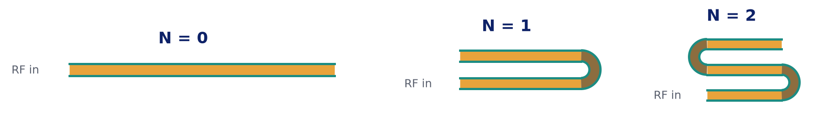
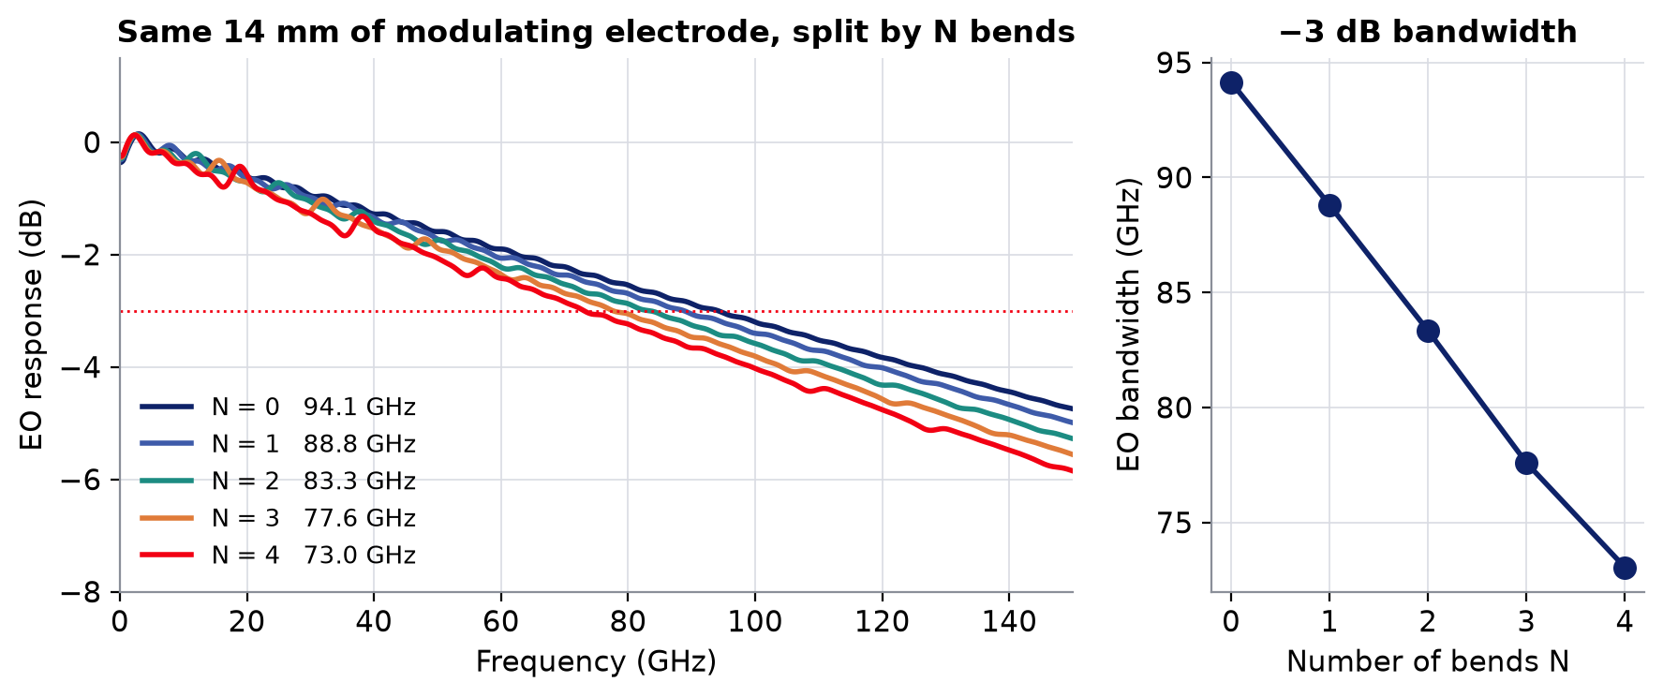
1
Why bends
A long electrode does not fit the chip: it is folded
−21 GHz
EO bandwidth lost
with 4 bends (Python)
14 mm
same modulating length
in every case
Notes:
To reach a low V_pi the electrode has to be long (14 mm here). On a compact chip it is folded: straight modulating sections joined by U-shaped bends, where the electrode and the two waveguides turn around together. The bends do not modulate, but the microwave still travels through them. The GUI's Python model already includes them exactly (a transmission-line cascade). With the same 14 mm of modulating electrode, each extra bend costs bandwidth: 94 GHz straight, 73 GHz with four 0.8 mm, 60 ohm bends. The INTERCONNECT model has to reproduce this.

Slide 7
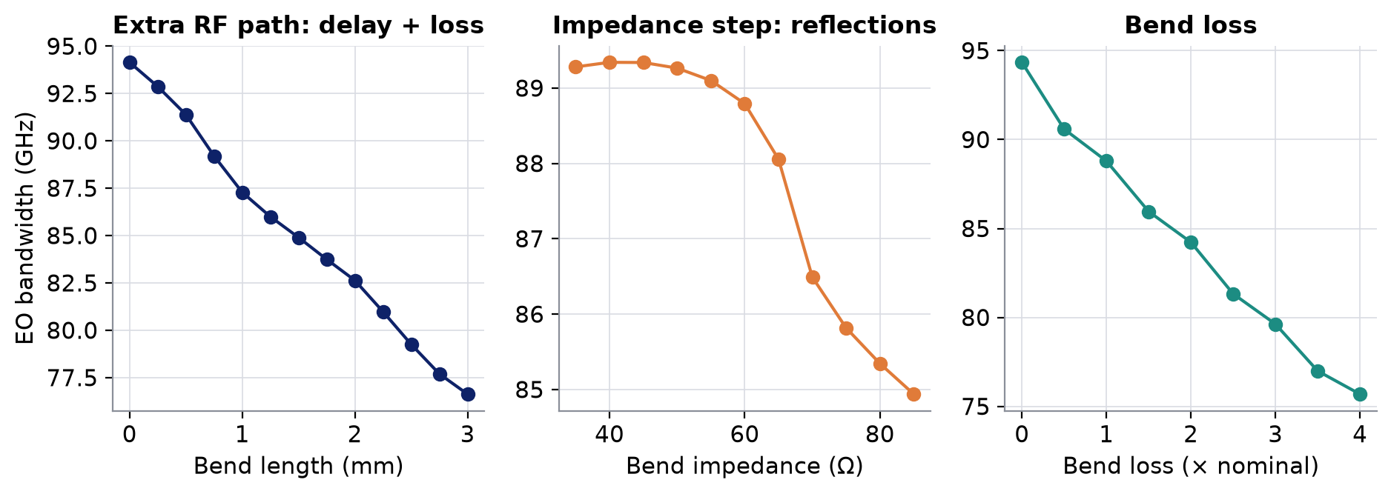
1
What a bend does to the microwave
One bend (N = 1), Python model
source
section 1
bend
section 2
load
Z step
Z step
Z step
Z step
Notes:
A bend is a short piece of transmission line with its own properties: length, impedance, loss and microwave index. Three effects follow. (1) Extra RF path: the microwave arrives later at section 2 than the light (walk-off) and is attenuated on the way. (2) Impedance steps: a bend with a different impedance reflects part of the wave at both ends, which creates ripple and costs bandwidth (a matched bend near 50-60 ohm costs nothing extra). (3) Bend loss itself. The plots sweep each one around the nominal bend (0.8 mm, 60 ohm, nominal loss).

Slide 8
2
First implementation: TW blocks + drive files
drive
SPAR 1
SPAR 2
TW, section 1
TW, section 2
OM
delay
OM
CW laser
Y
Y
detector
Network analyser
OM
delay
OM
bias φ
computed in Python, written to files
source impedance table, per section
TW, section 1
TW, section 2
load impedance table, per section
drive transfer V_{th}/V_{s}, per section
optical
SPAR k also drives the arm-2 TW block of section k
electrical
Notes:
The built-in TW block models ONE uniform line between ONE source and ONE load. To use it with bends, the electrode was cut into its straight sections: one TW block per section and per arm, each followed by its own Optical Modulator, with optical delays between the modulators for the light's travel time. What each section 'sees' of the rest of the electrode - the bends, the other sections, the real source and termination - was solved in Python and given to INTERCONNECT as files: a source impedance table, a load impedance table, and a drive transfer function applied by an S-parameter block (SPAR) in front of each section.

Slide 9
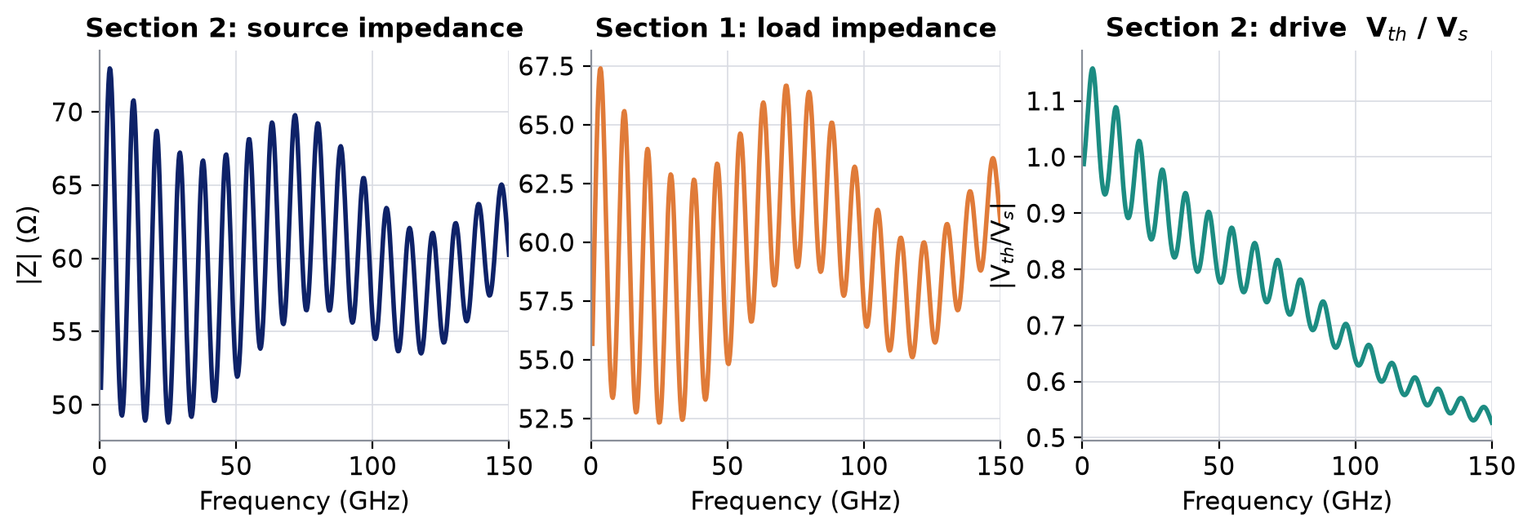
2
Each section sees the rest as a source and a load
source
source
section 1
section 1
bend
bend
section 2
load
load
V_{th}(f) behind Z_{src}(f)
section 2
Z_{load}(f)
Notes:
This is the Thevenin trick behind the first implementation. Seen from section 2, everything on the left (source, section 1, bend) collapses into a voltage source V_th(f) with an internal impedance Z_src(f); everything on the right collapses into a load Z_load(f). These are exact, but strongly frequency dependent (bottom: the ripple is the reflections inside the rest of the electrode). Python computed them for every section; INTERCONNECT only applied them. Validated against the Python cascade, but every piece of bend physics lived outside INTERCONNECT.

Slide 10
3
Why that is not enough
Python solves, INTERCONNECT replays
Python
solves the bent electrode
Files
3 tables per section
INTERCONNECT
applies them
Bend physics outside the simulator
Re-export at every change
Reactance frozen
reflections between sections are pre-computed
length, bend, Z_{s}, R_{t}: new files, new schematic
TW block: one source / load reactance, at one frequency
No far-end voltage
Two electrodes for two n_{g}
TW block not exact
the TW block has no output for it
one TW block per arm, per section
up to 1 dB / 14° off the exact line (section 5)
Notes:
The approach worked numerically, but INTERCONNECT was only replaying what Python had already solved. Consequences: (1) the bend physics - reflections between sections, the source and termination seen through the bends - never ran in INTERCONNECT; (2) any change of length, bend or termination needs new files and a new schematic, so no sweeps inside INTERCONNECT; (3) the TW block accepts a single constant source/load reactance, so pad parasitics are frozen at one frequency; (4) there is no output for the voltage at the far end of the line; (5) one electrode per arm just to carry two group indices; (6) and, as Step 0 later showed, the TW block itself is not an exact line. Goal: a block that is the line, so INTERCONNECT solves the whole bent electrode itself.

Slide 11
4
A scripted element: an empty block we program
line table
loss · Z₀ · n_{m} vs f, from the Touchstone
setup script
exact formulas, run once when the simulation starts
S-matrix of the block
how each output responds to each input, vs frequency
modulation (arm 1)
modulation 2 (arm 2)
TL line
RF in
RF out
↔ two-way ports
↑ ↓ one-way outputs
far-end voltage
Notes:
INTERCONNECT lets you create an empty 'scripted element': you choose its ports and write a short setup script. When the simulation starts the script reads the line table (loss, impedance and microwave index versus frequency, the same table the TW block uses), evaluates exact formulas and writes the block's S-matrix: for every pair of ports, how much comes out of one when a wave goes into the other, at every frequency. From then on INTERCONNECT treats it like any built-in block. Our 'TL line' block has two two-way RF ports (the two ends of the line), so reflections can travel in both directions, and up to three one-way outputs: the voltage seen by the light of arm 1, the same for arm 2 (its own group index), and the voltage at the far end.

Slide 12
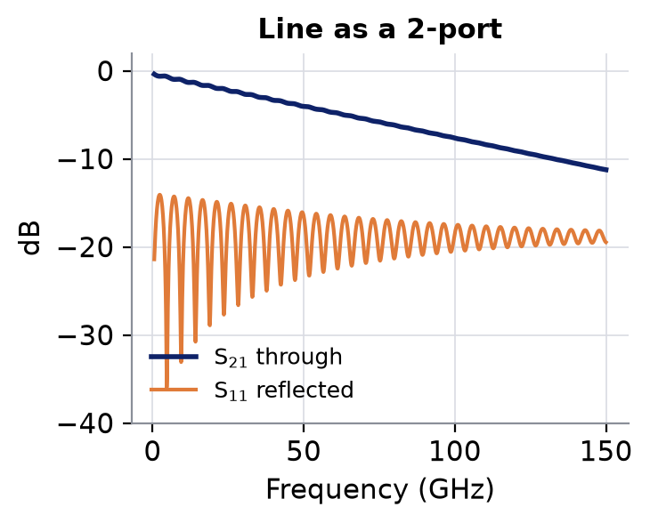
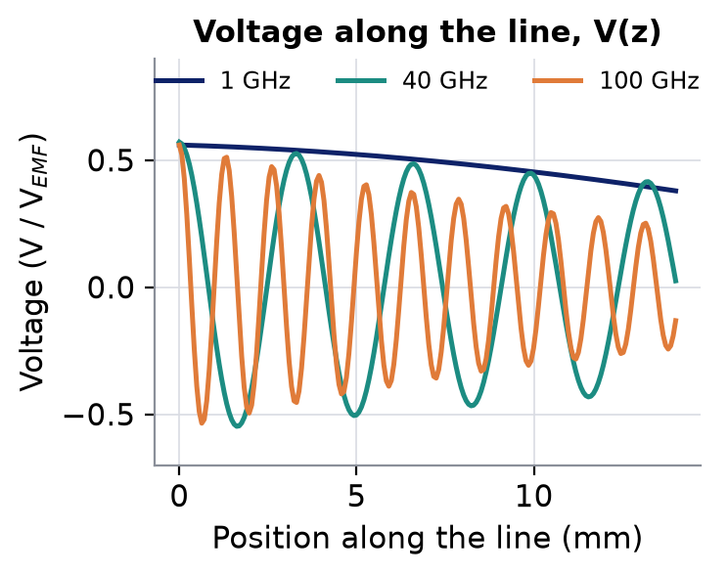
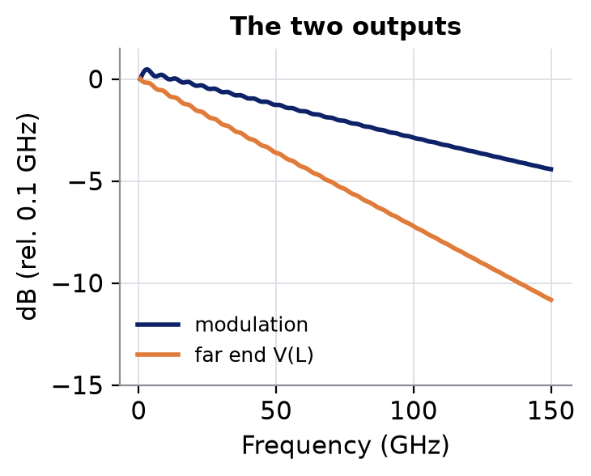
4
Exploded view of the TL line block
ports 1 ↔ 2: exact line
V(z) integrated by the light
the outputs
modulation = (1/L) ∫ V(z) · e^{jβz} dz, β = ω n_{g} / c (one integral per arm, with its own n_{g})
far end = V(L)
Notes:
Inside the block, three things. Left: the line as a two-port - the exact transmission and reflection of a uniform line of the measured loss, impedance and index (reference 50 ohm). Middle: the voltage along the line V(z) is a forward plus a backward wave; the light travels alongside it at its group velocity, so the phase the light accumulates is the integral of V(z) weighted by the light's own phase, divided by L. That integral is computed in closed form, no slicing - it is the same quantity the TW block outputs, and the same formula as the Python model. Done once with arm 1's group index (output 'modulation') and once with arm 2's ('modulation 2'). Right: the modulation output and the far-end voltage V(L), both versus frequency.

Slide 13
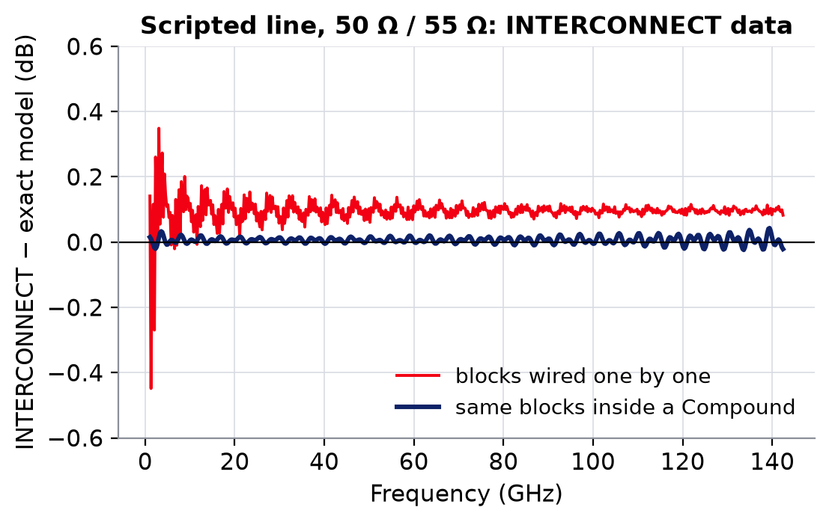
4
Source, termination and the Compound
to the modulators
Compound (scattering data analysis ON)
source
Z_{s}: R + L + C
TL line
termination
R_{t}: R + L + C
drive
far end
blocks one by one
each pass adds a filter delay → echoes late
inside a Compound
solved as one network → exact
Notes:
The source and the termination are also small scripted blocks, with their full R + L + C frequency dependence (the TW block took one value at one frequency). Why the Compound: wired one by one, each block is a separate digital filter and each pass through it adds a processing delay; a reflection that bounces between source and termination crosses the line several times and comes back late. On a mismatched line that is a large error (red, measured in INTERCONNECT). Grouped into a Compound with 'scattering data analysis' on, INTERCONNECT first solves the whole network in frequency, reflections included, and builds a single filter from it: the error drops to 0.04 dB (blue). The source and the termination must also be scripted: the built-in electrical connector reflects with the wrong sign in this configuration.

Slide 14
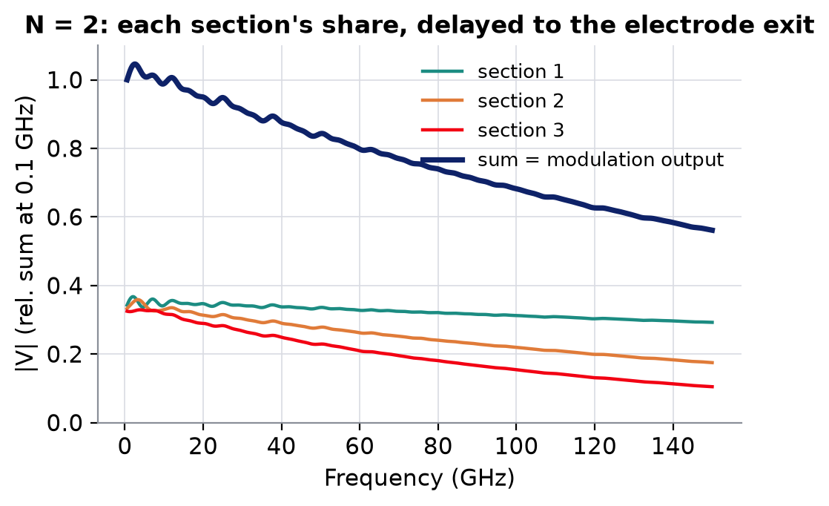
4
With bends: one TL electrode block
The whole bent electrode, solved inside one block
TL electrode
section 1
bend
section 2
bend
section 3
each share delayed by the light's transit to the exit
Σ
modulation (one per arm)
far end
electrode_layout.txt
section 4.67 mm · bend 0.8 mm · section 4.67 mm …
two tables: electrode line, bend line
Same schematic as a straight electrode
source → TL electrode → termination, one modulator per arm
no optical-delay blocks, no drive files
Notes:
For a bent electrode the same idea is extended to one block that contains the whole electrode. It reads a small layout file (the list of sections and bends with their lengths) and two line tables (electrode and bend). Inside, the pieces are cascaded exactly, so the reflections at every impedance step are included. For each modulating section it computes the voltage the light integrates there - exactly as the TL line does - and delays it by the time the light needs to travel from that section to the electrode exit. The delayed shares are summed into one modulation output per arm. Right: for N = 2, the three sections' shares and their sum. The bend itself contributes nothing to the sum but shifts and attenuates what follows. Result: a bent modulator has the same schematic as a straight one. The light's delays are inside the block rather than separate optical-delay blocks; those blocks produced a start-up artefact in the EO measurement.

Slide 15
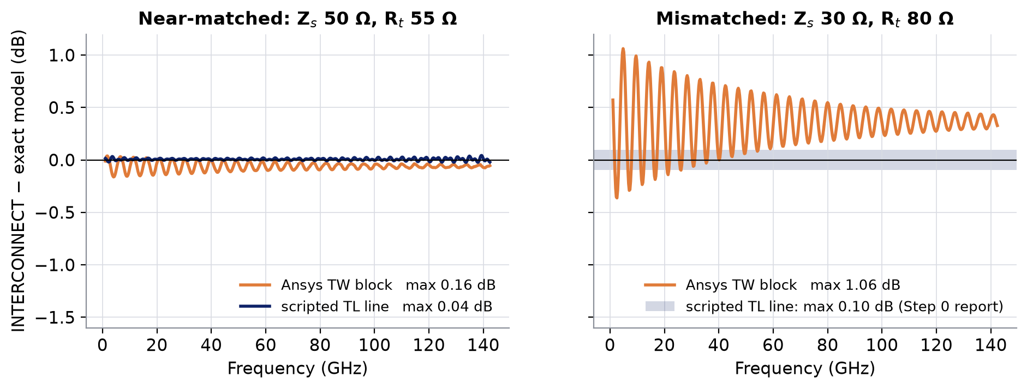
5
Built-in TW block vs scripted TL line
Both against the exact line model, measured in INTERCONNECT (Step 0)
 | TW block | TL line
Exact line | ✘ | ✔
Reflections solved | ✔ | ✔
R + L + C vs frequency | ✘ | ✔
Far-end voltage | ✘ | ✔
Two n_{g} on one line | ✘ | ✔
Bends inside the block | ✘ | ✔
max error vs exact | TW block | TL line
50 Ω / 55 Ω | 0.16 dB · 6° | 0.04 dB · 0.4°
30 Ω / 80 Ω | 1.06 dB · 14° | 0.10 dB · 0.4°
BW, 50 / 55 Ω | 98.2 GHz | 99.4 GHz
BW, 30 / 80 Ω | 58.3 GHz | 65.2 GHz
4–11×
smaller error
than the TW block
exact model: 99.6 GHz (50/55 Ω), 65.5 GHz (30/80 Ω); electrode alone, no optics
Notes:
Step 0 put the two blocks side by side in INTERCONNECT on the same straight 14 mm electrode, driven by a network analyser, and compared both with the exact line model. Near matched (50/55 ohm) the TW block is off by 0.16 dB and 6 degrees, the TL line by 0.04 dB and 0.4 degrees. On a deliberately mismatched line (30/80 ohm), where reflections dominate, the TW block is off by 1.06 dB and 14 degrees and loses 7 GHz of bandwidth; the TL line stays within 0.10 dB. The cause of the TW block's error is internal to it (not identified). The feature table summarises what each block can represent. The 30/80 ohm TL numbers are from the final Step 0 report.

Slide 16
6
Final EO bandwidth schematic
Any number of bends: the same five blocks
drive
Compound
arm 1
source
termin.
OM
TL electrode
sections + bends
CW laser
Y
Y
detector
Network analyser
OM
bias φ
5 blocks
arm 2
electrode path, any N
(TW + files, N = 4: 33)
far-end voltage → analyser input 2
Notes:
The final EO schematic. The electrical part is one Compound: scripted source (R+L+C), the TL electrode (all sections and bends), scripted termination (R+L+C). Its two modulation outputs drive the single modulator of each arm; its far-end output goes to the second input of the network analyser, so the voltage across the termination is read back too. The optical half is unchanged. Whatever the number of bends, the electrode path is five blocks; the first implementation needed 33 for four bends (TW + OM per section and arm, optical delays, drive S-parameter blocks), plus their files.

Slide 17
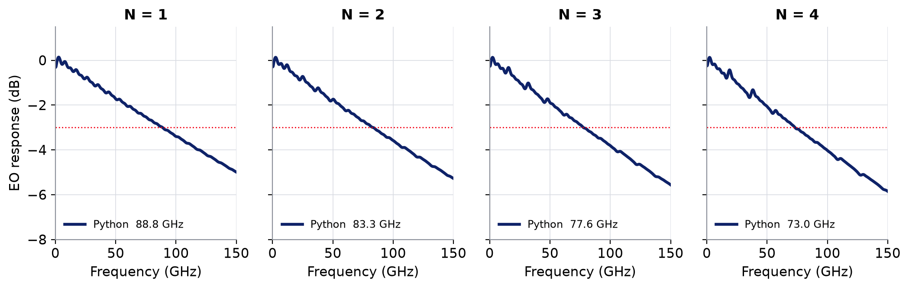
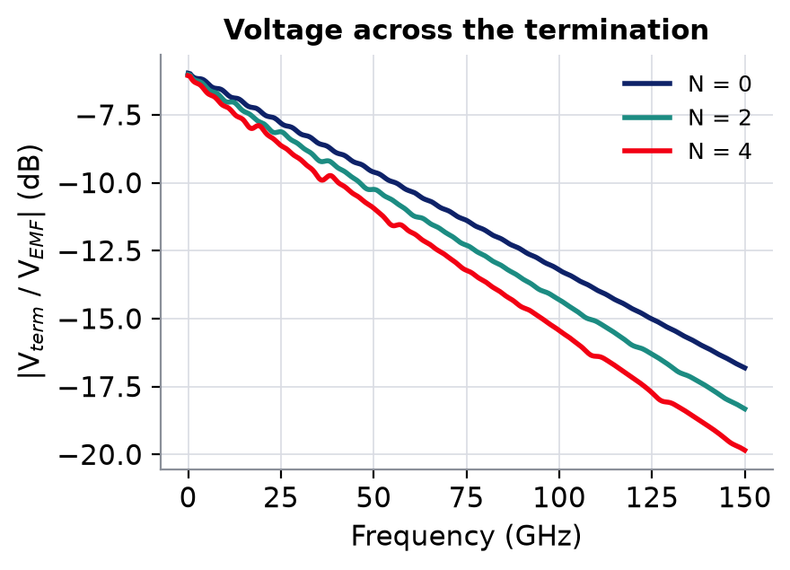
6
EO bandwidth with bends: validation
INTERCONNECT (TL electrode) vs Python, 1 to 4 bends
N | Python BW | INTERCONNECT BW
0 | 94.1 GHz | run pending
1 | 88.8 GHz | run pending
2 | 83.3 GHz | run pending
3 | 77.6 GHz | run pending
4 | 73.0 GHz | run pending
INTERCONNECT curves: run 'Step 1: bends 0-4 check'
Notes:
Validation of the final EO schematic against the Python model for one to four bends (equal sections, 0.8 mm 60 ohm bends, 14 mm of modulating electrode, 50/55 ohm). Top: normalised EO responses; bottom left: the voltage across the termination, which the old TW block could not give. The INTERCONNECT traces are corrected for two read-back artefacts of INTERCONNECT's optical path (a start-up spike and a two-sample average), which are not part of the device. [INTERCONNECT curves to be filled from the 'Step 1: bends 0-4 check' run.]

Slide 18
7
Final eye diagram schematic
PRBS
NRZ
timing reference
Compound
source
termin.
OM
TL electrode
sections + bends
CW laser
Y
Y
detector
Eye analyser
OM
bias φ
Eye analyser 2
voltage across the termination
Notes:
The eye schematic is the EO schematic with the PRBS / NRZ drive and the eye analyser. The same Compound drives the two modulators; a second eye analyser shows the voltage across the termination. For the validation an oscilloscope records the photodiode current, which is folded and measured by exactly the same code as the Python eye.

Slide 19
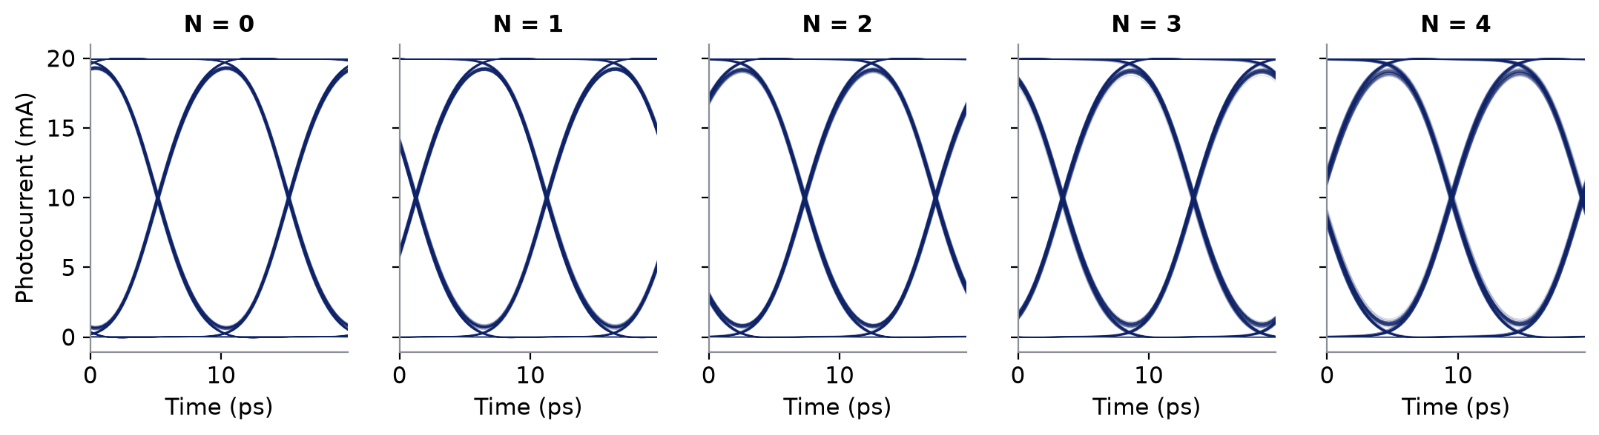
7
Eye with bends: INTERCONNECT vs Python
100 Gb/s NRZ, 2 Vpp, noise off
N | eye height Python | ER Python | height IC / Python | ER IC
0 | 17.96 mA | 18.3 dB | run pending | run pending
1 | 17.71 mA | 17.9 dB | run pending | run pending
2 | 17.51 mA | 17.5 dB | run pending | run pending
3 | 17.22 mA | 17.0 dB | run pending | run pending
4 | 17.01 mA | 16.7 dB | run pending | run pending
INTERCONNECT eyes: run 'Step 1: eye bends 0-4 check'
Notes:
Eye validation for zero to four bends. Each column: the Python eye (navy) and, once run, the INTERCONNECT eye (orange) folded by the same code. The bends close the eye slightly (height and ER drop with N), consistent with the lower EO bandwidth. [INTERCONNECT eyes to be filled from the 'Step 1: eye bends 0-4 check' run.]

Slide 20
Summary
Bends are solved inside INTERCONNECT
one TL electrode block: sections + bends, exact cascade
More accurate than the built-in block
≤ 0.1 dB vs up to 1 dB, on the same electrode
New outputs
far-end voltage · one line, two group indices
Simpler schematic
5 blocks for any N, no pre-computed files
Limits
EO read-back corrected for INTERCONNECT artefacts · sample rate ≥ 2.5 × top frequency
Notes:
Summary. The bent electrode is now a block that INTERCONNECT solves itself, more accurate than the built-in TW block, with outputs the built-in block cannot give, and a schematic that does not grow with the number of bends. Limits to keep in mind: INTERCONNECT's own optical path adds two read-back artefacts to the EO trace (a start-up spike and a two-sample average); they are removed when the trace is read, and are negligible in the eye. The sample rate has to stay well above the highest frequency of interest.

