Slide 1
Lifted electrodes on a SiO₂ buffer:
removing the lift-position resonance
femwell / scikit-fem eigenmode study at λ = 1575 nm
Notes:
Follow-up of the lifted-electrode study. A 200 nm SiO2 buffer is added under the whole electrode and across the gap, and the bottom gap is reduced to recover part of the electro-optic efficiency. This deck shows that the standing wave responsible for the lift-position resonance disappears, explains why, quantifies the Vpi cost, and closes with the final design point.

Slide 2
Summary
A 200 nm SiO₂ buffer under the lifted electrodes removes the standing wave completely: IL = 0.0480–0.0481 dB/cm for every lift position from 3.8 to 30.1 µm (88 simulations).
Without the buffer, at the same 3.2 µm gap, IL swings between 4 and 33 dB/cm with the lift position (period 0.90 µm).
Why: the buffer lowers the index of the wave guided under the gold (2.07 → 1.69) below the rib index (1.884). The wave can no longer travel sideways; the field under the metal is evanescent (−29 dB/µm) and never reaches the lift. Cutoff ≈ 38 nm.
The 1D cutoff model predicts the full 2D results quantitatively: ripple periods at 0 and 25 nm, decay rates at 50 and 200 nm.
Cost: the oxide sits in series with the LN and raises Vπ·L (1.65 → 2.15 V·cm at 3.2 µm gap). The gap sets the trade-off, independently of the lift.
Final design: 200 nm buffer, 3.4 µm gap → Vπ·L = 2.27 V·cm, IL = 0.026 dB/cm. Line of 14.85 mm with duty cycle 0.92 → Vπ = 1.66 V < 1.7 V.
1.66 V
0.026
Vπ, final design
(14.85 mm, duty 0.92)
IL (dB/cm),
final design
flat
38 nm
IL vs lift position,
3.8 – 30.1 µm
buffer thickness
at cutoff (1D)
Bottom line
The loss is no longer resonant: it is set only by the gap, and it is robust to lift position, lithography and fabrication tolerances at the lift.
Notes:
All values from the femwell N1xP1 vector FEM, production mesh re-converged for the buffered geometry: IL within 1.7 %, Vpi*L within 0.04 % of a 220k-triangle reference.

Slide 3
Starting point: the lift-position resonance
Previous lifted design: gold directly on the LN slab, gap 4.2 µm
What we found
IL oscillated with the lift position between 0.18 and 0.88 dB/cm, period 0.90 µm.
Cause: the rib mode leaks into a surface wave guided under the gold (index ≈ 2.08 > rib 1.883). The lift step reflects it; the gold-on-slab strip becomes a lossy resonator beside the rib.
Even at a 30 µm lift the step still reflects: ±1.1 % swing vs < ±0.2 % for a flat electrode.
Goal of this study
Remove the discontinuity's effect with minimal structural change: add a 200 nm SiO₂ buffer between the gold and the slab, and reduce the bottom gap from 4.2 to 3.2 µm to compensate the Vπ increase.
Notes:
Data: results/lift_sweep.csv (previous study). Nominal x_lift 7.0 um sat just past the first dip.

Slide 4
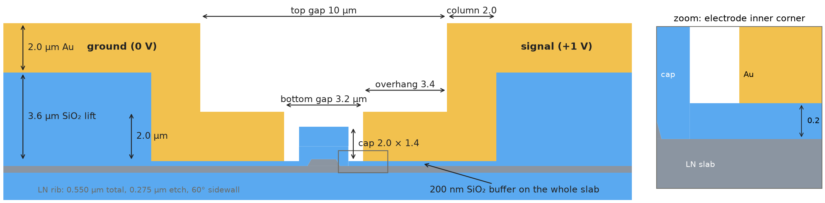
New geometry: lifted electrodes on a SiO₂ buffer
Two changes only: a 200 nm SiO₂ buffer on the whole slab and a 3.2 µm bottom gap
Buffer 200 nm SiO₂: under the lower block, under the lift (one oxide with it) and across the gap, fused with the cap
Bottom gap 3.2 µm (was 4.2); top gap 10 µm, column 2.0 µm → overhang 3.4 µm
Unchanged: λ = 1575 nm, LN 550 / 275 nm etch, electrodes 2.0 µm, cap 2.0 µm wide, EL_W = 30 µm
Vertical references from the buffer top (= bottom of the gold): lower block 2.0 µm, SiO₂ lift 3.6 µm, pad 2.0 µm, cap 1.4 µm
x_lift = GAP_TOP/2 + COL_W = 7.0 µm nominal; moved with GAP_TOP = 2·(x_lift − 2)
BUFFER_H = 0 gives back the previous lifted geometry exactly
Notes:
Geometry drawn directly from the polygons of cell 0 (cells/cell0_lifted_buffer.py).

Slide 5
Model implementation
Notebook: cells 0, 1, 5 updated; eigensolver, diagnostics and Vπ·L cells (2–4) unchanged
Cell 0: geometry and mesh
New parameters BUFFER_H (buffer) and LIFT_H (lift oxide); the lower block, cap, lift and pad all reference the buffer top
Buffer mesh follows its thickness (4 elements across, ≤ 50 nm); gold skin 18 nm with buffer, 12 nm without
Corner patches (6 nm mesh at the metal wedges) carved from every region they touch: valid for any BUFFER_H
Refined zone where the gold leaves the buffer (lift step)
Robustness: all regions snapped to a 1 pm grid. Float round-off (e.g. BUFFER_H = corner size, or xg + LOW_W ≠ GAP_TOP/2 + COL_W) produced zero-width slivers that gmsh rejected
Cell 5: leak diagnostic
Now measures the decay slope and ripple under the metal (inner edge → lift). The old test probed past the lift, where every case decays, and gave a false alarm with the buffer.
BUFFER_H = 0 check (gap 4.2, x_lift 7.0) | IL [dB/cm] | Vπ·L [V·cm]
Previous lifted notebook | 0.2216 | 2.2647
New notebook, BUFFER_H = 0 | 0.2220 | 2.2648
Leak diagnostic on the four buffer cases
0 nm: slope −0.7 dB/µm, ripple 18 dB → LEAKY
25 nm: slope −1.2 dB/µm, ripple 15 dB → LEAKY
50 nm: slope −11.5 dB/µm → BOUND
200 nm: slope −29.0 dB/µm → BOUND
Runtime
67 k triangles; full notebook ≈ 85 s (8-mode eigensolve ≈ 65 s) on 4 cores. Every sweep point was run with the same production mesh.
Notes:
The full notebook was executed end to end both at BUFFER_H = 200 nm and at BUFFER_H = 0 (gap 4.2), without errors.

Slide 6
Mesh convergence with the buffer
200 nm buffer, gap 3.2 µm, x_lift 7.0 µm; one-at-a-time refinements and a global reference
Mesh | Triangles | IL [dB/cm] | Vπ·L [V·cm]
Reference: everything near the mode ×1.5–2 finer | 220 k | 0.0473 | 2.1493
Production: buffer 50 nm, skin 18 nm | 67 k | 0.0481 | 2.1484
Buffer 25 nm / 12.5 nm | 87 k / 117 k | 0.0478 / 0.0478 | 2.1488 / 2.1489
Gold skin 12 nm / 8 nm | 87 k / 115 k | 0.0478 / 0.0476 | 2.1488
LN slab 25 → 15 nm | 122 k | 0.0479 | 2.1489
Corner patches 6 → 12 nm | 84 k | 0.0482 | 2.1479
Lift-step zone 40 → 20 nm, 1 → 2 µm long | 99 k | 0.0478 | 2.1487
Far slab 110 → 50 nm, lift oxide 150 → 80 nm | 105 k | 0.0478 | 2.1488
Gap air, cap, core, BOX ×1.4–1.6 finer | 98 k | 0.0475 | 2.1487
Accuracy
IL: production within +1.7 % of the reference; every single refinement moves it by < 1 %
Vπ·L: within 0.04 %
Why it is easier than before
With the buffer the field at the gold is weak and evanescent: no resonance to resolve, no long strip carrying a surface wave. The skin could be relaxed to 18 nm.
BUFFER_H = 0 automatically restores the 12 nm skin converged for the bare-gold design.
Notes:
Data: results/buffer/mesh_convergence_buffer200nm.csv.

Slide 7
IL vs lift position: the standing wave is gone
Same gap (3.2 µm), four buffer thicknesses; previous design for reference. Log scale
Buffer (gap 3.2) | IL range [dB/cm]
0 nm | 4.0 – 32.7
25 nm | 4.0 – 17.0
50 nm | 0.3256 – 0.3259
200 nm | 0.0480 – 0.0481
0 and 25 nm: strong resonance, periods 0.90 and 1.81 µm
50 and 200 nm: flat to the 4th digit
The transition happens between 25 and 50 nm, exactly where the 1D model puts the cutoff (≈ 38 nm)
Notes:
x_lift sampled every 0.1 um (0 nm, 200 nm) or 0.2 um (25, 50 nm) between 5 and 9 um; 200 nm from 3.8 to 12 um. The gap-3.2 no-buffer IL is much larger than the gap-4.2 one because the rib couples to the gold by tunnelling across the gap.

Slide 8
200 nm buffer: IL independent of the lift position
Linear scale, 3.8–30.1 µm; gap 3.2 µm (full sweep) and gap 3.4 µm (final design, spot checks)
 | gap 3.2 | gap 3.4
Points | 88 | 8
x_lift [µm] | 3.8 – 30.1 | 4.5 – 16.0
IL [dB/cm] | 0.0480 – 0.0481 | 0.0260 – 0.0260
Vπ·L [V·cm] | 2.148 – 2.156 | 2.270 – 2.275
IL changes by < 0.3 % over 26 µm of lift position: no ripple, no far-end residual
Vπ·L rises by < 0.4 % only when the column comes within ~2 µm of the gap (x_lift < 5 µm)
The lift position is now a free mechanical/RF design parameter
Notes:
Data: results/buffer/lift_sweep_buffer200nm.csv. Gap 3.4 um points at x_lift = 4.5-16 um.

Slide 9
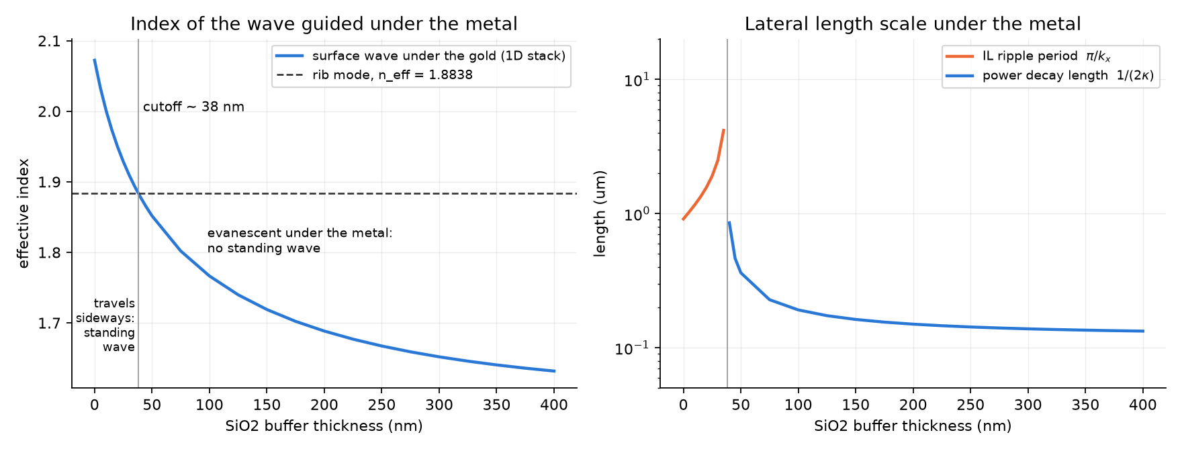
Why: the buffer pushes the surface wave below cutoff
1D mode of the stack Au / SiO₂ buffer / 275 nm LN slab / BOX, propagating sideways
Physical picture
Gold directly on LN supports a plasmon-like wave pulled into the high-index slab: n ≈ 2.07.
A low-index SiO₂ layer between gold and LN pushes the wave's field into the oxide: its index falls quickly (1.93 at 25 nm, 1.85 at 50 nm, 1.69 at 200 nm).
Crossing the rib index (1.884) at ≈ 38 nm switches the region under the gold from a leaky channel to a barrier.
At 200 nm the power decays in 0.15 µm under the gold: the lift at ≥ 3.8 µm is invisible to the mode.
Phase matching: the wave under the gold must share the rib's propagation constant β = k₀·n_rib. Its lateral wavenumber is k_x = k₀·√(n_sw² − n_rib²).
n_sw > n_rib: k_x real → the wave travels sideways, reflects at the lift → standing wave, IL period π/k_x.
n_sw < n_rib: k_x imaginary (κ) → the field under the gold is evanescent, decaying as exp(−2κx): nothing reaches the lift.
Notes:
The 1D solver is a finite-difference TM (Hz) mode solver of the layer stack with anisotropic LN; the band between in-plane eps = ne^2 and no^2 is < 0.01 in index.

Slide 10
Evidence: the 1D model predicts the full 2D simulations
No fitting: 1D stack index → predicted period (propagating) or decay rate (evanescent) → compared with femwell
Buffer | n_sw (1D) | Regime | 1D prediction | Full 2D simulation
0 nm | 2.072 | propagating | IL period 0.91 µm | 0.90 µm (4 peaks)
25 nm | 1.929 | propagating | IL period 1.90 µm | 1.81 µm (2 peaks)
50 nm | 1.852 | evanescent | decay 12.0 dB/µm | 11.5 dB/µm
200 nm | 1.688 | evanescent | decay 29.0 dB/µm | 29.0 dB/µm
Periods: from the IL peaks of the x_lift sweeps (parabolic peak fit). Decay rates: slope of |E|² along the slab between the inner edge and the lift (cell 5 diagnostic).
Agreement within 1–5 %; the residual at 25 nm comes from the rib's proximity and the oblique propagation, both ignored in 1D.
The same number explains both regimes: it is one mechanism, controlled by one parameter (the buffer index contrast/thickness).
Design rule
Buffer thickness well above the ≈ 38 nm cutoff. Margin matters: at 50 nm the decay is 2.5× slower than at 200 nm and IL is 7× higher at the same gap (0.33 vs 0.048 dB/cm).
Notes:
Decay rate predicted as 10*log10(e)*2*kappa with kappa = k0*sqrt(n_rib^2 - n_sw^2).

Slide 11
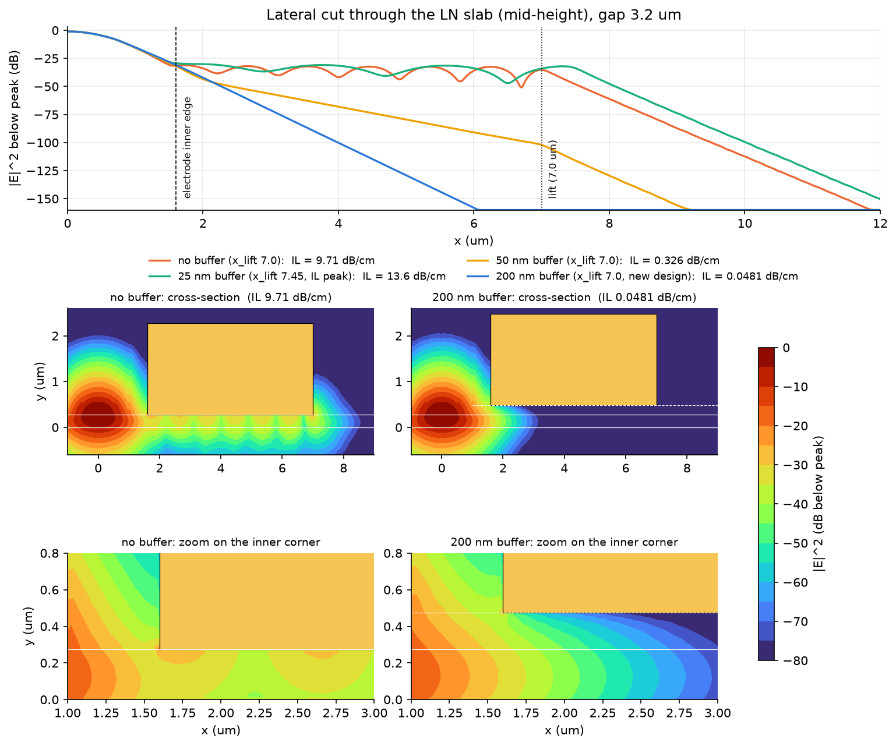
Field: standing wave without buffer, clean decay with it
|E|² in dB below peak, gap 3.2 µm
Top: cut through the slab
No buffer / 25 nm: plateau at −30…−45 dB all along the gold with regular ripples, abrupt change at the lift: power travels to the lift and back.
50 nm: straight line with a slower slope; 200 nm: straight line at −29 dB/µm, below −160 dB well before the lift.
Maps
No buffer: bright band under the whole lower block with nodes every ≈ 0.9 µm, the same period as the IL oscillation.
200 nm: the rib mode ends at the inner corner; under the gold the field fades within ~1 µm.
Zooms: without buffer the field enters the gold along the whole slab contact; with the buffer only the inner corner region sees it.
Notes:
Cases at x_lift = 7.0 um except 25 nm, shown at its IL peak (7.45 um).

Slide 12
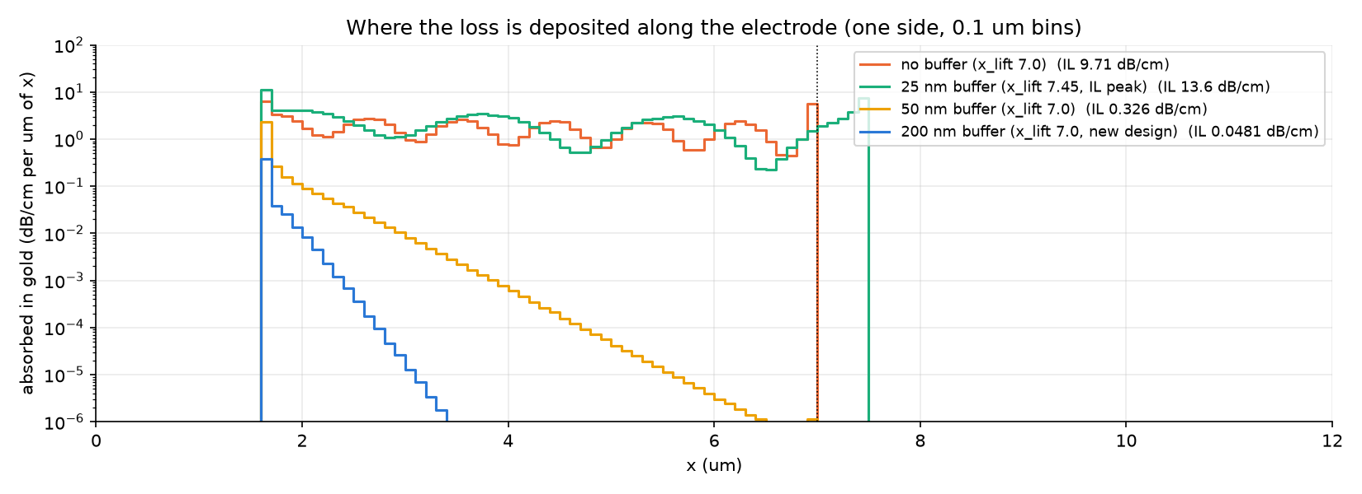
Where the loss is deposited
Absorbed power Im(ε)|E|² in the gold, binned along x (one electrode), scaled to dB/cm
Case (x_lift 7.0) | IL | within 1 µm of edge
No buffer | 9.71 | 26 %
25 nm (7.45) | 13.6 | 31 %
50 nm | 0.326 | 97 %
200 nm | 0.048 | 99.9 %
Leaky cases: absorption spread over the whole 5.4 µm lower block, ripple-modulated; only 26–31 % in the first micron.
200 nm: 99.9 % of the loss within 1 µm of the inner edge. Loss map of the notebook: 67 % in the bottom skin of the lower blocks, 33 % in the 50 nm corner patches, 0 % in the outer skin (near the lift).
Consequence: the remaining loss is controlled only by the distance rib–inner corner, i.e. by the bottom gap.
Notes:
Absorbed power integral is consistent with IL through the same constant (R = 7.54e8) as in the previous study.

Slide 13
The price: the oxide raises Vπ·L
Same gap (3.2 µm): the buffer is a low-permittivity layer in series with the LN
Buffer | Vπ·L [V·cm] | IL at x_lift 7.0 [dB/cm]
0 nm | 1.650 | 9.71 (resonant: 4–33)
25 nm | 1.799 | 7.08 (resonant: 4–17)
50 nm | 1.879 | 0.326
100 nm | 1.991 | 0.101
200 nm | 2.148 | 0.048
ε_DC(SiO₂) = 3.75 vs ε_DC(LN) = 28: the DC field must cross the low-permittivity oxide to enter the slab and part of the voltage drops there. At 0.63 V·cm per µm of gap, the 200 nm buffer costs as much as ≈ 0.8 µm of extra gap.
Vπ·L grows smoothly with thickness (+30 % at 200 nm); the loss falls much faster (resonant → 0.05 dB/cm).
For reference, the 200 nm buffer at the old 4.2 µm gap gives 2.75 V·cm / 0.002 dB/cm: reducing the gap is the right lever.
Notes:
Vpi*L barely depends on x_lift (2.148-2.157 V*cm), so these values hold for any lift position.

Slide 14
Gap trade-off at 200 nm buffer
IL no longer depends on the lift: the bottom gap alone sets Vπ·L vs loss
Gap [µm] | Vπ·L [V·cm] | IL [dB/cm]
2.4 | 1.635 | 0.651
2.6 | 1.770 | 0.326
2.8 | 1.899 | 0.169
3.0 | 2.025 | 0.089
3.2 | 2.148 | 0.048
3.4 | 2.271 | 0.026
3.6 | 2.392 | 0.014
Vπ·L is linear in the gap (+0.62 V·cm per µm); IL is exponential (×0.53 per +0.2 µm): tunnelling from the rib to the inner corner through the evanescent region.
Every 0.2 µm of gap costs ≈ 0.12 V·cm and halves the gold loss. 3.4 µm puts the gold loss at ≈ 0.03 dB/cm, negligible next to typical TFLN propagation loss.
Notes:
Gap scan at x_lift = 7.0 um (GAP_TOP fixed at 10 um, so the overhang changes with the gap).

Slide 15
Final design: 200 nm buffer, 3.4 µm gap
Vπ of a 14.85 mm line with 0.92 duty cycle
2.27 V·cm
0.026 dB/cm
flat
1.66 V
Vπ·L (simulated)
optical IL from the gold
IL = 0.0260 dB/cm for
x_lift = 4.5 – 16 µm
Vπ, final line
Vπ of the line
Line length L = 14.85 mm = 1.485 cm; duty cycle D = 0.92
Effective electro-optic length L·D = 1.485 × 0.92 = 1.366 cm
Vπ = (Vπ·L) / (L·D) = 2.27 / (1.485 × 0.92) = 1.66 V
Target < 1.7 V: met, with 0.04 V (2.2 %) of margin
Gold-induced optical loss over the line: 0.026 dB/cm × 1.485 cm ≈ 0.04 dB (upper bound: full length metallised)
Why this point
200 nm is 5× the cutoff thickness: the loss is non-resonant and insensitive to the lift position and to its fabrication tolerance.
3.4 µm instead of 3.2 µm: Vπ·L +0.12 V·cm, but the gold loss halves (0.048 → 0.026 dB/cm), while Vπ still meets the 1.7 V target.
Assumptions
Vπ·L from the 2D cross-section; duty cycle = fraction of the line with active electrodes. IL counts gold absorption only (no LN propagation / scattering loss).
Notes:
Simulated Vpi*L at gap 3.4 um: 2.2707 V*cm (x_lift 7.0 um); range over x_lift 4.5-16 um: 2.2701-2.2748. Vpi = 2.2707/(1.485*0.92) = 1.662 V. With the rounded 2.27 V*cm: 1.662 V.

Slide 16
Conclusions and next steps
Conclusions
A 200 nm SiO₂ buffer under the lifted electrodes eliminates the lift-position resonance: IL is flat over 3.8–30.1 µm.
Mechanism understood and verified: the buffer pushes the wave under the gold below the rib index (cutoff ≈ 38 nm); 1D predictions match the 2D simulations within a few %.
The buffer raises Vπ·L by ~30 % at fixed gap; the gap then sets the trade-off without any resonance.
Final design (200 nm, 3.4 µm): Vπ·L 2.27 V·cm, IL 0.026 dB/cm; 14.85 mm line, duty cycle 0.92 → Vπ = 1.66 V < 1.7 V.
Next steps
Independent check of the final design point (COMSOL).
Buffer thickness tolerance (e.g. 150–250 nm) and SiO₂ permittivity: effect on Vπ·L.
RF: impedance, microwave loss and velocity matching of the buffered lifted line.
Files (branch VPI-CODE)
results/buffer/VPI_interface_optimized_Lisbona_lifted_buffer.ipynb
cells/cell0/1/5_lifted_buffer.py
results/buffer/*.csv: lift sweeps, comparison sweeps, gap scan, mesh convergence, 1D index
results/buffer/*.png: figures of this deck
Notes:
All simulations are 2D cross-sections, z-invariant.

