Slide 1
CST straight line: port artefact and line extraction
Cascading, de-embedding with three lengths, a model of the port region, and what it means for INTERCONNECT

Slide 2
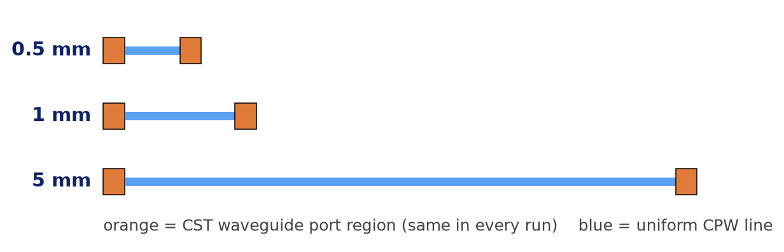
Why, and what was simulated
Goal: line data we can cascade in INTERCONNECT, then EO response, then crosstalk
Item | Value
Line | uniform CPW, S 35 µm, gap 4.15 µm, ground 49.85 µm, Au 2 µm
Lengths | 0.5, 1 and 5 mm, same ports and settings
Export | 2-port Touchstone, 50 Ω reference, 0–60 GHz
Wanted | α(f), n_m(f), Zc(f): any length follows
1 Cascade
five 1 mm runs vs one 5 mm run
2 De-embed
pairs of lengths → port-free γ, Zc
3 Port model
what the CST port adds to every run
4 Next
EO cascade, then coupled lines (crosstalk)
Key quantities.
ABCD (chain) matrix of each run: relates V, I at input to V, I at output, independent of the 50 Ω reference. A uniform line: A = D = cosh γℓ, B = Zc sinh γℓ, C = sinh γℓ / Zc. Cascading = multiplying ABCD matrices.

Slide 3
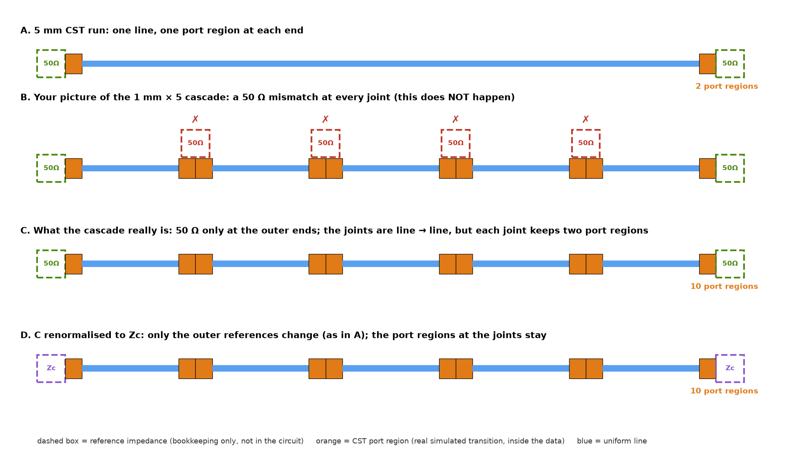
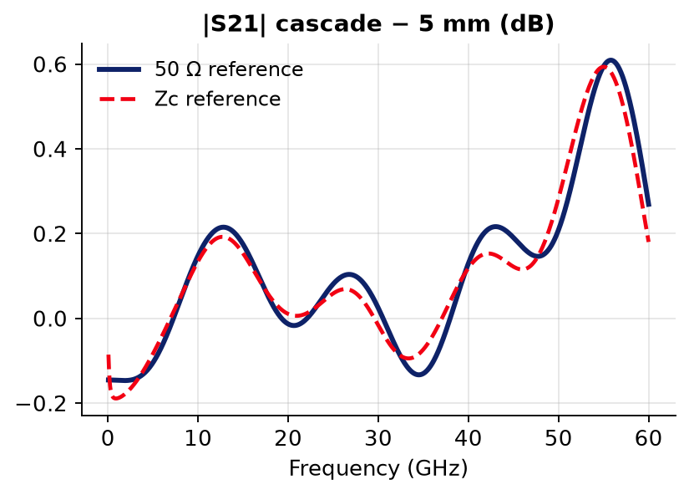
Cascading identical lines adds no mismatch
The 50 Ω reference is bookkeeping: it appears only at the two outer ends
Proof on an ideal line
Analytic line, Zc = 37 − 1j Ω: 1 mm⁵ vs 5 mm in 50 Ω → max |ΔS| = 2e-15.
ABCD joins V and I continuously: Zc meets Zc, nothing reflects.
Renormalising to Zc changes only the outer references, identically for both: max |S21| gap 0.61 dB (50 Ω) vs 0.59 dB (Zc). What is counted five times is the port region (orange), inside the data.

Slide 4
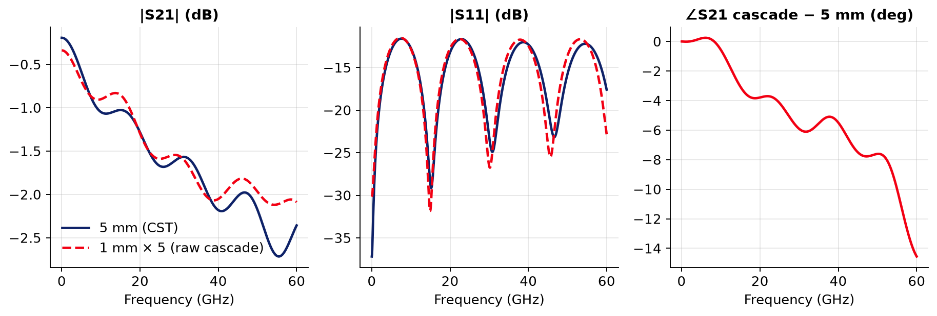
Raw cascade: 1 mm × 5 vs 5 mm
Close, but not exact: the error grows with frequency
|S21|
within 0.1 dB to ~35 GHz, up to 0.61 dB at 55 GHz.
|S11|
same −12 dB envelope (same Zc), minima shifted to lower f by 0.2–1 GHz.
∠S21
cascade accumulates extra phase: ~6° at 30 GHz, ~15° at 60 GHz.

Slide 5
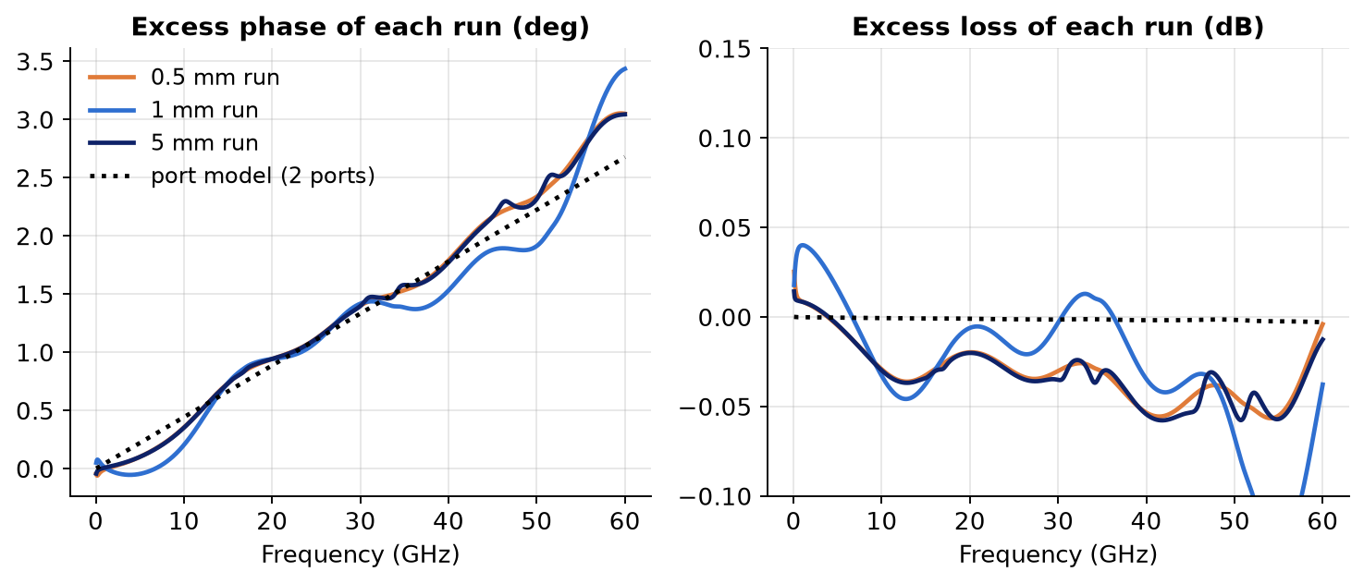
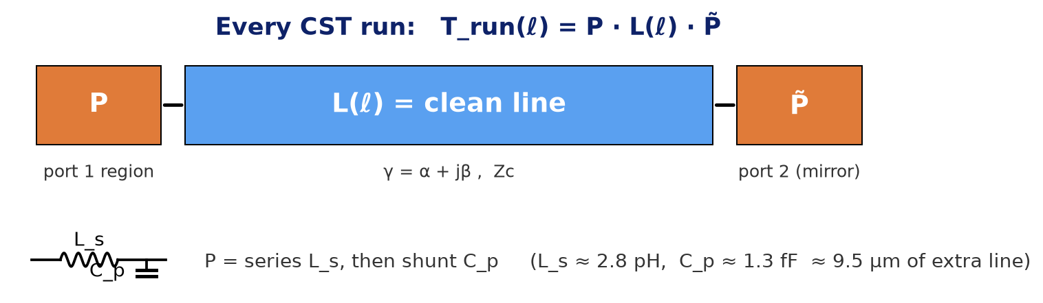
Every run carries the same, length-independent port artefact
Excess of each single run over the de-embedded line: identical for 0.5, 1 and 5 mm
Excess per run | 0.5 mm | 1 mm | 5 mm
phase @ 10 GHz | 0.36° | 0.21° | 0.35°
phase @ 30 GHz | 1.40° | 1.42° | 1.40°
phase @ 60 GHz | 3.05° | 3.44° | 3.04°
loss @ 30 GHz | -0.030 dB | -0.003 dB | -0.035 dB
Reading
Excess = apparent γℓ of one run − true γℓ (4.5 mm de-embedding).
Phase: 1.4° at 30 GHz, ~3° at 60 GHz, the same at 10× different lengths → a fixed block at the ports, not the line.
Loss: ±0.03 dB, at the run-to-run noise level.
Model (dotted): two port regions, each a series L_{s} + shunt C_{p}.

Slide 6
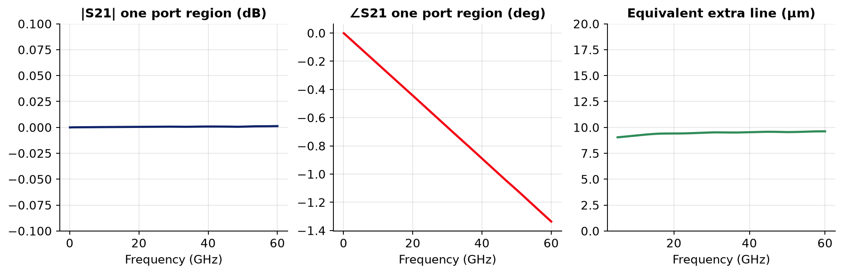
What one port region does
Series 2.8 pH + shunt 1.3 fF, fitted on all three runs: a pure phase delay
f (GHz) | |S21| (dB) | ∠S21 | |S11| (dB) | extra line
10 | +0.0003 | -0.22° | -61 | 9.2 µm
30 | +0.0007 | -0.67° | -51 | 9.5 µm
60 | +0.0012 | -1.34° | -45 | 9.6 µm
Physical meaning
≈ 9.5 µm of extra line per port: the reference plane sits slightly inside the line, where the 2D port mode settles into the 3D field.
Line per unit length: 238 nH/m, 178 pF/m → 2.8 pH ≈ 12 µm, 1.3 fF ≈ 7 µm.

Slide 7
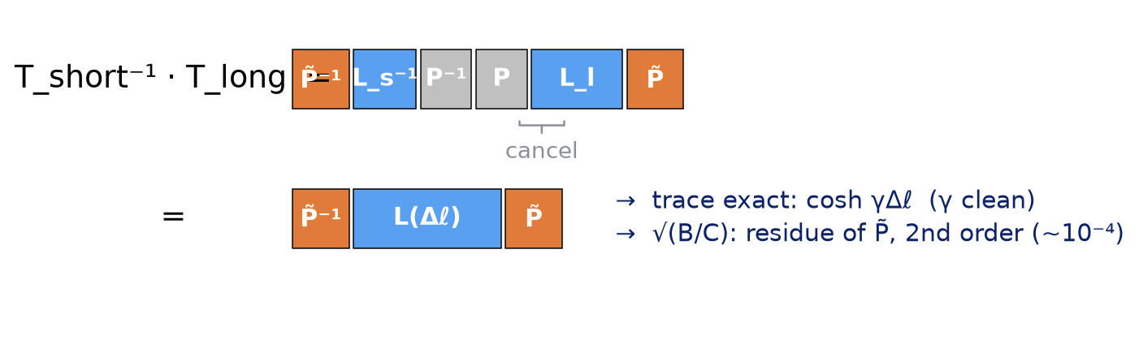
Two-length de-embedding: γ exact, Zc almost
Matrices do not commute: one port box survives, but it cannot change γ
Why γ is clean
γ sits in the eigenvalues e^{±γΔℓ} (trace); Zc in the eigenvectors (V/I of each wave).
P̃⁻¹(…)P̃ changes eigenvectors, never eigenvalues. tr(P̃⁻¹ L P̃) = tr(L).
Extraction
cosh γΔℓ = (A + D)/2 → e^{−γΔℓ} = A − √(A² − 1) (root with |·| < 1, passive line)
α = −ln|e^{−γΔℓ}| / Δℓ, β = −unwrap∠e^{−γΔℓ} / Δℓ, n_m = βc/ω
Phase unwrapped from DC: needs only a fine frequency grid, no resonance.
Size of the Zc residue
Series r alone: Zc'² = Zc² − r². With the fitted port: (|Z_{s}|/Zc)², (ωC_{p}Zc)² ≈ 10⁻⁴ → ~0.01 %.
Scatter seen in √(B/C) (±1 %, spikes at βΔℓ = mπ where B, C → 0) is numerical, not residue.

Slide 8
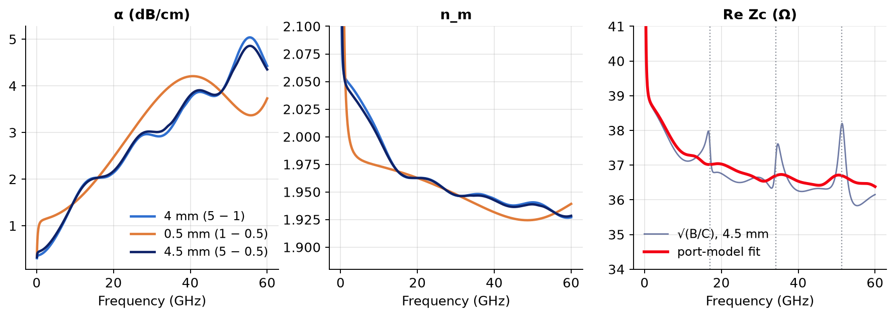
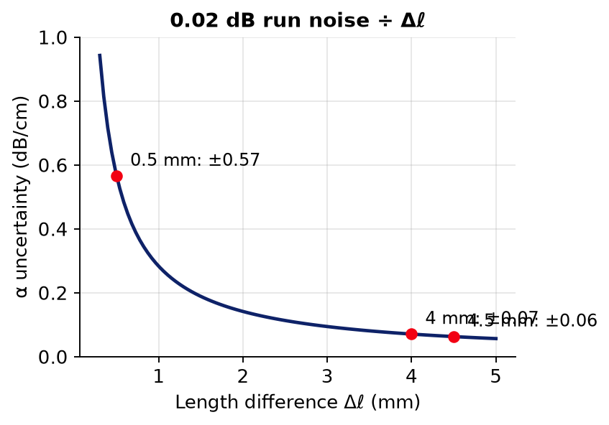
Three de-embedded lines
4 mm and 4.5 mm agree; the 0.5 mm difference is too short to beat the run noise
f | α 4 / 0.5 / 4.5 mm (dB/cm) | n_m 4 / 0.5 / 4.5 mm
1 GHz | 0.38 / 1.09 / 0.46 | 2.055 / 2.081 / 2.052
10 GHz | 1.58 / 1.51 / 1.57 | 2.001 / 1.973 / 1.998
30 GHz | 2.95 / 3.59 / 3.02 | 1.947 / 1.948 / 1.947
60 GHz | 4.43 / 3.73 / 4.35 | 1.927 / 1.939 / 1.928
Why 0.5 mm fails
Each run: ~0.02 dB, ~0.2° noise. Divided by Δℓ: 8× worse at 0.5 mm than at 4 mm.
Rule: largest Δℓ for γ.

Slide 9
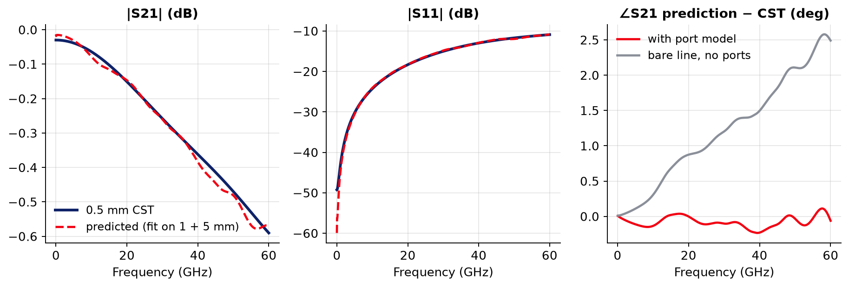
Predicting the 0.5 mm run from the 1 and 5 mm runs
The 0.5 mm data were not used: a blind test of the port model
1
γ from 5 − 1 mm (trace)
2
fit L_{s}, C_{p}, Zc to the 1 and 5 mm S11, S21
3
T = P · L(0.5 mm) · P̃ → S at 50 Ω
4
compare with CST 0.5 mm
f (GHz) | Δ|S21| | Δ∠S21 model | Δ∠S21 no ports
10 | -0.014 dB | -0.13° | +0.31°
30 | -0.002 dB | -0.10° | +1.20°
60 | +0.020 dB | -0.06° | +2.49°
Model: ≤ 0.02 dB, ≤ 0.2°. Without the port model the phase is off by 1.2° at 30 GHz, 2.5° at 60 GHz.

Slide 10
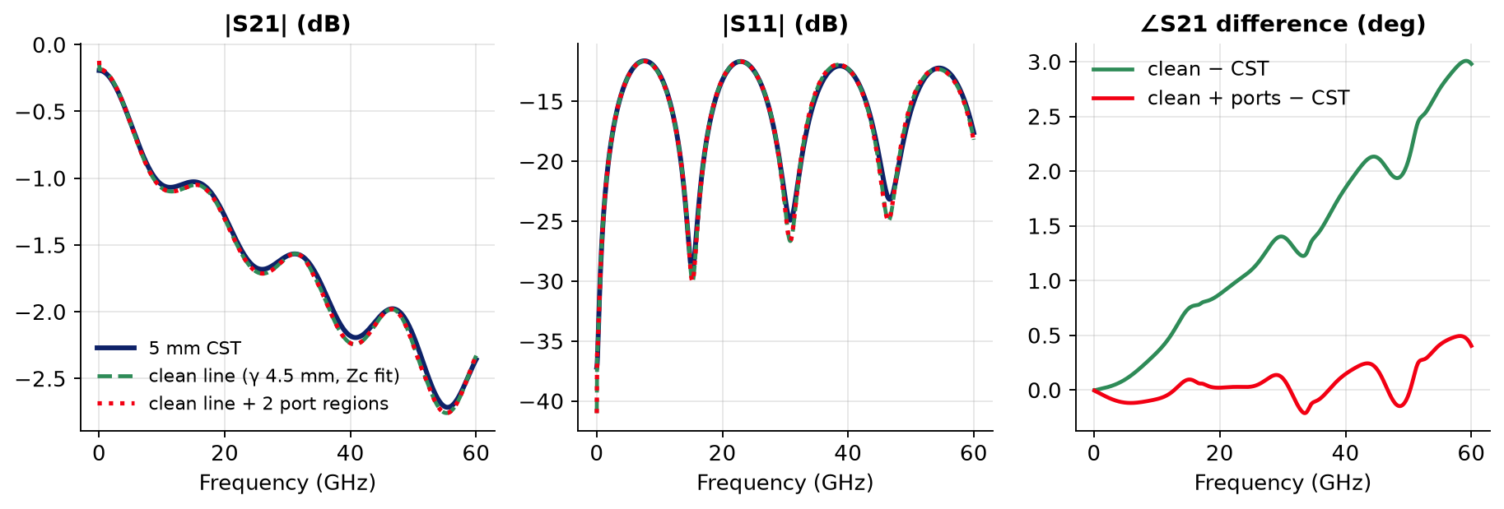
5 mm CST run vs the clean 4.5 mm-derived line
Clean line alone misses only the port phase; adding the two port regions closes the gap
 | max Δ|S21| | Δ∠S21 @ 30 GHz | Δ∠S21 @ 60 GHz
clean line (γ 4.5 mm, Zc fit) | 0.08 dB | +1.40° | +2.98°
clean line + 2 port regions | 0.08 dB | +0.11° | +0.40°
Consistency
|S11|, |S21| differences ≤ 0.08 dB, at noise level, both ways.
Phase difference = 2 port regions (1.4° at 30 GHz), as predicted.

Slide 11
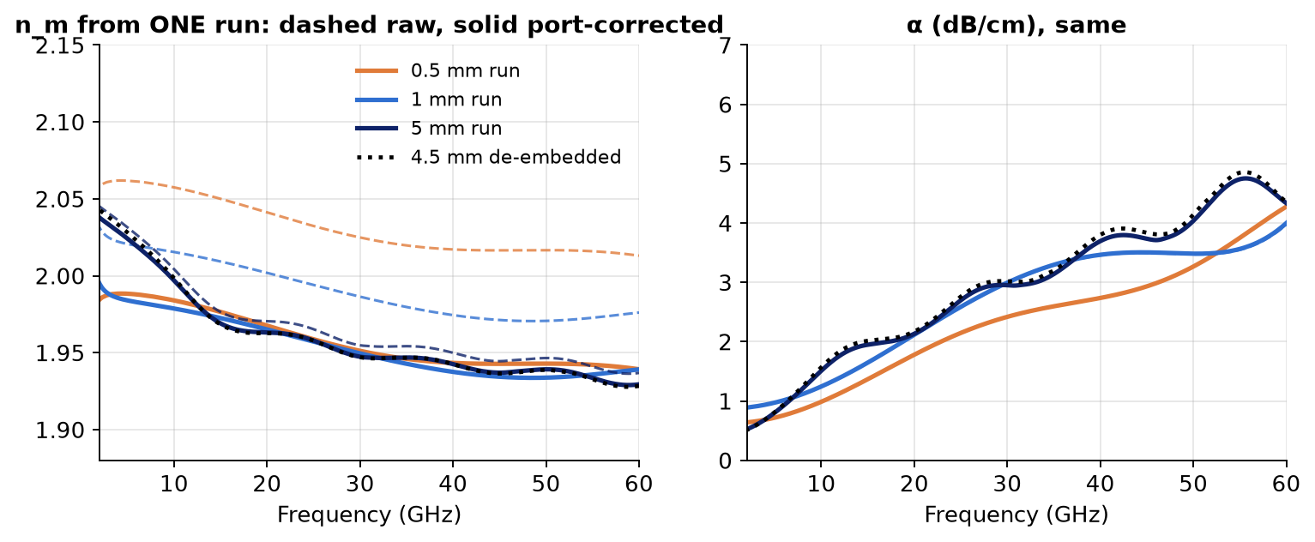
Port-free lines from a single run
Remove both port regions: L(ℓ) = P⁻¹ · T_run · P̃⁻¹ (P from the 1 + 5 mm fit)
n_m from one run | raw | port-corrected | 4.5 mm de-emb.
0.5 mm @ 10 GHz | 2.057 | 1.984 | 1.998
0.5 mm @ 30 GHz | 2.025 | 1.951 | 1.947
0.5 mm @ 60 GHz | 2.013 | 1.939 | 1.928
Independent test
The 0.5 mm run was not used to build P: its n_m error drops from 3–4 % to < 1 %.
What it fixes
Phase / n_m from one run, any length (the artefact is phase).
Port-free Touchstones of each run: docs/cst/cascade/cleaned/.
Future runs with the same ports and mesh: one length enough for n_m.
What it cannot fix
α from one short run: run noise (~0.02 dB) ÷ length. Loss still needs a length difference.
P must be re-characterised for a new cross-section or port setup.

Slide 12
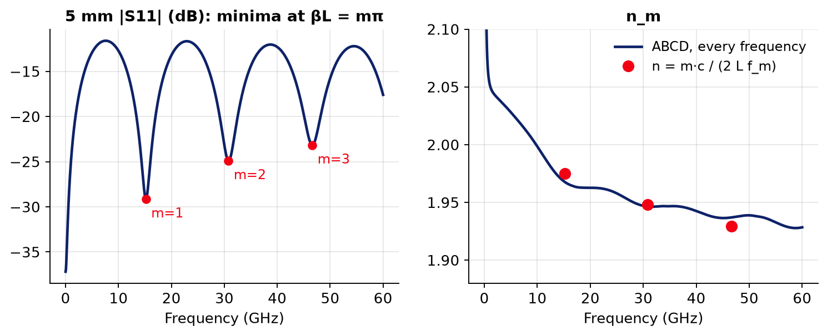
n_m: resonance (FSR) method vs ABCD extraction
Why 2 mm was thought to be the minimum, and why it is not
FSR method
Mismatched line: S11 = Γ(1 − e^{−2γL})/(1 − Γ²e^{−2γL}) → minima at βL = mπ:
n_m = m·c / (2 L f_m)
One minimum in band needs L ≥ c/(2 n_m f_max) ≈ 1.3 mm at 60 GHz → '2 mm'.
m | f_m (GHz) | n_m (FSR) | n_m (ABCD)
1 | 15.18 | 1.975 | 1.98
2 | 30.78 | 1.948 | 1.947
3 | 46.62 | 1.929 | 1.94
Take-aways
Both agree where minima exist; ABCD gives n_m at every frequency, any length.
Minima spacing gives the RF group index c/(2LΔf) = 1.92, 1.89, not the phase index n_m that sets walk-off (2–3 % error).
Short runs are fine for n_m with ABCD; their limit is the port share (now modelled) and noise for α.

Slide 13
What this means for INTERCONNECT
Segments from γ and Zc, not from raw Touchstones
Electrical cascade
Exact for any number of segments (ABCD identity).
More, shorter CST segments do not help: port share grows.
Electro-optic sampling
N lumped OMs sample V(z) at points: error ∝ (βΔz)² → Δz ≪ RF wavelength (~0.1 mm at 100 GHz).
TL scripted element: exact closed-form integral, one element per line.
Frequency → time
Each S-matrix becomes an FIR filter; outside a Compound every pass adds latency → wrong ripple (0.45–2.8 dB).
Fix: Compound with scattering data analysis (0.04 dB, 0.4°).
Crosstalk: not yet covered
Needs coupled lines: 2 modes, 4×4 S-matrix, modulation per line from both modes, victim terminations.
Same de-embedding: eigenvalues of T_s⁻¹T_l give γ_{e}, γ_{o} exactly.

Slide 14
Summary and next steps
Finding | Evidence
Cascading identical lines adds no mismatch; reference choice is bookkeeping | ideal line 2·10⁻¹⁵; renormalised gap unchanged
Every CST run has a fixed port artefact: ~9.5 µm of extra line per port, phase only | excess phase identical at 0.5 / 1 / 5 mm
Port region = 2.8 pH series + 1.3 fF shunt | blind prediction of 0.5 mm: ≤ 0.02 dB, ≤ 0.2°
γ from two lengths is exact; take the largest Δℓ | 4 mm and 4.5 mm agree (n_m ± 0.003)
Zc residue ~0.01 %; Zc ≈ 37.3 / 36.6 / 36.4 Ω at 10 / 30 / 60 GHz | port-model fit
Port-free lines from one run (phase); α still needs a length difference | 0.5 mm n_m error 3–4 % → < 1 %
Next
1 Line tables for INTERCONNECT: γ (4.5 mm pair) + Zc (fit); check a 5 mm line in INTERCONNECT against CST.
2 Optional CST check: port de-embedding of ~10 µm or a longer lead-in should remove the phase artefact.
3 Crosstalk: derivation of coupled lines first, then CST coupled pair at two lengths, then a 4-port scripted element.

