Slide 1
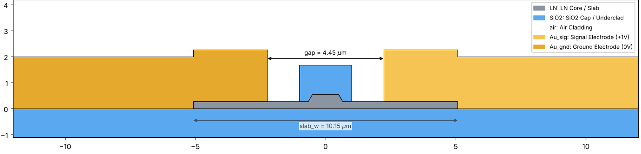
Istanbul: cross-section and nominal result
C-band tapeout, simulated at 1575 nm, gap 4.45 µm, slab 10.15 µm
Geometry
LN rib 1.0 µm top, 275 nm etch, 275 nm slab
SiO₂ cap 2.0 × 1.4 µm
Gold 2.0 µm, conformal: drops 275 nm past the slab end
Slab ends 2.85 µm inside the gold
Same cavity (2.85 µm) | Gap | IL (dB/cm)
Cordoba etched, flat gold | 4.20 µm | 0.209
Cordoba etched, flat gold | 4.45 µm | 0.092
Istanbul, stepped gold | 4.45 µm | 0.092
0.092 dB/cm
2.42 V·cm
insertion loss at nominal
Vπ·L at nominal
Low loss comes from the wider gap (field at the gold ≈ halved per +0.125 µm per side); the 275 nm gold step has no effect. Vπ·L pays +7 % vs Cordoba (2.27 V·cm).

Slide 2
Slab-width sweep: strong IL ripples, flat Vπ·L
Slab width from gap + 1 to gap + 8 µm, 100 nm step (71 points)
1.8 µm
ripple period in slab width
(0.9 µm cavity per side)
0.05 → 0.6
dB/cm within ±0.4 µm
of the nominal slab width
±0.04 %
Vπ·L variation over the sweep
(2.421 V·cm)
Peaks 1.03 / 0.73 / 0.60 dB/cm, troughs 0.02–0.06 dB/cm: the nominal sits on the rising edge of a peak. Slab-edge offsets of a few hundred nm can explain the scattered loop IL measurements.

Slide 3
Wavelength: the ripple pattern shifts across the C band
No buffer, gap 4.45 µm; same slab-width sweep at 1525, 1575 and 1625 nm
λ | IL @ 10.15 µm | Position
1525 nm | 0.262 dB/cm | on a peak
1575 nm | 0.092 dB/cm | rising edge
1625 nm | 0.080 dB/cm | in a trough
What changes with λ
Peaks move to wider slabs: ≈ +0.35 µm per +50 nm
Period 1.70 / 1.77 / 1.90 µm
Peaks grow with λ (≈ 0.5 → 1.3 dB/cm at 9 µm)
Vπ·L: 2.32 / 2.42 / 2.53 V·cm, flat vs slab
At the nominal slab, IL falls 3× from 1525 to 1625 nm, opposite to the normal gold-loss trend: a clear signature to look for in the measured C-band data.

Slide 4
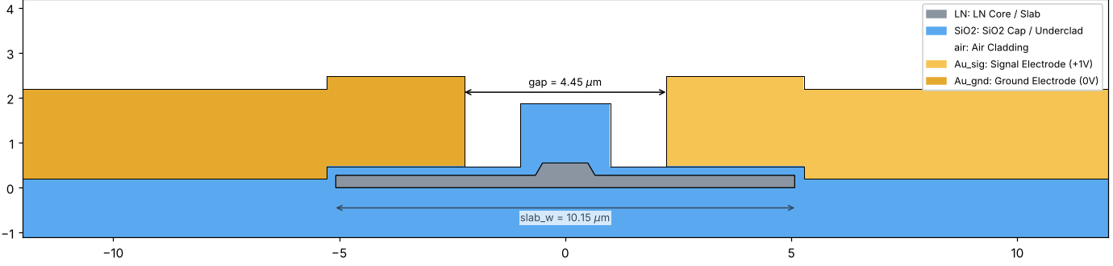
Istanbul + 200 nm buffer: gap recovers Vπ·L
Conformal buffer under all the gold; slab 10.15 µm, 1575 nm
+20 %
3.65 µm
0.013
7×
Vπ·L with buffer at 4.45 µm
(2.42 → 2.90 V·cm)
gap that restores 2.42 V·cm
dB/cm at 3.65 µm
lower IL than unbuffered
Slope ≈ 0.6 V·cm per µm of gap; IL rises from 0.001 to 0.013 dB/cm as the gap closes.

Slide 5
With the buffer the ripples disappear
Slab-width sweep at 1575 nm, both designs at the same nominal Vπ·L
0.0126 dB/cm
buffered IL, ±0.4 % over
5.45–12.45 µm
0.017 → 1.03
unbuffered IL range (dB/cm)
2.424 V·cm
buffered Vπ·L, flat above 7 µm
The buffer removes the gold contact at the slab end: no cavity, no ripples, IL independent of slab-width errors, at equal Vπ·L.

