Slide 1
Electrical crosstalk between TFLN electrodes from a single cross-section
2-D port-mode simulation vs full 3-D CST · pitch 200 µm · 1 mm and 5 mm lines

Slide 2
Two cross-section modes reproduce the 3-D crosstalk
2
1–5 dB
minutes
modes out of 6 carry all the crosstalk of a single-line launch
agreement with 3-D CST for 1 mm NEXT and FEXT
per frequency in 2-D, for any line length
Crosstalk = the slow phase drift between an even and an odd wave shared by the two lines
Everything needed comes from one 2-D cross-section: index and impedance of those two waves
Open point: 5 mm NEXT above 25 GHz (model 6–10 dB lower than 3-D), at the 3-D error floor

Slide 3
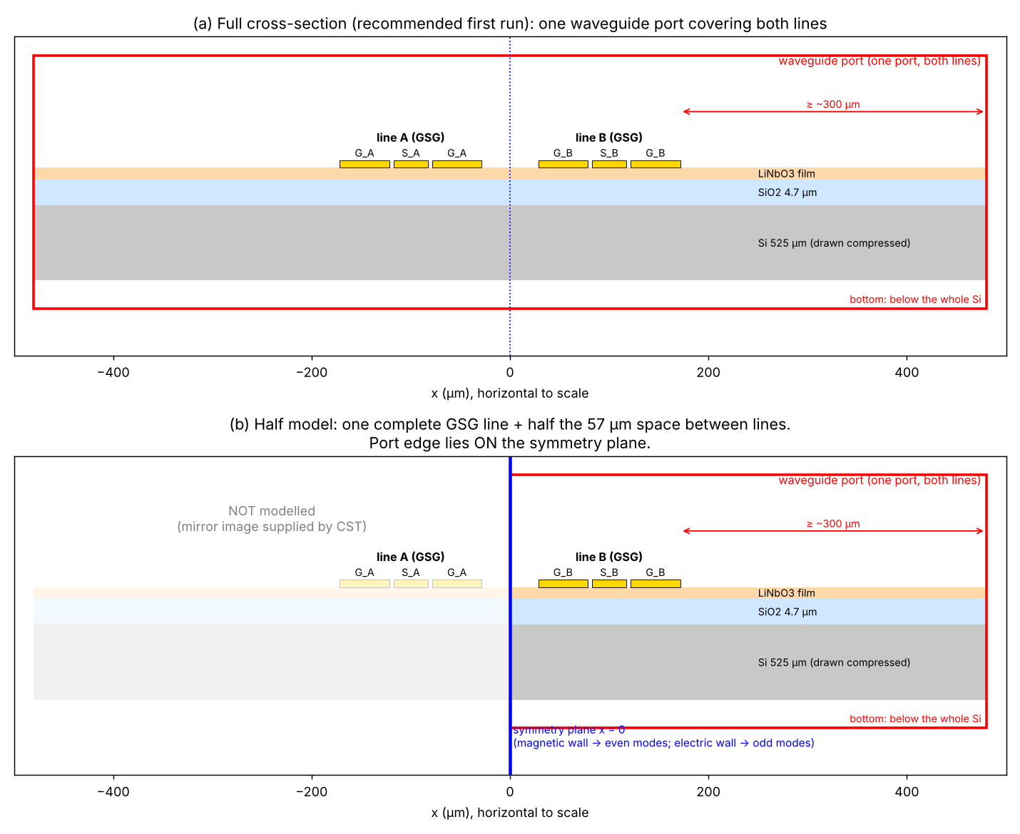
Two identical GSG lines with separate grounds
Thin-film LiNbO3 on SiO2 on 525 µm Si
Each line: ground–signal–ground (GSG), 35 µm signal, 4.15 µm gaps
Pitch 200 µm; inner grounds 57 µm apart
Question: how much of line A's signal appears on line B, at the near end (NEXT) and the far end (FEXT)?
Target length 14–15 mm, too long for direct 3-D runs

Slide 4
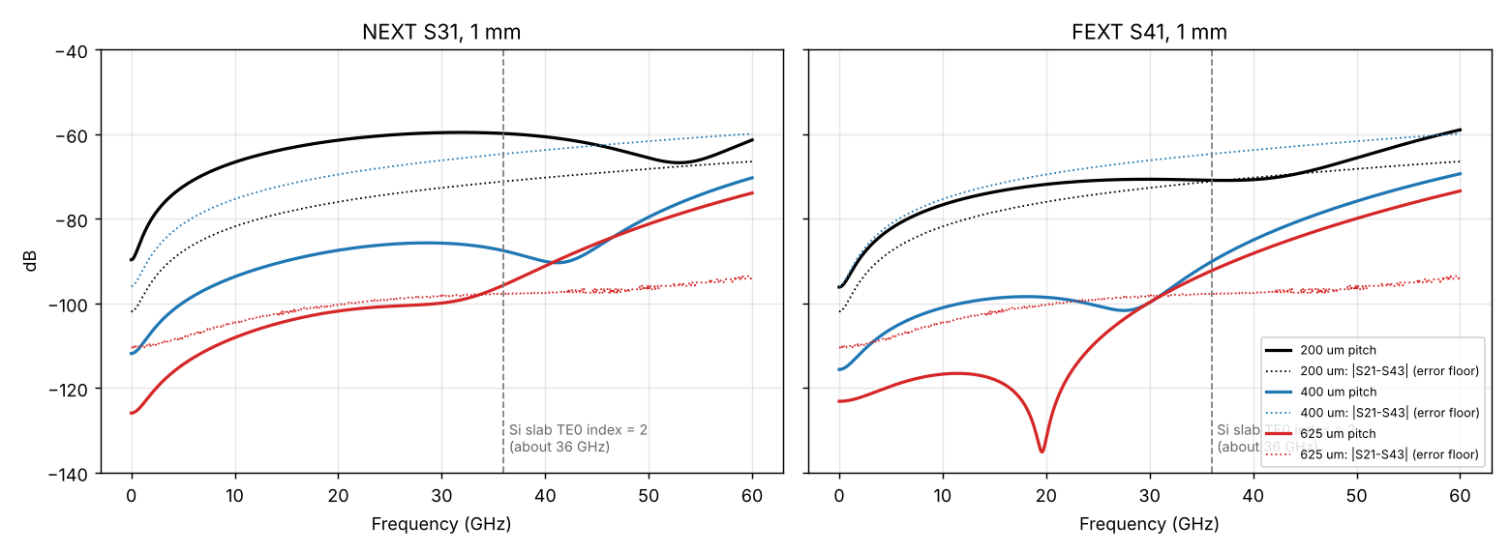
3-D runs: crosstalk falls fast with pitch, until the error floor
200 µm
NEXT ≈ −60 dB, FEXT ≈ −70 dB at 30 GHz (1 mm)
400 / 625 µm
below their own error floor (dotted) under ~30 GHz
Error floor = |S21 − S43|
Lines A and B are identical, so S21 and S43 should be equal. Their difference is the simulation's own error. Crosstalk below it cannot be trusted. Above ~30 GHz the 400 and 625 µm curves rise together: substrate leakage is a hypothesis, not proven.

Slide 5
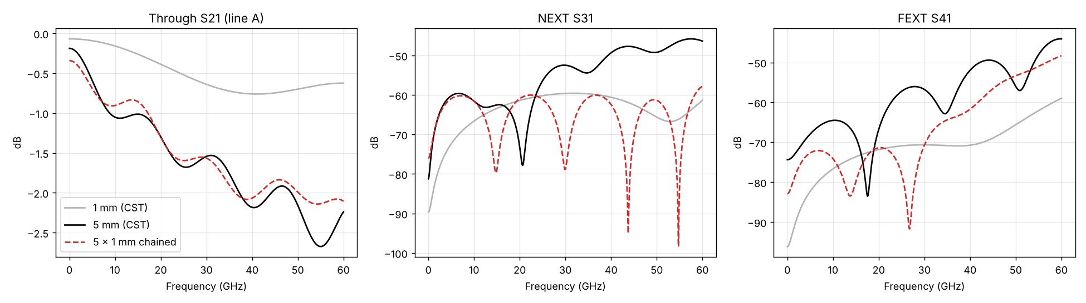
Chaining five 1 mm blocks does not give the 5 mm crosstalk
Port phase
37 vs 50 Ω
A/B asymmetry
Result
removed: no change
renormalised: dips remain
symmetrised: 0.0 dB change
through path OK; NEXT/FEXT wrong → need another method

Slide 6
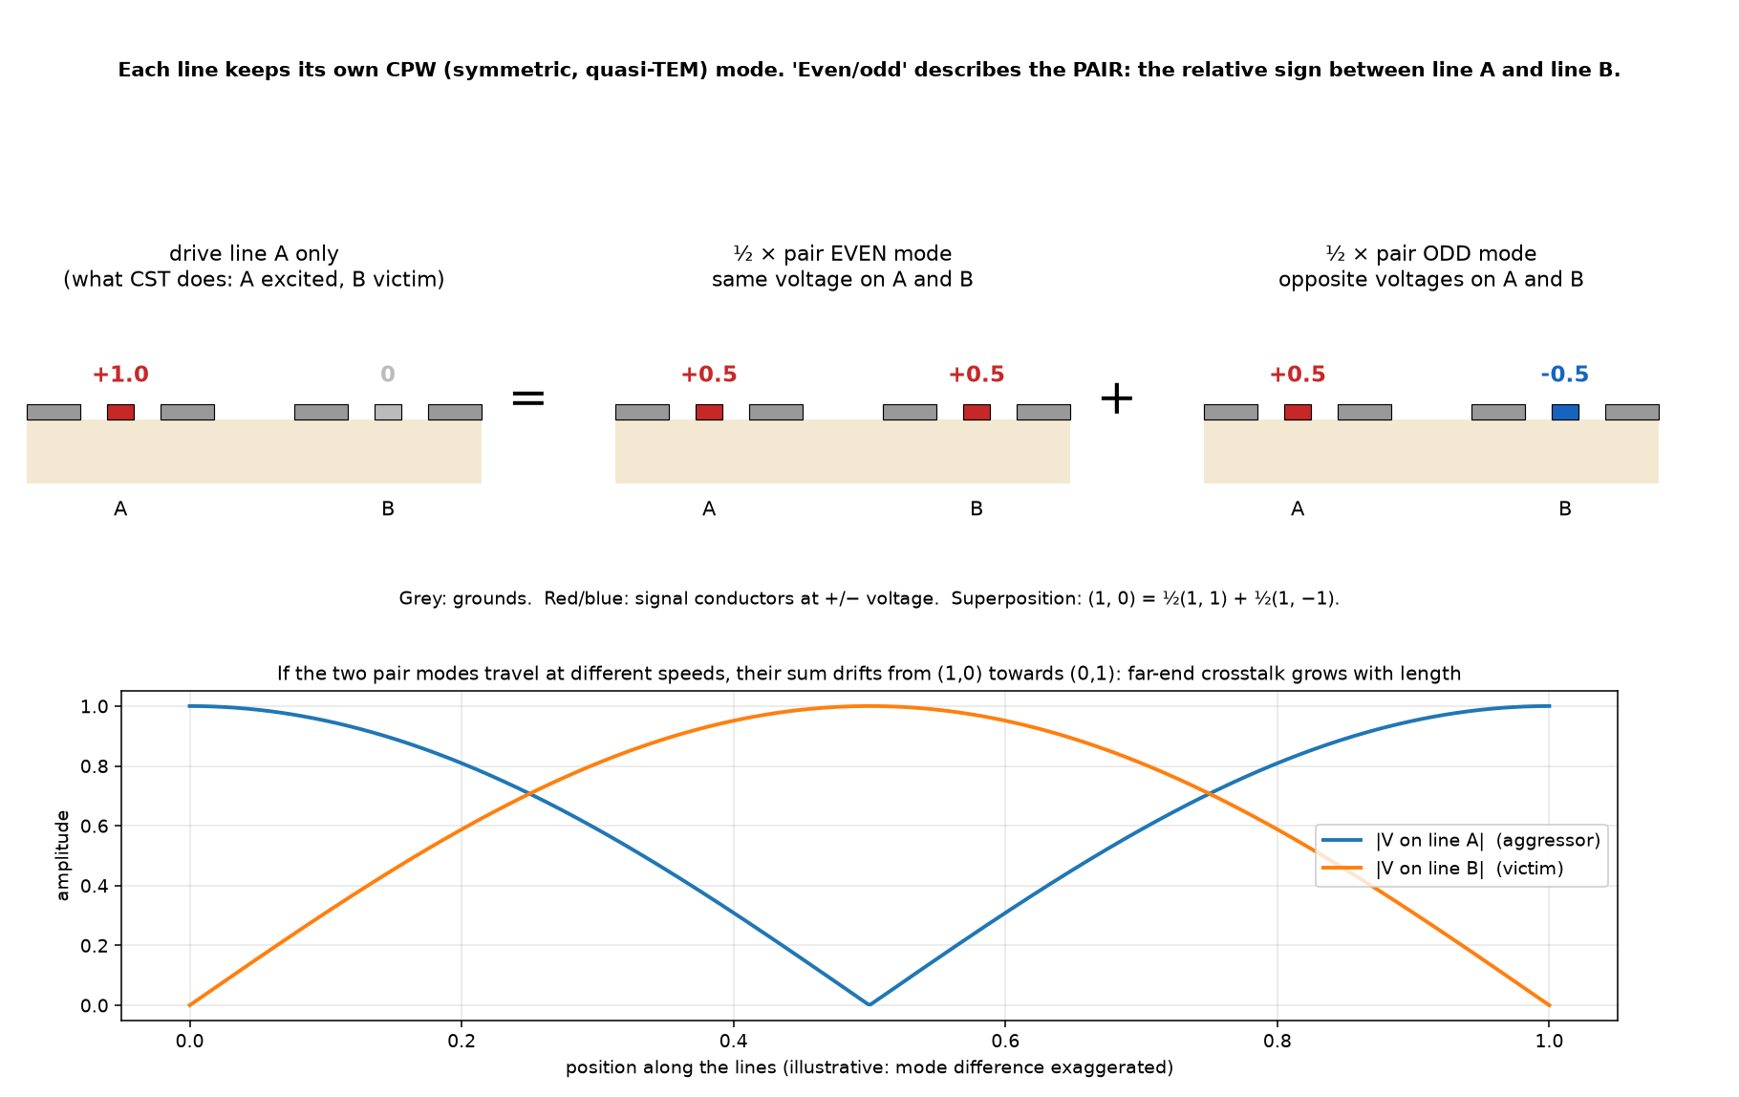
Idea: driving one line = half even wave + half odd wave
Even: same voltage on A and B. Odd: opposite voltages
Each wave keeps its shape along a uniform line, but the two travel at slightly different speeds
Their sum slowly moves from line A to line B: that is FEXT
Their impedances differ slightly: reflections at the ports no longer cancel on B: that is NEXT
Only 4 numbers needed: n_even, n_odd, Z_even, Z_odd

Slide 7
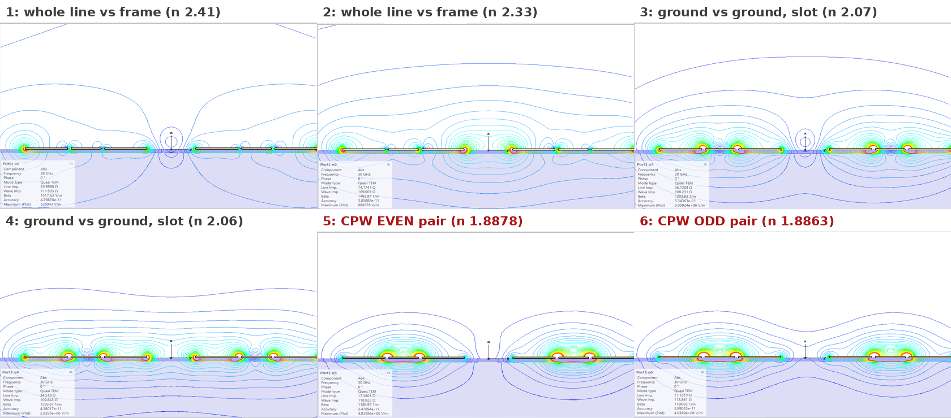
The 2-D port solve finds six quasi-TEM modes
6 metal strips + metal port frame = 7 conductors → 6 modes
Modes 5 and 6: field in the signal gaps, identical on both lines
Modes 1–4: ground-vs-ground or whole-line-vs-frame
CST time-domain port solver, 30 GHz, electric shielding, port 943 × 935 µm

Slide 8
A GSG launch can only excite the even and odd pair
6
−2
−2
= 2
modes available
own grounds tied, symmetric drive
current returns on own grounds
left
any voltage pattern on 6 strips (frame as reference)
both grounds of a line at the same potential: no slot modes (3, 4)
no net current per line: no line-vs-frame modes (1, 2)
line A in CPW mode, line B in CPW mode → even and odd
In the 3-D model
Where modes 1–4 can appear
Lumped ports with PEC bars tie each line's grounds and drive symmetrically: the two constraints hold at both ends.
Asymmetric launches, bends without ground bridges, pads tying grounds differently. To check for the lab probes.

Slide 9
Inputs: index difference and impedance ratio vs frequency
Both almost flat over 6–60 GHz
Impedance ratio: integrate the exported field across each gap → voltage per line; equal power → Z ∝ V²
Spread between grid rows (0.30–0.45 %) is the uncertainty → the model is drawn as a band

Slide 10
Hybrid model: 3-D average line + 2-D even/odd split
3-D single line (coworker)
speed, loss, Z vs f
includes gold losses
γ_even, γ_odd
Z_even, Z_odd
NEXT = ½(Γ_e − Γ_o)
FEXT = ½(T_e − T_o)
50 Ω ports, any length
2-D port modes (this work)
Δn(f), Z_even/Z_odd
Why hybrid
Why a band, not a line
The hexahedral port solver treats gold as a perfect conductor: n = 1.888, flat. The real line has n = 2.02 → 1.93 and loss. The split (Δn, ΔZ) comes from geometry and survives; the average comes from 3-D.
Z_even/Z_odd − 1 is known only to 0.30–0.45 %. The red band is the model with each end of that range. Δn is precise (from β).

Slide 11
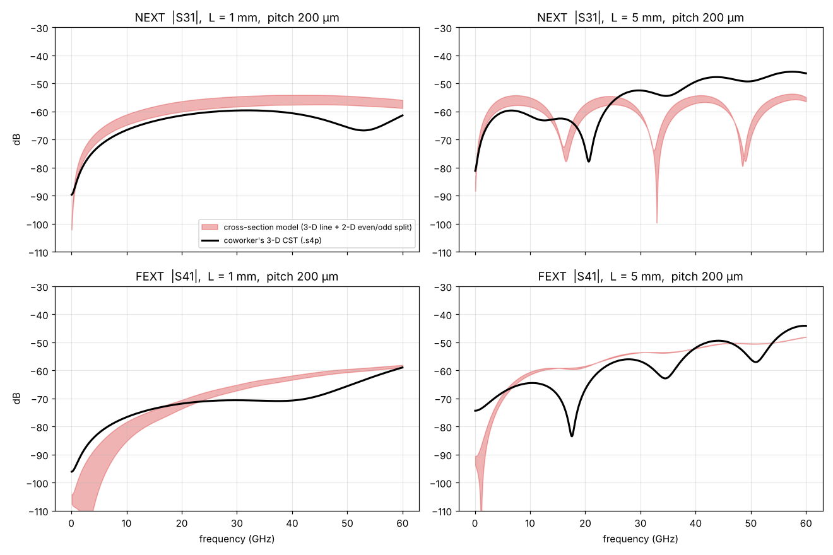
Model vs 3-D CST: levels agree, 5 mm ripples differ

Slide 12
Scorecard: 1 mm agrees, 5 mm NEXT is the open point
 | 6 GHz | 18 GHz | 30 GHz | 42 GHz | 60 GHz | Verdict
1 mm NEXT CST / model | −71 / −69…−65 | −62 / −61…−57 | −60 / −58…−55 | −61 / −58…−54 | −61 / −59…−56 | 1–5 dB high
1 mm FEXT CST / model | −81 / −97…−84 | −72 / −76…−72 | −71 / −67…−65 | −70 / −63…−61 | −59 / −59…−58 | good at 18, 60 GHz
5 mm FEXT CST / model | −67 / −68…−66 | −80 / −59 | −57 / −54 | −50 / −51 | −44 / −48 | envelope OK, dips not
5 mm NEXT CST / model | −60 / −58…−55 | −65 / −68…−62 | −53 / −62…−61 | −48 / −57…−54 | −46 / −56…−55 | 6–10 dB low > 25 GHz
Why 5 mm NEXT may be off
Why we cannot tell yet
A uniform line must show NEXT nulls every ~15 GHz. The 3-D 5 mm NEXT has none above 25 GHz: an extra near-end contribution (ports, ground modes) or numerical error.
The 5 mm 3-D error floor |S21 − S43| ≈ −56 dB at 30 GHz: the disputed values sit on it. Test: finer port mesh in the 5 mm 3-D run.

Slide 13
Cost: one cross-section replaces a family of long 3-D runs
hours
minutes
free
per 3-D run, each length, and the 5 mm run was already at its error floor
per 2-D frequency point with 2 adaptive passes; 5 points cover 6–60 GHz
any length afterwards: 1, 5 or 14 mm is a formula, no cascade
The first 2-D run took about 47 min with 3 adaptive passes; pass 3 changed the line impedance by only 0.36 %.

Slide 14
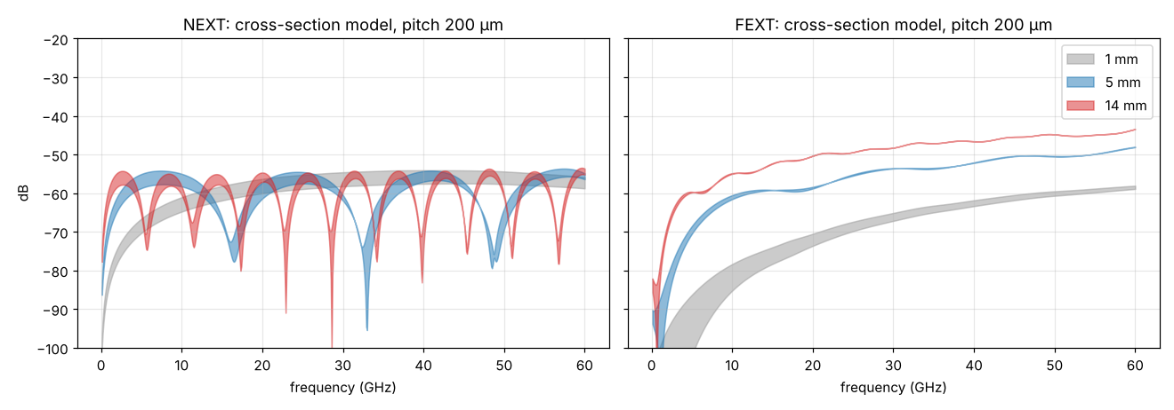
Prediction for the real 14 mm line
−48 dB
FEXT at 30 GHz
−43 dB
FEXT at 60 GHz
≈ −54 dB
NEXT at 60 GHz (line only)
FEXT grows with length (about +20 dB from 1 mm to 14 mm); it dominates for long lines
NEXT saturates with length; any near-end contribution from pads or ports must be added separately
Pitch 200 µm, straight uniform line, 50 Ω terminations

Slide 15
Slow-wave lines: same physics, one unit cell
Still uniform
Still even + odd
But no 2-D port
T-loaded grounds repeat every period p ≪ wavelength. Over a period the wave sees one effective n, Z, α: the line behaves as uniform.
Two identical, aligned lines keep the A↔B mirror symmetry: the pair modes are still even and odd (Bloch modes).
One cross-section cannot see the tees. Use one period instead.
Option 1: 3-D eigenmode solve of one period of both lines, periodic boundaries → β_even, β_odd
Option 2: short 3-D runs of N and 2N periods → 4-port transfer matrix → eigenvalues give γ_even, γ_odd and Bloch impedances (the extraction we already wrote, applied to cells)
Then the same model, the same INTERCONNECT block

Slide 16
Next steps
1. Finer port mesh in the 5 mm 3-D run: settles the NEXT question
2. INTERCONNECT coupled-electrode block: 4 RF ports + EO outputs, from this model
3. Unit-cell extraction for slow-wave lines

