Slide 1
Lifted electrodes on a SiO₂ buffer:
removing the lift-position standing wave
femwell / scikit-fem eigenmode study at λ = 1575 nm
Notes:
Lisbon lifted electrodes show an insertion loss that oscillates with the lift position. We show where it comes from, how a 200 nm SiO2 buffer removes it, what it costs in Vpi*L, and the final buffer/gap choice.

Slide 2
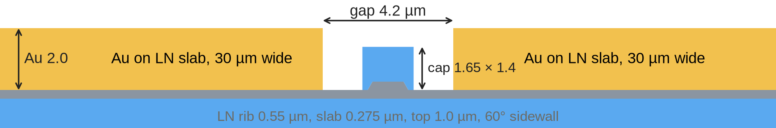
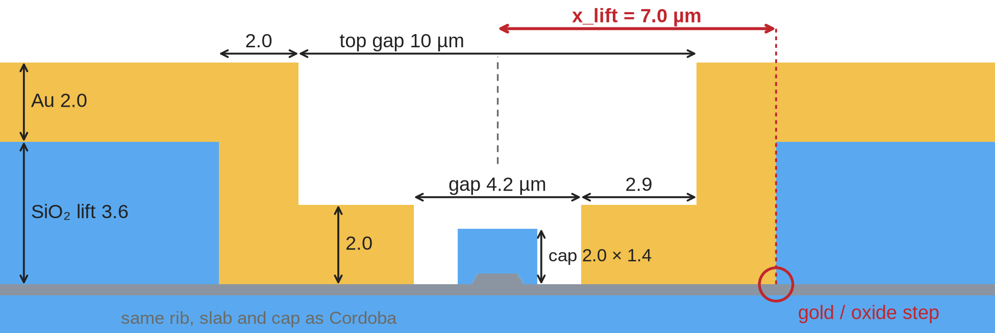
Lifting the gold: same Vπ·L, but IL oscillates with x_lift
Cordoba (gold flat on the LN slab) vs Lisbon (gold lifted onto SiO₂ at x_lift), both with a 4.2 µm gap
Cordoba (legacy)
Lisbon (lifted)
Lateral Fabry–Pérot cavity (gap edge ↔ gold/oxide step), L = x_lift − gap/2:
IL = IL∞ (1 − ρ²) / (1 − 2ρ cos(2k_{x}L + φ) + ρ²), ρ = ρ₀ e^(−2α_{x}L)
k_{x}, α_{x}: lateral wavenumber and gold absorption of the wave under the gold. Envelopes IL∞(1 ± ρ)/(1 ∓ ρ) converge to IL∞.
Fit (rms 0.002 dB/cm): IL∞ = 0.41 dB/cm (Cordoba 0.42); 2α_{x} = 0.175 µm⁻¹, π/k_{x} = 0.895 µm, vs 0.181 µm⁻¹ and 0.91 µm predicted by its 1D index.
2.26 | 2.26
+80 %
Vπ·L [V·cm], Cordoba | Lisbon
identical
IL for a 100 nm shift of x_lift
(7.1 → 7.2 µm: 0.33 → 0.60 dB/cm)
Notes:
Cross-sections drawn from the model polygons, same scale; dimensions in um. x_lift = distance from the rib centre to the point where the gold leaves the LN slab and climbs onto the SiO2 lift. Vpi*L: Cordoba 2.260, Lisbon 2.265 V*cm at the same 4.2 um gap. IL of Lisbon oscillates with a 0.9 um period around the Cordoba value; the steepest 100 nm step is 7.1 -> 7.2 um (0.33 -> 0.60 dB/cm), so the IL of a fabricated device is not predictable. Envelopes: the rib mode leaks into the wave guided under the gold, which bounces between two cut-off regions (gap edge and lift). The leakage rate is that of a source inside a Fabry-Perot cavity (Airy function), with round-trip factor rho = rho0*exp(-2*alpha*L), where alpha = Im(k_x) is the gold absorption of the lateral wave. Peaks (1+rho)/(1-rho) and dips (1-rho)/(1+rho) times IL_inf, so peak*dip = IL_inf^2 (measured sqrt(P*D) = 0.40-0.41 at every period) and both converge to IL_inf when the step is far. Free fit of all 46 points 6.5-11 um: IL_inf 0.412, rho0 0.91, 2*alpha 0.175 1/um, period 0.895 um. Independent 1D prediction from the complex index of the gold-guided wave (2.072 - 0.0095i) and n_rib 1.8834: 2*alpha 0.181 1/um, period 0.91 um. Data: results/lift_sweep.csv (beyond 11 um only sparse points, not shown).

Slide 3
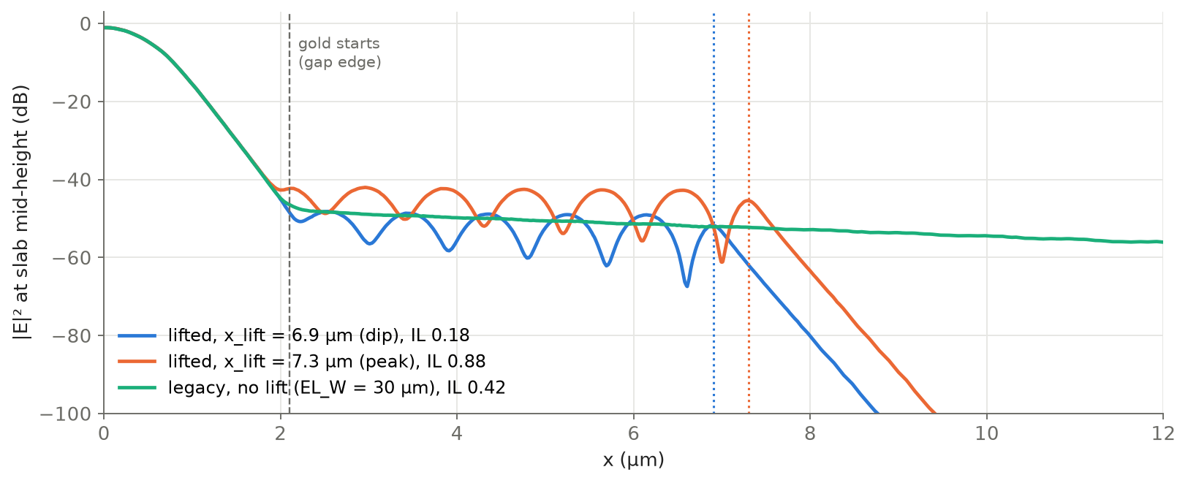
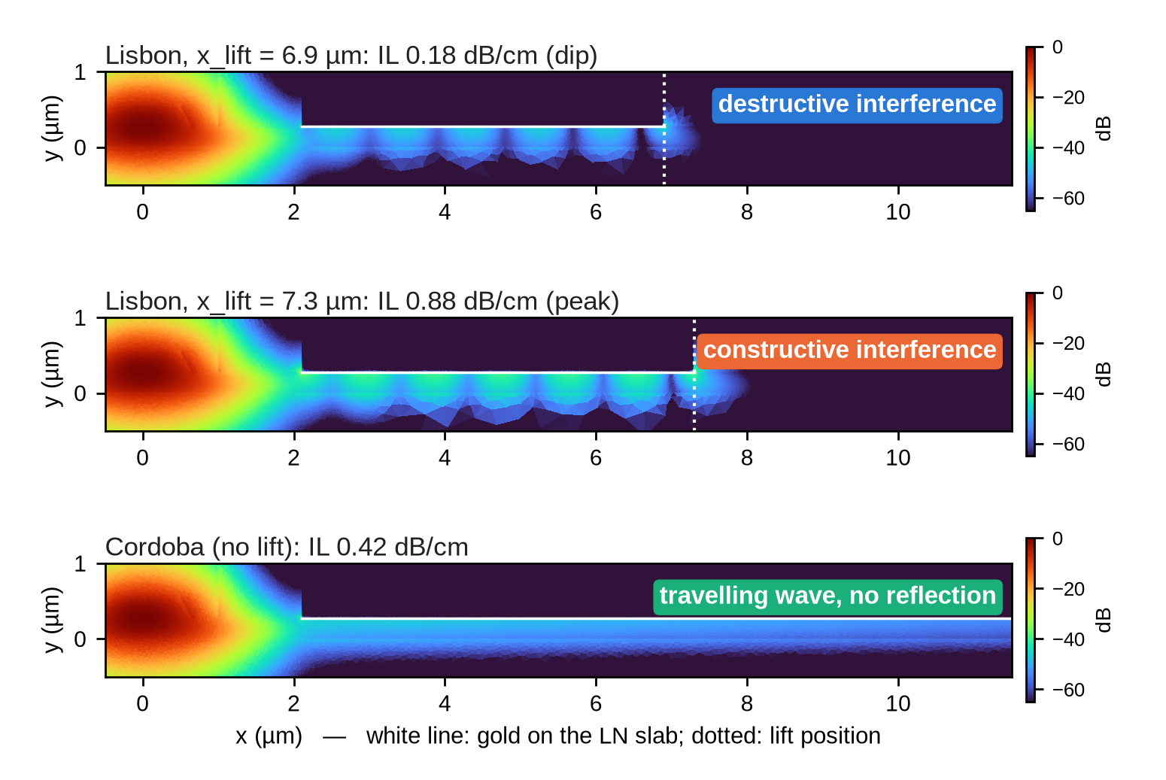
Origin: a standing wave in a lateral cavity under the gold
Only the gold-covered slab carries a lateral wave faster than the rib mode; the lift closes the cavity
Why 0.9 µm? Λ = λ / (2√(n_{Au}² − n_{rib}²)) = 1.575 / (2 × 0.863) = 0.91 µm (simulated 0.90): half the lateral wavelength, set by the indices only.
Cavity length: sets how many half-waves fit (≈ 5 at 7 µm). Resonance 2k_{x}L + φ = 2πm recurs every ΔL = Λ: one more half-wave per 0.9 µm of x_lift.
Notes:
Top left: |E|^2 at slab mid-height vs x. Dip (x_lift 6.9 um, IL 0.18) and peak (7.3 um, IL 0.88) show ripples between the gap edge and the lift; Cordoba shows a smooth, slowly decaying travelling wave. Right: field maps, same dB scale. Indices: 1D mode solve of each vertical stack (TM-like wave under the gold: Au / 275 nm LN slab / SiO2 BOX, n = 2.065-2.080 depending on the in-plane LN permittivity; gold-free slab with air or SiO2 on top: TE 1.70-1.80, TM 1.48-1.60). Rib mode: 2D FEM n_eff 1.8834. n > n_rib alone gives lateral leakage (a travelling wave, as in Cordoba, where 30 um of gold absorbs it: round trip attenuation e^-5). The standing wave needs the second mirror: in Lisbon the slab beyond x_lift has no gold, so the wave is cut off there and reflected. The gap edge is also cut off, so the wave bounces between two mirrors. Interference: at the dip the reflected wave returns out of phase at the gap edge and suppresses the leakage (destructive); at the peak it returns in phase and enhances it (constructive). Fringe period inside the cavity and IL period vs x_lift are both pi/k_x: the cavity length fixes the order m, not the spacing (as in a Fabry-Perot, where resonances are spaced by half a wavelength in length).

Slide 4
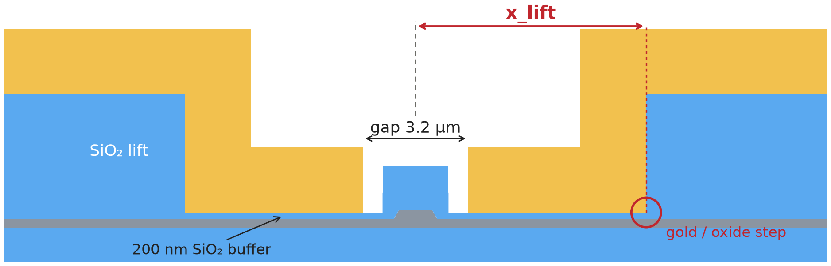
Possible solution: SiO₂ buffer
200 nm SiO₂ under the whole electrode and across the gap; bottom gap 4.2 → 3.2 µm
Lisbon on a SiO₂ buffer
Notes:
Chart top right: 1D effective index of the wave guided under the gold vs buffer thickness (mean of the two in-plane LN permittivities; cutoff 37-39 nm). Below the rib index the wave cannot be phase matched, so the rib mode cannot couple into a propagating wave: there is no standing wave to form, whatever x_lift. The 1D model matches the 2D simulations (period 0.90 vs 0.91 um at 0 nm; decay 28.98 vs 28.95 dB/um at 200 nm). Bottom: 200 nm buffer, 88 lift positions 3.8-30.1 um, IL 0.0480-0.0481 dB/cm. Chart shows up to 11 um; flat also at 12-30 um. Without buffer at gap 3.2 IL would be 4-30 dB/cm and still oscillating.

Slide 5
The price: higher Vπ·L, recovered with a narrower gap
The DC field must cross the low-ε oxide (ε 3.75 vs 28 in LN); narrowing the gap compensates
0.026
Final design – still to be frozen
buffer 200 nm, hp gap 3.4 µm for variant 1 – TBD – expected Vpi < 1.95 @ 1575
buffer 200 nm, hp gap 3.4 µm for variant 2 - TBD – expected Vpi < 1.95 @ 1575
buffer 200 nm, hp gap 3.4 µm for variant 3 - TBD – expected Vpi < 2.35 @ 1575
Notes:
Left: Vpi*L vs buffer thickness at gap 3.2 um, x_lift 7 um (150, 250 nm added for this deck). 150 nm: Vpi*L 2.077 vs 2.148 V*cm (-3.3 %), IL 0.068 vs 0.048 dB/cm. Centre/right: gap scan at 200 nm (GAP_TOP fixed at 10 um). Vpi*L grows linearly with the gap, IL falls exponentially. Gap 3.4 um: Vpi*L 2.2707 V*cm, IL 0.0260 dB/cm, flat for x_lift 4.5-16 um (2.270-2.275 V*cm). On the 14.84 mm line with duty cycle 0.925: Vpi = 1.654 V. The 1.7 V limit allows Vpi*L up to 2.334 V*cm (gap about 3.5 um), so 3.4 um keeps about 0.05 V of margin. Gold loss over the line: 0.039 dB.

Slide 6
Buffered design: robust to buffer-thickness error
SiO₂ buffer 130 → 270 nm (10 nm step), gap 3.4 µm, CAP 2.0 × 1.4 µm; measured spread ±20 nm (±40 nm extreme)
rib top WG_TOP = 1.0 µm
rib top WG_TOP = 1.4 µm
━● Lisbon, C band 1575 nm ━● Jerez, O band 1360 nm dashed horizontal: unbuffered at gap 4.2 µm; verticals: 200 nm nominal (navy), ±20 nm (grey solid), ±40 nm (grey dashed)
Notes:
Buffered lifted designs, gap 3.4 um, GAP_TOP 10 um, CAP_W 2.0 um, CAP_H 1.4 um from the buffer top (the cap moves with the buffer), 60 deg sidewalls. Lisbon: 550 nm film, 275 nm etch / 275 nm slab, 1575 nm. Jerez: 400 nm film, 170 nm etch / 230 nm slab, 1360 nm. Sellmeier LN (Zelmon) and SiO2 (Malitson), Johnson & Christy gold, converged mesh. Buffer 130-270 nm in 10 nm steps (60 runs) plus the unbuffered references at gap 4.2 um (dashed). Vpi*L is linear in the buffer thickness (deviation <= 6 mV*cm over the range): +1.3 mV*cm/nm (Lisbon) and +1.0 mV*cm/nm (Jerez), i.e. about +/-1.1 % at +/-20 nm and +/-2.3 % at +/-40 nm, the same for both rib widths. IL falls exponentially with the buffer (e-folding 150 nm Lisbon, 125 nm Jerez): about +/-15 % at +/-20 nm, but always below 0.036 dB/cm inside the +/-40 nm window. No ripple and no x_lift dependence appears anywhere in the range: the lateral wave under the gold stays cut off.

Slide 7
Measured buffer spread → Vπ·L and IL spread
Process data (32 chips per wafer) mapped onto the simulated sweep; rib top 1.0 µm
wafer | buffer (nm) | Lisbon Vπ·L (V·cm) | Lisbon IL (dB/cm) | Jerez Vπ·L (V·cm) | Jerez IL (dB/cm)
sil-A | 194 ± 18 (167–231) | 2.265 ± 0.025 | 0.028 (0.022–0.034) | 1.876 ± 0.019 | 0.016 (0.012–0.020)
sil-B | 214 ± 16 (189–246) | 2.291 ± 0.021 | 0.025 (0.020–0.029) | 1.896 ± 0.016 | 0.014 (0.010–0.017)
sil-C | 248 ± 16 (226–279) | 2.334 ± 0.018 | 0.019 (0.016–0.023) | 1.928 ± 0.014 | 0.010 (0.008–0.012)
no buffer, gap 4.2 | — | 2.267 | 0.23 (on ripple) | 1.915 | 0.075 (on ripple)
±1.1 %
±0.025
≤ 0.036
235 nm
Vπ·L per ±20 nm
(±2.3 % at ±40 nm)
V·cm: Vπ·L chip-to-chip σ
(sil-A, Lisbon)
dB/cm IL, any chip
(buffer ≫ 38 nm cutoff)
Jerez: buffer up to which gap 3.4
beats the unbuffered gap 4.2
Robust: the process spread moves Vπ·L by about 1 % and keeps IL ≤ 0.036 dB/cm; the wave under the gold stays cut off on every chip.
Margin: Jerez at gap 3.4 µm beats its unbuffered reference up to a 235 nm buffer; Lisbon matches it at 196 nm, so thicker wafers (sil-B/C) give Vπ·L 1–3 % above it: target the sil-A recipe, or narrow the gap by ≈ 0.1 µm (to be verified).
Notes:
Measured 'thick slab post etch' (the 200 nm buffer after etch-back of the ~1.4 um deposition): sil-A 0.194 +/- 0.018, sil-B 0.2135 +/- 0.016, sil-C 0.248 +/- 0.016 um (min-max 167-231, 189-246, 226-279 nm). Each wafer's mean and sigma are mapped through a quadratic fit of the simulated Vpi*L(buffer) and log IL(buffer), rib top 1.0 um (1.4 um behaves the same: Lisbon 2.167 / 2.192 / 2.233, Jerez 1.800 / 1.819 / 1.851 V*cm). IL ranges are for the thinnest/thickest chip; sil-C's thickest chip (279 nm) is a 9 nm extrapolation. Vpi*L sensitivity: +1.34 (Lisbon) / +1.02 (Jerez) mV*cm per nm. Chip-to-chip sigma of Vpi*L on sil-A: 0.025 V*cm (Lisbon), 0.019 V*cm (Jerez). Against the unbuffered gap-4.2 design: Jerez crosses at 235 nm, Lisbon at 196 nm (WG 1.0) / 199 nm (WG 1.4). Narrowing the gap by 0.1 um should recover about 0.06 V*cm for Lisbon (slope ~0.6 V*cm/um from the earlier 150 nm runs at gap 3.2/3.4) - to be checked with a simulation if pursued. Caveat: the model keeps the cap height constant above the buffer; if the cap top is set by the deposition, Vpi*L shifts by about -0.4 %.

Slide 8
Etching the LN slab vs a SiO₂ buffer
Can we remove the lateral standing wave of the lifted electrodes?
λ = 1575 nm · 550 nm film, 275 nm etch · gap 4.2 µm · x_lift 7 µm · 2D FEM (femwell)
Notes:
Follow-up of the lifted-electrode study: does a full etch of the LN slab remove the standing wave, how does it compare with the standard lifted and the buffered designs, and why the ripple behaves the way it does.

Slide 9
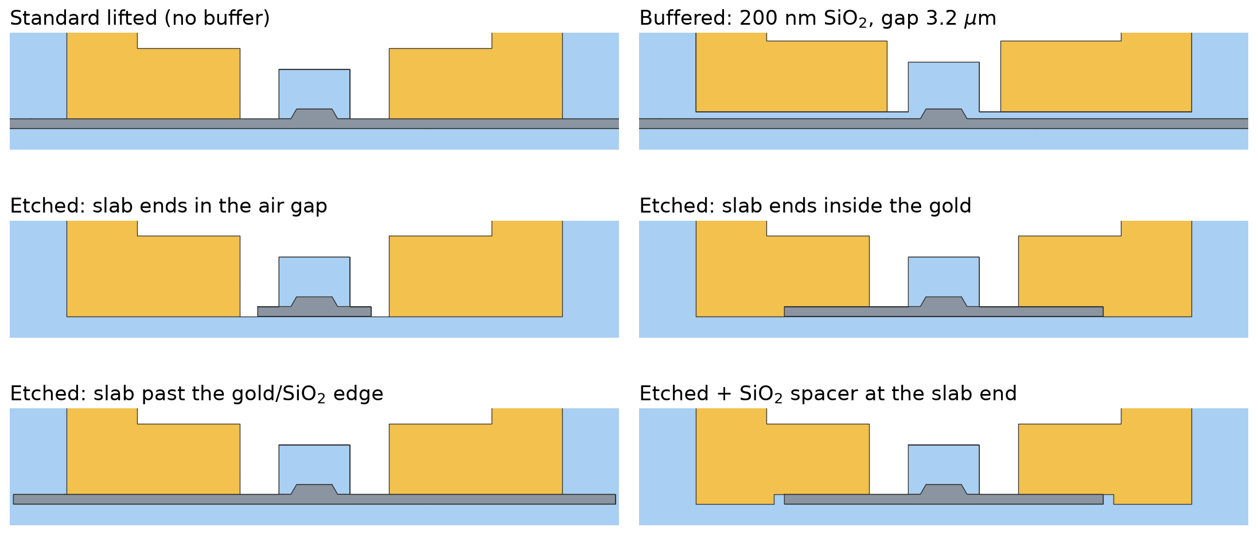
Geometries compared
Same rib, cap and lifted electrodes; only what sits under the gold changes
LN slab SiO₂ buffer / lift / BOX Au electrodes
Notes:
Etched slab: the slab is removed outside slab_w; gold fills the etched zone under the lower blocks, SiO2 under the pads, air in the gap. The spacer variant puts a SiO2 block between the slab end and the gold.

Slide 10
Etched slab: IL and Vπ·L vs slab width
λ = 1575 nm, gap 4.2 µm. slab_w = gap + 2d (d: slab edge beyond the gold inner edge)
≤ 0.003 dB/cm
slab ends in the gap
but Vπ·L 3.1 – 5.4 V·cm
0.04 – 7.4
dB/cm, slab ends in the gold
ripple period 1.79 µm in slab_w
= standard
slab past the gold/SiO₂ edge
IL 0.228 dB/cm at x_lift 7
Notes:
Three regimes. (1) slab_w < gap: no slab under the gold, no leak, IL ~0, but Vpi*L rises because the DC field crosses the air pocket. (2) slab ends in the gold: the gold-wrapped slab end is a mirror, ripples up to 7 dB/cm, first resonance at slab_w 4.95 um. (3) slab past the gold/SiO2 edge: identical to the standard lifted design; the cavity is clamped by x_lift. The orange curve uses a longer gold lower block (x_lift = 11 um) so the slab still ends in the gold up to slab_w 20: the ripple keeps decaying toward IL_inf. Check: at slab_w 8.6 / 10.4 / 12.2 the x_lift = 11 model gives the same IL as the nominal one within 0.2 %.

Slide 11
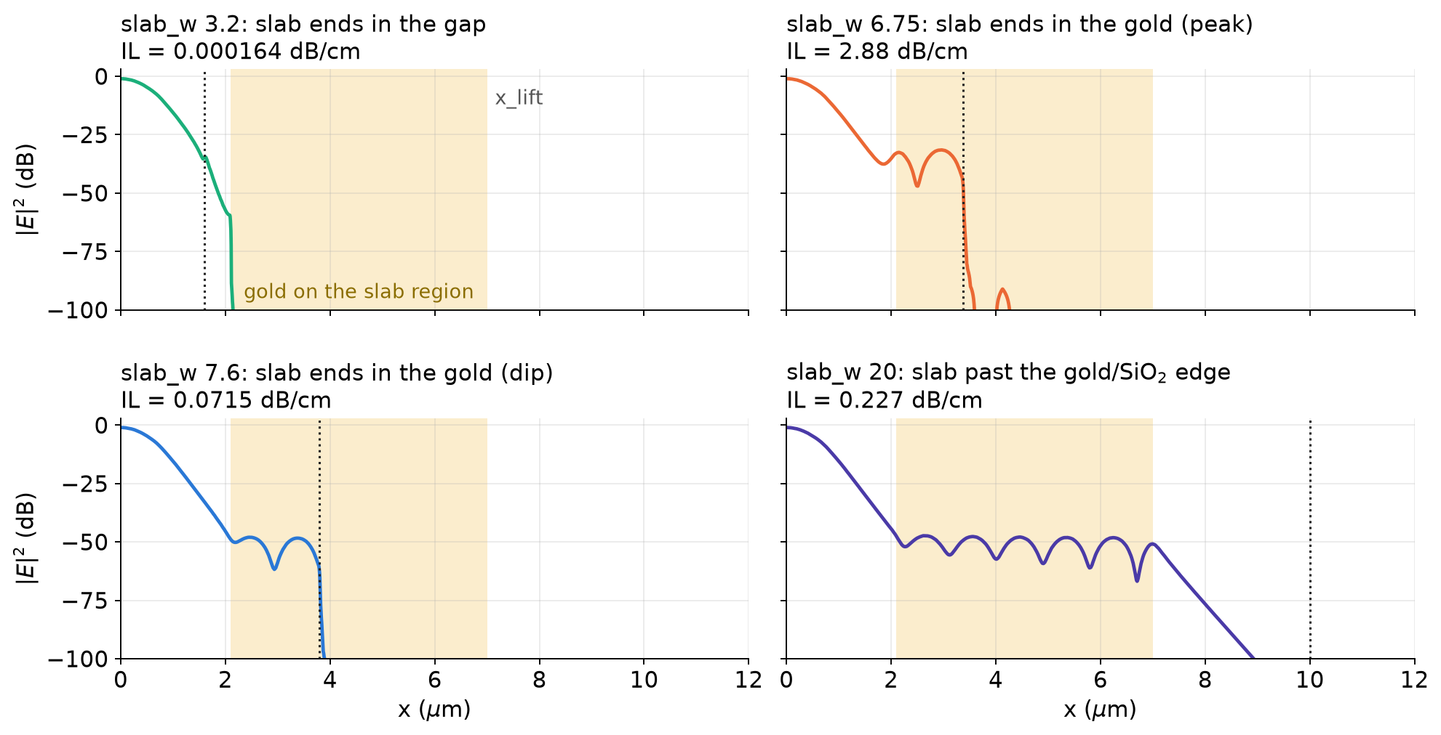
Where the light goes
|E|² along the slab mid-height; shaded = gold on the slab region, dotted = slab end
Notes:
Slab in the gap: the field never reaches the gold. Slab in the gold: a standing wave between the gold inner edge and the slab end. Slab past the edge: the standing wave stops at x_lift; beyond it the slab is under SiO2 and the field decays evanescently, so the slab end is invisible.

Slide 12
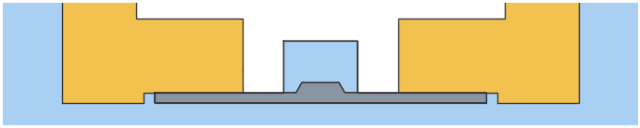
Countermeasure 1: SiO₂ spacer at the slab end
Slab ending in the gold, SiO₂ spacer of width w between slab end and gold (fabrication: not viable)
spacer w | peak IL | at slab_w
none | 2.88 | 6.75
100 nm | 2.88 | 6.60
300 nm | 2.93 | 6.50
600 nm | 3.04 | 6.50
The ripple survives at every width
Gold over SiO₂ cannot carry the wave (n < n_rib): the spacer is just another mirror, it only shifts the peaks
Notes:
Under the gold the wave can only be absorbed or reflected: beta of the rib mode exceeds k0*n of every cladding, so nothing can radiate away. A SiO2 spacer replaces the hard metal wall with a soft (evanescent) mirror: the peaks move by ~0.25 um in slab_w, their height does not drop (100, 300, 600 nm simulated). Wider spacers were not simulated: the spacer was judged not viable for fabrication, and from 300 to 600 nm the curve no longer changes.

Slide 13
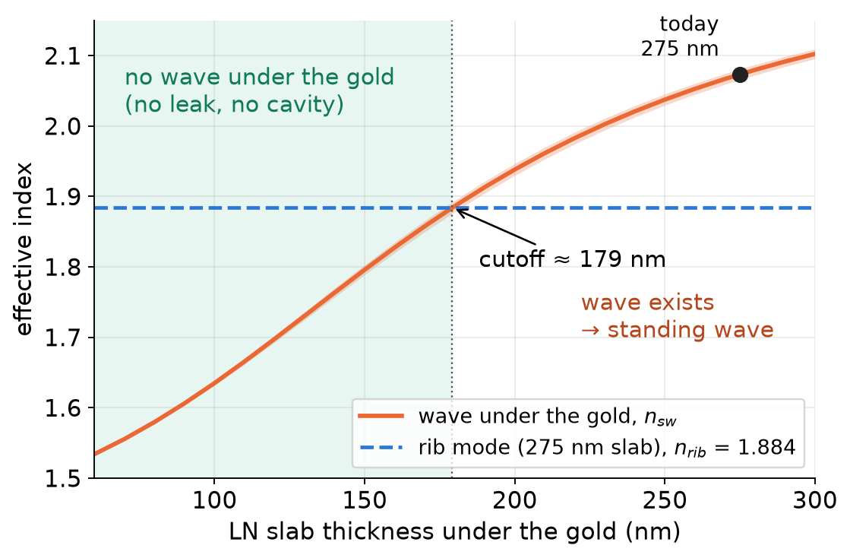
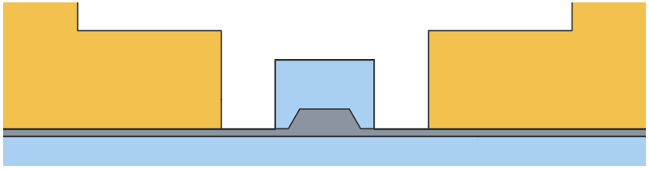
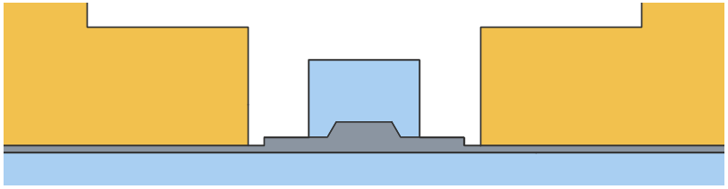
Countermeasure 2: no wave under the gold
A slab thinner than ~180 nm under the gold cannot carry the wave (1D model, 1575 nm)
A. deeper rib etch (one etch, 150 nm slab)
B. partial 2nd etch outside slab_w (125 nm)
Same materials, lift kept, no buffer
Notes:
The gold-bound wave under the electrodes needs enough LN: below ~180 nm its index drops under the rib-mode index and the lateral wave is cut off, exactly like the SiO2 buffer does. Two ways to get there without new materials: etch the rib deeper (one etch step, thin slab everywhere), or a second partial etch that thins the slab only outside slab_w, keeping the nominal 275 nm slab around the rib.

Slide 14
Option A: deeper rib etch
550 nm film, slab left after the rib etch: 275 nm (today) → 175 / 150 / 125 nm
slab | gap (µm) | IL (dB/cm) | Vπ·L (V·cm)
275 nm (today) | 4.2 | 0.18 – 0.89 | 2.27
200 nm | 4.2 | 0.0658 | 2.72
175 nm | 4.2 | 0.121 | 2.92
150 nm | 4.2 | 0.00344 | 3.15
150 nm | 3.6 | 0.0548 | 2.59
150 nm | 3.2 | 0.357 | 2.22
125 nm | 4.2 | 0.000585 | 3.43
125 nm | 3.6 | 0.011 | 2.81
125 nm | 3.2 | 0.0801 | 2.40
buffered 200 nm | 3.2 | 0.049 | 2.15
Ripple gone at ≤ 150 nm, but the thin slab weakens the EO overlap: Vπ·L +30 … +50 %
Narrowing the gap brings the gold onto the rib mode: IL rises
Notes:
Deeper rib etch: one process step, no new material. The ripple disappears (flat IL vs x_lift at 150 nm, nearly flat at 175 nm, close to the cutoff). But Vpi*L rises because less LN carries the DC field and the mode, and recovering it with a smaller gap puts the metal close to the mode.

Slide 15
Option B: partial second etch outside slab_w
Rib and 275 nm slab untouched; 125 nm LN left from slab_w outward; gap 4.2 µm
case | IL (dB/cm) | Vπ·L (V·cm)
slab_w 3.2 (step 0.5 µm before gold) | 0.00794 | 2.69
slab_w 3.6 (step 0.3 µm before gold) | 0.0176 | 2.54
slab_w 4.0 (step 0.1 µm before gold) | 0.0594 | 2.38
150 nm left, slab_w 3.6 | 0.0552 | 2.47
gap 3.2, slab_w 2.6, 100 nm left | 0.208 | 2.03
gap 3.2, slab_w 2.6, 125 nm left | 0.455 | 1.93
gap 3.2, slab_w 2.8, 125 nm left | 0.75 | 1.85
gap 3.4, slab_w 2.8, 125 nm left | 0.238 | 2.06
gap 3.6, slab_w 3.0, 100 nm left | 0.0569 | 2.27
gap 3.6, slab_w 3.0, 125 nm left | 0.124 | 2.18
buffered 200 nm, gap 3.2 | 0.049 | 2.15
step in the gap
step under the gold
Flat vs x_lift 6.5 – 7.5 µm: IL 0.0176 – 0.0176 dB/cm
Step must stay in the gap: under the gold it forms a short cavity (2.4 dB/cm at slab_w 4.4)
Notes:
Partial second etch: the slab is thinned to 125 nm from slab_w outward, so the gold sits on LN that cannot carry the lateral wave. IL is flat in x_lift. The DC field still crosses LN instead of air, so the Vpi*L penalty of the full etch is much smaller. Requirement: the thickness step must lie in the gap with margin for the litho overlay; if it falls under the gold, a short cavity forms.

Slide 16
All solutions: insertion loss vs Vπ·L
Each point is a ripple-free design (gap and thickness varied); lower-left is better
at Vπ·L | buffered | best alternative
≈ 1.95 V·cm | 0.141 dB/cm | 0.455 dB/cm
≈ 2.05 V·cm | 0.086 dB/cm | 0.208 dB/cm
≈ 2.27 V·cm | 0.026 dB/cm | 0.057 dB/cm
The buffer wins
At the same Vπ·L it has 2 – 3× lower IL than any thin-LN or etched variant
It needs no alignment-critical step
Notes:
Trade-off between loss and drive voltage. The buffered curve is its gap scan (2.4 to 3.6 um, 200 nm SiO2; computed with the previous SiO2 constant, ~2 % lower IL). Every alternative point lies above the buffered curve: for the same Vpi*L the alternatives absorb more, because thin LN under the gold still brings the metal closer to the mode, or the rib mode is less confined. The standard lifted design is a vertical bar: its IL depends on x_lift.

Slide 17
Final checks: robustness and cavity physics
Notes:
Three last sweeps: over-etch robustness of the buffered design, gap dependence of the standard lifted ripple, and the full-etch geometry with no SiO2 inside the electrodes; then why the two mirrors are equivalent.

Slide 18
Buffered design: robust to over-etch
200 nm SiO₂, gap 3.4 µm, x_lift 7 µm; 550 nm film, rib top 1.0 µm; slab 275 → 150 nm
+2.6 %
Vπ·L per 15 nm
of over-etch
flat
IL vs x_lift at 150 nm
(6.6 / 7.0 / 7.4 µm)
11× lower
IL: 0.026 → 0.0024 dB/cm
(275 → 150 nm slab)
Notes:
Etch-robustness study of the buffered design (gap 3.4 um, x_lift 7 um). The film stays 550 nm and the rib top 1.0 um with 60 deg sidewalls, so deeper etch thins the slab and widens the rib base. slab 275 nm: IL 0.0260 dB/cm, VpiL 2.271 V*cm; slab 260 nm: IL 0.0191 dB/cm, VpiL 2.329 V*cm; slab 245 nm: IL 0.0140 dB/cm, VpiL 2.391 V*cm; slab 230 nm: IL 0.0104 dB/cm, VpiL 2.457 V*cm; slab 215 nm: IL 0.0077 dB/cm, VpiL 2.527 V*cm; slab 200 nm: IL 0.0058 dB/cm, VpiL 2.601 V*cm; slab 185 nm: IL 0.0044 dB/cm, VpiL 2.681 V*cm; slab 170 nm: IL 0.0034 dB/cm, VpiL 2.766 V*cm; slab 155 nm: IL 0.0026 dB/cm, VpiL 2.858 V*cm; slab 150 nm: IL 0.0024 dB/cm, VpiL 2.890 V*cm. Vpi*L rises 2.6% for the first 15 nm and +27% at 150 nm: thinner slab, weaker EO overlap. IL keeps falling and stays flat in x_lift (the buffer keeps the wave under the gold cut off). Optically robust; the over-etch tolerance is set by Vpi*L.

Slide 19
Standard lifted: the gap sets the level, not the cavity
No buffer; x_lift swept (top gap varied) at bottom gap 3.9 / 4.2 / 5.0 µm
gap (µm) | IL∞ (dB/cm) | IL range (dB/cm) | period (µm) | 2α (1/µm) | Vπ·L (V·cm)
3.9 | 1.103 | 0.472 – 2.16 | 0.895 | 0.179 | 2.08
4.2 | 0.412 | 0.181 – 0.883 | 0.895 | 0.177 | 2.26
5.0 | 0.029 | 0.0129 – 0.0735 | 0.896 | 0.179 | 2.76
Same period, decay and phase vs L
→ the cavity is unchanged
IL∞ ∝ e^(−3.3·gap[µm]): the gap only sets how much light leaks in
Notes:
Standard lifted design, no buffer, 1575 nm. x_lift 6.5-11 um (0.1 um step) plus far points to 30 um; the 4.2 um gap is the earlier sweep, same code and constants. Right: IL normalised to its fitted IL_inf and plotted against the cavity length L = x_lift - gap/2 (gold inner edge to the gold/SiO2 edge): the three curves collapse, same period (0.895 um), envelope decay and phase. Only IL_inf changes: 1.10 / 0.41 / 0.030 dB/cm, i.e. exp(-3.3 um^-1 x gap), the overlap of the rib-mode tail with the gold edge. Far points (12-30 um) settle on IL_inf for every gap. Vpi*L 2.08 / 2.26 / 2.76 V*cm.

Slide 20
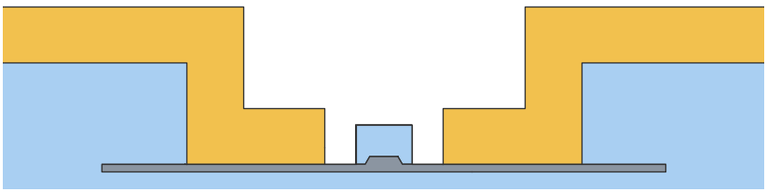
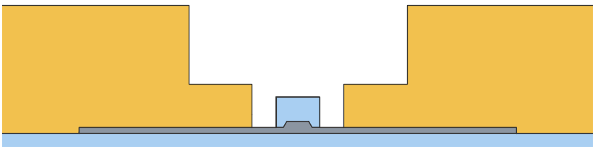
SiO₂ removed from the electrodes: same ripple
Full etch, gap 4.2 µm: slab ending in the gold; previous geometry = SiO₂ lift at slab level beyond x_lift = 7 µm
Previous: SiO₂ lift (gold/SiO₂ edge at 7 µm)
Now: solid gold electrodes, no SiO₂ inside
0.03 %
0.415
old gold/SiO₂ edge (slab_w 14)
median change,
slab ends in the gold
(28 points)
dB/cm asymptote
(Cordoba 0.42)
Notes:
Full etch, gap 4.2 um, x_lift 7 um. Coworker's test: remove all SiO2 from the electrodes (lower block, column and pad fused in one solid gold body out to 32 um, air outside), so the slab can only end inside the gold. Slab ending between the gap and 14 um: identical to the previous sweep (median 0.03 %, max 2.1 % at slab_w 13.95, next to where the SiO2 used to start). Past 14 um the flat 0.228 dB/cm line is gone: the slab end remains the only mirror and the ripple decays slowly to IL_inf = 0.415 dB/cm (Airy fit: period 0.894 um of slab-end position, 2alpha 0.179/um, rho0 0.948), the Cordoba (no reflection) level. Dotted: Airy envelope. Above 30 um the 1.6 um step aliases the 1.79 um ripple period. A full etch ending in the gold therefore makes IL depend on the etch-edge position with a 0.9 um period, consistent with the messy IL measured on the earlier full-etch tapeout.

Slide 21
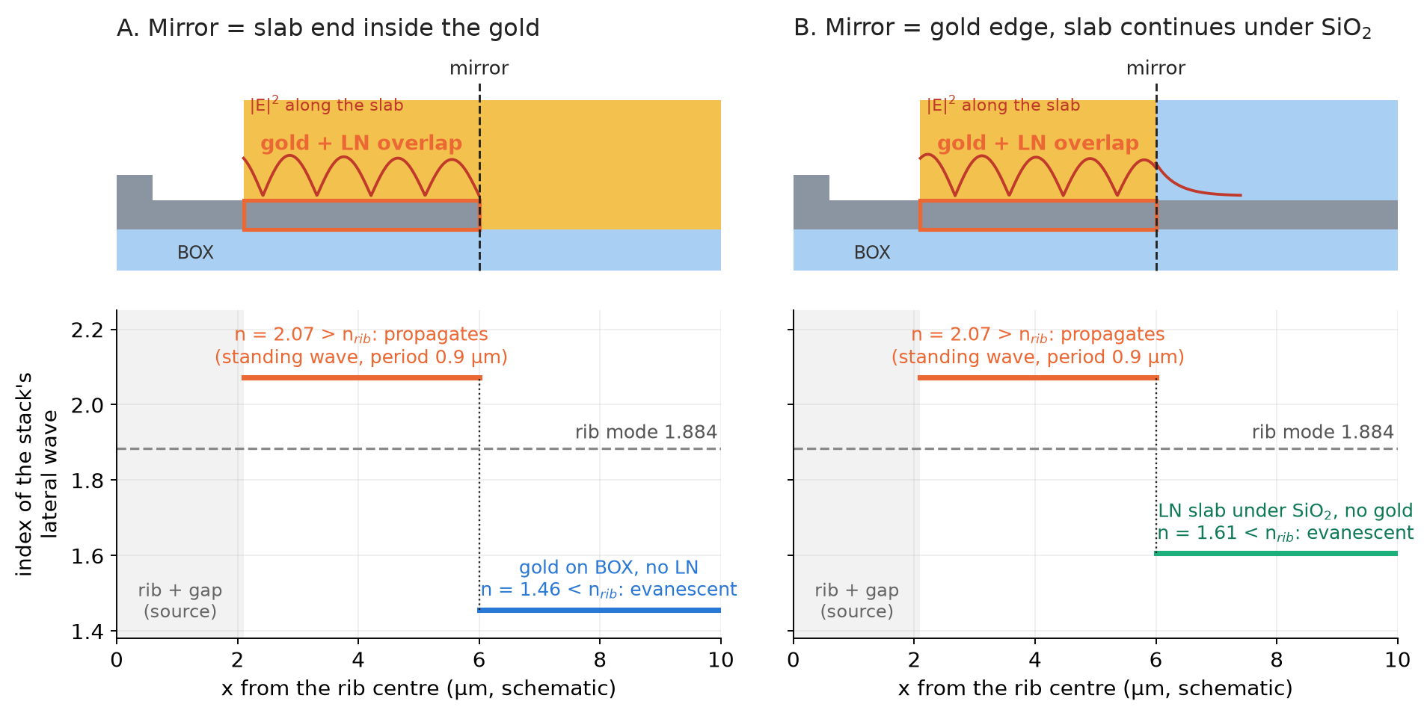
Why the slab end and the gold edge act the same
The lateral wave lives only where gold and LN slab overlap (1D stack indices, 1575 nm)
Gold + LN: n = 2.07 > 1.884
→ propagates sideways
Remove the LN: 1.46
Remove the gold: 1.61
→ both evanescent → reflection
Mirror = end of the overlap, whatever ends it
fit | slab end | gold edge
period (µm) | 0.895 | 0.894
IL∞ (dB/cm) | 0.414 | 0.415
decay 2α (1/µm) | 0.182 | 0.179
mirror ρ₀ | 0.957 | 0.922
Cavity sets period, decay, IL∞; the mirror only ρ₀ and phase
Notes:
The lateral wave is a hybrid (plasmon-assisted) mode of the vertical stack gold / LN slab / BOX. It needs both: the metal pulls the field to the top of the slab and raises its index to 2.07, above the rib mode (1.884), so it can be phase matched and propagate sideways (kx real, lateral wavelength 1.79 um, ripple period 0.9 um). Remove the LN (slab end inside the gold): the stack becomes gold on BOX, a gold/SiO2 surface plasmon with index 1.46. Remove the gold (gold edge, slab continues under SiO2): the stack becomes an oxide-clad LN slab, index 1.61. Both are below 1.884: kx becomes imaginary, the wave cannot continue and is reflected. So the mirror is simply the end of the gold-LN overlap; its height, the material that replaces the stack and the length of the overlap do not matter for the period, the decay and IL_inf, which belong to the overlap region. The termination only sets the reflection strength and phase: the gold-wrapped slab end is a hard mirror (node at the wall, rho0 0.957), the gold edge a soft one (evanescent tail into the oxide-clad slab, rho0 0.922; effective planes 0.3 um apart, hence the 0.34 um shift between the two IL curves). Indices: 1D TM model of each stack, average of the two in-plane LN permittivities, Sellmeier SiO2 and Johnson & Christy gold.

Slide 22
SiO₂ cap sweep on the buffered design
Lisbon lifted, 200 nm buffer, bottom gap 3.4 µm, 1575 nm, no slab etch; rib 1.0 and 1.4 µm
Sweep
Cap height 0.5 → 1.4 µm (from the buffer top)
Cap width 2.0 → 2.9 µm (0.25 µm from the electrodes at most)
100 nm steps, two rib widths: 200 runs, no failures
Reference cap 2.0 × 1.4 µm
Rib 1.0 µm: Vπ·L 2.271 V·cm, IL 0.0260 dB/cm
Rib 1.4 µm: Vπ·L 2.173 V·cm, IL 0.0279 dB/cm
At gap 3.4 µm the 1.4 µm rib recovers the unbuffered Vπ·L (2.175 V·cm)
−5 %
+22 %
Vπ·L, cap width 2.0 → 2.9 µm
IL, cap width 2.0 → 2.9 µm
−1 to −2.5 %
< 0.4 %
Vπ·L, cap height 1.4 → 0.5 µm
IL change with cap height
Cap width sets both Vπ·L and IL; cap height only lowers Vπ·L, at no loss cost.

Slide 23
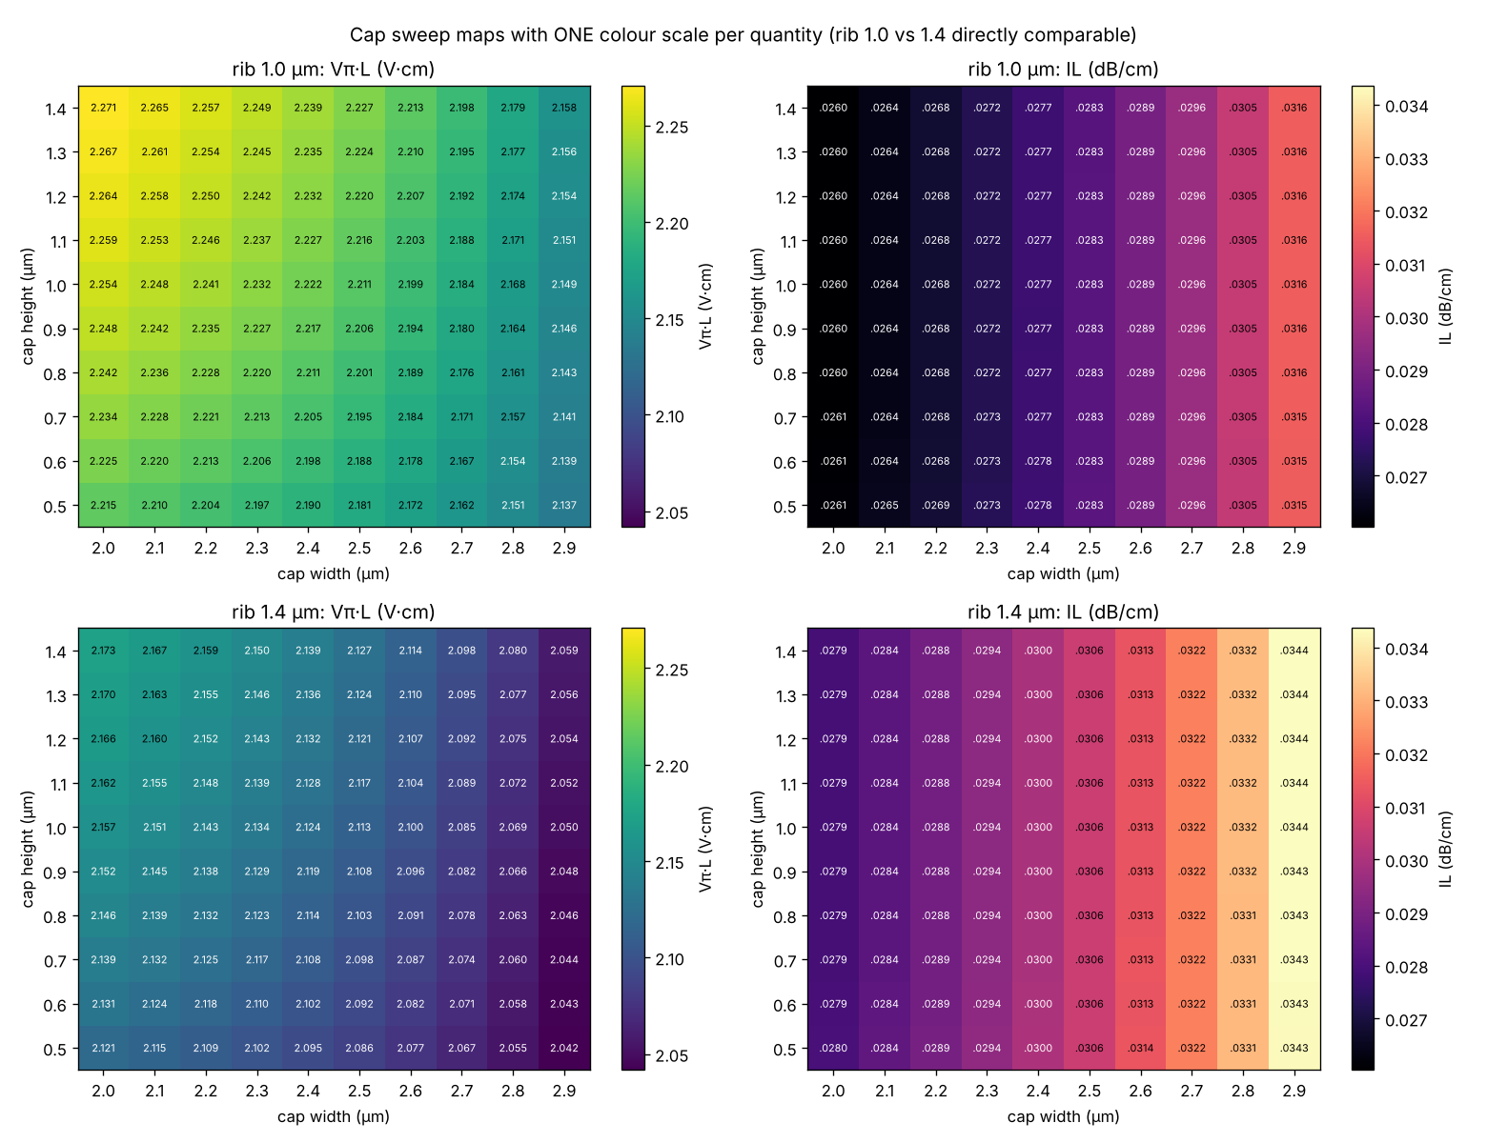
Cap sweep: Vπ·L and IL maps
One colour scale per quantity: rib 1.0 µm (top) and 1.4 µm (bottom) directly comparable

Slide 24
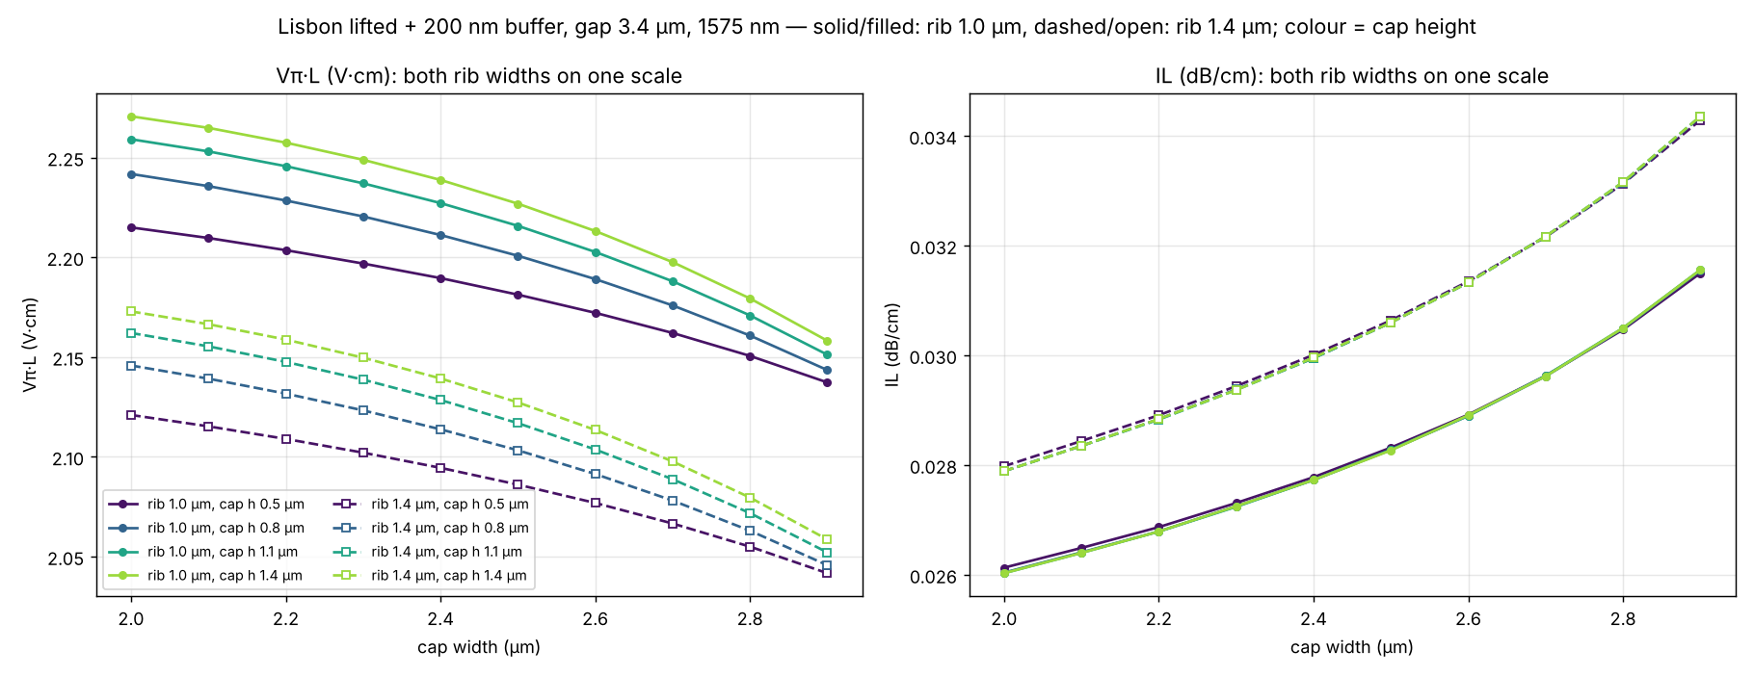
Cap width: trading loss for Vπ·L
Both rib widths on one scale; colour = cap height, solid = rib 1.0 µm, dashed = rib 1.4 µm
≈ 1 % of Vπ·L costs ≈ 4 % of IL; even the widest cap stays below 0.035 dB/cm, > 10× below unbuffered Cordoba. The 1.4 µm rib: ≈ 0.1 V·cm lower Vπ·L, ≈ 7–9 % higher IL, independent of the cap.

Slide 25
Conclusions
Lifted electrodes, λ = 1575 nm
0.026 dB/cm
2.27 V·cm
38 nm
IL, flat vs x_lift
200 nm buffer, gap 3.4 µm
Vπ·L at gap 3.4 µm
(+2.6 % per 15 nm over-etch)
buffer cutoff
200 nm = 5× margin
Cause: the wave under the gold exists only where gold and LN slab overlap; any end of the overlap is a mirror → lateral cavity, period 0.9 µm
Gap: scales the leak (IL∞ ∝ e^(−3.3·gap)), not the cavity
Slab etching: the slab end in the gold is just another mirror; ending it in the gap costs +35 … +140 % Vπ·L; thin LN under the gold costs 2 – 3× IL at equal Vπ·L
Buffer ≥ 38 nm SiO₂ removes the wave: keep 200 nm (no new material, no extra litho, robust to over-etch)
Notes:
Final recommendation: 200 nm SiO2 buffer, bottom gap 3.4 um: IL 0.026 dB/cm flat in x_lift, Vpi*L 2.27 V*cm. Over-etch: IL keeps decreasing and stays flat; Vpi*L +2.6% per 15 nm (+27% at 150 nm slab). The full-etch geometry ending in the gold reproduces the ripple whatever surrounds the electrodes; the messy IL of the earlier full-etch tapeout is consistent with this.

