Slide 1
RF impact of the Al₂O₃ (ALD) layer:
S₁₁ and S₂₁ before and after ALD
CORDOBA 4CA0162, 4CA0163 · JEREZ 6JZ0011 · HELSINKI 5HK0005 · chip averages, raw and smoothed

Slide 2
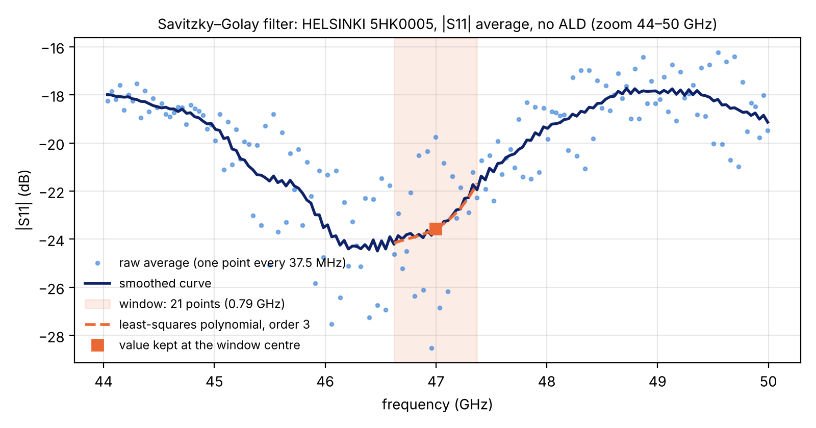
Savitzky–Golay smoothing
Applied to the chip-averaged |S| (dB); the raw average is always shown with it
Procedure
1. Raw average: mean over chips of |S| in dB at each frequency point (1601 points, 37.5 MHz spacing).
2. For each point, a polynomial of order 3 is fitted by least squares to the 21 points centred on it (±10 points, 0.79 GHz).
3. The smoothed value is the polynomial at the centre point; the window then moves by one point.
At the band edges the polynomial of the first and last window is used (scipy.signal.savgol_filter).
Choice of window
The window is short compared with the S₁₁ ripple period (≈ 8.4 GHz for 8 mm lines, ≈ 5.1 GHz for 13 mm): S₁₁ null depths below 20 GHz change by ≤ 0.1 dB.
Difference raw − smoothed (rms): S₁₁ 0.04–0.23 dB below 20 GHz, 0.39–2.00 dB at 40–60 GHz; S₂₁ ≤ 0.10 dB everywhere. The largest values come from HELSINKI no ALD, the noisiest set.

Slide 3
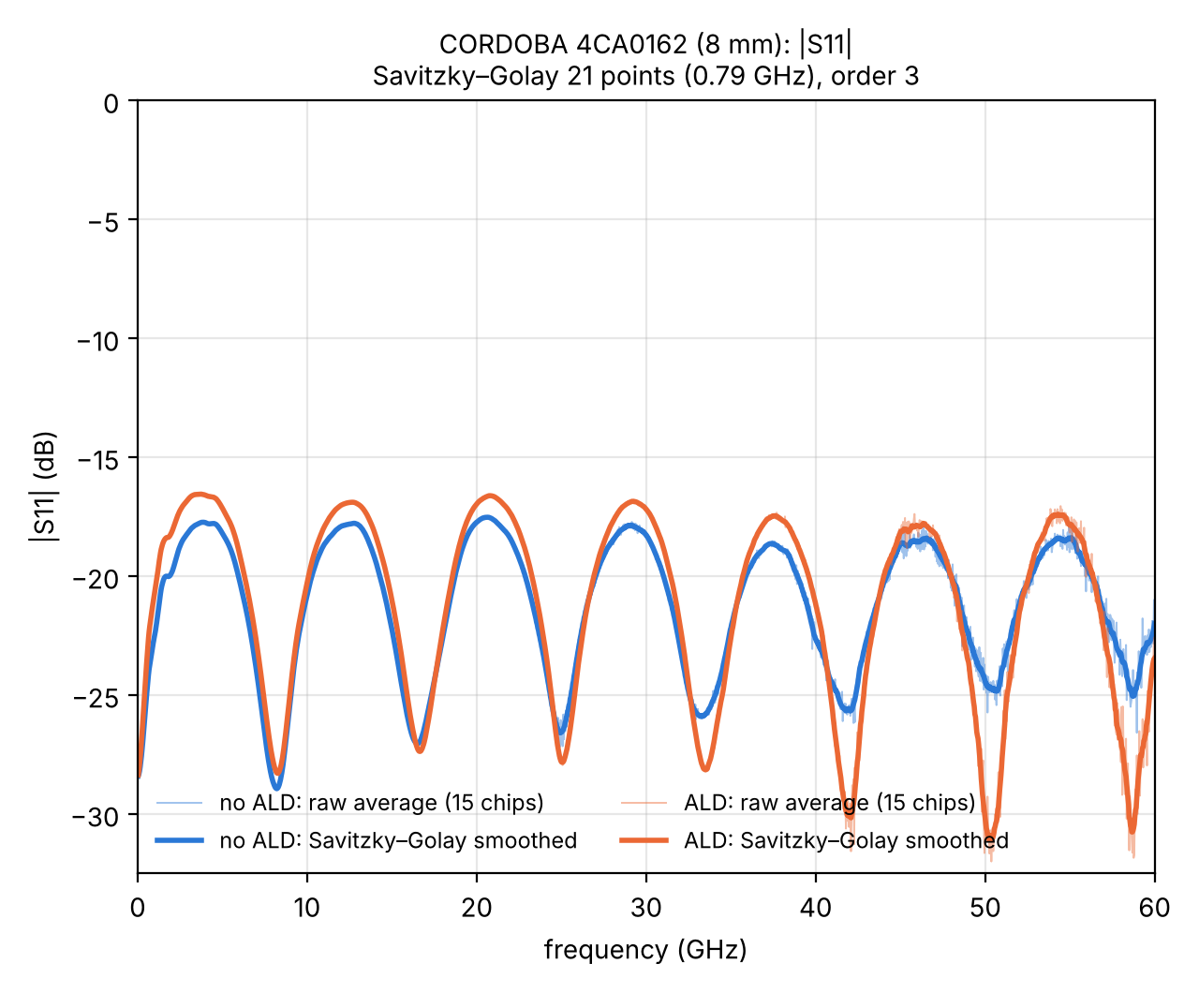
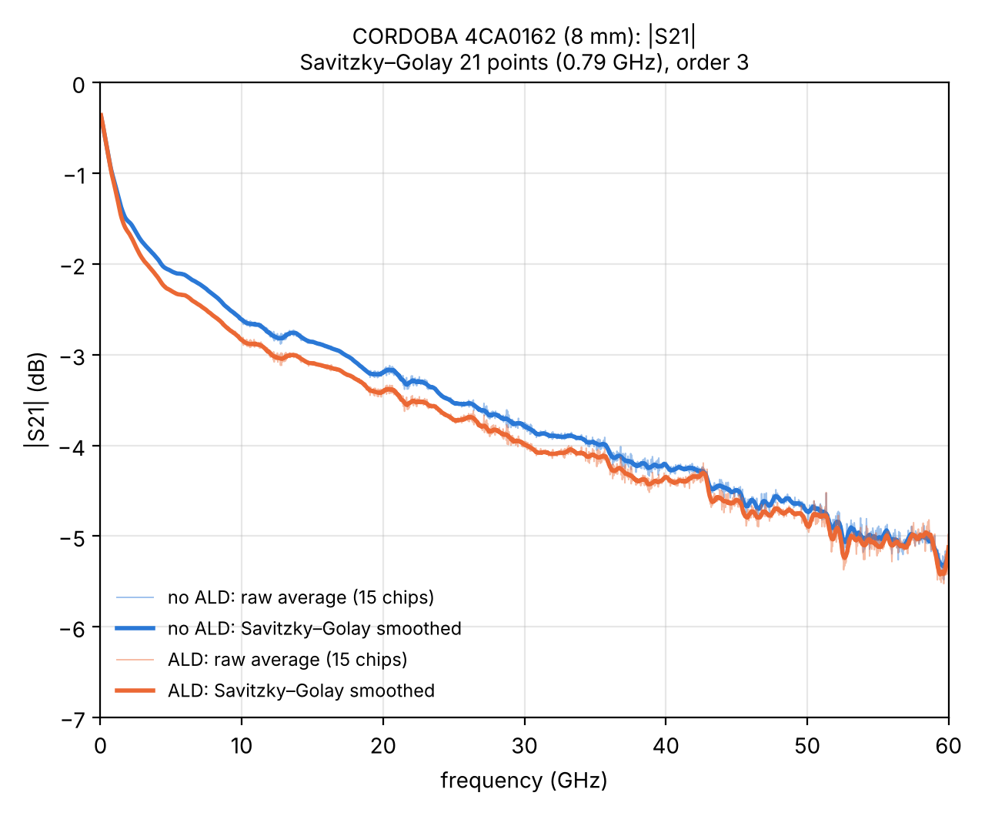
CORDOBA 4CA0162: |S₁₁| and |S₂₁|
8 mm line · 15 chips measured before and after ALD · thin: raw average, thick: smoothed

Slide 4
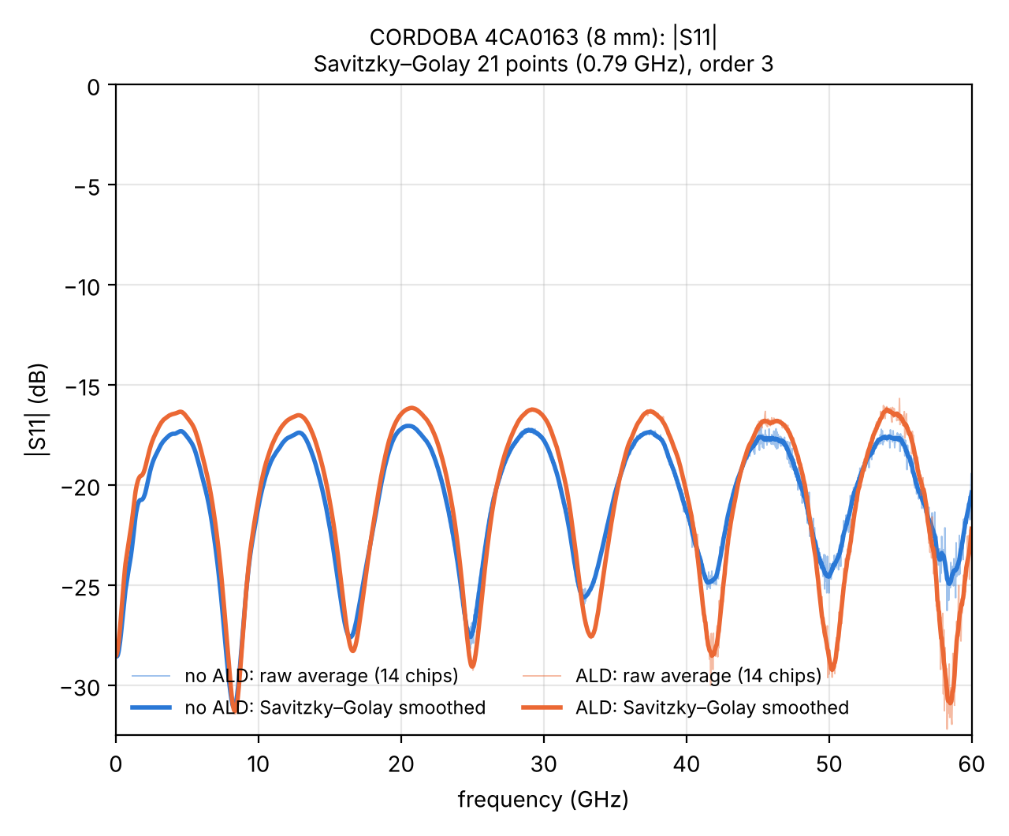
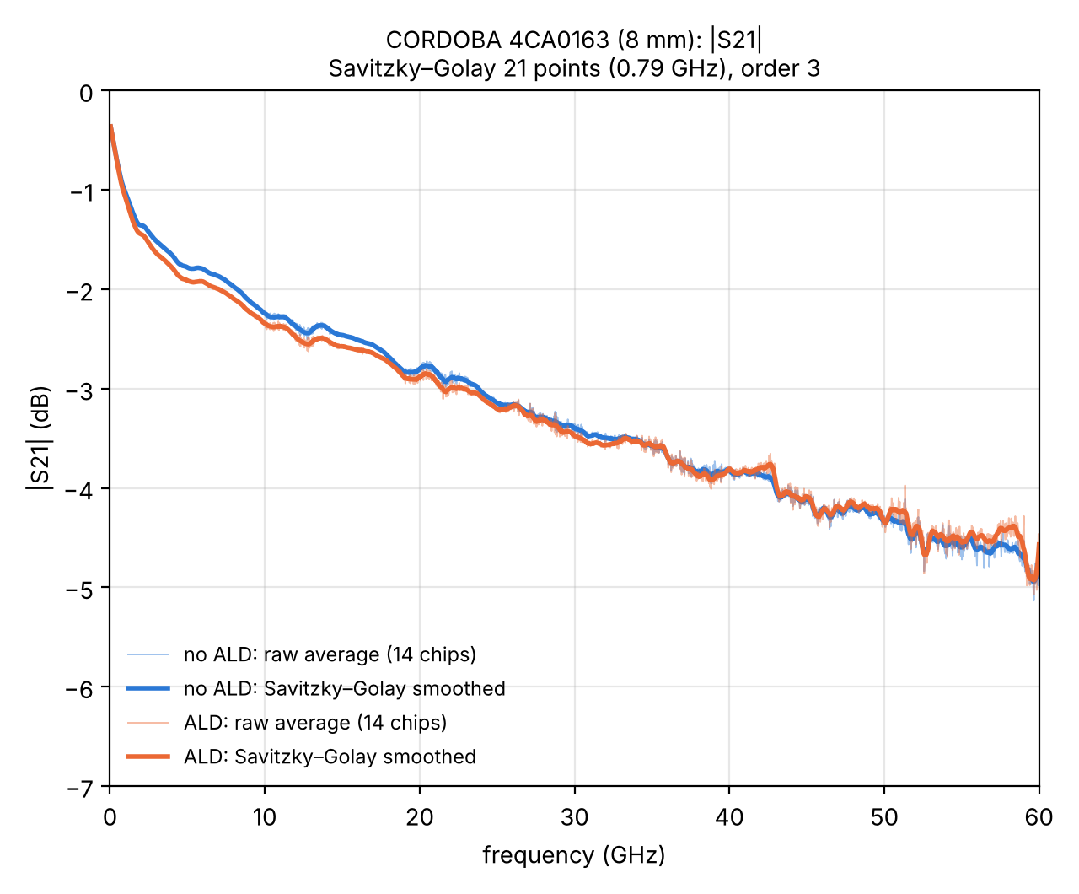
CORDOBA 4CA0163: |S₁₁| and |S₂₁|
8 mm line · 14 chips measured before and after ALD · thin: raw average, thick: smoothed

Slide 5
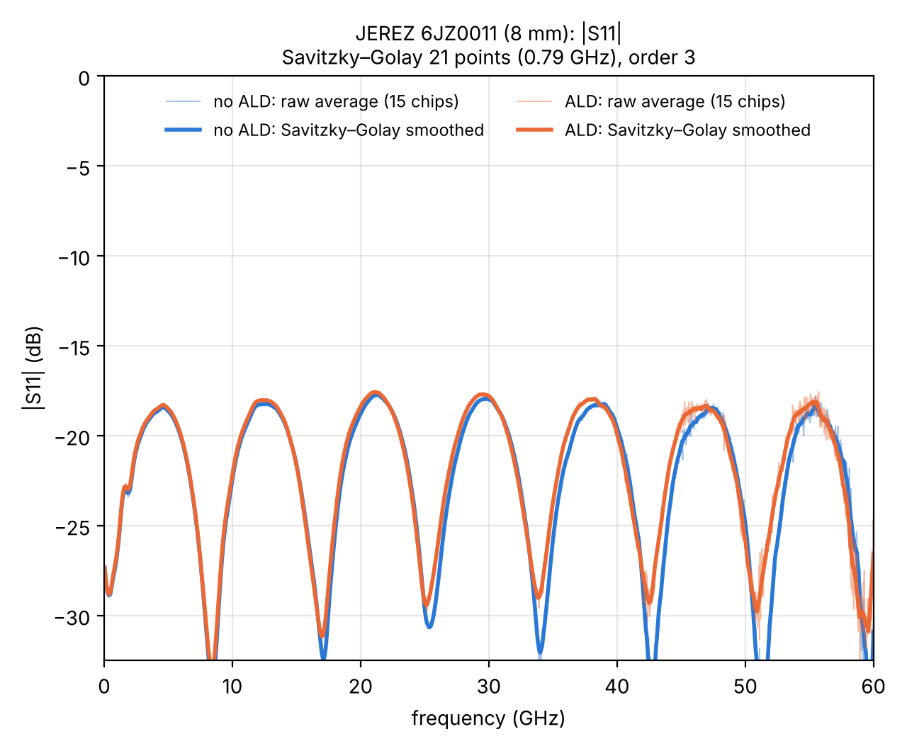
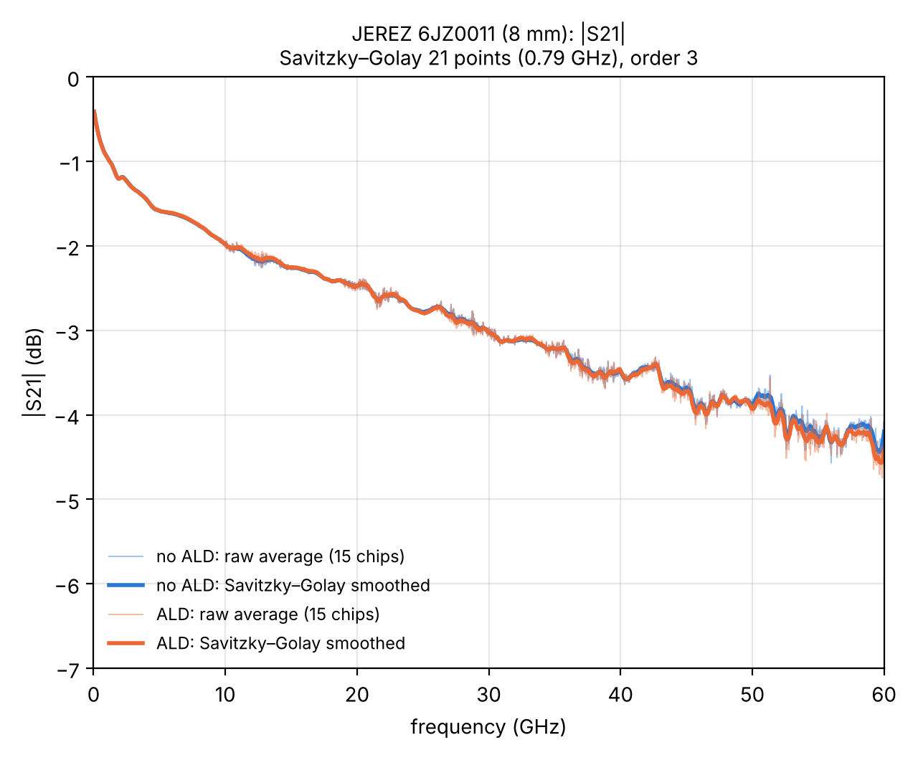
JEREZ 6JZ0011: |S₁₁| and |S₂₁|
8 mm line · 15 chips measured before and after ALD · thin: raw average, thick: smoothed

Slide 6
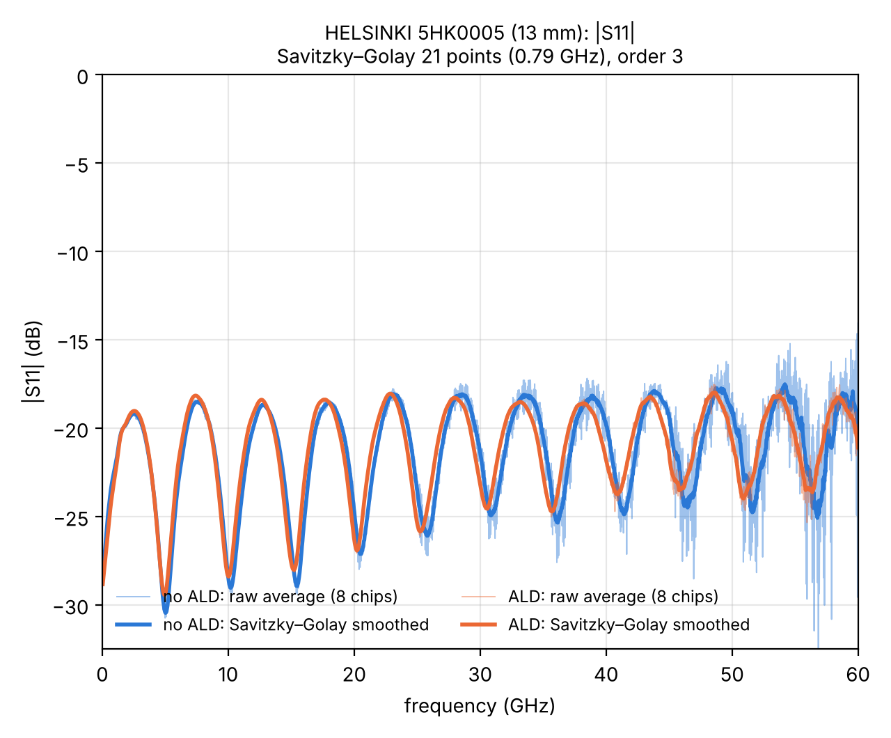
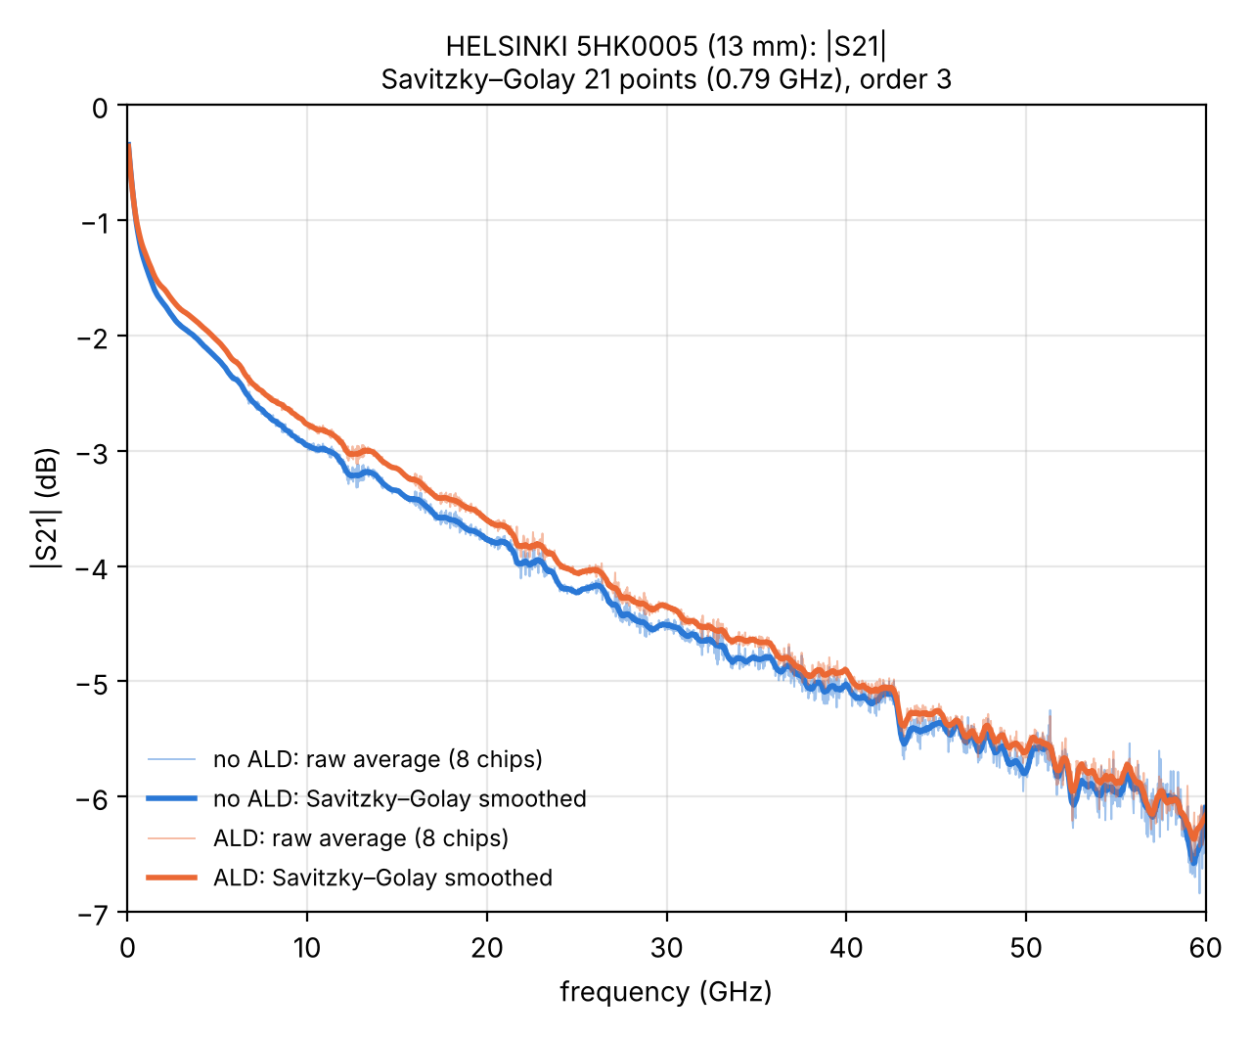
HELSINKI 5HK0005: |S₁₁| and |S₂₁|
13 mm line · 8 chips measured before and after ALD · thin: raw average, thick: smoothed

