Slide 1
Istanbul electro-optical crosstalk:
simulation and lab measurement comparison
CST time-domain full-wave simulations · 8.75 mm line pair, 625 µm pitch · module K00626

Slide 2
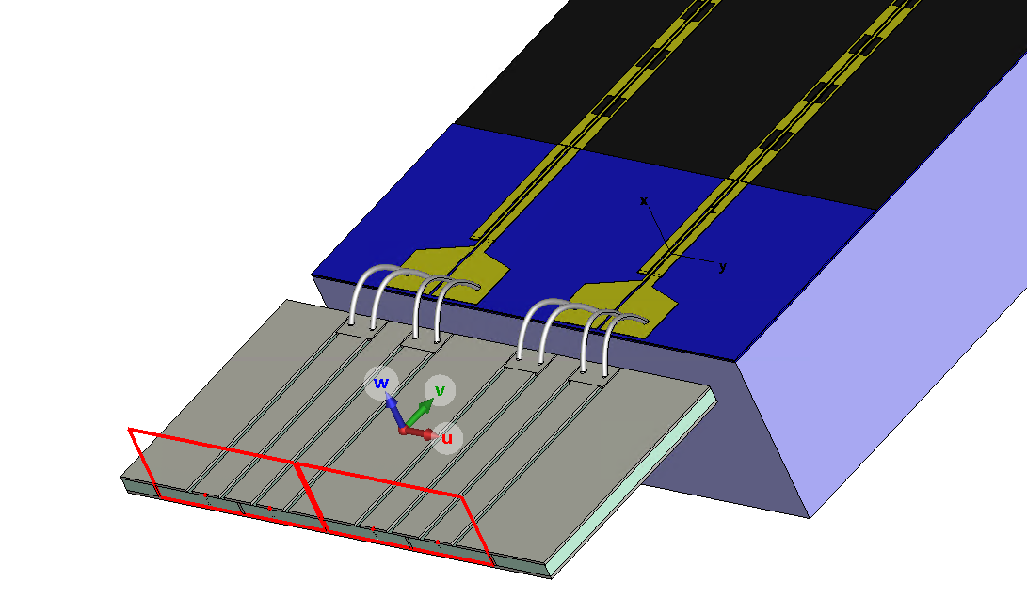
Purpose
A fast and reliable simulation of the EO crosstalk between adjacent modulators
1
Simulate
EO crosstalk of an Istanbul line pair and of the full module, from the driver output to the line end.
2
Compare
Simulated EO crosstalk against the lab measurement of module K00626.
Istanbul full-module model: driver carrier, bond wires, launch pads and the 8.75 mm line pair.
3
Establish
A validated simulation flow for later designs: pitch, terminations, assembly.

Slide 3
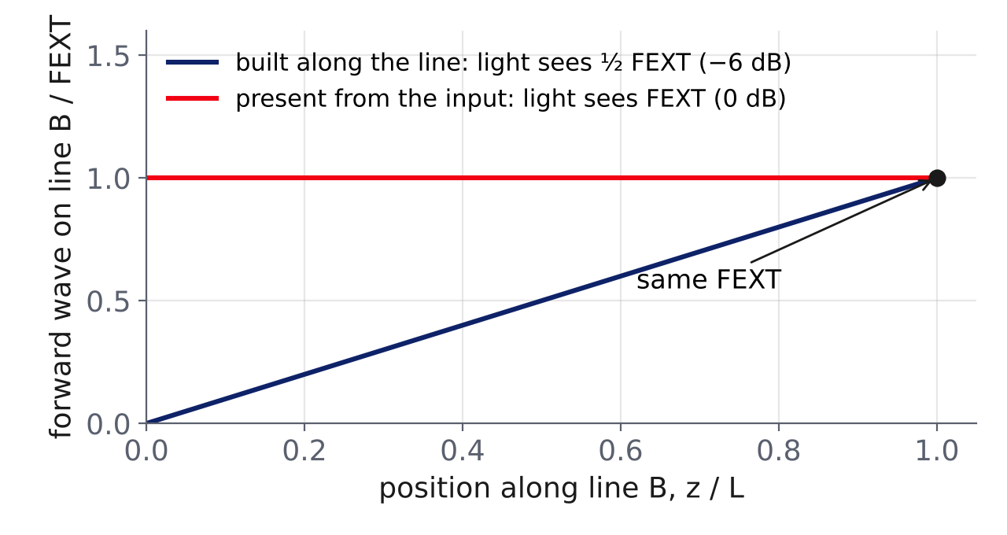
Why S-parameters are not sufficient
The EO crosstalk depends on the voltage profile V(z) along the whole victim line
Port data
S-parameters describe the four line ends only. NEXT and FEXT are the victim signal at its near and far end.
Optical response
The light collects the field along the full length, in step with its own travel time. Equal FEXT can give EO crosstalk differing by 6 dB.
Same FEXT, different EO crosstalk: the optical phase integrates V(z), not its end value.
Consequence
V(z) of both lines is taken from full-wave field monitors, every 1 GHz from 1 to 60 GHz (victim ripple period ≈ 6.5 GHz).

Slide 4
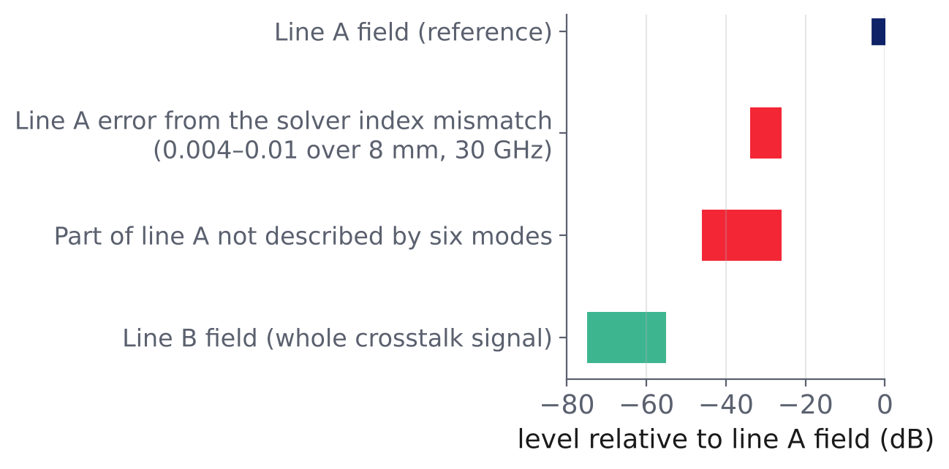
Eigenmode solver: physical insight, no quantitative crosstalk
Six-mode description of the Cordoba 8 mm pair (same platform, simpler geometry)
Strengths
Fast: one periodic cell, about 2 min per solution.
Lists the modes a line supports: even/odd coplanar pair, slot modes and, with a conductive bottom, a slow wave between all electrodes and the bottom (index ≈ 3.2).
Identified that slow wave as the backward wave found under line B in the time-domain fields.
Limits
Infinite uniform cell: no line ends, hence no reflections, end conversion or fields localised near the pads.
No pads, wire bonds, driver or bends.
Line B: misfit of 5–15 % up to 30 GHz, about 100 % at 60 GHz; one prediction test passed out of six.
Why line B fails
The imperfections in the description of line A (red) exceed the whole victim field (green). Mode model abandoned: the EO crosstalk is taken directly from the time-domain fields.

Slide 5

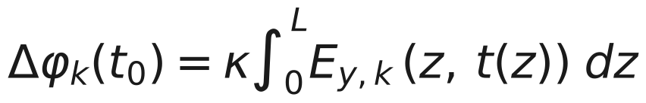
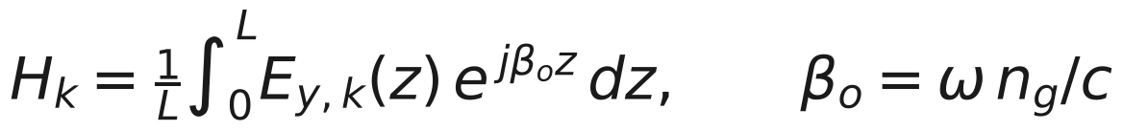
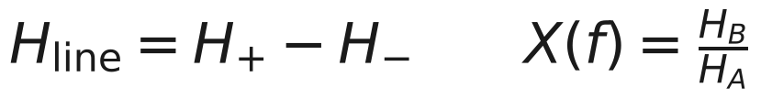
EO crosstalk from full-wave fields
CST time-domain solver; E_{y} exported in both gaps of both lines, every 5 µm
1. Light enters at t₀ and reaches z at
Assumption | Assessment
Full-wave field: forward, backward, substrate waves, reflections | Rigorous: no mode model
Linear Pockels effect, small signal, E_{y} only | Standard
Optical group index 2.27, constant; no optical loss | Standard, minor
E_{y} at one point per gap (x = 1.275 µm, 5 µm from centre), not an optical-mode overlap | Weakness: level depends on the point (2.2 dB for 2.5 µm); ratio partly compensates
Δz = 5 µm; solver stopped at −40 dB | ≤ 0.6 dB above 20 GHz, 1–2 dB below 15 GHz
2. Phase of arm k (κ: EO constant, equal for all arms)
3. Phasor field E(z)·exp(jωt): Δφ_{k} = κL·Re{H_{k}·exp(jωt₀)}, with
4. Push-pull (difference of the two gaps) and crosstalk
The integral is evaluated as a sum over the 5 µm samples. Backward waves meet the light with a phase that rotates along the line: their contributions cancel to a small residual. Forward waves keep their phase and add up.

Slide 6
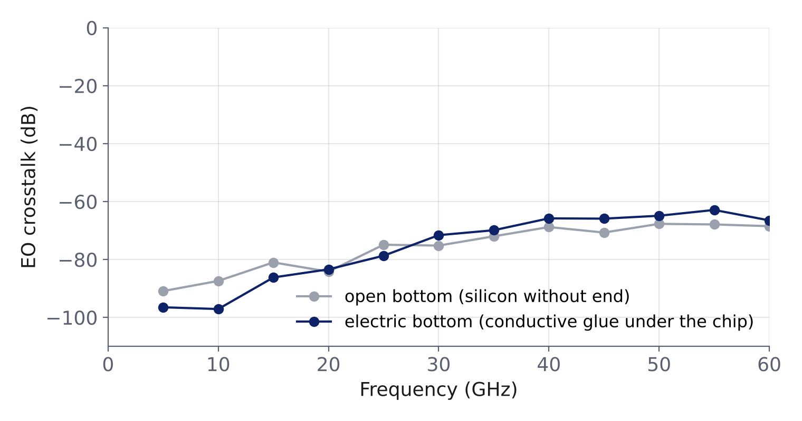
Simulation set-up (1/2): length, mesh, substrate bottom
Corrections derived from earlier Istanbul and Cordoba runs, applied to all Istanbul runs
1
Full-length line
Istanbul 1–8.75 mm: NEXT grows ≈ L²; the two-mode length extrapolation misses it by 10–30 dB. The 8.75 mm line is simulated directly.
2
Mesh refinement
Istanbul 3 mm: index 2.113 → 2.138 (1.2 %), i.e. 0.27 rad over 8.75 mm at 60 GHz: relevant for velocity matching. ≥ 4–5 cells across gaps and metal.
Cordoba 8 mm: the electric bottom changes the EO crosstalk by −10 to +5 dB and adds a ripple. Open-bottom results are not conservative.
3
Electric bottom
Chip on 40 µm conductive epoxy on Al₂O₃: a conductor under the silicon. Open boundary = unbounded substrate, without the wave guided between electrodes and bottom.

Slide 7
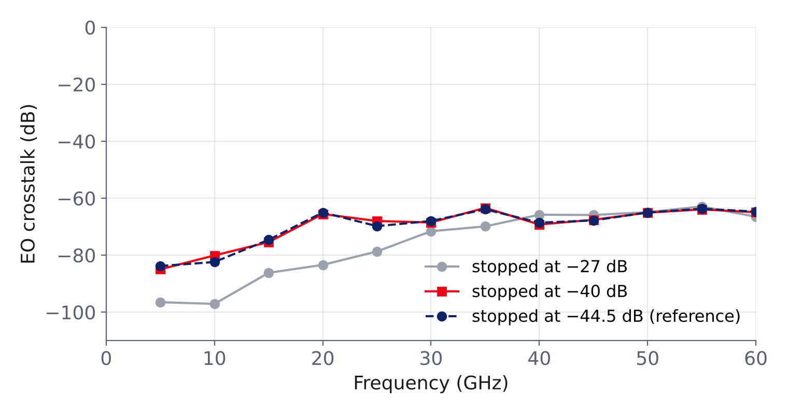
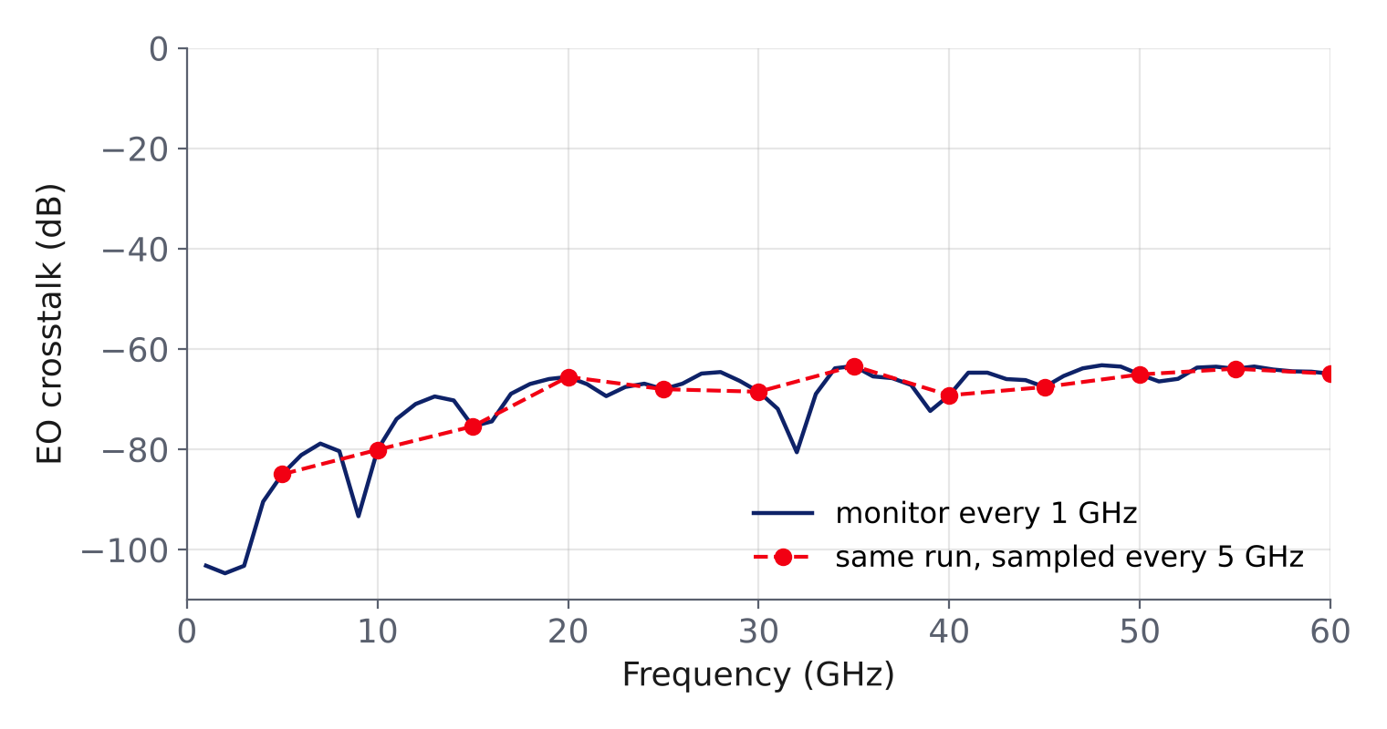
Simulation set-up (2/2): accuracy, monitors, excitation
Validated on the Cordoba 8 mm pair, where the victim is 55–75 dB below the aggressor
4
Accuracy −40 dB
5
Monitors every 1 GHz
6
One active port
At −27 dB the victim field is 40–240 % wrong (EO up to 18 dB). −40 dB: within 0.6 dB of −44.5 dB above 20 GHz.
5 GHz spacing misses the ≈ 7 GHz ripple; models fitted to sparse monitors failed prediction tests.
Line A input excited, all other ends terminated in the model: the lab drive in one run, 4× less time.

Slide 8
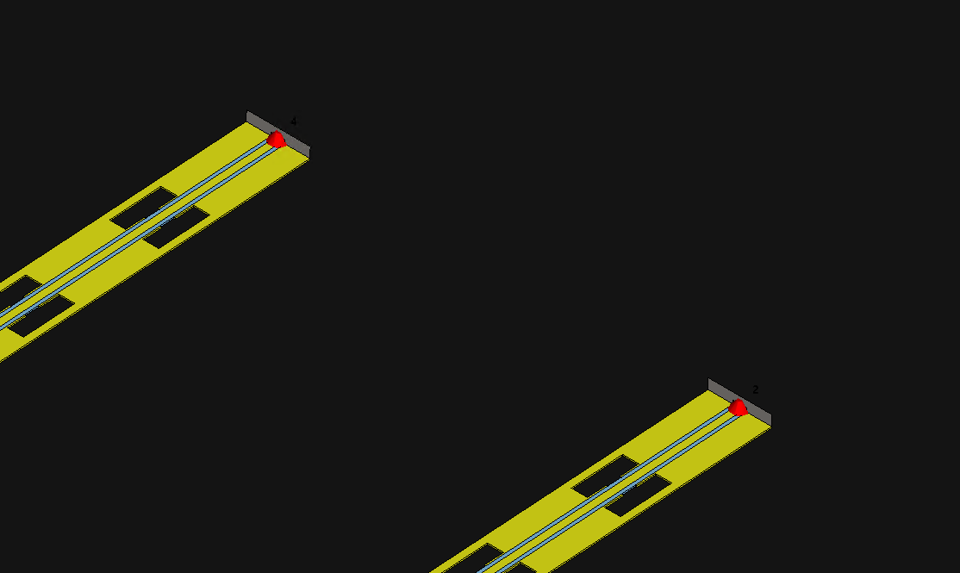
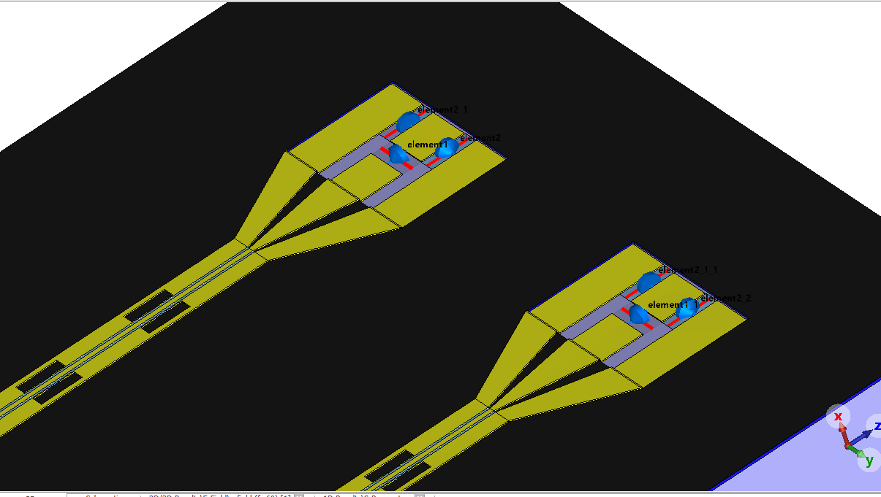
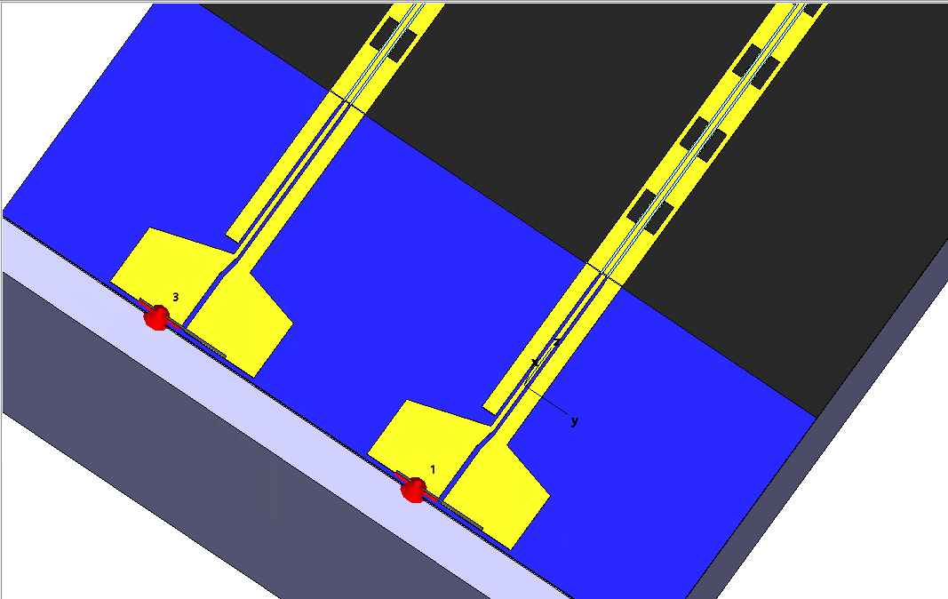
Modular build-up: four models
(b) and (c) each add one element to (a); (d) adds the driver to (c). Each change is isolated.
(a) Bare line pair
8.75 mm, pitch 625 µm. 50 Ω discrete ports at both ends of both lines.
(b) Real far-end termination
Pads on Si through an LN/SiO₂ trench; lumped RS 25 Ω + 2 × RG 50 Ω (50 Ω). Ports at the near end only.
(c) Input launch pads
Launch pads on oxide at the line input; 50 Ω discrete ports at the pads and at the far ends.
(d) Driver and bond wires
Al₂O₃ driver carrier with output traces, 8 bond wires (17 µm); waveguide ports on the carrier traces.

Slide 9
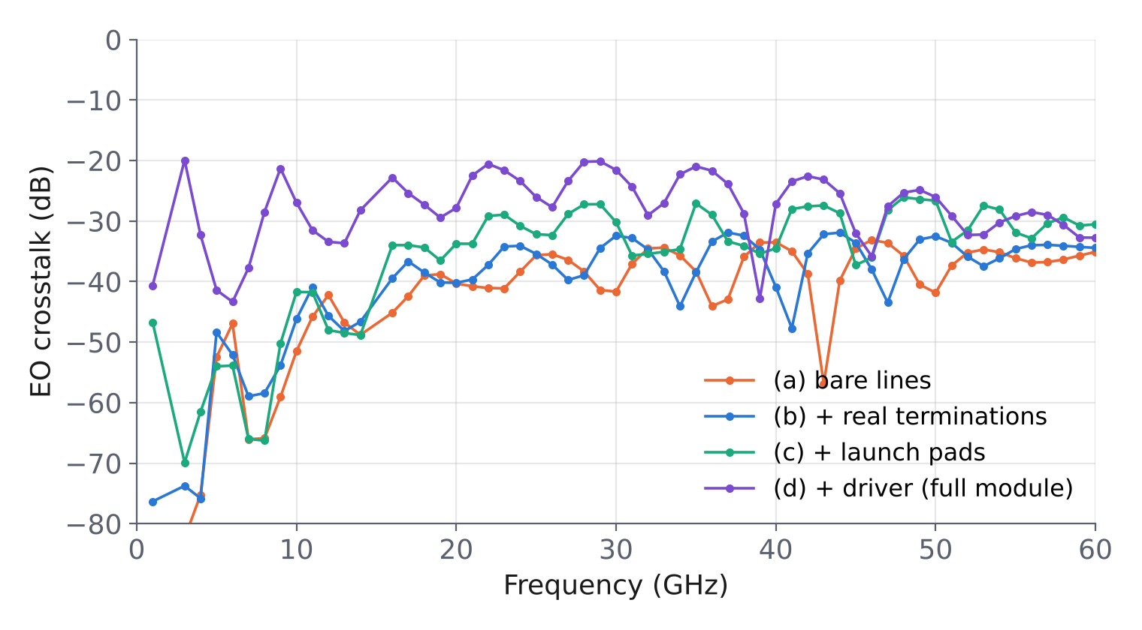
EO crosstalk: effect of each element
Medians over 5–60 GHz (2 and 15 GHz excluded: corrupted export in run c)
Step | EO change | Cause
(a) → (b) | +1.5 dB | ≈ 50 Ω like the port of (a); different reflection phase at the far-end pads
(a) → (c) | +5.4 dB | Pads couple a wave onto B at the line input, then carried along with the light
(c) → (d) | +6.4 dB (≥ 10 dB below 10 GHz) | Driver carrier and bond wires inject a strong victim signal before the line
Bare line: −38.4 dB · real termination: −36.7 dB · launch pads: −32.8 dB · full module: −27.3 dB
Ripple
Period 6.2–6.8 GHz in all four runs: a property of the line (round trip ≈ 150 ps).

Slide 10
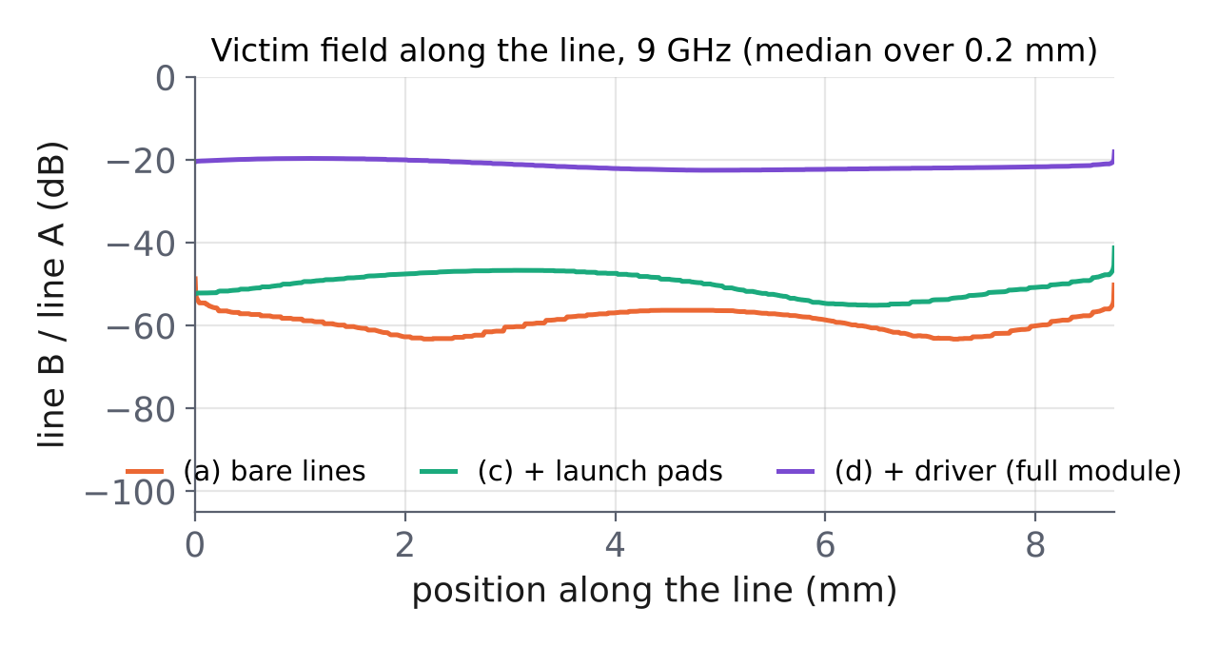
Full module: EO crosstalk ≈ FEXT
The driver-side coupling places the victim signal at the line input
Observation
In (d) the victim field is already −20 dB at the line input and stays constant along the line (3 and 9 GHz); in (a) and (c) it is −50 to −70 dB. The added coupling lies between the driver port and the line input (carrier traces or bond wires, not separated).
Consequence
A victim wave present from the input travels with the light over the full length: EO ≈ FEXT. Coupling built along the line gives EO ≈ FEXT − 6 dB (bare line: −4.8 dB).

Slide 11
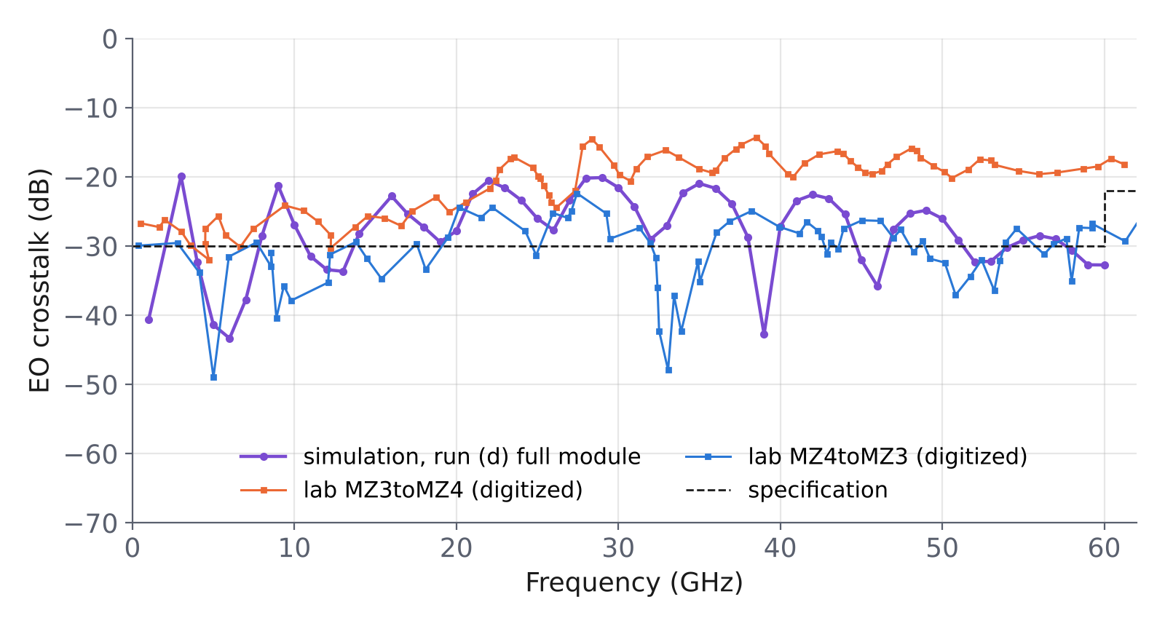
Comparison with the lab measurement
Module K00626: simulated EO crosstalk within the spread of the measured curves
Lab data
Six curves (three pairs, both directions), spread ≈ 10 dB. Two curves digitized from the report image: estimates only.
Agreement
Simulated median −27 dB, inside the lab range (−19 to −30 dB). Ripple 6.2–6.8 GHz simulated, ≈ 5 GHz measured.
Limits
A sharper comparison needs numerical lab data. Real driver, assembly and lab settings are not modelled.
Digitized with WebPlotDigitizer (automeris.io): pixel resolution ≈ 0.2 GHz and 0.15 dB, overlapping curves, notches under-sampled.

Slide 12
Conclusions
−27 dB
−19 to −30 dB
≈ 6.5 / 5 GHz
Simulated EO crosstalk, full module (median)
Lab range, module K00626 (medians)
Ripple period, simulation / lab
Method
EO crosstalk from full-wave fields: no mode model.
Full length, fine mesh, electric bottom, −40 dB, 1 GHz monitors, one active port.
Physics
Each module element raises the EO crosstalk; the driver side most.
Coupling at the input travels with the light: EO ≈ FEXT, not FEXT − 6 dB.
Next
Numerical lab data.
Optical-mode overlap instead of point sampling.
Real driver and assembly variations.

