Slide 1
Spatial-cognition QA benchmark
Generated items — what the model sees · not a frozen eval set

Slide 2
Advances so far (generation pipeline)
• Taxonomy locked: 4 classes × 8 constructs (+ FoR axis)
• SPOC episode → Episode GT (poses, visibility, edges, displacement, layout)
• Generated items: CODE-locked answers + answer_source from metadata
• Frame annotator for GT review (not model input)
• Still upcoming: GT Validator · vision-necessity · FREEZE · Model Evaluation
Not a frozen eval set — generated items only.

Slide 3
Generated items — what the model sees
Strict GT-backed MC candidates · raw ordered frames · not a frozen set

Slide 4
Egocentric encoding
Relation of a visible object to the viewer's current pose.
How to read the example
Single labeled current view: report the object's bearing in the camera frame.
2 strict GT-backed example(s) selected automatically from the supplied items.
Answers are locked by code from episode GT — not invented by an LLM.

Slide 5
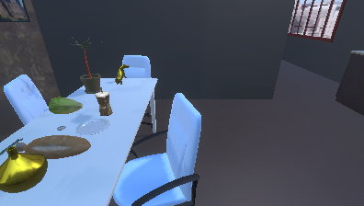
Egocentric encoding · Example 1 · question and answer
current view · find Vase
Question
Where is the Vase relative to you right now?
Options
A. to your right
B. ahead of you
C. behind you
D. to your left
Single current view: bearing in the camera/viewer frame.
Answer: D — to your left
house_006068 · FoR=egocentric · steps=0→0 · style=concise · house_006068_egocentric_encoding_0_0_Vase_8_32_concise

Slide 6
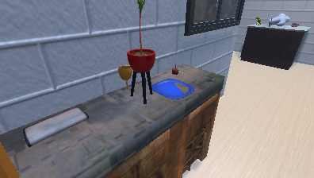
Egocentric encoding · Example 2 · question and answer
current view · find Counter Top
Question
Where is the Counter Top relative to you right now?
Options
A. to your right
B. to your left
C. behind you
D. ahead of you
Single current view: bearing in the camera/viewer frame.
Answer: A — to your right
house_007514 · FoR=egocentric · steps=0→0 · style=concise · house_007514_egocentric_encoding_0_0_CounterTop_2_2_concise

Slide 7
Allocentric encoding
Relation between two visible objects in a trusted object-centered frame.
How to read the example
Requires intrinsic object facing (object-frame edges); viewer-relative approximations are rejected.
No strict GT-backed example is available; the next slide explains the blocker.
Answers are locked by code from episode GT — not invented by an LLM.

Slide 8
Allocentric encoding · strict example unavailable
Definition: Relation between two visible objects in a trusted object-centered frame.
Metadata blocker: no trusted reference facing edges object frame empty.
No example is shown because an unprovable item would violate the benchmark's GT-only invariant.
This is an explicit unsupported result, not a missing slide or generation failure.

Slide 9
Spatial working memory
Recall a previously seen location/relation/count under load and delay.
How to read the example
Ordered frames: encode → navigation delay → query. Relation items recall bearing; count items ask how many of a category you saw.
2 strict GT-backed example(s) selected automatically from the supplied items.
Answers are locked by code from episode GT — not invented by an LLM.

Slide 10
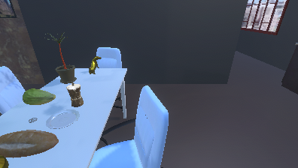
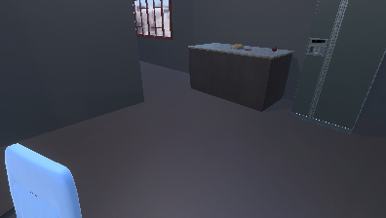
Spatial working memory · Example 1 · navigation sequence 1/1
Ordered stream: count distinct category instances seen up to now.
encode · last clear view of Chair
navigation · frame 1
query · now
Sequence: 3 frames · delay k=2 navigation steps · raw images shown to the model

Slide 11
Spatial working memory · Example 1 · question and answer
encode · last clear view of Chair
query · now
Question
How many distinct Chairs have you seen up to this point?
Options
A. 5
B. 3
C. 2
D. 4
Ordered stream: count distinct category instances seen up to now.
Endpoint recap · full 3-frame navigation on preceding slide(s)
Answer: B — 3
house_006068 · FoR=allocentric · steps=0→2 · style=concise · house_006068_spatial_working_memory_recall_count_0_2_Chair_c

Slide 12
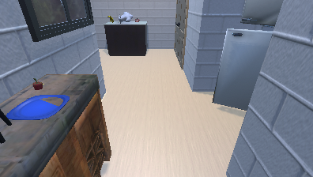
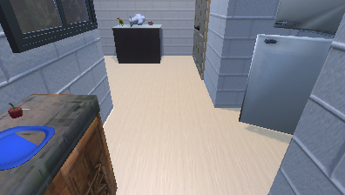
Spatial working memory · Example 2 · navigation sequence 1/1
Ordered stream: encode → navigate → recall earlier bearing (gone at query).
encode · last clear view of House Plant
navigation · frame 1
query · now
Sequence: 3 frames · delay k=2 navigation steps · raw images shown to the model

Slide 13
Spatial working memory · Example 2 · question and answer
encode · last clear view of House Plant
query · now
Question
You last saw the House Plant 2 steps ago: where was it relative to you at that time?
Options
A. to your right
B. behind you
C. to your left
D. ahead of you
Ordered stream: encode → navigate → recall earlier bearing (gone at query).
Endpoint recap · full 3-frame navigation on preceding slide(s)
Answer: D — ahead of you
house_007514 · FoR=egocentric · steps=0→2 · style=concise · house_007514_spatial_working_memory_recall_relation_0_2_Hous

Slide 14
Invisible displacement
Track an object's location after it is hidden and relocated out of view.
How to read the example
Encode while visible; object moves while hidden; query when still absent — use the destination cue in the question.
No strict GT-backed example is available; the next slide explains the blocker.
Answers are locked by code from episode GT — not invented by an LLM.

Slide 15
Invisible displacement · strict example unavailable
Definition: Track an object's location after it is hidden and relocated out of view.
Metadata blocker: no placement with distinguishable encode hidden query and unique options.
No example is shown because an unprovable item would violate the benchmark's GT-only invariant.
This is an explicit unsupported result, not a missing slide or generation failure.

Slide 16
Spatial updating
Update the bearing of a static object after the viewer moves.
How to read the example
Ordered navigation: encode early, track your motion, report the updated bearing at the final pose.
2 strict GT-backed example(s) selected automatically from the supplied items.
Answers are locked by code from episode GT — not invented by an LLM.

Slide 17
Spatial updating · Example 1 · navigation sequence 1/1
Ordered stream: encode → own motion → updated bearing at final pose.
encode · last clear view of Vase
navigation · frame 1
query · now
Sequence: 3 frames · delay k=2 navigation steps · raw images shown to the model

Slide 18
Spatial updating · Example 1 · question and answer
encode · last clear view of Vase
query · now
Question
Considering the last 2 navigation steps, where is the Vase relative to you now?
Options
A. to your right
B. ahead of you
C. behind you
D. to your left
Ordered stream: encode → own motion → updated bearing at final pose.
Endpoint recap · full 3-frame navigation on preceding slide(s)
Answer: D — to your left
house_006068 · FoR=egocentric · steps=0→2 · style=concise · house_006068_spatial_updating_0_2_Vase_8_32_concise

Slide 19
Spatial updating · Example 2 · navigation sequence 1/1
Ordered stream: encode → own motion → updated bearing at final pose.
encode · last clear view of House Plant
navigation · frame 1
query · now
Sequence: 3 frames · delay k=2 navigation steps · raw images shown to the model

Slide 20
Spatial updating · Example 2 · question and answer
encode · last clear view of House Plant
query · now
Question
Considering the last 2 navigation steps, where is the House Plant relative to you now?
Options
A. ahead of you
B. to your right
C. behind you
D. to your left
Ordered stream: encode → own motion → updated bearing at final pose.
Endpoint recap · full 3-frame navigation on preceding slide(s)
Answer: D — to your left
house_007514 · FoR=egocentric · steps=0→2 · style=concise · house_007514_spatial_updating_0_2_HousePlant_2_18_concise

Slide 21
Perspective-taking
Imagine standing at landmark A facing B; report where landmark C is.
How to read the example
Frames are labeled A/B/C (first clear views of each landmark). Answer is C in the imagined A→B frame — not the camera's egocentric bearing.
2 strict GT-backed example(s) selected automatically from the supplied items.
Answers are locked by code from episode GT — not invented by an LLM.

Slide 22
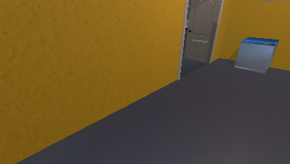
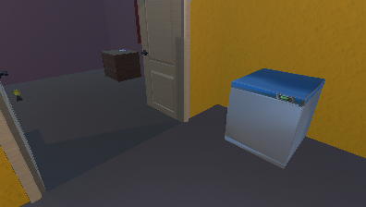
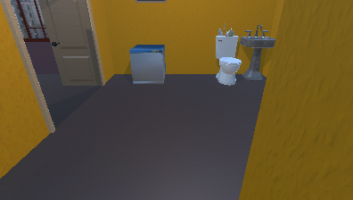
Perspective-taking · Example 1 · question and answer
A · stand here (Automatic Washer)
B · face toward (Dresser)
C · locate (Sink)
Question
Imagine standing at the Automatic Washer, facing the Dresser. From that position, where is the Sink?
Options
A. to your left
B. behind you
C. to your right
D. ahead of you
Imagined pose: stand at Automatic Washer, face Dresser, locate Sink — not the camera’s egocentric answer.
Answer: B — behind you
house_006068 · FoR=allocentric · steps=47→64 · style=concise · house_006068_perspective_taking_47_64_sink-with-faucet_5_0_0

Slide 23
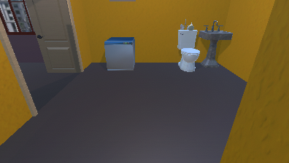
Perspective-taking · Example 2 · question and answer
A · stand here (Automatic Washer)
B · face toward (Dresser)
C · locate (Toilet)
Question
Imagine standing at the Automatic Washer, facing the Dresser. From that position, where is the Toilet?
Options
A. to your left
B. behind you
C. to your right
D. ahead of you
Imagined pose: stand at Automatic Washer, face Dresser, locate Toilet — not the camera’s egocentric answer.
Answer: B — behind you
house_006068 · FoR=allocentric · steps=47→64 · style=concise · house_006068_perspective_taking_47_64_Toilet_5_1_ObjaAutomat

Slide 24
Route knowledge
Retrace a walked source→goal as collected-format actions.
How to read the example
Stills with a letter marker at each landmark's 2D bbox center. The model writes actions; score = continuous xz+heading replay (ObjectNav 1.0 m success / traversed-edge validity / SPL), not exact-match to the stored recorded walk.
No strict GT-backed example is available; the next slide explains the blocker.
Answers are locked by code from episode GT — not invented by an LLM.

Slide 25
Route knowledge · strict example unavailable
Definition: Retrace a walked source→goal as collected-format actions.
Metadata blocker: no experienced landmark to landmark walk:geodesic below scene median=85,geodesic euclidean ratio lt 1.1=45,actions unusable=44,geodesic lt 1m=19,goal not after source=6,same snapped node=6,source name eq goal=5.
No example is shown because an unprovable item would violate the benchmark's GT-only invariant.
This is an explicit unsupported result, not a missing slide or generation failure.

Slide 26
Survey-based route planning
Plan a never-walked source→goal from layout (viewed, untraversed).
How to read the example
Stills with a letter marker at each landmark's 2D bbox center. Reference is a continuous BFS on viewed edges. Score uses viewed-edge validity (must leave the walked graph) and SPL on the viewed subgraph.
1 strict GT-backed example(s) selected automatically from the supplied items.
Answers are locked by code from episode GT — not invented by an LLM.

Slide 27
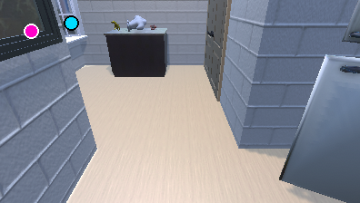
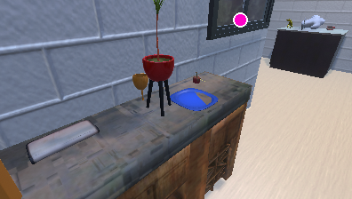
Survey-based route planning · Example 1 · question and answer
source sighted · Window marked with a cyan dot
goal sighted · Pouch
Question
Based on what you've seen of this space, list the navigation actions, in order, that go from the Window marked with a cyan dot to the Pouch.
Source, goal, and action walk
Plan (never walked): Window marked with a cyan dot → Pouch
Evidence: viewed but never walked · continuous BFS reference · scored on viewed edges (28 hops on the stored viewed-edge path)
Stored walk: → ↓
Letter marker at the object bbox center on that still.
Score: success = within 1.0 m of the goal (continuous replay); validity = stay on viewed edges and use at least one unwalked hop; efficiency = SPL vs viewed shortest path.
SOURCE (Window marked with a cyan dot) and GOAL (Pouch) carry a letter marker. The panel glyph row shows one valid never-walked plan (continuous BFS). Validity requires viewed edges plus at least one unwalked hop.
Stored sequence is analysis-only — any valid walk that meets success/validity counts.
house_007514 · FoR=allocentric · steps=0→6 · style=concise · house_007514_survey_based_route_planning_0_6_window_2_1_Obja

Slide 28
Takeaways
• Taxonomy is the capability axis; FoR is cross-cutting.
• Each construct is shown with strict GT-backed examples or an explicit metadata blocker.
• Answers are CODE-locked to GT; images shown = model input.
• Temporal examples show the ordered frame sequence, not only its endpoints.
• Unsupported constructs remain visible as honest metadata gaps.
• Next wall: validate → vision-necessity → FREEZE → evaluate VLMs.

