Slide 1
Beta Altera Floorplan Results

Slide 2
Altera Freedom level
Dealing with an Altera Board gives us a great degree of freedom in creating partially reconfigurable regions. Every block on the board could ideally be a region, this means that in a 220x175 blocks board we could generate 38500 regions.

Slide 3
Freedom Price
This great freedom degree gives us a lot of possibilities when it comes to choosing a possible area for a region, but this makes our choice incredibly computationally heavy.

Slide 4
Problem Example
Let’s think for a moment at a problem with N regions, each of them requiring just one block (suppose 1 LAB). Even excluding the reducible areas (areas bigger than what actually needed, such as a 2x2 area in this case) each region has 38500 possible positions, this means N*38500 possible areas! (192500 for just 5 regions)
This is clearly too much to handle in a reasonable time.

Slide 5
Proposed Solution
The way we propose to tackle this problem is reducing this freedom by “discretizing” the board, this ,in general , prevent the solution from reaching the global optimum, but it allows the computation to end in a reasonable time.

Slide 6
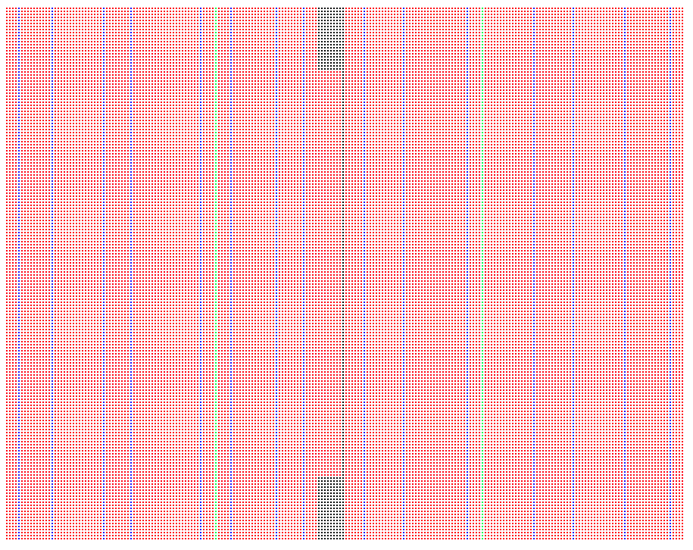
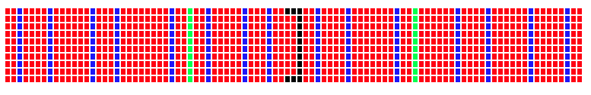
Discretization Example

Slide 7
Discretization
In the previous example we discretized a 220x175 board into a 86x10 representation, this allows us to work with a reasonable number of possible areas.

Slide 8
Future ideas
In very critical cases this discretization could affect the feasibility of the solution and not only its performance (e.g. : in the previous solution 11 regions that requires the exact amount of blocks of one row in the original fpga).
For this particular cases we thought that if a feasible solution is not found the software could restart the computation using a less strict discretization (requiring a lot more time).

Slide 9
Examples

Slide 10
1 Region 1 Lab
Even with the problem generated with only for placing 1 region that needs 1 LAB block we can see the difference between the discretizing and completely free approach:
With Discretization: Time to optimize=0.5 sec
Complete Freedom: Time to optimize=163 sec

Slide 11
More Regions
The next examples are generated using N regions with a requirement of 100 LAB and definitively discard the complete freedom approach.

Slide 12
More Regions Results
 | Only Feasibility |  | With Objective Function
N.Of Regions | Discretized Version | Complete Version | Discretized Version | Complete Version
1 | 0.814 | >10 min | 0.809 | >10 min
2 | 1.477 | >20 min | 1.622 | >20 min
3 | 2.138 | >20 min | 2.162 | >20 min
4 | 2.861 | >20 min | 2.943 | >20 min
5 | 3.433 | >20 min | 3.508 | >20 min

Slide 13
Comparing Precision: Regions Parameters
Region | LAB | DSP | MK20
1 | 1000 | 30 | 20
2 | 1000 | 0 | 0
3 | 100 | 0 | 0
4 | 2000 | 10 | 20
5 | 400 | 10 | 0

Slide 14
Comparing Precision: Regions Parameters
Region | LAB | DSP | MK20
1 | 1000 | 30 | 20
2 | 1000 | 0 | 0
3 | 100 | 0 | 0
4 | 2000 | 10 | 20
5 | 400 | 10 | 0
Region | LAB | DSP | MK20
6 | 1000 | 0 | 0
7 | 100 | 20 | 0
8 | 0 | 0 | 30
9 | 1500 | 5 | 0
10 | 500 | 0 | 0

Slide 15
Number of regions | Bitstream Weigth | Perimeter Weight | Wasted Rsc Weight | Low Prec Time | Medium Prec Time | High Prec Time
5 | 0 | 0 | 0 | 7.189s 6.3s | 16.866s 14.913s | 75.064s 69.098s
5 | 100 | 0 | 0 | 18.553s 17.986s | 30.748s 29.15s | 75.634s 69.497s
5 | 0 | 0 | 100 | 7.219s 6.439s | 16.913s 15.564s | 74.51s 71.607s
5 | 50 | 50 | 50 | 23.421s 22.62s | 28.106s 27.985s | 76.331s 70.562s
5 | 100 | 100 | 100 | 23.594s 18.819s | 28.871s 28.809s | 78.667s 68.57s
10 | 0 | 0 | 0 | 13.332s 11.922s | 33.451s 29.222s | 133.174s 117.03s
10 | 100 | 0 | 0 | 28.743s 19.56s | 42.496s 39.821s | 131.595s 118.379s
10 | 0 | 0 | 100 | 14.819s 12.78s | 33.873s 30.268s | 129.653s 119.936s
10 | 50 | 50 | 50 | 28.313s 27.027s | 39.474s 43.31s | 130.743s 115.888s
10 | 100 | 100 | 100 | 28.588s 26.802s | 43.527s 38.94s | 132.643s 125.556s

