Slide 1


Spring Pet Clinic Presentation

Slide 2
Presentation Outline
Internal Structure
Development Lifecycle
I. Introduction (#3-#4)
I. Technical Specification (#32)
II. Tech Stack (#5-#17)
II. Development & Local Testing (#33)
III. Architecture (#18-#20)
III. Build (#34)
IV. Module Roles (#21-#29)
IV. Application Startup (#35)
V. Testing (#30-#31)
The presentation consists of two parts:
Internal Structure of the Pet Clinic Application: Global Architectural Components.
Its present the Pet Clinic app structural components — modules, architectural layers, technology stack and explain how they interact within the context of Spring Boot architecture.
Application Development Lifecycle Stages in Pet Clinic. The project followed a simplified development cycle, which is typical for demo, educational, or small-scale applications

Slide 3
I. Introduction & Goals — Part 1 (Overview)
What is it?
Spring PetClinic is an official sample application that demonstrates best practices and common design patterns in the Spring Framework ecosystem
It is built as a fully functional, production‑ready example for learning and exploring modern Java/Spring application architecture
Why is it needed?
A hands‑on learning reference for Spring Boot, MVC, REST, and JPA
A blueprint for enterprise‑grade application architecture
Enables quick ramp‑up for new team members and projects
Whom is it for?
Developers new to Spring Framework
Architects & senior engineers exploring best practices
Trainers & mentors teaching Spring Boot and its patterns
Why is it interesting?
Created and endorsed by the Spring Framework team
Shows how a modern Spring app is structured and implemented
Enables learning by doing — exploring real working code
Provides a solid foundation for extending or building your own projects

Slide 4
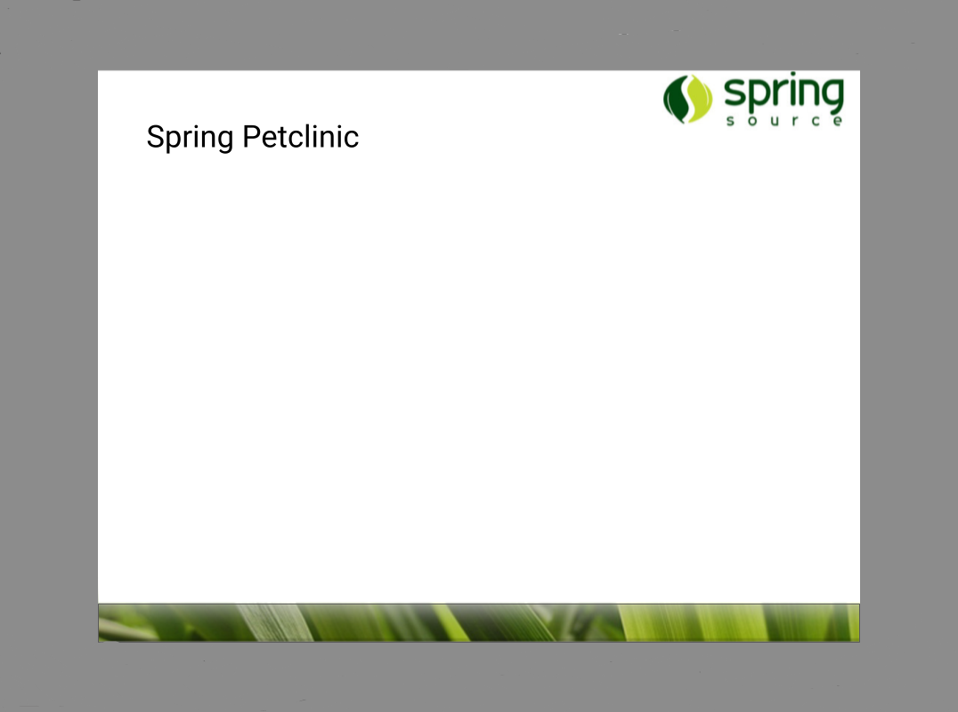
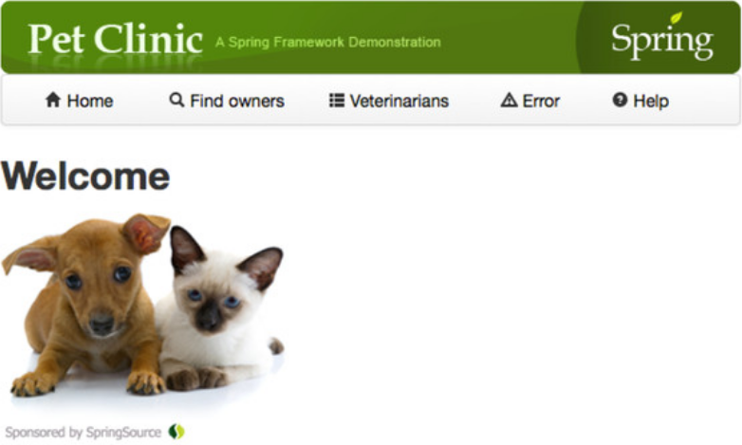
I. Introduction & Goals — Part 2 (Links & Demo)
Click here to copy the Pet Clinic link
Click here to view the live demo

Slide 5
Internal Structure
II. Modern Spring Boot Technology Stacks
Core Stack Overview
Slide 6
Substack
Overview
Slide 14
This section aims to present the technologies applied and clarify their respective roles within the context of the PetClinic application.
The Core Stack includes the fundamental technologies and libraries on which the PetClinic application is built.
The Substack consists of additional tools and debugging utilities. These components are not essential for launching or building the application architecture and can be disabled without affecting its core functionality.

Slide 6
‹#›
Internal Structure
II. Core Technology Stack
Java 17 LTS – Language and Platform (Slide 7 )
Maven 3.9.6 — Build and Dependency (Slide 8)
Spring Framework 6.1 — The Core Framework (Slide 9)
Spring Boot 3.3.1 — Process Automation (Slide 10)
REST Endpoints – Communication Interface (Slide 11)
Thymeleaf – Visualization (HTML Templates) (Slide 12)
H2 – the default database used (Slide 13)

Slide 7
‹#›
Internal Structure
II. Core Technology Stack
Part 1 - Java 17 LTS
Java 17 LTS is the core language of the Spring ecosystem. It supports modern language features and ensures long-term stability.
It is not part of the application code itself and does not reside inside the spring-petclinic/ project directory.
Installation is performed manually and is recommended from the official Oracle site: https://jdk.java.net/17/
Once installed, Java is placed in a system directory. For Windows, the typical path is: C:\Program Files\Java\jdk-17.
To check the installed version, run the following command in the terminal: java -version
The unpacked Oracle distribution typically takes up ~300–350 MB of disk space.
Primary Function - Java serves as the runtime platform for the entire application: it compiles the code and executes all classes in Spring Framework and Spring Boot.
Compatibility - Java 17 LTS works seamlessly with Maven, Gradle, and IntelliJ IDEA, and is required for Spring Boot 3.x and Spring Framework 6.

Slide 8
‹#›
Internal Structure
II. Core Technology Stack
Part 2 - Maven 3.9.6
Maven 3.9.6 – Build and Dependency Management System
It is not part of the application code itself and does not reside inside the spring-petclinic/ project directory.
Maven is installed manually from the official Apache website: https://maven.apache.org/download.cgi
The installation folder can be arbitrary. For example: C:\Program Files\Apache\Maven\apache-maven-3.9.6\
The unpacked Maven folder occupies approximately 10–15 MB.
All downloaded project dependencies are stored in: C:\Users\<user>\.m2\repository\ (This directory is called the local Maven repository)
The local repository may consume anywhere from 100 MB to several GB
To check the installed version, run the following command in the terminal: mvn -v
Maven Primary Functions — 1. A build and dependency management system; 2. It invokes Java to compile and run the application
Maven → invokes Java → Java compiles and launches the application

Slide 9
‹#›
Internal Structure
II. Core Technology Stack
Part 3 - Spring Framework 6.1
Spring Framework 6.1 is a framework (set of libraries) for building Java applications. It can be added to a project as a dependency.
It is not part of the application code itself and does not reside inside the spring-petclinic/ project directory.
It is not installed manually. Spring Framework is automatically included in the project via Maven. It is added to the pom.xml as a dependency, and Maven automatically downloads all required modules from the central repository and saves them in the local repository.
To check the installed version - the version can be found in the parent pom.xml tags.
Spring Boot resides in the local repository folder C:\Users\<user>\.m2\repository\org\springframework\
The entire Framework 6.1 typically occupies ~15–25 MB in the local repository.
Spring Framework 6.1 Primary Functions — It is the foundation on which all Spring-based applications are built. It provides: 1. DI/IoC container (dependency injection and management); 2. Application context; 3. Bean lifecycle management; 4. Core infrastructure for Spring Boot.
Spring Framework 6.1 is a mandatory base for applications built with Spring Boot 3.x.

Slide 10
‹#›
Internal Structure
II. Core Technology Stack
Part 4 - Spring Boot 3.3.1
Spring Boot 3.3.1 is a framework (on top of Spring Framework) that simplifies configuration and application startup. It can be added as a dependency
It is not part of the application code itself and does not reside inside the spring-petclinic/ project directory.
It is not installed manually. Spring Boot is automatically included in the project via Maven. It is added to the pom.xml as a dependency, and Maven automatically downloads all required modules from the central repository and saves them in the local repository.
To check the installed version - the version can be found in the parent pom.xml tags.
It resides in the local Maven repository folder C:\Users\<user>\.m2\repository\org\springframework\boot\.
The entire Spring Boot 3.3.1 typically occupies ~25–40 MB in the local repository.
Spring Boot 3.3.1 Primary Functions — It is a layer built on top of Spring Framework, that automatically configures the application and simplifies development. It provides: 1. Auto-configuration (no need to manually define beans); 2. An embedded web server (Tomcat); 3. Spring Boot starters – pre-configured dependency sets; 4. Spring Boot DevTools and Actuator; 5. Built-in launch support

Slide 11
‹#›
Internal Structure
II. Core Technology Stack
Part 5 - REST Endpoints
REST Endpoints are the communication interface (API) between the application and external clients (such as a frontend or a mobile app).
The ability to define REST endpoints is provided by the spring-boot-starter-web dependency, which is automatically included via Maven in the pom.xml file.
It is fully integrated into Spring Boot and requires no manual configuration to work.
REST controllers are part of the application’s source code and are located within the spring-petclinic/ project directory .
The connection is established through the spring-boot-starter-web dependency, which is a part of Spring Boot and enables Spring MVC and REST capabilities.
Primary function of REST Endpoints: Expose application data via HTTP API (GET, POST, PUT, DELETE).
Additional functions include: JSON serialization (via Jackson), CORS support, request validation, path matching, and partial support for HATEOAS.

Slide 12
‹#›
Internal Structure
II. Core Technology Stack
Part 6 - Thymeleaf
Thymeleaf is a server-side Java template engine used for rendering dynamic HTML content
PetClinic uses Thymeleaf 3.x version, managed via Maven.
It is downloaded automatically via Maven as part of spring-boot-starter-thymeleaf.
Themplates live in src/main/resources/templates/, while the engine itself is a Spring Boot dependency.
Thymeleaf is fully integrated into Spring Boot and requires no manual configuration to work.
Primary Thymeleaf function: Rendering HTML pages with model data.

Slide 13
‹#›
Internal Structure
II. Core Technology Stack
Part 7 - H2
In the current version of PetClinic, the built-in relational database H2 is used by default.
H2 is an external dependency. It is not part of the application’s source code and does not reside inside the spring-petclinic/ project directory. However, the SQL scripts (schema.sql, data.sql) are located in src/main/resources.
H2 is not installed manually — it is automatically included via the com.h2database:h2 dependency, which is transitively pulled in by spring-boot-starter-data-jpa.
At runtime, H2 is launched in memory, typically consuming less than 2MB of RAM.
In the context of PetClinic, H2 is not intended for production use, but it offers maximum convenience for demonstration, learning, and local development.

Slide 14
‹#›
Internal Structure
II. Substack
DevTools – Development Tools (Slide 15)
Actuator — Monitoring Tools (Slide 16)
Logging — Console Output (Slide 17)

Slide 15
‹#›
Internal Structure
II. Sub Technology Stack
Part 1 - DevTools
Spring Boot DevTools = Spring Boot Development Tools
Included in PetClinic as a dependency in pom.xml.
In Pet Clinic, DevTools facilitates local development, speeds up debugging and testing, and is explicitly excluded from production environments.
Primary DevTools function: automatic restart (hot reload) of the application when code changes are detected.
Additional features include: – Improved UI/HTML development workflow: changes to Thymeleaf templates and static resources are applied without a full restart. – Disabling of caches for faster feedback during front-end development. – Redirecting logs to the console, automatic browser launch on startup, and other productivity enhancements.

Slide 16
‹#›
Internal Structure
II. Sub Technology Stack
Part 2 - Actuator
Spring Boot Actuator – a monitoring and management module for observing the application at runtime.
Included in PetClinic as a dependency in pom.xml.
It does not have its own source folder. It is integrated into the application codebase but does not affect business logic.
In PetClinic, Actuator provides runtime insight into the application by exposing endpoints such as: /actuator/health – system health status; /actuator/info – basic application info; /actuator/metrics – performance and usage metrics; – and much more.
Primary Actuator function: extends the API with additional GET endpoints available under the /actuator/* path.
Actuator exposes monitoring data via HTTP endpoints under /actuator/*, which developers can access using a browser, REST client, or terminal tools like curl.

Slide 17
‹#›
Internal Structure
II. Sub Technology Stack
Part 3 - Logging
Log is a record of an event that occurred during the execution of a program or system.
Logging in this app – standard Spring Boot logging system based on SLF4J + Logback.
Included in PetClinic transitively via Spring Boot starters.
It has no separate folder but may be configured via application.properties.
Integrated passively – it does not affect business logic.
Primary function: capturing and displaying application events (errors, startup, requests).
Additional features: log levels, profile support, optional file output.
Output is directed to the console by default.

Slide 18
III. Architecture Overview
Part 1 - Multi‑module Monolith Architecture
Web
User (Browser)
Data Wrapping
Data
Exchange
Model
Data Wrapping
Service
Limits of source code
External resources
Data Wrapping
Data
Exchange
Repository
DB
Spring PetClinic implements two architectural concepts: a multi‑module (layered) monolith as the overall application structure, and MVC as the request processing pattern.
Spring PetClinic built as a single .jar, with a clear and well‑defined logical structure.
Data Exchange - Active data flow: requests, responses, processing. Web–Service–Repository work together to move data.
Data Wrapping - Passive data structure: a common data format shared across layers. Model doesn’t initiate communication, it provides structure and context for the data exchanged.

Slide 19
III. Architecture Overview
Part 2 - MVC Processing Pattern Architecture
M
V
C
Model
Web
С - Controlers
V - View (Thymleaf)
Data
Data
Service
Wrapping
Exchange
Data
Exchange
Repository
Spring PetClinic implements two architectural concepts: a multi‑module (layered) monolith as the overall application structure, and MVC as the request processing pattern.
MVC is implemented across two modules: M in Model, C and V in Web (Controller + Thymeleaf templates).
The Service is not part of the MVC structure, but it provides the Controller with the necessary business logic.
The Repository is neither directly nor indirectly related to the MVC pattern.

Slide 20
III. Architecture Overview
Part 3 - Code Architecture of the Application
spring-petclinic/
├─ src/
│ └─ main/
│ └─ java/
│ └─ org.springframework.samples.petclinic
│ ├── pom.xml
│ ├─ model ← Package: org.springframework.samples.petclinic.model
│ ├── pom.xml
│ ├─ repository ← Package: org.springframework.samples.petclinic.repository
│ ├── pom.xml
│ ├─ service ← Package: org.springframework.samples.petclinic.service
│ ├── pom.xml
│ └─ web ← Package: org.springframework.samples.petclinic.web
├─ resources/
│ └─ templates/
├─ test/java/
├─ pom.xml
Code structure in the IDE (the developer’s view).
A clean multi‑layered monolith: a single .jar & each module contains its own pom.xml file.

Slide 21
IV. Application Module Roles OverView
Web Module
Slide 22-23
Service Module
Slide 24-25
Repository Module
Slide 26-27
Model Module
Slide 28-29

Slide 22
IV. App Module Roles: Web Module
Part 1 - Internal Structure of the Web Module
HTTP requests from the browser (via URL)
Data from the Service & Model
Data from the controller
Data from the domain Model
Web
Input
Input
Controllers - Processing HTTP requests, preparing rendering
View Thymeleaf templates - form the final HTML
Output
Output
HTML redirect
Commands, parameters, data to the Service, Model
HTML response to the browser
The web module in Spring PetClinic follows a clear internal split:
Controllers handle requests and coordinate logic via the service layer.
Thymeleaf templates render views based on model data returned by the controllers.

Slide 23
IV. App Module Roles: Web Module
Part 2 - Code Architecture of the Web Module
├── pom.xml
└─ web ← Package: org.springframework.samples.petclinic.web
/ ├── ClinicController.java - General application pages
├── CrashController.java - Demo for error handling
├── OwnerController.java - CRUD operations for pet owners
├── PetController.java - CRUD operations for pets
├── VisitController.java - CRUD operations for visits
├── VetController.java - Displaying the list of veterinarians
├── WelcomeController.java - Home page display
├── PetTypeFormatter.java - Formatter for pet types
└── ClinicBindingInitializer.java - Spring MVC binder configuration
├─ resources/
└─ templates/
├── owners/ - HTML forms for pet owners
├── pets/ - HTML forms for pet
├── visits/ - HTML forms for visits
├── vets/ - HTML forms for veterinarians
└── welcome.htmlСтруктура шаблонов соответствует контроллерам, поддерживая CRUD-логики
Code structure in the IDE (the developer’s view).
Controllers and view templates are physically separated, but together they form a single functional unit of the web module. Spring MVC automatically links both components.
Has its own pom.xml in the root of the module

Slide 24
IV. App Module Roles: Service Module
Part 1 - Internal Structure of the Service Module
Input Source – Controllers from the Web module
Commands – Create, update, and delete operations
Parameters for business operations – Identifiers or filters for queries
Transaction context
Validated data from HTML forms
Input
Service - Implementation of the application's business logic
Output
Back to the Web module controllers
Ready-to-use model objects: Owner, Pet, Visit, Vet, and their collections
Execution statuses (success, errors, Optional, null)
Additional business-level results
Data passed to the View layer (Thymeleaf)
Repository module calls for read/write operations
The Service module has a flat and uniform structure without any internal separation
All business logic of the application is implemented in the Service module.

Slide 25
IV. App Module Roles: Service Module
Part 2 - Code Architecture of the Service Module
├── pom.xml
└── service ← Package: org.springframework.samples.petclinic.service
├── ClinicService.java - Interface for managing owners, pets, visits, and veterinarians
├── ClinicServiceImpl.java - A class implementing the ClinicService interface
├── OwnerService.java - Interface for managing owners
├── PetService.java - Interface for managing pets
├── VetService.java - Interface for managing veterinarians
└── VisitService.java - Interface for managing visits
Code structure in the IDE (the developer’s view)
The entire implementation consists of Java classes and interfaces in a single package
All business logic is concentrated in a single package
Has its own pom.xml in the root of the module

Slide 26
IV. App Module Roles: Repository Module
Part 1 - Internal Structure of the Repository Module
Input Source – Service module
Object identifiers (ID)
Domain objects themselves (Owner, Pet, Visit, Vet)
Object filtering parameters
Input
Repository Providing data access to the database via Spring Data JPA
Output
Back to the Service module
Entities — complete Owner, Pet, Visit, and Vet objects (or their lists) retrieved from the database.
The Repository module has a flat and uniform structure without any internal separation
This module serves as a bridge between the business logic and the database

Slide 27
IV. App Module Roles: Repository Module
Part 2 - Code Architecture of the Repository Module
├── pom.xml
└── repository ← Package: org.springframework.samples.petclinic.repository
├── OwnerRepository.java - Owner Data Access Interface
├── PetRepository.java - Pet Data Access Interface
├── VetRepository.java - Vet Data Access Interface
└── VisitRepository.java - Visit Data Access Interface
Code structure in the IDE (the developer’s view)
The entire implementation consists of Java classes and interfaces in a single package
Has its own pom.xml in the root of the module

Slide 28
IV. App Module Roles: Model Module
Part 1 - Internal Structure of the Model Module
Model module POJO space for:
Entity-to-table
- Functioning of the Web, Service, and Repository modules
mapping
DB
- Data exchange between modules
The functioning of the Web, Service, and Repository modules in the PetClinic application, as well as the flow of data between them, is based on the use of entities (POJO classes) from the Model module
The Model module does not depend on any other module
It is aligned (not dependent) with database tables through annotations
All other modules depend on the Model because they use its entities

Slide 29
IV. App Module Roles: Model Module
Part 2 - Code Architecture of the Model Module
├── pom.xml
└── model ← Package: org.springframework.samples.petclinic.model
├── BaseEntity.java - Contains the common id field
├── NamedEntity.java - Extends BaseEntity, adds the name field
├── Owner.java - Pet owner
├── Pet.java - A pet, with references to its type, visits, and owner
├── PetType.java - Type of pet (e.g., cat, dog, etc.)
├── Specialty.java - Vet's specialty
├── Vet.java - Veterinarian
└── Visit.java - A pet's visit to the veterinarian
Code structure in the IDE (the developer’s view)
The entire implementation consists of Java classes in a single package
Has its own pom.xml in the root of the module, without dependency tags

Slide 30
V. Testing Strategies
Part 1 - General scheme of the each module
Functioning module
Real data input from module-source
Real production structure & function
Real data output to module-receiver
Simulated data (mocks) from Mockito library
Test structure & function
Test data output to assertion mechanism
Each module in PetClinic has two structures:
The production structure – operates in the production environment.
The test structure – used for testing and verifying the functionality of the component.
The test structure is part of the module's overall structure – it does not exist separately, but its purpose is to verify the behavior of the production structure in isolation and under test control.
Mocks are software objects that replace real dependencies in modules to isolate the test layer from the production environment.
Assertions are verification commands used in tests to ensure that a module functions correctly, returns the expected data, and exhibits the intended behavior

Slide 31
V. Testing Strategies
Part 2 - The code-level of Testing Strategies
spring-petclinic/
├─ src/
│ └─ main/
│ └─ java/
│ └─ org.springframework.samples.petclinic
├─ resources/
│ └─ templates/
│ ─ test/java/
│ └─ java/
│ └── org/springframework/samples/petclinic/
│ ├── model/ ← Unit tests for models
│ ├── repository/ ← JPA tests for repositories
│ ├── service/ ← Unit and integration tests
│ ├── web/ ← MockMvc web tests
│ └── PetClinicApplicationTests/ ← General tests
├─ pom.xml
Code structure in the IDE (the developer’s view).

Slide 32
‹#›
Development Lifecycle
I. Technical Specification
Essential Sections of the Technical Specification
Section | Description
1. Application Goals and Purpose | Understand why the product is being created and what problems it solves
2. Functional Requirements | Define the essential features of the application
3. Data Structure and Entities | Clarify what information is stored and how it is structured
4. User Roles and Access Rights | Define the security and permission model
5. Implementation Constraints | Specify the required technologies, environment, and integration boundaries
Technical Specification (TS) is a document that defines the core requirements of a software product — its functionality, interfaces, architecture, constraints, and acceptance criteria. It serves as the foundation for development, testing, and client-developer collaboration.

Slide 33
‹#›
Development Lifecycle
II. Development & Local Testing
1. At this stage, the application is developed as a system of source files.
Developers create entities, repositories, services, and controllers.
Business logic is implemented, and request mappings are configured.
Database interactions are defined.
2. At the same time, unit and layer tests are written to verify components in isolation.
Unit tests are created for services and controllers.
Mocks are used to isolate the test logic.
Test development runs in parallel: each feature is accompanied by tests verifying its behavior in isolation.
Bugs are detected early and fixed iteratively.
3. Code for a new project is not written from scratch, but assembled using Spring Initializr or well-established building blocks.
The project skeleton may include:
Base packages (controller, service, repository, etc.).
Standard test structure: src/test/java.
Default test dependencies: JUnit, Mockito, Spring Test.
4. The application is launched at this stage — before the build — from the development environment (IDE) or via mvn spring-boot:run.

Slide 34
‹#›
Development Lifecycle
III. Build
How it works in practice
1. На стадии Build вся система файлов исходного кода собирается в один исполняемый JAR-файл (или WAR)
2. Сборка происходит по команде Maven:·
mvn clean install;
3. Состав JAR:
.class-файлы
ресурсы
зависимости
META-INF, манифест, bootloader
4. Исполняемый файл размещается в папке target/ (например, target/petclinic.jar)
5. JAR-файл является самодостаточным исполняемым артефактом, переносимым и запускаемым как единое целое.
6. Исполняемый файл запускает приложение вне среды разработки IDE и пригодный для переноса, тестирования в других средах и деплоя.

Slide 35
‹#›
Development Lifecycle
IV. Application Startup
How it works in practice
1. Стадия Application Startup в Spring PetClinic представляет собой момент запуска собранного приложения, в ходе которого происходит автоматическая инициализация всех компонентов, подключение к базе данных и активация встроенного веб-сервера.
Благодаря Spring Boot, эта стадия требует минимальной ручной настройки и выполняется по принципу "convention over configuration".
2. Запуск JAR-файла происходит по команде:
java -jar spring-petclinic.jar
3. Внутренние процессы после запуска.
Вызывается SpringApplication.run(...)
Инициализируется Spring Boot ApplicationContext
Сканируются компоненты
Настраиваются зависимости
Запускается встроенный Tomcat
Подключается БД
4. После успешного запуска и инициализации выводится сообщение:
Started PetClinicApplication in X seconds
Пользователь может открыть браузер и перейти на: http://localhost:8080
В результате, приложение готово принимать HTTP-запросы

Slide 36
образец чистый

Slide 37
Spring Petclinic

