Slide 1
responsive, real-time
with Backbone.js and WebSockets
Andrei Cîmpean, @Andrei_Cimpean

Slide 2
Today, we are going to look at how we are building a real-time, responsive JavaScript client app.
For Google Chrome.
And IE8.

Slide 3
What is a real-time application ?
What is a responsive application ?
It enables users to receive information as soon as it is published
Its UI updates instantly, no matter what

Slide 4
Why do we need “real-time, responsive”
a client imports entries, packages them and puts them up on the market for another users to bid on and, if they win the auction, to pay
an app that behaves like a market
allows clients to sell and bid
time constrained user actions ( seconds )

Slide 5
What we needed to do
structure the market on the client app
communication mechanism
don't stress the server
support only Chrome and IE 8+ :|
make sure it works at least a full day without crashing or requiring a full page refresh

Slide 6
Technology decisions
Backbone.js + plugins – for structure
CometD – for communication

Slide 7
Structure
Backbone.js + plugins

Slide 8
Backbone.js ( http://backbonejs.org/ )
BB is a JavaScript library with a RESTful JSON interface, and is based on the model–view–presenter (MVP) application design paradigm. It provides:
models with key-value binding and custom events
collections with a rich API of enumerable functions
views with declarative event handling
routing system with History API support

Slide 9
Backbone.js ( http://backbonejs.org/ )
// model definition
var Package = Backbone.Model.extend({
doSomething: function() { … }
});
// collection definition
var Repository = Backbone.Collection.extend({
model: Package
});

Slide 10
Backbone.js ( http://backbonejs.org/ )
Entry and Package as Models,
Entries and Repository ( fancy for packages) as Collections
add an Entries collection in Package to satisfy relationship

Slide 11
Backbone.js Views
var PackageWithBid = Backbone.View.extend({
events: {
"click .button.accept": "accept",
"click .button.reject": "reject"
},
render: function () { ... }
...
});
new PackageWithBid({ model: repository.first() }).render().el; // DOM element

Slide 12
Backbone.js Views
views can be binded to model or collection events
managing a large number of nested views can be a pain

Slide 13
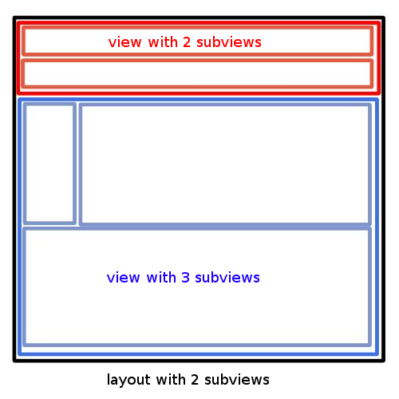
Backbone.js LayoutManager
( https://github.com/tbranyen/backbone.layoutmanager )
a better way to structure views
easy to set up
render() is now managed
gain beforeRender() and afterRender()
manages cleanup

Slide 14
Nesting Views
var ViewBids = Backbone.View.extend({
manage: true, // needed by layout manager for our approach
beforeRender: function() {
this.collection.each(function() {
this.insertView(new PackageWithBid());
}, this);
},
serialize: function() {
return { package: this.model };
}
});

Slide 15
Why Backbone.js ?
Backbone.js was chosen because it is small, very light; The entire source code can be read with ease ( ~ 1500 LOC )
good documentation
a big community with a lot of plugins, some really good

Slide 16
Communication
WebSockets

Slide 17

“It has to be a bit more complicated.”
Internet Explorer Dev Team

Slide 18
WebSockets ( http://www.websocket.org/ )
a full-duplex single socket connection over which messages can be sent between client and server
doesn't work in Internet Explorer

Slide 19
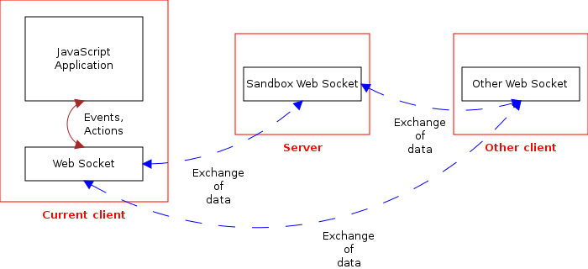
WebSockets

Slide 20
Sorting out IE8+
any browser with Flash can support WebSocket using a web-socket-js shim/polyfill
  flash leaks memory
fallback system: long-polling vs flash
  flash leaks memory
use a “wrapper” that enables fallback

Slide 21
CometD ( http://cometd.org/ )
scalable HTTP-based event routing bus that uses a Ajax Push technology pattern known as Comet
provides meta-channels for error messages
provides channels that can be used to filter content update by subscribing to them:
var sub = socket.subscribe('/foo/bar/', function() { ... });
cometd.unsubscribe(sub);

Slide 22
Connecting to a CometD server
function connect(path) {
window.socket.configure({ url: path });
window.socket.addListener('/meta/subscribe',metaSubscribe);
window.socket.addListener('/meta/handshake', metaHandshake);
window.socket.addListener('/meta/connect', metaConnect);
return window.socket.handshake({
ext: { authentication: { user: username, sessionid: sessionid } }
});
}

Slide 23
Architecture decisions
use comet channels
  an update channel, where bids on the client's repository are sent
  an offer channel, where new packages are sent for other clients to bid on

Slide 24
Architecture decisions
pass-through REST-like server:
  GET returns appropriate responses
  POST, PUT, DELETE
    200 OK - if server is not dead
    confirmation on a channel will be received as soon as possible

Slide 25
Optimism and responsiveness
we are optimists
each action that would require a confirmation is actually displayed as if it was a success immediately
if the confirmation message says that something failed, we just display a notification and revert. Most of the time this is not required.

Slide 26
Reverting optimism
when the action is performed, after the server call we replace old views with ones representing the new state ( one property )
if the confirmation invalidates the action, we restore the previous state and re-render all
this approach guards almost all the actions a user can perform in the application

Slide 27
Reverting optimism
actions that change more than just an order state, first create a snapshot of itself
if the confirmation invalidates the action, we restore the snapshot and re-render all
for these, we render the view representing the new state but block them with a loading animation

Slide 28
So, basically
be optimistic when rendering but prepared to raise alarms
always use ;

