Slide 1
Software Design
Prof. Mihaela Dinsoreanu
Contact: room D01, Baritiu 26-28
E-mail: mihaela.dinsoreanu@cs.utcluj.ro

Slide 2
Housekeeping Details
Time & Location:
See Schedule on www.ac.utcluj.ro
Prerequisites:
Programming Techniques Course
Software Engineering Course
Grading:
Project 20%
Lab 20%
Final Exam 60%

Slide 3
Housekeeping continued..
TA’s
30231 – Kinga Budai
30232 – Grigore Vlad
30233 – Samuel Dolean
30234 – Iulia Stefana Chirila
30235 – Cristina Radulescu
30236 – Mariana Lucut
30237, 30238 – Timotei Dolean
30239 – Alexandru Marchis
302310 – Cristian Chira
30431 – Andrei Corovei
30432 – Tudor Vlad
30433 – Vlad Buzea
30434 – Alexandru Cosma
CSC – Vlad Stoian

Slide 4
Housekeeping continued..
Lab sessions are compulsory
Maximum 3 absences allowed (should be caught up)
Only one assignment/week can be presented
Attend the lab sessions only with your group
2 types of projects
Common (1 semester)
Research-oriented (can be continued as DS projects and Diploma projects)
Machine learning in fields like life sciences, NLP,…
Network analysis, deep learning, ….
Course files
http://users.utcluj.ro/~dinso/PS2018…to be set up

Slide 5
References
Software Architectures
Ian Gorton, Essential Software Architecture, Springer, second ed. 2011.
Taylor, R., Medvidovic, N., Dashofy, E., Software Architecture: Foundations, Theory, and Practice, 2010, Wiley.
Len Bass, Paul Clements, Rick Kazman, Software Architecture in Practice, 3rd edition, 2013.
David Patterson, Armando Fox, Engineering Long-Lasting Software: An Agile Approach Using SaaS and Cloud Computing, Alpha Ed.
Buschmann, Frank, Regine Meunier, Hans Rohnert, Peter Sornmerlad, and Michael Stal. 2001. Pattern-oriented system architecture, volume 1: A system of patterns. Hoboken, NJ: John Wiley & Sons. [POSA book]
Fowler Martin, Patterns of Enterprise Application Architecture, Addison-Wesley Professional, 2002
Design Patterns
E. Gamma, R. Helm, R. Johnson, and J. Vlissides. Design Patterns. AddisonWesley, 1995. [GoF]
Craig Larman, Applying UML and Patterns: An Introduction to Object-Oriented Analysis and Design and Iterative Development (3rd Edition), Prentice Hall, 2004, ISBN: 0131489062
Courses
B. Meyer (ETH Zurich)
G. Kaiser (Columbia Univ. NY)
I. Crnkovic (Sweden)
(Univ. of Copenhagen)
R. Marinescu (Univ. Timisoara)
SaaS (Stanford)

Slide 6
Course Content [Tentative]
1. Introduction. OOP Concepts. SOLID
2. Class design principles (GRASP). Package Design principles
3 – 5. Architectural Patterns
6. Live coding session
7-8. Enterprise applications patterns
9-11. Design Patterns
12. Service oriented design
13. Quality Attributes
14. Exam review

Slide 7
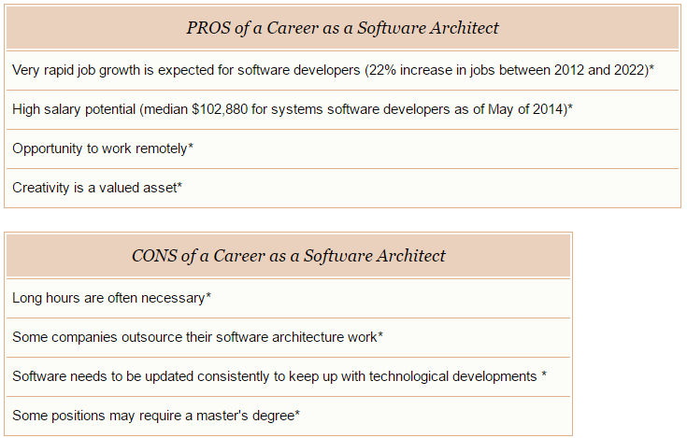
Why study Software Architecture?
Source: *U.S. Bureau of Labor Statistics

Slide 8
Objectives
After completing this course, you should be able to:
Identify the most relevant functional and non-functional requirements of a software system and to document them
Generate architectural alternatives for a problem and select among them
Design and motivate software architectures for (large scale) software systems
Recognize and apply major software architectural styles, design patterns, and frameworks
Describe a software architecture using various documentation approaches and architectural description languages

Slide 9
Software Design Techniques
What are Software Design Techniques?
SD Techniques provide a set of practices for analysing, decomposing, and modularising software system architectures
characterized by structuring the system architecture on the basis of its components rather than the actions it performs.

Slide 10
Learning SD Techniques
Rules Junior Developer
algorithms, data structures and programming languages
write programs, although not always good ones
Principles Senior Developer
software design & programming paradigms with pros and cons
importance of cohesion, coupling, information hiding, dependency management etc.
Patterns of solutions Technical Architect
design models
understand how design solutions interact and can be integrated

Slide 11
Where do you stand?
You know the Rules
1-2 OO programming languages (Java, C++, C#)
some experience in writing programs (< 10 KLOC)
You heard about Principles
"Open-Closed"; "Liskov Substitution Principle" etc.
Maybe (in)voluntary applied some of them
You aim to become "design masters“
writing good software is not some "magic"
not exclusively tailored for geniuses, gurus

Slide 12
What do you need?
Knowledge
is obtained by reading books or attending lectures – terminology, concepts, principles, methods, and theories
Understanding
is obtained from using your knowledge by applying it in hands-on activities, e.g., practical exercises, assignments, projects, discussions
Skills
are obtained by actively and continuously gathering knowledge and understanding of the subject matter – working hard is one secret of becoming skillful

Slide 13
Today’s outline
Basic OOP Overview
SOLID Class Design Principles
General Responsibility ASsignment Principles (GRASP)
Package Design
Cohesion Principles
Coupling Principles

Slide 14
References
Robert Martin http://butunclebob.com/ArticleS.UncleBob.PrinciplesOfOod
SOLID ebook
GRASP
Craig Larman, Applying UML and Patterns: An Introduction to Object-Oriented Analysis and Design and Iterative Development, 3rd Ed, Addison Wesley, 2004 – Chapters 17, 18.
Courses
B. Meyer (ETH Zurich)
R. Marinescu (Univ. Timisoara)
https://martinfowler.com/articles/injection.html

Slide 15
What is a class?
A type that encapsulates
State (Attributes)
Constructors
Behavior (Methods)
Class candidates:
Person
Mihaela
AddAccount

Slide 16
How to declare a class (java)
class ClassName [extends ParentName implements InterfaceName(s)]
{
[modifier(s)] type attribute1;
…
[modifier(s)] return_type method1(param_list)
{//method body here}
}
Access modifiers: public, protected, private
“Mutability” modifier: final
“Scope” modifier: static

Slide 17
The Person class
class Person {
private int birthYear;
private String firstName, lastName;
private boolean employed;
private int nrOfLegs;
//constructor(s)
//setters & getters
}
What should we make static?
What should we make final?

Slide 18
The Person class
//code here
class Person {
private final int birthYear;
private String firstName, lastName;
private boolean employed;
private static int nrOfLegs;
//constructor(s)
//setters & getters
..
}
static
final

Slide 19
Overloading methods
Define in a class methods with the same name and different:
Number of parameters
Type of parameters
Return type
class Person {
public int calculateAge() {
return Date.currentYear() – birthYear;}
public int calculateAge (int year ) {
return year – birthYear;}
public float calculateAge() {
return Date.currentYear() – birthYear;}
}

Slide 20
What is an object?
A specific entity of the type defined by the class.
Has specific values for the attributes
me is an object of type Person.
Person me = new Person();
me.firstName = “Mihaela”
me.lastName = “Dinsoreanu”
me.employed = true
me.numberOfLegs = ??

Slide 21
How to use objects?
Call public methods to query the object (getters)
String name = me.getfirstName() + “ “ + me.getlastName();
int birthY = me.getbirthYear();
int age = me.calculateAge();
…

Slide 22
How to use objects? (2)
Call public methods to set attribute values (setters)
me.setfirstName(fN);
me.setlastName(lN);
me.setbirthYear(bY);
me.setAge(int age);
…
How are parameters passed?
By value !
Primitive type?
Reference?

Slide 23
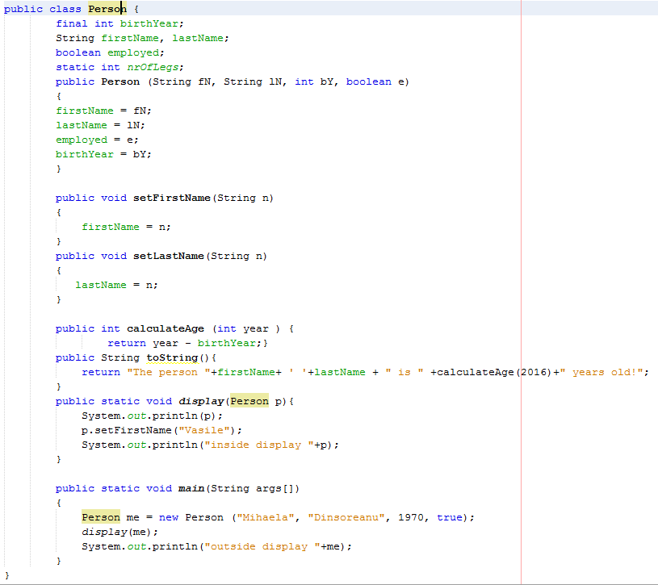
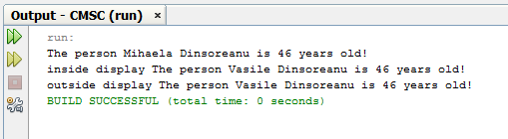

Slide 24
What is inheritance?
The way to reuse CLASSES to create more specific classes
Represents the IS-A relationship
The attributes and methods of the superclass are inherited in the subclass
FINAL classes cannot be subclassed!
Examples:
Student IS-A Person
Dog IS-A Animal
Truck IS-A Vehicle
Square IS-A Rectangle

Slide 25
Overriding methods
Change the inherited code of the method
The method signature DOESN’T change!
Can all methods be overridden?
FINAL methods cannot!
class Student extends Person {
…
public String toString() {
return “This is student ”+ firstName + “ “ +lastName;}
}

Slide 26
What is Composition?
The way to reuse OBJECTS in order to create more complex objects.
Represents HAS-A relationship
Examples:
House HAS-A Door
Vehicle HAS-A Engine
Person HAS-A Heart

Slide 27
class Person {
private Heart heart;
private String firstName, lastName;
…
Person (Heart h, String fN, …)
}
class Heart {
private double pulse;
private double weight;
..
}

Slide 28
Inheriting a superclass
What is inherited?
Attributes
Methods
Constructors
What can you do in a subclass?
use the inherited fields and methods directly
declare a field in the subclass with the same name as the one in the superclass, thus hiding it (not recommended).
declare new fields in the subclass that are not in the superclass.
write a new instance method in the subclass that has the same signature as the one in the superclass, thus overriding it. (NOT FINAL!!!)

Slide 29
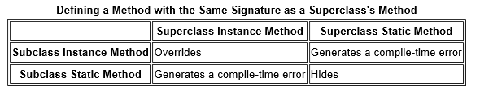
[2]
write a new static method in the subclass that has the same signature as the one in the superclass, thus hiding it.
declare new methods in the subclass that are not in the superclass.
write a subclass constructor that invokes the constructor of the superclass, either implicitly or by using the keyword super.

Slide 30
class Base {
private int i;
public int getI() {return i;}
public void setI(int j) {i = j;}
}
public class Test extends Base {
public static void main(String args[]) {
Test t = new Test();
t.setI(5);
System.out.println(i);
System.out.println(t.getI());
} }

Slide 31
Polymorphism
The possibility to consider an instance as having different types. NOT ANY TYPE!!!!
String display(Person p) {
System.out.println(p);
}
Person me, you;
me = new Person();
you = new Student();
display(me); => “me@32342323”
display(you); => “This is student …..”

Slide 32
Martin’s signs of poor design
Rigidity
code difficult to change
Fragility
code breaks in unexpected places
even small changes can cause cascading breaks
Immobility
code is so tangled that it's impossible to reuse anything
Viscosity
design viscosity:
much easier to hack than to preserve original design
“easy to do the wrong thing, but hard to do the right thing” (R.Martin)
environment viscosity
Long compile times
Long versioning control times…

Slide 33
Causes of Poor Design
Changing Requirements
is inevitable
both better designs and poor designs have to face the changes;
good designs are stable
Dependency Management
the issue of coupling and cohesion
It can be controlled!
create dependency firewalls

Slide 34
Class Design Principles
Single Responsibility
Open-Closed
Liskov Substitution
Interface Segregation
Dependency Inversion

Slide 35
SOLID

Slide 36
Single Responsibility
THERE SHOULD NEVER BE MORE THAN ONE REASON FOR A CLASS TO CHANGE

Slide 37
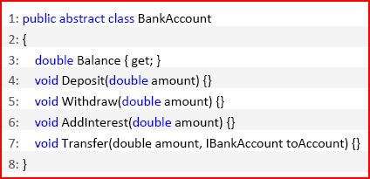
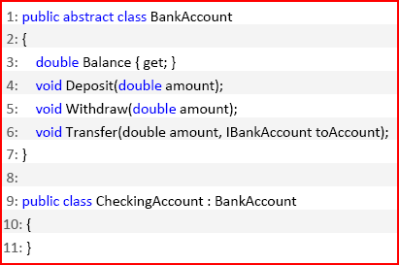
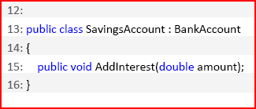
Example

Slide 38
Anti-example: Active Record
/* Active Record */
public class Student {
private final UUID guid;
private int studentID;
private String name;
private char grade;
public Student() {
this.guid = UUID.randomUUId();
}
public Student(UUID guid) {
this.guid = guid;
}
//Getters and Setters
public int getStudentId() {
return studentID;
}
public void setStudentId(int studentID) {
this.studentID = studentID;
}
//Domain Logic Methods
public boolean passes() {
return grade!='F';
}
public boolean onProbation() { return grade<'D';} }
//SQL Operation Methods
public synchronized static Student findByGuId(UUID uniqueID) throws ActiveRecordException {
try {
Connection db = /* You need an object which is responsible for opening and closing connections */
String statement = "SELECT ‘guid’, ‘grade’, ‘studentID’, ‘name’ FROM ‘students’ where ‘guid’=?";
PreparedStatement dbStatement = db.prepareStatement(statement);
dbStatement.setString(1, uniqueID.toString());
ResultSet rs = dbStatement.executeQuery();
while(rs.next()) {
UUID guid = UUID.fromString(rs.getString("guid"));
String name = rs.getString("name");
char grade = rs.getString("grade").charAt(0);
int studentID = rs.getInt("studentID");
Student student = new Student(guid);
student.name = name;
student.grade = grade;
student.studentID = studentID; return student;
}
return null;
} catch (SQLException e) {

Slide 39
Refactor

Slide 40
Swiss army knives vs. regular cutlery

Slide 41
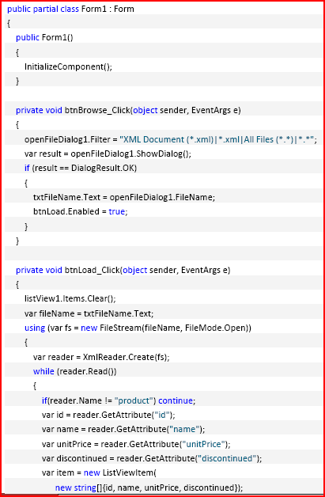
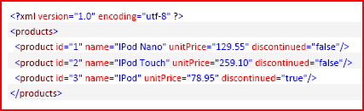
What’s wrong with this?

Slide 42
Responsibilities
Storing the model => Product class
Loading data from the data source => Loader
Mapping a single XML node to a product =>Mapper
Return a list of instances of type Product => ProductRepository
Displaying data, delegating requests triggered by the user to a controller or presenter => MVC/MVP

Slide 43
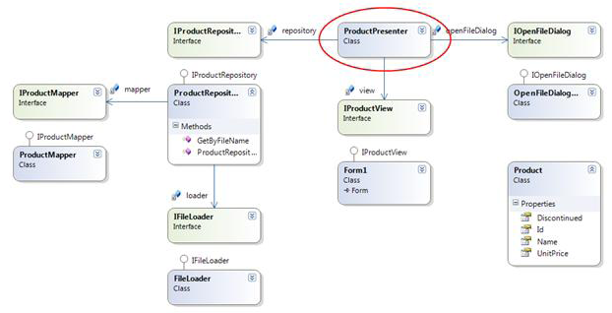
Refactored design

Slide 44
Open-Closed Principle (OCP)
Modules should be written so they can be extended without requiring them to be modified (open for extension but closed for modification).

Slide 45
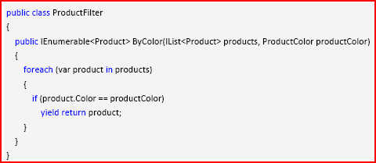
Example
User: “We need to also be able to filter by size.” Developer: “Just size alone or color and size? “
User: “Umm probably both.”

Slide 47
OCP respected?
CLOSED?
Every time a user asks for new criteria to filter a product, do we have to modify the ProductFilter class?
OPEN?
Every time a user asks for new criteria to filter a product, can we extend the behavior of the ProductFilter class to support the new criteria, without opening up the class file again and modifying it?

Slide 48
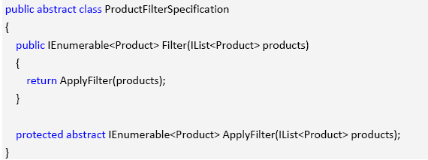
Solution?
Commit to an interface, not an implementation => Strategy pattern

Slide 49
Techniques
Dynamic polymorphism
Static polymorphism
Templates, generics

Slide 50
Strategic closure
Closure not complete but strategic
Use abstraction to gain explicit closure
provide class methods which can be dynamically invoked to determine general policy decisions
design using abstract ancestor classes
Use "Data-Driven" approach to achieve closure
place volatile policy decisions in a separate location
e.g. a configuration file or a separate object
minimizes future change locations

Slide 51
OCP Heuristics (I)
Make all member variables private.
Changes to public data are always at risk to “open” the module
They may have a rippling effect requiring changes at many unexpected locations;
Errors can be difficult to completely find and fix.

Slide 52
OCP Heuristics (II)
RTTI is dangerous.
RTTI is ugly and dangerous
If a module tries to dynamically cast a base class pointer to several derived classes, any time you extend the inheritance hierarchy, you need to change the module
recognize them by type switch or if-else-if structures
Not all these situations violate OCP all the time
when used only as a "filter"

Slide 53
RTTI Example
public class Client
{
public DrawShapes(Collection shapes)
{
Iterator i = shapes.iterator();
while(i.hasNext())
{
try
{
Circle c = (Circle)i.next();
c.DrawCircle();
}
catch(...)
try
{
Square s = (Square)i.next();
s.DrawSquare();
}
catch(...)
}
}
}
//RTTI breaks OCP
public abstract class Shape
{ };
public class Square extends Shape
{
private Point topLeftCorner;
private double side;
public DrawSquare() {//code here}
}
public class Circle extends Shape
{
private Point center;
private double radius;
public DrawCircle() {//code here}
}

Slide 54
RTTI continued
public class Circle extends Shape
{
private Point center;
private double radius;
public void Draw() {//code here}
}
public class Client
{
public DrawSquares(Collection shapes) {
Iterator i = shapes.iterator();
while(i.hasNext()) {
try
{
Square c = (Square)i.next();
c.Draw();
}
catch(...)
}
}
}
//RTTI does not break OCP
public abstract class Shape
{
public abstract Draw();
};
public class Square extends Shape
{
private Point topLeftCorner;
private double side;
public void Draw() {//code here}
}

Slide 55
Liskov Substitution Principle (LSP)
Functions that use references to base classes must be able to use objects of derived classes without knowing it.

Slide 56
LSP Violation
class Rectangle
{
private:
double width;
double height;
public:
void setWidth(double w)…
void setHeight(double h)…
}
class Square inherits Rectangle ?

Slide 57
IS-A relationship refers to BEHAVIOR
Override setWidth() and setHeight()
Duplicate code
Problem - Static binding (C++)
void g(Rectangle& r)
{
r.setWidth(4);
r.setHeight(5);
}

Slide 58
Problem continued
Dynamic binding
class Rectangle
{
private:
double width;
double height;
public:
virtual void setWidth(double w)…
virtual void setHeight(double h)…
}
void g(Rectangle& r)
{
r.setWidth(4);
r.setHeight(5);
assert(r.getWidth()*r.getHeight()==20);
}

Slide 59
Design by Contract [Meyer]
Basic notation: (P, Q: assertions, i.e. properties of the state of the computation. A: instructions).
{P} A {Q}
Total correctness: Any execution of A started in a state satisfying P will terminate in a state satisfying Q.
Design by contract
1. Preconditions of the derived class method are no stronger than the base class method.
2. Postconditions of the derived class method are no weaker than the base class method.

Slide 60
LSP Heuristics
It is illegal for a derived class, to override
a base-class method with a NOP method
NOP = a method that does nothing
Solution 1: Inverse Inheritance Relation
if the initial base-class has only additional behavior
Solution 2: Extract Common Base-Class
if both initial and derived classes have different behaviors

Slide 61
Interface Segregation Principle (ISP)
Clients should not be forced to depend upon interfaces that they don’t use.

Slide 62
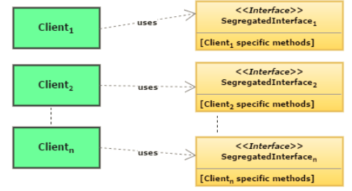
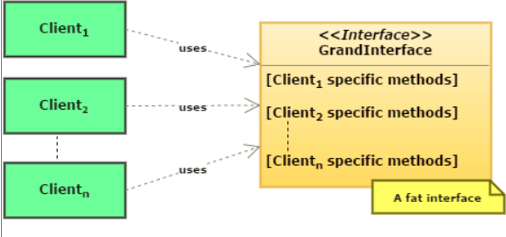
ISP [https://www.javabrahman.com/programming-principles/interface-segregation-principle-explained-examples-java/]

Slide 63
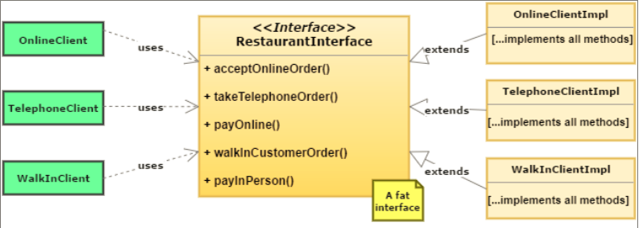
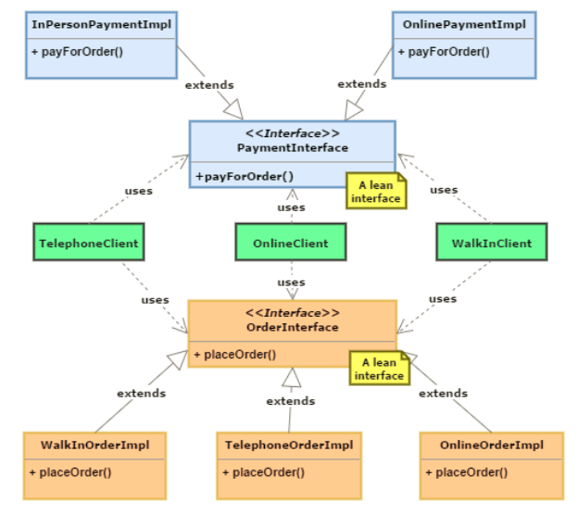
ISP Example

Slide 64
ISP Example
Separation thru Multiple Inheritance vs. separation thru delegation

Slide 65
Dependency Inversion Principle (DIP)
I.High-level modules should not depend on low-level modules.
Both should depend on abstractions.
II.Abstractions should not depend on details. Details should depend on abstractions.
R. Martin

Slide 66
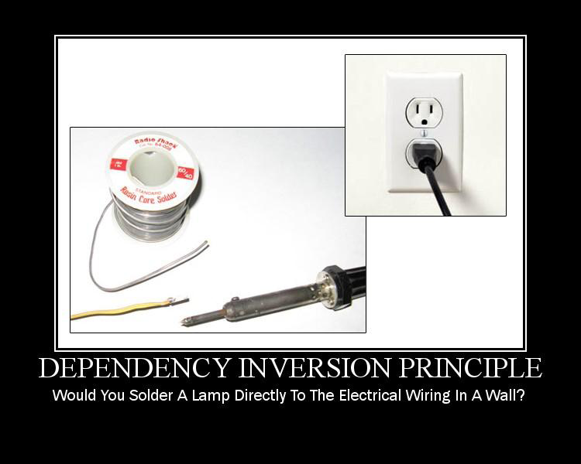
DIP

Slide 67
DIP
A base class in an inheritance hierarchy should not know any of its subclasses
Modules with detailed implementations are not depended upon, but depend themselves upon abstractions
OCP states the goal; DIP states the mechanism;
LSP is the insurance for DIP

Slide 68
DIP Heuristics (I)
Design to an interface, not an implementation!
Abstract classes/interfaces:
tend to change less frequently
abstractions are ‘hinge points’ where it is easier to extend/modify
shouldn’t have to modify classes/interfaces that represent the abstraction (OCP)
Exceptions
Some classes are very unlikely to change;
therefore little benefit to inserting abstraction layer
Example: String class
In cases like this can use concrete class directly

Slide 69
DIP Heuristics (II)
Avoid Transitive Dependencies
Avoid structures in which higher-level layers depend on lower-level abstractions:
In example below, Policy layer is ultimately dependent on Utility layer.
Use inheritance and abstract ancestor classes to effectively eliminate transitive dependencies:

Slide 70
DIP
Policy Layer
depends on
Mechanism
Layer
depends on
Utility Layer
Policy Layer
depends on
Policy Service
Interface
Mechanism
Layer
depends on
Mechan. Service Interface
Utility Layer

Slide 71
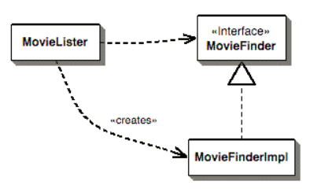
Dependency Injection
public class MovieLister {
private MovieFinder finder;
public MovieLister() {
this.finder = new MovieFinderImpl("movies.txt");}
txt
Another MovieFinderImpl
SQL DB
https://martinfowler.com/articles/injection.html

Slide 72
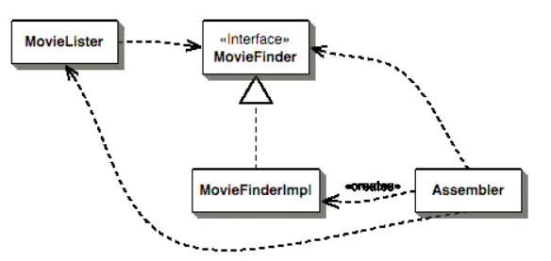
Types of DI
Constructor
public MovieLister(MovieFinder finder) {
this.finder = finder; }
class TextMovieFinder...
public TextMovieFinder(String filename) { this.filename = filename; }
//configuration code in a different class
private MutablePicoContainer configureContainer() {
MutablePicoContainer pico = new DefaultPicoContainer();
Parameter[] finderParams = {new ConstantParameter("movies.txt")};
pico.registerComponentImplementation(MovieFinder.class, TextMovieFinder.class, finderParams);
pico.registerComponentImplementation(MovieLister.class);
return pico;
}
//test the code
MutablePicoContainer pico = configureContainer();
MovieLister lister = (MovieLister) pico.getComponentInstance(MovieLister.class);

Slide 73
Setter DI with Spring
public class MovieLister {
private MovieFinder finder;
public void setFinder(MovieFinder finder) { this.finder = finder; }}
class TextMovieFinder...
…
public void setFilename(String filename) {
this.filename = filename;
}
//configuration
<beans>
<bean id="MovieLister" class="spring.MovieLister">
<property name="finder">
<ref local="MovieFinder"/>
</property>
</bean>
<bean id="MovieFinder" class="spring.TextMovieFinder">
<property name="filename">
<value>movies1.txt</value>
</property>
</bean>
</beans>
//test
public void testWithSpring() throws Exception {
ApplicationContext ctx = new FileSystemXmlApplicationContext("spring.xml");
MovieLister lister = (MovieLister) ctx.getBean("MovieLister");

Slide 74
Wrap-up
Our objective is to develop GOOD software design
EACH PROBLEM HAS SEVERAL SOLUTIONS!
Design
Technology
Code
Basic Design Principles have to be respected!

