Slide 1
Software Design
Lecture 2

Slide 2
Content
General Responsibility ASsignment Principles (GRASP)
Package Design
Cohesion Principles
Coupling Principles

Slide 3
References
Robert Martin http://butunclebob.com/ArticleS.UncleBob.PrinciplesOfOod
Taylor, R., Medvidovic, N., Dashofy, E., Software Architecture: Foundations, Theory, and Practice, 2010, Wiley
Craig Larman, Applying UML and Patterns: An Introduction to Object-Oriented Analysis and Design and Iterative Development, 3rd Ed, Addison Wesley, 2004 – Chapters 17, 18.
Courses
B. Meyer (ETH Zurich)
R. Marinescu (Univ. Timisoara)

Slide 4
Last time
OOP concepts +
Single Responsibility
Open-Closed
Liskov Substitution
Interface Segregation
Dependency Inversion

Slide 5
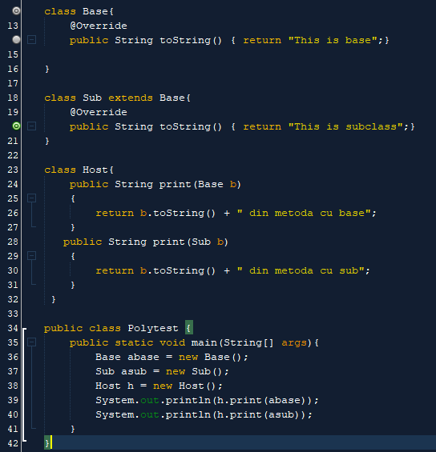

Challenge
Overloading
Compiler error?
Output?

Slide 6
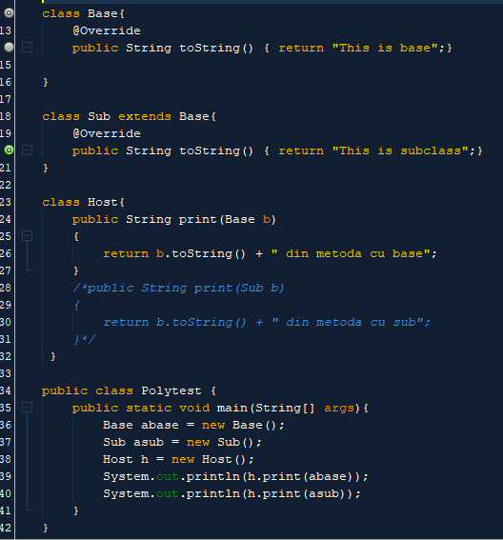

Delete one method
Error?
Output?

Slide 7
GRASP
General Responsibility Assignment Software Patterns
OO system = objects sending messages to other objects to complete operations.
Issues:
Responsibilities assigned to objects
Interaction ways between objects
To arrive at a good object-oriented design we use principles applied during the creation of interaction diagrams and/or responsibility assignment: e.g. GRASP patterns.

Slide 8
Responsibilities
Knowing responsibilities:
knowing about private encapsulated data;
knowing about related objects;
knowing about things it can derive or calculate;
Doing responsibilities:
doing something itself;
initiating action in other objects;
controlling and coordinating activities in other objects;
A responsibility is not the same as a method, but methods are implemented to fulfil responsibilities.

Slide 9
GRASP: General Principles in Assigning Responsibilities
From Craig Larman's 9 patterns:
Expert
Creator
Controller
Low Coupling
High Cohesion
Polymorphism
Pure Fabrication
Indirection
Don't Talk to Strangers (Law of Demeter)

Slide 10
Case Study – POS System
A POS system is a computerized application used (in part) to record sales and handle payments; it is typically used in a retail store.
It includes hardware components such as a computer and bar code scanner, and software to run the system. It interfaces to various service applications, such as a third-party tax calculator and inventory control.
These systems must be relatively fault-tolerant; that is, even if remote services are temporarily unavailable (such as the inventory system), they must still be capable of capturing sales and handling at least cash payments (so that the business is not crippled).

Slide 11
Models
Challenge: How do we get from the NLP requirements to an implementable model?
Domain Model
Sale
Item
Payment
Product
Register
Design Model
?

Slide 12
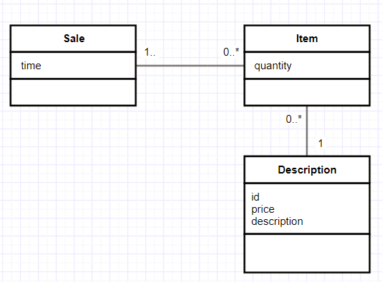
Design Model
How do we calculate the amount of money that should be paid?

Slide 13
Information Expert
Problem: What is the most basic principle by which responsibilities are assigned in object-oriented design?
Solution: Assign a responsibility to the information expert - the class that has the necessary information to fulfill the responsibility
Example: In the POS application, what class has the information needed to calculate the total amount of money?
SALE

Slide 14
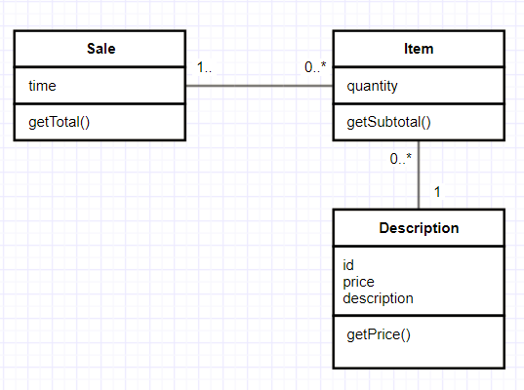
Information Expert – Sale class

Slide 15
Conclusion
Discussion
Expert is used more than any other pattern in the assignment of responsibilities.
Whenever information is spread across different objects, they will need to interact via messages in order to share the work.
Benefits
Information encapsulation is maintained since objects use their own information to fulfill tasks => supports low coupling
Behavior is distributed across the classes that have the required information => more cohesive "lightweight" class definitions

Slide 16
Creator
Problem: Who should be responsible for creating a new instance of some class?
Solution: Assign class B the responsibility to create an instance of class A if one of the following is true:
B contains A objects
B closely uses A objects
B has the initialising data that will be passed to A when it is created.
Example: In the POS application who should be responsible for creating an Item instance?
Which is the class that contains/closely uses/has initialization data of Item instances?
SALE

Slide 17
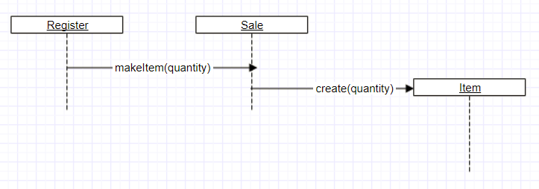
Creator

Slide 18
Conclusion
Discussion:
Creator guides assigning responsibilities related to the creation of objects.
Sometimes a creator is found by looking for the class that has the initialising data that will be used during creation.
For example, who should be responsible to create a Payment instance ?
Benefits:
Low Coupling is supported
Contraindications:
Complex creation procedures
Solution ?

Slide 19
Controller
Problem: Who should be responsible for handling a system event?
A system event is a high level event generated by an external actor.
A Controller is a non-user interface object responsible for handling a system event.
Solution: Assign the responsibility for handling a system event to a class representing one of the following choices:
Represents the overall "system" (facade controller);
Represents a person in the real-world that might be involved in the task (role controller);
Represents an artificial handler of all system events of a use-case (use-case controller)

Slide 20
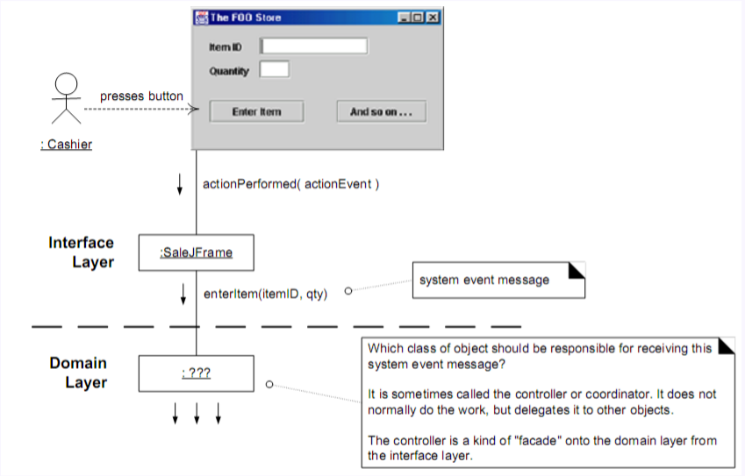
Controller
Example: In the point of sale application the current system operations have been identified as:
endSale()
enterItem()
makePayment()

Slide 21
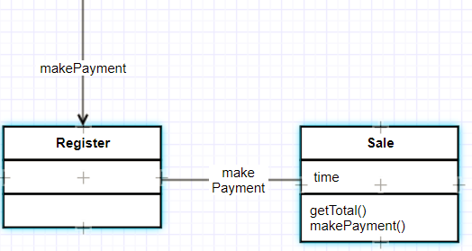
Solution
By the Controller pattern, here are some choices:
Register, POSSystem: represents the overall "system," device, or subsystem
ProcessSaleSession, ProcessSaleHandler: represents a receiver or handler of all system events of a use case scenario

Slide 22
Discussion
Normally, a controller should delegate to other objects the work that needs to be done; it coordinates or controls the activity. It does not do much work itself.
Facade controllers are suitable when there are not "too many" system events
A use case controller is an alternative to consider when placing the responsibilities in a facade controller leads to designs with low cohesion or high coupling
Controller class is called bloated, if
The class is overloaded with too many responsibilities.
Solution – Add more controllers
Controller class also performing many tasks instead of delegating to other class.
Solution – controller class has to delegate things to others.

Slide 23
Conclusions
Benefits:
Increased potential for reusable components:
it ensures that business or domain processes are handled by the layer of domain objects rather than by the interface layer.
the application is not bound to a particular interface.
Reason about the state of the use case:
As all the system events belonging to a particular use case are assigned to a single class, it is easier to control the sequence of events that may be imposed by a use case (e.g. MakePayment cannot occur until EndSale has occurred).

Slide 24
Low Coupling
How strongly are the objects connected to each other?
Coupling – object depending on other object.
When depended upon element changes, it affects the dependant also.
Prefer low coupling – assign responsibilities so that coupling remains low.
Minimizes the dependency hence making the system maintainable, efficient and code reusable

Slide 25
Coupling
TypeX depends on TypeY if
TypeX has an attribute that refers to a TypeY instance, or TypeY itself.
TypeX has a method which references an instance of TypeY, or TypeY itself, by any means. (Typically include a parameter or local variable of type TypeY, or the returned object is an instance of TypeY.)
TypeX is a direct or indirect subclass of TypeY.
TypeY is an interface, and TypeX implements that interface.

Slide 26
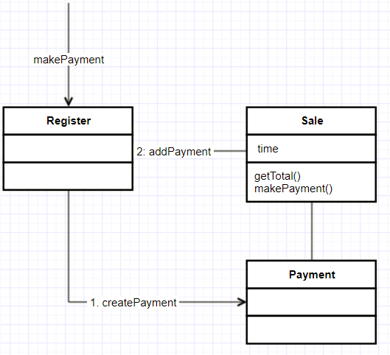
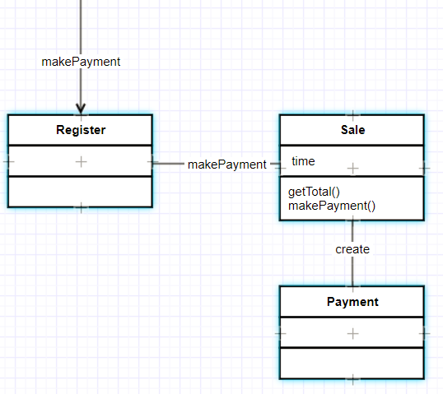
Which is better coupled?

Slide 27
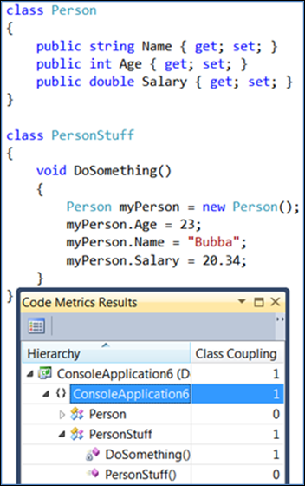
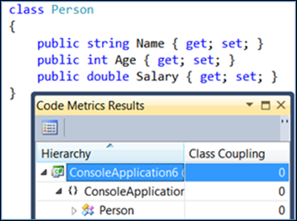
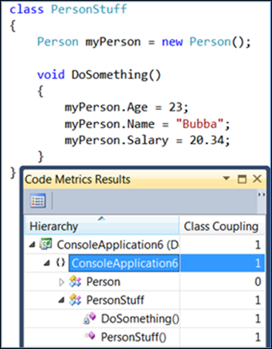
Measuring coupling
[https://blogs.msdn.microsoft.com/zainnab/2011/05/25/code-metrics-class-coupling/]

Slide 28
High Cohesion
How are the operations of any element functionally related?
Related responsibilities into one manageable unit.
Prefer high cohesion
Clearly defines the purpose of the element
Benefits
Easily understandable and maintainable.
Code reuse
Low coupling

Slide 29
Cohesive?

Slide 30
Lack of cohesion (LCOM)
LCOM measures the dissimilarity of methods in a class by instance variable or attributes.
Functional cohesion - the design unit (module) performs a single well-defined function or achieves a single goal.
Sequential cohesion - the design unit performs more than one function, but these functions occur in an order prescribed by the specification, i.e., they are strongly related.
Communication cohesion - a design unit performs multiple functions, but all are targeted on the same data.

Slide 31
LCOM cont’d
Procedural cohesion - a design unit performs multiple functions that are procedurally related. The code in each module represents a single piece of functionality defining a control sequence of activities.
Temporal cohesion - a design unit performs more than one function, and they are related only by the fact that they must occur within the same time span (ex. a design that combines all data initialization into one unit and performs all initialization at the same time even though it may be defined and utilized in other design units).
Logical cohesion - a design unit that performs a series of similar functions (ex. the Java class java.lang.Math)

Slide 32
LCOM4
LCOM4 measures the number of "connected components" in a class.
A connected component is a set of related methods (and class-level variables).
Methods a and b are related if:
they both access the same class-level variable, or
a calls b, or b calls a.
There should be only one connected component in each class.
If there are 2 or more components, the class should be split into so many smaller classes.

Slide 33
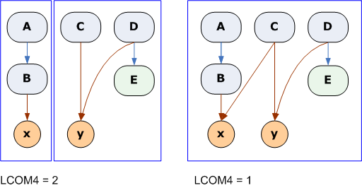
LCOM4

Slide 34
Law of Demeter
Weak Form
Inside of a method M of a class C, data can be accessed in and
messages can be sent to only the following objects:
this and super
data members of class C
parameters of the method M
object created within M
by calling directly a constructor
by calling a method that creates the object
global variables
Strong Form:
In addition to the Weak Form, you are not allowed to access directly inherited members

Slide 35
LoD Example
class Demeter {
private A a;
public void example(B b)
{
C c;
c = func();
b.invert();
a = new A();
a.setActive();
c.print();
}
}
passed parameters
created objects
directly held component objects

Slide 36
LoD Counter Example
class Course
{
Instructor boring = new Instructor();
int pay = 5;
public Instructor getInstructor() { return boring; }
public Instructor getNewInstructor() {return new Instructor(); }
public int getPay() {return pay; }
}
class C {
Course test = new Course();
public void badM() { test.getInstructor().fired(); }
public void goodM() { test.getNewInstructor().hired(); }
public int goodOrBadM?() { return test.getpay() + 10;}
}

Slide 37
LoD good example
class Course {
Instructor boring = new Instructor();
int pay = 5;
public Instructor fireInstructor(){ boring.fired(); }
public Instructor getNewInstructor() { return new Instructor();}
public int getPay() { return pay ; }
}
class C {
Course test = new Course();
public void reformedBadM() {test.fireInstructor();}
public void goodM() {test.getNewInstructor().hired();}
public int goodOrBadM() { return test.getpay() + 10;}
}

Slide 38
LoD for children
You can play with yourself.
You can play with your own toys
You can play with toys that were given to you.
You can play with toys you've made yourself.

Slide 39
LoD Benefits
Coupling Control
reduces data coupling
Information hiding
prevents from retrieving subparts of an object
Information restriction
restricts the use of methods that provide information
Few Interfaces
restricts the classes that can be used in a method
Explicit Interfaces
states explicitly which classes can be used in a method

Slide 40
Acceptable LoD Violations
If optimization requires violation
Speed or memory restrictions
If module accessed is a fully stabilized “Black Box”
No changes to interface can reasonably be expected due to extensive testing, usage, etc.
Otherwise, do not violate this law!!
Long-term costs will be very prohibitive

Slide 41
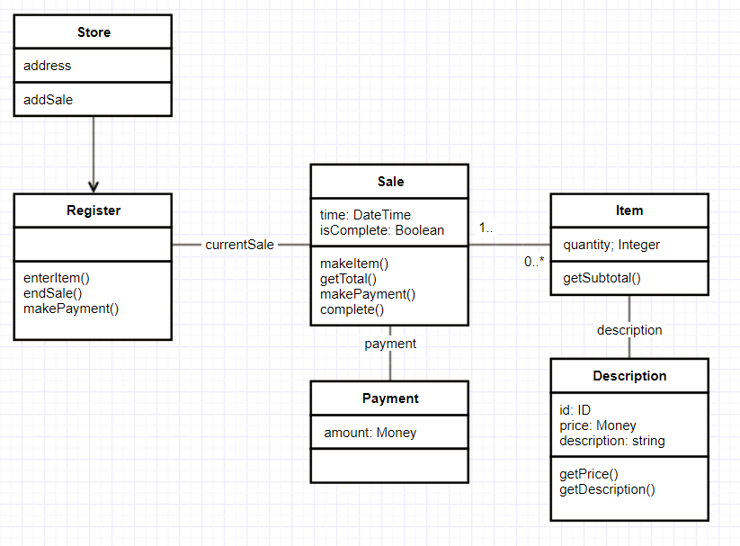
Final Design

Slide 42
High-level Design
Dealing with large-scale systems
team of developers, rather than an individual
Classes are a valuable but not sufficient mechanism
too fine-grained for organizing a large scale design
need mechanism that impose a higher level of order
Packages
a logical grouping of declarations that can be imported in other programs
containers for a group of classes (UML)
reason at a higher-level of abstraction

Slide 43
Issues of High-Level Design
Goal
partition the classes in an application according to some criteria and then allocate those partitions to packages
Issues
What are the best partitioning criteria?
What principles govern the design of packages?
creation and dependencies between packages
Design packages first? Or classes first?
i.e. top-down vs. bottom-up approach
Approach
Define principles that govern package design
the creation and interrelationship and use of packages

Slide 44
Principles of OO High-Level Design
Cohesion Principles
Reuse/Release Equivalency Principle (REP)
Common Reuse Principle (CRP)
Common Closure Principle (CCP)
Coupling Principles
Acyclic Dependencies Principle (ADP)
Stable Dependencies Principle (SDP)
Stable Abstractions Principle (SAP)

Slide 45
What is really Reusability ?
Does copy-paste mean reusability?
Disadvantage: You own that copy!
you must change it, fix bugs.
eventually the code diverges
Maintenance is a nightmare
Martin’s Definition:
I reuse code if, and only if, I never need to look at the source-code
treat reused code like a product ⇒ don’t have to maintain it
Clients (re-users) may decide on an appropriate time to use a newer version of a component release

Slide 46
Reuse/Release Equivalency Principle (REP)
The granule of reuse is the granule of release. Only components that are released through a tracking system can be efficiently reused. [R. Martin]
Either all the classes in a package are reusable or none of it is! [R. Martin]

Slide 47
What does this mean?
Reused code = product
Released, named and maintained by the producer.
Programmer = client
Doesn’t have to maintain reused code
Doesn’t have to name reused code
May choose to use an older release

Slide 48
The Common Reuse Principle
All classes in a package [library] should be reused together. If you reuse one of the classes in the package, you reuse them all. [R.Martin]
If I depend on a package, I want to depend on every class in that package! [R.Martin]

Slide 49
What does this mean?
Criteria for grouping classes in a package:
Classes that tend to be reused together.
Packages have physical representations (shared libraries, DLLs, assembly)
Changing just one class in the package -> re-release the package -> revalidate the application that uses the package.

Slide 50
Common Closure Principle (CCP)
The classes in a package should be closed against the same kinds of changes.
A change that affects a package affects all the classes in that package
[R. Martin]

Slide 51
What does this mean?
Another criteria of grouping classes:
Maintainability!
Classes that tend to change together for the same reasons
Classes highly dependent
Related to OCP
How?

Slide 52
Reuse vs. Maintenance
REP and CRP makes life easier for reuser
packages very small
CCP makes life easier for maintainer
large packages
Packages are not fixed in stone
early in project focus on CCP
later when architecture stabilizes: focus on REP and CRP

Slide 53
Acyclic Dependencies Principles (ADP)
The dependency structure for released component must be a Directed Acyclic Graph (DAG).There can be no cycles. [R. Martin]

Slide 54
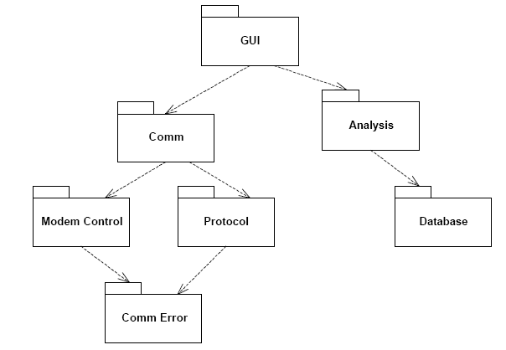
Dependency Graphs

Slide 55
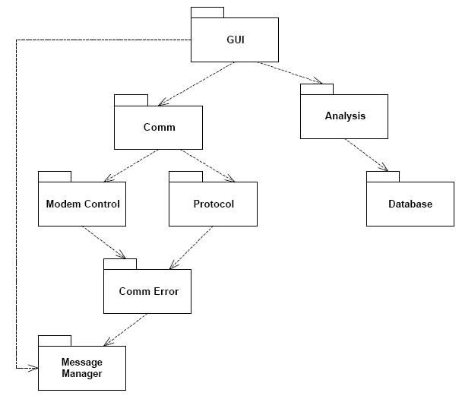
Breaking the Cycle
Add a new package
Message Manager

Slide 56
Breaking the Cycle
DIP + ISP

Slide 57
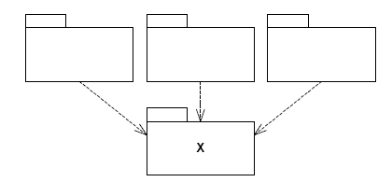
Stability
Stability is related to the amount of work in order to make a change.
Stability defined by:
Responsibility and
Independence
responsible and independent
irresponsible and dependent

Slide 58
Stability metrics
Ca – Afferent coupling (incoming dependencies)
How responsible am I?
Ce – Efferent coupling (outgoing dependencies)
How dependant am I?
Instability I
I = Ce/(Ca+Ce)
Example for X:
Ca = 3, Ce = 0 => I = 0 (very stable)

Slide 59
Stable Dependency Principle (SDP)
Depend in the direction of stability.
What does this mean?
Depend upon packages whose I is lower than yours.
Counter-example

Slide 60
Where to Put High-Level Design?
High-level architecture and design decisions don't change often
shouldn't be volatile ⇒ place them in stable packages
design becomes hard to change ⇒ inflexible design
How can a totally stable package (I = 0) be flexible enough to withstand change?
improve it without modifying it...
Answer: The Open-Closed Principle
classes that can be extended without modifying them ⇒ Abstract Classes

Slide 61
Stable Abstractions Principle (SAP)
Stable packages should be abstract packages.
What does this mean?
Stable packages should be on the bottom of the design (depended upon)
Flexible packages should be on top of the design (dependent)
OCP => Stable packages should be highly abstract

Slide 62
Abstractness metrics
Nc = number of classes in the package
Na = number of abstract classes in the package
A = Na/Nc (Abstractness)
Example:
Na = 0 => A = 0
What about hybrid classes?

Slide 63
The Main Sequence
I should increase as A decreases

Slide 64
The Main Sequence
Zone of Pain
highly stable and concrete ⇒ rigid
famous examples:
database-schemas (volatile and highly depended-upon)
concrete utility libraries (instable but non-volatile)
Zone of Uselessness
instable and abstract ⇒ useless
no one depends on those classes
Main Sequence
maximizes the distance between the zones we want to avoid
depicts the balance between abstractness and stability.

Slide 65
Wrap-up
Principles for good class design related to
Assigning Responsibilities (GRASP)
Package design
Coupling
Cohesion

