Slide 1
Software Design
Lecture 6

Slide 2
Content (next lectures)
Organizing the Business Logic
Mapping to Relational Databases
Web Presentation
Concurrency

Slide 3
References
Martin Fowler et. al, Patterns of Enterprise Application Architecture, Addison Wesley, 2003 [Fowler]
Univ. of Aarhus Course Materials
Univ. of Utrecht Course Materials

Slide 4
Patterns for Enterprise Applications [Fowler]
Enterprise Applications
Persistent data
Volume of data
Concurrent access
Complicated user interface
Integration with other applications
Conceptual dissonance
Business logic

Slide 5
Enterprise applications
Example: B2C online retailer
High volume of users: scalability
Example: processing of leasing agreements
Complicated business logic
Rich-client interface
Complicated transaction behavior
Example: expense tracking for small company

Slide 6
Principal layers
See pattern Layers in [POSA]
Here: applied to enterprise applications
Presentation logic
Interaction with user
Command-line or rich client or Web interface
Business logic
Validation of input and calculation of results
Data access logic
Communication with databases and other applications

Slide 7
Page Controller
Template View
Presentation
Front Controller
Transform View
Transaction Script
Domain Model
Domain
Active Record
Table Module
Data Mapper
Row Data Gateway
Table Data Gateway
Data Source

Slide 8
More detailed layering
Presentation
Controller/Mediator
Business Logic
Data Mapping
Data Source

Slide 9
But first…
Some basic patterns
Gateway
Record Set

Slide 10
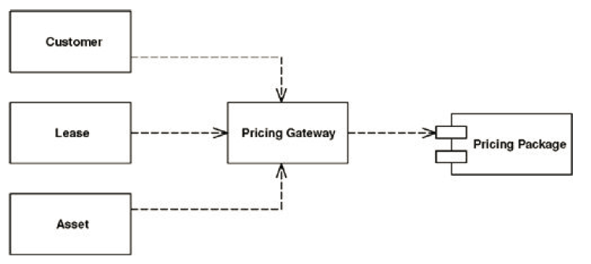
Gateway
An object that encapsulates access to an external system or resource

Slide 11
Gateway – How it works
External resources - each with its own API
Wraps all the API specific code into a Gateway whose interface is defined by the client
Should be simple and minimal. Additional complex logic should be placed in the client
Can be generated.
Examples: Gateways to access Databases
Repository in Spring
DBContext in EF (.NET)

Slide 12
Gateway - Benefits
Easier handling of awkward API’s
Easier to swap out one kind of resource for another
Easier to test by giving you a clear point to deploy Service Stubs (A stand-in implementation of an external service)

Slide 13
Gateway - Example
Build a gateway to an interface that just sends a message using the message service
int send(String messageType, Object[] args);
Confirmation message
messageType = ‘CONFIRM’;
args[0] = id;
args[1] = amount;
args[2] = symbol;

Slide 14
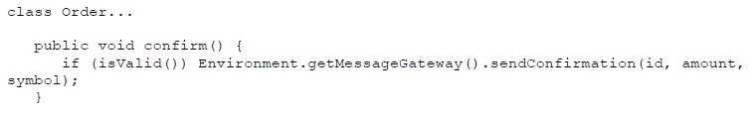
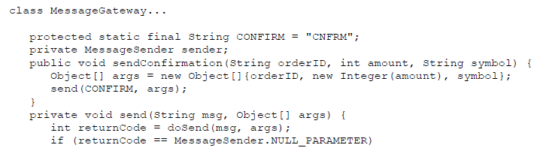
Better…

Slide 15
Gateway vs. Façade vs. Adapter
The façade is usually done by the writer of the service for general use, while a Gateway is written by the client for their particular use.
A façade always implies a different interface to what it's covering, while a Gateway may copy the wrapped interface entirely, being used for substitution or testing purposes
Adapter alters an implementation's interface to match another interface which you need to work with.
With Gateway there usually isn't an existing interface, although you might use an adapter to map an implementation to an existing Gateway interface. In this case the adapter is part of the implementation of the Gateway

Slide 16
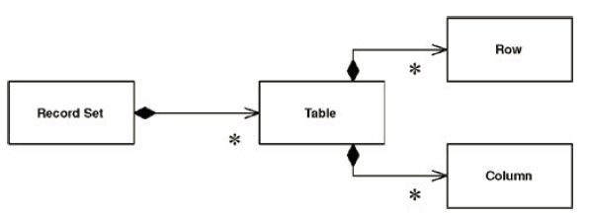
Record Set
An in-memory representation of tabular data

Slide 17
Record Set – how it works
Provides an in memory structure that looks exactly like the result of a SQL query, but can be generated and manipulated by other parts of the system.
Usually provided by the framework/platform
Examples:
DataSet of ADO.NET
RowSet of JDBC
JPA Entity in Spring
A disconnected Record Set is one that is separated from it's link to the data source

Slide 18
Business Logic Layer
“ …It involves calculations based on inputs and stored data, validation of any data that comes in from the presentation, and figuring out exactly what data source logic to dispatch …” [Fowler]

Slide 19
Organizing the Business Logic
Key architectural decisions, which influence structure of other layers.
Pure patterns
Transaction Script
Domain Model
Hybrid patterns
Active Record
Table Module

Slide 20
Domain Logic Patterns
Presentation
Page Controller
Template View
Front Controller
Transform View
Transaction Script
Domain Model
Domain
Table Module
Active Record
Table Data Gateway
Row Data Gateway
Data Mapper
Data Source

Slide 21
Transaction Script
A TS organizes the business logic primarily as a single procedure where each procedure handles a single request from the presentation. [Fowler]
The TS may make calls directly to the DB or through a thin DB wrapper.
Think of a script for a use case or business transaction.
Remember “use-case controller”?

Slide 22
Transaction Script
… is essentially a procedure that takes the
input from the presentation,
processes it with validations and calculations,
stores data in the database,
(invokes any operations from other systems, and)
replies with more data to the presentation perhaps doing more calculation to help organize and format the reply data.
[Fowler]

Slide 23
TS Features
Business logic is organized by procedures
Each procedure handles a single transaction
Transaction: well-defined endpoint
Must be complete on all-or-nothing basis
Makes call directly to the database
May be organized as:
a separate class/TS (Command pattern)
several TS/class

Slide 24
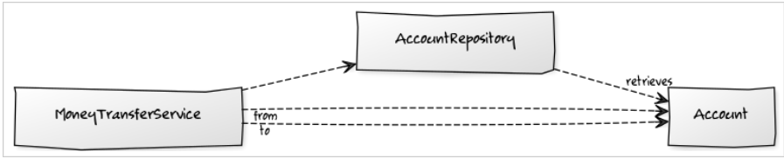
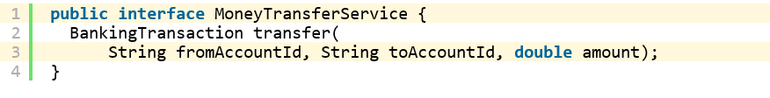
Example (http://lorenzo-dee.blogspot.ro/2014/06/quantifying-domain-model-vs-transaction-script.html)
Banking application
Money transfer functionality

Slide 25
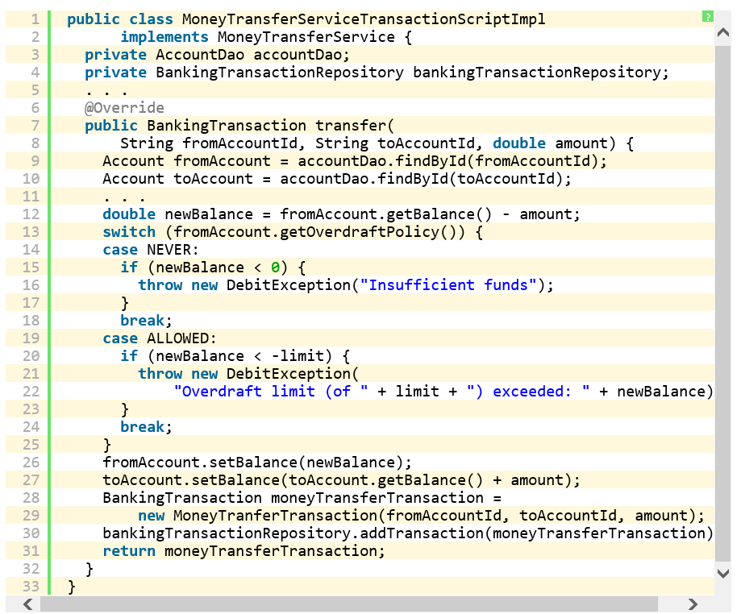
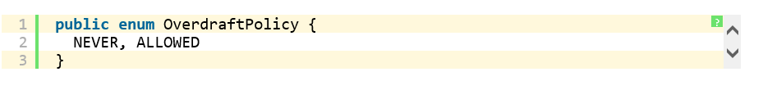
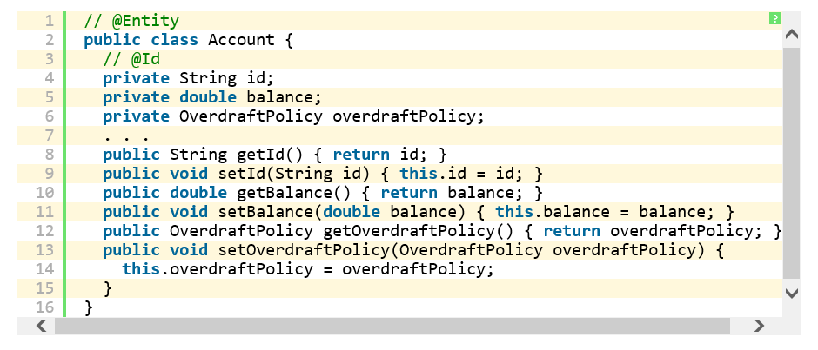

Slide 26
Analysis
Strengths
Simplicity
Weaknesses
complicated transaction logic
duplicated logic

Slide 27
Domain Model (EA Pattern)
An object model of the domain that incorporates both behavior and data. [Fowler]
A DM creates a web of interconnected objects, where each object represents some meaningful individual, whether as large as a corporation or as small as a single line in an order form.

Slide 28
Domain Model (EA Pattern)
Realization (via design classes) of UML Domain Model (conceptual classes).
E.g. person, book, shopping cart, task, sale item, …
Domain Model classes contain logic for handling validations and calculations.
E.g. a shipment object calculates the shipping charge for a delivery.

Slide 29
DM Features
Business logic is organized as an OO model of the domain
Describes both data and behavior
Different from database model
Process, multi-valued attributes, inheritance, design patterns
Harder to map to the database
Risk of bloated domain objects

Slide 30
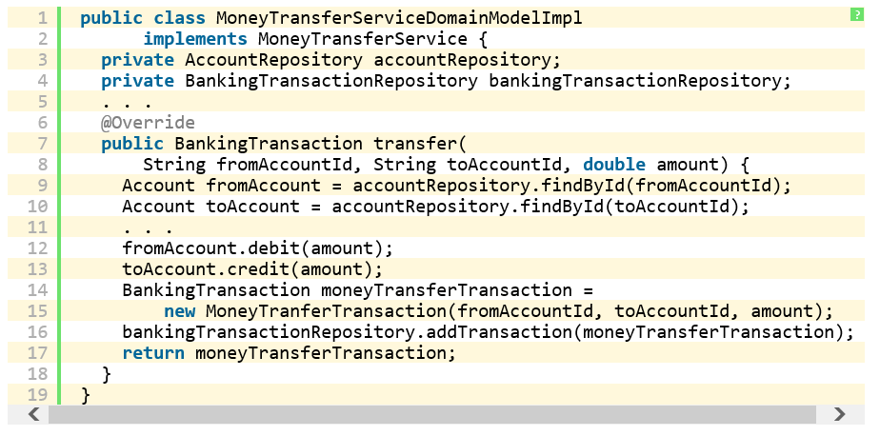
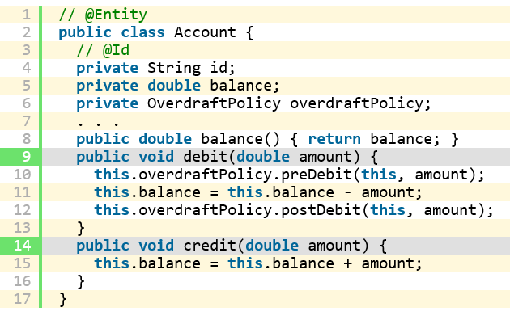

Slide 31
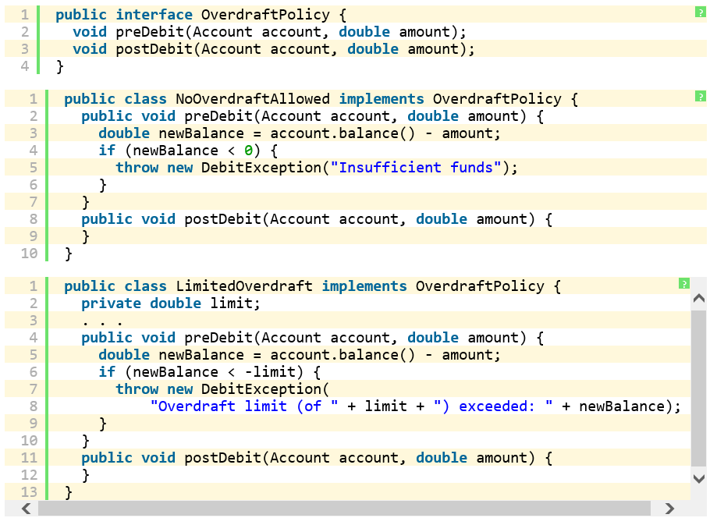

Slide 32
Choosing a Domain Logic Pattern
Which one to choose?
Influenced by the complexity of domain logic.
Application is simple access to data sources
→ Transaction Script, (or Active Record, Table Module)
Significant amount of business logic
→ Domain Model
TS is simpler:
Easier and quicker to develop and maintain.
But can lead to duplication in logic / code.
DM – difficult access to relational DB
Which would be easier to refactor?
TS->DM or DM-> TS

Slide 33
Towards Data Source Patterns
Hybrid patterns.
Active Record
Table Module
Pure patterns.
Row Data Gateway,
Table Data Gateway,
Data Mapper
…

Slide 34
Data Source Patterns
Presentation
Page Controller
Template View
Front Controller
Transform View
Transaction Script
Domain Model
Domain
Table Module
Active Record
Table Data Gateway
Row Data Gateway
Data Mapper
Data Source

Slide 35
Table Module
Provide a single object for all the behavior on a table
Organizes domain logic with one class per table
Table Module has no notion of an identity for the objects that it's working with
Id references are necessary

Slide 36
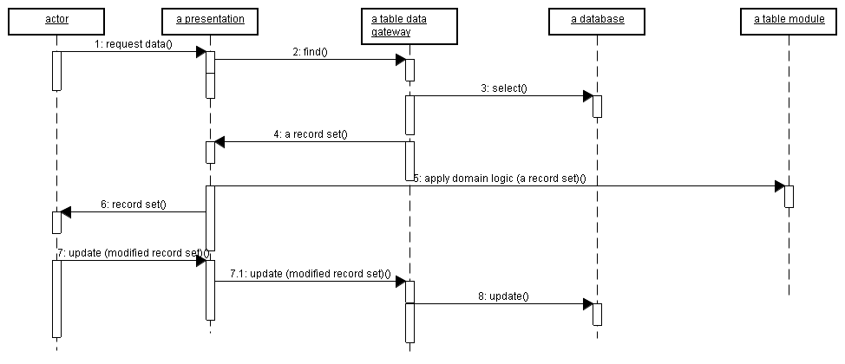
Typical interactions for TM

Slide 37
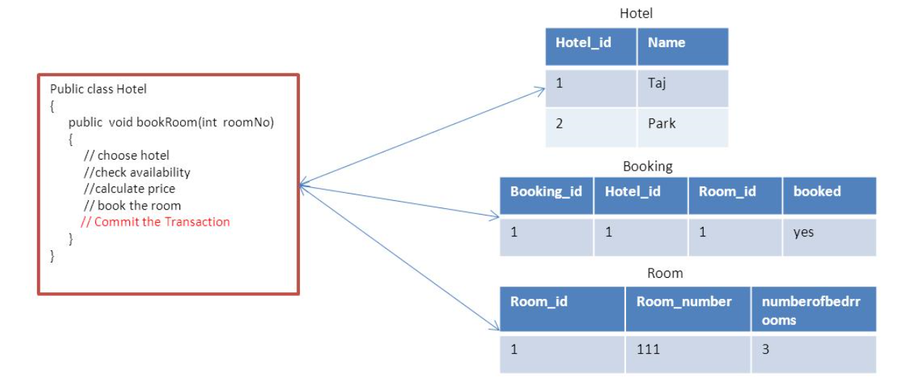
TS vs TM

Slide 38
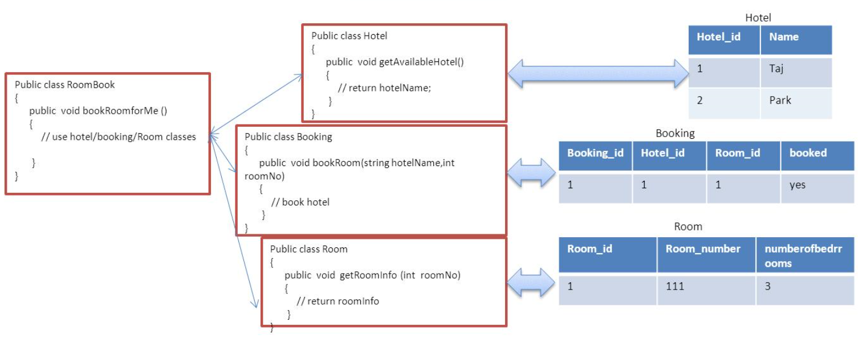
TS vs TM

Slide 39
Example - Revenue Recognition (RR)
Revenue recognition is a common problem in business systems.
when you can actually count the money you receive on your accounting books.
E.g. selling a S/W package $120 today
Book $40 today,
$40 in 30 days,
$40 in 60 days.
[Fowler]

Slide 40
Revenue Recognition concepts
Product type: description of item to be sold
Contract: covers only one product.
Revenue recognition: varies per product type.
For each product instance: a set of revenue recognition instances

Slide 41
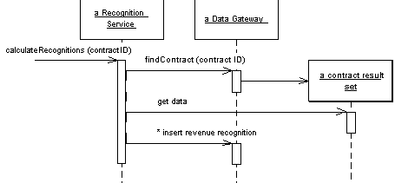
TS: Calculating Revenue Recognitions

Slide 42
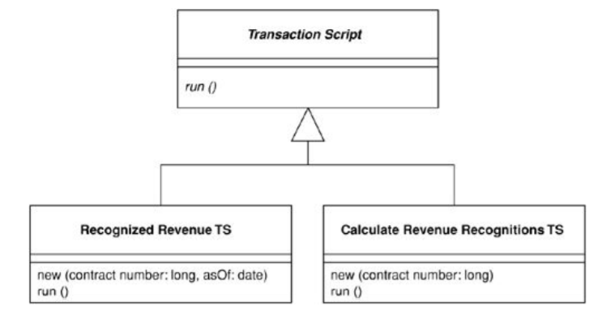
Using Command in TS

Slide 43
Implementation
Database
CREATE TABLE products (ID int primary key, name varchar, type varchar)
CREATE TABLE contracts (ID int primary key, product int, revenue decimal, dateSigned date)
CREATE TABLE revenueRecognitions (contract int, amount decimal, recognizedOn date, PRIMARY KEY (contract, recognizedOn))

Slide 44
Implementation
calculate the amount of recognition due by a particular day:
select the appropriate rows in the revenue recognitions table,
sum up the amounts.

Slide 45
Gateway class
class Gateway...
public ResultSet findRecognitionsFor(long contractID, MfDate asof) throws SQLException
{
PreparedStatement stmt = db.prepareStatement(findRecognitionsStatement);
stmt.setLong(1, contractID);
stmt.setDate(2, asof.toSqlDate());
ResultSet result = stmt.executeQuery();
return result; }
private static final String findRecognitionsStatement = "SELECT amount " + " FROM revenueRecognitions " + " WHERE contract = ? AND recognizedOn <= ?";
private Connection db;

Slide 46
RecognitionService class
class RecognitionService...
public Money recognizedRevenue(long contractNumber, MfDate asOf)
{
Money result = Money.dollars(0);
try {
ResultSet rs = db.findRecognitionsFor(contractNumber, asOf);
while (rs.next())
{
result = result.add(Money.dollars(rs.getBigDecimal("amount")));
}
return result;
}
catch (SQLException e) {
throw new ApplicationException (e); }
}

Slide 47
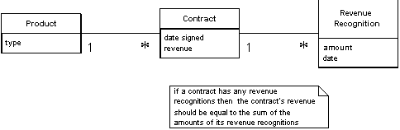
RR Domain Model

Slide 48
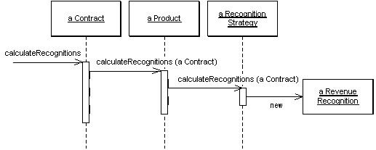
Domain Model: Calculating Revenue Recognitions

Slide 49
Extensibility
What if we have to apply a new RR strategy?
Transaction Script:
New conditional, or
New method.
Domain Model:
Create new RR Strategy class.

Slide 50
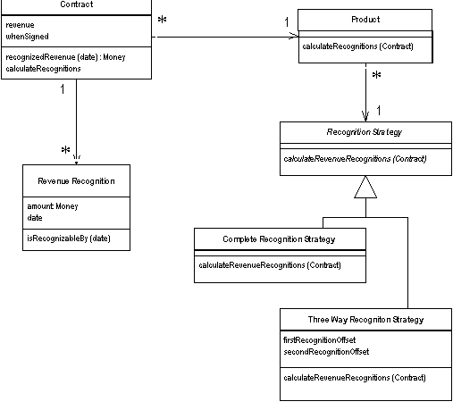
Using Strategy in Domain Model

Slide 51
Implementation
class RevenueRecognition...
private Money amount;
private MfDate date;
public RevenueRecognition(Money amount, MfDate date)
{
this.amount = amount;
this.date = date;
}
public Money getAmount()
{
return amount;
}
boolean isRecognizableBy(MfDate asOf)
{
return asOf.after(date) || asOf.equals(date);
}

Slide 52
Contract class
class Contract...
private List revenueRecognitions = new ArrayList();
public Money recognizedRevenue(MfDate asOf)
{
Money result = Money.dollars(0);
Iterator it = revenueRecognitions.iterator();
while (it.hasNext())
{
RevenueRecognition r = (RevenueRecognition) it.next();
if (r.isRecognizableBy(asOf))
result = result.add(r.getAmount());
}
return result;
}

Slide 53
Introducing strategies…the Contract
class Contract...
private Product product;
private Money revenue;
private MfDate whenSigned;
private Long id;
public Contract(Product product, Money revenue, MfDate whenSigned)
{
this.product = product;
this.revenue = revenue;
this.whenSigned = whenSigned;
}

Slide 54
Introducing strategies …the Product
class Product...
private String name;
private RecognitionStrategy recognitionStrategy;
public Product(String name, RecognitionStrategy recognitionStrategy)
{
this.name = name;
this.recognitionStrategy = recognitionStrategy;
}
public static Product newWordProcessor(String name)
{
return new Product(name, new CompleteRecognitionStrategy());
}
public static Product newSpreadsheet(String name)
{
return new Product(name, new ThreeWayRecognitionStrategy(60, 90));
}
public static Product newDatabase(String name)
{
return new Product(name, new ThreeWayRecognitionStrategy(30, 60)); }

Slide 55
Introducing strategies …the Strategy
class RecognitionStrategy...{
abstract void calculateRevenueRecognitions(Contract contract); }
class CompleteRecognitionStrategy...
void calculateRevenueRecognitions(Contract contract)
{
contract.addRevenueRecognition(new RevenueRecognition(contract.getRevenue(), contract.getWhenSigned()));
}
class ThreeWayRecognitionStrategy...

Slide 56
Introducing strategies
class Contract...
public void calculateRecognitions()
{
product.calculateRevenueRecognitions(this);
}
class Product...
void calculateRevenueRecognitions(Contract contract)
{ recognitionStrategy.calculateRevenueRecognitions(contract);
}

Slide 57
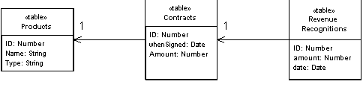
TM in the RR example

Slide 58
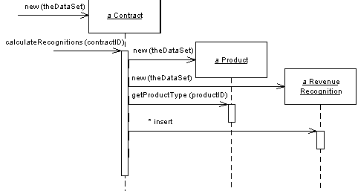
RR problem with TM

Slide 59
Implementation (C#)
class TableModule...
protected DataTable table;
protected TableModule(DataSet ds, String tableName)
{
table = ds.Tables[tableName];
}

Slide 60
ContractModule subclass
class ContractModule...
public ContractModule (DataSet ds) : base (ds, "Contracts") {}
public DataRow this [long key]
{
get
{
String filter = String.Format("ID = {0}", key);
return table.Select(filter)[0];
}
}
contract = new ContractModule(dataset);

Slide 61
RevenueRecognition class
class RevenueRecognition...
public Decimal RecognizedRevenue (long contractID, DateTime asOf)
{
String filter = String.Format("ContractID = {0} AND date <= #{1:d}#", contractID,asOf);
DataRow[] rows = table.Select(filter);
Decimal result = 0;
foreach (DataRow row in rows)
{
result += (Decimal)row["amount"];
}
return result;
}

Slide 62
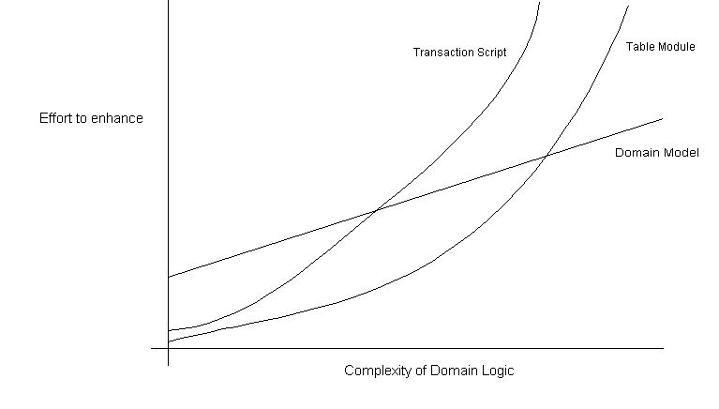
Which one to use?

Slide 63
Active Record
Fowler: An object that wraps a record data structure of an external resource, such as a row in a database table, and adds some domain logic to that object.
An AR object carries both data and behavior.
The essence of an AR is a Domain Model in which the classes match very closely the record structure of the underlying database.
Notes:
No fields.
Find methods return ResultSet

Slide 64

Class operations
construct an instance of the Active Record from a SQL result set row
construct a new instance for later insertion into the table
static finder methods to wrap commonly used SQL queries and return Active Record objects
methods to update the database and insert into the database with the data in the Active Record
getting and setting methods for the fields
methods that implement some pieces of business logic

Slide 65
Implementation
class Person...
private String lastName;
private String firstName;
private int numberOfDependents;
create table people (ID int primary key, lastname varchar, firstname varchar, number_of_dependents int)

Slide 66
Find + Load an object
class Person...
private final static String findStatementString = "SELECT id, lastname, firstname, number_of_dependents" + " FROM people" + " WHERE id = ?";
public static Person find(Long id)
{
Person result = (Person) Registry.getPerson(id);
if (result != null) return result;
PreparedStatement findStatement = null;
ResultSet rs = null;
try
{ findStatement = DB.prepare(findStatementString); findStatement.setLong(1, id.longValue());
rs = findStatement.executeQuery();
rs.next();
result = load(rs);
return result;
} catch (SQLException e) { throw new ApplicationException(e); }
finally { DB.cleanUp(findStatement, rs); }
}

Slide 67
public static Person load(ResultSet rs) throws SQLException
{
Long id = new Long(rs.getLong(1));
Person result = (Person) Registry.getPerson(id);
if (result != null) return result;
String lastNameArg = rs.getString(2);
String firstNameArg = rs.getString(3);
int numDependentsArg = rs.getInt(4);
result = new Person(id, lastNameArg, firstNameArg, numDependentsArg);
Registry.addPerson(result);
return result;
}

Slide 68
Next Time
More about layers structuring

