Slide 1
Software design
Lecture 7

Slide 2
Content
Data Source Patterns
Gateways
Data Mapper
Object-Relational Structural Patterns
Object-Relational Behavioral Patterns
Lazy Load
Identity Map
Object-Relational Metadata Mapping Patterns
Metadata Map
Query Object
Repository

Slide 3
References
Martin Fowler et. al, Patterns of Enterprise Application Architecture, Addison Wesley, 2003 [Fowler]
Microsoft Application Architecture Guide, 2009 [MAAG]
Paulo Sousa, Instituto Superior de Engenharia do Porto, Patterns of Enterprise Applications by example
http://jayurbain.com/msoe/se380/outline.html
Sun: Core J2EE Pattern Catalog
http://www.oracle.com/technetwork/java/dataaccessobject-138824.html

Slide 4
Data Source Patterns
Hybrid Data Source Pattern (discussed)
Active Record
Table Module
Pure Data Source Patterns
Gateways
Row Data Gateway (RDG)
Table Data Gateway (TDG)
Data Mapper
Notes:
* Data Mapper patterns actually should be a part of the Domain Logic layer.

Slide 5
Data Source Patterns (the magic behind frameworks…)
Role of the data source layer is to communicate with the various pieces of infrastructure that an application needs to do its job.
Dominant part of this is the problem of talking to a database.
Typically a RDBMS. SQL a major reason for the popularity of RDBMS.
Can also include NoSQL DB’s, e.g., Dynamo, Mongo; MemCache, search engine interfaces, remote services, XML, etc.
Back-end web services.
Remember the Gateways (provide access to an external resource)

Slide 6
Gateway
Definition
An object that encapsulates access to an external system or resource
Wise to separate SQL (and other forms of data access, query language) from domain logic, and place it in separate classes.
Separation of concerns.
Common technique is to define a class which maps exactly to a table in the database => the gateways and the tables are thus isomorphic
Contains all the database mapping code for an application, that is all the SQL for CRUD operations
Contains no domain logic

Slide 7
Example
Instead of writing SQL statements to interact with your database, use methods and properties of objects.
Ex. instead of something like this:
String sql = "SELECT * FROM persons WHERE id = 10”
Statement statement = connection.createStatement();
ResultSet results = statement.executeQuery(sql);
if(results.next()) name = results.getString(2, “FIRST_NAME”);
Do something like this:
Person p = repository.getPerson(10);
String name = p.firstName;
or similar code (lots of variations here)
Some frameworks also put code in static methods on the classes themselves:
Person p = Person.get(10);

Slide 8
Table Data Gateway
An object that acts as a gateway to a database table. One instance handles all the rows in the table. [Fowler]
Generic data structure of tables and rows that mimics the tabular nature of a DB. Can be used in many parts of application.
Needs a single instance for all rows.
Needs caching strategy, cursors to access database, manage result set.
Common to have GUI tools that work directly with record set
Notes:
No fields.
Find methods return ResultSet

Slide 9
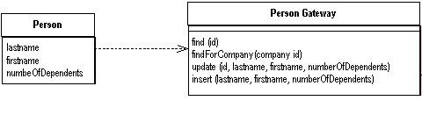
TDG
find(id) : RecordSet
findWithLastName(String) : RecordSet
Iterate through RecordSet
Update, delete, insert, ...
Notes:
No fields.
Find methods return ResultSet

Slide 10
Features
No attributes
CRUD methods
Challenge: how it returns information from a query ?
Data Transfer Object
RecordSet
Goes well with Table Module
Suitable for Transaction Scripts

Slide 11
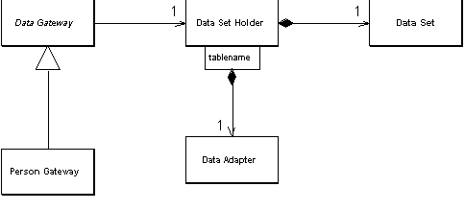
Using ADO.NET DataSets

Slide 12
Implementation
class DataSetHolder...
public DataSet Data = new DataSet();
private Hashtable DataAdapters = new Hashtable();
class DataGateway...
public DataSetHolder holder;
//public DataSet Data

Slide 13
Implementing find behavior
class DataGateway...
public void LoadAll()
{
String commandString = String.Format(„Select * from {0}", TableName);
holder.FillData(commandString, TableName);
}
public void LoadWhere(String whereClause)
{
String commandString =
String.Format(„Select * from {0} where {1}", TableName, whereClause);
holder.FillData(commandString, TableName);
}

Slide 14
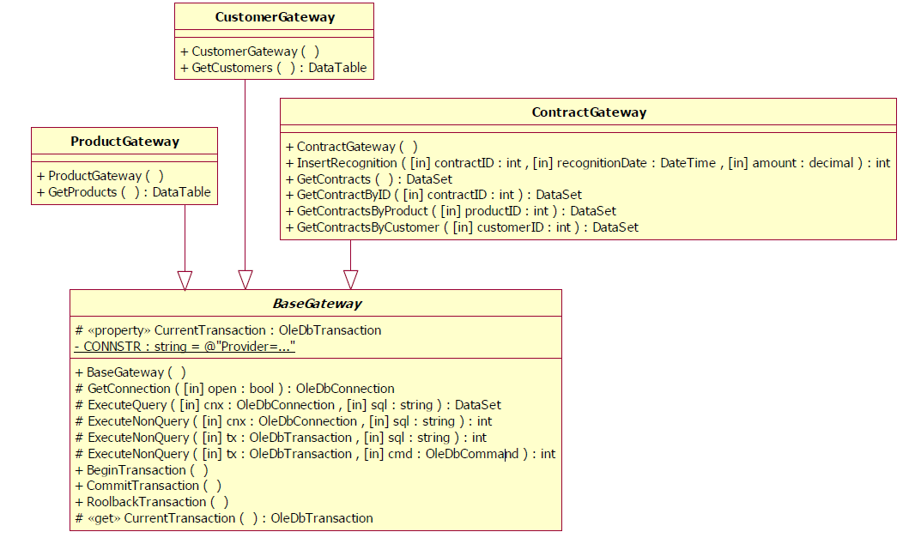
TDG in the Revenue Recognition Pb

Slide 15
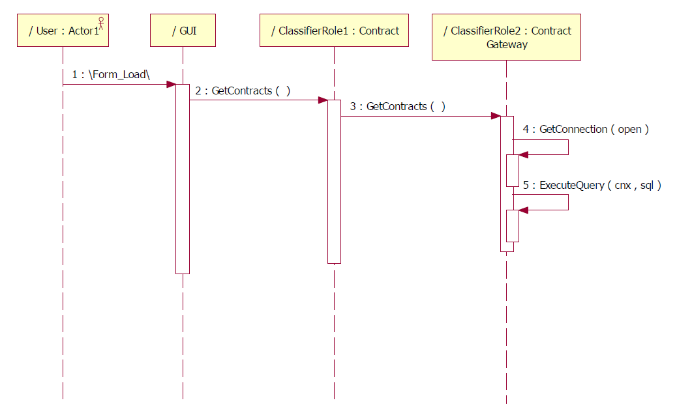
TM+TDG Get contracts

Slide 16
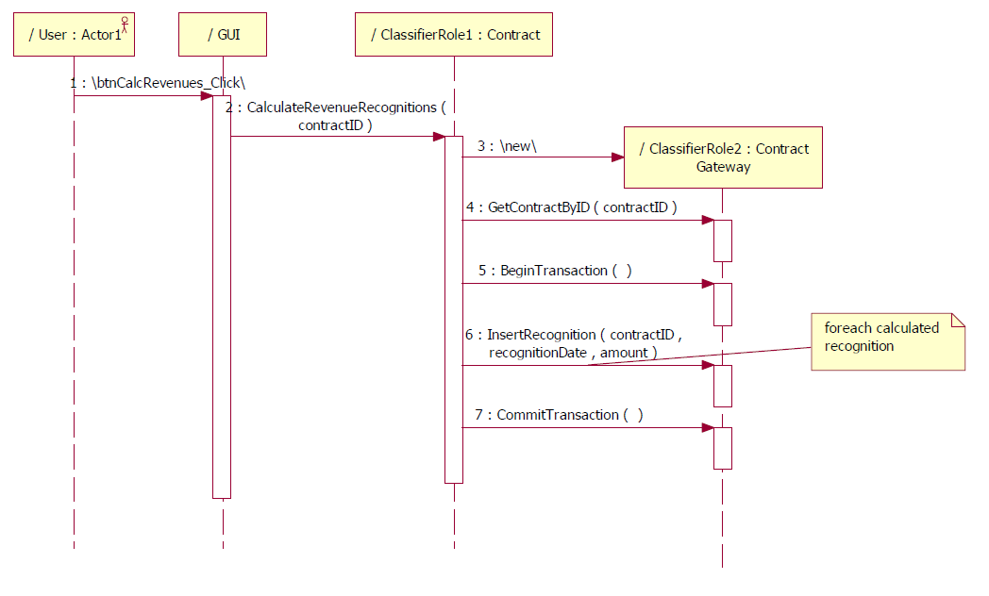
TM+TDG Calculate Revenues

Slide 17
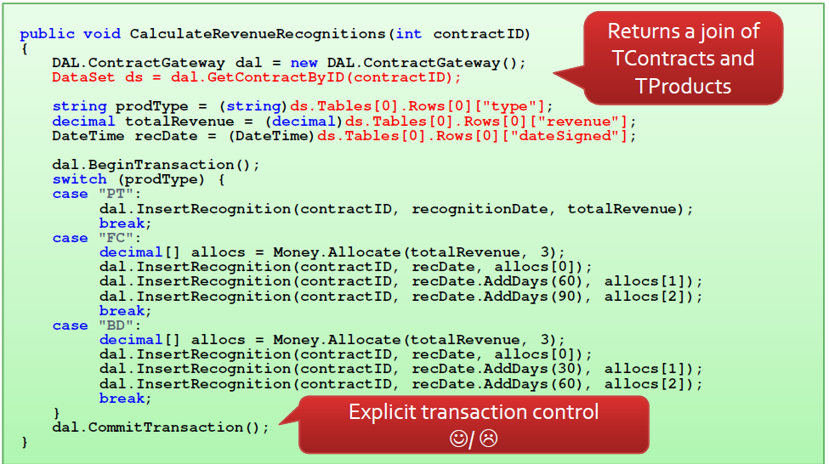
Translated in Code

Slide 18
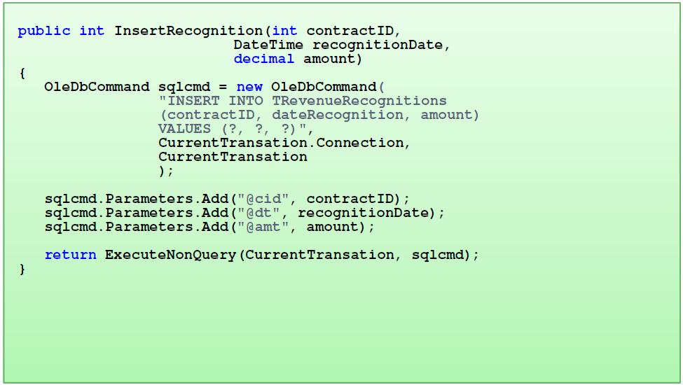

Slide 19
Row Data Gateway
An object that acts as a single record in the data source
Allows in memory storage of object instance without need to access DB.
Needs an instance of an object for each row.
Typical approach for object-relational mapping tools, e.g., Hibernate.
Fowler RDG combines two roles
Class …Finder with find(id):Gateway method which returns the ‘object’ (i.e. SELECT statements)
Class …Gateway which is the ‘object’
Notes:
Fields – table columns.
Finder methods: static.
insert, update, delete on instance.

Slide 20
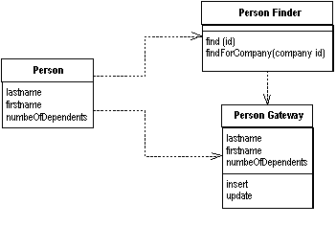
Row Data Gateway
Notes:
Fields – table columns.
Finder methods: static.
insert, update, delete on instance.

Slide 21
How it works?
Separate data access code from business logic
Type conversion from the data source types to the in-memory types
Works particularly well for Transaction Scripts
Where to put the find operations that generate the Row Data ?
separate finder objects
each table in a relational database will have:
one finder class
one gateway class for the results

Slide 22
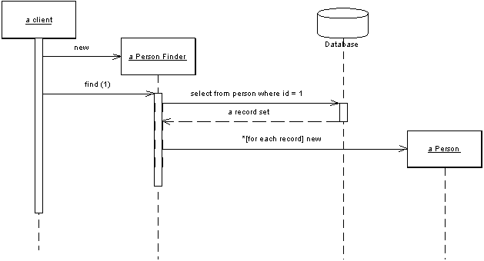
RDG behavior

Slide 23
Implementation
class PersonGateway...
{
private String lastName;
private String firstName;
private int numberOfDependents;
public String getLastName()
{ return lastName; }
public void setLastName(String lastName)
{ this.lastName = lastName; }
…
public void insert() {..}
public void update() {…}
public static PersonGateway load(ResultSet rs) {…}
..
}

Slide 24
Class PersonGateway
private static final String updateStatementString = "UPDATE people " + " set lastname = ?, firstname = ?, number_of_dependents = ? " + " where id = ?";
public void update() {
PreparedStatement updateStatement = null;
try { updateStatement = DB.prepare(updateStatementString); updateStatement.setString(1, lastName); updateStatement.setString(2, firstName);
updateStatement.setInt(3, numberOfDependents); updateStatement.setInt(4, getID().intValue()); updateStatement.execute(); }
catch (Exception e)
{ throw new ApplicationException(e); }
finally
{DB.cleanUp(updateStatement); } }
…

Slide 25
PersonFinder
class PersonFinder...
private final static String findStatementString = "SELECT id, lastname, firstname, number_of_dependents " + " from people " + " WHERE id = ?";
public PersonGateway find(Long id)
{
PersonGateway result = (PersonGateway)Registry.getPerson(id);
if (result != null) return result;
try
{
PreparedStatement findStatement = DB.prepare(findStatementString); findStatement.setLong(1, id.longValue());
ResultSet rs = findStatement.executeQuery();
rs.next();
result = PersonGateway.load(rs);
return result;
} catch (SQLException e) { throw new ApplicationException(e);
}

Slide 26
Using RDG as a holder for the domain object
class Person...
private PersonGateway data;
public Person(PersonGateway data)
{ this.data = data; }
public int getNumberOfDependents()
{
return data.getNumberOfDependents();
}

Slide 27
Data Transfer Object (DTO)
An object that carries data between processes in order to reduce the number of method calls.
Usually a set of attributes + setters and getters
Usually aggregates data from all the server objects that the remote object is likely to want to get data from.
DTOs are usually structured in tree structures (based on composition) containing primitive types and other DTOs
Structured around the needs of a particular client (i.e. corresponding to web pages/GUI screens).

Slide 28
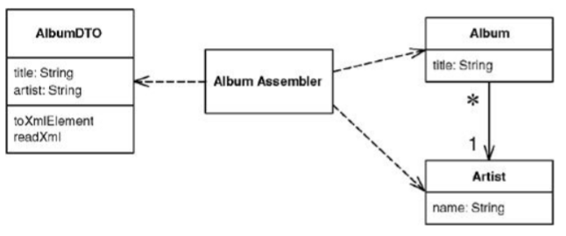
Example

Slide 29
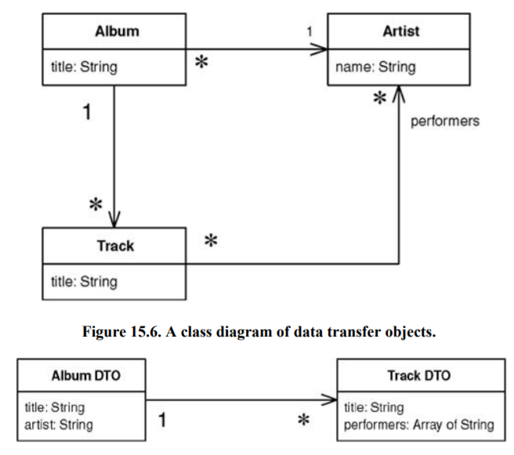
Example

Slide 30
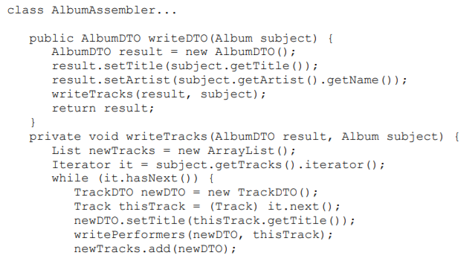
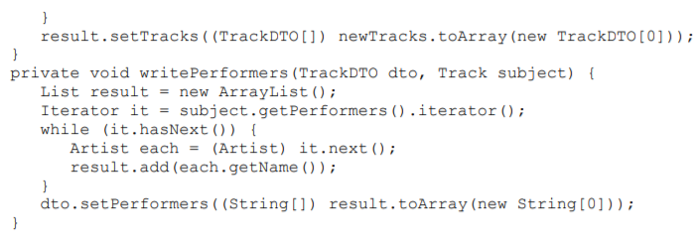
How to create the DTO

Slide 31
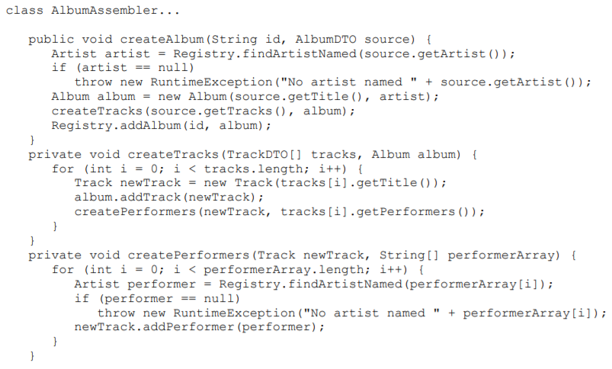
How to create the domain object from the DTO

Slide 32
What to consider
Keep the DTO structures simple – they have to be serializable
Use one DTO for a whole interaction vs. different ones for each request?
Use one DTO for both request and response vs. different ones for each?
DTO can be a Record Set
DTOs and domain objects might need mapping

Slide 33

Data Mappers
Acts as an intermediary between Domain Models and the database.
Allows Domain Models and Data Source classes to be independent of each other

Slide 34
Data Mapper Layer …
Can either
Access the database itself, or
Make use of a Table Data Gateway.
Does not contain Domain Logic.
When it uses a TDG, the Data Mapper can be placed in the (lower) Domain layer.

Slide 35
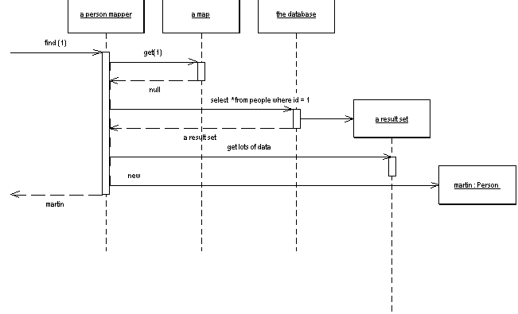
Retrieving data

Slide 36
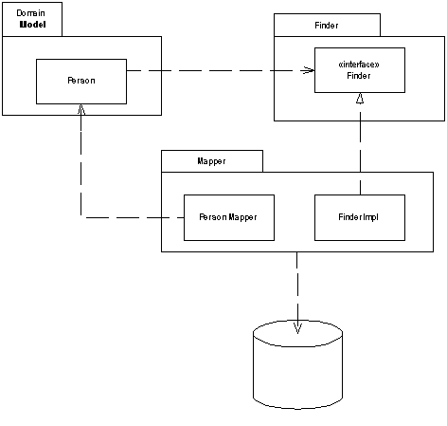
Finding objects

Slide 37
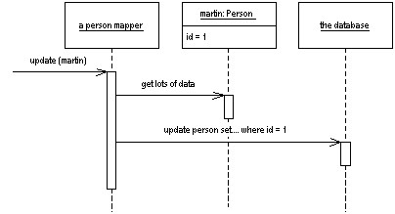
Updating data

Slide 38
Features
Independent database schema and object model
Extra layer
Makes sense with Domain Model

Slide 39
Implementation
class Person...
private String name;
private int numberOfDependents;
…
create table people (ID int primary key, lastname varchar, firstname varchar, number_of_dependents int)

Slide 40
AbstractMapper
class AbstractMapper...
protected Map loadedMap = new HashMap();
abstract protected String findStatement();
protected DomainObject abstractFind(Long id)
{
DomainObject result = (DomainObject) loadedMap.get(id);
if (result != null) return result;
PreparedStatement findStatement = null;
try
{
findStatement = DB.prepare(findStatement()); findStatement.setLong(1, id.longValue());
ResultSet rs = findStatement.executeQuery();
rs.next();
result = load(rs);
return result;
} catch (SQLException e)
{ throw new ApplicationException(e); }
finally { DB.cleanUp(findStatement); }
}

Slide 41
Load method in AbstractMapper
class AbstractMapper...
protected DomainObject load(ResultSet rs) throws SQLException
{
Long id = new Long(rs.getLong(1));
if (loadedMap.containsKey(id))
return (DomainObject) loadedMap.get(id);
DomainObject result = doLoad(id, rs);
loadedMap.put(id, result);
return result;
}
abstract protected DomainObject doLoad(Long id, ResultSet rs) throws SQLException;

Slide 42
Mapper class implements finder
class PersonMapper...
protected String findStatement()
{
return "SELECT " + COLUMNS + " FROM people" + " WHERE id = ?";
}
public static final String COLUMNS = " id, lastname, firstname, number_of_dependents ";
public Person find(Long id)
{
return (Person) abstractFind(id);
}

Slide 43
doLoad in PersonMapper
class PersonMapper...
protected DomainObject doLoad(Long id, ResultSet rs) throws SQLException
{
String name = rs.getString(2)+” “ + rs.getString(3);
int numDependentsArg = rs.getInt(4);
return new Person(id, name, numDependentsArg);
}

Slide 44
Mapping Problem
Data mapper: maps the Table – Class structure
Object-relational mapping tools are available, e.g., Hibernate,jOOQ.
Different approaches:
Hibernate built with JPA, objects -> sql
jOOQ sql->objects (more linq like)
Notes:
* Data Mapper patterns actually should be a part of the Domain Logic layer.

Slide 45
Structural problems
Object Relationships structural mapping problems
Links
Inheritance
Object-Relational Structural Patterns
Single Table Inheritance
Class Table Inheritance
Concrete Table Inheritance

Slide 46
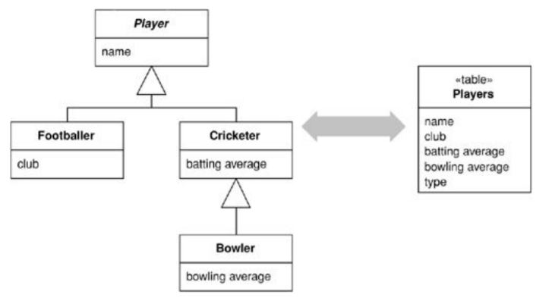
Single Table Inheritance

Slide 47
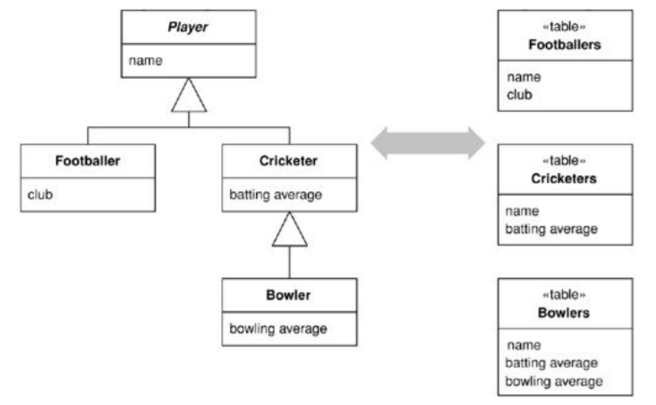
Concrete Table Inheritance

Slide 48
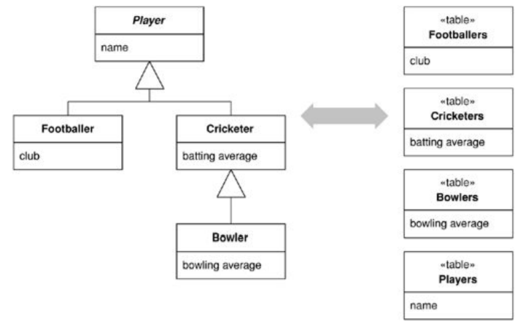
Class Table Inheritance

Slide 49
Behavioral problems
Networks of objects
E.g. Invoice heading relates to invoice details
Invoice details refers to Products
Products refers to Suppliers
…
What to do?
Load them all into memory?
How to disallow multiple in-memory copies
Object-Relational Behavioral Patterns
Lazy Load
Identity Map

Slide 50
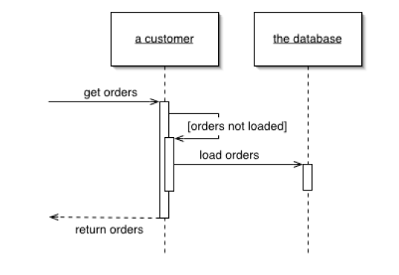
Lazy load
An object that doesn't contain all of the data you need but knows how to get it.

Slide 51
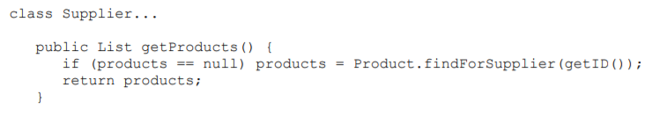
Implementation options
Lazy initialization: every access to the field checks first to see if it's null. If so, it calculates the value of the field before returning the field.
Virtual proxy: looks like the object but doesn’t contain anything. Only when one of its methods is called does it load the object from the database.
Ghost: the real object in a partial state. Ex. when you load the object from the database it contains just its ID. Whenever you try to access a field it loads its full state.

Slide 52
Discussion
Inheritance might be a problem with Lazy Load
Can easily cause more database accesses than you need (ex. fill a collection with Lazy Loads)
Deciding when to use Lazy Load is all about deciding how much you want to pull back from the database as you load an object, and how many database calls that will require.

Slide 53
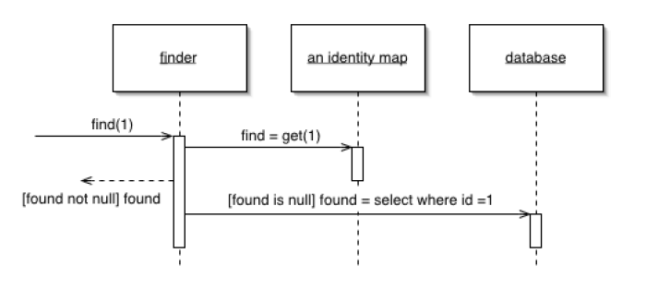
Identity map
Ensures that each object gets loaded only once by keeping every loaded object in a map. Looks up objects using the map when referring to them

Slide 54
How it works
Map key?
Primary key in the table (if it is a single column and immutable)
Explicit vs. generic
findPerson(1)
find (“Person”, 1)
How many?
One map/session (if you have database-unique keys)
One map/table
One map/class
One map/inheritance tree

Slide 55
When to use it
Use an Identity Map to manage any object brought from a database and modified.
Acts as a cache for database reads
May not need an Identity Map for immutable objects
Helps avoid update conflicts within a single session, but it doesn't do anything to handle conflicts that cross sessions
(see the Concurrency topic)

Slide 56
Object-Relational Metadata Mapping Patterns
Metadata Mapping
Query Object
Repository

Slide 57
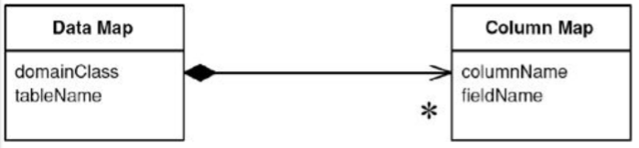
Metadata Mapping
Holds details of object-relational mapping in metadata
How to use the metadata information in the running code
Code generation
Reflective programming

Slide 58
Code generation
Input: metadata
Output: source code of Data Mapper classes
Discussion:
Changes to the mapping require recompiling and redeploying
Generated code is more explicit so easier to debug
Access to metadata and parsing take place only during the build and not during execution

Slide 59
Reflection
The reflective program asks for a method and then runs an invoke() on that method passing in the parameters.
i.e. treat methods and fields as data
Discussion:
Code is harder to debug
Flexible since names of fields and methods are read from a file
Slower (depends on the actual environment)
Access of metadata and parsing is done during execution but only once (keep the in-memory representation)

Slide 60
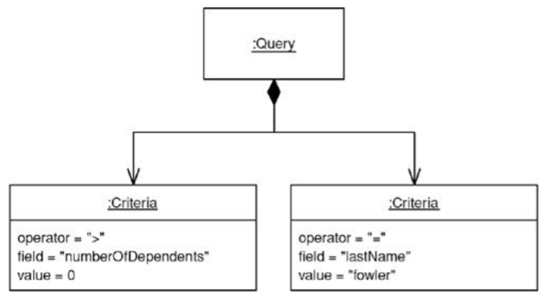
Using a Query Object
An object that represents a database query

Slide 61
How it works
Is an application of the Interpreter DP geared to represent a SQL query
Can represent queries in the language of the in-memory objects rather than the database schema (i.e. object and field names instead of column/table names)
Discussion:
Keeps DB schema encapsulated
Support for multiple databases/schemas

Slide 62
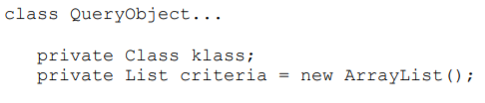
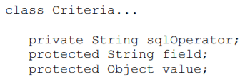
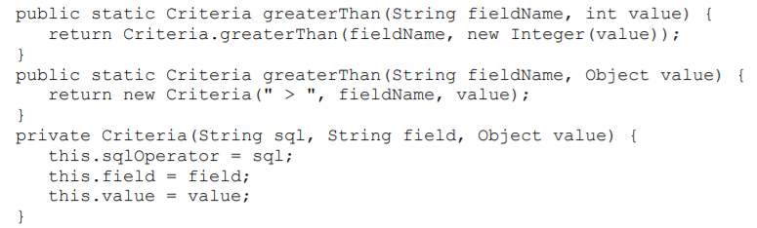

Example

Slide 63
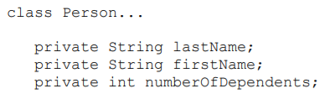
Applying the QueryObject

Slide 64
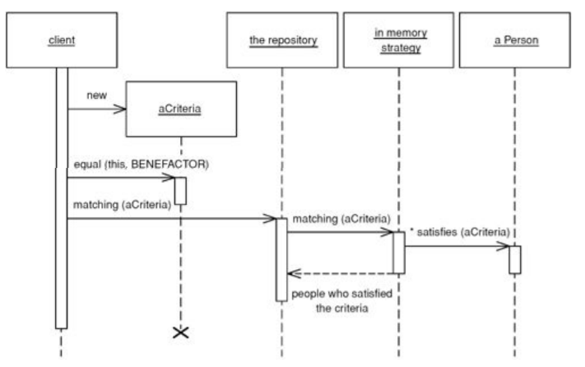
Repository
Mediates between Domain Model and Data Mapping
Acts like an in-memory collection of Domain objects

Slide 65
How it works
Replaces specialized finder methods on DataMapper with specification-based approach for object selection
In Query Object: clients construct a criteria object, add() it to the Query Object and execute the query
In Repository: clients construct a criteria, passes it to the Repository and asks to select those objects that match.
Under the covers, Repository combines Metadata Mapping with a Query Object to automatically generate SQL code from the criteria. Can be done:
the criteria know how to add themselves to a query,
the Query Object knows how to incorporate criteria objects,
the Metadata Mapping itself controls the interaction

Slide 66
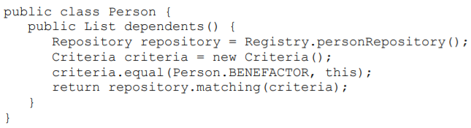
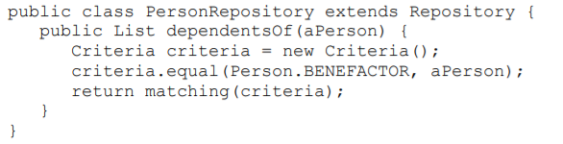
Example

Slide 67
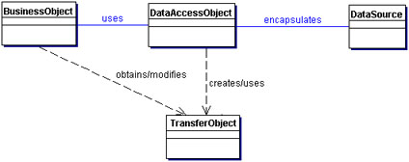
Related Patterns: DAO Pattern
Intent: Abstract and Encapsulate all access to the data source
Sun Developer Network - Core J2EE Patterns
http://www.oracle.com/technetwork/java/dataaccessobject-138824.html

Slide 68
Participants and responsibilities
BusinessObject: represents the data client. It is the object that requires access to the data source to obtain and store data.
DataAccessObject (aka Gateway): the primary object of this pattern. It abstracts the underlying data access implementation for the BusinessObject to enable transparent access to the data source. The BusinessObject also delegates data load and store operations to the DataAccessObject.
DataSource: represents a data source implementation. A data source could be a database such as an RDBMS, OODBMS, XML repository, flat file system, etc.
Transfer Object: used as a data carrier. The DataAccessObject may use a Transfer Object to return data to the client. The DataAccessObject may also receive the data from the client in a Transfer Object to update the data in the data source.

Slide 69
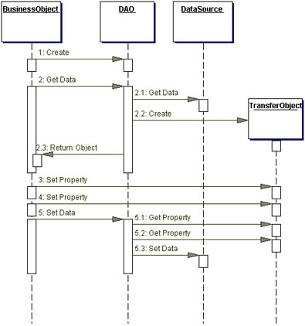
How it works

Slide 70
How to get the DAO
Strategies to get DAO’s:
Automatic DAO Code Generation Strategy
Metadata Mapping applied
JPA Hibernate
Factory for Data Access Objects Strategy
Use Factory Method: When the underlying storage is not subject to change from one implementation to another, use the Factory Method pattern to produce a number of DAOs needed by the application.
Use Abstract Factory: When the underlying storage is subject to change from one implementation to another, this strategy may be implemented using the Abstract Factory pattern.

Slide 71
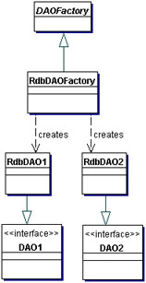
Factory method

Slide 72
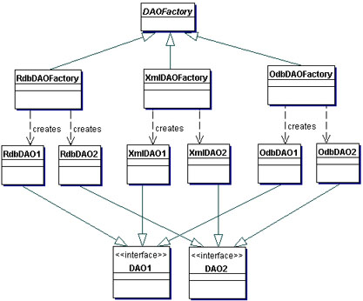
Abstract Factory

Slide 73
Next time
More patterns ☺
Concurrency
Presentation

