Slide 1
SOFTWARE DESIGN
Lecture 8

Slide 2
Content
Handling concurrency
Presentation patterns

Slide 3
References
Martin Fowler et. al, Patterns of Enterprise Application Architecture, Addison Wesley, 2003 [Fowler]
Microsoft Application Architecture Guide, 2009 [MAAG]
SaaS Course Stanford
Stuart Thiel, Enterprise Application Design Patterns: Improved and Applied, MSc Thesis, Concordia University Montreal, Quebec, Canada [Thiel]
Ólafur Andri Ragnarsson, Presentation Layer Design, 2014.

Slide 4
Offline Concurrency Patterns
Multiple threads that manipulate the same data
A solution -> Transaction managers….
as long as all data manipulation is within a transaction.
What if data manipulation spans transactions?

Slide 5
Business Transactions
ACID
Transactional resource (ex. Database)
Increase throughput -> short transactions
Transactions mapped on a single request
Late transactions -> read data first, start transaction for updates
Transactions spanning several requests -> long transactions
Lock escalation (row level -> table level)

Slide 6
Concurrency problems
Lost updates
Inconsistent read
Correctness failure
Liveness – how much concurrency can the system handle?

Slide 7
Execution contexts
“A request corresponds to a single call from the outside world which the software works on and optionally sends back a response”
“A session is a long running interaction between a client and server.”
“A process is a, usually heavyweight, execution context that provides a lot of isolation for the internal data it works on.”
“A thread is a lighter-weight active agent that's set up so that multiple threads can operate in a single process.”

Slide 8
Application Server Concurrency
process-per-session
Uses a lot of resources
process-per-request
Pooled processes
Sequential requests
Resources for a request should be released
thread-per-request
More efficient
No isolation

Slide 9
Solutions
isolation: partition the data so that any piece of data can only be accessed by one active agent.
immutable data: separate the data that cannot be modified.
mutable data than cannot be isolated:
Optimistic Concurrency Control
Pessimistic Concurrency Control

Slide 10
Optimistic Concurrency Control
Prevents conflicts between concurrent business transactions, by detecting a conflict and rolling back the transaction.
Conflict detection
Lock hold during commit
Supports concurrency
Low frequency of conflicts
Used for not critical consequences

Slide 11
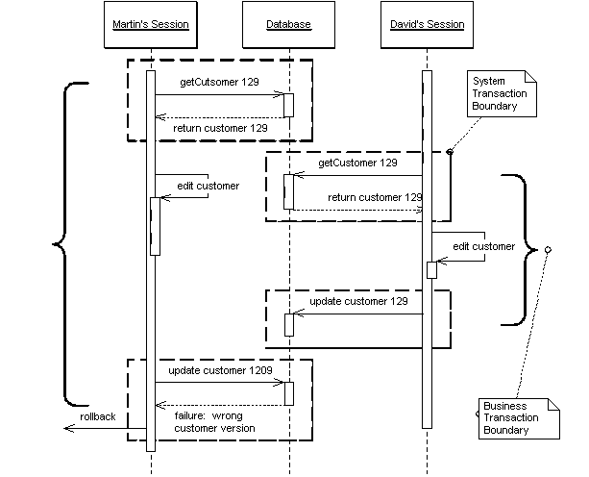

Slide 12
Pessimistic Concurrency Control
Prevents conflicts between concurrent business transactions by allowing only one business transaction to access data at once.
Conflict prevention
Lock hold during the entire transaction
Does not support concurrency
Used for critical consequences

Slide 13
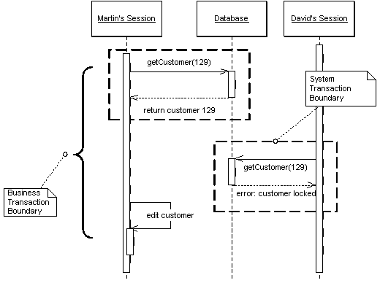

Slide 14
Preventing inconsistent reads
Optimistic control
Versioning
Pessimistic control
Read ->shared lock
Write -> exclusive lock
Temporal reads
Date+time stamps
Implies full history storage

Slide 15
Deadlocks
Pick a victim
Locks with deadlines
Preventing:
Force to acquire all the necessary locks at the beginning
Enforce a strategy to grant locks (ex. Alphabetical order of the files)
Combine tactics

Slide 16
Locking
To implement it you need to:
know what type of locks you need,
build a lock manager,
define procedures for a business transaction to use locks
Lock types
Exclusive write lock
Exclusive read lock
Read/write lock
Read and write locks are mutually exclusive.
Concurrent read locks are acceptable

Slide 17
Lock manager
The lock manager's job is to grant or deny any request by a business transaction to acquire or release a lock
A table that maps locks to owners
Locks should be private to the lock manager.
Business transactions should access only the lock manager
Protocol of Business transaction to use the lock manager
what to lock (i.e. the ID/primary key)
when to lock (i.e. lock first, load data next)
when to release a lock (i.e. after transaction completion),
how to act when a lock cannot be acquired.

Slide 18
Analysis
Access to the lock table must be serialized
Performance bottleneck
Consider granularity (Coarse grained lock)
Possible deadlocks
Lock timeout for lost sessions

Slide 19
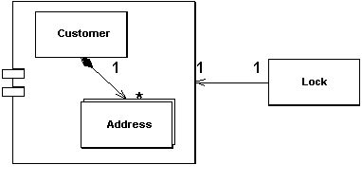
Coarse-Grained Lock
Lock a set of related objects with a single lock

Slide 20
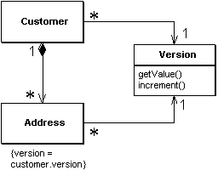
How it works
A single point of contention for locking a group of objects
Optimistic Lock – shared version

Slide 21
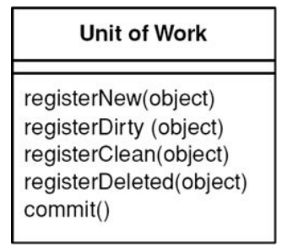
Unit of work
Maintains a list of objects affected by a business transaction and coordinates the writing out of changes and the resolution of concurrency problems.

Slide 22
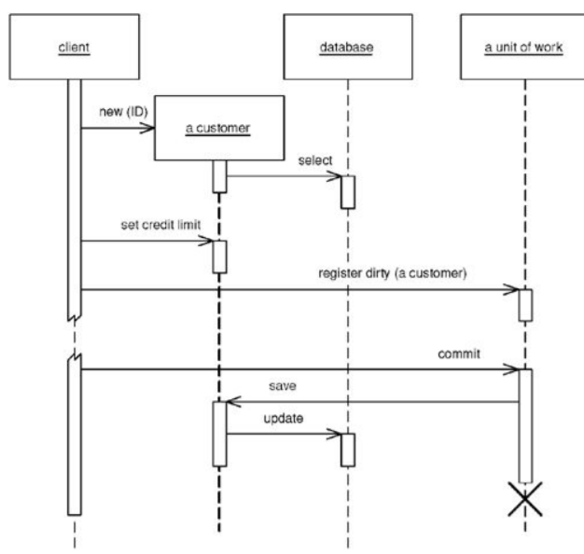
Having the caller register a changed object.

Slide 23
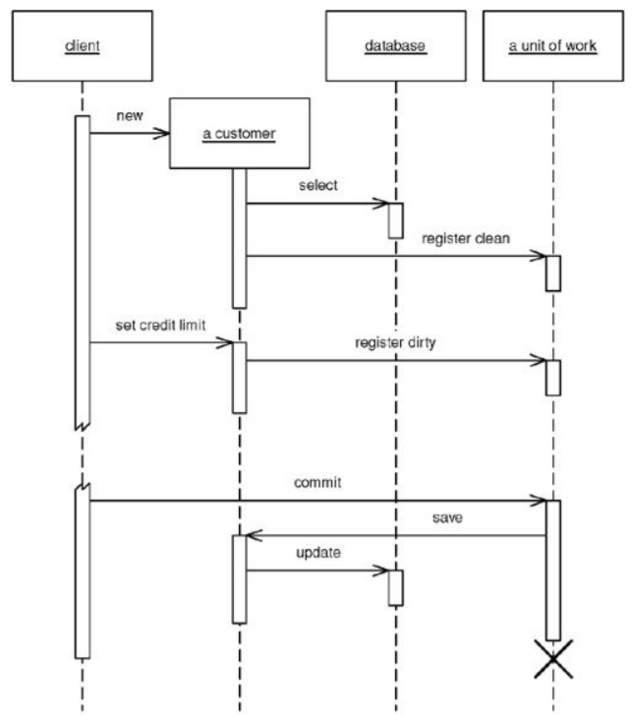
Getting the receiver object to register itself.

Slide 24
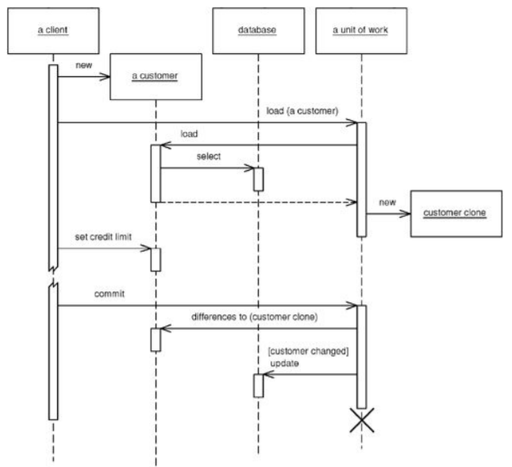
Using the Unit of Work as the controller for database access.

Slide 25
EA Patterns
Page Controller
Template View
Presentation
Front Controller
Transform View
Transaction Script
Domain Model
Domain
Active Record
Table Module
Data Mapper
Row Data Gateway
Table Data Gateway
Data Source

Slide 26
History of Web Application Architecture

Slide 27
Early technology
HTML (HyperText Markup Language)
Standard markup language used to create Web pages
CGI (Common Gateway Interfaces)
Scripts (usually Perl) using common interface between the Web server and programs that generate Web content
Servlet
Java programming to extend the capabilities of the web server
Well defined API through run-time environment
Typically used for dynamic web content generation

Slide 28
Web Templating Engine
Embedded code within static HTML elements
Mix of static and dynamic HTML
“Model 1” Architecture
Examples
Java Server Pages (JSP)
PHP
Active Server Pages (ASP) .Net

Slide 29
Web Templating Engine

Slide 30
MVC Frameworks
MVC Pattern
ServerSide Framework
“Model 2” Architecture
Examples
ASP. NET MVC Framework
Struts, Spring MVC (Java)
Ruby on Rails (Ruby)
Django (Python)
Grails (Groovy)

Slide 31
AJAX
Asynchronous JavaScript And XML
Dynamic content changes without reloading the entire page
interactive and dynamic web apps
approaching rich client capability
HTML/CSS + DOM +
XmlHttpRequest Object +
JavaScript + JSON/XML

Slide 32
Process of Web Application
1. Application Download
Mobile code (JavaScript, HTML, Applets, Flash) download to the client (web browser)
2. Presentation Flow
Dynamic visual rendering of the UI (screen changes, new
screens, etc.) in response to user input and data state changes
3. Data Interchange
The exchange of data between two software components or tiers (search, updates, retrieval, etc.)

Slide 33
Web Templating Engine Framework

Slide 34
Characteristics
Tight coupling between presentation flow and data
Interchange (both in the web server)
Triggering a Presentation Flow (web page update) in a web application initiates a Data Interchange operation
Every Data Interchange operation results in a Presentation Flow operation
Presentation flow and data interchange are
orthogonal concerns that should be decoupled
Separate concerns

Slide 35
Typical Model 2 Architecture
Web templating engines + MVC frameworks + Ajax

Slide 36
Service Oriented Front End Architecture (SOFEA)
Service Oriented Front End Architecture – Synonymous
with “Single Page” Web Applications
Life above the Service Tier
How to Build Application Front-ends in a Service-Oriented World
(Ganesh Prasad, Rajat Taneja, Vikrant Todankar)
ReST Architectural Style
Not an implementation
Prasad, et al. propose that the SOA revolution has left
behind application front ends/UI’s
Designing web services API’s: http://jayurbain.com/msoe/se2840/slides/RESTfulWebServices.pdf

Slide 37
Legacy Architecture

Slide 38
SOFEA

Slide 39
SOFEA Process Allocation

Slide 40
SOFEA Principles
Application Download, Data Interchange, and
Presentation Flow must be decoupled
No part of the client should be evoked, generated or templated from the server-side.
Presentation Flow is a client-side concern only
All communication with the application server should be
using services (REST, SOAP, etc.)
The MVC design pattern belongs in the client, not the server

Slide 41
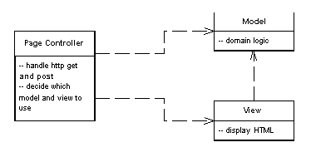
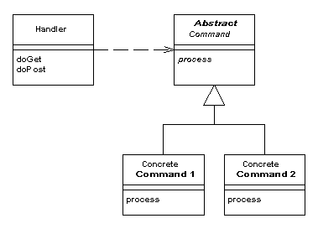
Controllers
One for each page – Page controller
One per application – Front controller

Slide 42
Page Controller
As Script
Servlet or CGI program
Applications that need logic and data
As Server Page
ASP, PHP, JSP
Use helpers to get data from the model
Logic is simple to none
Basic responsibilities
Decode the URL and extract all data for the action.
Create and invoke any model objects to process the data. All relevant data from the HTML request should be passed to the model so that the model objects don’t need any connection to the HTML request.
Determine which view should display the result page and forward the model information to it.

Slide 43
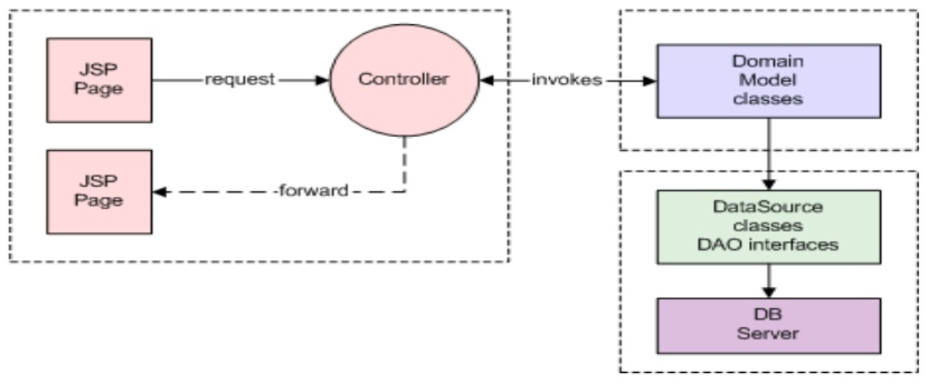
Page Controller

Slide 44
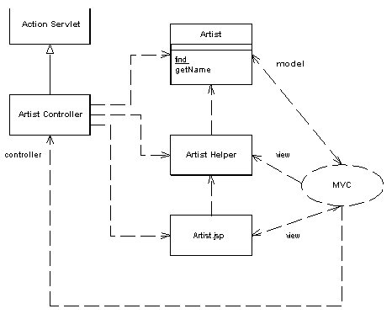
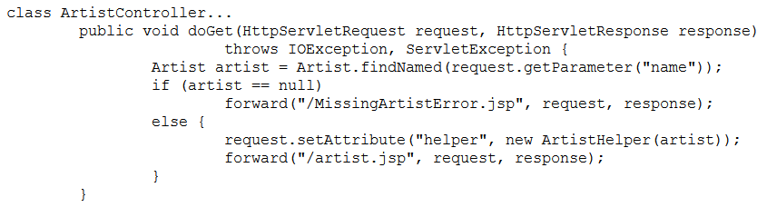
Servlet controller and a JSP view (Java)
http://www.thingy.com/recordingApp/artist?name=danielaMercury.
In web.xml map /artist to a call to ArtistController
<servlet>
<servlet-name>artist</servlet-name>
<servlet-class>actionController.ArtistController</servlet-class>
</servlet>
<servlet-mapping>
<servlet-name>artist</servlet-name>
<url-pattern>/artist</url-pattern> </servlet-mapping>

Slide 45
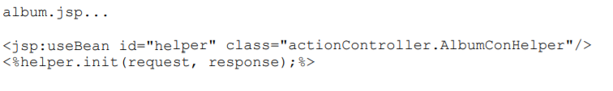
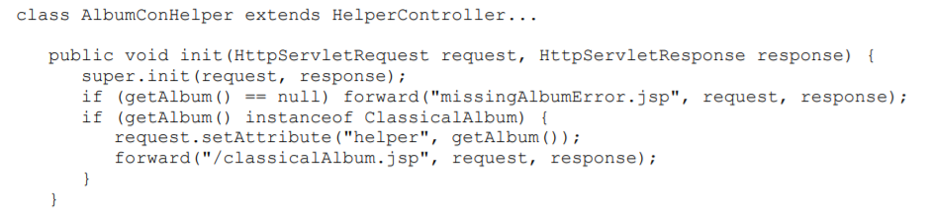
JSP as request handler
Delegates control to the helper
The handler JSP is the default view

Slide 46
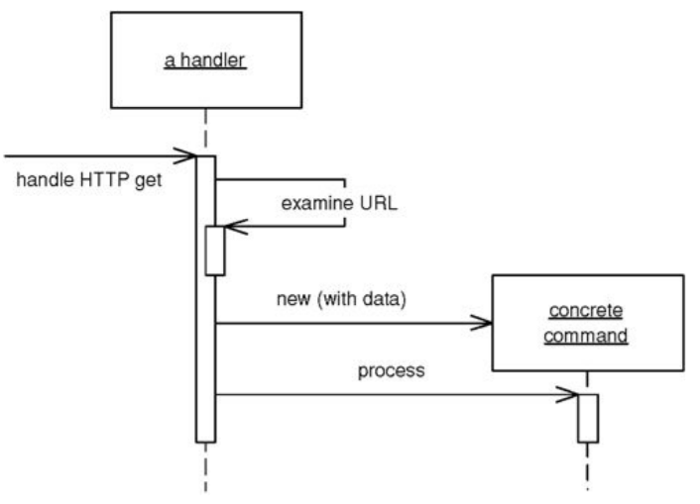
Front controller
If many similar things are done when handling a request (i.e. security, internationalization, etc.)
One controller handles all requests
Usually structured in two parts:
a web handler (rather a class than a server page)
a hierarchy of commands (classes)

Slide 47
Front controller
Handler decides what command:
statically
parses the URL and uses conditional logic;
advantage of explicit logic,
compile time error checking on dispatch,
flexibility in URL look-up
dynamically
takes a standard piece of the URL and uses dynamic instantiation to create a command class;
allows to add new commands without changing the Web handler;
can put the name of the command class into the URL or can use a properties file that binds URLs to command class names.

Slide 48
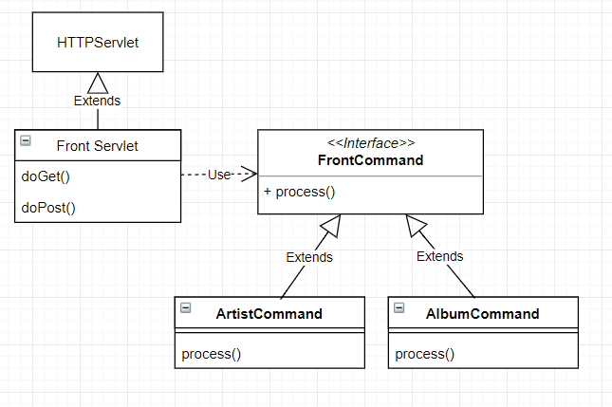
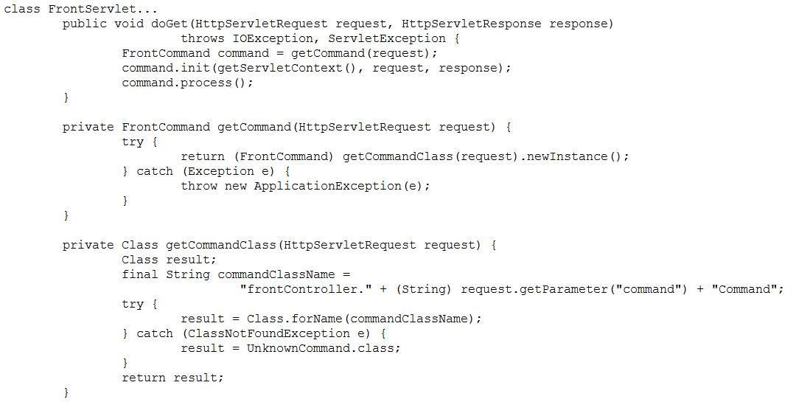
Example
http://localhost:8080/isa/
music?name=astor&command=Artist

Slide 49
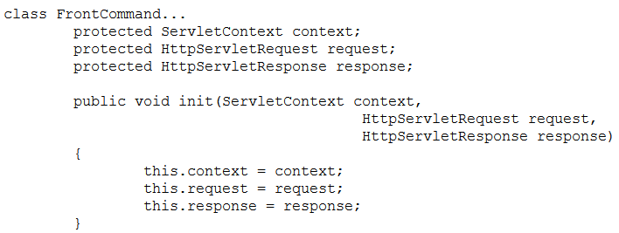
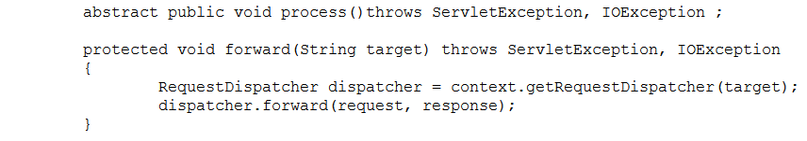
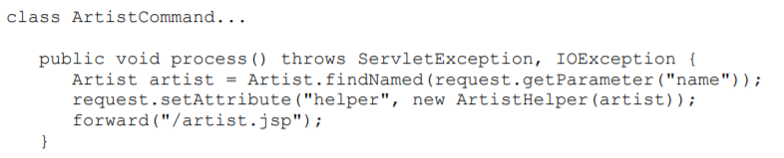

Slide 50
Discussion
Only one Front Controller has to be configured into the Web server
You can add new commands without changing anything.
Because new command objects are created with each request, it is thread safe.
Both the handler and the commands are part of the controller. As a result the commands can (and should) choose which view to use for the response. The only responsibility of the handler is in choosing which command to execute.
Re-factor code better in command hierarchy

Slide 51
Discussion
Page Controller:
simple controller logic
a natural structuring mechanism where particular actions are handled by particular server pages or script classes.
Front Controller:
greater complexity;
handles duplicated features (i.e. security, internationalization, providing particular views for certain kinds of users) in one place.
single point of entry for centralized logic

Slide 52
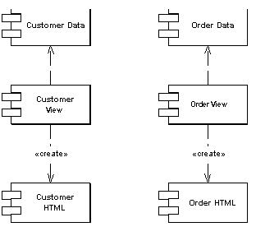
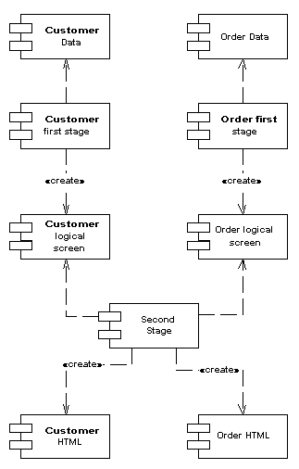
View
Single step stage
Two step stage

Slide 53
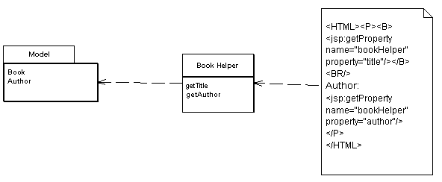
Template View
Embed markers into a static HTML page when it's written
When the page is used to service requests, the markers are replaced by the results of some computation
server pages:
ASP, JSP, or PHP.
allow to embed arbitrary programming logic, referred to as scriptlets, into the page.

Slide 54
Conditional display
<IF condition = "$pricedrop > 0.1"> ...show some stuff </IF>
Templates become programming languages
Move the condition to the helper to generate the content
What if the content should be displayed but in different ways?
Helper generates the markup
OR use focused tags:
<IF expression = "isHighSelling()"><B></IF><property name = "price"/><IF expression = "isHighSelling()"></B></IF>
replaced by
<highlight condition = "isHighSelling" style = "bold"><property name = "price"/></highlight>

Slide 55
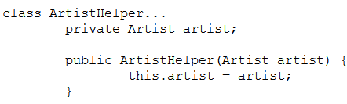


JSP Template View (see Page Controller)

Slide 56
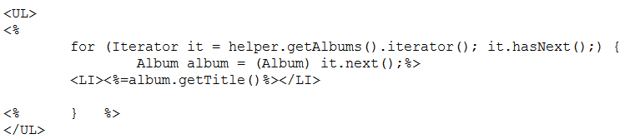
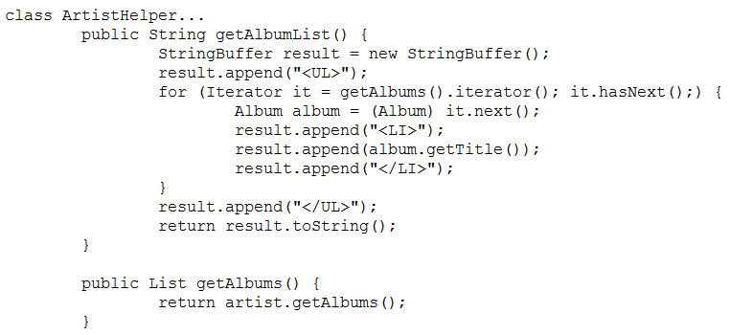

Show a list of albums for an artist

Slide 57
Discussion
Benefits:
Compose the structure of the page based on the template
Separate design from code (helper)
Liabilities
Common implementations make it too easy to put complicated logic onto the page => hard to maintain
Harder to test than Transform View

Slide 58
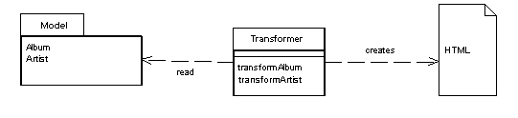
Transform View
Input: Model
Output: HTML
can be written in any language, yet the dominant choice is XSLT (EXtensible Stylesheet Language Transformation).
Input: XML
XML data can be returned as:
natural return type
output type which can be transformed to XML automatically
Data Transfer Object, that can serialize as XML

Slide 59
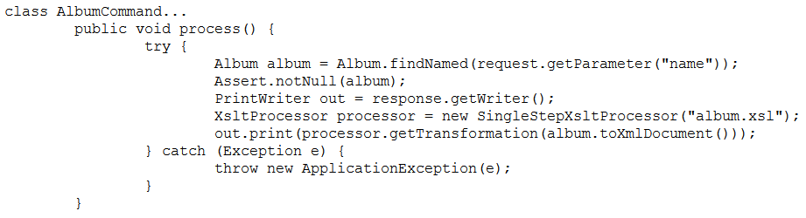
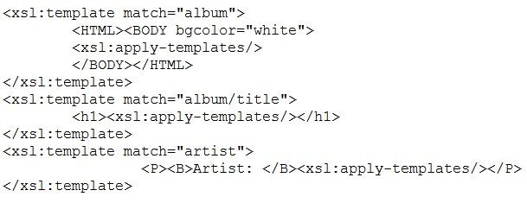
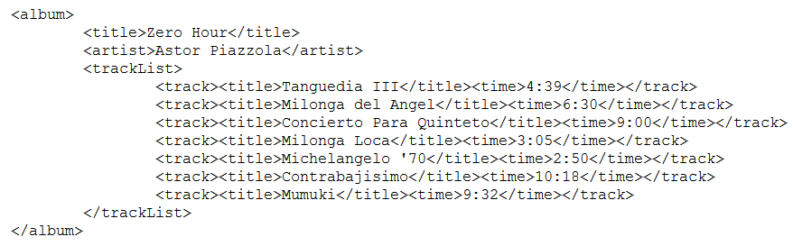
Translated in code

Slide 60
Advantages
Portability: use the same XSLT with XMLs from J2EE or .NET
Avoid too much logic in view, hence focus on the HTML rendering
Easier to test: run the Transform View and capture the output for testing.
Easier to change the appearance of a Web site: change the common transforms.

Slide 61
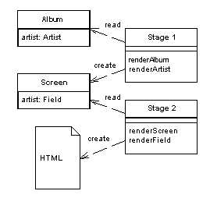
Two step view
Multi-page application:
transforms the model data into a logical presentation without any specific formatting
converts that logical presentation with the actual formatting needed.

Slide 62
How to do it
two-step XSLT:
domain-oriented XML => presentation-oriented XML,
presentation-oriented XML => HTML.
presentation-oriented structure as a set of classes (table/row class):
domain information instantiates T/R classes.
renders the T/R classes into HTML
each presentation-oriented class generates HTML for itself or
having a separate HTML renderer class
Template View based approach
The template system converts the logical tags into HTML.

Slide 63
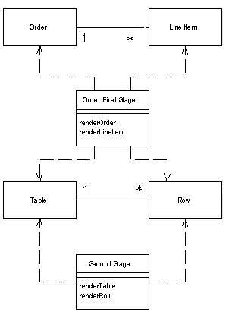
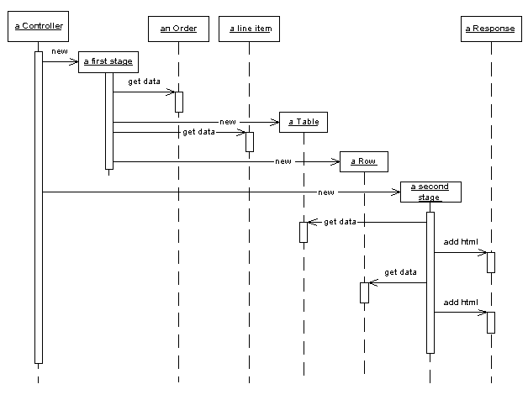
Example

Slide 64
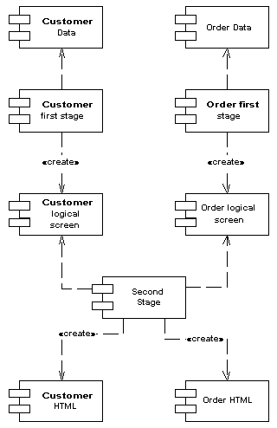
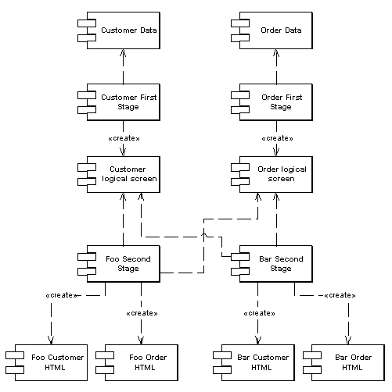
One vs. two appearances

Slide 65
Discussion
Advantages:
Two step view solves the difficulty with Transform view w.r.t. multiple transforms module & global changes.
If the website has multiple appearances/themes, the complexity is higher. With two step view, the issue is resolved and the advantage is compounded with multiple pages/themes.
Liabilities:
It’s hard to find enough commonality between the screens to get a simple enough presentation-oriented structure
Not for designers/non-programmers. Programmers have to write code for different rendering.
Harder programming model to learn
Complexity increases if multiple devices have to be supported. Then, the logical structure has to be common for multiple devices too.

Slide 66
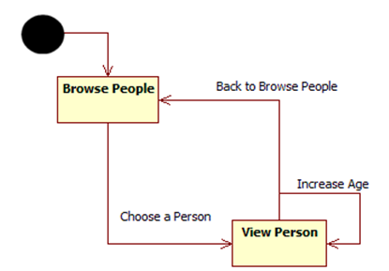
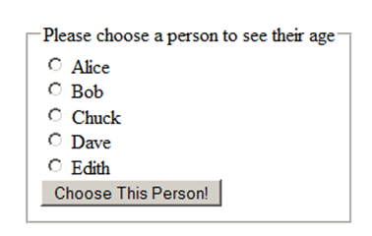
Putting it all together [Thiel]
People management web app
Browse people
View person
Change person data (i.e. increase age)

Slide 67
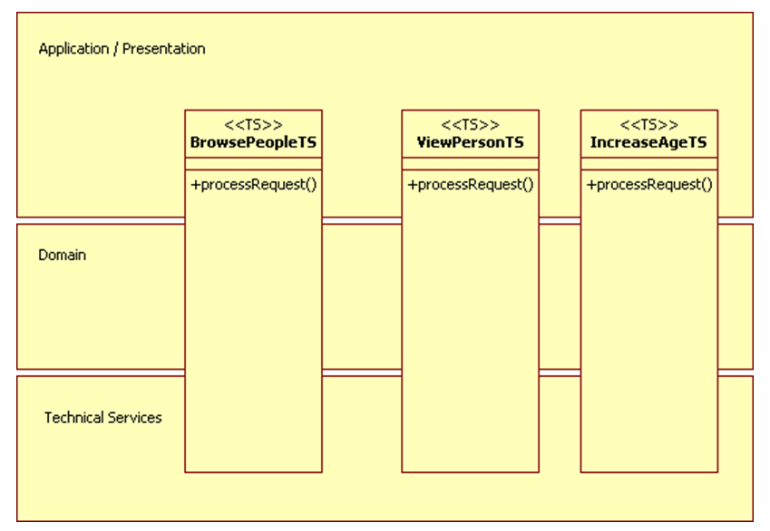
Just TS

Slide 68
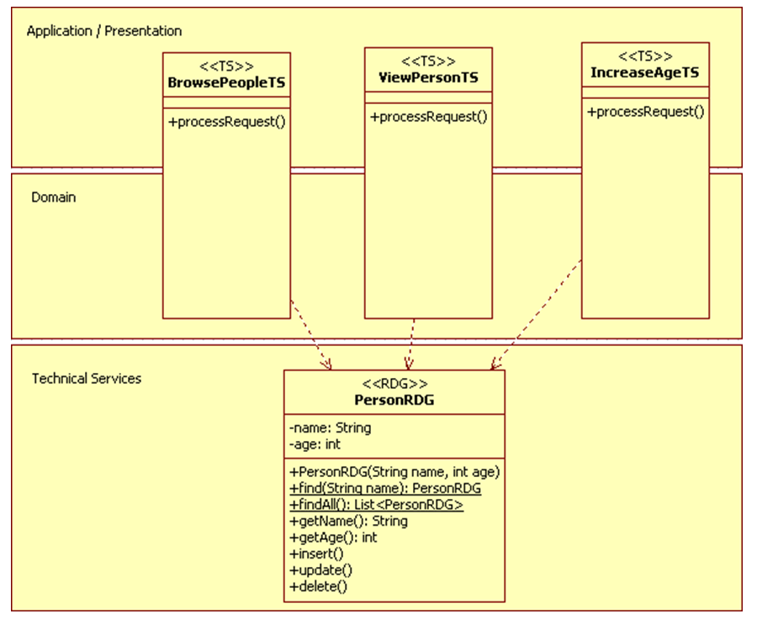
TS + RDG

Slide 69
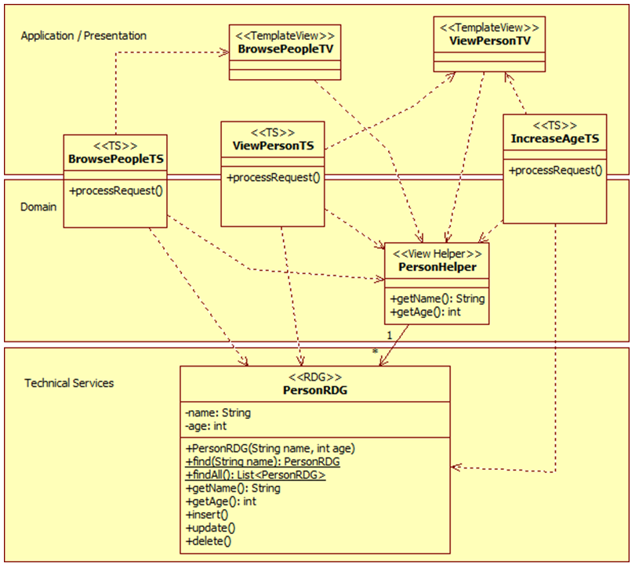
TS + RDG + TV

Slide 70
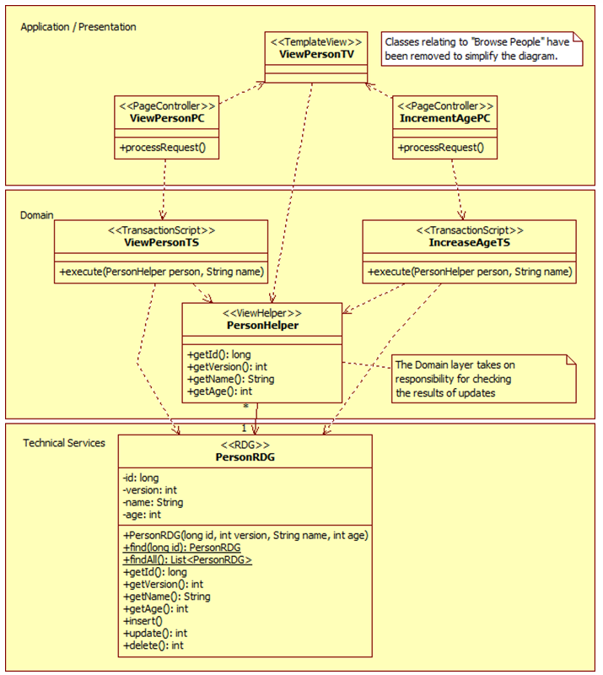
TS+RDG+TV +PC

Slide 71
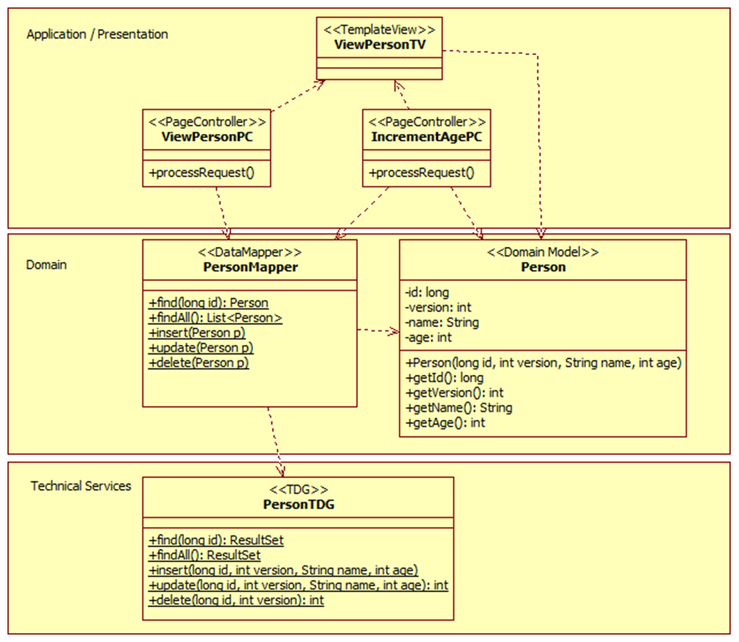
DM+TDG+DMapper+TV+PC

Slide 72
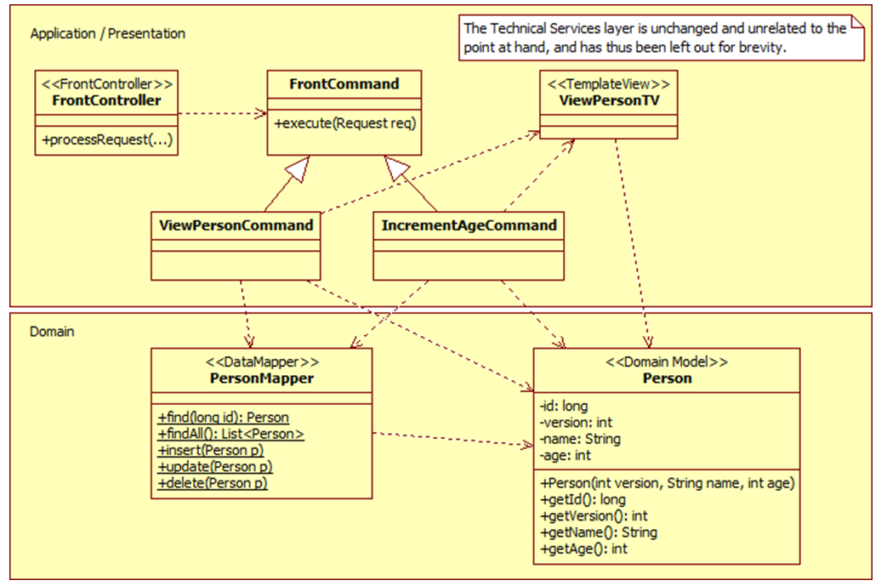
…or DM+…+FC

Slide 73
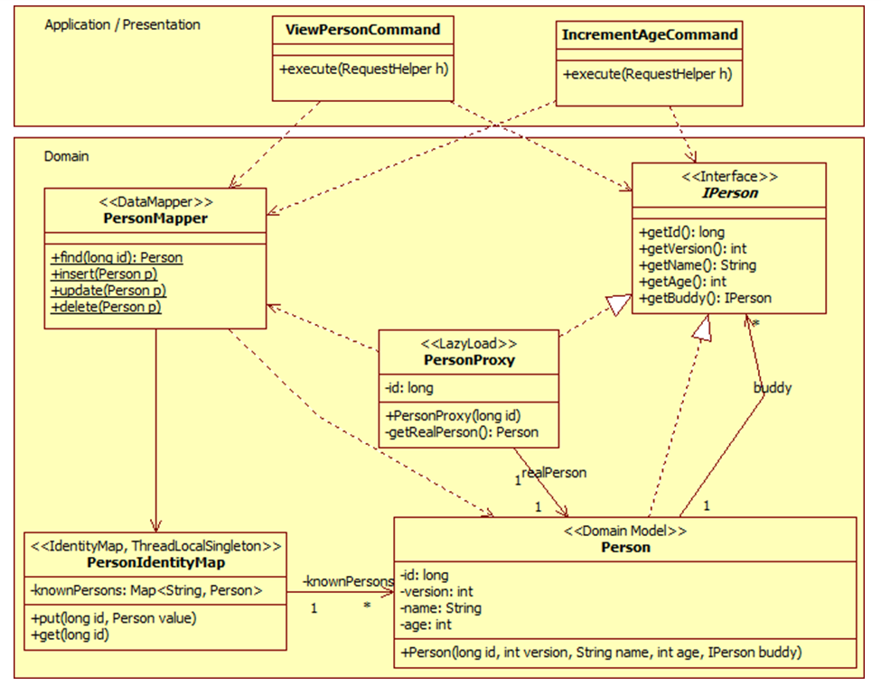
…+ Lazy load + IM

Slide 74
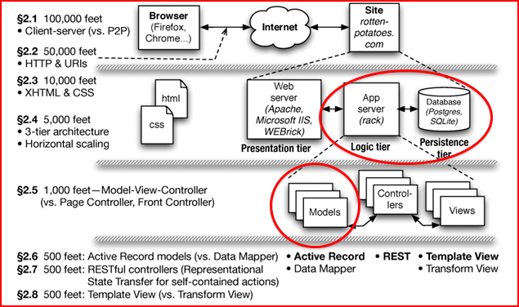
The Web

Slide 75
Next time
Design Patterns

