Slide 1

CLOSURES
PROTOTYPAL INHERITANCE
OBJECT ORIENTED PROGRAMMING
Internship Spring 2021

Slide 2
Agenda
Scope
Closure
Prototypical Inheritance
Object Oriented Programming

Slide 3
Scope
Scope is the accessibility of variables, functions, and objects during runtime.
The advantage of the scope:
security to your code;
solves the naming problem;

Slide 4
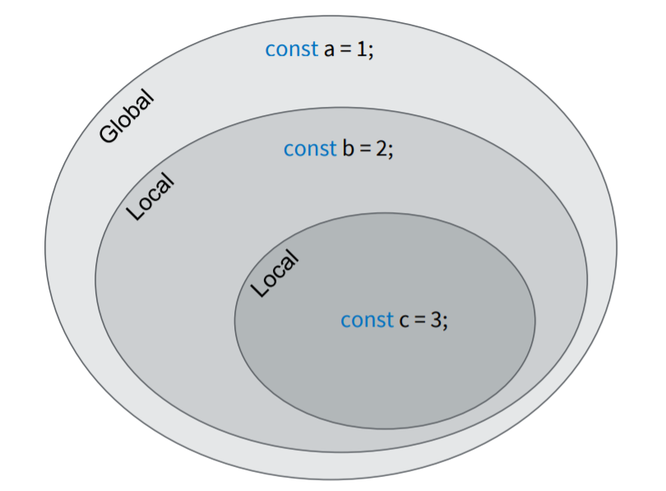
Scope

Slide 5
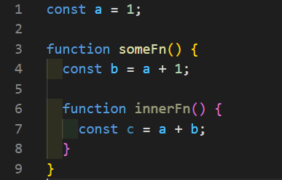
Lexical Scope

Slide 6
Least Exposure Principle and Closures
Block and function scope limits the exposure of variables.
Functions remember these referenced scoped variables via closure.
Closure is a behavior of functions.
For closure to be observed, a function must be invoked in a different branch of the scope chain from where it was originally defined.

Slide 7
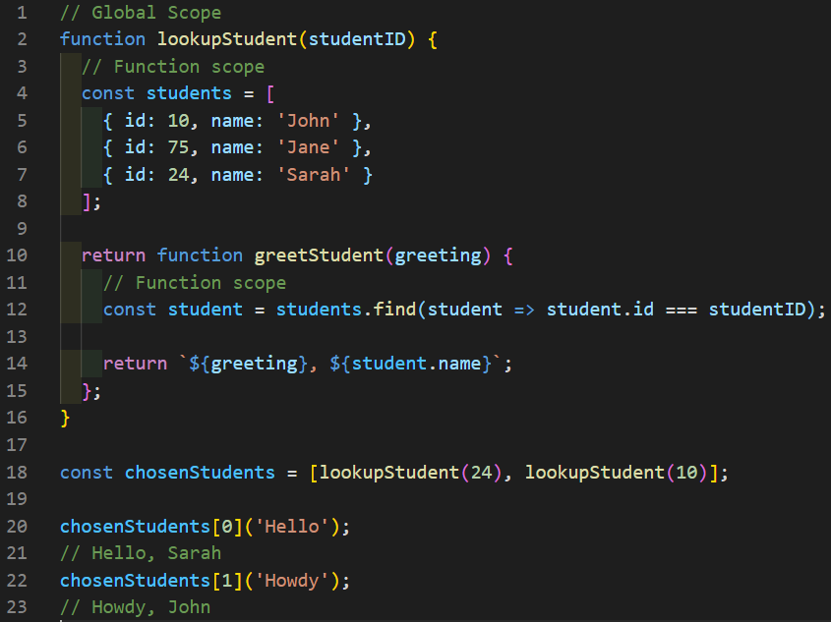
Closure in action
Each reference from the inner function to the variable in an outer scope is called a closure

Slide 8
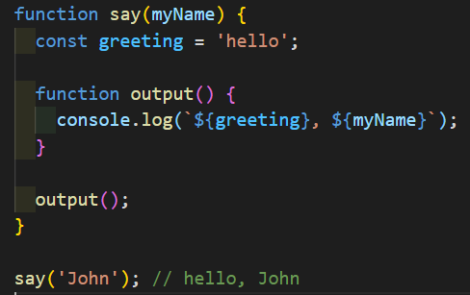
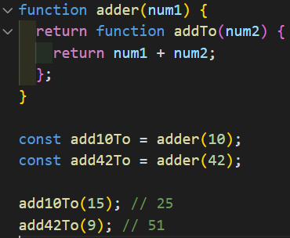
Other closure examples

Slide 9
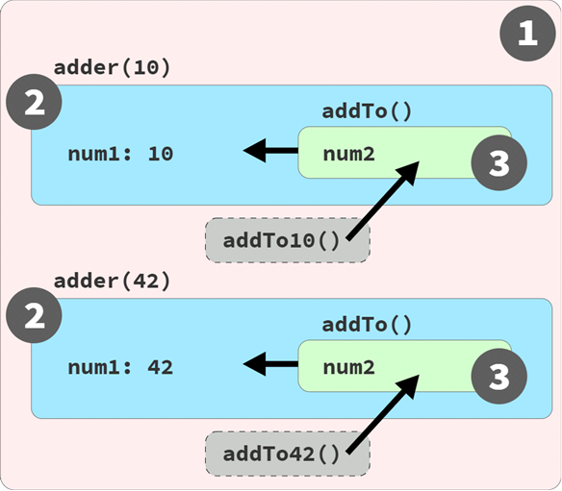
Closure in action

Slide 10
Closure Definition
We're ready to define closure:
Closure is observed when a function uses variable(s) from outer scope(s) even while running in a scope where those variable(s) wouldn't be accessible.
The key parts of this definition are:
Must be a function involved
Must reference at least one variable from an outer scope
Must be invoked in a different branch of the scope chain from the variable(s).

Slide 11
Object Oriented Programming
Objects interacting with one another through methods and properties
Used to store data, structure applications into modules and keep code clean.

Slide 12
Benefits of OOP
Encapsulation
Reduce complexity + Increase reusability..
Reduce complexity + isolate impact of changes.
Abstraction
Eliminate redundant code.
Inheritance
Polymorphism
Refactor ugly switch/case statements.

Slide 13
Encapsulation
x
y
z
fn()
fn()
fn()
fn()
Grouping properties and methods that operate on them under a single unit.

Slide 14
Abstraction
Hide the Details
Show the Essentials

Slide 15
OUTLINE
Objects
Prototypes
Prototypical Inheritance
ES6 Classes

Slide 16
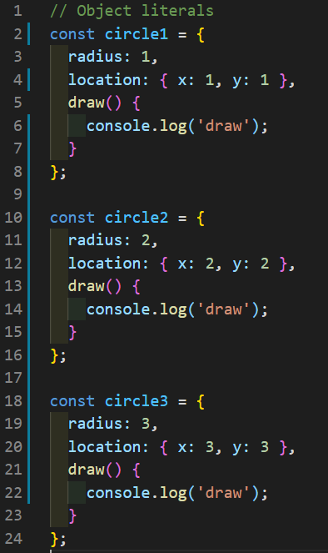
Object literals

Slide 17
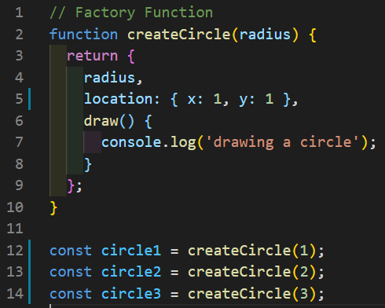
Factories

Slide 18
Constructor Function
BLUEPRINT radius location draw
radius: 1, location: { x: 1, y: 1 }, draw() { console.log('draw') }
radius: 2, location: { x: 2, y: 2 }, draw() { console.log('draw') }
radius: 3, location: { x: 3, y: 3 }, draw() { console.log('draw') }

Slide 19
Constructor Property
Factory Function – return an object from a function.
Constructor Function - use this keyword with the new operator.
Constructor property - reference of the function that was used to construct an object.

Slide 20
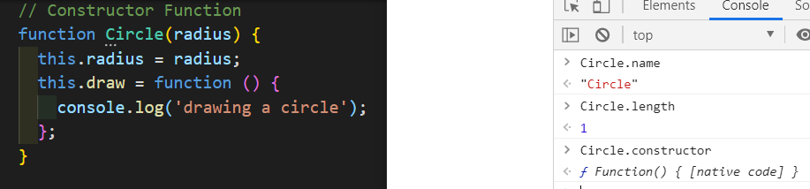
Functions are objects
“function name() {}” syntax
Adding or removing properties

Slide 21
Coding Examples
Abstraction
Private Properties and Methods
Getters and setters
Inheritance

Slide 22
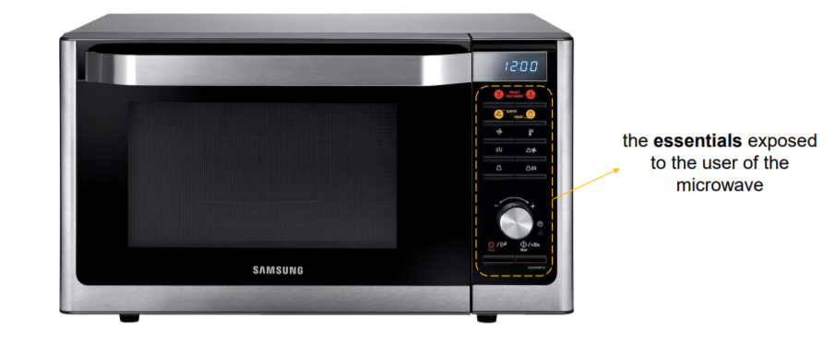
Abstraction

Slide 23
Inheritance
Circle
Square
computeOptimumLocation()
computeOptimumLocation()

Slide 24
Inheritance
Base/Super/Parent
Shape
IS-A
ComputeOptimumLocation()
Circle
Square
Derived/Sub/Child

Slide 25
Multi-level inheritance
Object
Shape
Circle
circle

Slide 26
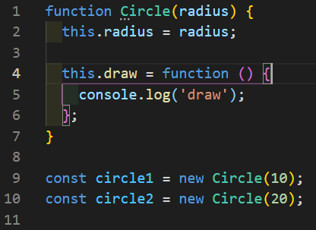
Prototype vs Instance members
There are two kinds of properties in JavaScript:
Instance members.
Prototype members.

Slide 27
Polymorphism
Shape draw()
Circle override draw()
Square override draw()

Slide 28
When to use inheritance?
Animal
eat()
walk()
Person
Dog
Goldfish

Slide 29
Change the Hierarchy
Animal
eat()
Mammal
Fish
walk()
swim()
Person
Dog
Goldfish

Slide 30
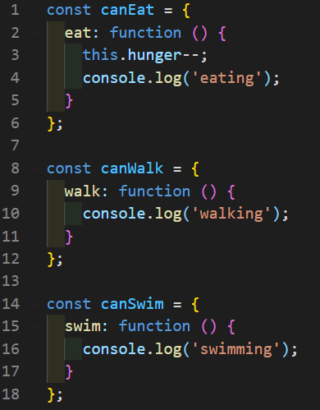
Favor Composition over Hierarchy
If you want to use inheritance, keep it to one level.
Use mixins to achieve composition

Slide 31

ES6 Classes

Slide 32
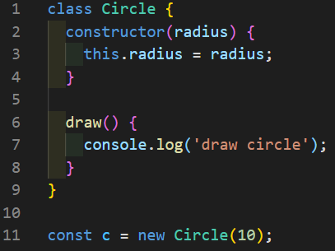
ES6 Classes
Classes in JavaScript are different than classes in Java or C#.
ES6 classes are syntactical sugar over Prototypical Inheritance.

Slide 33
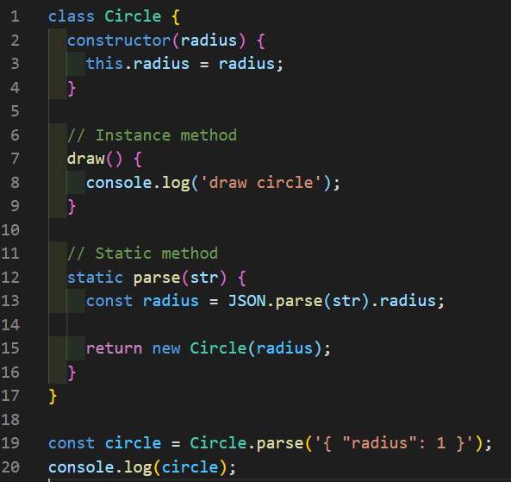
Static Methods
There are two types of methods in OOP:
Instance Methods
Static Methods

Slide 34
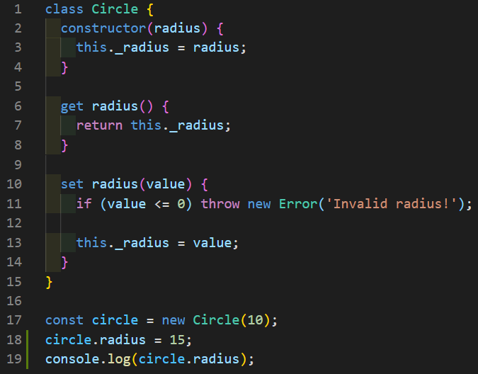
Getters and Setters

Slide 35
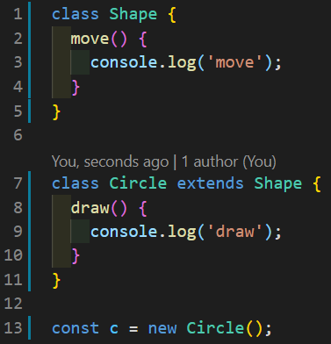
Inheritance
Inherit using "extends" keyword.
No need to reset the prototype and the constructor

Slide 36
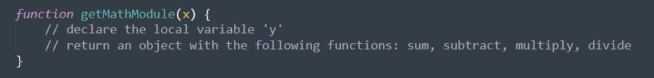
CLOSURE HOMEWORK
Create a function which returns a module with the following accessible functions: sum, subtract, multiply, divide – that will perform the operations over 2 values. One of the values should be passed as a parameter to the module function, the other one should be a local variable.

Slide 37
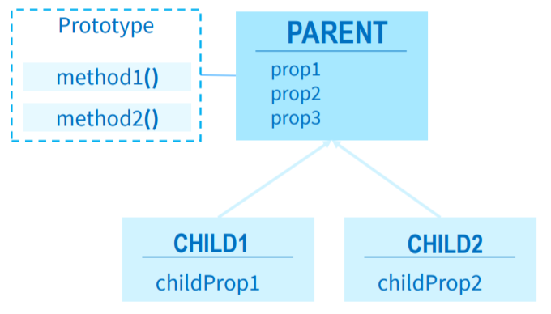
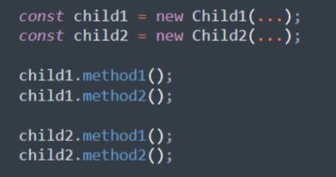
PROTOTYPES HOMEWORK
Choose a topic/theme that you’re interested in. For example Movies, Cars, Music, Sports etc. (Don’t use the examples from the slides)
Implement the below prototypal inheritance diagram using the topic you chose:
Create some instances with the child constructor functions and call the prototype methods:
* Don’t use generic names as prop1, method1. Use some property and method names related to the chosen topic.

Slide 38
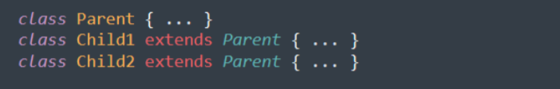
OOP HOMEWORK
Implement everything from the PRTOTOTYPES HOMEWORK using ES6 Classes.

Slide 39
Thank you
Andrei Turcanu - Developer
andrei.turcanu@endava.com

