Slide 1
Machine Learning Project
Student :Iuliu Andrei Steau

Slide 2
Problem Statement
The project should describe the results of a well-chosen machine learning model on two datasets of different sizes, one with approximately ~1000 samples and less than 100 features and the other with over ~100,000 samples and 1000+ features. In addition, detailed analyzes of the data and performance evaluations must be presented to demonstrate the correctness of the results obtained

Slide 3

Wine Quality Dataset
Target ? QUALITY
The small data set contains data on wine quality, having 13 attributes and 1143 samples. These parameters describe the physical and chemical properties of the wine
Fixed and Volatile acidity
Citric acid
residual sugar
chlorides
Free and Total sulfur dioxide
Density
pH
sulphates
alcohol

Slide 4
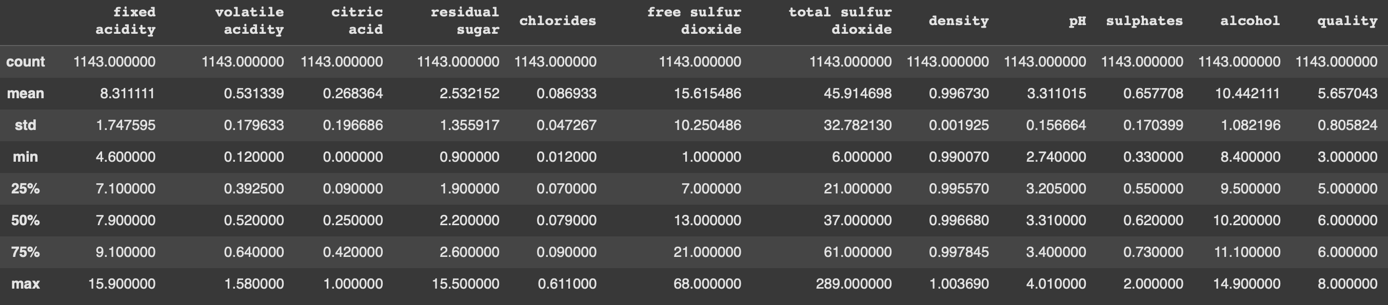
Analysis of variables

Slide 5
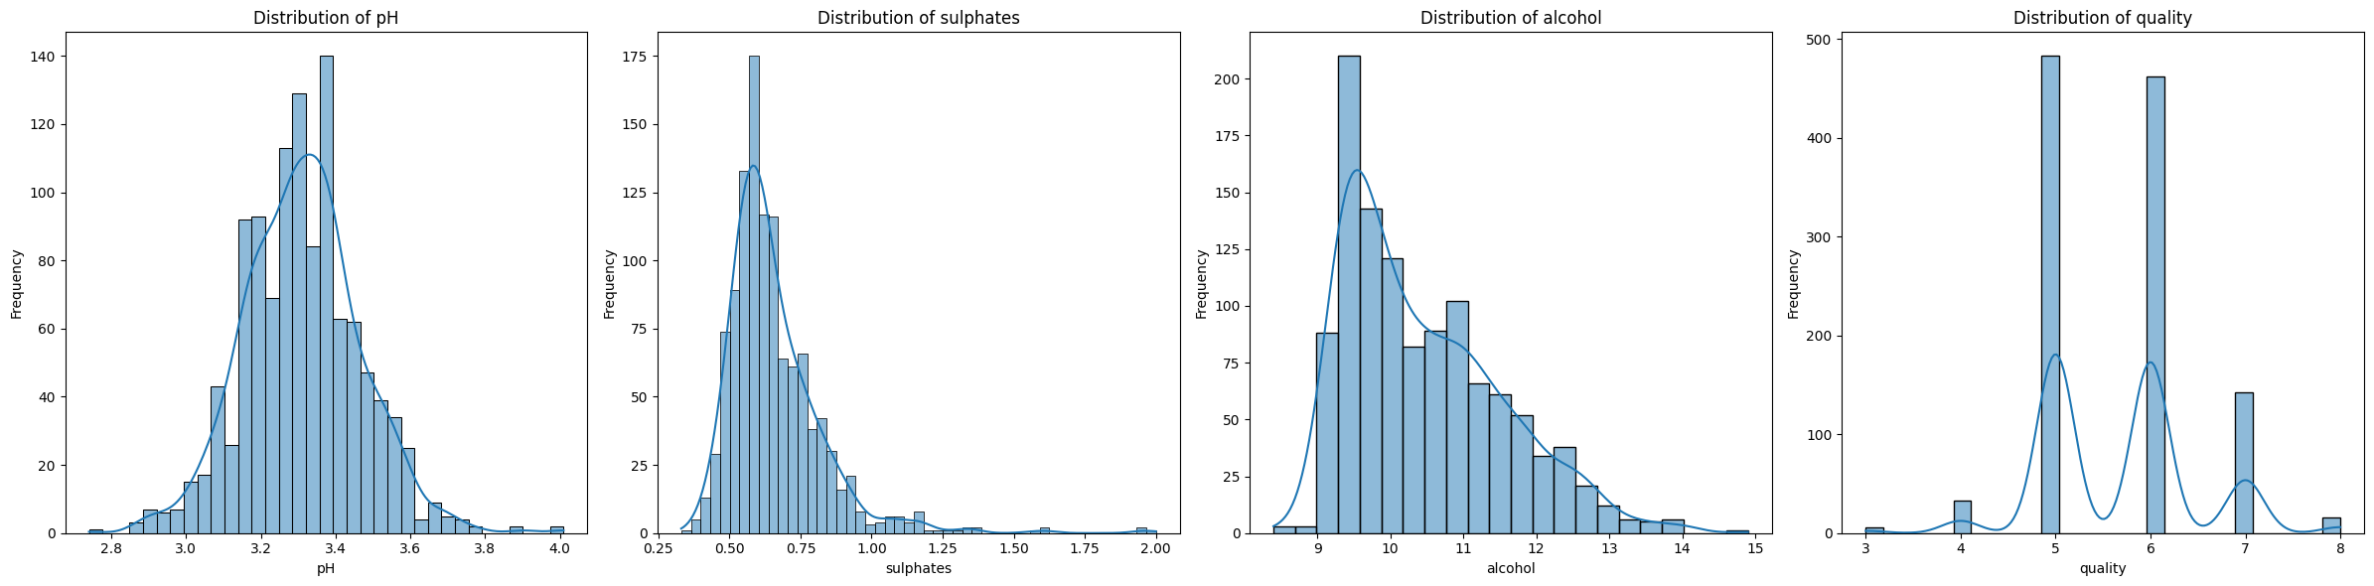
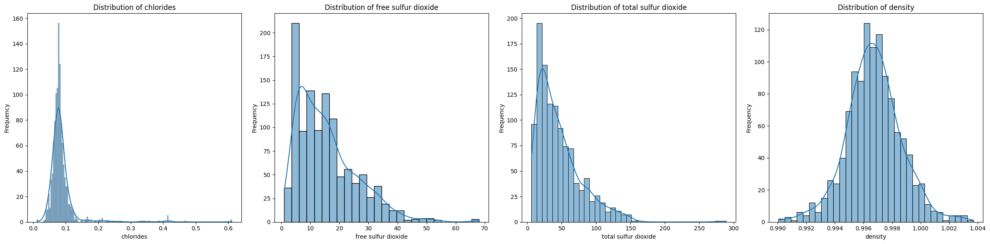
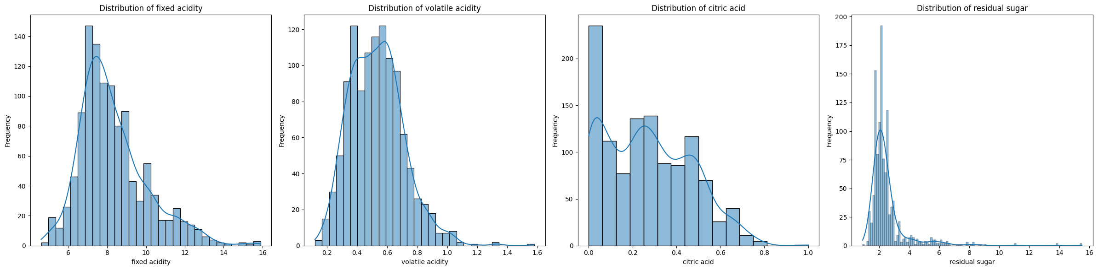
Data distribution

Slide 6
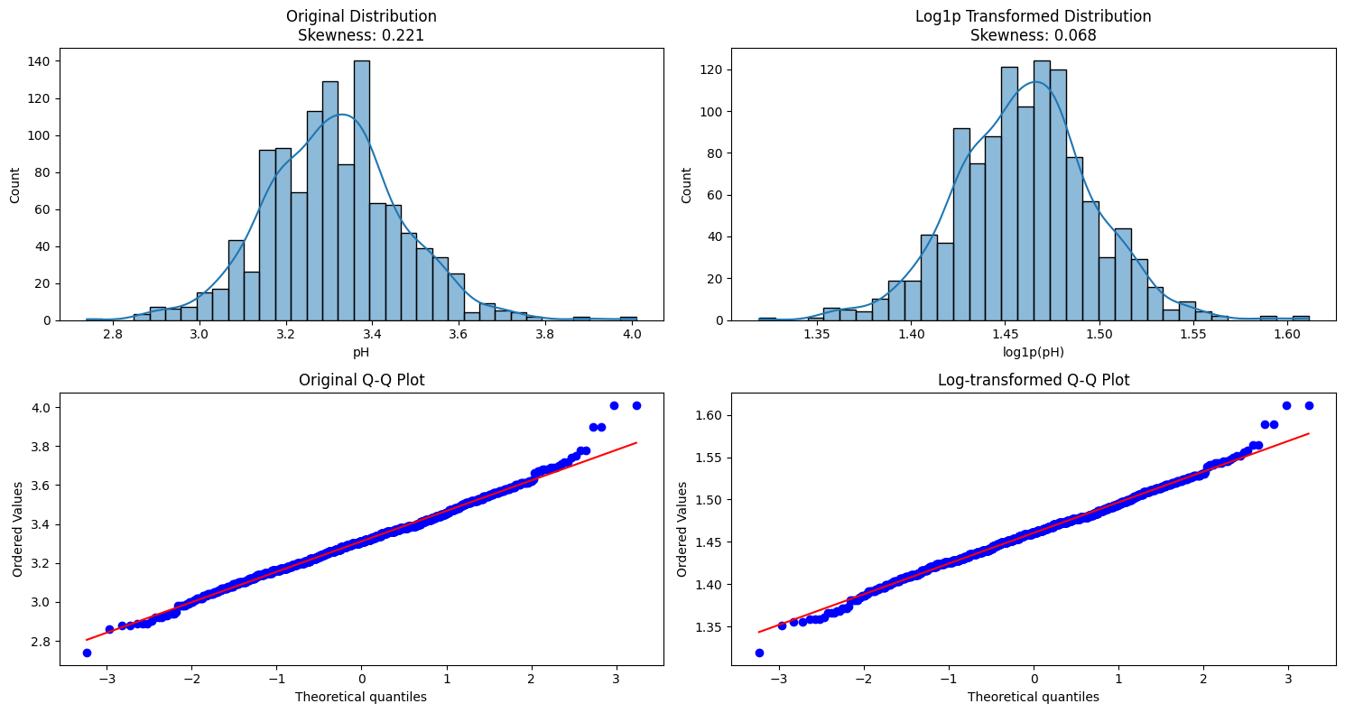
Logaritmic Transformed Distribution

Slide 7
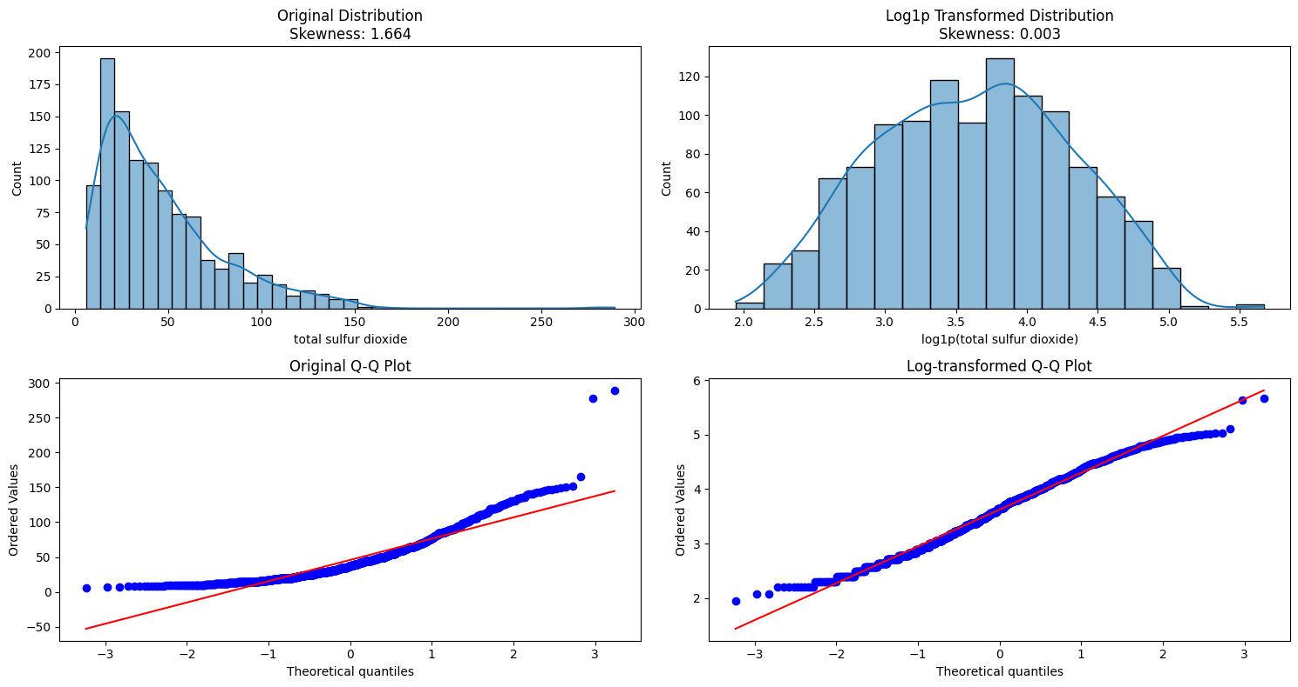
Logaritmic Transformed Distribution

Slide 8
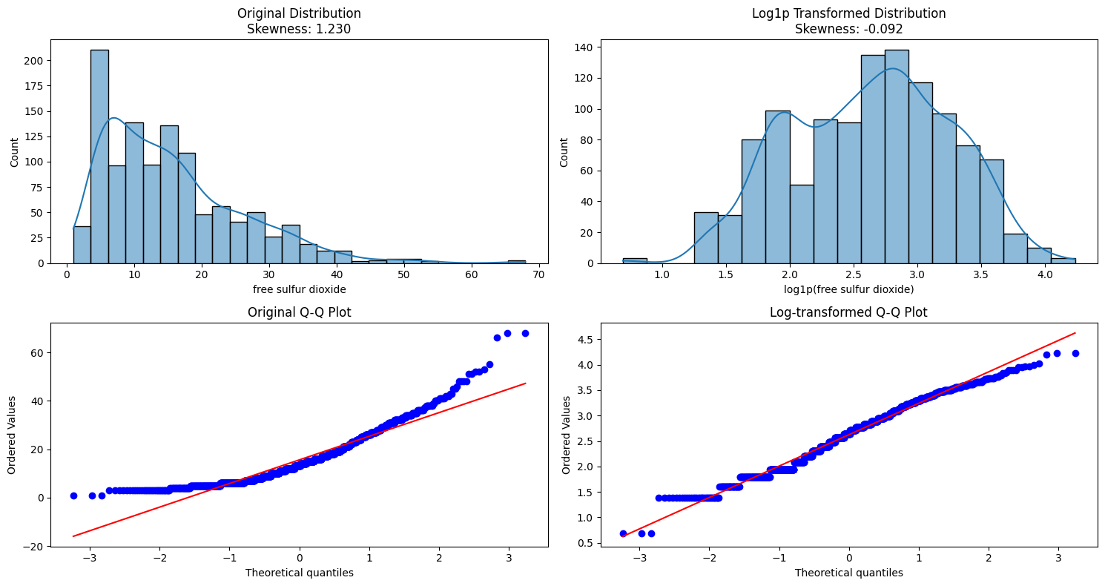
Logaritmic Transformed Distribution

Slide 9
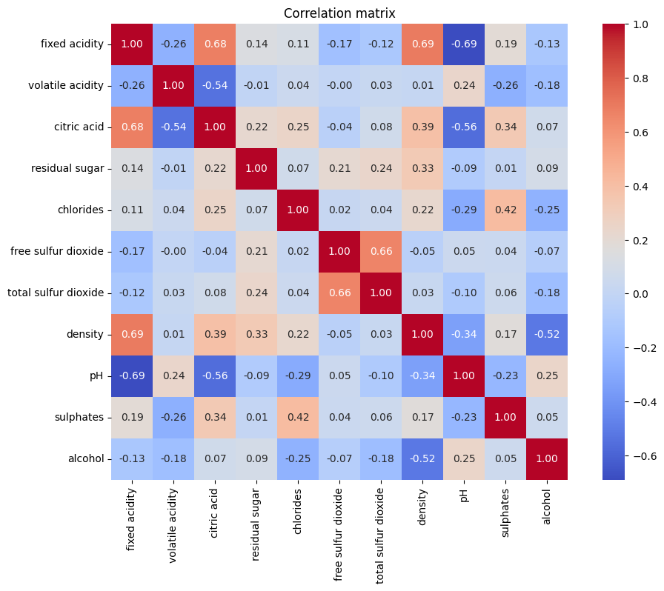
Correlation Matrix

Slide 10

Feature Scaling
scaler = StandardScaler()
column_names = X.columns
X_train = pd.DataFrame(scaler.fit_transform(X_train), columns=column_names)
X_resampled = pd.DataFrame(scaler.fit_transform(X_resampled), columns=column_names)
X_test = pd.DataFrame(scaler.transform(X_test), columns=column_names)
$x^{′}$ = $\frac{x −μ}{σ}$
$x$ is the original feature value
$μ$ is the mean of the feature
$σ$ is the standard deviation of the feature.

Slide 11

SMOTE
As we saw in the previous slides, the data distribution for the target is uneven
Solution? => SMOTE
SMOTE (Synthetic Minority Oversampling Technique) is a method used to address class imbalance in datasets by generating synthetic samples for the minority class rather than duplicating existing ones. It improves model performance, especially for classifiers sensitive to data imbalance. SMOTE works by creating synthetic samples along the line segments between a minority class sample and its nearest neighbors.
Let $x_{i}∈$ $ℝ^{d}$ be a minority class instance, and $x_{mn}$ be one of its k-nearest neighbors. A synthetic instance $x_{new}$ is generated as:
$x_{new}$ = $x_{i}$ +$λ$ * ($x_{mn}$ - $x_{i}$ )
where $λ ∈$ [0,1] is a random number, ensuring the new point lies between $x_{i}$ and $x_{nm}$​.

Slide 12
Random Forest
Random Forest is an ensemble learning algorithm used for classification and regression tasks. It constructs multiple decision trees during training and combines their outputs to improve predictive accuracy and control overfitting.
Key Features:
Bootstrap Aggregation (Bagging): Uses random subsets of the data to train each tree, improving generalization.
Feature Randomness: Selects a random subset of features for splitting nodes, reducing correlation between trees.
Voting Mechanism: In classification, the output is the majority vote across all trees; in regression, it’s the average of predictions.

Slide 13
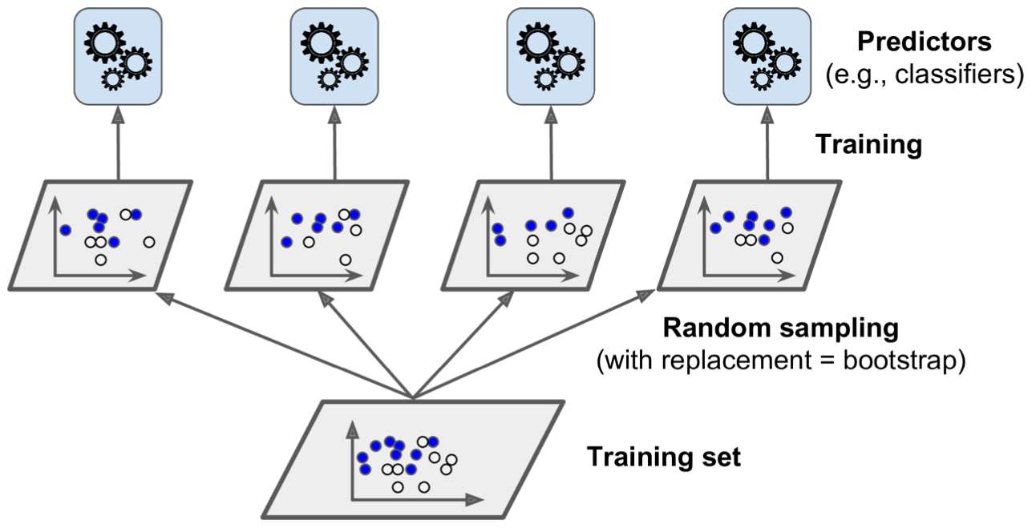
Random Forest

Slide 14
Hyperparameter tuning
%%time
param_grid = {
'n_estimators': [75, 100, 125],
'max_depth': [30, 40, 50, None],
'max_features': ['sqrt', 'log2', None],
'min_samples_split': [2, 5, 10],
'min_samples_leaf': [1, 2, 4],
'criterion': ['gini', 'entropy'],
'class_weight': ['balanced', 'balanced_subsample', {1:1,2:1,3:2,0:3,4:5},None],
}
base_model = RandomForestClassifier(random_state=42, oob_score=True)
grid_search = GridSearchCV(base_model, param_grid=param_grid,
cv=3,
scoring='accuracy',
verbose=2,
n_jobs=-1)
grid_search.fit(X_resampled, y_resampled)
best_rf_model = grid_search.best_estimator_
rf_predictions = best_rf_model.predict(X_test)
accuracy_score_rf = accuracy_score(y_test, rf_predictions)
print(f"Accuracy: {accuracy_score_rf}, OOB_SCORE:{best_rf_model.oob_score_}")
conf_matrix = confusion_matrix(y_test, rf_predictions)
print("Confusion Matrix:")
print(conf_matrix)
print("Best Hyperparameters Found:")
print(grid_search.best_params_)

Slide 15

GridSearch
GridSearch is a hyperparameter optimization technique used to find the best combination of parameters for a machine learning model by exhaustively searching through a manually specified parameter grid.
GridSearch evaluates all possible combinations of hyperparameter values from a defined grid. If you have:
p parameters, each with a different number of possible values: $n_{1}$, $n_{2} … n_{p}$
The total number of combinations is:
C = $n_{1}$ x $n_{2}$ .. x $n_{p}$
Time complexity T(considering we use RF) : O(m*n*log(n))
Time complexity Grid Search = C x k x T

Slide 16
Results
Accuracy: 0.6461988304093568 OOB_Score: 0.6481271282633371
Confusion Matrix:
[[ 0 7 3 0 0]
[ 0 130 10 5 0]
[ 0 62 72 5 0]
[ 0 4 20 19 0]
[ 0 2 2 1 0]]
Class 0:
True Positives (TP): 0.0
False Negatives (FN): 10.0
False Positives (FP): 0.0
True Negatives (TN): 332.0
Class 1:
True Positives (TP): 130.0
False Negatives (FN): 15.0
False Positives (FP): 75.0
True Negatives (TN): 122.0
Class 2:
True Positives (TP): 72.0
False Negatives (FN): 67.0
False Positives (FP): 35.0
True Negatives (TN): 168.0
Class 3:
True Positives (TP): 19.0
False Negatives (FN): 24.0
False Positives (FP): 11.0
True Negatives (TN): 288.0
Class 4:
True Positives (TP): 0.0
False Negatives (FN): 5.0
False Positives (FP): 0.0
True Negatives (TN): 337.0
Number of Correct Predictions per Class:
Class 0: 0 out of 10
Class 1: 130 out of 145
Class 2: 72 out of 139
Class 3: 19 out of 43
Class 4: 0 out of 5
Accuracy per Class:
Class 0: 0.00%
Class 1: 89.66%
Class 2: 51.80%
Class 3: 44.19%
Class 4: 0.00%

Slide 17
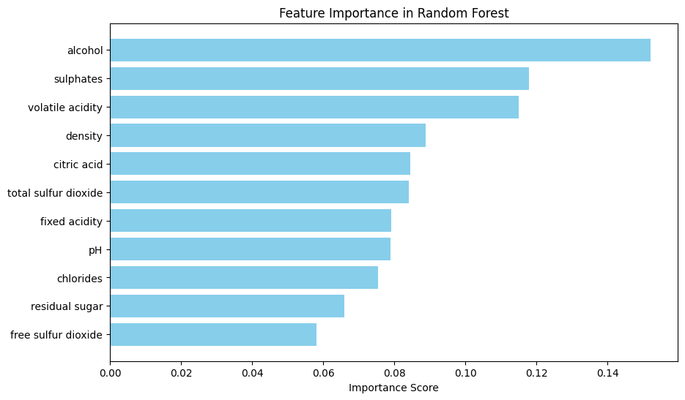
Feature importance

Slide 18
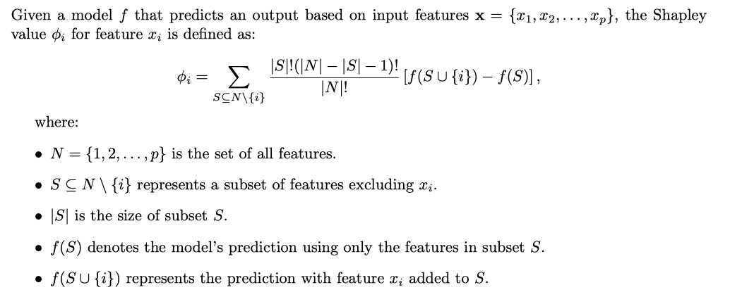
Shapley values

Slide 19
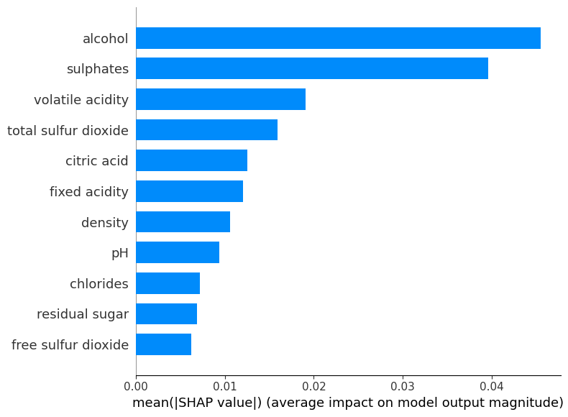
Shapley values

Slide 20
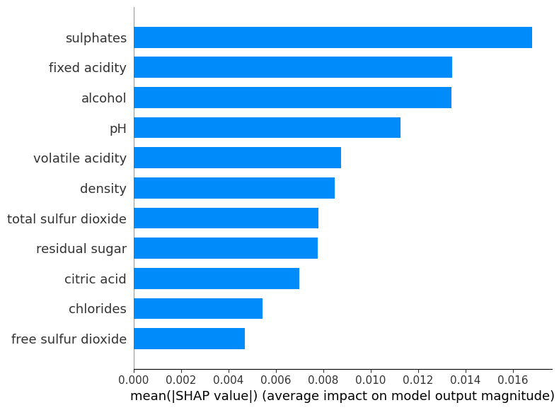
Shapley values Class 0

Slide 21
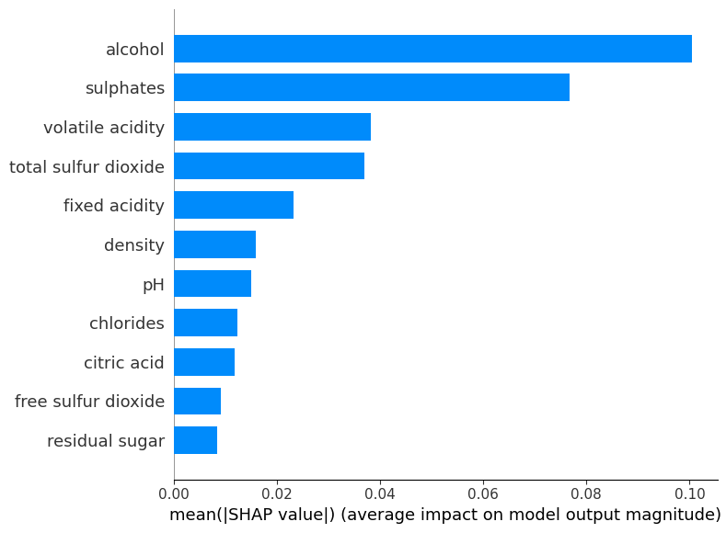
Shapley values Class 1

Slide 22
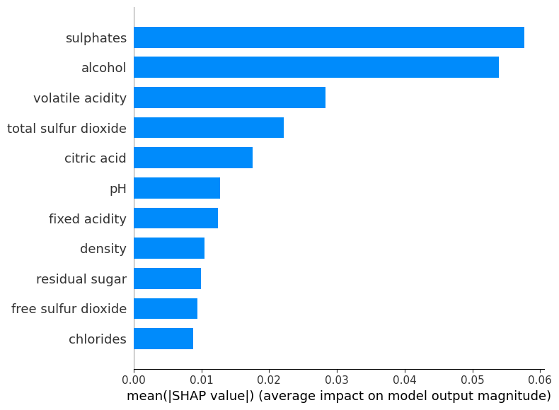
Shapley values Class 2

Slide 23
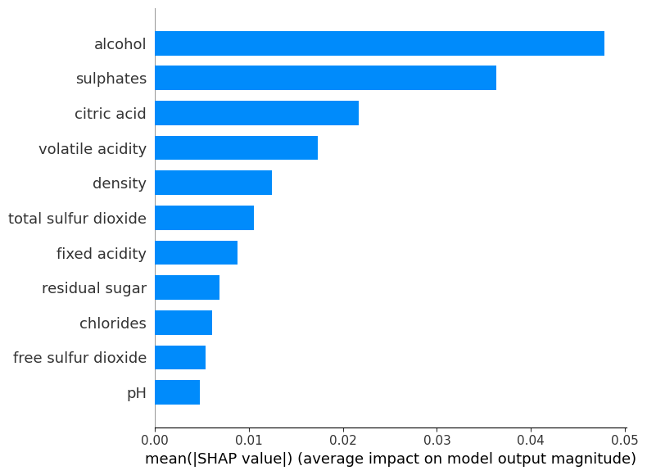
Shapley values Class 3

Slide 24
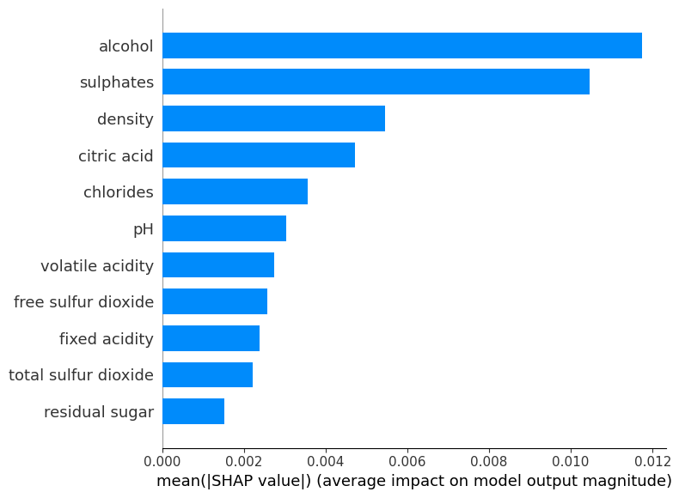
Shapley values Class 4

Slide 25
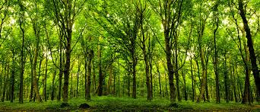
Forest cover Dataset
Target ? Cover type
The big data set contains data about forest cover, having 55 attributes and 581k samples. These parameters describe the physical and chemical properties of the wine
Numerical attributes Elevation Aspect Slope Horizontal and Vertical Distances (4 distances) Hillshade (3 hillshades)
Categorical attributes
Wilderness (4 areas)
Soil Types (38 types)

Slide 26
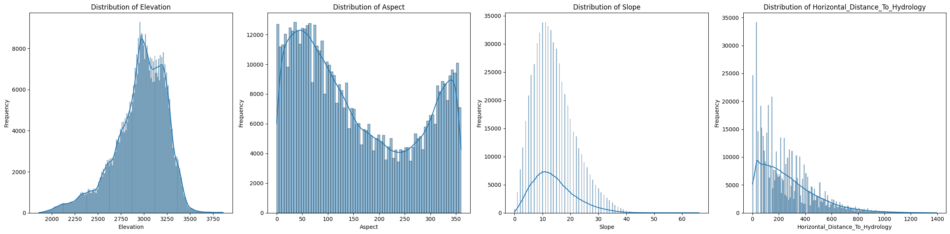
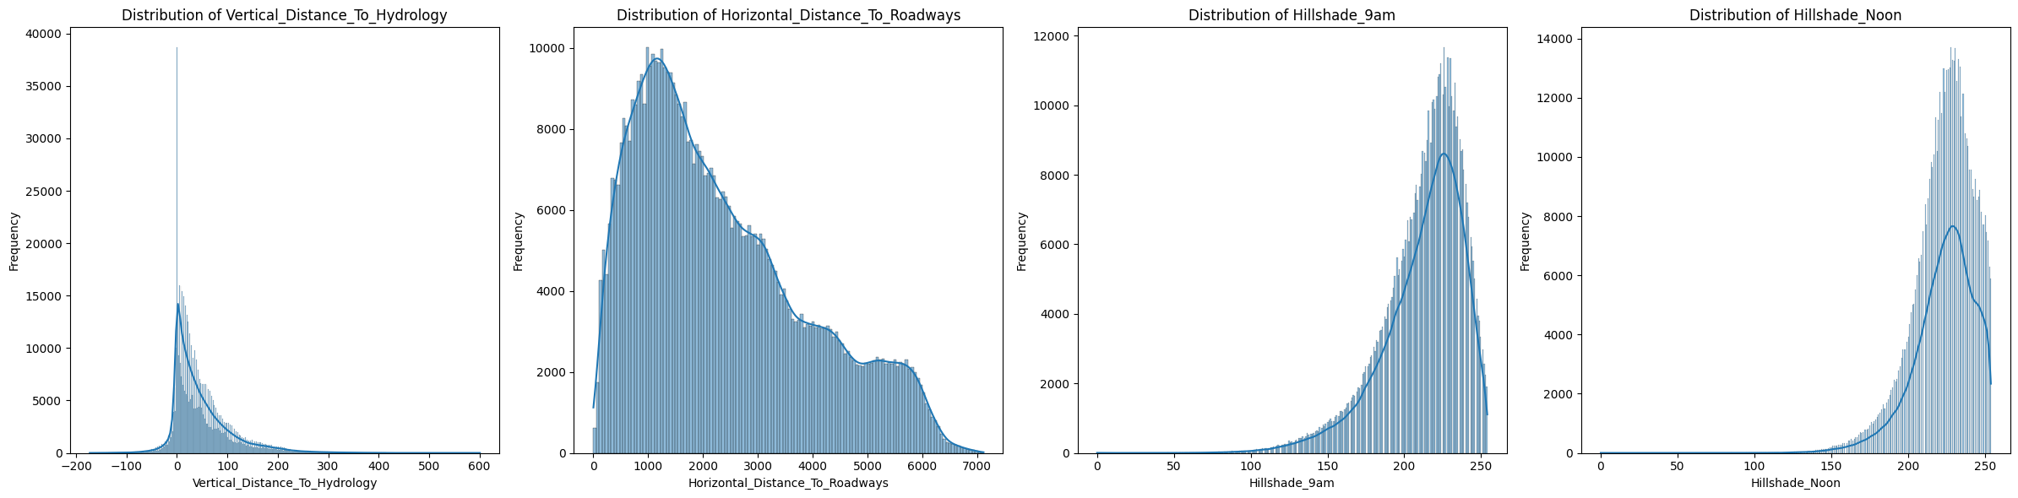
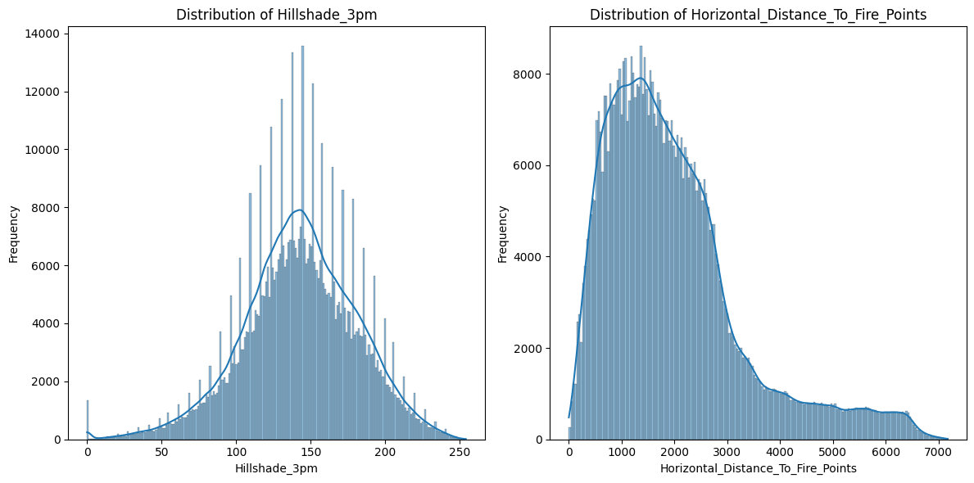
Numerical Data Distribution

Slide 27
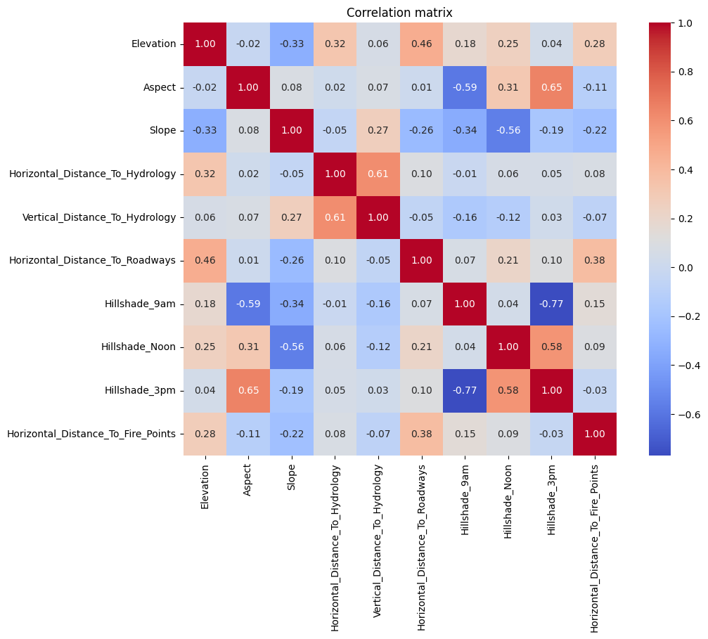
Correlation Matrix

Slide 28
RF Model
smote= SMOTE(sampling_strategy={3:6000,4:20000,5:36000,6:42000,2:75000,0:198310}, random_state=42)
X_resampled, y_resampled = smote.fit_resample(X_train, y_train)
%%time
base_model = RandomForestClassifier(random_state=42,class_weight="balanced",oob_score=True,
n_estimators=140,criterion="entropy",max_depth=40,min_samples_leaf=4,
min_samples_split=5)
base_model.fit(X_train, y_train)
rf_predictions = base_model.predict(X_test)
accuracy_score_rf = accuracy_score(y_test, rf_predictions)
print(f"Accuracy: {accuracy_score_rf}",f"OOB_Score: {base_model.oob_score_}")
conf_matrix = confusion_matrix(y_test, rf_predictions)
correct_predictions_per_class = conf_matrix.diagonal()
total_predictions_per_class = conf_matrix.sum(axis=1)
print("\nNumber of Correct Predictions per Class:")
for class_idx, correct in enumerate(correct_predictions_per_class):
print(f"Class {class_idx}: {correct} out of {total_predictions_per_class[class_idx]}")
print("\nAccuracy per Class:")
for class_idx, (correct, total) in enumerate(zip(correct_predictions_per_class, total_predictions_per_class)):
accuracy = correct / total if total > 0 else 0
print(f"Class {class_idx}: {accuracy:.2%}")

Slide 29
First results
Accuracy: 0.861448962731779 OOB_Score: 0.9388086784621891
Number of Correct Predictions per Class:
Class 0: 55874 out of 63552
Class 1: 76046 out of 84991
Class 2: 8244 out of 10726
Class 3: 389 out of 824
Class 4: 1262 out of 2848
Class 5: 2900 out of 5210
Class 6: 5439 out of 6153
Accuracy per Class:
Class 0: 87.92%
Class 1: 89.48%
Class 2: 76.86%
Class 3: 47.21%
Class 4: 44.31%
Class 5: 55.66%
Class 6: 88.40%
CPU times: user 2min 15s, sys: 599 ms, total: 2min 16s
Wall time: 2min 15s

Slide 30
Additional attempts
['Elevation’,
'Horizontal_Distance_To_Roadways', 'Horizontal_Distance_To_Fire_Points’,
'Wilderness_Area4’,
'Horizontal_Distance_To_Hydrology’,
‘Wilderness_Area1’,
'Vertical_Distance_To_Hydrology’,
'Hillshade_9am’,
'Wilderness_Area3’,
'Aspect']
%%time
base_model_3 = RandomForestClassifier(random_state=42,class_weight="balanced",oob_score=True,
n_estimators=145,criterion="entropy",max_depth=40,min_samples_leaf=4,
min_samples_split=5)
base_model_3.fit(X_resampled[important_features], y_resampled)
rf_predictions_3 = base_model_3.predict(X_test[important_features])
accuracy_score_rf_3 = accuracy_score(y_test, rf_predictions_3)

Slide 31
Final results
Accuracy: 0.9551358545988617 OOB_Score: 0.9692627080365519
Number of Correct Predictions per Class:
Class 0: 60607 out of 63552
Class 1: 81392 out of 84991
Class 2: 10252 out of 10726
Class 3: 756 out of 824
Class 4: 2621 out of 2848
Class 5: 4839 out of 5210
Class 6: 6017 out of 6153
Accuracy per Class:
Class 0: 95.37%
Class 1: 95.77%
Class 2: 95.58%
Class 3: 91.75%
Class 4: 92.03%
Class 5: 92.88%
Class 6: 97.79%

Slide 32

Thank you for attention !

