Slide 1
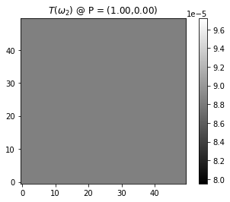
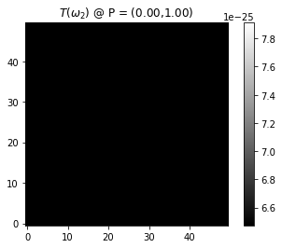
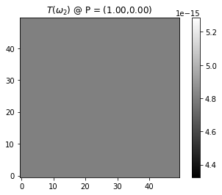
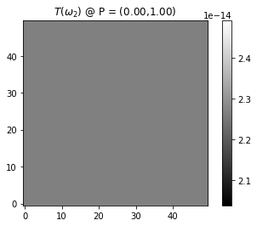
def psi(x,y,z):
return 0.00001
def theta(x,y,z):
return np.pi/2+0.00001
def phi(x,y,z):
return 0.00001
def psi(x,y,z):
return 0.00001
def theta(x,y,z):
return np.pi/2+0.00001
def phi(x,y,z):
return np.pi/2+0.00001
PINDEX = 0
PINDEX = 1
PINDEX = 0
PINDEX = 1

