Slide 1

Motion Coherent Tracking with Multi-Label MRF Optimization
David Tsai Matthew Flagg James M. Rehg
Computational Perception Lab
School of Interactive Computing
Georgia Institute of Technology

Slide 2
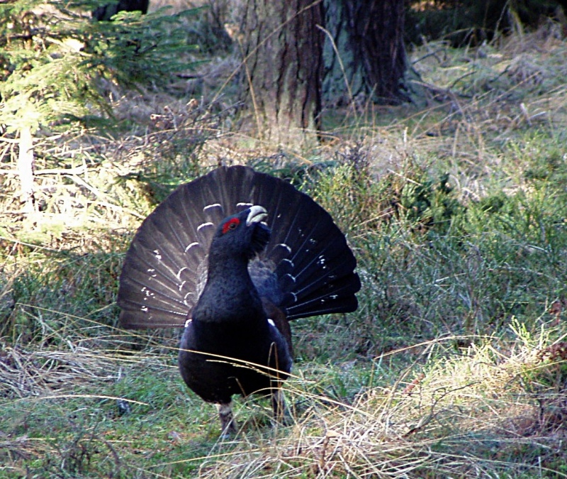
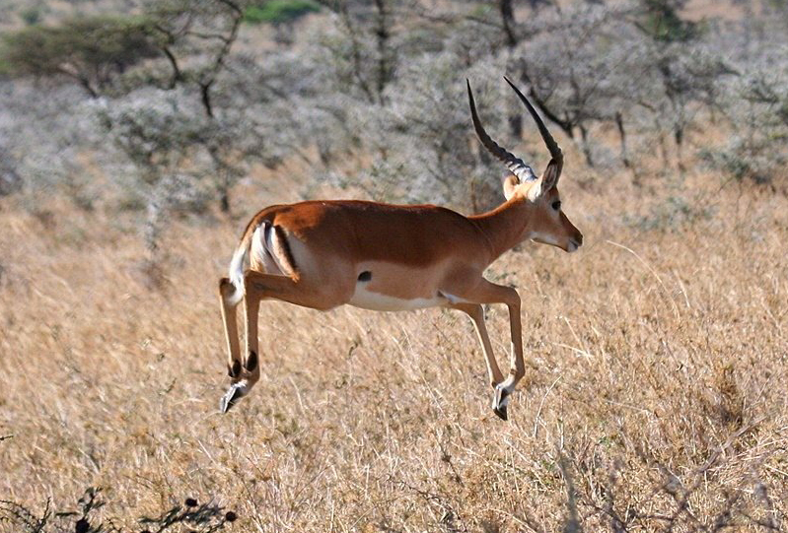
Tracking Animals for Behavior Analysis
Lekking display
Stotting behavior
Wide range of animal morphologies and biological questions
“Tracking” via segmentation of the animal
http://www.kinetrack.org
Notes:
We’re interested in tracking a wide range of animals to help biologists collect behavioral data. Due to the great range of animal morphologies, our focus is on segmenting the animal over time. This segmentation can serve as the basis for specific behavioral measurements. The kinetrack website maintained by my collaborator Tucker Balch describes some of our on-going collaborations with biologists.
The bird is a Capercallie, the animal is a Thompson’s gazelle

Slide 3
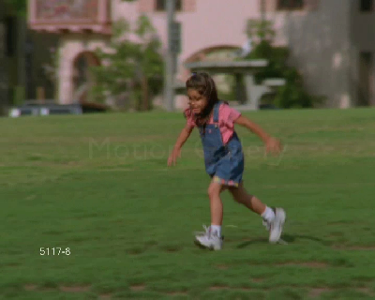
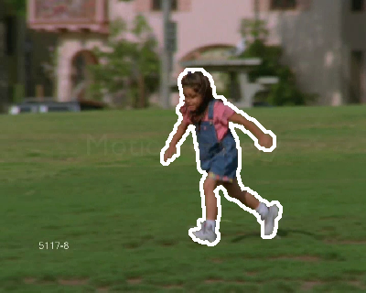
Goal
Input video
Output
Automatic video object cut-out
Offline analysis with minimum user input
Behavior analysis via post-processing

Slide 4
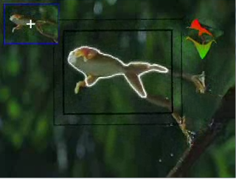
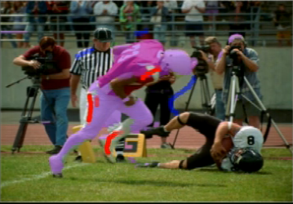
Previous Work
Bibby et al. ECCV’08
Bai et al. SIGGRAPH’09
* Real-time, automatic
* Not focused on
segmentation
* High-quality segmentation
* Significant manual effort
is required
Notes:
We want something inbetween these concerns

Slide 5
Approach
Segmentation in video volume MRF
Formulate as joint label assignment
No shape priors, adaptation, etc.
Joint label space encodes per-pixel segmentation and motion
Enforce motion coherence
SegTrack database with video segmentation ground truth
Comparison to existing methods

Slide 6
MRF Multi-Label Space
t+1
Temporal
neighbors
t
Spatial
neighbors
p
{ , } X {-2, -1, 0, +1, +2}

Slide 7
MRF Multi-Label Space
{ , +1}
t+1
Temporal
neighbors
t
Spatial
neighbors
p
{ , } X {-2, -1, 0, +1, +2}

Slide 8
Multi-Label MRF Assignment
Find joint label assignment minimizing:
Data
Smoothness

Slide 9
Data Term
t+1
Optical flow
t
RGB likelihood
foreground
background

Slide 10
Smoothness Term
Attribute
Coherence
t+1
t
p

Slide 11
Smoothness Term
Attribute
Coherence
t+1
t
Lowest
Cost
Assignment
p

Slide 12
Smoothness Term
Motion
Coherence
t+1
t
p

Slide 13
Smoothness Term
Motion
Coherence
t+1
t
Lowest
Cost
Assignment
p

Slide 14
Optimization
Challenge: Combinatorics of label space
162 labels/pixel => 19.4M labels/frame
Solution:
Process video in subvolumes, constrain the solution across the boundaries
Spatial mult-grid (factor of 16 savings)
Use Fast-PD by Komodakis et.al.
We have found Fast-PD to converge significantly faster than graphcut
20 seconds/frame for 300 x 400 image

Slide 15
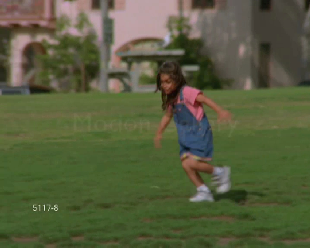
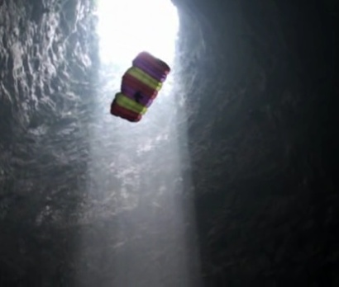
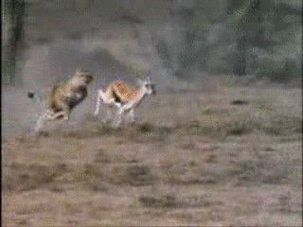
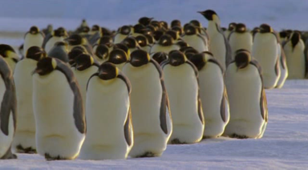
SegTrack Database
A new database for video segmentation with ground truth
Three attributes that impact performance:
Color overlap between target and background
Interframe motion
Change in target shape

Slide 16
Experiment
Quantitative Comparison with Chockalingam et.al ICCV’09

Slide 17
Quantitative Comparison
Comparison with Birchfield et.al ICCV 2009
Sequence | Color | Motion | Shape | Our Score | Birchfield
Parachute | 0.038 | 0.119 | 0.024 | 235 | 502
Girl | 0.205 | 0.145 | 0.147 | 1304 | 1755
Monkeydog | 0.299 | 0.243 | 0.132 | 563 | 683
Penguin | 1.02 | 0.016 | 0.013 | 1705 | 6627
Birdfall | 0.466 | 0.283 | 0.070 | 252 | 454
Cheetah | 0.760 | 0.273 | 0.187 | 1142 | 1217
SegTrack Database metrics and scores

Slide 18
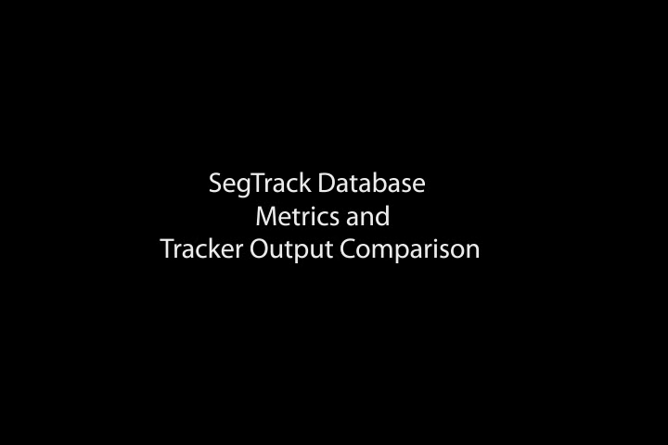
Video Results

Slide 19
Conclusion
New approach to video object cut-out based on temporally-coherent MRF
New SegTrack dataset to facilitate quantitative evaluations of segmentation performance
Promising experimental results, including comparison to two recent methods

