Slide 1
Subspace and Kernel Methods
April 2004
Seong-Wook Joo

Slide 2
Motivation of Subspace Methods
Subspace is a “manifold” (surface) embedded in a higher dimensional vector space
  Visual data is represented as a point in a high dimensional vector space
  Constraints in the natural world and the imaging process causes the points to “live” in a lower dimensional subspace
Dimensionality reduction
  Achieved by extracting ‘important’ features from the dataset → Learning
  Is desirable to avoid the “curse of dimensionality” in pattern recognition → Classification
    With fixed sample size, the classification performance decreases as the number of feature increases
Example: Appearance-based methods (vs model-based)

Slide 3
Linear Subspaces
≈
x_{i} ≈ _{b=1..k} q_{bi} u_{b}
X_{dxn}
U_{dxk}
Q_{kxn}
Definitions/Notations
  X_{dxn}: sample data set. n d-vectors
  U_{dxk}: basis vector set. k d-vectors
  Q_{kxn}: coefficient (component) sets. n k-vectors
Note: k could be up to d, in which case the above is a “change of basis” and ≈ → =
Selection of U
  Orthonormal bases
    Q is simply projection of X onto U: Q = U^{T} X
  General independent bases
    If k=d, Q is obtained by solving linear system
    if k<d, do some optimization (e.g., least squares)
Different criterion for selecting U leads to different subspace methods
Notes:
If we do PCA, k can be up to min(d,n) since rank(XX^{T}) <= min(d,n)
Linear subspace projection: U with orthonormal cols, x’ = UU^{T} x, x’ is closest (Euclidean dist) approx to x.
If U is square, UU^{T}=U^{T}U=I and x’=x

Slide 4
ICA (Independent Component Analysis)
Assumption, Notation
  Measured data is a linear combination of some set of independent signals (random variables x representing (x(1)…x(d)) or row d-vectors)
  x_{i} = a_{i1}s₁ + … + a_{in}s_{n} = a_{i} S (a_{i} : row n-vector)
  zero-mean x_{i} , a_{i} assumed
  X = AS (X_{nxd}: measured data, i.e., n different mixtures, A_{nxn}: mixing matrix, S_{nxd}: n independent signals)
Algorithm
  Goal: given X, find A and S (or find W=A⁻¹ s.t. S=WX)
  Key idea
    By the Central Limit Theorem, sum of independent random variables becomes more ‘Gaussian’ than the individual r.v.’s
    Some linear comb. v X is maximally non-Gaussian when v X=s_{i}, i.e., v=w_{i} (naturally, this doen’t work when s is Gaussian)
  Non-Gaussianity measures
    Kurtosis (a 4th order stat), Negentropy
Notes:
Since the vectors here are row vectors, in our column vector notation everything has to be transposed: X=AS becomes X^{T}=S^{T}A^{T} = UQ
Note there are ambiguities: variance (scale) X = AS = (AM⁻¹)(MS) = A’S’, permutation of independent components X = (AP⁻¹)(PS) = A’S’

Slide 5
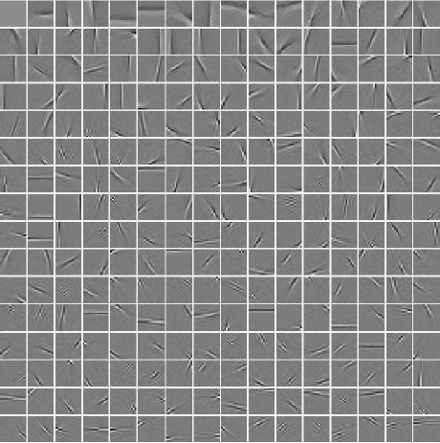
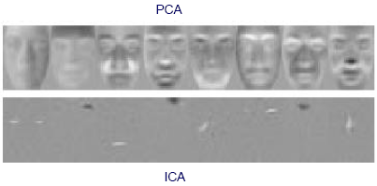
ICA Examples
Natural images
Faces (vs PCA)

Slide 6
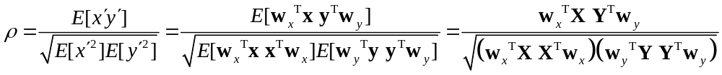
CCA (Canonical Correlation Analysis)
Assumption, Notation
  Two sets of vectors X = [x₁…x_{m}], Y = [y₁…y_{n}]
  X, Y: measured from the same semantic object (physical phenomenon)
  projection for each of the sets: x' = w_{x}x, y' = w_{y}y
Algorithm
  Goal: Given X, Y find w_{x}, w_{y} that maximizes the correlation btwn x', y'
  XX^{T} = C_{xx}, YY^{T} = C_{yy} : within-set cov. , XY^{T} = C_{xy} : between set cov.
  Solutions for w_{x}, w_{y} by generalized eigenvalue problem or SVD
    Taking the top k vector pairs W_{x}=(w_{x1}…w_{xk}), W_{y}=(w_{y1}…w_{yk}), correlation matrix_{kxk} of the projected k-vectors x', y' is diagonal with diagonals maximized
    k ≤ min(m,n)

Slide 7
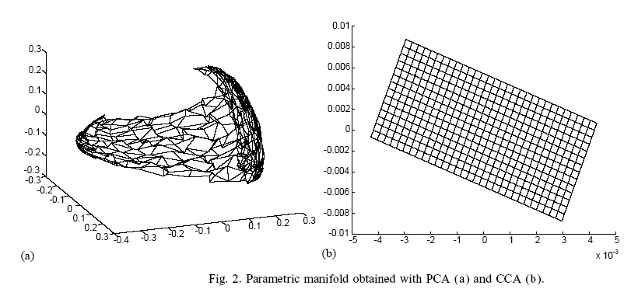
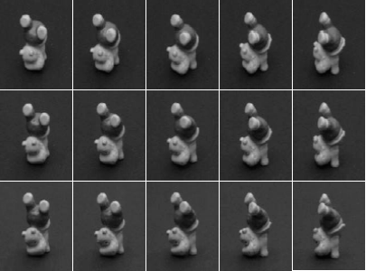
CCA Example
X: training images, Y: corresponding pose params (pan, tilt) = (φ,θ)
First 3 principle components, parameterized by pose (φ,θ)
First 2 CCA factors, parameterized by pose (φ,θ)

Slide 8
Comparisons
PCA
  Unsupervised
  Orthogonal bases ← min. Euclidean error
  Transform into uncorrelated (Cov=0) variables
LDA
  Supervised
  (properties same as PCA)
ICA
  Unsupervised
  General linear bases
  Transform into variables not only uncorrelated (2nd order) but also as independent as possible (higher order)
CCA
  Supervised
  Separate (orthogonal) linear bases for each data set
  Transformed variables’ correlation matrix is ‘maximized’

Slide 9
Kernel Methods
Kernels
  Φ(.): nonlinear mapping to a high dimensional space
  Mercer kernels can be decomposed into dot product
    K(x,y) = Φ(x)•Φ(y)
Kernel PCA
  X_{dxn} (cols of d-vectors) → Φ(X) (high dimensional vectors)
  Inner-product matrix = Φ(X)^{T}Φ(X) = [K(x_{i},x_{j})] ≡ K_{nxn}(X,X)
  First k eigenvectors e: transform matrix E_{nxk} = [e₁…e_{k}]
  The ‘real’ eigenvectors are Φ(X)E
  New pattern y is mapped (into prin. components) by
    (Φ(X)E)^{T} Φ(y) = E^{T} Φ(X)^{T} Φ(y) = E^{T} K_{nx1}(X,y)
  The “trick” is to somehow use dot products wherever Φ(x) occurs
Exists kernel versions of FDA, ICA, CCA, …
Notes:
Recall in PCA when d>>n, we first find the eigenvectors of X^{T}X (instead of XX^{T}) to reduce the cov. matrix size from dxd to nxn. Then by multiplying X in front of the eigenvects, we can get the original eigenvects.
Note Φ(.) is not explicitly derived. It is defined by what their dot product looks like (i.e.,the kernel)

Slide 10
References
Overview
  H. Bischof and A. Leonardis, “Subspace Methods for Visual Learning and Recognition”, ECCV 2002 Tutorial slides
  http://www.icg.tu-graz.ac.at/~bischof/TUTECCV02.pdf
  http://cogvis.nada.kth.se/hamburg-02/slides/UOLTutorial.pdf (shorter version)
  H. Bischof and A. Leonardis, “Kernel and subspace methods for computer vision” (Editorial), Pattern Recognition, Volume 36, Issue 9, 2003
  Baback Moghaddam, “Principal Manifolds and probabilistic Subspaces for Visual Recognition”, PAMI, Vol 24, No 6, Jun 2002 (Introduction section)
  A. Jain, R. Duin, J. Mao, “Statistical Pattern Recognition: A Review”, PAMI, Vol 22, No 1, Jan 2000 (section 4: Dimensionality Reduction)
ICA
  A. Hyvärinen and E. Oja, “Independent component analysis: algorithms and applications”, Neural Networks, Volume 13, Issue 4, Jun 2000 http://www.sciencedirect.com/science/journal/08936080
CCA
  T. Melzer, M. Reiter and H. Bischof, “Appearance models based on kernel canonical correlation analysis”, Pattern Recognition, Volume 36, Issue 9, 2003
  http://www.sciencedirect.com/science/journal/00313203

Slide 11
Kernel Density Estimation
aka Parzen windows estimator
The KDE estimate at x using a “kernel” K(·,·) is equivalent to the inner product ⟨ Φ(x),1/n_{i} Φ(x_{i}) ⟩ = 1/n_{i}K(x,x_{i})
  inner product can be seen as a similarity measure
KDE and classification
  Let x’ = Φ(x), assume class ω₁, ω₂ ’s mean c₁’,c₂’ are of same dist from origin (=equal prior?)
  Linear classifier
    ⟨x’,c₁’-c₂’⟩ > 0 ? ω₁: ω₂
    = 1/n₁ _{i∈ω1} ⟨x’,x_{i}’⟩ - 1/n₂ _{i∈ω2} ⟨x’,x_{i}’⟩
    = 1/n₁ _{i∈ω1} K(x,x_{i}) - 1/n₂ _{i∈ω2} K(x,x_{i})
    This is equivalent to the “Bayes classifier” with the densities estimated by KDE
Notes:
<,> is just another notation for dot product (inner product)

Slide 12
=
Getting coefficients for orthonormal basis vectors:
Q_{kxn}
(U_{dxk})^{T}
X_{dxn}

