Slide 1

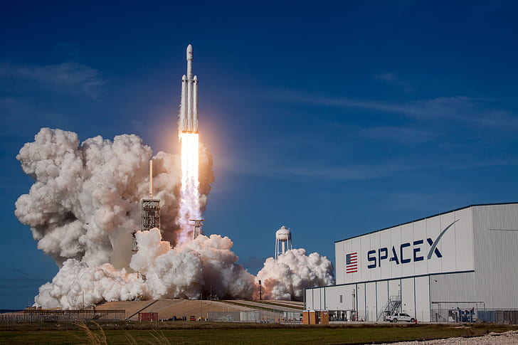
IBM Data Science Capstone Project Space X
Andrej Djukic
Space Exploration Technologies

Slide 2



OUTLINE
Executive Summary
Introduction
Methodology
Results
Visualization – Charts
Dashboard
Discussion
Findings & Implications
Conclusion
Appendix

Slide 3

EXECUTIVE SUMMARY
Data Collection
Data Wrangling
EDA with data visualization
EDA with SQL
Building an interactive map with Folium
Building a Dashboard with Plotly Dash
Predictive analysis (Classification)
EDA results

Slide 4

INTRODUCTION
Project background and context
We predicted if the Falcon 9 first stage will land successfully. SpaceX advertises Falcon 9 rocket launches on its website, with a cost of 62 million dollars; other providers cost upward of 165 million dollars each, much of the savings is because SpaceX can reuse the first stage. Therefore, if we can determine if the first stage will land, we can determine the cost of a launch. This information can be used if an alternate company wants to bid against SpaceX for a rocket launch.
Common problems that needed solving.
What influences if the rocket will land successfully?
The effect each relationship with certain rocket variables will impact in determining the success rate of a successful landing.
What conditions does SpaceX have to achieve to get the best results and ensure the best rocket success landing rate.

Slide 5

METHODOLOGY
•Data collection methodology:
•SpaceX Rest API
•(Web Scrapping) from Wikipedia
•Performed data wrangling (Transforming data for Machine Learning)
One Hot Encoding data fields for Machine Learning and dropping irrelevant columns
•Performed exploratory data analysis (EDA) using visualization and SQL
Plotting : Scatter Graphs, Bar Graphs to show relationships between variables to show patterns of data.
•Performed interactive visual analytics using Folium and Plotly Dash
•Performed predictive analysis using classification models
•How to build, tune, evaluate classification models

Slide 6
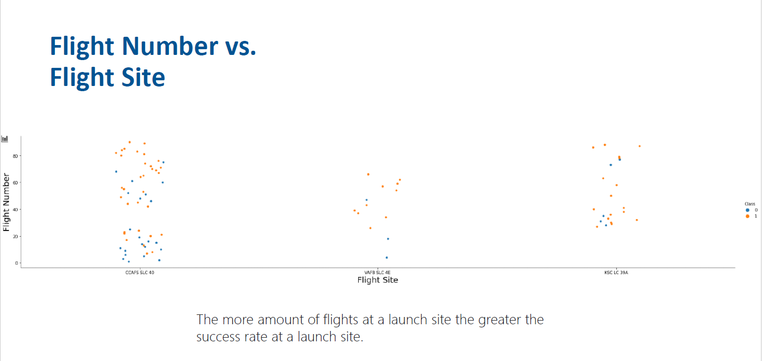
RESULTS

Slide 7
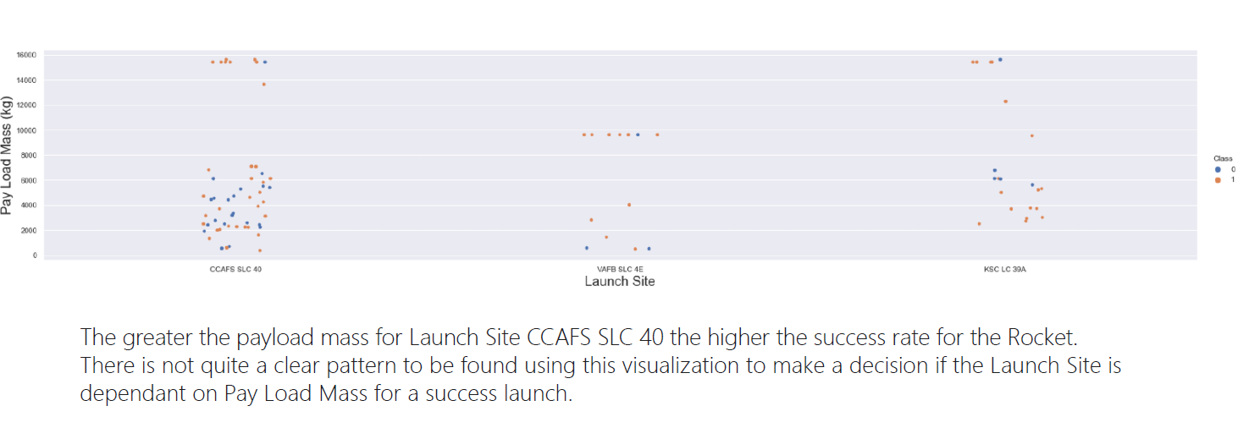
Payload Mass Vs Launch Site
< Bar chart of top 10 programming languages for the next year goes here.>

Slide 8
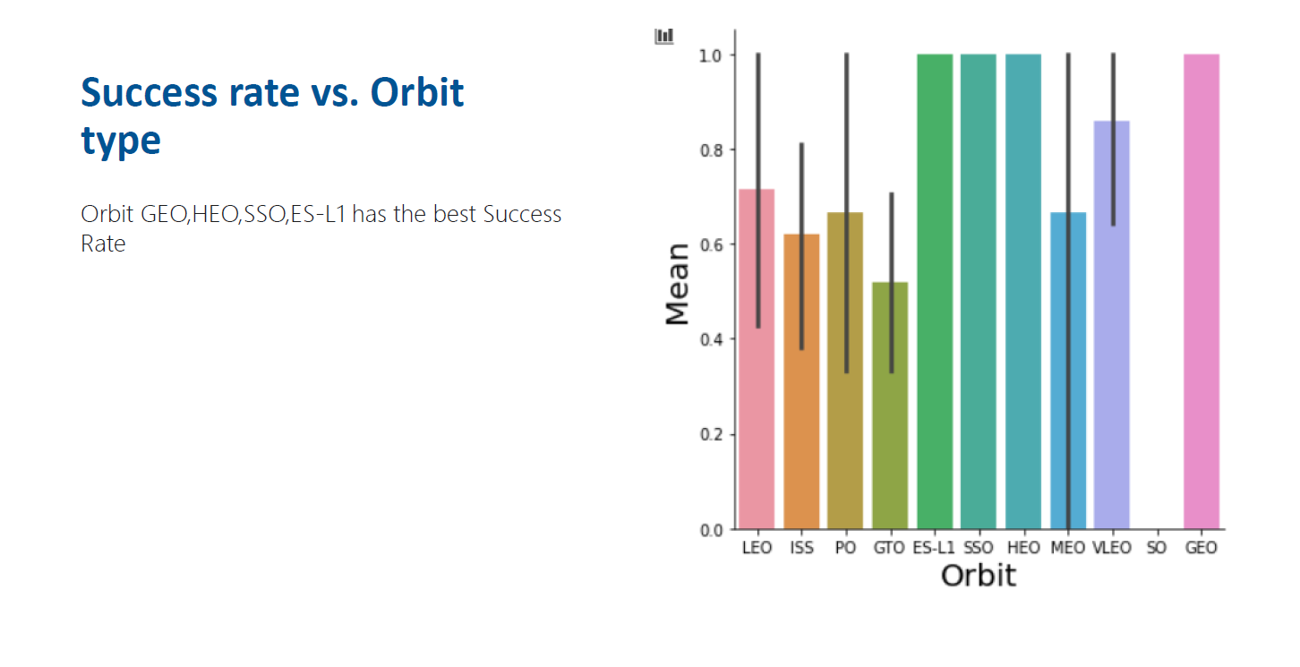
Success rate vs Orbit type
Findings
Finding 1
Finding 2
Finding 3
Implications
Implication 1
Implication 2
Implication 3

Slide 9
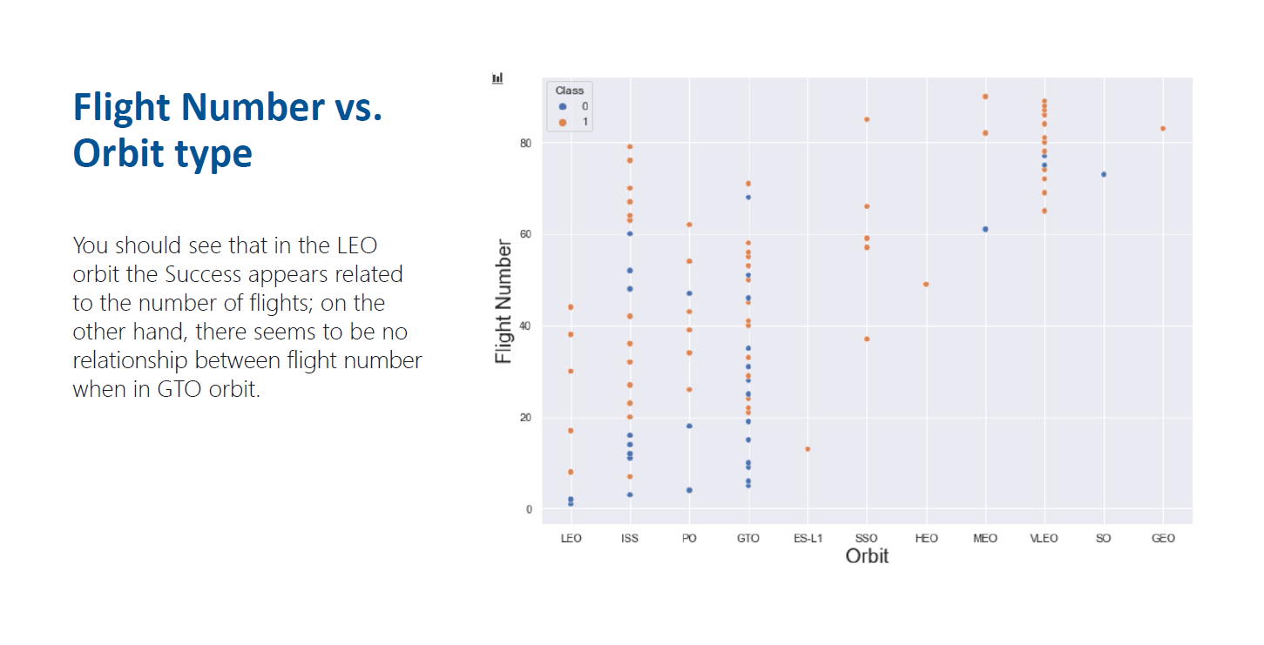
DATABASE TRENDS
Current Year
Next Year
< Bar chart of top 10 databases for the current year goes here >
< Bar chart of top 10 databases for the next year goes here.>

Slide 10
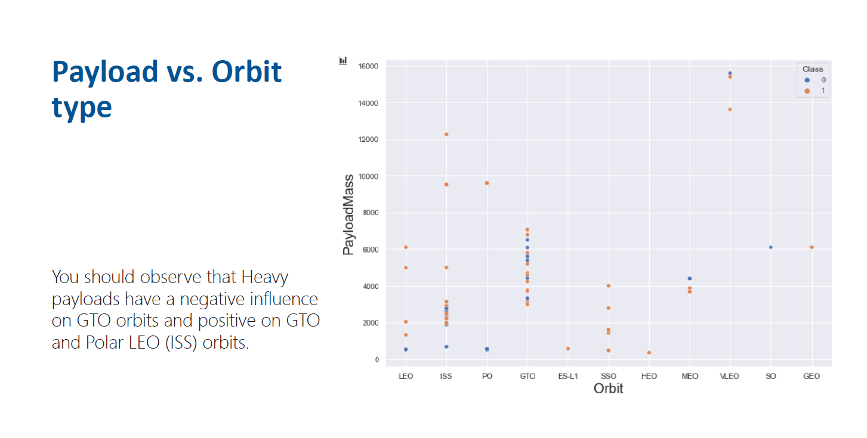
DATABASE TRENDS - FINDINGS & IMPLICATIONS
Findings
Finding 1
Finding 2
Finding 3
Implications
Implication 1
Implication 2
Implication 3

Slide 11
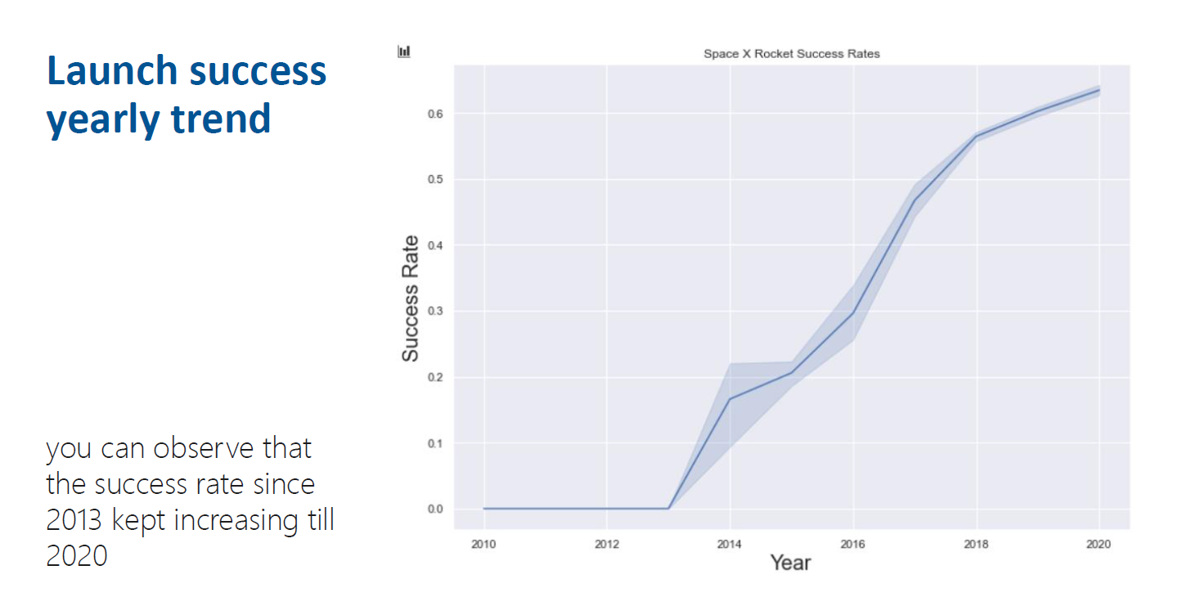

DASHBOARD
<The GitHub link of the Cognos/Looker Studio dashboard goes here.>

Slide 12
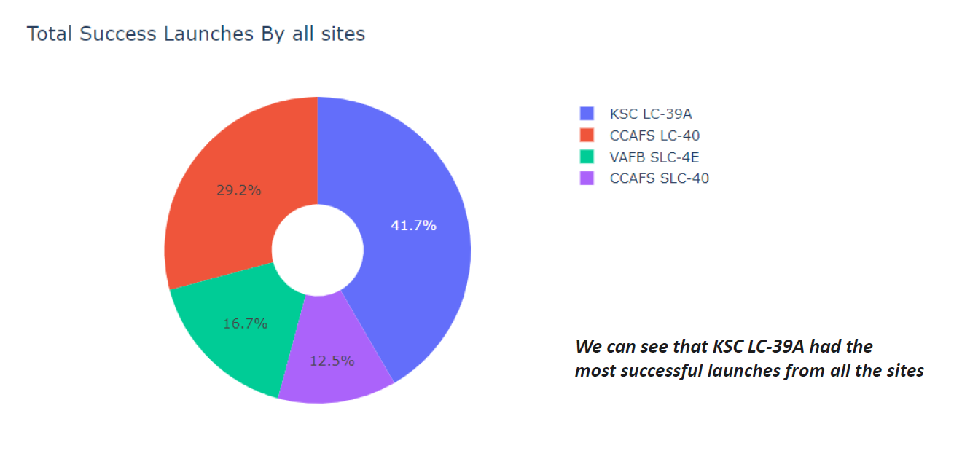
DASHBOARD TAB 1
Screenshot of dashboard tab 1 goes here

Slide 13
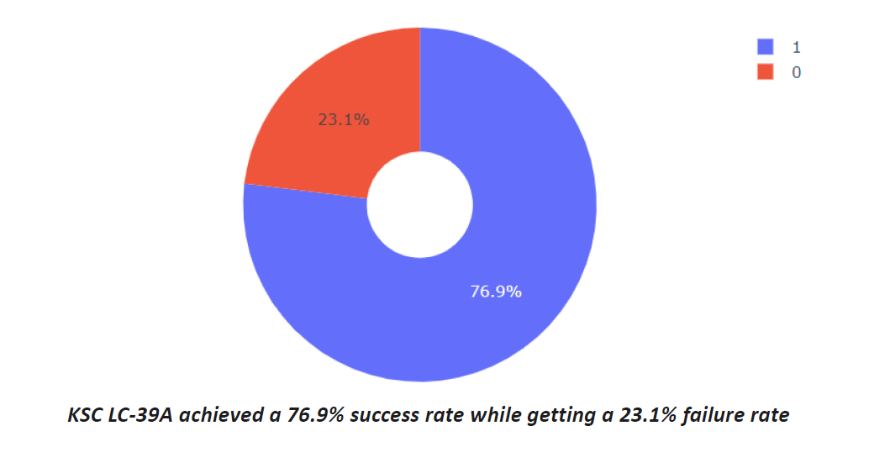
DASHBOARD TAB 2

Slide 14
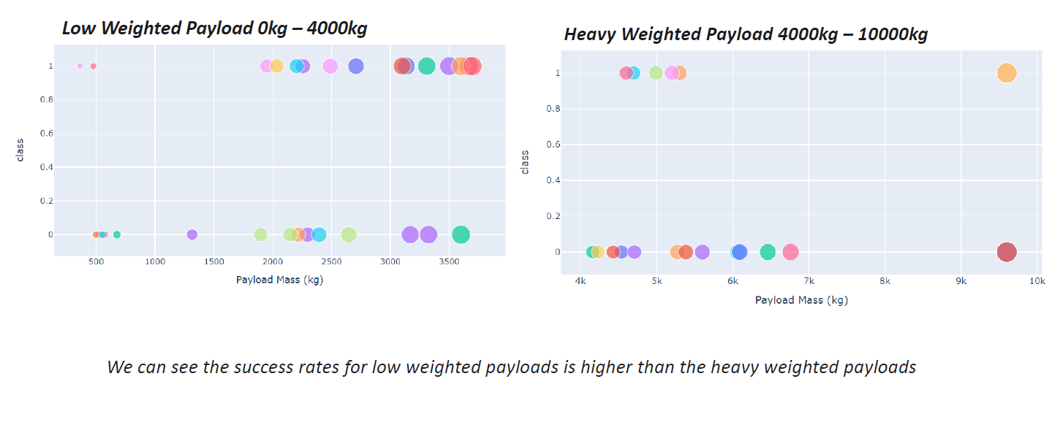
DASHBOARD TAB 3
Screenshot of dashboard tab 3 goes here

Slide 15

CONCLUSION
•The Tree Classifier Algorithm is the best for Machine Learning for this dataset
•Low weighted payloads perform better than the heavier payloads
•The success rates for SpaceX launches is directly proportional time in years they will eventually perfect the launches
•We can see that KSC LC-39A had the most successful launches from all the sites
•Orbit GEO,HEO,SSO,ES-L1 has the best Success Rate

Slide 16

APPENDIX
•Haversine formula
•ADGGoogleMaps Module (not used but created)

Slide 17
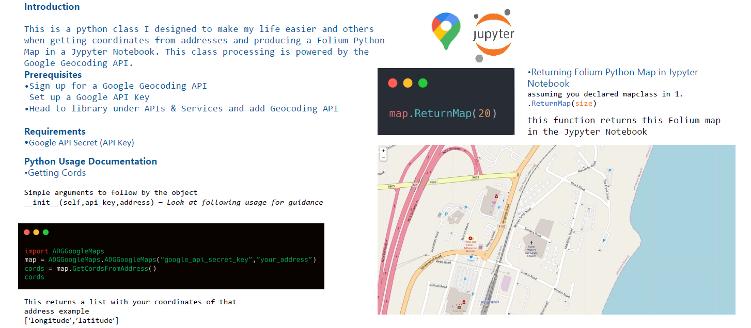
ADGGoogleMaps Module
In Module 1 you have collected the job posting data using Job API in a file named “job-postings.xlsx”. Present that data using a bar chart here. Order the bar chart in the descending order of the number of job postings.

Slide 18
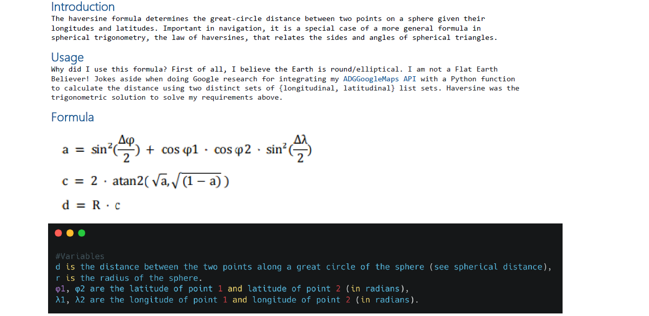
Haversine Formula

