Slide 1
10707 Deep Learning: Spring 2020
Andrej Risteski
Machine Learning Department
Lecture 2: Representational power of neural networks

Slide 2

Supervised learning
Empirical risk minimization approach: minimize a training loss $l$ over a class of predictors ℱ:
$\hat{f}= \underset{f∈ℱ}{argmin} \underset{\left(x,y\right):training samples}{Σ}l\left(f\left(x\right), y\right)$
Three pillars:
(1) How expressive is the class $ℱ$? (Representational power)
(2) How do we minimize the training loss efficiently? (Optimization)
(3) How does ${\hat{f}}^{ }$perform on unseen samples? (Generalization)

Slide 3

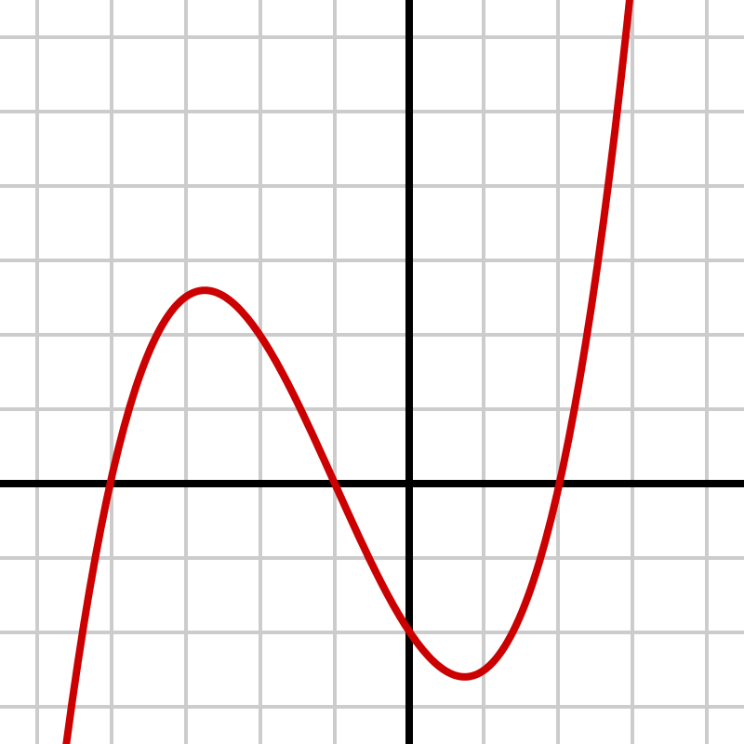
Expressivity
What do we mean by expressivity?
Expressive = functions in class can represent “complicated” functions

Slide 4
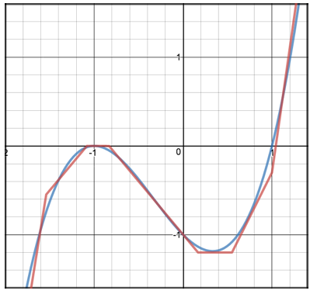
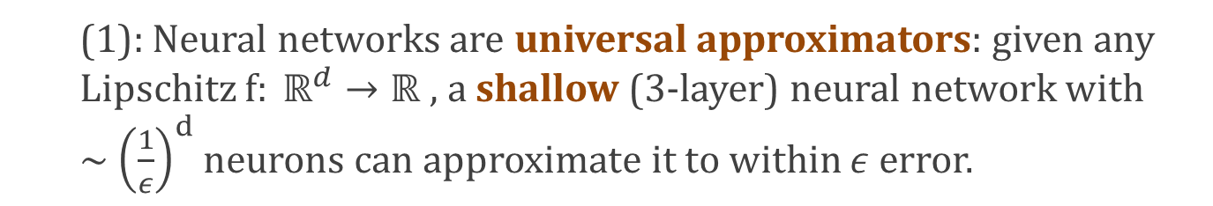
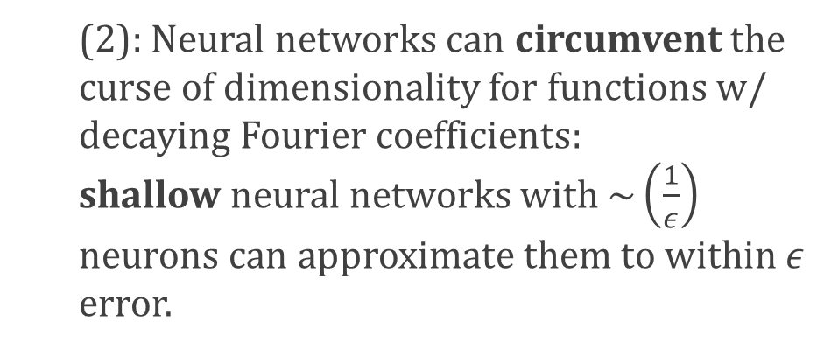
“Universal” expressivity of neural networks
(1): Neural networks are universal approximators: given any Lipschitz $f: ℝ^{d}→ℝ ,$ a shallow (3-layer) neural network with ~ ${\left(\frac{1}{ε}\right)}^{d}$neurons can approximate it to within $ε$ error.
“curse of dimensionality”
(2): Neural networks can circumvent the curse of dimensionality for functions w/ decaying Fourier coefficients: shallow neural networks with $\sim {\left(\frac{1}{ε}\right)}^{ }$ neurons can approximate them to within $ε$ error.

Slide 5
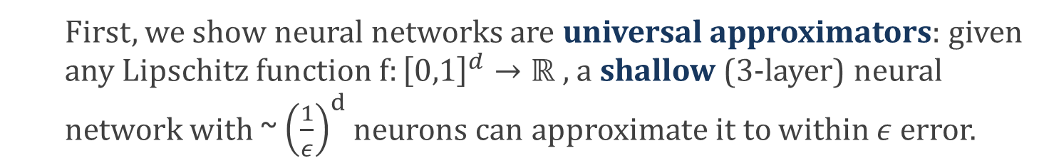

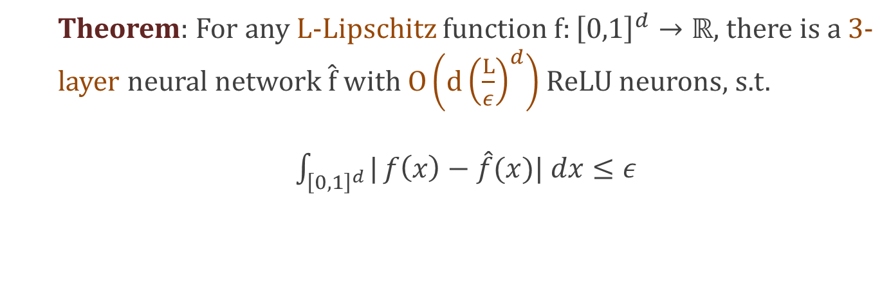

Universal approximation I: Lipschitz function are approximable
Recall, a function $f:{\left[0,1\right]}^{d}→ℝ$is L-Lipschitz, if: $∀x,y∈{\left[0,1\right]}^{d}, \left|f\left(x\right)−f\left(y\right)\right|≤L{\left|\left|x−y\right|\right|}_{2}$
First, we show neural networks are universal approximators: given any Lipschitz function $f:{\left[0,1\right]}^{d}→ℝ ,$ a shallow (3-layer) neural network with ~ ${\left(\frac{1}{ε}\right)}^{d}$neurons can approximate it to within $ε$ error.
Theorem: For any L-Lipschitz function $f:{\left[0,1\right]}^{d}→ℝ,$ there is a 3-layer neural network $\hat{f}$with $O\left(d{\left(\frac{L}{ε}\right)}^{d}\right)$ ReLU neurons, s.t.
$\int_{{\left[0,1\right]}^{d}}^{ }{|}f\left(x\right)−\hat{f}(x)| dx≤ε$
$l_{1}$ error

Slide 6



Universal approximation I: Proof intuition
Part 1: using Lipschitzness, we can “query” the values of function f approximately by querying its values on a fine grid.
y
$$\left|f\left(y\right) −f\left(x\right)\right|≤Lδ$$
$$δ$$
x
Part 2: we can approximate f as linear combination of “queries”.
$$f\left(x\right)≈\sum_{cells C_{i}}{1_{x∈C_{i}} f(x_{i})}$$
Part 3: Approximate the indicators using ReLUs

Slide 7

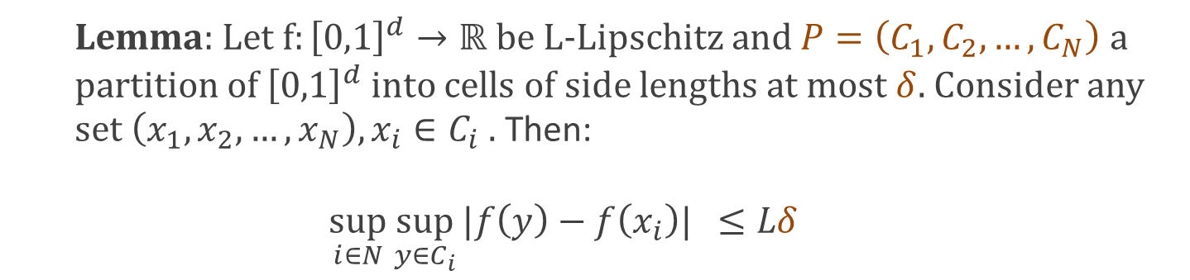




Universal approximation I: Part 1, formally
Lemma: Let $f:{\left[0,1\right]}^{d}→ℝ$ be L-Lipschitz and $P=\left(C_{1},C_{2},…, C_{N}\right)$a partition of ${\left[0,1\right]}^{d}$ into cells of side lengths at most $δ.$ Consider any set $\left(x_{1},x_{2},…, x_{N}\right), x_{i}∈C_{i} .$ Then:
$$\sup_{i∈N}\sup_{y∈C_{i}}{|f\left(y\right)−f\left(x_{i}\right)|} ≤Lδ$$
y
Proof: By Lipschitzness, we have
$$δ$$
$$x_{i}$$
$$∀i, y∈C_{i}: \left|f\left(y\right) −f\left(x_{i}\right)\right|≤L|y−x_{i}|$$
$$≤Lδ$$
$$□$$

Slide 8
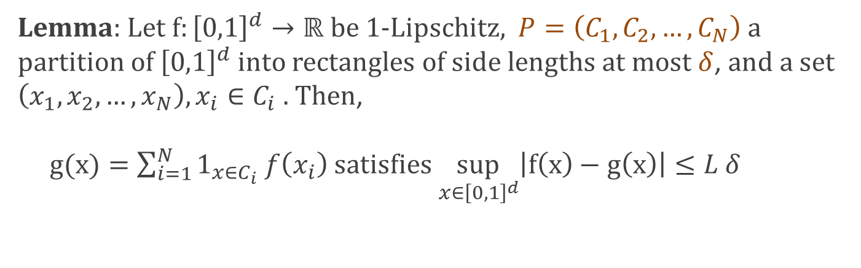

Universal approximation I: Part 2, formally
Lemma: Let $f:{\left[0,1\right]}^{d}→ℝ$ be 1-Lipschitz, $P=\left(C_{1},C_{2},…, C_{N}\right)$a partition of ${\left[0,1\right]}^{d}$ into rectangles of side lengths at most $δ$, and a set $\left(x_{1},x_{2},…, x_{N}\right), x_{i}∈C_{i} .$ Then, $g(x)=\sum_{i=1}^{N}{1_{x∈C_{i}} f\left(x_{i}\right)}$ satisfies $\sup_{x∈{\left[0,1\right]}^{d}}\left|f\left(x\right)−g\left(x\right)\right|≤L δ$
Proof: Let $x∈C_{i}$. Then, $1_{x∈C_{i}}$ = 1, and $1_{x∈C_{j}}=0$ for $j≠i.$
So, g(x) = $f\left(x_{i}\right)$.
By Lemma 1, $\left|f\left(x\right)−g\left(x\right)\right|$ = $\left|f\left(x\right)−g\left(x_{i}\right)\right|≤L δ$
$$□$$

Slide 9
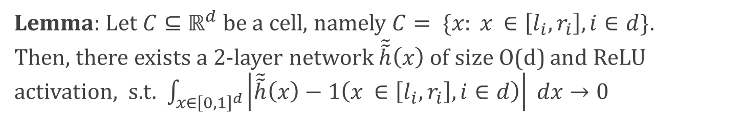
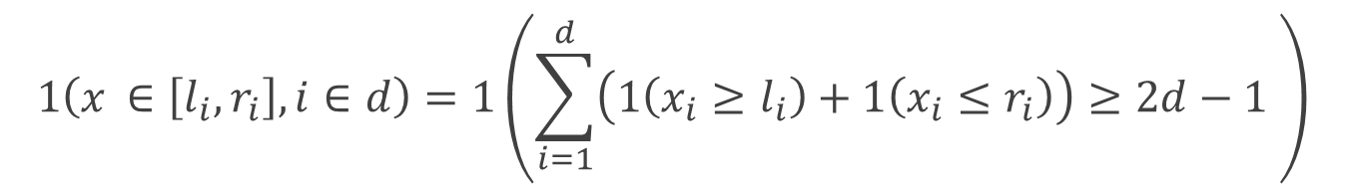
Universal approximation I: approximating indicators of cells
Lemma: Let $C⊆ℝ^{d}$ be a cell, namely $C= \{x: x_{ }∈\left[l_{i}, r_{i}\right], i∈d\}$. Then, there exists a 2-layer network $\tilde{\tilde{h}}\left(x\right)$ of size O(d) and ReLU activation, s.t. $\int_{x∈{\left[0,1\right]}^{d}}{\left|\tilde{\tilde{h}}\left(x\right)−1\left(x_{ }∈\left[l_{i}, r_{i}\right], i∈d\right)\right| dx}→0$
Proof: First, write indicator for cell as:
$$1\left(x_{ }∈\left[l_{i}, r_{i}\right], i∈d\right)=1\left(\sum_{i=1}^{d}{\left(1\left(x_{i}≥l_{i}\right)+1\left(x_{i}≤r_{i}\right)\right)≥2d−1 }\right)$$
Why? x is in cell iff all the indicators $1\left(x_{i}≥l_{i}\right)+1\left(x_{i}≤r_{i}\right)$ are on.
All these indicators are on iff they sum to $2d$.
(If at least one is off, they sum to $2d$-1)
If we can approximate indicators, we’re all good!

Slide 10











Universal approximation I: approximating indicators of cells
Claim: For $τ≥0, x∈ℝ:$
$$≤1, if 0≤x≤1/τ$$
$\left|1\left(x≥0\right)−\left(σ\left(τx\right)−σ\left(τx −1\right)\right)\right|$ =
$$0, otherwise$$
Proof: Consider several cases:
$1\left(x≥0\right)$ = 0
and $σ\left(τx\right)−σ\left(τx −1\right)$ = 0, so
Case 1, $x≤0$:
Slope $τ$
$$1\left(x≥0\right)−\left(σ\left(τx\right)−σ\left(τx −1\right)\right)=0$$
Case 2, $x≥1/τ$:
$1\left(x≥0\right)$ = 1
and $σ\left(τx\right)−σ\left(τx −1\right)$ = 1, so
$$1\left(x≥0\right)−\left(σ\left(τx\right)−σ\left(τx −1\right)\right)=0$$
Case 3, $0≤x≤1/τ$:
$1\left(x≥0\right)$ = 1
and $σ\left(τx\right)−σ\left(τx −1\right)$ = $τx$, so
$\left|1\left(x≥0\right)−\left(σ\left(τx\right)−σ\left(τx −1\right)\right)\right|=τx≤1$

Slide 11
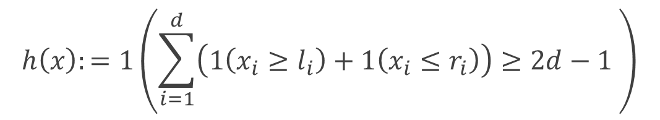
Universal approximation I: approximating indicators of cells
$$h\left(x\right):=1\left(\sum_{i=1}^{d}{\left(1\left(x_{i}≥l_{i}\right)+1\left(x_{i}≤r_{i}\right)\right)≥2d−1 }\right)$$
Replace all indicators by difference of ReLUs. What is the error?
For brevity, let $\tilde{1}\left(x\right)=σ\left(τx\right)−σ\left(τx −1\right),$ for some $τ$ we will choose.
Let $\tilde{h}\left(x\right)≔1\left(\sum_{i=1}^{d}{\left(\tilde{1}\left(x_{i}≥l_{i}\right)+\tilde{1}\left(x_{i}≤r_{i}\right)\right)≥2d−1 }\right)$
l$\tilde{\tilde{h}}\left(x\right)≔\tilde{1}\left(\sum_{i=1}^{d}{\left(\tilde{1}\left(x_{i}≥l_{i}\right)+\tilde{1}\left(x_{i}≤r_{i}\right)\right)≥2d−1 }\right)$
(Change the approximations “iteratively”.)

Slide 12
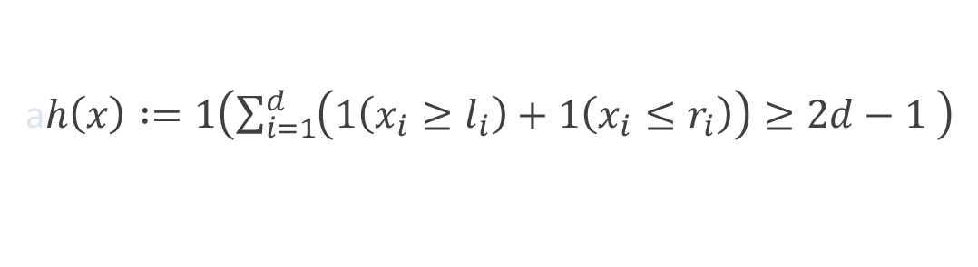
Universal approximation I: approximating indicators of cells
a$h\left(x\right) :=1\left(\sum_{i=1}^{d}{\left(1\left(x_{i}≥l_{i}\right)+1\left(x_{i}≤r_{i}\right)\right)≥2d−1 }\right)$
a$\tilde{h}\left(x\right)≔1\left(\sum_{i=1}^{d}{\left(\tilde{1}\left(x_{i}≥l_{i}\right)+\tilde{1}\left(x_{i}≤r_{i}\right)\right)≥2d−1 }\right)$
l$\tilde{\tilde{h}}\left(x\right)≔\tilde{1}\left(\sum_{i=1}^{d}{\left(\tilde{1}\left(x_{i}≥l_{i}\right)+\tilde{1}\left(x_{i}≤r_{i}\right)\right)≥2d−1 }\right)$
We have:
$$\int_{x∈[0,1]}{\left|\tilde{\tilde{h}}\left(x\right)−h\left(x\right)\right|dx=\int_{x∈{\left[0,1\right]}^{d}}{\left|\tilde{\tilde{h}}\left(x\right)−\tilde{h}\left(x\right)+\tilde{h}\left(x\right) −h\left(x\right)\right|dx }}$$
$$≤\int_{x∈{\left[0,1\right]}^{d}}{\left(\left|\tilde{\tilde{h}}\left(x\right)−\tilde{h}\left(x\right)\right|+\left|\tilde{h}\left(x\right)−h\left(x\right)\right| \right)dx}$$
Triangle inequality
Let’s handle two terms one by one.

Slide 13



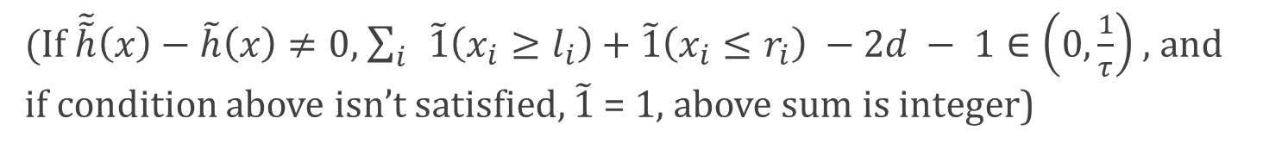
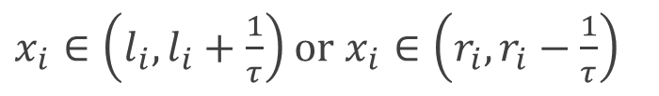
Universal approximation I: approximating indicators of cells
a$\tilde{h}\left(x\right)≔1\left(\sum_{i=1}^{d}{\left(\tilde{1}\left(x_{i}≥l_{i}\right)+\tilde{1}\left(x_{i}≤r_{i}\right)\right)≥2d−1 }\right)$
l$\tilde{\tilde{h}}\left(x\right)≔\tilde{1}\left(\sum_{i=1}^{d}{\left(\tilde{1}\left(x_{i}≥l_{i}\right)+\tilde{1}\left(x_{i}≤r_{i}\right)\right)≥2d−1 }\right)$
$$≤1, if 0≤x≤1/τ$$
$\left|1\left(x≥0\right)−\left(σ\left(τx\right)−σ\left(τx −1\right)\right)\right|$ =
Claim:
$$0, otherwise$$
$x_{i}∈\left(l_{i}, l_{i}+\frac{1}{τ}\right)$ or $x_{i}∈\left(r_{i}, r_{i}−\frac{1}{τ}\right)$
$\tilde{\tilde{h}}\left(x\right)−\tilde{h}\left(x\right)≠0$ only if $∃i$:
First:
$($If $\tilde{\tilde{h}}\left(x\right)−\tilde{h}\left(x\right)≠0$, $\sum_{i}{ }\tilde{1}\left(x_{i}≥l_{i}\right)+\tilde{1}\left(x_{i}≤r_{i}\right) −2d − 1∈\left(0,\frac{1}{τ}\right)$, and if condition above isn’t satisfied, $\tilde{1}$ = 1, above sum is integer)
Measure of such x’s is bdd by $\frac{2d}{τ}$, so $\int_{x∈{\left[0,1\right]}^{d}}{ |}\tilde{\tilde{h}}\left(x\right)−\tilde{h}\left(x\right)|≤\frac{2d}{τ}$

Slide 14
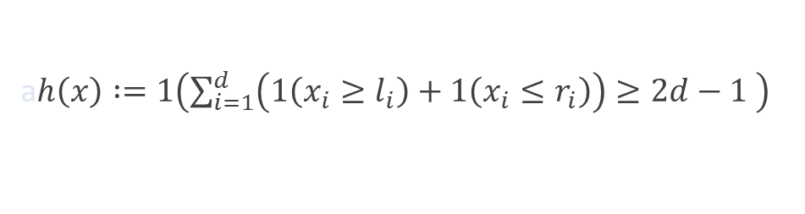
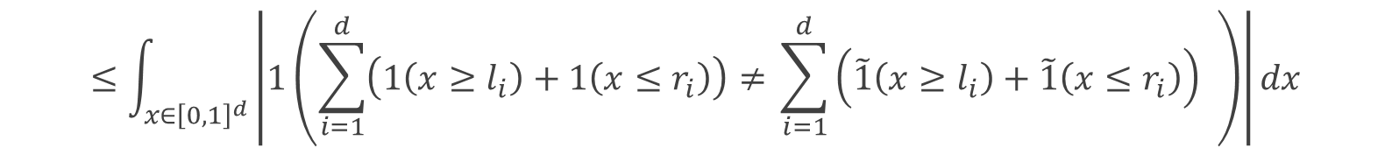



Universal approximation I: approximating indicators of cells
a$h\left(x\right) :=1\left(\sum_{i=1}^{d}{\left(1\left(x_{i}≥l_{i}\right)+1\left(x_{i}≤r_{i}\right)\right)≥2d−1 }\right)$
a$\tilde{h}\left(x\right)≔1\left(\sum_{i=1}^{d}{\left(\tilde{1}\left(x_{i}≥l_{i}\right)+\tilde{1}\left(x_{i}≤r_{i}\right)\right)≥2d−1 }\right)$
$$≤1, if 0≤x≤1/τ$$
$\left|1\left(x≥0\right)−\left(σ\left(τx\right)−σ\left(τx −1\right)\right)\right|$ =
Claim:
$$0, otherwise$$
$$\int_{x∈[0,1]}{\left|\tilde{h}\left(x\right)−h\left(x\right)\right| dx}$$
Indicators are equal if inputs are equal
Second:
$$≤\int_{x∈{\left[0,1\right]}^{d}}{\left|1\left(\sum_{i=1}^{d}{\left(1\left(x≥l_{i}\right)+1\left(x≤r_{i}\right)\right)≠ }\sum_{i=1}^{d}{\left(\tilde{1}\left(x≥l_{i}\right)+\tilde{1}\left(x≤r_{i}\right)\right) }\right)\right|dx}$$
$$≤\int_{x∈{\left[0,1\right]}^{d}}{\sum_{i=1}^{d}{1\left(1\left(x≥l_{i}\right)≠\tilde{1}\left(x≥l_{i}\right)\right)}+\sum_{i=1}^{d}{1\left(1\left(x≤r_{i}\right)≠\tilde{1}\left(x≤r_{i}\right)\right)}dx}$$
By Claim
$$≤2d/τ$$

Slide 15
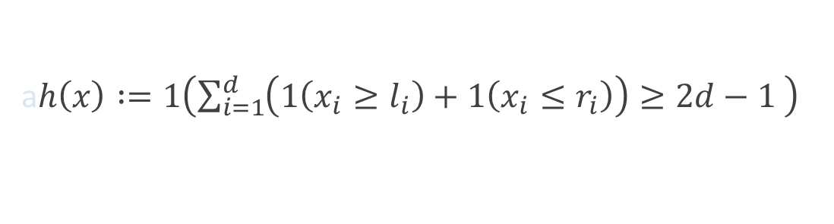
Universal approximation I: approximating indicators of cells
a$h\left(x\right) :=1\left(\sum_{i=1}^{d}{\left(1\left(x_{i}≥l_{i}\right)+1\left(x_{i}≤r_{i}\right)\right)≥2d−1 }\right)$
a$\tilde{h}\left(x\right)≔1\left(\sum_{i=1}^{d}{\left(\tilde{1}\left(x_{i}≥l_{i}\right)+\tilde{1}\left(x_{i}≤r_{i}\right)\right)≥2d−1 }\right)$
l$\tilde{\tilde{h}}\left(x\right)≔\tilde{1}\left(\sum_{i=1}^{d}{\left(\tilde{1}\left(x_{i}≥l_{i}\right)+\tilde{1}\left(x_{i}≤r_{i}\right)\right)≥2d−1 }\right)$
Putting together, we have:
$$\int_{x∈{\left[0,1\right]}^{d}}{\left|\tilde{\tilde{h}}\left(x\right)−h\left(x\right)\right|dx=\int_{x∈{\left[0,1\right]}^{d}}{\left|\tilde{\tilde{h}}\left(x\right)−\tilde{h}\left(x\right)+\tilde{h}\left(x\right) −h\left(x\right)\right|dx }}$$
$$≤4d/τ$$
Also, $\tilde{\tilde{h}}\left(x\right)$ is a 2-layer net with ReLU activations and $O\left(d\right)$nodes!

Slide 16
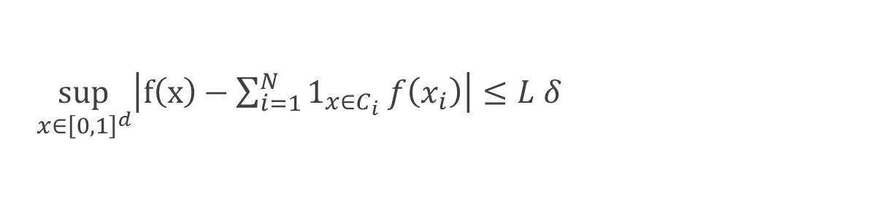
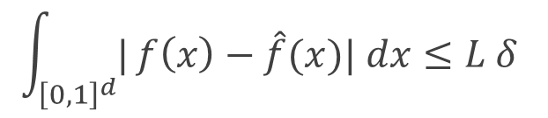


Universal approximation I: Putting everything together
a$\sup_{x∈{\left[0,1\right]}^{d}}\left|f\left(x\right)−\sum_{i=1}^{N}{1_{x∈C_{i}} f\left(x_{i}\right)}\right|≤L δ$
By Part 1+2,
${\left(\frac{1}{δ}\right)}^{d}$
Moreover, the number of cells N can be bounded by
By indicator approximation: can approximate arbitrarily well by taking
$τ→∞$with a 2-layer ReLU net.
Combining the above two points, we get a ${\left(\frac{1}{δ}\right)}^{d}−$sized 3-layer net s.t.
$$\int_{{\left[0,1\right]}^{d}}^{ }{|}f\left(x\right)−\hat{f}(x)| dx≤L δ$$
Taking $δ=\frac{ε}{L},$ the theorem follows.

Slide 17








Universal approximation I: approximating indicators of cells
Claim: For $τ≥0, \int_{x∈[−∞,+∞]}{\left|1\left(x≥0\right)−\left(σ\left(τx\right)−σ\left(τx −1\right)\right)\right|≤\frac{1}{τ} }$
Proof: Consider several cases:
$1\left(x≥0\right)$ = 0
Case 1, $x≤0$:
and $σ\left(τx\right)−σ\left(τx −1\right)$ = 0, so
$$1\left(x≥0\right)−\left(σ\left(τx\right)−σ\left(τx −1\right)\right)=0$$
Case 2, $x≥1/τ$:
$1\left(x≥0\right)$ = 1
and $σ\left(τx\right)−σ\left(τx −1\right)$ = 1, so
$$1\left(x≥0\right)−\left(σ\left(τx\right)−σ\left(τx −1\right)\right)=0$$
Case 3, $0≤x≤1/τ$:
$1\left(x≥0\right)$ = 1
and $σ\left(τx\right)−σ\left(τx −1\right)$ = $τx$, so
$1\left(x≥0\right)−\left(σ\left(τx\right)−σ\left(τx −1\right)\right)=τx≤1$
Integrating, we get the claim of the lemma.

Slide 18



Universal approximation I: approximating hyperplane indicators
Consider $σ(B\left(\left\langle x, e_{i}\right\rangle −l_{i} −δ\right))$, for B large. We claim this is a good approximation of $1\left(x≥l_{i}\right)$. Notice that:
If $\left\langle x, e_{i}\right\rangle ≤l_{i}+δ$ : $σ\left(B\left(\left\langle x, e_{i}\right\rangle −l_{i}−δ\right)\right)=0$
$$σ\left(B\left(\left\langle x, e_{i}\right\rangle −l_{i}\right)\right)=B\left(\left\langle x, e_{i}\right\rangle −l_{i}\right)$$
If $\left\langle x, e_{i}\right\rangle >l_{i}+δ,\left\langle x, e_{i}\right\rangle ≤1$:
$$≤B\left(\left\langle x, e_{i}\right\rangle −l_{i}\right)$$

Slide 19

Universal approximation I: back to approximating indicators
Recall, we are trying to approximate
$$1\left(x_{ }∈\left[l_{i}, r_{i}\right], i∈d\right)=\sum_{i=1}^{d}{\left(1\left(x≥l_{i}\right)+1\left(x≤r_{i}\right)\right)}$$
According to previous slide, $σ(B\left(\left\langle x, e_{i}\right\rangle −l_{i} −δ\right))$

Slide 20
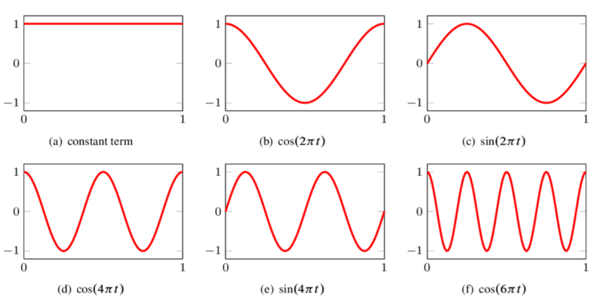



Escaping the curse of dimensionality: Nuggets of Fourier analysis
Can the ${\left(\frac{1}{ε}\right)}^{d}$dependence be avoided for “nice” functions? Yes! Relevant property is decay of the Fourier coefficients.
Recall: The Fourier basis for “nice” functions from $ℝ^{d}→ℝ$ consists of basis functions ${\{{e_{w}\left(x\right)= e}^{i⟨w, x ⟩}=cos\left(⟨w, x ⟩\right)+i sin(⟨w, x ⟩)|w∈ℝ^{d}\}}^{ }.$
$|\left|w\right||$ is larger: function oscillates more

Slide 21
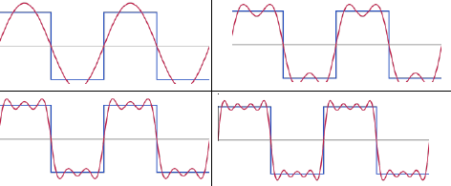
Escaping the curse of dimensionality: Nuggets of Fourier analysis
Can the ${\left(\frac{1}{ε}\right)}^{d}$dependence be avoided for “nice” functions? Yes! Relevant property is decay of the Fourier coefficients.
Recall: The Fourier basis for “nice” functions from $ℝ^{d}→ℝ$ consists of basis functions ${\{{e_{w}\left(x\right)= e}^{i⟨w, x ⟩}=cos\left(⟨w, x ⟩\right)+i sin(⟨w, x ⟩)|w∈ℝ^{d}\}}^{ }.$
Higher and higher frequencies => better approximation

Slide 22


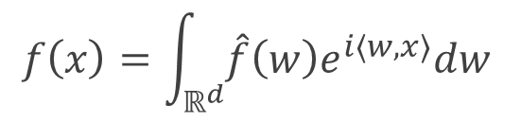


Escaping the curse of dimensionality: Nuggets of Fourier analysis
Can the ${\left(\frac{1}{ε}\right)}^{d}$dependence be avoided for “nice” functions? Yes! Relevant property is decay of the Fourier coefficients.
Recall: The Fourier basis for “nice” functions from $ℝ^{d}→ℝ$ consists of basis functions ${\{{e_{w}\left(x\right)= e}^{i⟨w, x ⟩}=cos\left(⟨w, x ⟩\right)+i sin(⟨w, x ⟩)|w∈ℝ^{d}\}}^{ }.$
Recall: The Fourier integral theorem gives coefficients for this basis:
Defining ${\hat{f}\left(w\right)=\int_{ℝ^{d}}{f\left(x\right)e^{−i⟨w, x⟩}dx}}^{ }$, we have:
$${f\left(x\right)=\int_{ℝ^{d}}{\hat{f}\left(w\right)e^{i⟨w, x⟩}dw}}^{ }$$
Coefficient for basis fn $e^{i⟨w, x ⟩}$

Slide 23
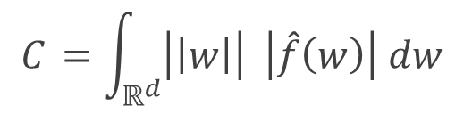
Escaping the curse of dimensionality: Nuggets of Fourier analysis
Can the ${\left(\frac{1}{ε}\right)}^{d}$dependence be avoided for “nice” functions? Yes! Relevant property is decay of the Fourier coefficients.
Def.: The Barron constant of a function f is the quantity
$${C_{ }=\int_{ℝ^{d}}{\left|\left|w\right|\right| \left|\hat{f}\left(w\right)\right| dw}}^{ }$$
Interpretation: the higher-order Fourier coefficients (i.e. high-oscillation parts of f) are small.
We will look for $O_{C_{ }}\left(\frac{1}{ε}\right)$ dependence of the size of the network.

Slide 24
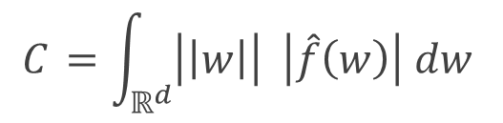

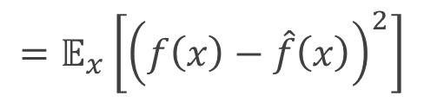

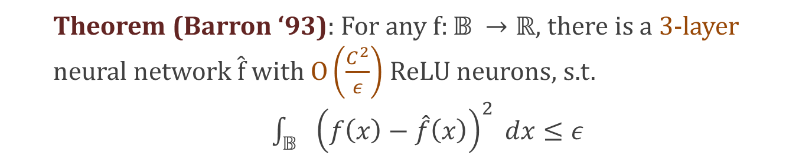
Escaping the curse of dimensionality: Barron’s Theorem
Def.: The Barron constant of a function f is the quantity
$${C_{ }=\int_{ℝ^{d}}{\left|\left|w\right|\right| \left|\hat{f}\left(w\right)\right| dw}}^{ }$$
=$\{x∈ℝ^{d}:\left|\left|x\right|\right|≤1\}$
Theorem (Barron ‘93): For any $f:𝔹^{ }→ℝ,$ there is a 3-layer neural network $\hat{f}$with $O\left(\frac{C_{ }^{2}}{ε}\right)$ ReLU neurons, s.t.
$\int_{𝔹^{ }}^{ }{ }{\left(f\left(x\right)−\hat{f}\left(x\right)\right)}^{2} dx≤ε$
$$=𝔼_{x}\left[{\left(f\left(x\right)−\hat{f}\left(x\right)\right)}^{2}\right]$$
$l_{2}$ error

Slide 25
Barron’s theorem: proof idea
Step 1: Show that any continuous function f can be written as an “infinite” convex combination of cosine-like activations . (Main tool: Fourier integral theorem)
Step 2: Show that a function f with small Barron constant can in fact be approximately written as a convex combination of a small number of cosine-like activations. (Main tool: subsampling the above infinite combination and concentration bounds.)
Step 3: Show that the cosine non-linearities can be approximated by sigmoid non-linearities. (Main tool: classical approximation theory.)

Slide 26
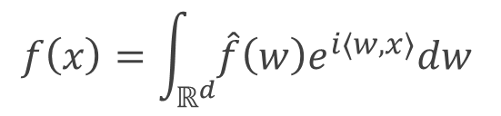
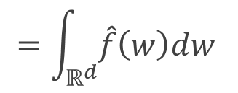
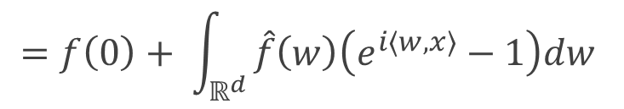
Step 1: infinite convex combination of cosine-like activations
By Fourier integral theorem, we have:
$${f\left(x\right)=\int_{ℝ^{d}}{\hat{f}\left(w\right)e^{i⟨w, x⟩}dw}}^{ }$$
$${=f\left(0\right)+ \int_{ℝ^{d}}{\hat{f}\left(w\right)\left(e^{i\left\langle w, x\right\rangle }−1\right)dw}}^{ }$$
$${=\int_{ℝ^{d}}{\hat{f}\left(w\right)dw}}^{ }$$

Slide 27
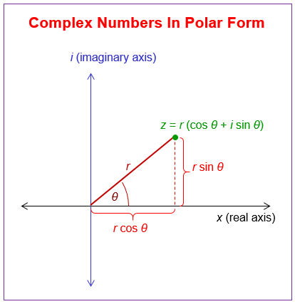
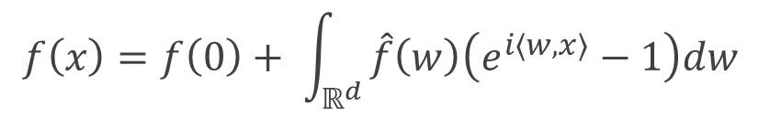


Step 1: infinite convex combination of cosine-like activations
$${f\left(x\right)=f\left(0\right)+ \int_{ℝ^{d}}{\hat{f}\left(w\right)\left(e^{i\left\langle w, x\right\rangle }−1\right)dw}}^{ }$$
By Fourier integral theorem,
Recall the polar form of a complex number:
$z=\left|z\right| {e^{i φ_{z}} }^{ }$
$=\left|z\right| (\cos{φ_{z}+i\sin{φ_z)}}$

Slide 28
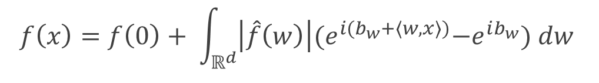
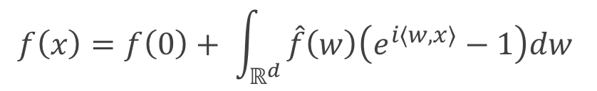

Step 1: infinite convex combination of cosine-like activations
$${f\left(x\right)=f\left(0\right)+ \int_{ℝ^{d}}{\hat{f}\left(w\right)\left(e^{i\left\langle w, x\right\rangle }−1\right)dw}}^{ }$$
By Fourier integral theorem,
$z=\left|z\right| {e^{i φ_{z}} }^{ }$
Recall the polar form of a complex number:
Hence, we can rewrite the Fourier integral formula as:
$${\begin{aligned}f\left(x\right)=f\left(0\right)+ \int_{ℝ^{d}}{\left|\hat{f}\left(w\right)\right|{(e}^{i(b_{w}+\left\langle w, x\right\rangle )}−e^{ib_{w}}) dw} \\ \end{aligned}}^{ }$$

Slide 29
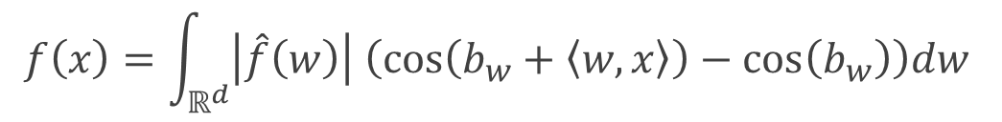
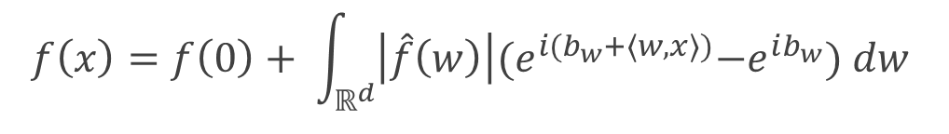

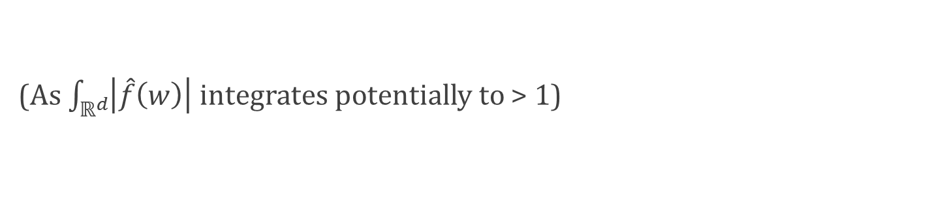
Step 1: infinite convex combination of cosine-like activations
$${\begin{aligned}f\left(x\right)=f\left(0\right)+ \int_{ℝ^{d}}{\left|\hat{f}\left(w\right)\right|{(e}^{i(b_{w}+\left\langle w, x\right\rangle )}−e^{ib_{w}}) dw} \\ \end{aligned}}^{ }$$
$${e^{iy}=cos\left(y\right)+i sin(y) }^{ }$$
Recall the expansion of complex exponentials:
As f is a real-valued function, only the real part of the above expression will survive. Hence,
$${f\left(x\right)=\int_{ℝ^{d}}{\left|\hat{f}\left(w\right)\right| \left(cos\left(b_{w}+\left\langle w,x\right\rangle \right)−\cos\left(b_{w}\right)\right)dw}}^{ }$$
Linear combination of cosine functions, but not convex!
(As $\int_{ℝ^{d}}{\left|\hat{f}\left(w\right)\right| }$integrates potentially to > 1)

Slide 30
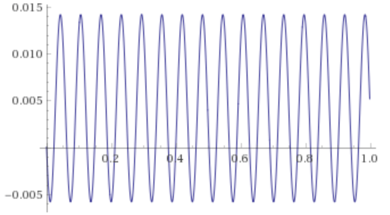
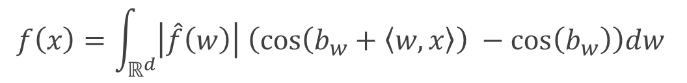
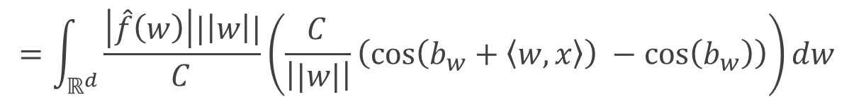
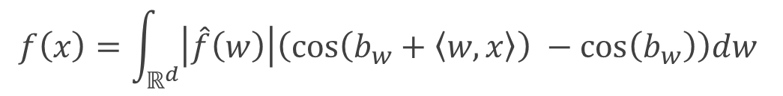
Step 1: infinite convex combination of cosine-like activations
$${f\left(x\right)=\int_{ℝ^{d}}{\left|\hat{f}\left(w\right)\right| \left(cos\left(b_{w}+\left\langle w,x\right\rangle \right) −\cos\left(b_{w}\right)\right)dw}}^{ }$$
We will rewrite:
$${f\left(x\right)=\int_{ℝ^{d}}{\left|\hat{f}\left(w\right)\right|\left(cos\left(b_{w}+\left\langle w,x\right\rangle \right) −\cos\left(b_{w}\right)\right)dw}}^{ }$$
$$=\int_{ℝ^{d}}{\frac{\left|\hat{f}\left(w\right)\right||\left|w\right||}{C_{ }}\left(\frac{C_{ }}{\left||w|\right|}\left(cos\left(b_{w}+\left\langle w,x\right\rangle \right) −\cos\left(b_{w}\right)\right)\right)dw}$$
Convex combination of cosine-like activations!
(As $\int_{ℝ^{d}}{\frac{\left|\hat{f}\left(w\right)\right|\left||w|\right|}{C_{ }}=1}$)

Slide 31
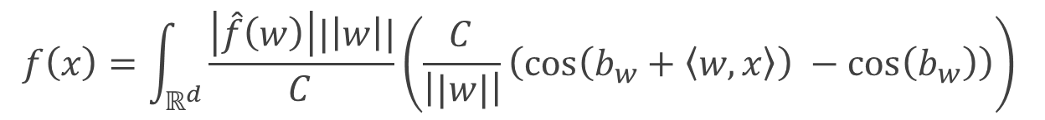
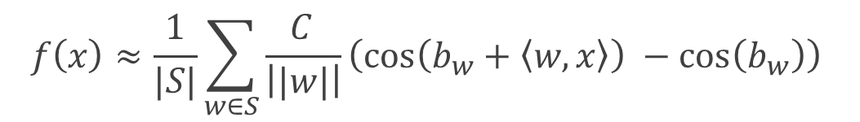
Step 2: convex combination of small number of cosine-like activations
$${f\left(x\right)=\int_{ℝ^{d}}{\frac{\left|\hat{f}\left(w\right)\right||\left|w\right||}{C_{ }}\left(\frac{C_{ }}{\left||w|\right|}\left(cos\left(b_{w}+\left\langle w,x\right\rangle \right) −\cos\left(b_{w}\right)\right)\right)}}^{ }$$
Recall:
We will prove that there is a set S of w’s, s.t.
$${f\left(x\right)≈\frac{1}{|S|}\sum_{w∈S}{\frac{C_{ }}{\left||w|\right|}\left(cos\left(b_{w}+\left\langle w,x\right\rangle \right) −\cos\left(b_{w}\right)\right)}}^{ }$$
Remember, these integrate to 1, so form a distribution over w’s.
Natural idea: subsampling!
Repeat r times:
Choose a new ${w∈ℝ}_{ }$ to add to S with probability $\frac{\left|\hat{f}\left(w\right)\right||\left|w\right||}{C}$

Slide 32

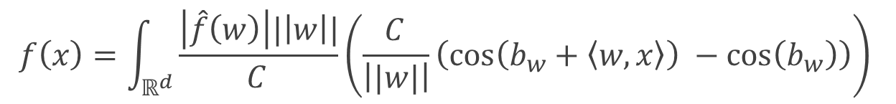
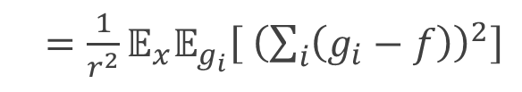
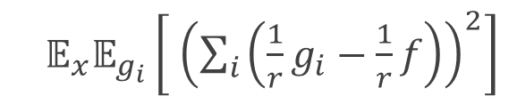
Step 2: convex combination of small number of cosine-like activations
$${f\left(x\right)=\int_{ℝ^{d}}{\frac{\left|\hat{f}\left(w\right)\right||\left|w\right||}{C_{ }}\left(\frac{C_{ }}{\left||w|\right|}\left(cos\left(b_{w}+\left\langle w,x\right\rangle \right) −\cos\left(b_{w}\right)\right)\right)}}^{ }$$
Recall:
Repeat r times:
Choose a new ${w∈ℝ}_{ }$ to add to S with probability $\frac{\left|\hat{f}\left(w\right)\right||\left|w|\right|}{C}$
Let $g_{i}^{ }$ be a random variable, denoting the i-th selected w.
Let ${g=\frac{1}{r}\sum_{i=1}^{r}{g_{i} }}_{ }^{ }$. Then, we have:
a$𝔼_{x}𝔼_{g_{i}}\left[ {\left(\sum_{i}{\left(\frac{1}{r}g_{i}−\frac{1}{r}f\right)}\right)}^{2}\right]$
a$=\frac{1}{r^{2}}𝔼_{x}𝔼_{g_{i}}\left[ {\left(\sum_{i}{\left(g_{i}−f\right)}\right)}^{2}\right]$
a$𝔼_{x}𝔼_{g}\left[{(g(x)−f(x))}^{2}\right]=$
Direct substitution
All $g_{i}^{ }−f$ are mean-0, (since ${𝔼[g}_{i}^{ }]=f$), and independent.

Slide 33


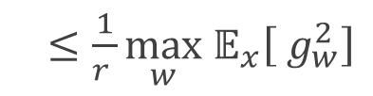
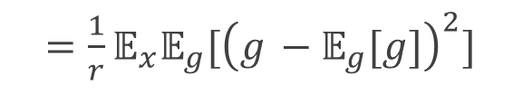
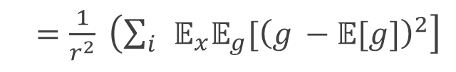






Step 2: convex combination of small number of cosine-like activations
Repeat r times:
Choose a new ${w∈ℝ}_{ }$ to add to S with probability $\frac{\left|\hat{f}\left(w\right)\right|\left|w\right|}{C}$
$𝔼_{x}𝔼_{g_{i},g_{j}} [\left(g_{i}−f\right)\left(g_{j}−f\right)]$=
Then, we have:
$$𝔼_{x}[𝔼_{g_{i} }\left[\left(g_{i}−f\right)\right]𝔼_{g_{j}}\left[\left(g_{j}−f\right)\right]=$$
$$0$$
a${𝔼_{x}𝔼}_{g}\left[{(g−f)}^{2}\right]$
a$=\frac{1}{r^{2}}{𝔼_{x}𝔼}_{g_{i}}\left[ {\left(\sum_{i}{\left(g_{i}−f\right)}\right)}^{2}\right]$
a$=\frac{1}{r^{2}} \left(\sum_{i}{ }𝔼_{x}𝔼_{g}{[\left(g_{i}−f\right)}^{2}\right]+\sum_{i≠j}{{𝔼_{x}𝔼}_{g_{i},g_{j}}[\left(g_{i}−f\right)\left(g_{j}−f\right)])) }$
$${𝔼[g}_{i}^{ }]=f$$
a$=\frac{1}{r^{2}} \left(\sum_{i}{ }𝔼_{x}𝔼_{g}{[\left(g_{ }−𝔼[g]\right)}^{2}\right]$
a$=\frac{1}{r}𝔼_{x}𝔼_{g}{[\left(g_{ }−𝔼_{g}[g]\right)}^{2}]$
a$=\frac{1}{r}$ $({𝔼_{x}𝔼}_{g}{[g^{2}]−{𝔼_{x}𝔼}_{g}{\left[g\right]}^{2})}^{ }$
a$≤\frac{1}{r}$ ${𝔼_{g}𝔼}_{x}{[g^{2}] }^{ }$
a$≤\frac{1}{r^{ }}\max_{w} 𝔼_{x}\left[ g_{w}^{2}\right]$
Slight abuse of notation
Change order of expectations

Slide 34



Step 2: convex combination of small number of cosine-like activations
Repeat r times:
Choose a new ${w∈ℝ}_{ }$ to add to S with probability $\frac{\left|\hat{f}\left(w\right)\right|\left|w\right|}{C}$
Let $g_{i}^{ }$ denote the i-th selected w. Let ${g=\frac{1}{r}\sum_{i=1}^{r}{g_{i} }}_{ }^{ }$
a$≤\frac{1}{r^{ }}\max_{w} 𝔼_{x}\left[ g_{w}^{2}\right]$
Then, we have:
a${𝔼_{x}𝔼}_{g}\left[{(g−f)}^{2}\right]$
Writing out $𝔼_{x}\left[ g_{w}^{2}\right]$ explicitly, we will show that:
$$∀w:\int_{x∈𝔹}{{\left(\frac{C_{ }}{\left|\left|w\right|\right|}\left(cos\left(b_{w}+\left\langle w,x\right\rangle \right) −\cos\left(b_{w}\right)\right)\right)}^{2}dx ≤C^{2}}$$

Slide 35


Step 2: convex combination of small number of cosine-like activations
C$laim: ∀w:\int_{x∈𝔹}{{\left(\frac{C_{ }}{\left|\left|w\right|\right|}\left(cos\left(b_{w}+\left\langle w,x\right\rangle \right) −\cos\left(b_{w}\right)\right)\right)}^{2}dx≤C^{2}}$
Note, cos is 1-Lipschitz (show this if you don’t see it!). Hence:
$$\left|\left(cos\left(b_{w}+\left\langle w,x\right\rangle \right) −\cos\left(b_{w}\right)\right)\right|≤\left|\left\langle w,x\right\rangle \right|≤\left|\left|w\right|\right| |\left|x\right||$$
$${\left(\frac{C_{ }}{\left|\left|w\right|\right|}\left(cos\left(b_{w}+\left\langle w,x\right\rangle \right) −\cos\left(b_{w}\right)\right)\right)}^{2}≤{C^{2}\left|\left|x\right|\right|}^{2}≤C^{2}$$
So,
Integrating, the claim follows.

Slide 36



Step 2: convex combination of small number of cosine-like activations
Repeat r times:
Choose a new ${w∈ℝ}_{ }$ to add to S with probability $\frac{\left|\hat{f}\left(w\right)\right|\left|w\right|}{C}$
Let $g_{i}^{ }$ denote the i-th selected w. Let ${g=\frac{1}{r}\sum_{i=1}^{r}{g_{i} }}_{ }^{ }$
a$≤\frac{C^{2}}{r^{ }}$
Plugging in previous bound:
a$𝔼_{g}𝔼_{x}\left[{(g−f)}^{2}\right]$
If the expectation of a random variable is $≤\frac{C^{2}}{r^{ }}$, there must be some realization of it w/ value $≤\frac{C^{2}}{r^{ }}$. Hence:
There exist some $g$, s.t. $𝔼_{x}\left[{\left(g(x)−f(x)\right)}^{2}\right]≤\frac{C^{2}}{r}$
Almost there! g is a width $r$ network, with cosine-like activation.

Slide 37


Step 3: approximating the cosines
Finally, we approximate the cosine-like activations using sigmoids.
$$g_{w}\left(x\right)=\frac{C_{ }}{\left|\left|w\right|\right|}\left(cos\left(b_{w}+\left\langle w,x\right\rangle \right) −\cos\left(b_{w}\right)\right)$$
Let us denote
Namely, we show that: there exists a 2-layer neural net $G_{0}$of size ${O\left(\frac{1}{ε}\right)}_{ }^{ }$with sigmoid activations, s.t. ${\sup_{x∈𝔹}\left| G_{0}\left(x\right)−g_{w}\left(x\right)\right|≤ε}_{ }^{ }$

Slide 38







Step 3: approximating the cosines
$$g_{w}\left(x\right)=\frac{C_{ }}{\left|\left|w\right|\right|}\left(cos\left(b_{w}+\left\langle w,x\right\rangle \right) −\cos\left(b_{w}\right)\right)$$
Exists 2-layer neural net $G_{0}$of size ${O\left(\frac{1}{ε}\right)}_{ }^{ }$with sigmoid activations, s.t. ${\sup_{x∈𝔹}\left| G_{0}\left(x\right)−g_{w}\left(x\right)\right|≤ε}_{ }^{ }$
First, we rewrite $g_{w}\left(x\right)$ slightly:
$$=\frac{C_{ }}{\left|\left|w\right|\right|}\left(cos\left(b_{w}+|\left|w\right||\left\langle \frac{w}{|\left|w\right||},x\right\rangle \right) −\cos\left(b_{w}\right)\right)$$
$$g_{w}\left(x\right)$$
$$≔h_{w}(y)$$
$$y$$
Hence, $g_{w}\left(x\right)=h_{w}\left(\left\langle \frac{w}{\left|\left|w\right|\right|},x\right\rangle \right)$, i.e. a composition of a linear function and $h_{w}$, and the domain of $h_{w}$ is [-1,1] (univariate!). Suffices to approx. $h_{w}$ using sigmoids.

Slide 39








Step 3: approximating the cosines
$$h_{w}(y)=\frac{C_{ }}{\left|\left|w\right|\right|}\left(cos\left(b_{w}+|\left|w\right||y\right) −\cos\left(b_{w}\right)\right)$$
Exists 2-layer neural net $G_{0}$of size ${O\left(\frac{1}{ε}\right)}_{ }^{ }$with sigmoid activations, s.t. ${\sup_{x∈[−1,1]}\left| G_{0}\left(y\right)−h_{w}\left(y\right)\right|≤ε}_{ }^{ }$
Check derivative bd gives Lipschitzness!
1. $h_{w}$ is C-Lipschitz:
${h′}_{w}(y)=C\sin\left(b_{w}+|\left|w\right||y\right)$
2. Grid the interval [-1,1] into intervals ${[l_{i},r_{i}]}_{ }$of size $ε/C$. Pick arbitrary $y_{i}∈[l_{i},r_{i}]$
$$ε/C$$
Same as in the first theorem, we have
$$\sup_{x∈[−1,1]}\left| \sum_{i}{1\left(y∈\left[l_{i}, r_{i}\right]\right)h_{w}(y_{i})}−h_{w}(y)\right|≤ε$$

Slide 40



Step 3: approximating the cosines
$$h_{w}(y)=\frac{C_{ }}{\left|\left|w\right|\right|}\left(cos\left(b_{w}+|\left|w\right||y\right) −\cos\left(b_{w}\right)\right)$$
Exists 2-layer neural net $G_{0}$of size ${O\left(\frac{1}{ε}\right)}_{ }^{ }$with sigmoid activations, s.t. ${\sup_{x∈[−1,1]}\left| G_{0}\left(y\right)−h_{w}\left(y\right)\right|≤ε}_{ }^{ }$
$$\sup_{x∈[−1,1]}\left| \sum_{i}{1\left(y∈\left[l_{i}, r_{i}\right]\right)h_{w}(y_{i})}−h_{w}\left(y\right)\right|≤ε$$
3. We can write the indicators as differences of step functions:
$$ε/C$$
$$1\left(y∈\left[l_{i}, r_{i}\right]\right)=1\left(y≥l_{i}\right)−1(y≥r_{i})$$
Hence, it suffices to approximate a step function using a sigmoid.

Slide 41




Step 3: approximating the cosines
$$h_{w}(y)=\frac{C_{ }}{\left|\left|w\right|\right|}\left(cos\left(b_{w}+|\left|w\right||y\right) −\cos\left(b_{w}\right)\right)$$
Exists 2-layer neural net $G_{0}$of size ${O\left(\frac{1}{ε}\right)}_{ }^{ }$with sigmoid activations, s.t. ${\sup_{x∈{\left[0,1\right]}^{d}}\left| G_{0}\left(x\right)−h_{w}\left(x\right)\right|≤ε}_{ }^{ }$
Approximating a step function using a sigmoid:
$$\lim_{τ→∞} \sup_{x∈{\left[0,1\right]}^{d}}\left| 1(x≥a)−\frac{1}{1+e^{−τ(x−a)}}\right|=0$$
Hence, taking $τ$ large enough, we can drive the error as small as possible (in the $l_{∞}$ sense.)
Putting everything together, the claim follows.

Slide 42
Parting thoughts
All results we proved are existential: they prove that a good approximator exists. Finding one efficiently (much less so using gradient descent) is a different matter.
The choices of non-linearities are usually very flexible: most results of the type we saw can be re-proven using different non-linearities. (Examples in homework.)
Many other results of similar flavor. For instance, there are also results that deep, but narrow networks are universal approximators.

