Slide 1
10707 Deep Learning: Spring 2021
Andrej Risteski
Machine Learning Department
Lecture 3: Benefits of depth

Slide 2
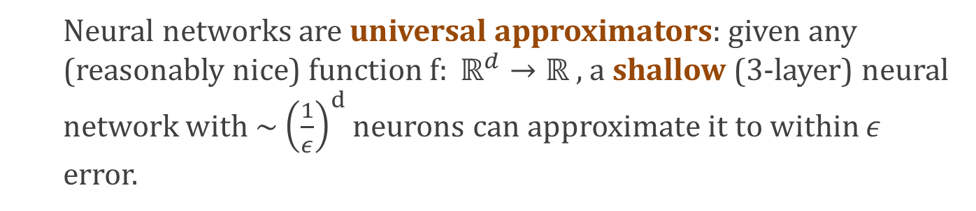
Recap
Recall from previous lecture:
Neural networks are universal approximators: given any (reasonably nice) function $f: ℝ^{d}→ℝ ,$ a shallow (3-layer) neural network with ~ ${\left(\frac{1}{ε}\right)}^{d}$neurons can approximate it to within $ε$ error.
Is there any point to depth?
Are deeper networks more powerful?

Slide 3
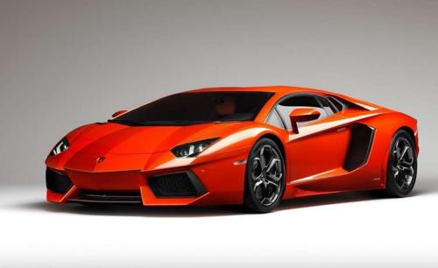
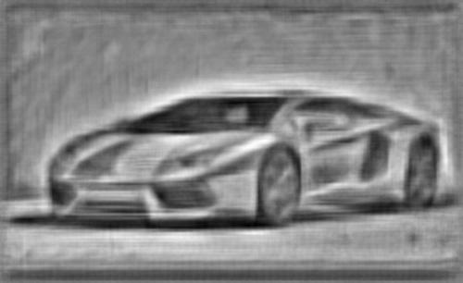
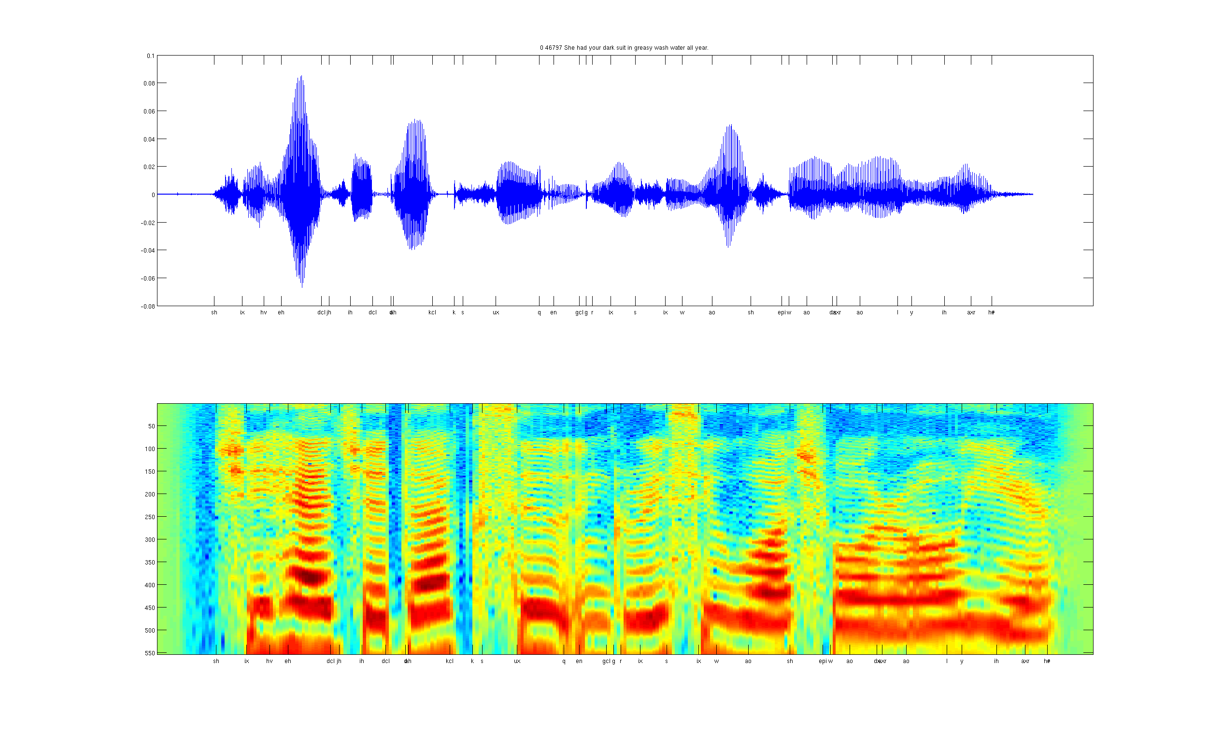

Part of the deep learning story
Data
Feature extraction
Learning algorithm
Object detection
Image
vision features
Recognition
Audio classification
Audio
Speaker
identification
audio features

Slide 4
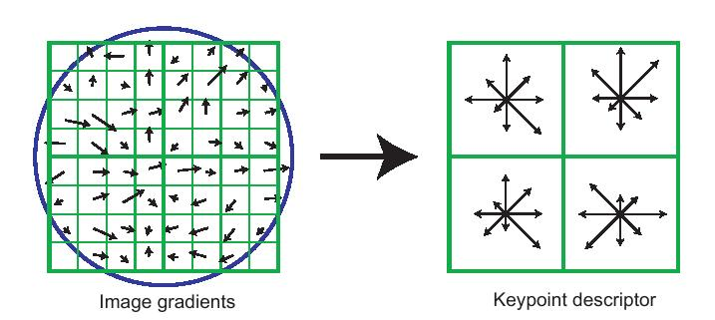
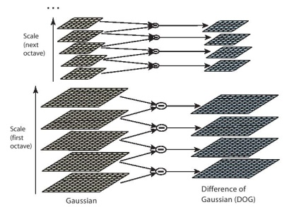
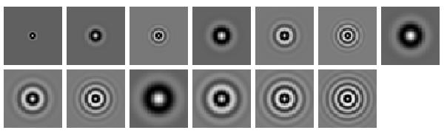
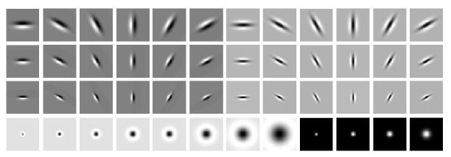
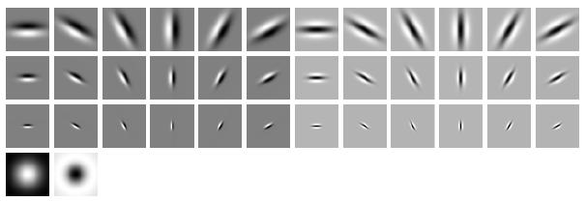
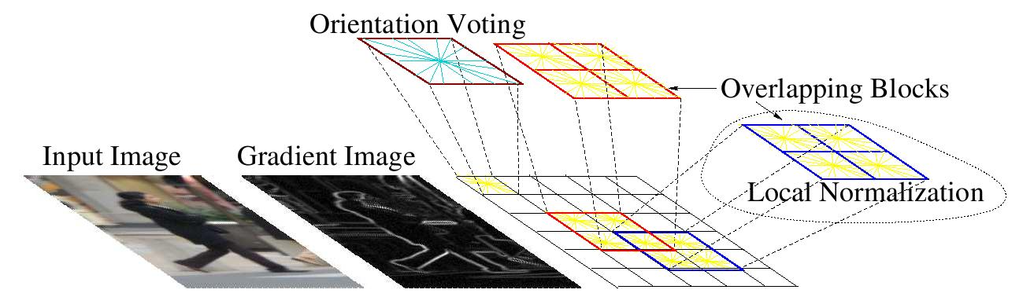
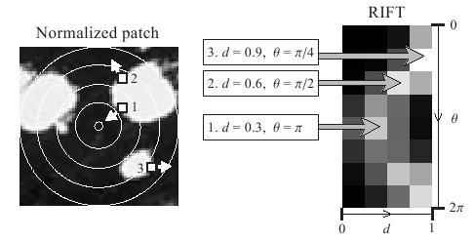
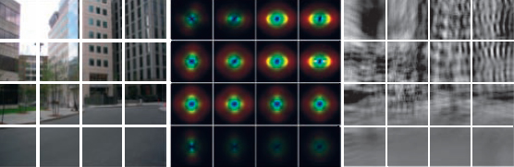
Old school: hand-craft features
SIFT
Textons
HoG
RIFT
GIST

Slide 5
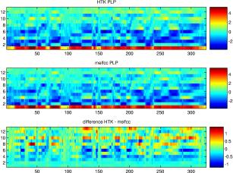
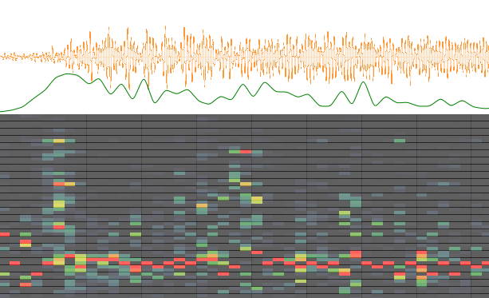
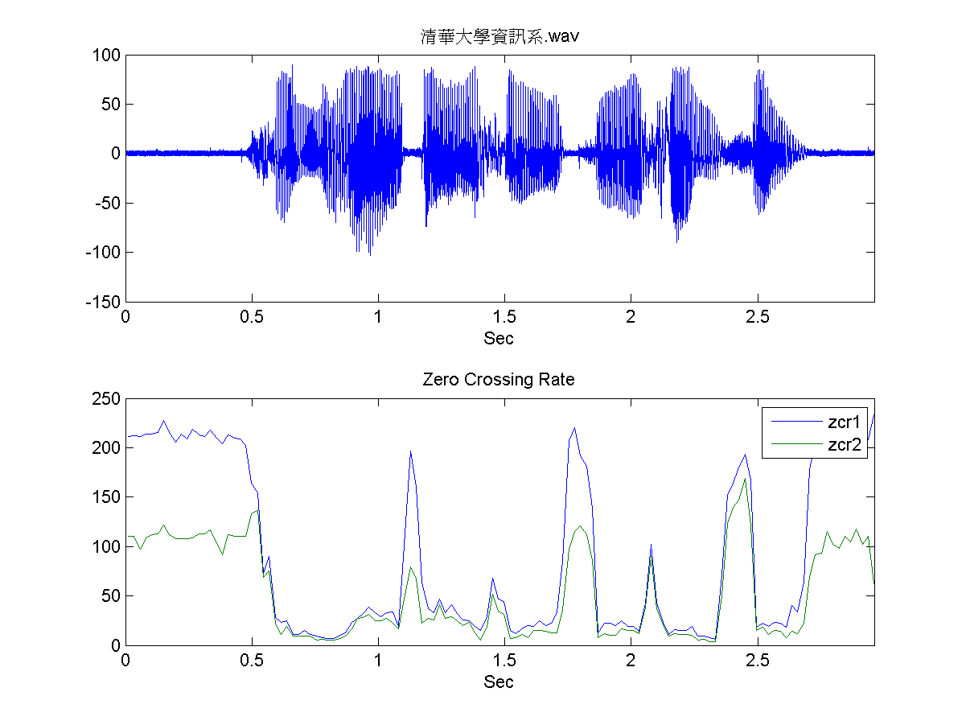
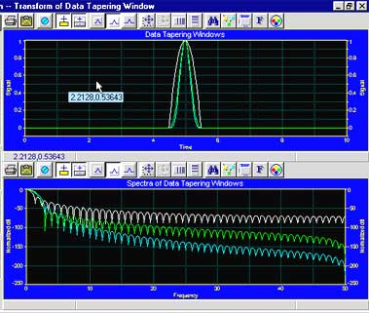
Old school: hand-craft features
Spectrogram
MFCC
Flux
ZCR
Rolloff

Slide 6
Old school: hand-craft features
Feature learning:
Can we automatically learn useful features?
Spectrogram
MFCC
Flux
ZCR
Rolloff

Slide 7
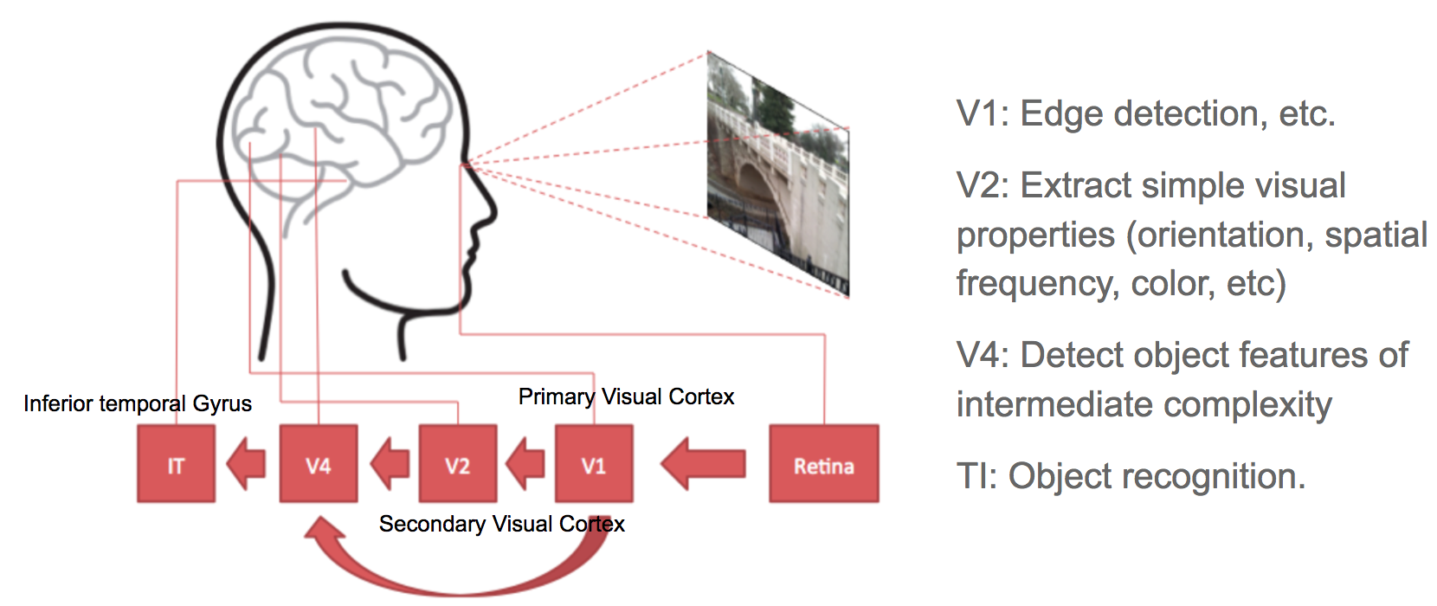
Early inspirations from visual cortex
Image: Wang, Raj “On the Origin of Deep Learning.”

Slide 8
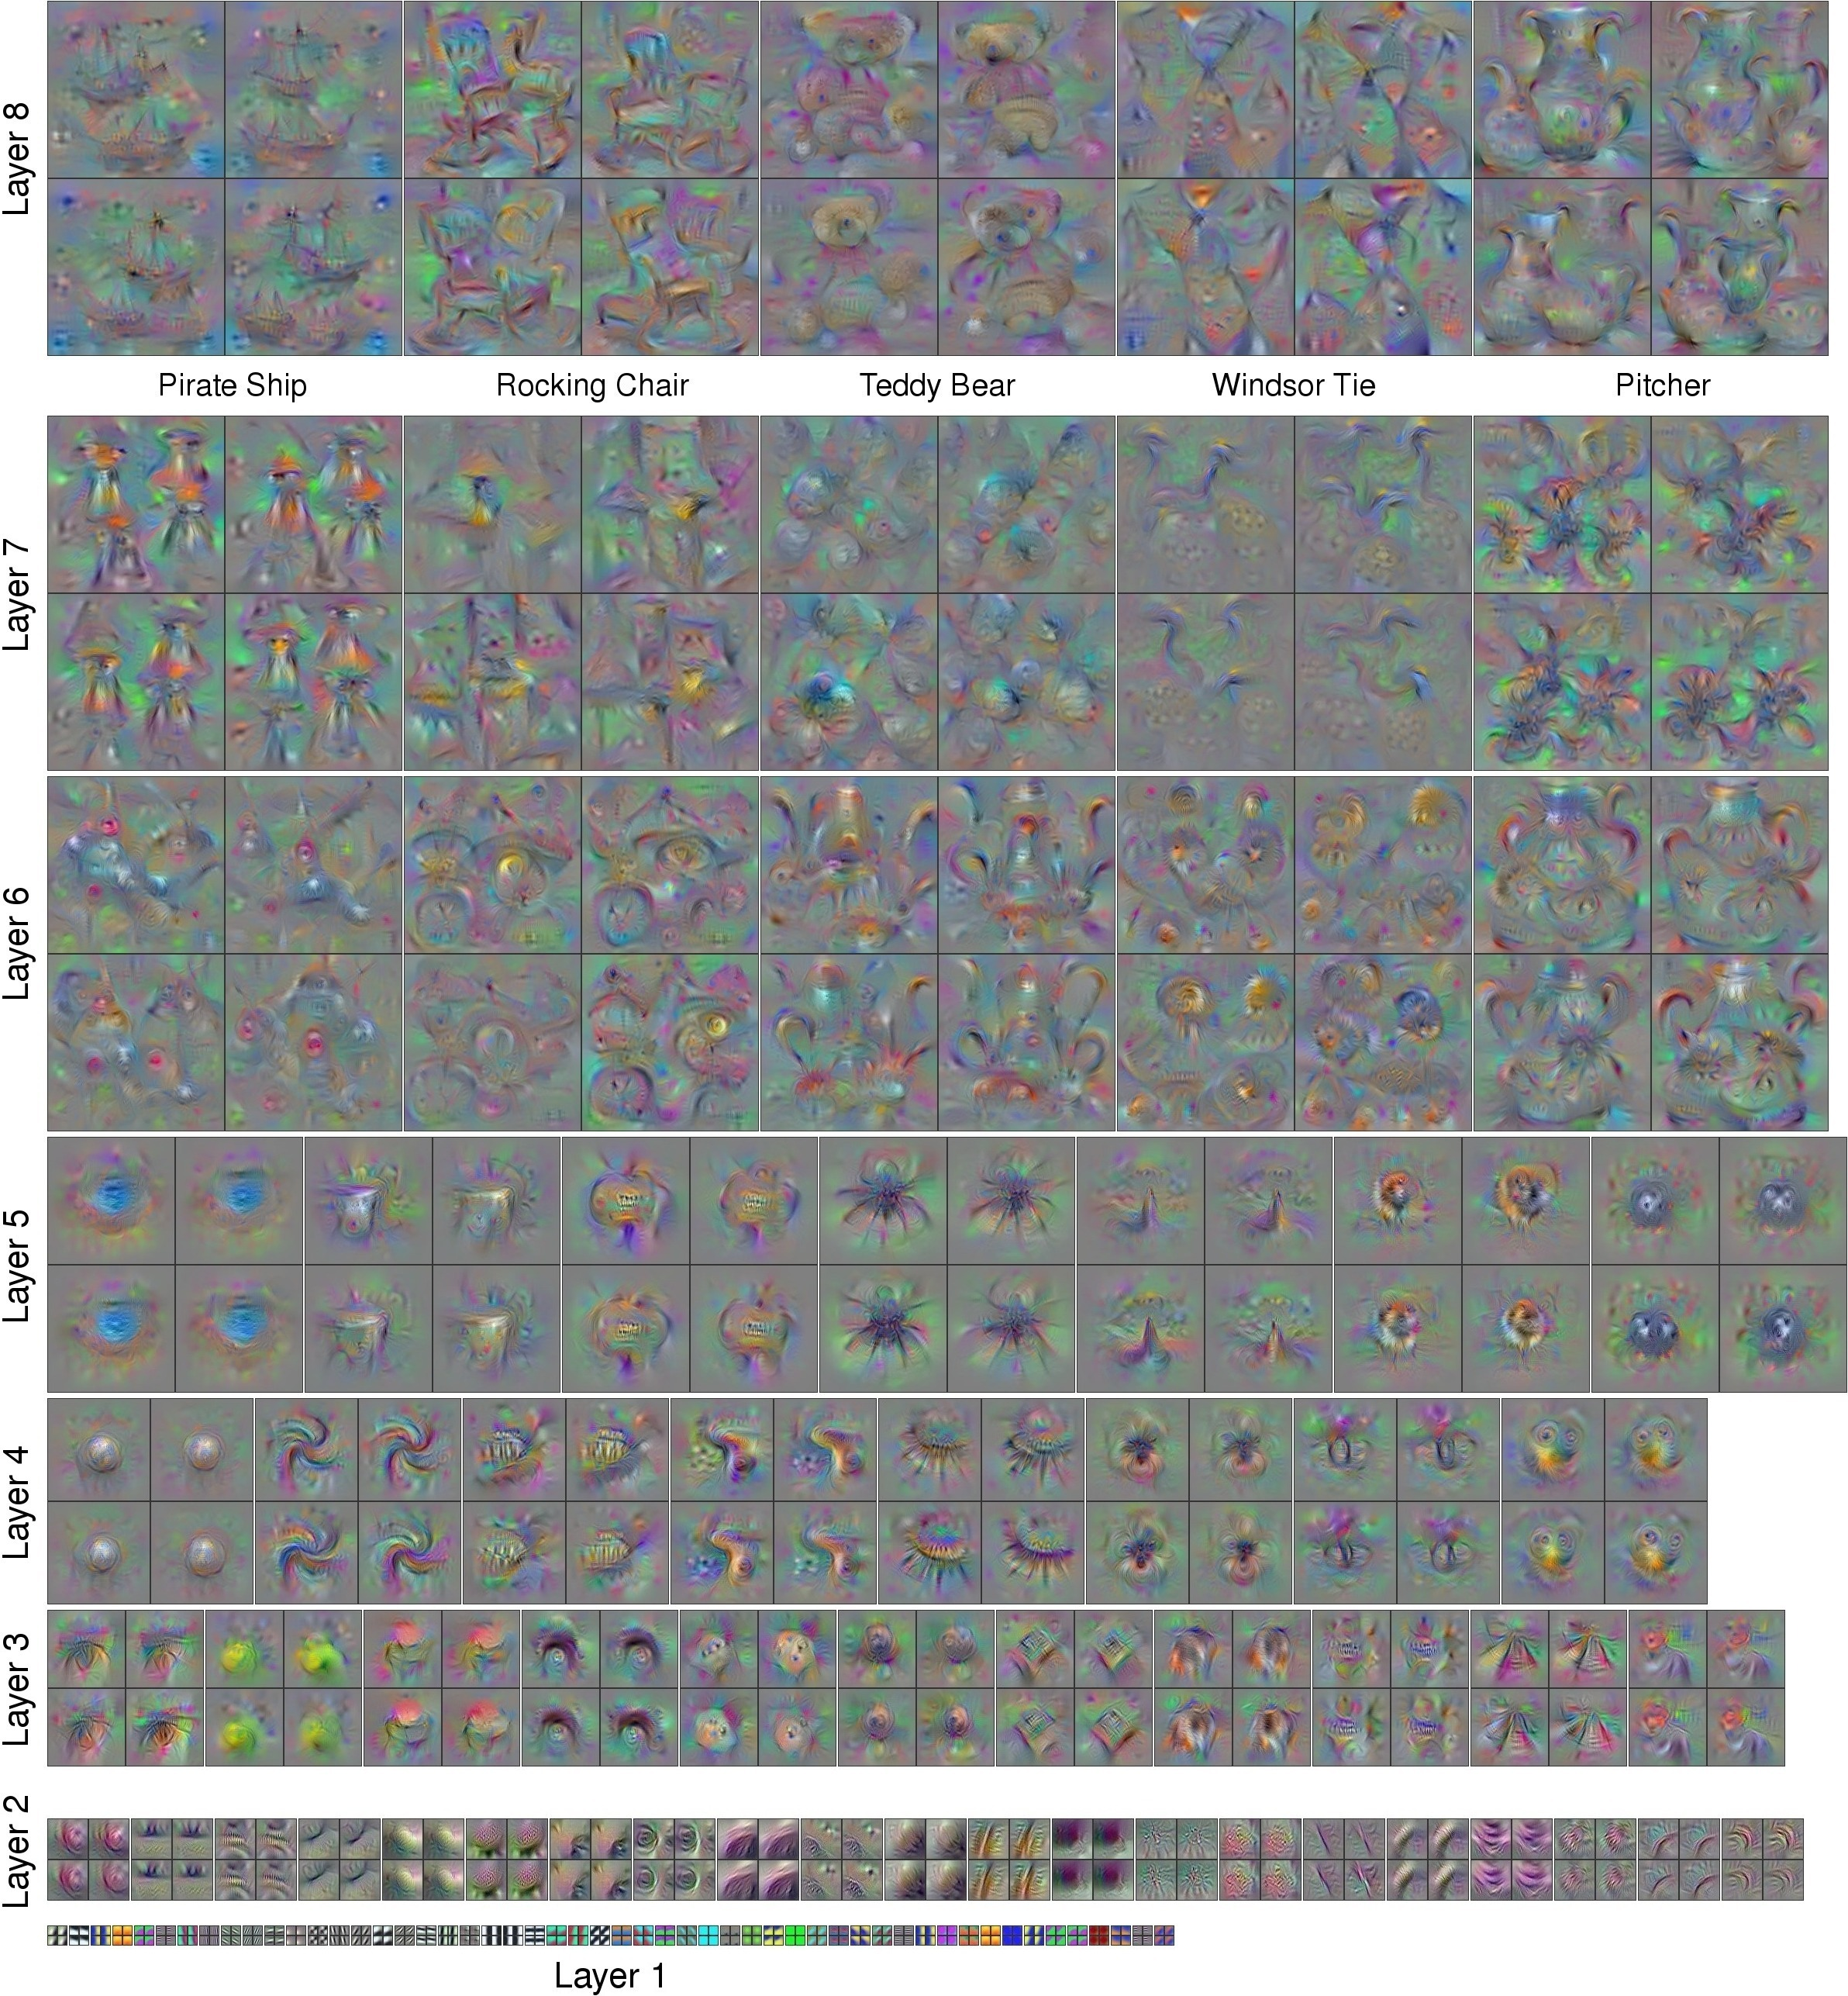
What do deep networks learn?
Yosinski et al ‘15:
http://yosinski.com/deepvis
Q: What “patterns” do neurons
respond to?
A: From random start, do gradient descent to find an input for which neuron activation* is high.
*: This produces completely unrecognizable images – they are regularized w/ an image prior.

Slide 9
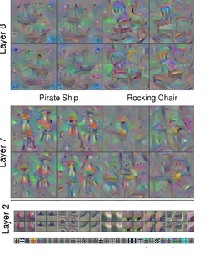
What do deep networks learn?
Yosinski et al ‘15:
http://yosinski.com/deepvis
Q: What “patterns” do neurons
respond to?
A: From random start, do gradient descent to find an input for which neuron activation* is high.
*: This produces completely unrecognizable images – they are regularized w/ an image prior.

Slide 10
What do deep networks learn?
Yosinski et al ‘15:
http://yosinski.com/deepvis
Q: What “patterns” do neurons
respond to?
Easier: (but not easy it turns out!)
Can we exhibit even one function that can be represented as a small deep network, but cannot as a small shallow network?
A: From random start, do gradient descent to find an input for which neuron activation* is high.
*: This produces completely unrecognizable images – they are regularized w/ an image prior.

Slide 11
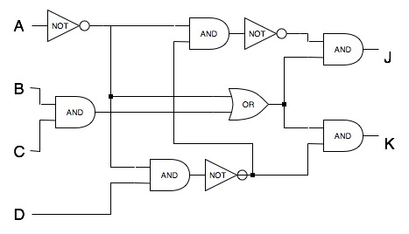
A brief history of depth separation
Early roots: theoretical computer science
Boolean circuits: a directed acyclic graph model for computation over binary inputs; each node (“gate”) performs an operation (e.g. OR, AND, NOT) on the inputs from its predecessors.

Slide 12

A brief history of depth separation
Early roots: theoretical computer science
Boolean circuits: a directed acyclic graph model for computation over binary inputs; each node (“gate”) performs an operation (e.g. OR, AND, NOT) on the inputs from its predecessors.
Relaxation of the P vs NP question: separate more “structured” models of computation – e.g. shallow vs deep Boolean circuits.
Seminal result by Håstad (‘86): parity function (calculates parity of number of ones in input) cannot be approximated by a small constant-depth circuit with OR and AND gates. [Highly non-trivial; Gödel Prize!!]

Slide 13
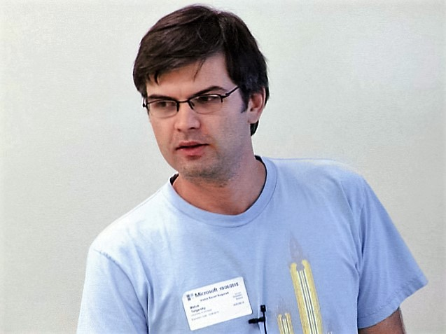
Modern iterations of depth separation
Related architectures/models of computation
Sum-product networks [Bengio, Delalleau ‘11]
Weaker measures of complexity
Bound on number of linear regions for ReLU networks [Montufar, Pascanu, Cho, Bengio ‘14]
True approximation error results
A small deep network cannot be approximated by a small shallow network [Telgarsky ‘15]

Slide 14
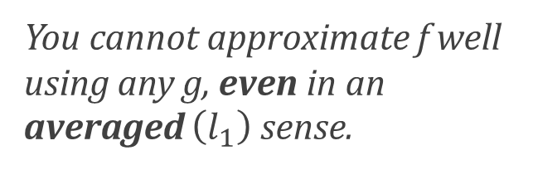
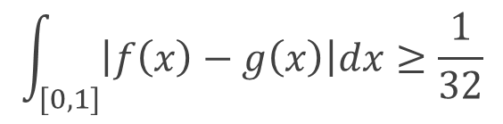

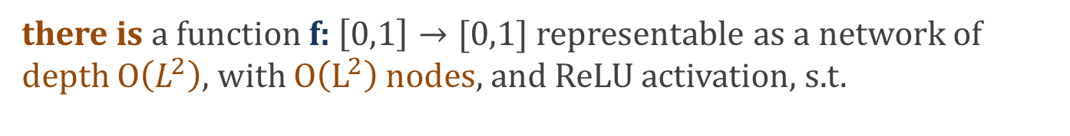
Separating deep and shallow networks
Can be imitated for higher dim too
Family of functions for ever L
Theorem (Telgarsky ‘15): For every $L∈ℕ$ ,
there is a function f: $\left[0,1\right]→[0,1]$ representable as a network of depth $O\left(L^{2}\right),$ with $O\left(L^{2}\right)$nodes, and ReLU activation, s.t.
for every network g : $\left[0,1\right]→ℝ$ of depth $L$ and $≤2^{L}$nodes, and ReLU activation, we have
$$\int_{[0,1]}{\left|f\left(x\right)−g\left(x\right)\right|dx≥\frac{1}{32}}$$
You cannot approximate f well using any g, even in an averaged $\left(l_{1}\right)$ sense.
Outputting trivial approximation g = 0 will give error 1, so this is a really bad approximation.

Slide 15
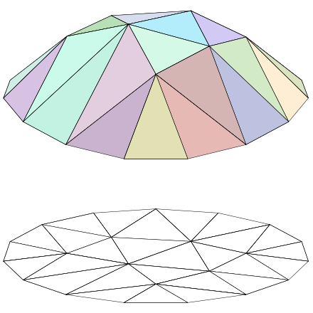
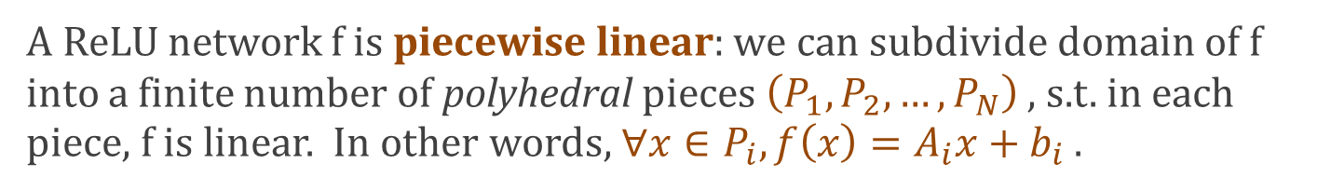
Q: what can deep networks do easily?
A ReLU network f is piecewise linear: we can subdivide domain of f into a finite number of polyhedral pieces $\left(P_{1},P_{2},…, P_{N}\right)$ , s.t. in each piece, f is linear. In other words, ${∀x∈P}_{i}, f\left(x\right)=A_{i}x+b_{i}$ .
(Once we know which ReLUs are in the linear regime, and which are zeroed out, the function f calculates is linear.)
Deeper networks can make a larger number of pieces.

Slide 16
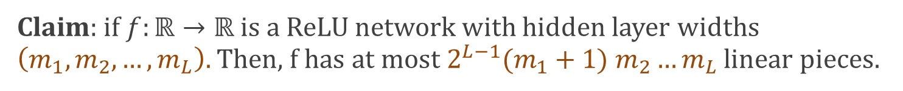


Shallow functions have few linear pieces
Let’s reason how the number of linear pieces behaves under compositions.
Claim: if $f:ℝ→ℝ$ is a ReLU network with hidden layer widths $\left(m_{1},m_{2},…, m_{L}\right).$ Then, f has at most ${2^{L−1}(m}_{1}+1) m_{2}…m_{L}$ linear pieces.
$$m_{L}$$
$$m_{1}$$

Slide 17





Shallow functions have few linear pieces
Let’s reason how the number of linear pieces behaves under compositions.
Claim: if $f:ℝ→ℝ$ is a ReLU network with hidden layer widths $\left(m_{1},m_{2},…, m_{L}\right).$ Then, f has at most ${2^{L−1}(m}_{1}+1) m_{2}…m_{L}$ linear pieces.
Induction on L:
Proof:
L = 1:
$$w^{′}h\left(x\right)$$
$$x≥−\frac{b}{w}$$
If only one hidden node: one value if
$$h\left(x\right)=\max{(wx+b, 0)}$$
$$x<−\frac{b}{w}$$
another if
$$x$$

Slide 18
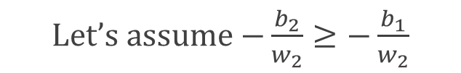




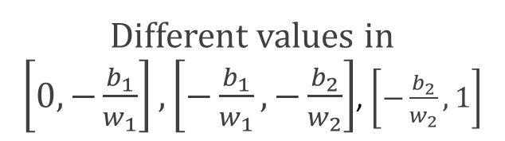
Shallow functions have few linear pieces
Let’s reason how the number of linear pieces behaves under compositions.
Claim: if $f:ℝ→ℝ$ is a ReLU network with hidden layer widths $\left(m_{1},m_{2},…, m_{L}\right).$ Then, f has at most ${2^{L−1}(m}_{1}+1) m_{2}…m_{L}$ linear pieces.
Induction on L:
Proof:
L = 1:
Each node introduces at most one breakpoint, e.g.:
$$w^{′}h\left(x\right)$$
Let’s assume $−\frac{b_{2}}{w_{2}}≥−\frac{b_{1}}{w_{2}}$
$$\max{(w_{1}x+b_{1}, 0)}$$
$$\max{(w_{2}x+b_{2}, 0)}$$
v
Different values in $\left[0,−\frac{b_{1}}{w_{1}}\right],\left[−\frac{b_{1}}{w_{1}},−\frac{b_{2}}{w_{2}}\right]$, $\left[−\frac{b_{2}}{w_{2}},1\right]$
$$x$$

Slide 19
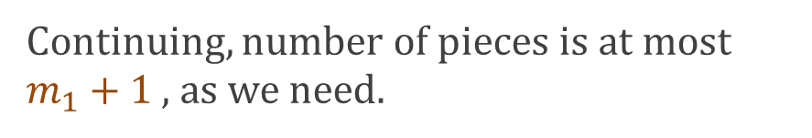
Shallow functions have few linear pieces
Let’s reason how the number of linear pieces behaves under compositions.
Claim: if $f:ℝ→ℝ$ is a ReLU network with hidden layer widths $\left(m_{1},m_{2},…, m_{L}\right).$ Then, f has at most ${2^{L−1}(m}_{1}+1) m_{2}…m_{L}$ linear pieces.
Induction on L:
Proof:
L = 1:
Continuing, number of pieces is at most $m_{1}+1$ , as we need.

Slide 20
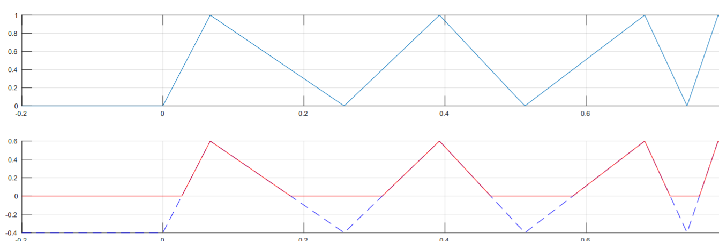

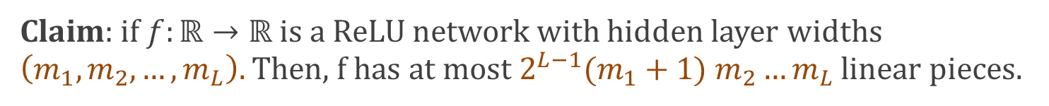
Shallow functions have few linear pieces
Claim: if $f:ℝ→ℝ$ is a ReLU network with hidden layer widths $\left(m_{1},m_{2},…, m_{L}\right).$ Then, f has at most ${2^{L−1}(m}_{1}+1) m_{2}…m_{L}$ linear pieces.
Inductive step:
Proof:
Take any node in penultimate layer:
By inductive hypothesis, pre-activation of node is piecewise linear, $≤{2^{L−2}(m}_{1}+1) m_{2}…m_{L−1}$ pieces.
Applying ReLU to pre-activation of node can at most double the number of pieces for that node !
Pre-activation
fn for node
Post-activation
fn for node

Slide 21
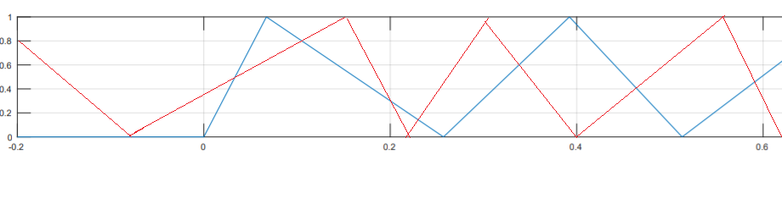
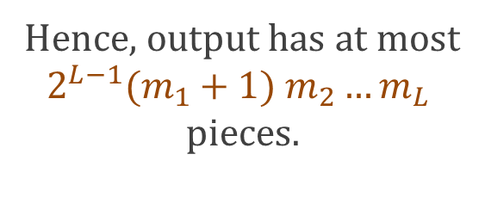
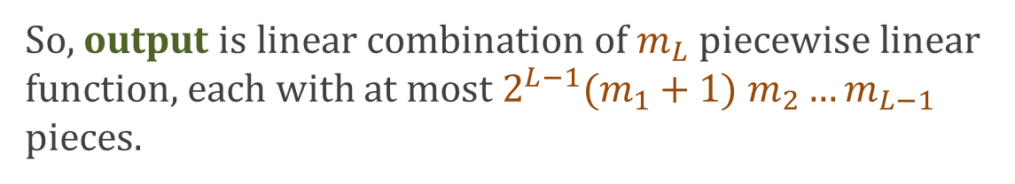
Shallow functions have few linear pieces
Claim: if $f:ℝ→ℝ$ is a ReLU network with hidden layer widths $\left(m_{1},m_{2},…, m_{L}\right).$ Then, f has at most ${2^{L−1}(m}_{1}+1) m_{2}…m_{L}$ linear pieces.
Induction on L:
Proof:
So, output is linear combination of $m_{L}$ piecewise linear function, each with at most ${2^{L−1}(m}_{1}+1) m_{2}…m_{L−1}$ pieces.
A linear comb. of 2 piecewise lin. fns, each w/ at most a and b pieces gives a piecewise lin. fn w/ at most a+b pieces:
Hence, output has at most
$${2^{L−1}(m}_{1}+1) m_{2}…m_{L}$$
pieces.

Slide 22







Deep function with many oscillations
The player : the “triangle” map $Δ:[0,1]→ℝ$
$$2x, if x≤1/2$$
$$Δ\left(x\right)=2σ\left(x\right)−2σ\left(2x−1\right)=$$
$$2−2x, if x>1/2$$
$$1$$
$$0$$
$$\frac{1}{2}$$
$$1$$

Slide 23
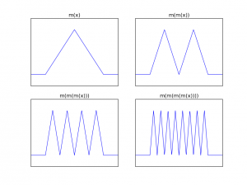








Deep function with many oscillations
$$2x, if x≤1/2$$
$$Δ\left(x\right)=2σ\left(x\right)−2σ\left(2x−1\right)=$$
$$2−2x, if x>1/2$$
Idea: compose the triangle function w/ itself many times!
$$1$$
Idea: composing it k times should look like sawtooth with $2^{k−1 }peaks$
$$0$$
$$\frac{1}{2}$$
$$1$$
We’ll show that function w/ small number of linear pieces can’t approximate this well.

Slide 24
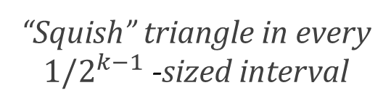






Deep function with many oscillations
$$2x, if x≤1/2$$
$$Δ\left(x\right)=2σ\left(x\right)−2σ\left(2x−1\right)=$$
$$2−2x, if x>1/2$$
Claim: $Δ^{k}\left(x\right)=Δ^{ }\left(2^{k−1}x −⌊2^{k−1}x⌋\right)$
“Squish” triangle in every $1/2^{k−1}$ -sized interval
Proof: Induction:
K=1: by definition
K $⇒$ K+1:
$$x≤\frac{1}{2}:$$
$${ Δ}^{k+1}\left(x\right)=Δ^{k}\left(Δ\left(x\right)\right)$$
$$=Δ^{k}\left(2x\right)$$
$$=Δ^{ }\left(2^{k}x −⌊2^{k}x⌋\right)$$

Slide 25








Deep function with many oscillations
$$2x, if x≤1/2$$
$$Δ\left(x\right)=2σ\left(x\right)−2σ\left(2x−1\right)=$$
$$2−2x, if x>1/2$$
Claim: $Δ^{k}\left(x\right)=Δ^{ }\left(2^{k−1}x −⌊2^{k−1}x⌋\right)$
“Squish” triangle in every $1/2^{k−1}$ -sized interval
Proof: Induction:
K=1: by definition
K $⇒$ K+1:
$$x>\frac{1}{2}:$$
$${ Δ}^{k+1}\left(x\right)=Δ^{k}\left(Δ\left(x\right)\right)$$
$$=Δ^{k}\left(2−2x\right)$$
$$=Δ^{k−1}(Δ\left(2−2x\right))$$
$$=Δ^{k−1}(Δ\left(1−(2−2x\right)))$$
$${=Δ}^{k−1}(Δ(2x−1))$$
$=Δ\left(2^{k}x −2^{k} −⌊2^{k}x −2^{k}⌋\right))$
$=Δ\left(2^{k}x −⌊2^{k}x ⌋\right))$

Slide 26

Deep function with many oscillations
$$2x, if x≤1/2$$
$$Δ\left(x\right)=2σ\left(x\right)−2σ\left(2x−1\right)=$$
$$2−2x, if x>1/2$$
Claim: $Δ^{k}\left(x\right)=Δ^{ }\left(2^{k−1}x −⌊2^{k−1}x⌋\right)$
“Squish” triangle in every $1/2^{k−1}$ -sized interval
The function f in the theorem will be $Δ^{{2L}^{2}+2}\left(x\right)$
We will show shallow g’s can’t approximate f.

Slide 27
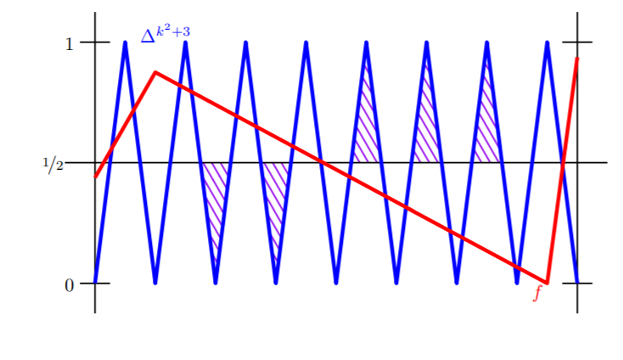
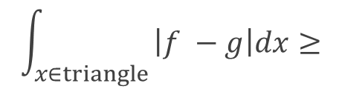



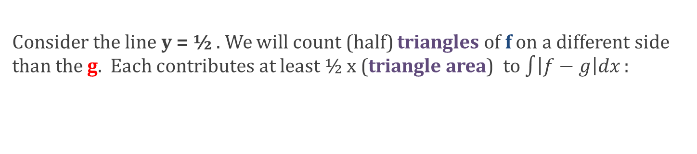
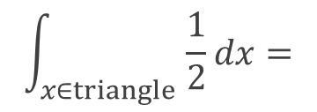
Shallow g’s can’t approximate $f$
$−$= g
$−$= f
Consider the line y = ½ . We will count (half) triangles of f on a different side than the g. Each contributes at least ½ x (triangle area) to $\int{\left|f−g\right|dx}:$
$$\int_{x∈triangle }{\left|f −g\right|dx≥}$$
$$\int_{x∈triangle }{\frac{1}{2}dx=}$$
½ x (triangle area)

Slide 28
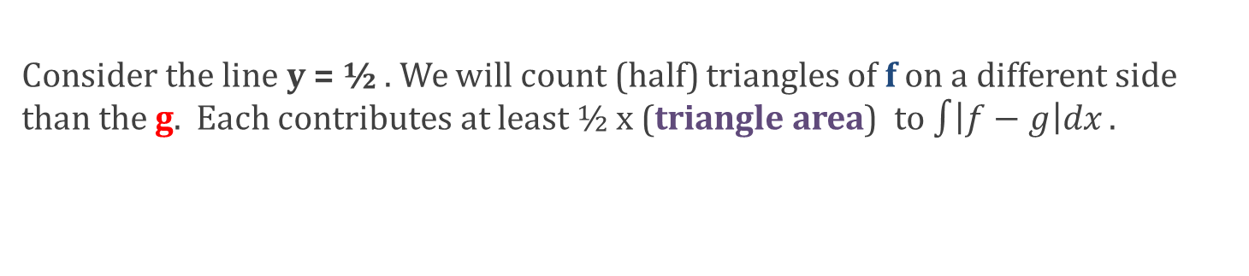
Shallow g’s can’t approximate $f$
$−$= g
$−$= f
Consider the line y = ½ . We will count (half) triangles of f on a different side than the g. Each contributes at least ½ x (triangle area) to $\int{\left|f−g\right|dx}.$
Let $N_{f}=2^{2L^{2}+2}−1$ and $N_{g}$ be the number of (half) triangles of f, g.
Since we get $2^{{2L}^{2}+1}$ copies of $Δ$, each gives 2 half triangles, but 1 is lost due to boundary

Slide 29
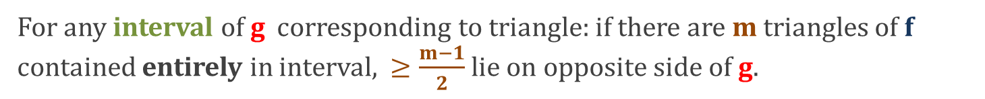

Shallow g’s can’t approximate $f$
$−$= g
$−$= f
Consider the line y = ½ . We will count (half) triangles of f on a different side than the g. Each contributes at least ½ x (triangle area) to $\int{\left|f−g\right|dx}.$
Let $N_{f}=2^{2L^{2}+2}−1$ and $N_{g}$ be the number of triangles of f, g.
For any interval of g corresponding to triangle: if there are m triangles of f contained entirely in interval, $≥\frac{m−1}{2}$ lie on opposite side of g.
We “miss” at most$N_{g}$triangles (i.e. they are not contained entirely in an interval of g) – one for each boundary between triangles.
Hence, we “contribute” at least ${(N}_{f}{−2N}_{g})/2$ triangles.

Slide 30
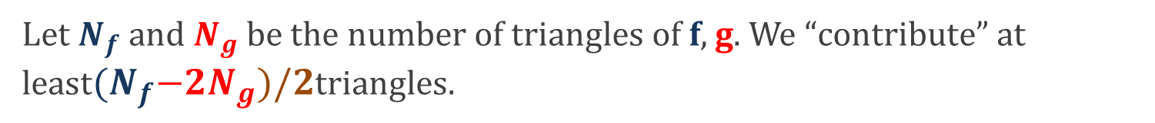
Shallow g’s can’t approximate $f$
$−$= g
$−$= f
Let $N_{f}$ and $N_{g}$ be the number of triangles of f, g. We “contribute” at least${(N}_{f}{−2N}_{g})/2$triangles.
Size of g
Now, since shallow nets have small $N_{g}:{ N}_{g}≤{\left(2n\right)}^{L}≤2^{{2L}^{2}}$
We also showed that ${ N}_{f}=2^{2L^{2}+2}−1$
$⇒$We “contribute” at least $2^{2L^{2}}−1$ triangles.

Slide 31
Shallow g’s can’t approximate $f$
$−$= g
$−$= f
We “contribute” at least$2^{2L^{2}}−1$ triangles.
Each triangle has area ½ x (base) x (height)
= ½ x (${\frac{1}{2^{2L^{2}+2}}}^{ }$) x ½ = $\frac{1}{2^{{2L}^{2}+4 }}$
$\left(2^{2L^{2}}−1\right)×\frac{1}{2^{2L^{2}+4 }} ≥\frac{1}{32}$
Total contribution:
□

Slide 32
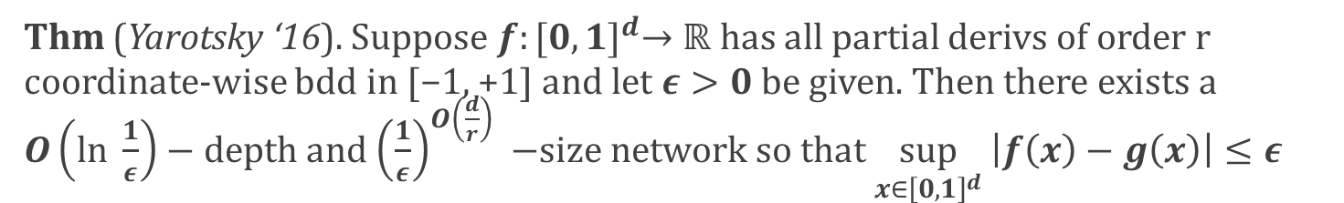
Parting thoughts
Thm can be generalized to d dimensions, lots of other activation functions. (Need to bound # of pieces for multidim compositions.)
There can be benefits of depth to approximating smooth functions
Thm (Yarotsky ‘16). Suppose $f:{[0,1]}^{d}→ℝ$ has all partial derivs of order r coordinate-wise bdd in [−1, +1] and let $ε>0$ be given. Then there exists a $O\left(ln \frac{1}{ε}\right)−depth$ and ${\left(\frac{1}{ε}\right)}^{O\left(\frac{d}{r}\right)} −$size network so that $\sup_{x∈{\left[0,1\right]}^{d}} \left|f\left(x\right)−g\left(x\right)\right|≤ε$
Interaction of depth w/ architecture: depth tends to be problematic from an optimization point of view (“vanishing gradient problem”).
Lots of proposal architectures to remedy this (ResNet, DenseNet)
In general, interplay of depth with both optimization and generalization is not well understood.
Stay tuned!

