Slide 1
10707 Deep Learning: Spring 2021
Andrej Risteski
Machine Learning Department
Lecture 5: Intro to optimization

Slide 2

Supervised learning
Empirical risk minimization approach: minimize a training loss $l$ over a class of predictors ℱ:
$\hat{f}= \underset{f∈ℱ}{argmin} \underset{\left(x,y\right):training samples}{Σ}l\left(f\left(x\right), y\right)$
Three pillars:
(1) How expressive is the class $ℱ$? (Representational power)
(2) How do we minimize the training loss efficiently? (Optimization)
(3) How does ${\hat{f}}^{ }$perform on unseen samples? (Generalization)

Slide 3



The world of continuous optimization
$$\min_{x∈ℝ^{d}} f(x)$$
The typical training task in ML can be cast as:
Usually, it is cheap to calculate $f\left(x\right), ∇f(x)$, but (more) expensive to calculate higher-order derivatives.
Most algorithms we will look at are iterative: they progressively pick points $x_{1},x_{2},…$ that are supposed to bring “improvement”.
Non-exhaustive coverage: entire field of optimization, with applications vastly beyond ML. We focus on deep-learning-relevant methods.

Slide 4
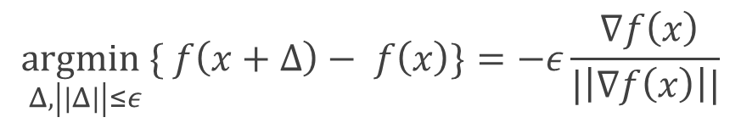
The mother of all optimization algorithms: gradient descent
The simplest optimization algorithm: Taylor expand and find the direction of “steepest” descent. More precisely:
By Taylor’s theorem, we have $f\left(x+Δ\right)≈f\left(x\right)+Δ^{T}∇f\left(x\right)+O\left({||Δ||}^{2}\right)$
So, if we ignore higher-order effects, we have
$$\underset{Δ, \left|\left|Δ\right|\right|≤ε}{argmin}\{ f\left(x+Δ\right)− f\left(x\right)\}=−ε\frac{ ∇f\left(x\right)}{|\left|∇f\left(x\right)\right||}$$
i.e. we should move (appropriately scaled) opposite of the gradient

Slide 5

Gradient descent, pictorially
What can we hope for, in the case that $|\left|Δ\right||→0$?
We stop moving when $∇f\left(\hat{x} \right)≈0:$ these care called stationary points.
What kinds of stationary points are there?

Slide 6
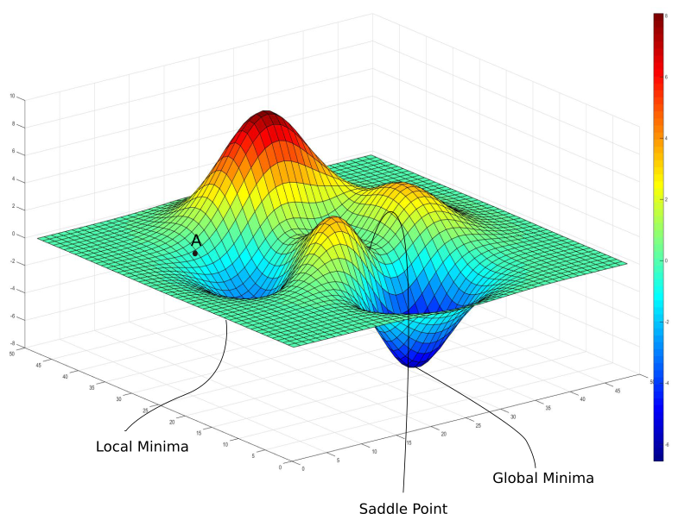
Types of stationary points
Global minimum: actual minimizer, namely $f\left(\hat{x} \right)≤f\left(x\right), ∀x∈ℝ^{d}$
Local minimum: $f\left(\hat{x} \right)≤f\left(x\right), ∀x s.t. \left|\left|x−\hat{x}\right|\right|≤ε$ for some $ε>0$
Local maximum: $f\left(\hat{x} \right)≥f\left(x\right), ∀x s.t. \left|\left|x−\hat{x}\right|\right|≤ε$ for some $ε>0$
Saddle points: stationary point that is *not* a local min/max.

Slide 7
Types of stationary points
Global minimum: finding these in general is very hard (both in theory – NP-hard, as well as in practice)
Local minimum: seem to work quite well often. Some theoretical understanding of why in very restricted cases.
Saddle points: typically bad, arise from invariances in input. Want to avoid these. (Stay tuned.)

Slide 8
Checking for local minima?
Second order checks: Hessian approximates a function to second order
Taylor’s thm: $f\left(x+Δ\right)≈f\left(x\right)+Δ^{T}∇f\left(x\right)+\frac{1}{2}Δ^{T}∇^{2}f\left(x\right)Δ+ O\left({||Δ||}^{3}\right)$
$$≈f\left(x\right)+{\frac{1}{2}Δ}^{T}∇^{2}f\left(x\right)Δ+ O\left({||Δ||}^{3}\right)$$
If $∇^{2}f\left(x\right) ≻0:$ for any direction $Δ$, and small enough $|\left|Δ\right||$
$$Δ^{T}∇^{2}f\left(x\right)Δ+ O\left({||Δ||}^{3}\right)≥0,\text{so} f\left(x+Δ\right)>f(x)$$
Local minimum! (Flipped for local maximum)
If $∇^{2}f\left(x\right)$ has both positive and negative eigenvalues:
Saddle point (not a local minimum/maximum)
If neither of these attains, test is inconclusive!

Slide 9
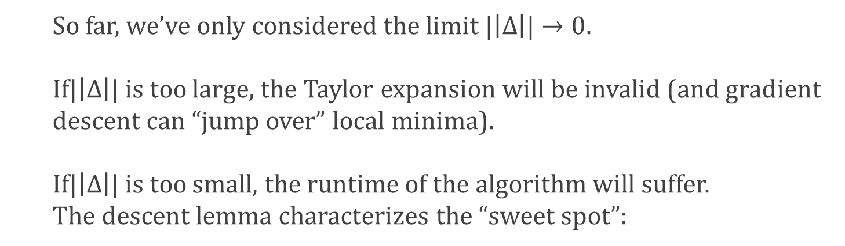

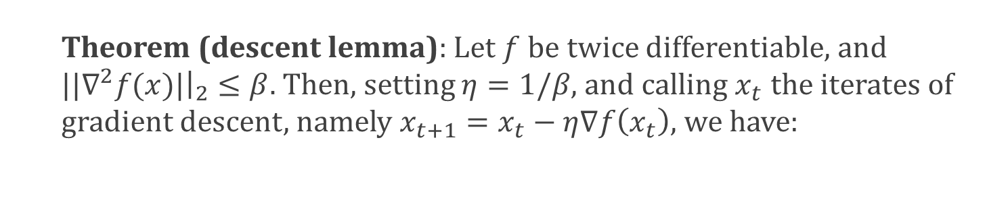
The descent lemma: analyzing gradient descent
So far, we’ve only considered the limit $|\left|Δ\right||→0$. If$|\left|Δ\right||$ is too large, the Taylor expansion will be invalid (and gradient descent can “jump over” local minima). If$|\left|Δ\right||$ is too small, the runtime of the algorithm will suffer. The descent lemma characterizes the “sweet spot”:
Theorem (descent lemma): Let $f$ be twice differentiable, and ${||∇}^{2}f(x)|{\left.​\right|}_{2}≤β.$ Then, setting $η=1/β$, and calling $x_{t}$ the iterates of gradient descent, namely $x_{t+1}=x_{t}−η∇f\left(x_{t}\right)$, we have:
$$f\left(x_{t}\right)−f\left(x_{t+1}\right)≥\frac{1}{2β}{||∇}^{ }f(x_{t})|{{\left.​\right|}^{2}}_{2}$$

Slide 10


Using the descent lemma: Lyapunov functions
Theorem (descent lemma): Let $f$ be twice differentiable, and ${||∇}^{2}f(x)|{\left.​\right|}_{2}≤β.$ Then, setting $η=1/β$, and calling $x_{t}$ the iterates of gradient descent, namely $x_{t+1}=x_{t}−η∇f\left(x_{t}\right)$, we have:
$$f\left(x_{t}\right)−f\left(x_{t+1}\right)≥\frac{1}{2β}{||∇}^{ }f(x_{t})|{{\left.​\right|}^{2}}_{2}$$
Suppose $f$ is lower bounded (e.g. $f≥0)$, and ${f(x}_{0})≤M$
Suppose we want point $x_{t}$, s.t. $\left|\left|{∇f(x}_{t}\right)\right||≤ε.$
Lyapunov (potential) fn argument: suppose $∀t∈[0,T]$, $\left|\left|{∇f(x}_{t}\right)\right||≥ ε$
Then, $f\left(x_{T}\right)≤f\left(x_{0}\right)−T\frac{1}{2β}ε≤M−T\frac{1}{2β}ε$.
Also, $f\left(x_{T}\right)≥0$.
Putting these together, we get $T≤2 Mβ/ε$

Slide 11
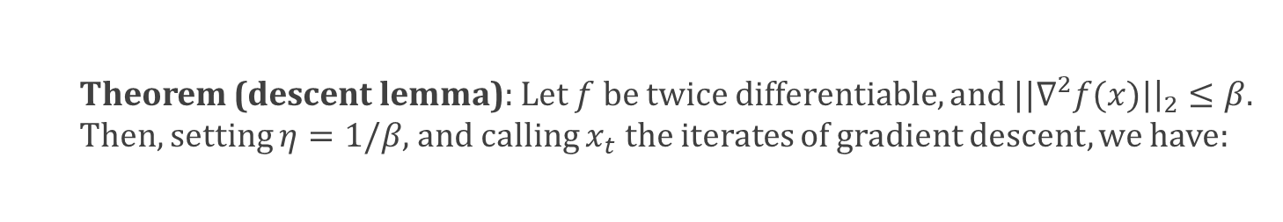

Proving the Descent Lemma
Theorem (descent lemma): Let $f$ be twice differentiable, and ${||∇}^{2}f(x)|{\left.​\right|}_{2}≤β.$ Then, setting $η=1/β$, and calling $x_{t}$ the iterates of gradient descent, we have:
$$f\left(x_{t}\right)−f\left(x_{t+1}\right)≥\frac{1}{2β}{||∇}^{ }f(x_{t})|{{\left.​\right|}^{2}}_{2}$$
Proof:
By Taylor expansion and the mean value theorem, we have
$$f\left(x+Δ\right)=f\left(x\right)+Δ^{T}∇f\left(x\right)+\frac{1}{2}Δ^{T}∇^{2}f\left(y\right)Δ$$
Moreover, $Δ^{T}∇^{2}f\left(y\right)Δ≤{||∇}^{2}f\left(y\right)\left|{\left.​\right|}_{2}\right|\left|Δ\right|{\left.​\right|}_{2}^{2}≤β|\left|Δ\right|{\left.​\right|}_{2}^{2}$.
Plugging in $Δ=−η∇f\left(x_{t}\right):$
$$f\left(x_{t+1}\right)≤f\left(x_{t}\right)−η{\left|\left|∇f\left(x_{t}\right)\right|\right|}^{2}+\frac{1}{2}βη^{2}{\left|\left|∇f\left(x_{t}\right)\right|\right|}^{2}$$
$$=f\left(x_{t}\right)−1/β{\left|\left|∇f\left(x_{t}\right)\right|\right|}^{2}+\frac{1}{2}1/β{\left|\left|∇f\left(x_{t}\right)\right|\right|}^{2}$$
$$=f\left(x_{t}\right)−1/2β{\left|\left|∇f\left(x_{t}\right)\right|\right|}^{2}$$

Slide 12
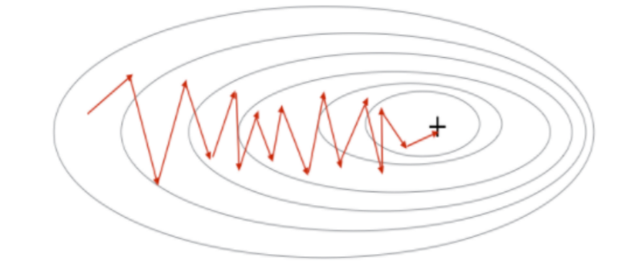
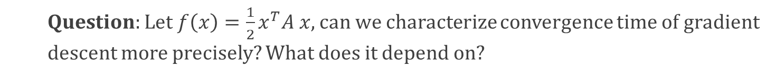
Understanding gradient descent locally
Let’s consider $f$’s that are quadratic. (Close to local minima, this will be “true” due to Taylor). What quadratics are bad/good for gradient descent?
Bad behavior: gradients don’t point
towards minimizer – a lot of zig-zaging until we reach minimizer.
Intuitively: ellipsoidal contours (level sets) should be worse than spherical level sets.
Question: Let $f\left(x\right)={\frac{1}{2}x}^{T}A x$, can we characterize convergence time of gradient descent more precisely? What does it depend on?

Slide 13
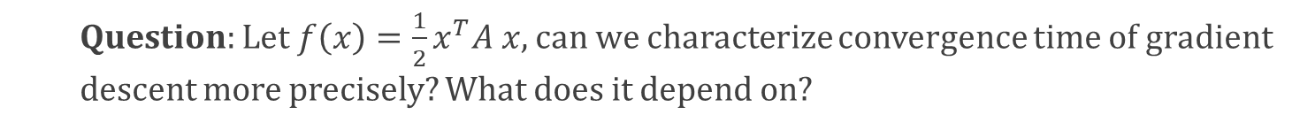



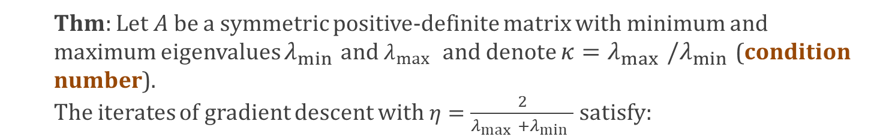
Understanding gradient descent locally
Question: Let $f\left(x\right)={\frac{1}{2}x}^{T}A x$, can we characterize convergence time of gradient descent more precisely? What does it depend on?
Thm: Let $A$ be a symmetric positive-definite matrix with minimum and maximum eigenvalues $λ_{\min{ }}$and $λ_{\max{ }}$ and denote ${κ=λ}_{\max{ }}/λ_{\min{ }}$(condition number). The iterates of gradient descent with $η=\frac{2}{λ_{\max{ }}+λ_{\min{ }}}$ satisfy:
$$\left|\left|x_{t}\right|\right|≤{\left(\frac{κ−1}{κ+1}\right)}^{t}|\left|x_{0}\right||$$
$=\left|\left|x_{t}−0\right|\right|$, i.e. distance from optimum
$=\left|\left|x_{0}−0\right|\right|$, i.e. distance from optimum

Slide 14
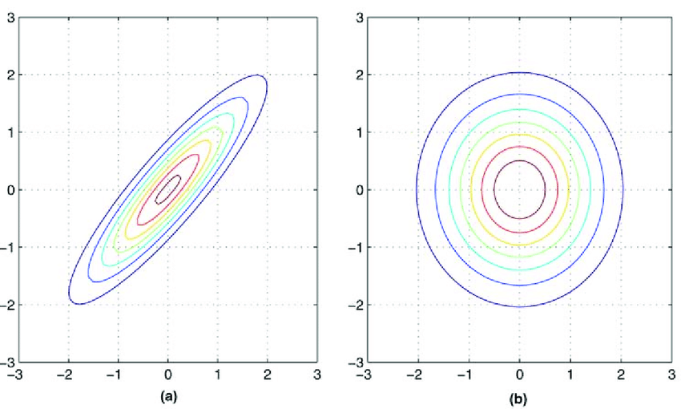
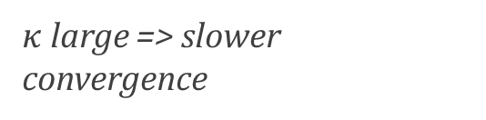
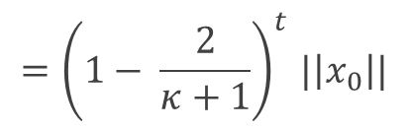

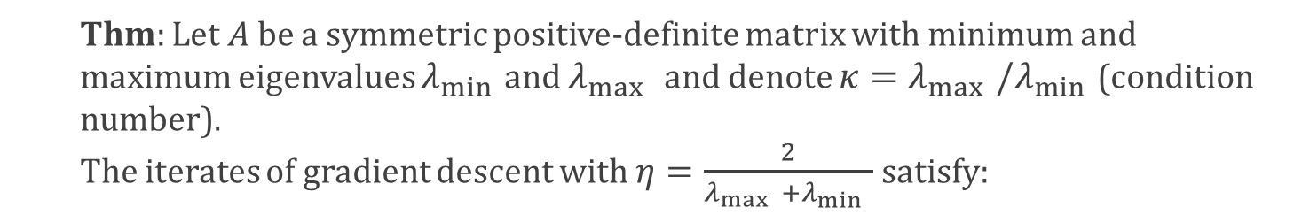
Understanding gradient descent locally
Question: Let $f\left(x\right)={\frac{1}{2}x}^{T}A x$, can we characterize convergence time of gradient descent more precisely? What does it depend on?
Thm: Let $A$ be a symmetric positive-definite matrix with minimum and maximum eigenvalues $λ_{\min{ }}$and $λ_{\max{ }}$ and denote ${κ=λ}_{\max{ }}/λ_{\min{ }}$(condition number). The iterates of gradient descent with $η=\frac{2}{λ_{\max{ }}+λ_{\min{ }}}$ satisfy:
$$\left|\left|x_{t}\right|\right|≤{\left(\frac{κ−1}{κ+1}\right)}^{t}|\left|x_{0}\right||$$
$${=\left(1− \frac{2}{κ+1}\right)}^{t}|\left|x_{0}\right||$$
$κ$ large => slower convergence

Slide 15


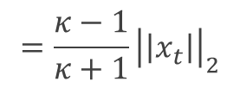

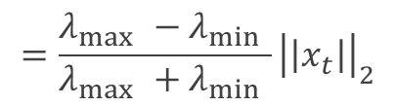




Understanding gradient descent locally
Question: Let $f\left(x\right)={\frac{1}{2}x}^{T}A x$, can we characterize convergence time of gradient descent more precisely? What does it depend on?
Thm: Let $A$ be a symmetric positive-definite matrix with minimum and maximum eigenvalues $λ_{\min{ }}$and $λ_{\max{ }}$ and denote ${κ=λ}_{\max{ }}/λ_{\min{ }}$(condition number). The iterates of gradient descent with $η=\frac{2}{λ_{\max{ }}+λ_{\min{ }}}$ satisfy:
$$\left|\left|x_{t}\right|\right|≤{\left(\frac{κ−1}{κ+1}\right)}^{t}|\left|x_{0}\right||$$
Proof:
$$|\left|x_{t+1}\right||=|\left|x_{t}−η∇f\left(x_{t}\right)\right||$$
$$=|\left|x_{t}−ηAx_{t}\right||$$
$$=|\left|(I−ηA)x_{t}\right||$$
$$≤{\left|\left|I−ηA\right|\right|}_{2}{\left|\left|x_{t}\right|\right|}_{2}$$
$$≤{\max\left(\left|1−ηλ_{max}\right|, \left|1−ηλ_{\min{ }}\right|\right)}_{ }{\left|\left|x_{t}\right|\right|}_{2}$$
$$=\frac{λ_{\max{ }}−λ_{\min{ }}}{λ_{\max{ }}+λ_{\min{ }}}{\left|\left|x_{t}\right|\right|}_{2}$$
$$=\frac{κ−1}{κ+1}{\left|\left|x_{t}\right|\right|}_{2}$$

Slide 16
Fixes to the conditioning problem
What can we do for poorly conditioned problems?
Quadratic problem suggests solution: we can solve it in closed form!!
If $f\left(x\right)={\frac{1}{2}x}^{T}A x+b^{T}x+c$, minimizer is $A^{−1}b$. (Just take derivatives, set to 0.)
What do we do for arbitrary f? Approximate function to second order!!
By Taylor’s thm: $f\left(x+Δ\right)≈f\left(x\right)+Δ^{T}∇f\left(x\right)+\frac{1}{2}Δ^{T}∇^{2}f\left(x\right)Δ+ O\left({||Δ||}^{3}\right)$
Ignoring 3rd and higher order terms, and using the above observation for quadratics:
Set $x_{t+1}=x_{t}−η{\left(∇^{2}f\left(x_{t}\right)\right)}^{−1} ∇f\left(x_{t}\right)$
Newton’s method.

Slide 17
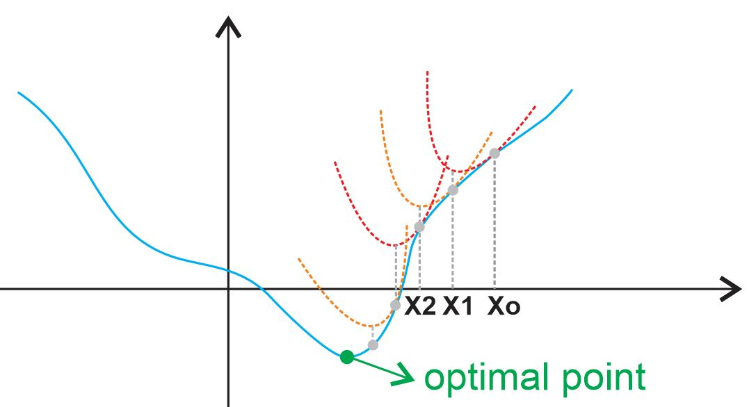
Fixes to the conditioning problem
Set $x_{t+1}=x_{t}−η{\left(∇^{2}f\left(x_{t}\right)\right)}^{−1} ∇f\left(x_{t}\right)$
Newton’s method.
Problem: need to invert a $d×d$matrix => $d^{3}$runtime. Way too expensive.

Slide 18


Momentum (Polyak ‘64)
Alternative fix: instead of using the gradient at the current step, use a linear combination of the gradients at prior steps. “Smooths” out zig-zagging, but not relying too much on current gradient.
Linear combination of prior gradients + current one
$v_{t+1}=−∇f\left(x_{t}\right)+βv_{t}$
$$x_{t+1}={x_{t}+ηv}_{t+1}$$
Helps provably! You’ll show in homework that for the quadratic case we considered, i.e. $f\left(x\right)=x^{T}A x$:
$$\left|\left|x_{t}\right|\right|≤{\left(\frac{\sqrt{κ}−1}{\sqrt{κ}+1}\right)}^{t}|\left|x_{0}\right||$$

Slide 19
Momentum (Nesterov ‘83)
Nesterov acceleration is a lookahead variant of momentum, which has provable benefits for *any* convex function. (And is in a certain precise sense, the optimal first-order optimization algorithm).
Evaluate gradient at a
“lookahead” point
$v_{t+1}=−∇f\left(x_{t}+β_{ }v_{t}\right)+β_{ }v_{t}$
$$x_{t+1}={x_{t}+η_{ }v}_{t+1}$$
Magical! There’s been a mini cottage industry to “explain” Nesterov acceleration.

Slide 20
Taking gradients of neural networks: backpropagation
The workhorse for training neural networks: an algorithm that for a network with V nodes and E edges calculates the gradient in linear time O(V+E).
The name backpropagation was introduced by Rumelhart, Hinton, Williams ‘86, but so natural that it was rediscovered multiple times (as early as 60s). Algorithm seems to first be mentioned in Werbos’ thesis ‘74 in the context of neural networks.
In control theory: Kelley ‘60, Bryson ’61 [cast as dynamic programming];
In theoretical computer science: Baur-Strassen lemma ’83 [in the context of algebraic circuits]

Slide 21
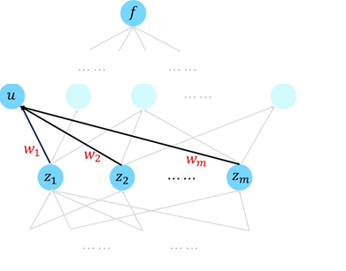
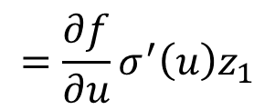

Taking gradients of neural networks: backpropagation
The main tool for deriving backprop: chain rule
Suppose $f(y) = f(x_{1}(y), x_{2}(y), …, x_{n}(y))$
Then, $\frac{∂f}{∂y} =\sum_{i=1}^{n}{ \frac{∂f}{∂x_{i}}}\frac{∂x}{∂y}$
Observation 1: It suffices to take derivatives with respect to node functions.
$$\frac{∂f}{∂w_{1}} =\frac{∂f}{∂u}\frac{∂u}{∂w_{1}}$$
$$=\frac{∂f}{∂u}\frac{∂σ(\left\langle w, z\right\rangle +b)}{∂w_{1}}$$
$$=\frac{∂f}{∂u}σ^{′}\left(u\right)z_{1}$$

Slide 22
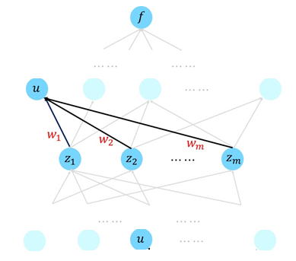



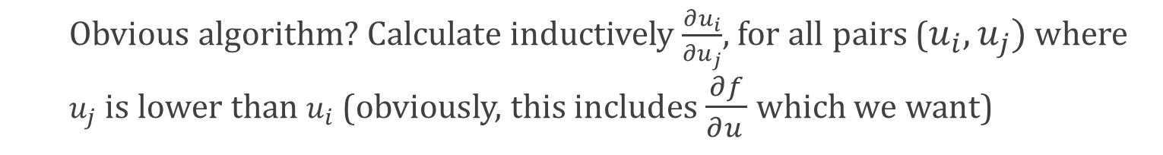
Taking gradients of neural networks: backpropagation
Observation 2: The obvious forward propagation algorithms results in runtime of $Ω\left(V^{2}\right)$. (Bad! We want O(V+E))
Obvious algorithm? Calculate inductively $\frac{∂u_{i}}{∂u_{j}}$, for all pairs ($u_{i}, u_{j})$ where $u_{j}$ is lower than $u_{i}$ (obviously, this includes $\frac{∂f}{∂u_{ }}$ which we want)
$$\frac{∂u_{i}}{∂u_{j}} =\sum_{k}{\frac{∂u_{i}}{∂z_{k}}\frac{∂z_{k}}{∂u_{j}}}$$
t+1
$$u_{i}$$
Easy as in prior slide
Have these by inductive hypothesis.
$$u_{j}$$

Slide 23
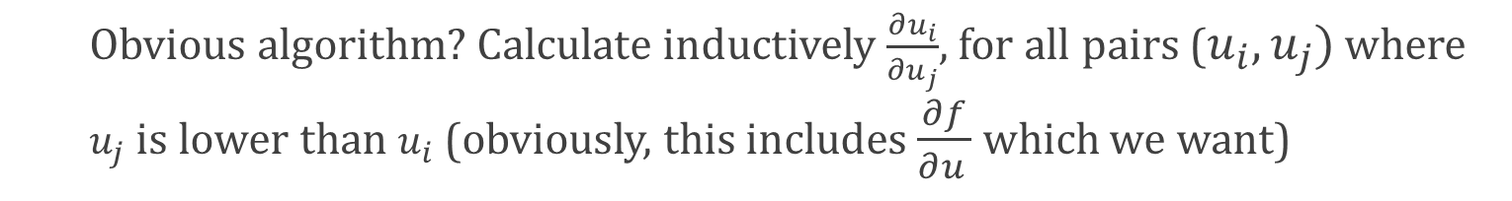
Taking gradients of neural networks: backpropagation
Observation 2: The obvious forward propagation algorithms results in runtime of $O\left(V^{2}\right)$. (Bad! We want O(V+E))
Obvious algorithm? Calculate inductively $\frac{∂u_{i}}{∂u_{j}}$, for all pairs ($u_{i}, u_{j})$ where $u_{j}$ is lower than $u_{i}$ (obviously, this includes $\frac{∂f}{∂u_{ }}$ which we want)
$$\frac{∂u_{i}}{∂u_{j}} =\sum_{k}{\frac{∂u_{i}}{∂z_{k}}\frac{∂z_{k}}{∂u_{j}}}$$
t+1
$$u_{i}$$
Bad – this will end up with $Ω\left(V^{2}\right)$ algorithm.
$$u_{j}$$

Slide 24

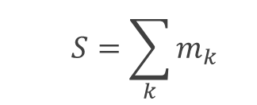

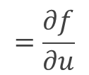

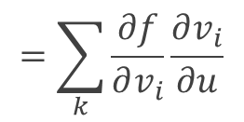
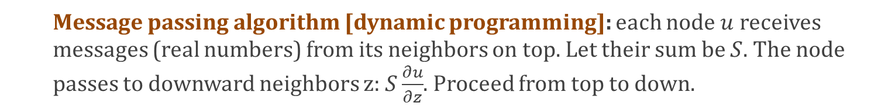

Taking gradients of neural networks: backpropagation
Observation 3: The better way to do this is in a backward fashion.
Message passing algorithm [dynamic programming]: each node $u$ receives messages (real numbers) from its neighbors on top. Let their sum be $S$. The node passes to downward neighbors z: $S\frac{∂u}{∂z}$. Proceed from top to down.
Claim: The sum of the messages that each node
u computes S is equal to $\frac{∂f}{∂u_{ }}$.
$$v_{1} v_{2} v_{3} v_{4}$$
Proof: By induction.
Suppose u is at layer t, and inductive hypothesis holds for layers t+1 and above. Sum of messages to u satisfies:
$$m_{1} m_{2} m_{3} m_{4}$$
$$S=\sum_{k}{m_{k}}$$
$$=\sum_{k}{\frac{∂f}{∂v_{i}}}\frac{∂v_{i}}{∂u}$$
$$=\frac{∂f}{∂u}$$
$$u$$
$$z$$
Def. of messages
Inductive hypothesis

Slide 25
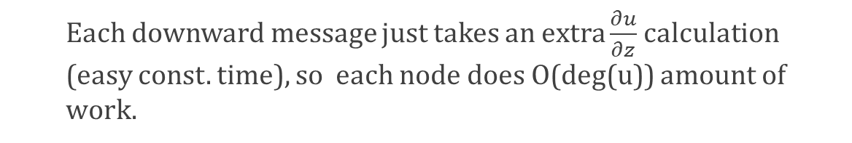
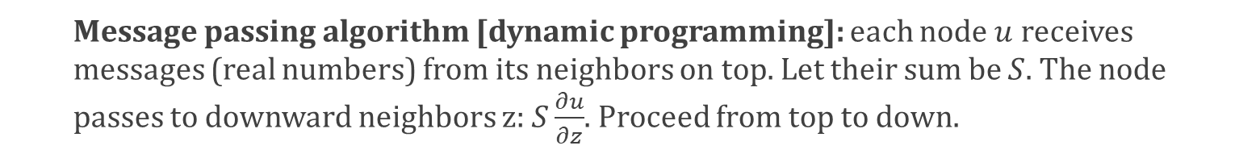



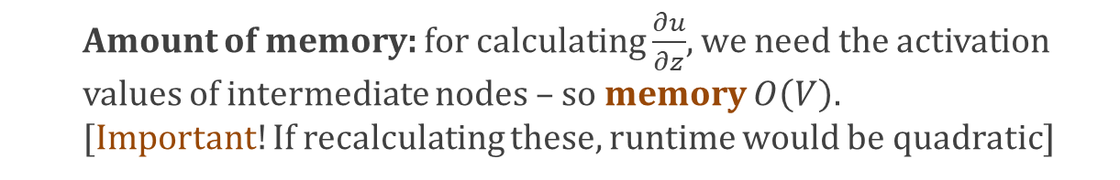

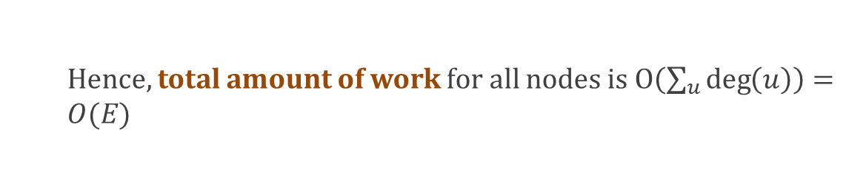
Taking gradients of neural networks: backpropagation
Observation 3: The better way to do this is in a backward fashion.
Message passing algorithm [dynamic programming]: each node $u$ receives messages (real numbers) from its neighbors on top. Let their sum be $S$. The node passes to downward neighbors z: $S\frac{∂u}{∂z}$. Proceed from top to down.
Amount of work: each node u needs to sum its upward neighbor messages (at most deg(u) of them), and pass a message to its downward neighbors (at most deg(u) of them).
$$v_{1} v_{2} v_{3} v_{4}$$
Each downward message just takes an extra $\frac{∂u}{∂z}$ calculation (easy const. time), so each node does O(deg(u)) amount of work.
$$m_{1} m_{2} m_{3} m_{4}$$
$$u$$
Hence, total amount of work for all nodes is $O\left(\sum_{u}{\deg\left(u\right)}\right)=O(E)$
Amount of memory: for calculating $\frac{∂u}{∂z}$, we need the activation values of intermediate nodes – so memory $O\left(V\right).$ [Important! If recalculating these, runtime would be quadratic]
$$z$$

