Slide 1

US 114050 · LESSON 3 · NQF LEVEL 5
Explain how Information Technology can be used in Business
Word processors, spreadsheets, databases, graphics and the integrated office suites of 2026 — their functions, and their effects on the business
TIME
SESSION
MODULE
QUALITY ASSURANCE
90 minutes · Self & Group
Friday, 21 Aug 2026 · 09h00 – 14h00
Module 1 · Professional Team Development
QCTO / MICT SETA
ITSS Learn · Investec · Corporate Banking Technology

Slide 2
WORD PROCESSORS
The most common of all computer applications
Word processing: using a computer to create, edit and print documents — create it, store it electronically, display it on screen, modify it from the keyboard, print or share it.
The great advantage over a typewriter: change anything without retyping the document — correct, delete, insert and move text freely.
In 2026 it also saves to the cloud automatically, keeps a version history, and lets several people edit the same document at once.
The tools a business will meet: Microsoft Word (Microsoft 365, with Copilot), Google Docs (Google Workspace, with Gemini) and the free LibreOffice Writer.
IN BUSINESS
Letters, quotations, contracts, reports, policies, minutes — produced faster and with fewer errors, kept on-brand with templates, finished together in the cloud.
US 114050 · Lesson 3 — How IT can be used in business · NQF 5
2

Slide 3
WORD PROCESSORS
Basic features every word processor supports
Insert text
Delete text
Cut and paste
Copy
Add text anywhere in the document.
Erase characters, words, lines or pages.
Remove a section and insert it elsewhere.
Duplicate a section of text.
Page size & margins
Search & replace
Word wrap
Print
Change them — the text re-fits automatically.
Find a phrase; swap every occurrence.
New lines start themselves; text re-flows.
Hardcopy — or a PDF for email and WhatsApp.
TEXT EDITOR OR WORD PROCESSOR?
A program with only these basics is a text editor (Windows Notepad). Word processors that add much more are called full-featured word processors.
US 114050 · Lesson 3 — How IT can be used in business · NQF 5
3

Slide 4
WORD PROCESSORS
What full-featured word processors add
Fonts & layout
Headers, footers & numbering
Mail merge
Typefaces, bold, italics; margins and indents; WYSIWYG.
Custom top and bottom of every page — numbers tracked.
A list plus a template: personalised letters and labels.
Spell checker & thesaurus
Contents & indexes
Macros
Unrecognised words highlighted; synonyms built in.
Contents, indexes, footnotes, cross-references — automated.
Record keystrokes once; replay them on routine work.
WHAT 2026 ADDS
Track changes and comments · real-time co-authoring with named cursors · Copilot and Gemini drafting, summarising and translating · dictation with automatic punctuation.
US 114050 · Lesson 3 — How IT can be used in business · NQF 5
4

Slide 5
SPREADSHEETS
A grid of cells that does the arithmetic for you
A spreadsheet is a rectangular table (grid) of information, often financial — the name comes from ledgers “spread” across two facing pages.
Electronic spreadsheets keep the rows, columns and cells but add formulas — =SUM(B2:B13) — and every dependent formula recalculates the instant a number changes.
Charts, pivot tables and conditional formatting turn the numbers into pictures and summaries.
The 2026 line-up: Microsoft Excel (Copilot writes formulas and analyses data), Google Sheets (browser, real-time sharing) and the free LibreOffice Calc.
IN BUSINESS
Budgets, cash-flow forecasts, price lists, sales analysis, stock counts, dashboards — and “what if” scenarios tested before money is spent (the decision stages from Lesson 2).
US 114050 · Lesson 3 — How IT can be used in business · NQF 5
5

Slide 6
DATABASES
Structured records, queried for answers
A database is a structured collection of records stored so that a program — or a person using a query language — can consult it to answer questions.
The DBMS is the software that manages and queries the database; the schema describes the facts it holds and the relationships among them.
A typical query: “How many burgers with two or more patties were sold in March in region 4?” — the answer is information for a decision.
The relational model rules (Lesson 2): related tables of rows and columns, linked by shared values.
IN BUSINESS
Customer records (CRM), stock and inventory, sales history, loyalty, payroll, point-of-sale. Questions answered in seconds — and POPIA makes the business guard the personal data it holds.
US 114050 · Lesson 3 — How IT can be used in business · NQF 5
6

Slide 7
DATABASES
The database engines of 2026
SQL Server / Azure SQL
PostgreSQL & MySQL
Oracle Database
Microsoft's engine on-premise and its cloud twin — the corporate mainstay.
The open-source workhorses behind most of the web's applications.
The heavyweight of large enterprises, banks and government systems.
MongoDB
Access & Airtable
In the cloud
A NoSQL store for records that do not fit neatly into tables.
Where small businesses start — friendly forms over real databases.
Most new databases run as managed cloud services, not on an office server.
US 114050 · Lesson 3 — How IT can be used in business · NQF 5
7

Slide 8
GRAPHICS
Digitally creating and manipulating visual content
Geometry
Animation
Rendering
Imaging
Representing and processing surfaces and shapes.
Representing and manipulating motion.
Algorithms that reproduce how light falls on a scene.
Image acquisition and image editing.
IN BUSINESS
Logos and branding, adverts, social-media posts, product photos, packaging, signage, slides. A professional image builds trust — and in-house design is fast and cheap.
US 114050 · Lesson 3 — How IT can be used in business · NQF 5
8

Slide 9





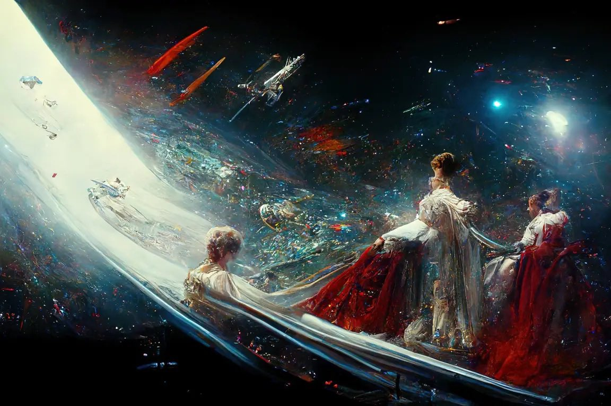
GRAPHICS
The 2026 toolbox
Canva
Photoshop & Illustrator
Figma
Browser design for posts, flyers and slides.
Pro photo editing and vector art, with Firefly AI.
Collaborative design in the browser, for teams.
Blender
CapCut & Premiere Pro
AI image generation
Free, professional 3D modelling and animation.
Video editing for adverts and social media.
Firefly, DALL·E and Midjourney draw from a prompt.
US 114050 · Lesson 3 — How IT can be used in business · NQF 5
9

Slide 10
GRAPHICS
An AI-generated artwork, from one sentence
Generative AI drafts images from a text prompt — describe the visual, refine, and export.
In business: campaign concepts, product mock-ups and social artwork in minutes instead of days.
Rules still apply: check licensing, brand fit and honesty before publishing AI-generated visuals.
Théâtre d'Opéra Spatial — generated with Midjourney by Jason M. Allen; it won a Colorado State Fair art competition in 2022 and started a worldwide debate.
US 114050 · Lesson 3 — How IT can be used in business · NQF 5
10

Slide 11
INTEGRATED OFFICE SUITES
Microsoft 365 — one subscription, tools that work together
An office suite bundles the word processor, spreadsheet, presentations and email — one look and feel, one spell checker, live links between applications.
Live links keep work current: an Excel chart pasted into a Word report updates when the numbers change.
Office began in 1989 (Mac) and 1990 (Windows) as Word + Excel + PowerPoint. Today it is Microsoft 365 — a cloud subscription priced per user per month.
A 2026 business subscription: Word, Excel, PowerPoint, Outlook, OneNote, Teams, OneDrive and SharePoint — with Copilot woven through all of them.
IN BUSINESS
A quotation drafted in Word, costed in Excel, presented in PowerPoint, shared in Teams and signed off the same day — on desktop, browser, tablet or phone.
US 114050 · Lesson 3 — How IT can be used in business · NQF 5
11

Slide 12
INTEGRATED OFFICE SUITES
The rest of the 2026 market
Google Workspace
LibreOffice
iWork · Zoho · OnlyOffice · WPS
Docs, Sheets, Slides, Gmail, Drive, Meet with Gemini — browser-first, collaboration is its superpower.
Free, open-source, fully offline — Writer, Calc, Impress and Base. Opens Microsoft formats.
Apple's suite plus capable challengers — all read and write the standard formats.
COMPATIBILITY IS WHAT MATTERS
.docx, .xlsx and .pptx are the de facto exchange standards; PDF is the standard for final documents. Weigh cost, collaboration, connectivity and staff skills.
US 114050 · Lesson 3 — How IT can be used in business · NQF 5
12

Slide 13
INTEGRATED OFFICE SUITES
The suites that came before — and what they teach
Suite | What it bundled | What happened
Lotus SmartSuite | Word Pro · 1-2-3 · Freelance Graphics · Approach · Organizer | Discontinued — 1-2-3 ended in 2013
Corel WordPerfect Office | WordPerfect · Quattro Pro · Paradox | Survives only in a small legal niche
CorelDRAW | Vector graphics (still Corel's best-seller) | Lives on — as a graphics tool, not a suite
THE LESSON
Compatibility beats features. Users would not leave the formats everyone else used — the same reason .docx and .xlsx still rule in 2026.
US 114050 · Lesson 3 — How IT can be used in business · NQF 5
13

Slide 14
PULLING IT TOGETHER
Function and effect — what you must be able to explain
Application | Function — what it does | Effect — what it changes
Word processors | Create, edit and share documents | Faster, error-free, on-brand paperwork
Spreadsheets | Calculate, analyse and chart numbers | Accurate arithmetic; “what if” before money moves
Databases | Store and query business records | Facts on demand; one trusted copy of the truth
Graphics | Create the visual face of the business | Professional image at low in-house cost
Integrated suites | Bundle it all with email and cloud files | One subscription; data flows, skills transfer
US 114050 · Lesson 3 — How IT can be used in business · NQF 5
14

Slide 15
NOW PROVE IT
Your work for Lesson 3
Questioning session
Slide quizzes
45 minutes · Self & Group — explain each application's functions AND effects. AI-marked on the Exercises tab.
Every section gates on its five questions — all correct unlocks Next.
Self assessment
Logbook project — Research
“I am able to explain how IT can be used in business” — tick it honestly.
Show how IT is used in everyday business, with articles and pictures. Mark it 114050.
US 114050 · Lesson 3 — How IT can be used in business · NQF 5
15

Slide 16
IT is how a business writes, counts, remembers and shows itself.
Word processors for the paperwork · spreadsheets for the numbers · databases for the records · graphics for the brand · one integrated suite tying it all together — always explain the function AND the effect.
US 114050 · National Certificate: IT — System Support · SAQA ID 48573 · ITSS Learn
US 114050 · Lesson 3 — How IT can be used in business · NQF 5
16

