Slide 1

ITSS LEARN · BUILT FOR ERUDITIO
Give Eruditio one operating system for every learnership.
Teach, mark, track, communicate, report and audit in one place — so Eruditio can scale delivery without scaling paperwork.
BUILT FOR
QUALITY ASSURED
RUNS ON
WHO USES IT
NC: IT Systems Support
SAQA 48573 · NQF 5
QCTO / MICT SETA
audit-ready evidence
Any device — installable,
works offline
Learners + 4 staff roles,
up to Super User
Eruditio × ITSS Learn · Problem-to-outcome proposal
Notes:
Welcome and thank you for the time. Today I want to show you the platform we use to run the IT Systems Support learnership end to end — it is called ITSS Learn. One sentence summary: it is a single app in which learners are taught, assessed, tracked and supported, and in which all the administration, evidence and compliance paperwork produces itself. It is live today, runs on any device, and was purpose-built for this exact qualification — SAQA 48573, NQF Level 5, 148 credits, quality-assured under QCTO / MICT SETA.

Slide 2
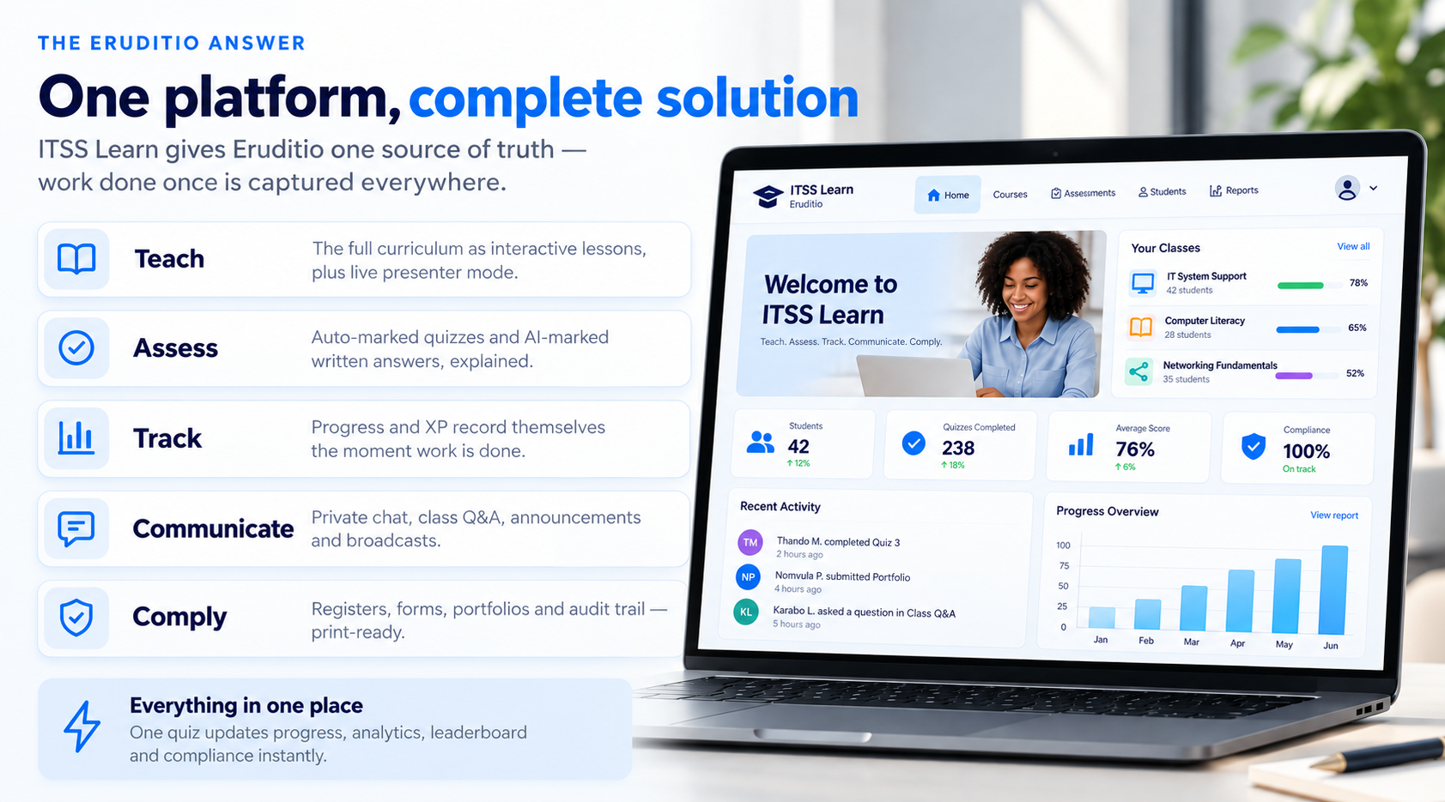






What the platform offers
One platform, five jobs
ITSS Learn gives Eruditio one source of truth — work done once is captured everywhere.
Teach
The full curriculum as interactive lessons, plus live presenter mode.
Assess
Auto-marked quizzes and AI-marked written answers, explained.
Track
Progress and XP record themselves the moment work is done.
Communicate
Private chat, class Q&A, announcements and broadcasts.
Comply
Registers, forms, portfolios and audit trail — print-ready.
Everything in one place — one quiz updates progress, analytics, leaderboard and compliance instantly.
3
Notes:
ITSS Learn replaces all of that with one app doing five jobs. Teach — the full curriculum lives in the app as interactive lessons, with a live classroom presenter mode. Assess — quizzes and written answers are marked automatically, including by AI, with explained feedback. Track — progress records itself the moment work is done; nobody captures anything. Communicate — private chat, class Q&A, announcements and broadcasts, all moderated. Comply — every register, form, portfolio and audit trail is generated by the platform, print-perfect. The key message: it is not five tools glued together — it is one system where each part feeds the others. A quiz taken in class instantly updates progress, analytics, the leaderboard and the compliance dashboard, with zero admin typing.

Slide 3
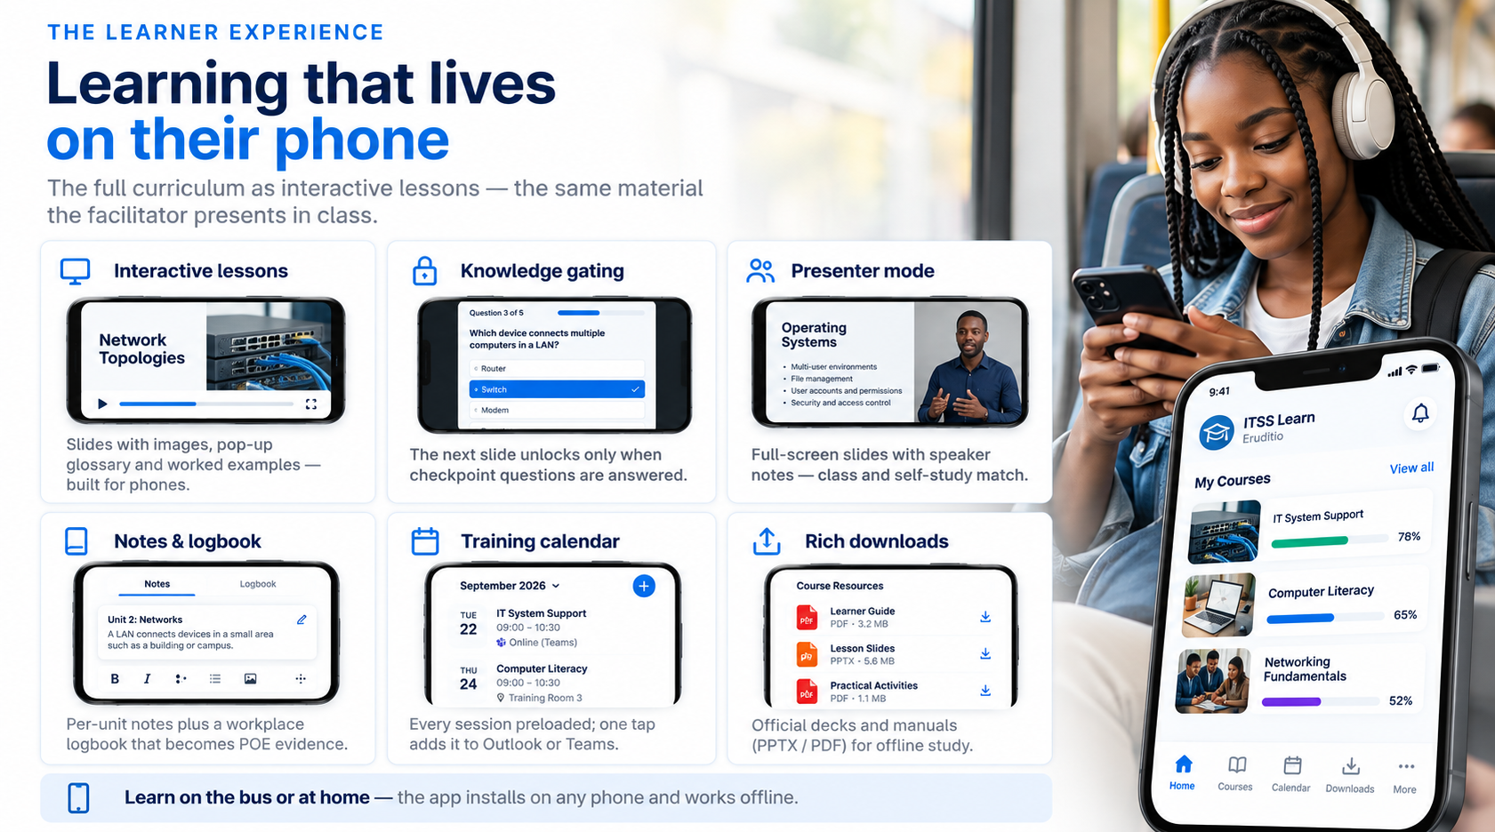





THE LEARNER EXPERIENCE
Learning that lives on their phone
The full curriculum as interactive lessons — the same material the facilitator presents in class.
Interactive lessons
Knowledge gating
Presenter mode
Slides with images, pop-up glossary and worked examples — built for phones.
The next slide unlocks only when checkpoint questions are answered.
Full-screen slides with speaker notes — class and self-study match.
Notes & logbook
Training calendar
Rich downloads
Per-unit notes plus a workplace logbook that becomes POE evidence.
Every session preloaded; one tap adds it to Outlook or Teams.
Official decks and manuals (PPTX / PDF) for offline study.
Learn on the bus or at home — the app installs on any phone and works offline.
5
Notes:
Now the learner's side — this is what your learners live in every day. Lessons are interactive slide decks with photos, diagrams, pop-up glossary definitions and collapsible worked examples — not PDFs. Knowledge gating: the next slide can stay locked until the learner answers a checkpoint question correctly, so nobody can page through without engaging. The same material has a classroom presenter mode — full-screen slides with speaker notes — so what is taught live on Friday is exactly what learners revise on their phone on Monday. There is a personal logbook for workplace evidence, session notes, and a built-in training calendar that adds sessions to Outlook or Teams with one tap — no API keys, nothing leaves the device. Official slide decks and manuals are downloadable as PPTX / PDF for offline study. Everything works on the learner's own phone — no laptop required.

Slide 4


THE LEARNER EXPERIENCE
Instant marking — even written answers
Learners get marks and reasons the moment they submit. Staff never mark a script by hand.
4 auto-marked types
AI marks written work
Feedback that teaches
Multiple choice, select-all, ordering, matching — instant scores.
Ticks the sentence that earned each mark; AI credits own-words answers.
Names the missing idea and quotes the lesson line that covers it.
Attempts capped
Full transparency
Zero marking backlog
Marked attempts limited; assessments lock with staff-only unlock.
Staff see every option picked and every sentence typed.
Marks and records exist the second a learner presses submit.
6
Notes:
Assessment is where the platform saves the most staff time — and where learners feel the biggest difference. Four question types mark themselves instantly: multiple choice, select-all, drag-to-order and matching, with attempt history and best-score tracking. Written answers get a two-stage AI marker. Stage one is deterministic key-idea detection — it places a tick on the exact sentence that earned each mark. Stage two sends rejected answers to a large language model that judges meaning, so a learner who answers correctly in their own words still gets the credit. Feedback is explanatory: the app tells the learner which idea is missing and quotes the exact lesson line that teaches it — and a gentle in-browser spellchecker helps with typed answers. Marked attempts are capped and self-assessments lock after saving, with a staff-only unlock — results cannot be gamed. And there is full transparency: staff can open any learner and see every option picked and every sentence typed. Key line for the client: marking that used to take a facilitator evenings now happens in the second the learner presses submit.

Slide 5



THE LEARNER EXPERIENCE
Motivation and community built in
XP, badges and an honest leaderboard keep momentum; chat and Q&A keep every learner supported.
XP, levels & badges
Live leaderboard
Q&A & announcements
Newcomer to Legend — computed only from real recorded work.
Honest competition on quizzes, evidence and attendance.
Threaded class questions, staff announcements, live quizzes.
Private 1-to-1 chat
Class photo wall
Safe by design
Direct line to the facilitator — presence, read receipts, broadcast.
Shared course memories, played back as a slideshow.
Staff can open any conversation read-only — database-enforced.
7
Notes:
Twelve months is a long programme — motivation is a real risk. The platform bakes it in. Learners earn XP across 8 levels, from Newcomer to Legend, plus badges — and every point is computed from real recorded work: quizzes passed, evidence uploaded, registers signed. It cannot be inflated, so the class leaderboard is honest and genuinely competitive. Community features keep the cohort connected between Fridays: class Q&A with threaded replies, announcements from staff, live multiplayer quiz sessions, and a class photo wall for the social side. Every learner also has a private 1-to-1 chat line to the facilitator — with online presence, read receipts and message editing — so questions get asked early instead of festering. Staff can broadcast one message privately to every learner at once, and authorised staff can open any conversation read-only for safeguarding — enforced by the database itself.

Slide 6



EVIDENCE
The Portfolio of Evidence runs itself
A guided 37-item checklist, phone uploads to private cloud storage, in-app sign-off, one-click export.
Guided POE checklist
Upload from a phone
Review & sign-off
8 sections, 37 items — from certified ID to unit assignments.
Photos, PDFs and documents straight into private cloud storage.
Assessors record competent / not-yet-competent on each item.
One-click ZIP export
Digital logbook
Dual accounting
A learner's complete portfolio in seconds — not days.
Structured per-unit logbook, cloud-saved and printable.
A coaching view plus a strict, auditable view for credits.
8
Notes:
The Portfolio of Evidence is usually the most painful part of any learnership — here it runs itself. Learners get a guided checklist: 8 sections, 37 evidence items, from certified ID copy to the signed learnership agreement to per-unit assignments. They photograph or upload documents straight from their phone — up to 10 files per item — into private cloud storage. Assessors review and sign off each item in the app, with a clear competent / not-yet-competent verdict workflow, so learners always see exactly what is outstanding. When the moderator or the SETA asks for a portfolio, staff export any learner's entire POE as a ZIP in one click — no more days of assembling paper files. The workplace logbook is digital too. And the dual accounting model — a lenient coaching view plus a strict auditable view — means you always know exactly what is claimable.

Slide 7





THE ADMIN EXPERIENCE
Run the session from one screen
Attendance, enrolment, onboarding and content — the daily mechanics of the course, automated.
Digital attendance
Print-perfect forms
Digital enrolment
Signed on phones; ink extracted from a photographed signature.
Pixel-accurate registers and registration forms, auto-filled.
Biographical form captured once — never re-typed.
Onboarding pack
Central content
1-click broadcast
Welcome document with calendar, POE guide and app how-to.
Upload decks and figures once — synced to every device.
One private message to every learner at once.
9
Notes:
Now the administrative side — first, the day-to-day running of a session. Attendance: the register is digital. Learners sign on their phone in seconds; a learner can even photograph their pen-on-paper signature and the platform extracts clean ink strokes automatically. Registers print as pixel-perfect replicas of the official paper form — every register at once if you like. Enrolment: the official registration form and the biographical enrolment form are digitised to match the paper originals exactly. Learners complete them once online; forms auto-fill from stored data and print exactly like the originals. Each new learner can be handed an auto-generated onboarding pack — programme overview, calendar, required documents, POE guide and app how-to — built in one click. Content management is central: staff upload slide decks and lesson figures and they sync to every device instantly. And one click sends a private broadcast to every learner — session reminders, venue changes, deadline nudges. The message: a facilitator runs the entire Friday session from one screen.

Slide 8
THE ADMIN EXPERIENCE
See every learner, live
A live cohort dashboard, automatic at-risk flags and drill-down to every learner's actual work.
Cohort dashboard
Early-warning flags
Drill into anyone
Completion, averages, attendance, last-seen and XP — one table.
At-risk learners flagged automatically, with reasons.
Every answer, upload and signed register on record.
Compliance view
CSV export
Management reports
Milestones and document completeness at a glance.
Full analytics table for BI, board packs and SETA reports.
Formal reports served in-app, Super User only.
10
Notes:
Second admin superpower: visibility. The analytics dashboard shows the whole cohort live in one sortable table — completion percentage, quiz and exercise averages, attendance rate, last-seen and XP for every learner. The early-warning engine flags at-risk learners automatically and states the reasons: low completion, poor attendance, inactivity, low scores. You intervene in week 3, not month 3. Drill into any learner and see their actual work — every quiz option picked, every sentence typed, every file uploaded, every register signed. The compliance dashboard tracks milestones and document completeness across the cohort. Everything exports: the full analytics table to CSV for your own reporting, and formal management reports can be served inside the app, restricted to the Super User. For a client, this is the difference between hoping the programme is on track and knowing it is.

Slide 9

THE ADMIN EXPERIENCE
Audit-ready by default
The paperwork a SETA / QCTO audit demands is generated, tracked and exportable — not reconstructed.
Full audit trail
Certificates
Deliverables tracked
Every action logged with actor and timestamp; CSV export.
Statements of results and certificates, print-ready.
Lesson plans and assessment records against deadlines.
Evidence on demand
Moderation-ready POE
Honest credit
Registers, forms and logbooks print like the originals.
Complete portfolio ZIPs with verdicts and sign-off history.
Claimed credits always match recorded evidence.
11
Notes:
Third admin pillar: compliance and paperwork that produces itself. Every significant action — sign-ins, enrolments, uploads, marks, reviews, deletions — lands in a shared audit trail with actor and timestamp, exportable to CSV. When the verifier asks 'who marked this and when', the answer is one click away. Certificates and statements of results generate as print-ready documents from real completion data. The provider deliverables — lesson plans before delivery, assessment records within five days, progress reports — are tracked against their deadlines. And because every register, form, portfolio and declaration is digital and print-perfect, a SETA or QCTO audit stops being a scramble: you print the evidence pack on demand. Position this as risk reduction for the client's compliance and HR teams.

Slide 10


TRUST
Security enforced by the database
Learner privacy and role separation are guaranteed at the data layer — even outside the app.
Row-level security
5-tier role system
Private storage
The database itself blocks access to other learners' data.
Every screen, action and report adapts to the role.
Evidence behind authentication — no public links.
Everything audited
Account lifecycle
POPIA-conscious
Submissions, messages and sign-offs logged with timestamps.
Sign-up, password recovery, promotion — self-service.
Personal-data reports served privately to authorised staff.
12
Notes:
Security and privacy — usually the first question from a corporate client. Privacy is enforced in the database itself with row-level security. A learner physically cannot query another learner's messages, files or records — even if they bypass the app entirely. That is a much stronger guarantee than app-side checks. Five roles — Learner, Facilitator, Assessor, Moderator, Super User — and every screen adapts to the role. Sensitive reports are Super User only. Files live in a private storage bucket, never on a public URL. Every significant action is audited: submissions, messages, deletions and sign-offs, with actor and timestamp. Accounts have a full lifecycle: email sign-up, password recovery, promotion and demotion, and remove-profile-from-device. Personal data in reports is kept out of the codebase and served only to authorised signed-in staff. This design directly supports POPIA obligations around minimising access to personal information.

Slide 11

THE PLATFORM
Works everywhere, maintains itself
An installable web app with offline support and central updates — nothing for IT to deploy or patch.
Installs like an app
Works offline
Real-time sync
Phone, tablet, laptop or desktop — no app store needed.
Local cache keeps studying alive; syncs on reconnect.
Start on a PC in class, finish on the phone at home.
Zero-install updates
Teams / Outlook
Polished experience
Everyone is on the latest version at next refresh.
Sessions deep-link into calendars — no API keys.
Dark & light themes and print-optimised output.
13
Notes:
The platform itself removes every classic IT objection. It installs like an app on any phone, tablet or computer — but there is nothing to deploy: it is a progressive web app, no app store or MDM packaging needed. It keeps working offline — a local cache means learners in low-signal areas can keep studying, and work syncs when they reconnect. Real-time cloud sync means work saved on one device appears on every other — start on a PC in class, finish on the phone at home. Updates ship centrally: every user gets the newest version on next refresh — no versions to manage, no rollouts. Dark and light themes, print-optimised output for every document, and zero-secret integrations with Teams, Outlook and calendar apps — deep links and files only, so no API keys and no data leaving the device. Total infrastructure the client must install and maintain: none.

Slide 12
THE ERUDITIO PAYOFF
Running the course: before and after
Task | The paper way | With ITSS Learn
Attendance | Paper register chased and filed | Signed on phones; prints itself
Marking | Evenings of hand-marking | Instant — AI marks written work
Progress capture | Hand-updated spreadsheets | Records itself as work is done
At-risk learners | Noticed at month-end — too late | Flagged automatically, with reasons
Moderation prep | Days assembling paper portfolios | One-click ZIP of the full POE
Reporting | Collating registers and marks | CSV / PDF / ZIP on demand
Onboarding | Printed packs, re-typed forms | Digital forms + welcome pack
Staff hours go back into coaching — the platform does the capture, marking and filing.
14
Notes:
This table is the operational summary — walk it row by row. Attendance: paper registers passed around and filed become digital signatures captured in seconds with print-perfect output. Marking: evenings of hand-marking become instant auto-marking plus AI marking of written answers. Progress capture: hand-updated spreadsheets disappear — progress records itself. Struggling learners: instead of month-end surprises, the platform flags them automatically with reasons. Moderation prep: days of assembling paper portfolios become a one-click ZIP. Stakeholder reporting: collation becomes on-demand CSV / PDF / ZIP exports. Onboarding: printed packs and re-typed forms become digital enrolment plus a generated welcome pack. Close with: the platform gives your staff their evenings back and gives you certainty the programme is on track.

Slide 13

SUMMARY
What each side gets
In learners' hands
In your team's hands
Learn, practise and submit from one app
Instant marks with reasons — AI included
Progress that updates itself
Private chat, Q&A, XP and leaderboard
Sign the register in seconds
Forms completed once, never re-written
Live answers, activity and risk status
Zero manual marking or capture
Audit-ready evidence on demand
1-click CSV / PDF / ZIP for SETA & QCTO
Broadcasts and read-only moderation
Role control with a full audit trail
15
Notes:
One-slide summary of the value on each side. For learners: everything in one app on their own phone — learning, instant marks with reasons including AI, self-updating progress, a private line to the facilitator, digital signing of the register, and forms they complete exactly once. For your team: live truth about every learner's answers, activity and risk status; zero manual marking or capture; audit-ready evidence on demand; one-click CSV / PDF / ZIP exports for SETA and QCTO reporting; broadcasts and read-only conversation moderation; and role-controlled access with a full audit trail. If the client remembers one thing: learners get a better course, and the provider team gets their time back — from the same system.

Slide 14

It teaches, marks, tracks, communicates,
reports and audits — on its own.
ITSS Learn is live today, running the National Certificate: IT Systems Support (NQF 5) end to end — ready to become Eruditio's digital delivery backbone.
Next step: a 30-minute live walkthrough
Eruditio × ITSS Learn · SAQA ID 48573 · QCTO / MICT SETA
16
Notes:
Close. ITSS Learn can run the entire learnership digitally — it teaches, marks, tracks, communicates, reports and audits on its own. It is not a concept: it is live today, running this exact qualification with the full curriculum, calendar and compliance pack inside. Suggested next step: a 30-minute live walkthrough — sign in as a learner, take a quiz and watch the AI mark a written answer, then sign in as a facilitator and watch the dashboard update in real time. Then leave the demo environment with them to explore.

