Slide 1
Gateway Persistence
Operational & Edge cache considerations

Slide 2
Problem statement
After a review and evaluation of the data and operational requirements for the Gateway Program, gaps and limitations have been identified with the existing solution – especially as it relates to the ordering functionality

Slide 3
Data Persistence Categories
Four distinct classes of data have been identified in review of the Gateway requirements.
Category | Description & Usage | Examples | Retrieval
Write Once, Read Few (WORF) | Append-only data queue; no updates or deletes. | Customer interaction data Transaction/event logs (beyond the 30-day retention of Splunk) | Group retrieval by date; specific record retrieval by ID only (usually first returned as part of a group).
Write Few, Read Many (WFRM) | Infrequently updatable data set(s); updates may be temporal, version-specific, or wipe-and-replace. | Application configuration settings (includes version criteria in key) User preferences (replace) Reference data (includes effective date criteria in key) Adaptive search (party, account, location, equipment) source data (replace) | Based on business key, as defined by each data domain.
Queue-Managed & Rolling List | Small data set, relatively consistent in size; frequent updates driven by events or batch schedule. | Last n Account serviced history Pending customer(s) in queue KPI and dashboard statistics Near real-time performance characteristics (prior to transition to WORF state, above) | Always retrieve full data set; display may be limited to Top n rows or otherwise filtered based on user-preferences.
Transaction State (prior to biller submit) | Persistence of Gateway-managed objects (orders, notes, tasks, etc.); volume based on adoption and usage. | In-flight transaction details (shopping cart) Scratchpad | Based on any combination of: Adaptive search criteria (party, account, location) Party contact information (phone, email) Specific transaction ID (usually first returned as part of a date-range based group).

Slide 4
Existing State
Application/Category | Current State | Gaps | Comments
Customer Interactions (RTCCA) | Transactional data written to SQL Server tables, each modeled to a specific source system | Scalability is a concern Unable to correlate interactions across data sources Expensive to maintain | Interactions have common elements (account, type, date/time, etc.); current model does not identify or leverage these common elements.
Transaction Logging | Logs written to Splunk | 30-day retention limit | Time-based analysis enhanced with larger than 30-day sample; allows for period-over-period trending (once KPIs defined and catalogued)1
Configuration Settings & Rules | Stored in MongoDB, embedded with Service Router. Version history not maintained (update via wipe-and-replace). | Version history
Adaptive Search | Adaptive search currently runs against SOLO, through ES and SOLO data service calls | Search performance Control of result set | Artificial size limitations of the existing service cause inaccurate results to be returned.
Reference Data | RDM data replicated to SOLO | No services to expose RDM data for consumption Transformation is required to support transaction (low-medium complexity) or translation (high complexity)
User Preferences Gateway Ordering Scratchpad | Not currently supported. E-Commerce supports saving and retrieving shopping carts with full data lifecycle management considerations (active, inactive, purged) implemented on a SQL Server platform. | Retention of user preferences Recovery of in-flight transaction Scratchpad functionality can be greatly enhanced by addition of persistence; order can be completed to point of submittal to biller | Gateway search capabilities to be enhanced to facilitate retrieval of stored transaction object(s); workflow management to be enhanced to support recovery-in-place.
Gaps and limitations have been identified between the design/operational requirements of Gateway (especially Gateway Ordering) and the existing data availability

Slide 5
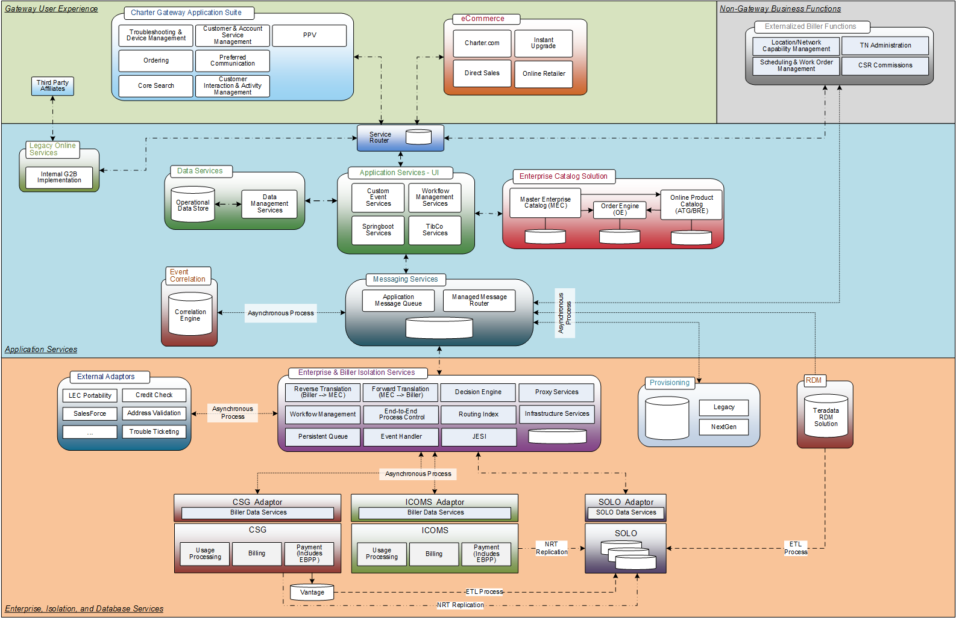
End-State Application Architecture
Features:
Event-based Architecture; supports both synchronous and asynchronous interactions
Operational Data close to application, modeled for consumption, performance and flexibility (solo+)
Leverages “edge-cache” architecture
Individual components are cloud-ready

Slide 6

One platform…

Slide 7
Reference Data (from RDM*)
Common WFRM data from the Teradata RDM platform will be consumed by different portions of the architecture in different ways:
UX (Transactional)
BI (Translational)
* Does not include “reference data” to support adaptive search functionality (e.g. party, account, location, equipment, etc.)

Slide 8
Reference Data Granularity
Four levels of granularity:
Global
Biller-Specific
Regional
Local (SPA)
Granularity may differ between transaction (UX) and translation (BI); transactional values may also be limited by process (e.g. Reason code)
RDM Tables Identified with Gateway Impact | Granularity | GW Priority | MEC Rules | UI Picklist | UI Process | JESI Biller Map | JESI Order Process
Dwelling Type | Biller | 1 | Y |  | Y
**Dwelling Type Category | Biller | 1 | ?
Work Order Reason | Region | 1 |  | Y |  | Y
Work Order Cancel Reason | Region | 1 |  | Y |  | Y
Bad Words | Global | 1 |  |  | Y
Customer Type | Global | 2 |  |  | Y |  | Y
House Custom Field | Region | 2 | Y
Salutation Code | Global | 2 |  | Y |  | Y
Phone Type | Global | 2 |  | Y |  | Y
9xx Discount Code | SPA | 3 |  |  |  |  | Y
9xx Install Code | SPA | 3 |  |  |  |  | Y
9xx Package Code | SPA | 3 |  |  |  |  | Y
9xx Service Code | SPA | 3 |  |  |  |  | Y
Class Service Code Element | SPA | 3 |  |  |  |  | Y
Discount Code | SPA | 3 |  |  |  |  | Y
Install Time Code | Region | 3 |  |  |  |  | Y
VIP Flag | Biller | 3 | Y |  |  |  | Y
House Status | Global | 3 | Y
Product Type | Global | 3 | Y
Franchise Tax Area | Biller | 3 | Y |  |  |  | Y
Region | Biller | 3 | Y |  |  |  | Y
Division | Biller | 3 | Y |  |  |  | Y
Work Order Job Type | Region | 3 |  |  |  |  | Y
Work Order Status Code | Biller | 3 |  |  |  |  | Y
Line Of Business | Global | 3 | Y

Slide 9
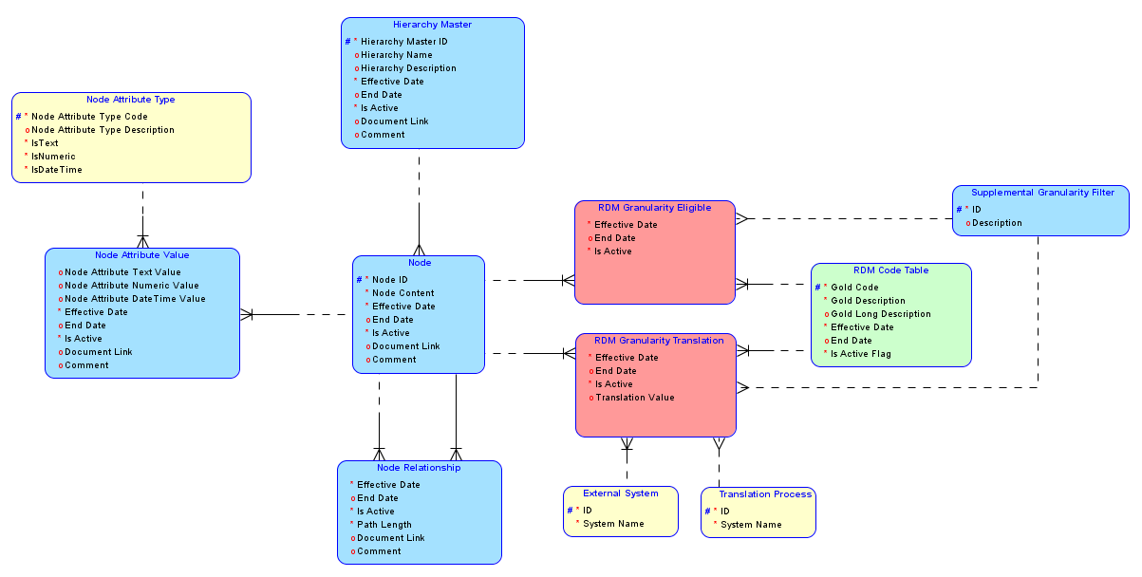
Reference Data Storage Pattern
A common model can be used to persist reference data for operational use.
Application use does not require persistence of RDM translation data set(s).

Slide 10
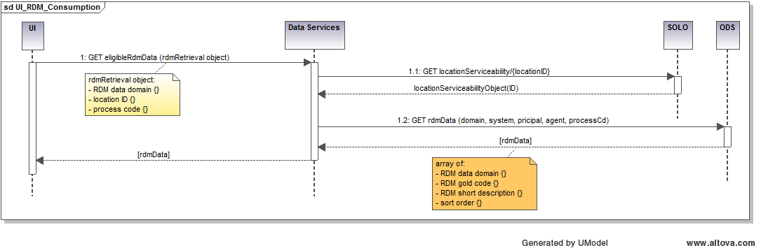
Transactional Reference Data Consumption
Service model supports retrieving any RDM data set for presentation, based on locational and process eligibility.
Supports localization through an optional locationId; if present retrieves location details from existing serviceability call.
Persists reference data in ODS for retrieval

Slide 11
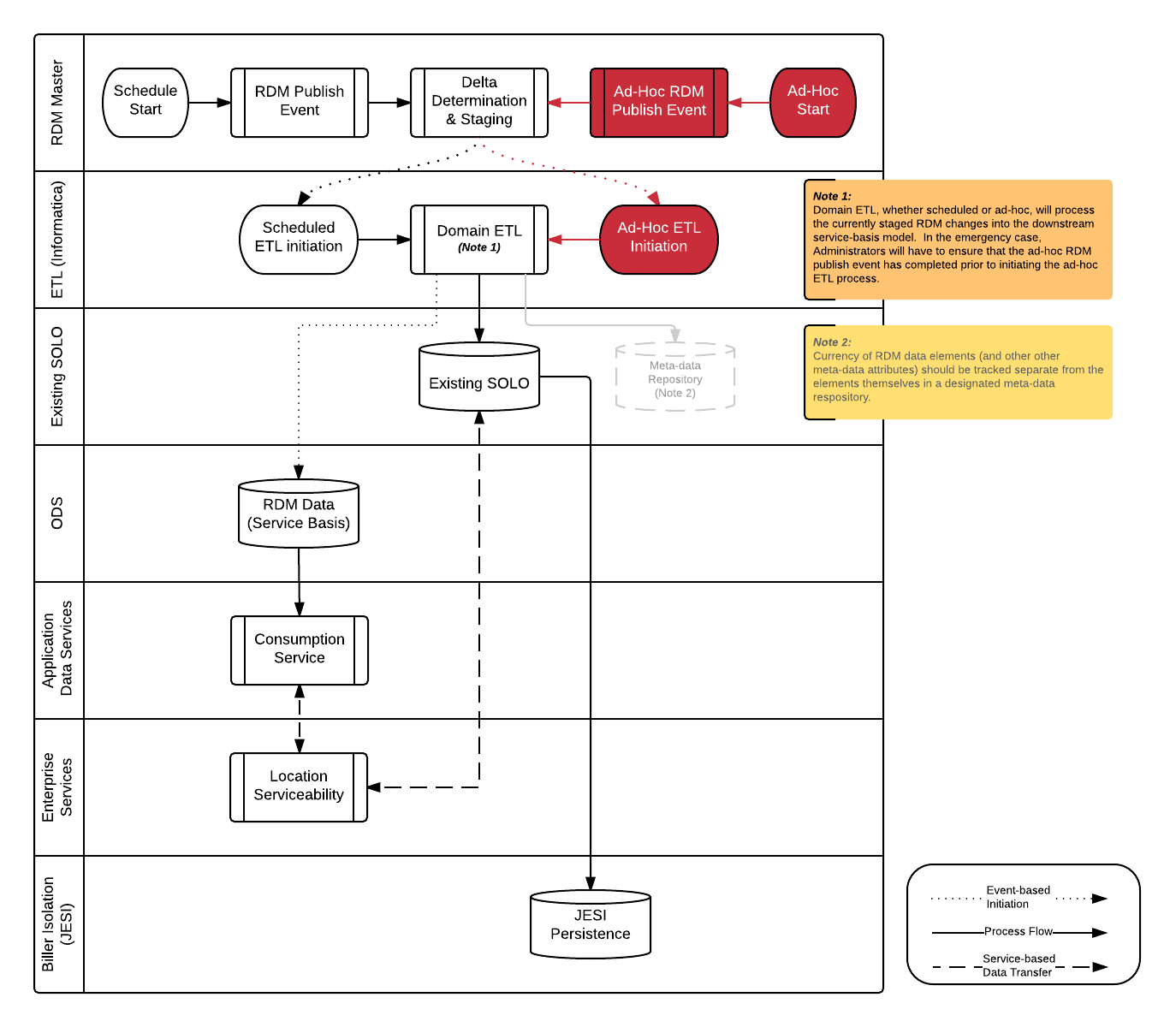
Reference Data Flow
Service model supports retrieving any RDM data set for presentation, based on locational and process eligibility.
Supports localization through an optional locationId; if present retrieves location details from existing serviceability call.
Persists reference data in ODS for retrieval

Slide 12
Customer Interactions (rtcca)
Logging and retrieval of customer touch-points.
Applications:
Calltracker
Resolvity
Synchronoss
Coming Soon…
Enhanced Troubleshooting
TPSI
“Ask Charter”
Gateway Ordering

Slide 13
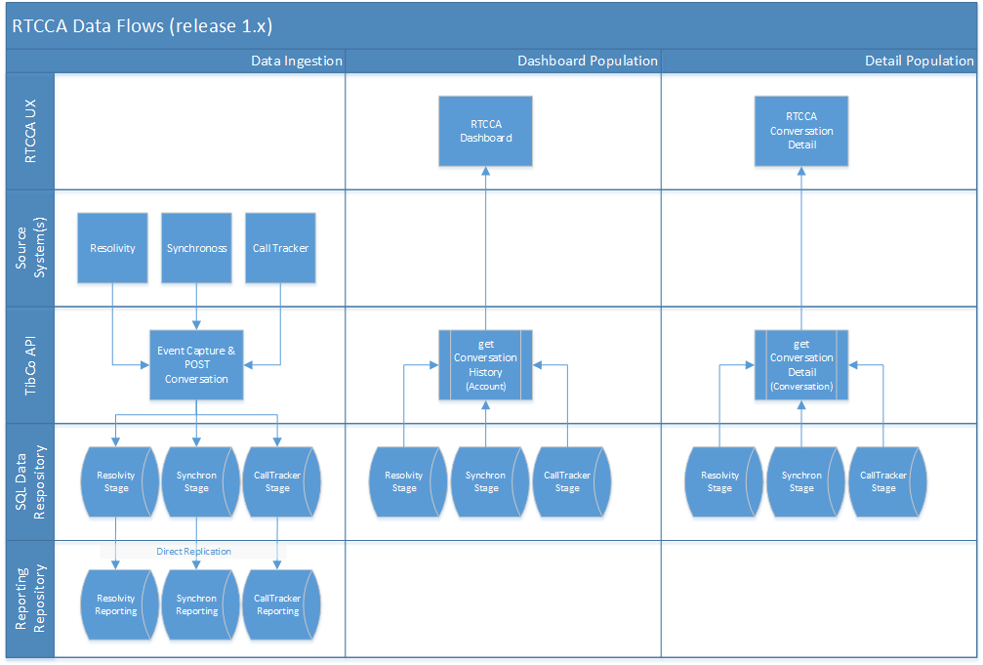
Current State
Initial deployment:
Relational Structure (SQL-Server)
Direct correlation between source system, database table, and related services
Limitations:
Source data changes require database structural changes and coordinated service deployments
Integration of new sources requires new tables and new service development/deployment
Relational storage is inherently more expensive than commodity-based “big-data” storage

Slide 14
Refactoring the RTCCA Solution
Factors driving re-evaluation of solution architecture
Known changes to existing RTCCA feeds
Known net-new data sources to be included in the scope of RTCCA
Known and anticipated KPI definitions and reporting requirements
Gateway mega-program data persistence requirements
Other enterprise-level data management initiatives
Resulting RTCCA Project Re-Prioritization
Limited Functionality enhancements; existing sources only
Convert data persistence from relational to “Big-Data” architecure
Incorporate standardized design of interaction messages, including definition of
Elements Common to all messages
Common Elements by Interaction Type (e.g. Phone, Email, chat, etc.)
Source-Specific Elements
Feed “aggregate” data to XDW for management reporting and KPI valuation
Include linkage in “aggregates” sufficient to support drill-down functionality in reports
Functionality | Original Request | Revised Request | Comments
Existing source enhancements | Throughout phase 2 | Interim State #1 | All changes to existing sources can be grouped and delivered with existing platform; changes will be incorporated in the repository refactoring design.
Management reporting from XDW | Release 2.0; additional KPIs in later phases | Interim State #2 | Refactor the data repository from relational (SQL Server) to big-table-based (Cassandra) IAW enterprise direction.
New Source ingestion | Throughout phase 2 | Proposed “End” State | Standard design supports east ingestion of new data sources (as well as enhancements to existing sources)

Slide 15
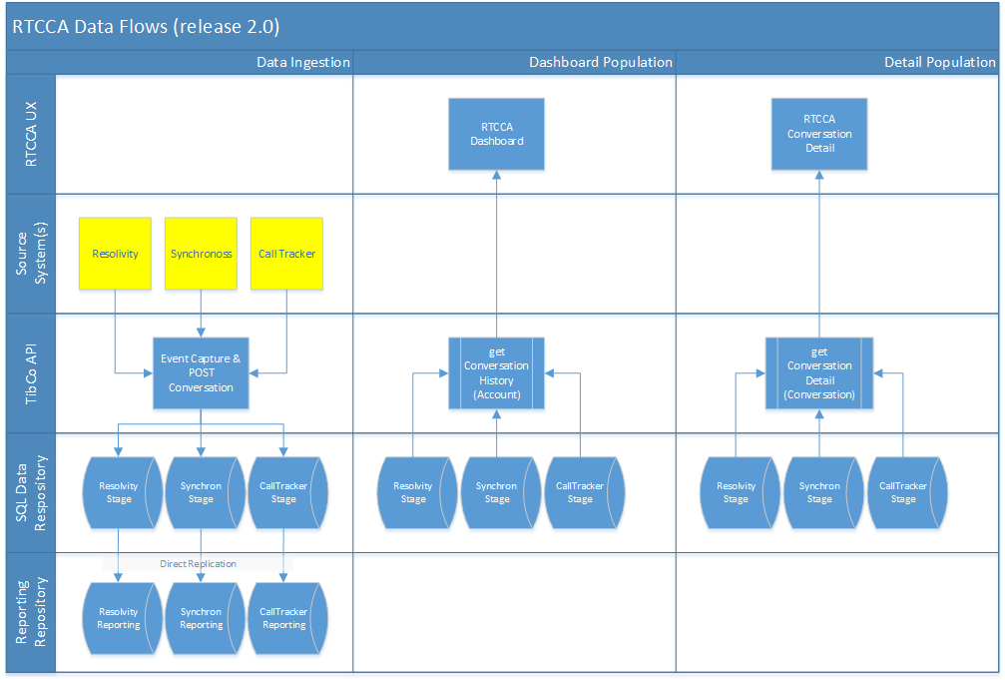
Interim State #1
Initial deployment:
Relational Structure (SQL-Server)
Direct correlation between source system, database table, and related services
Limitations:
Source data changes require database structural changes and coordinated service deployments
Integration of new sources requires new tables and new service development/deployment
Relational storage is inherently more expensive than commodity-based “big-data” storage

Slide 16
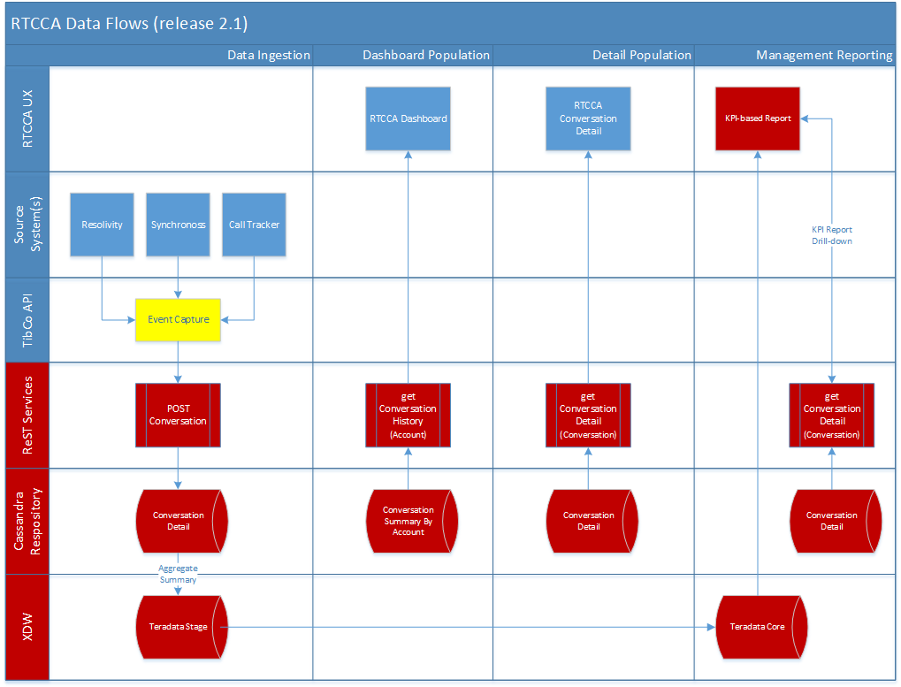
Interim State #2
Initial deployment:
Relational Structure (SQL-Server)
Direct correlation between source system, database table, and related services
Limitations:
Source data changes require database structural changes and coordinated service deployments
Integration of new sources requires new tables and new service development/deployment
Relational storage is inherently more expensive than commodity-based “big-data” storage

Slide 17
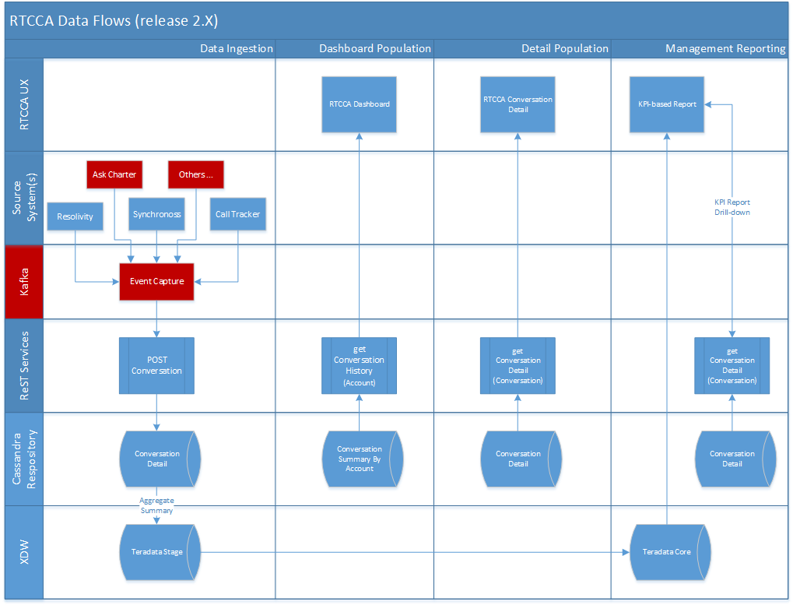
“End” state
Event-based Messaging (Kafka):
Replace TibCo for messaging
Scarce, expensive resources
Complex optimization/performance tuning
Benefits:
Reduced TCO
Decreasing O&M complexity

Slide 18
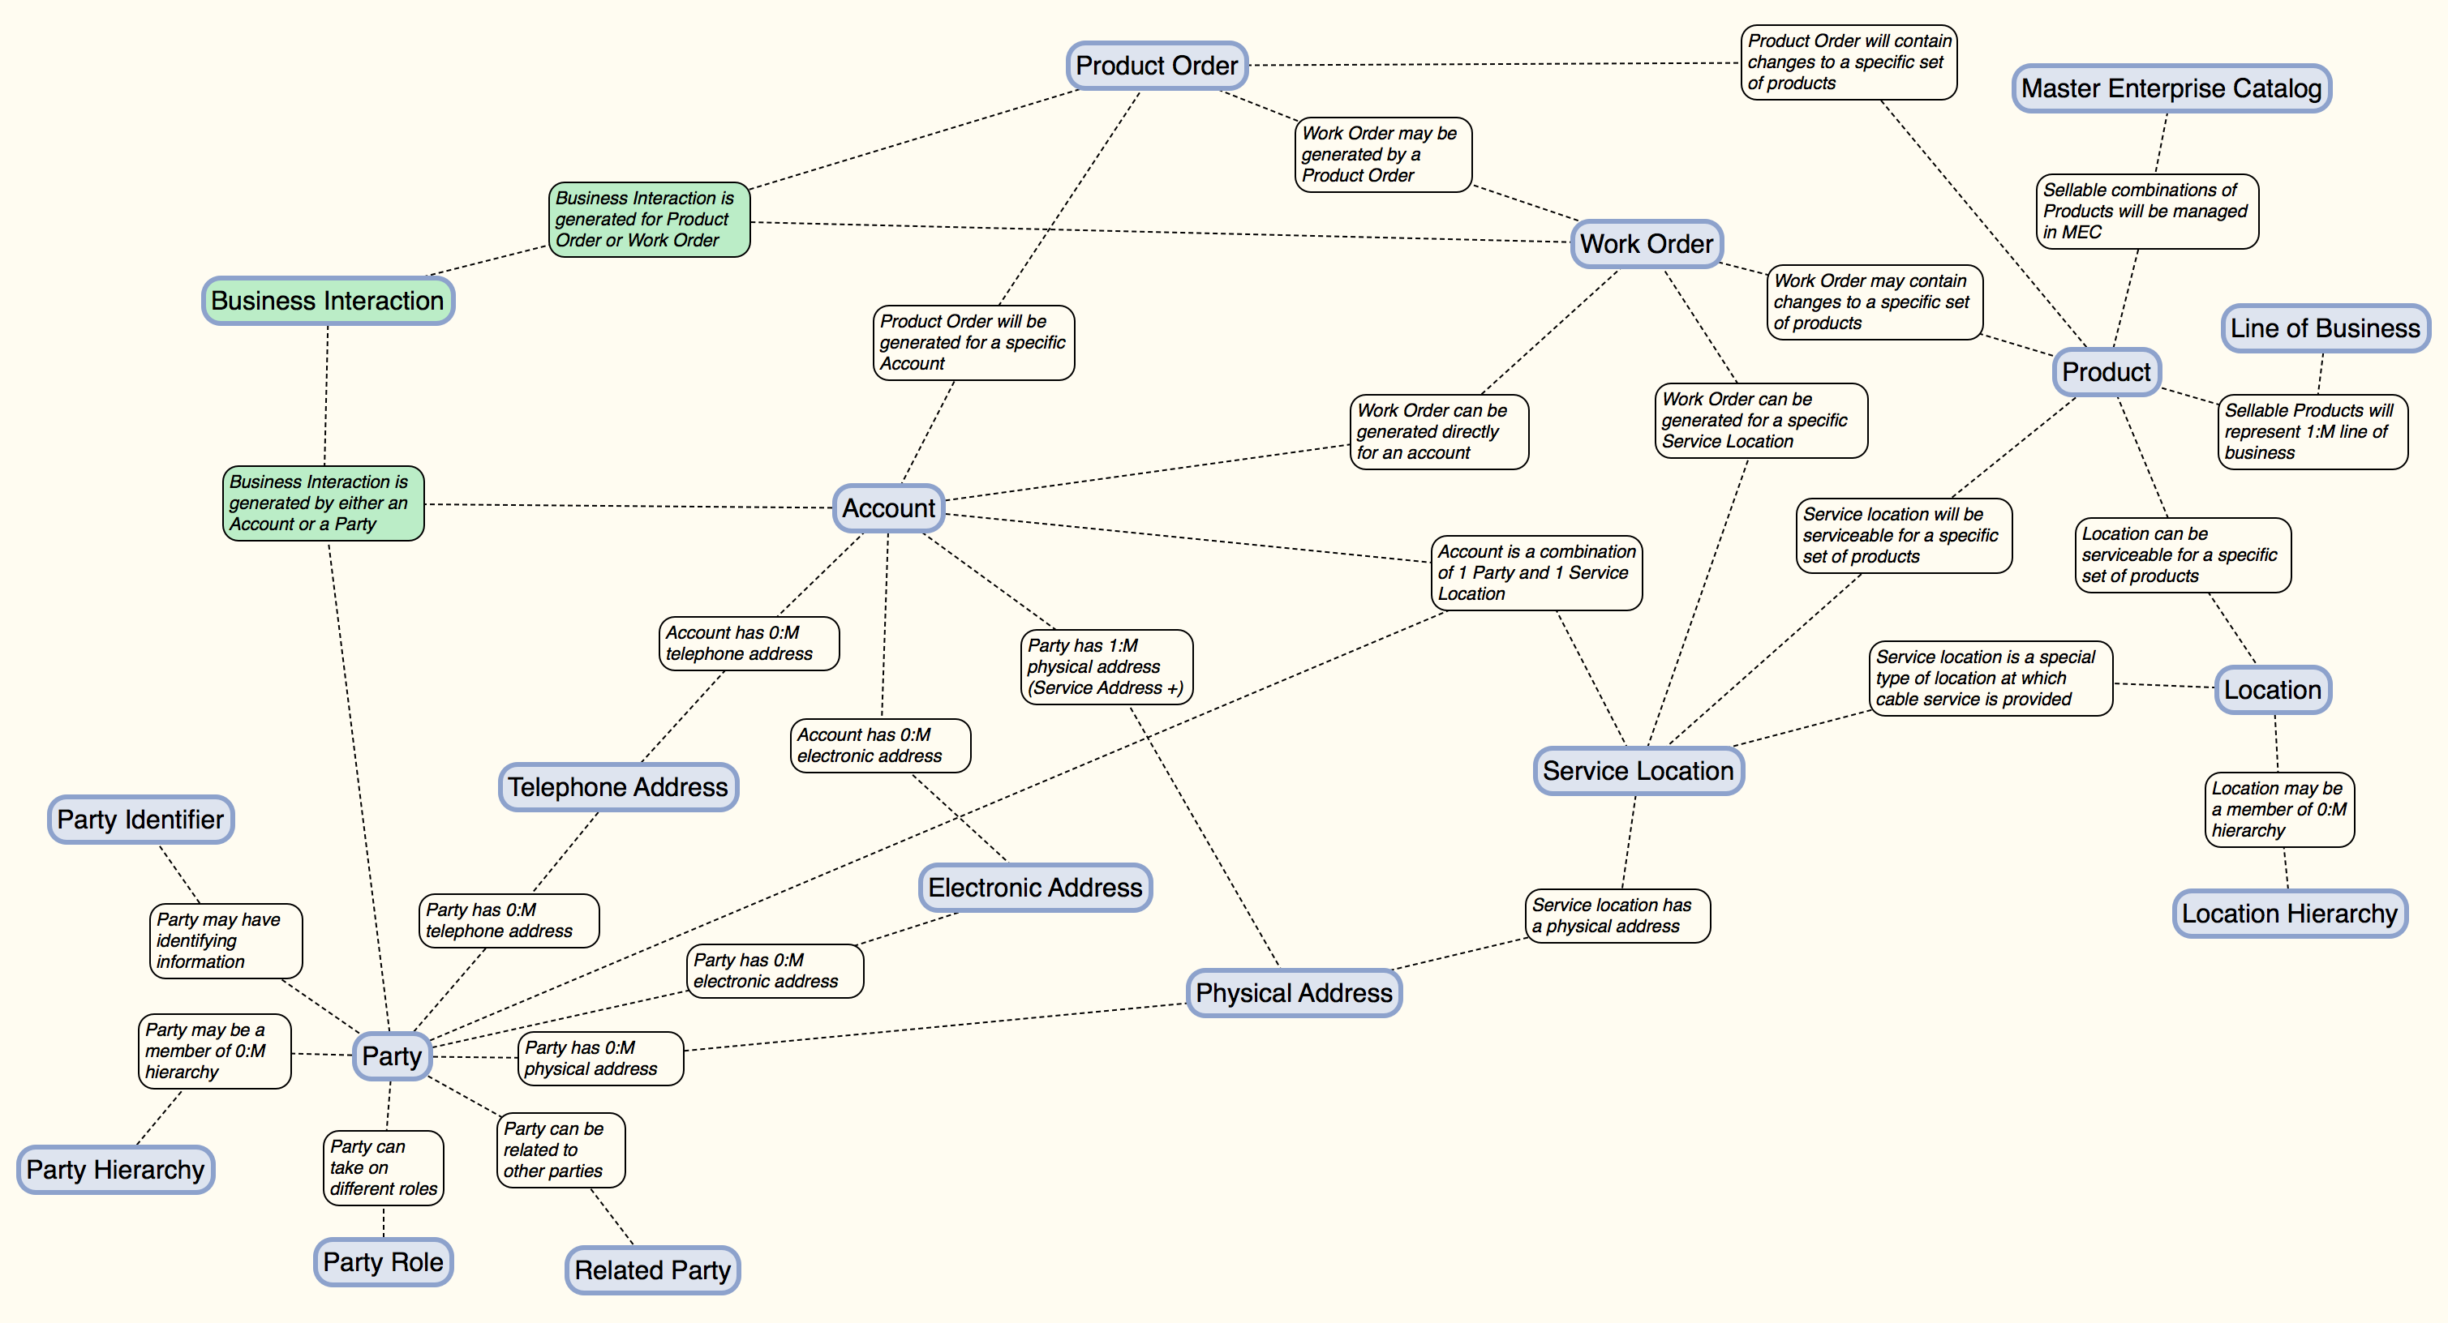
Transactional data
A high-level Conceptual model for Charter transactions:
Persistence of gateway-managed objects

Slide 19
Gateway Ordering Transaction Management
Current SOLO data model and services are not conducive to direct support of in-flight transaction processing
Application transactions need to be channel- and biller-agnostic and support charter operations; current models are CSG-centric, creating challenges in a multi-biller environment
Integration of Amdocs MEC creates additional complexity, requiring synchronization across multiple offer catalogs (Amdocs, ESE/ESE-P, ICOMS offers) and price structures
Different transaction models by sales channel limit reuse and operational flexibility
Recommendation:
Create charter-focused operational model for specific transactions; deploy to application-level ODS and expose via dedicated direct data microservices
Provide support for managing data lifecycle of order while in development (prior to biller submittal); includes create/retrieve/update capabilities
Supports cross-channel save cart and offline transaction functionality
Architecting to solve for these cases also supports rolling list/queue-managed data sets as well as other WFRM data sets

Slide 20

Questions

