Slide 1
IPO Interactions & TIBCO Persistence

Slide 2
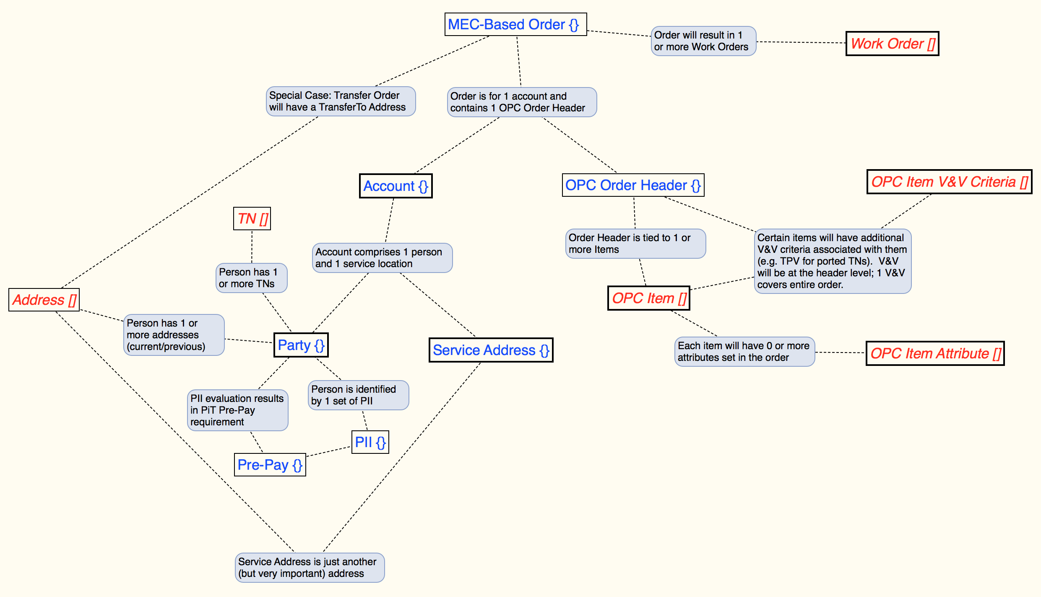
In-Process Order Structure
Notes:
OPC = Offer/Product/Component
OPC Item V&V (Validation/Verification) includes TPV (GO Phase2) and will be extended to include existing disclaimer information and self-acknowledgements (eCommerce)
PII (Personal Identifying Information), if persisted, will require additional controls; PII data will be flushed at the completion of the transaction
Pre-Pay information can persist with order

Slide 3
Events Impacting In-Process Order
Process Step | Name | IPO Impact | Action | Endpoint
W04a | Request Offer Customization Details | Initial Creation | Post | ../inProcessOrder/v1
W22 | Order Validation Response | Write validated order items & attributes; status == VALIDATED | Put | ../inProcessOrder/v1/{inProcessOrder-ID}/validatedOrder
W08 | Submit Order Response | Update Order Header with Biller & SOLO references; status == SUBMITTED | Put | ../inProcessOrder/v1/ {inProcessOrder-ID}/submittedOrder
W30 | TPV PIN Response, if applicable | Updates V&V with TPV PIN | Put | ../inProcessOrder/v1/ {inProcessOrder-ID}/thirdPartyVerification
W10 | Update Order – Work Order Schedule Response | Updates work order with selected schedule window; status = SCHEDULED | Put | ../inProcessOrder/v1/ {inProcessOrder-ID}/scheduledOrder
W11 | Customer Verification Request | Capture and submit credit check evaluation criteria; status == CREDITCHECK | Put | ../inProcessOrder/v1/ {inProcessOrder-ID}/customerVerification
 | Customer Verification Response | Retrieve credit check Pre-Payment information | Get | ../inProcessOrder/v1/ {inProcessOrder-ID}/customerVerification
W27 | Update Order – Billing Address Response | Add billing address to order (separate from Service Address) | Put | ../inProcessOrder/v1/ {inProcessOrder-ID}/billingAddress
W12 | Update Order – Confirm Response | Order is complete and IPO can be destroyed; status == CONFIRMED | Put | ../inProcessOrder/v1/ {inProcessOrder-ID}/confirmedOrder

Slide 4
Create Order
Orchestrated as part of OE Request Offer Customization Details (process documentation step W04A)
POST …/inProcessOrders/v1
Populates:
Party
Service Address (from prior lookup)
MEC-Based Order
OPC Order Header
Party TN (if provided in Search)
Account (responsible party & service address)
IPO Order ID generated in TIBCO (GUID?)
Does NOT populate any Biller or SOLO ID fields

Slide 5
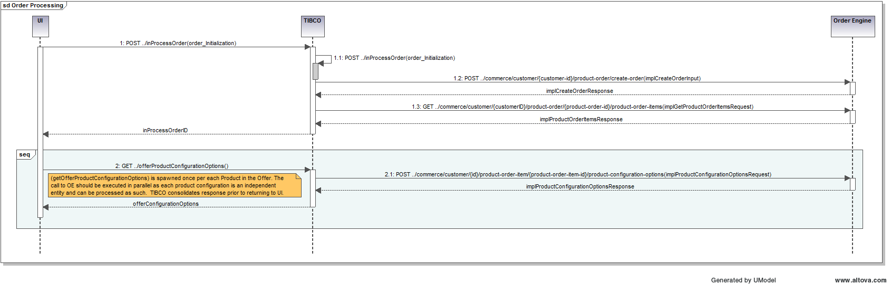
Create Order Orchestration

Slide 6
Order Validation Response
From an application perspective, Order Validation (from OE) is the first step of the submitOrder process, invoked when leaving the Offer Configuration Options screen (Item W22 in Process Documentation). Once we get a successfully validated Order from OE, we need to update the IPO with the validated configuration options from OE.
PUT ../inProcessOrders/v1/{inProcessOrderID}/opcOrderItems (POST?)
PUT ../inProcessOrders/v1/{inProcessOrderID}/opcOrderItems/{itemNumber}/attributes (POST?)
Populates:
OPC_ITEM array
OPC_ITEM_ATTRIBUTE array

Slide 7
Submit Order Response
On a successful response from the Biller that the order has been successfully placed (W08 in process documentation), we can now update the IPO with appropriate Biller (and SOLO) IDs and other key order information:
PUT ../inProcessOrders/v1/{inProcessOrderID}/[SPECIFIC ENDPOINT TO BE DEFINED]
Updates & Populates:
Biller Order ID
SOLO Product Order ID
SOLO MEC Order ID
Biller Account Number
SOLO Account ID
Biller & SOLO Work Order
Party Address (=Service Address)

Slide 8
TPV PIN Response
If telephone porting is part of the Order and Third-Party Verification is required, the submitOrder process will orchestrate the initiation of TPV through issuance of a PIN. On a successful return of this call (W30 in process documentation), we will update the IPO with the TPV PIN.
Populates:
TPV PIN

Slide 9
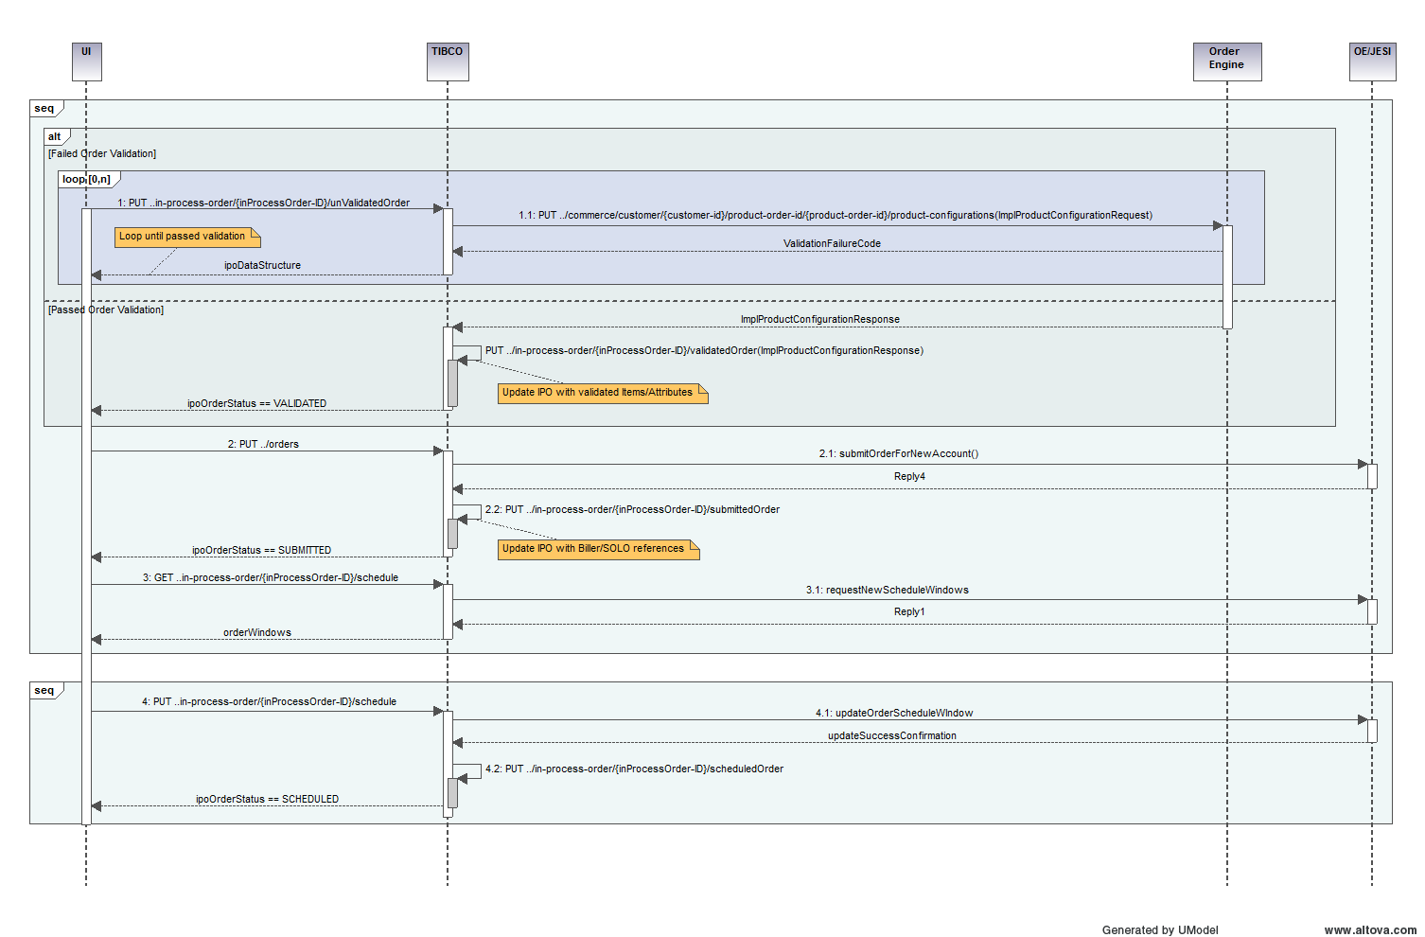
Order Verification/Submittal Orchestration

Slide 10
Update Order – Work Order Schedule Response
On a successful (orchestration of) submitOrder, the user is then presented with the scheduling screen where he can negotiate with the customer specifics about the installation. When completed and successfully scheduled in the Biller (process documentation step W10), we update IPO with the selected schedule.
PUT ../inProcessOrders/v1/{inProcessOrderID}/workOrder
Updates:
Work Order Array
Note: in GO Phase 2, we will not be splitting jobs into multiple work orders, so there will only be 1 item in the Work Order array; this will likely change in subsequent phases.

Slide 11
Customer Verification Request
The Customer Verification (nee Credit Check – process documentation step W11) requires capturing several items of Personal Identifying Information (e.g. Social Security Number, Driver License Number/State, etc).
Do we need to persist this information or is the browser cache sufficient?

Slide 12
Customer Verification Response
Pre-Pay information (is pre-pay required and reason) is generated by the Customer Verification (process documentation step W11). This information is not subject to enhanced data privacy constraints (not PII). This information is persisted in the IPO order.
PUT ../inProcessOrders/v1/{inProcessOrderID}/[SPECIFIC ENDPOINT TO BE DEFINED]
Populates:
Pre-Pay information

Slide 13
Update Order – Billing Address Response
Prior to confirmation and completion, the customer has the option to change his billing address for this account (triggering an Account update in Biller/SOLO – process documentation step W27).
Do we need to persist this information?

Slide 14
Update Order – Confirm Response
When complete, the user performs a final “confirmation” of the order that updates the MEC_Order_Header table in SOLO. This (process documentation step W12) is used to signify that the process is complete, the interaction with the customer is ended, and no further data will be collected.
Do we need to persist this information?

