Slide 1
A Machine Learning approach to Arrhythmia detection
Álvaro Lopes Nº96148
André Lopes Nº96351

Slide 2
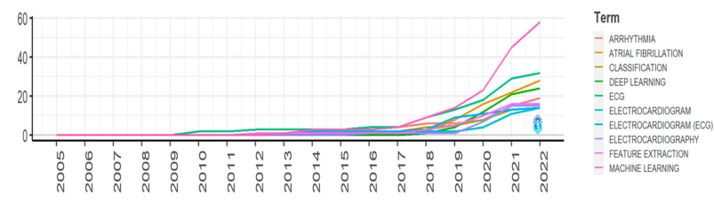
Introduction
By 2060, 17.9 million people in Europe will be affected by atrial fibrillation.
There is a growing trend for arrhythmia detection using machine learning methods.

Slide 3
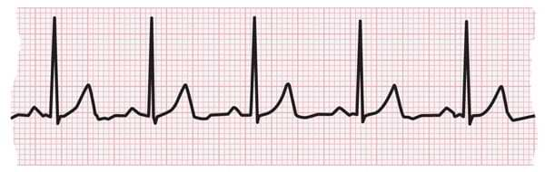
Medical overview
A heart arrhythmia is an irregular heartbeat caused by malfunctioning electrical signals that control the heart.
Five main types of arrhythmias: tachycardia, bradycardia, premature heartbeat, supraventricular arrhythmias and ventricular arrhythmias.
The main form of diagnostic for arrhythmia is the analysis of an ECG by a medical professional.

Slide 4
Data set
MIT-BIH Arrhythmia Database: ECG recordings obtained between 1975 and 1979.
48 half-hour ECG recordings obtained from 47 subjects. 23 random recordings and 25 purposely chosen.
25 men aged 32 to 89 years and 22 women aged 23 to 89 years.
Original recordings were analog and were later digitized.

Slide 5
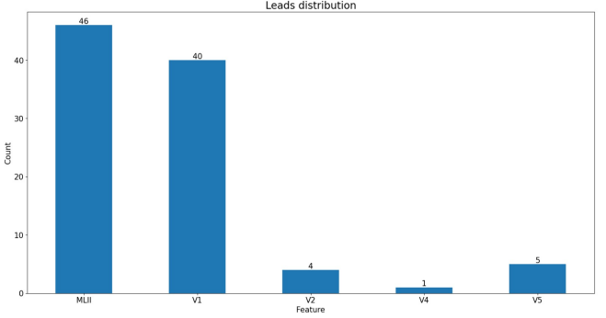
Data set
MLII, V1, V2, V4 and V5 signals.
Readings from the electrodes of the ECG, two for each patient: csv file.
Annotations made by cardiologists: txt file.

Slide 6
Objectives
Apply machine learning techniques to the data set.
Identify if a beat is normal, or if it is some kind of arrhythmia.
Preprocessing the data.
Defining the features to be extracted.
Train several models and evaluate their performance.

Slide 7
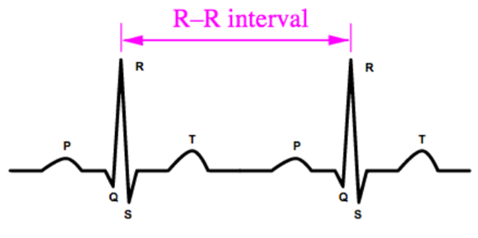
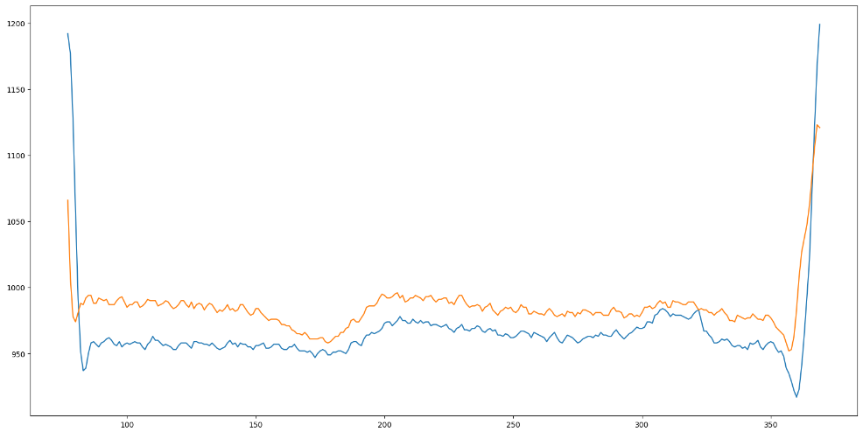
Data Preprocessing
R-R interval segmentation

Slide 8
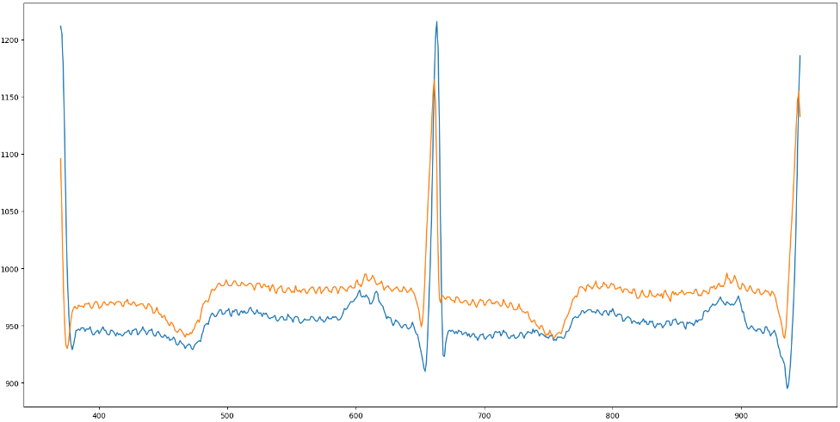
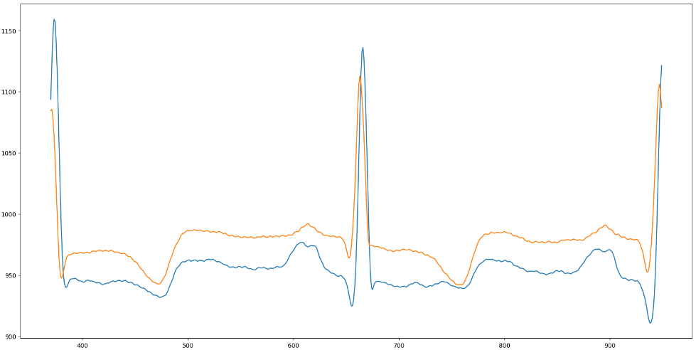
Data Preprocessing
Noise filtering

Slide 9
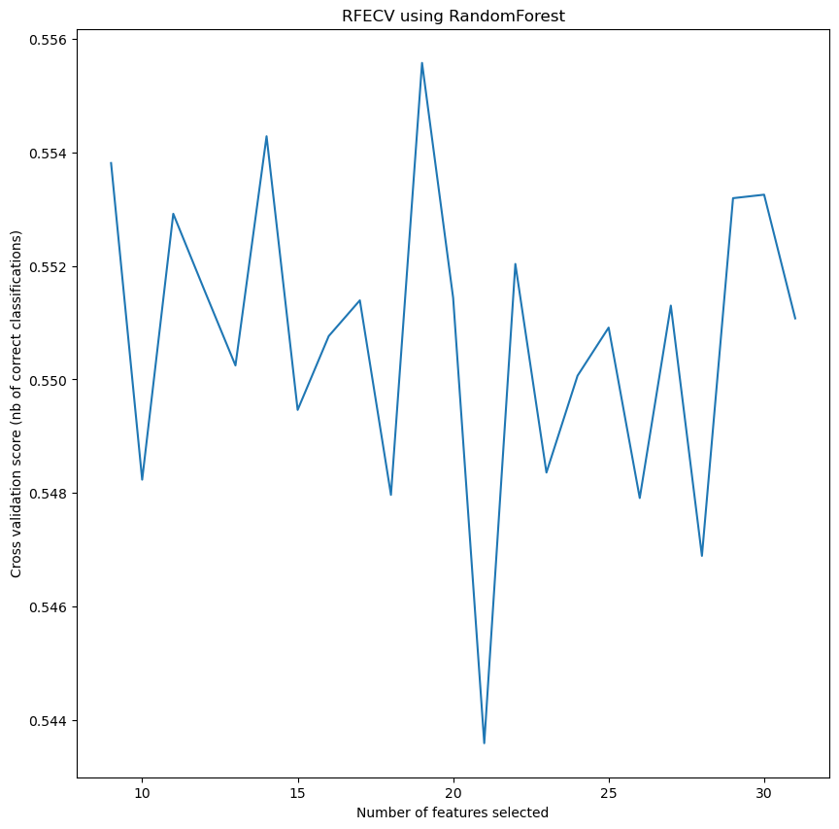
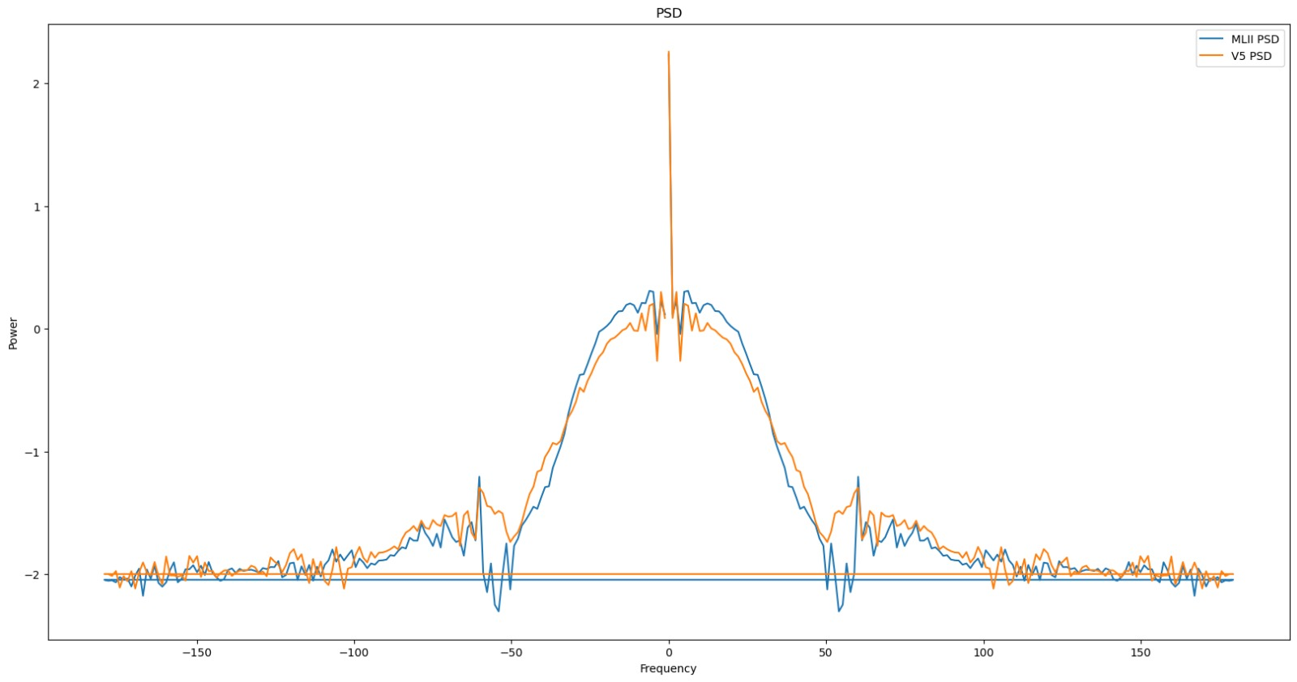
Feature extraction
Statistical time-domain features
Frequency-domain features
RFE with cross validation

Slide 10
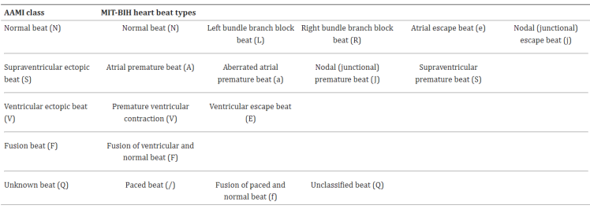
Target variable and classes aggregation
Target variable: "Type".
Aggregation according to AAMI standard.

Slide 11

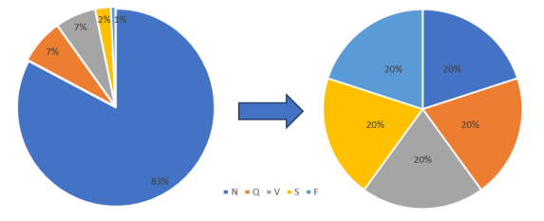
Dataset balancing

Slide 12
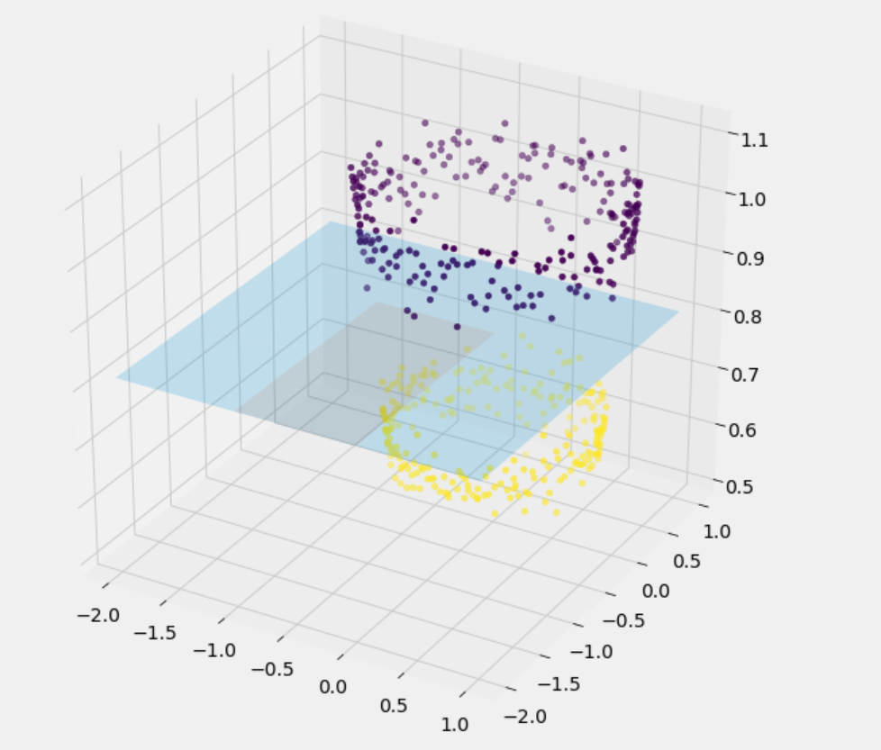
Support Vector Machine
Grid search cross validation performed
Penalty parameter C: 0.1, 1, 10 and 100.
Kernels: linear, polynomial, radial basis function and sigmoid.
Decision function shape: one-vs-rest and one-vs-one.

Slide 13
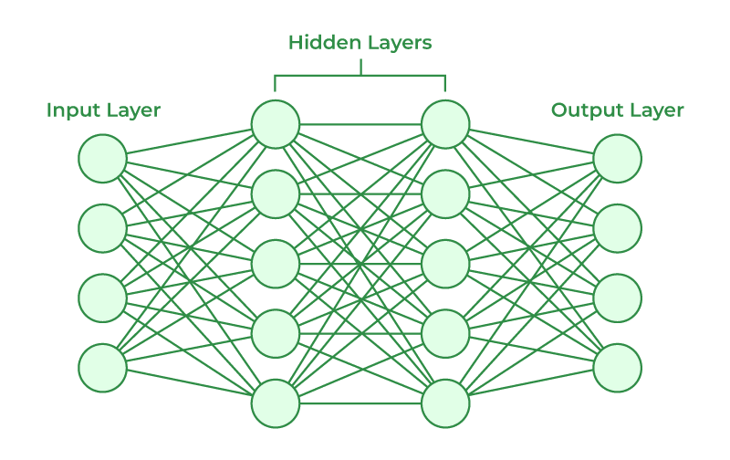
Neural network
Input layer: 19 neurons.
4 fully connected hidden layers with ReLU activation were used with 128 neurons each.
Output layer: 5 neurons, softmax activation function.

Slide 14
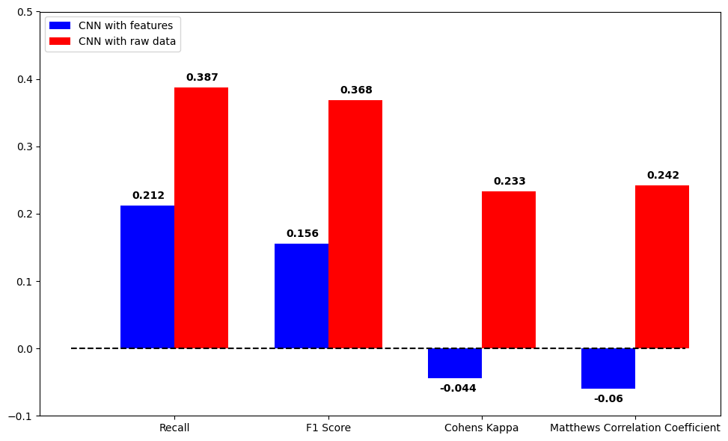
Convolutional Neural Networks
Features extracted from data
or
Raw data

Slide 15
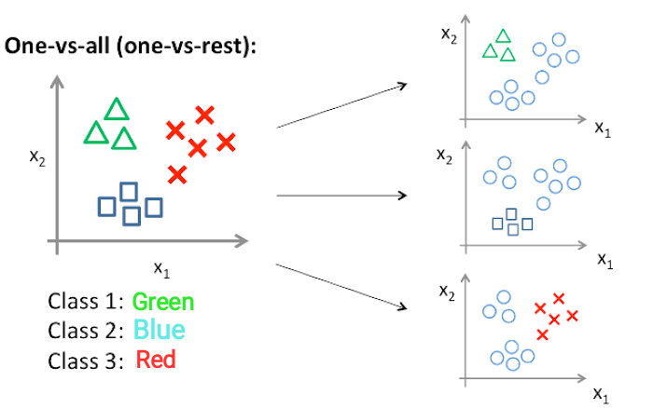
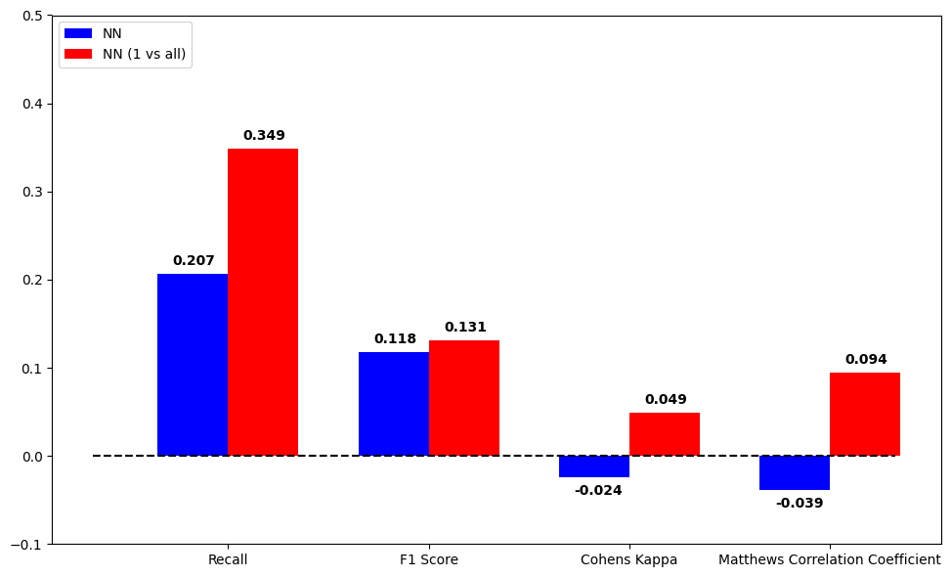
Neural Network (1 vs All approach)

Slide 16
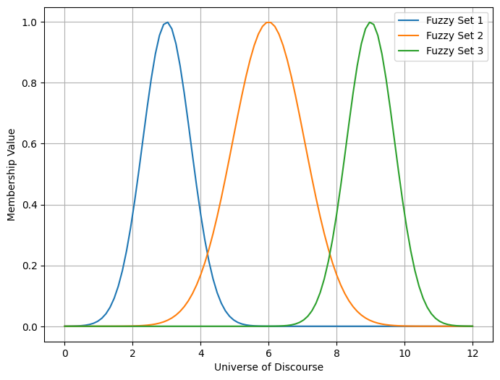
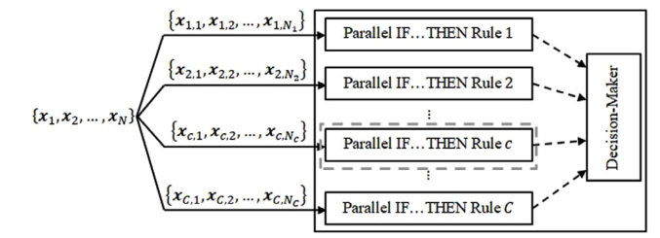
Fuzzy models
Takagi-Sugeno based model
ALMMo-0 classifier

Slide 17
Results
 | Recall | F1 Score | Cohen’s Kappa | Matthews correlation coefficient
SVM | 0.329 | 0.145 | 0.044 | 0.097
Neural Network | 0.207 | 0.118 | -0.024 | -0.039
NN (1 vs All) | 0.349 | 0.131 | 0.049 | 0.094
CNN (features) | 0.212 | 0.156 | -0.044 | -0.060
CNN (raw signals) | 0.387 | 0.368 | 0.233 | 0.242
Takagi-Sugeno | 0.170 | 0.050 | 0.023 | 0.050
ALMMo-0 | 0.286 | 0.200 | 0.035 | 0.045

Slide 18
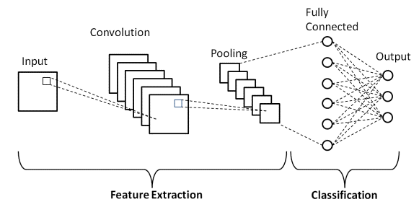
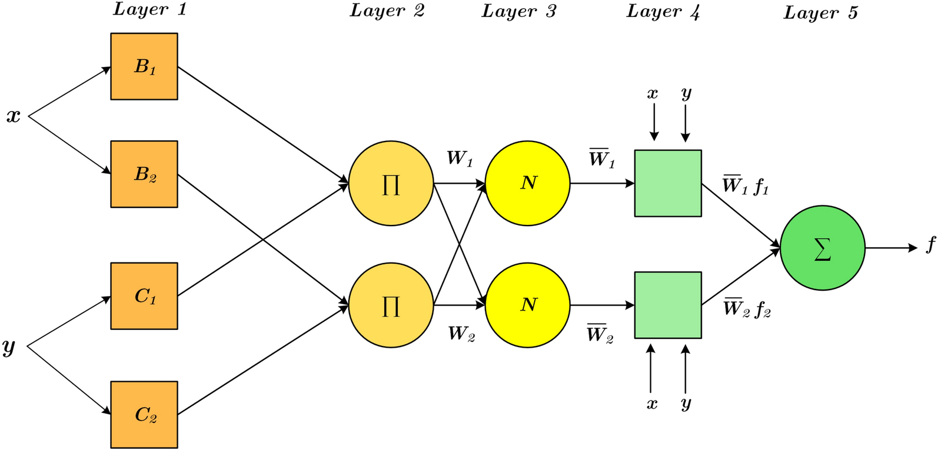
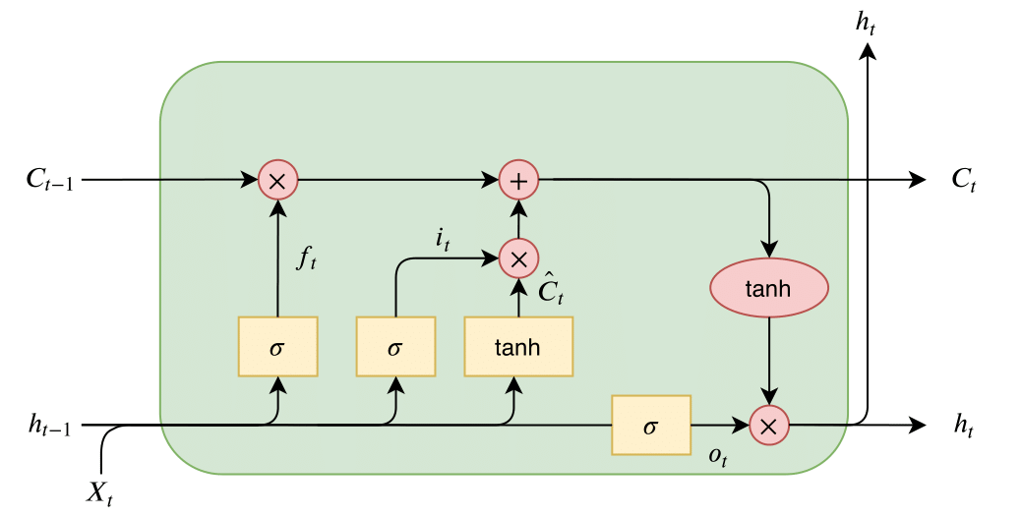
Conclusion
Feature engineering
Preprocessing
CNNs and LSTMs
Neuro-fuzzy models

