Slide 1

Accelerated discovery of inorganic thermoelectric materials
8 Nov 2024
KRICT ChemDX Hackathon

Slide 2
Background
Linear regression
Finds a straight line that best fits the data, assuming a linear relationship between input and output.
Polynomial regression
Extends linear regression by fitting a polynomial curve, capturing more complex, non-linear relationships.
Types of regression
Gradient boosting
Builds an ensemble of weak learners sequentially, focusing on reducing residual errors.
Random forest
Uses an ensemble of decision trees trained on random subsets of the data to improve stability and accuracy.
Neural network
Uses layers of interconnected nodes to capture complex, non-linear relationships, often useful for high-dimensional data.

Slide 3
Background
Type | Advantages | Disadvantages
Linear regression | Simple Efficient for linear relationships. | Struggles with non-linear data and can be sensitive to outliers.
Polynomial regression | Captures non-linear relationships and is more flexible than linear regression | High-degree polynomials can lead to overfitting and instability in predictions.
Gradient boosting | Handles complex patterns well, and can achieve high accuracy. | Computationally intensive
Random forest | Robust to overfitting, reduces variance, and works well with non-linear data. | may struggle with extrapolation beyond the training data.

Slide 4
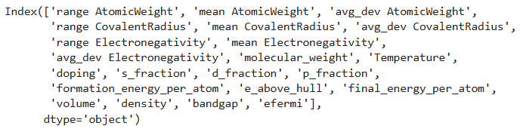
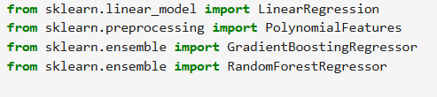
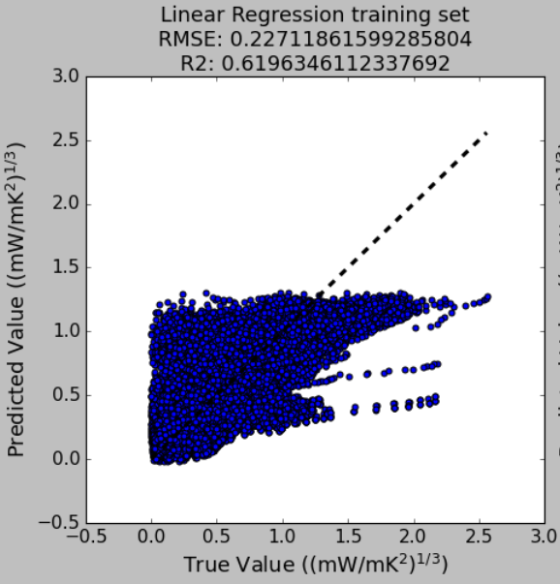
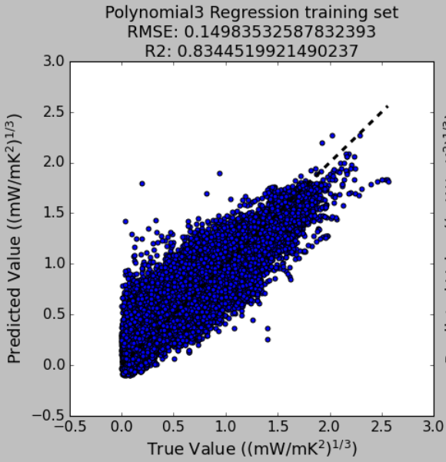
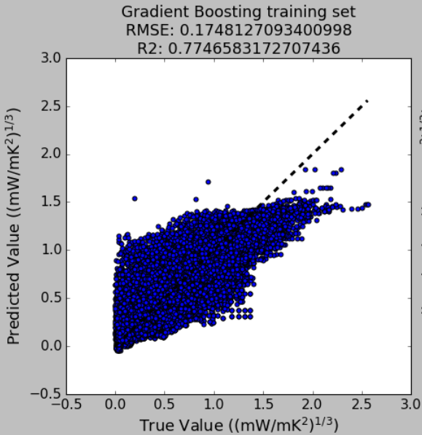
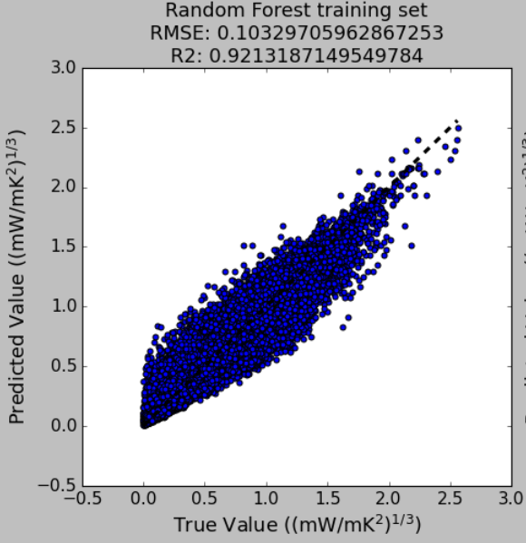
Examples)
Scikit-Learn

Slide 5
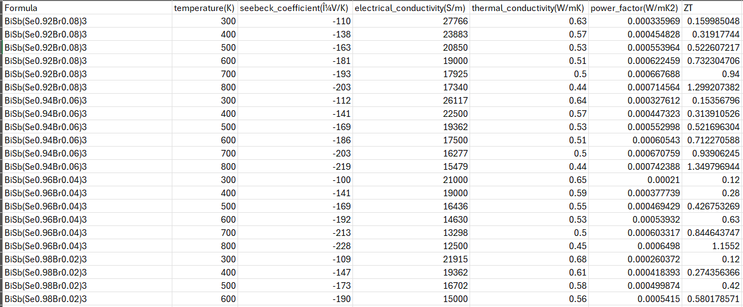
LitDX - Thermoelectrics

Slide 6
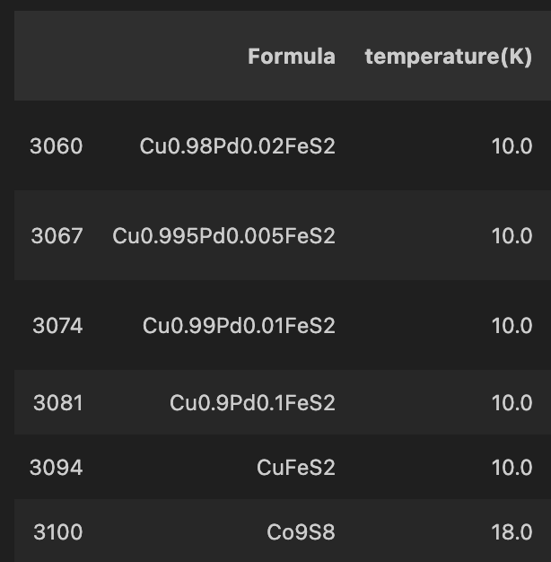
Dataset
Dataset size: 5205

Slide 7
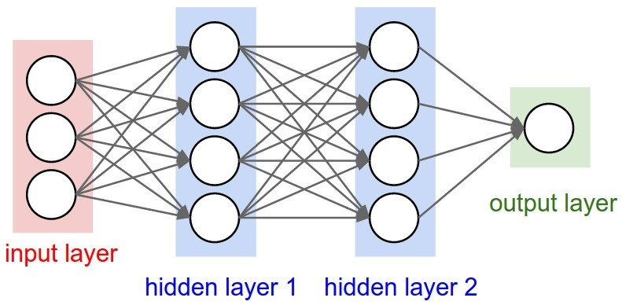
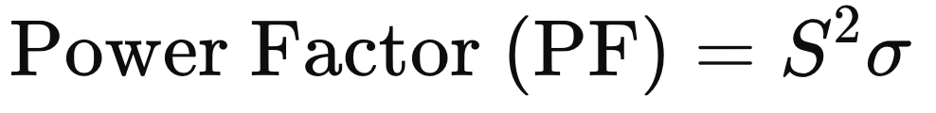
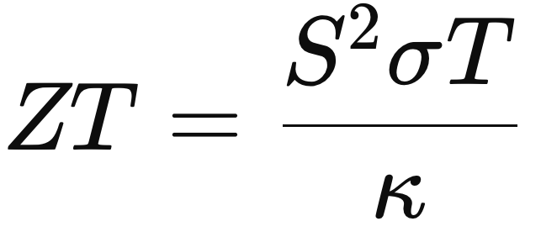


















Fingerprints and ML model architecture
Chemical Composition
Single-task
Multi-task
$x$₁, $x$₂, … , $x$_{n}
$x$₁, $x$₂, … , $x$_{n}
Stochiometric attributes
Elemental property statistics
Electronic structure attributes
Ionic compound attributes
Temperature
ML
$$\text{ML}$$
$$\text{ML}$$
$$\text{ML}$$
$$σ$$
$$s$$
$$k$$
$$σ$$
$$s$$
$$k$$
+
$$\text{Power} \text{Factor}$$
$$\text{ZT}$$
$$\text{Power} \text{Factor}$$
$$\text{ZT}$$
L Ward et al, npj Comp Mat, 2016, 10.1038/npjcompumats.2016.28
$$σ$$
$$s$$
$$k$$

Slide 8
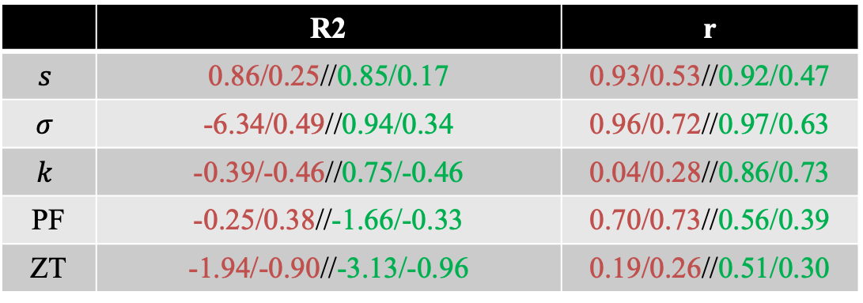
Model performance
Test1ST/Test2ST//Test1^{MT}/Test2^{MT}
 | R2 | r
$$s$$ | 0.86/0.25//0.85/0.17 | 0.93/0.53//0.92/0.47
$$σ$$ | -6.34/0.49//0.94/0.34 | 0.96/0.72//0.97/0.63
$$k$$ | -0.39/-0.46//0.75/-0.46 | 0.04/0.28//0.86/0.73
PF | -0.25/0.38//-1.66/-0.33 | 0.70/0.73//0.56/0.39
ZT | -1.94/-0.90//-3.13/-0.96 | 0.19/0.26//0.51/0.30
Multi-task
ZT predicted < -5.0 are removed
Train and Validation: 3041 + 761
Test1: Unseen test data: 951
Test2: Unseen test data with material composition not present in the Train/Validation set: 450

Slide 9
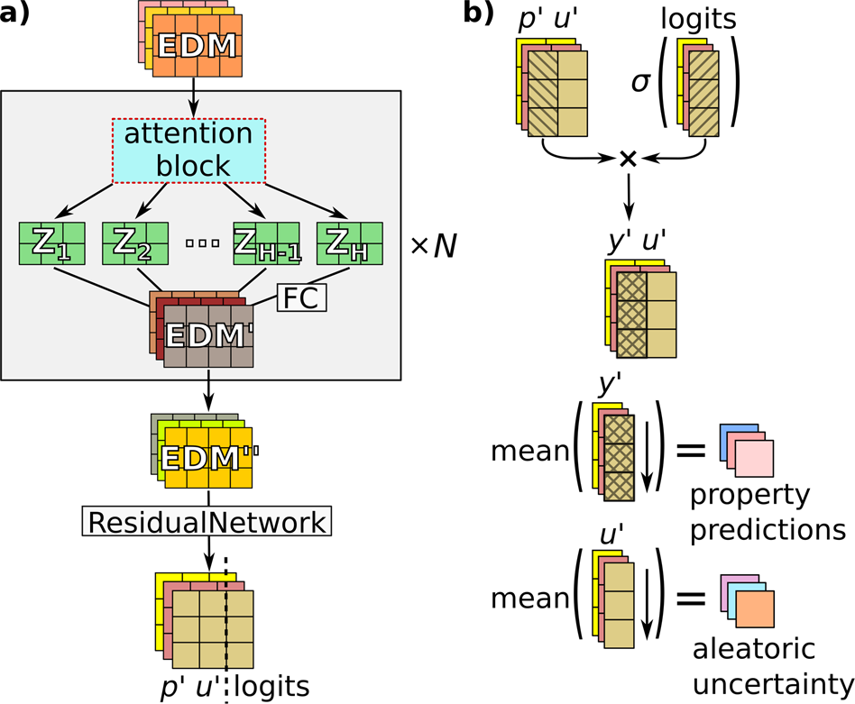
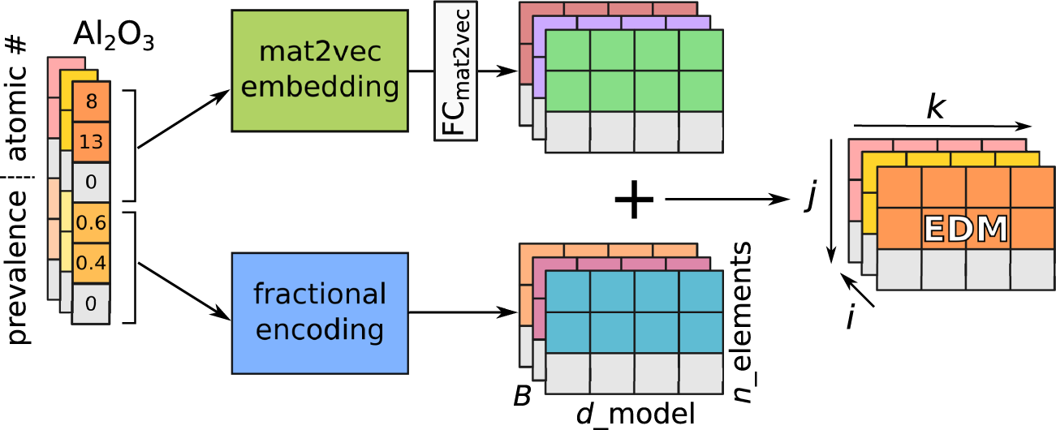
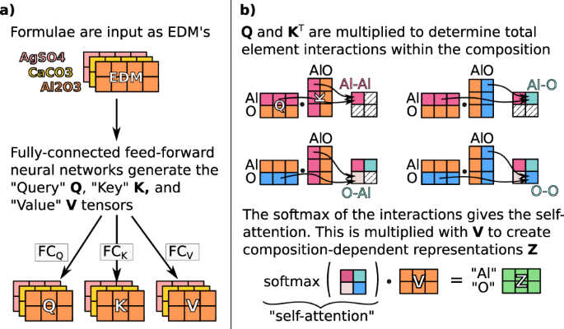
Model training
A Yang et al, npj Comp Mat, 2021, 10.1038/s41524-021-00545-1

Slide 10
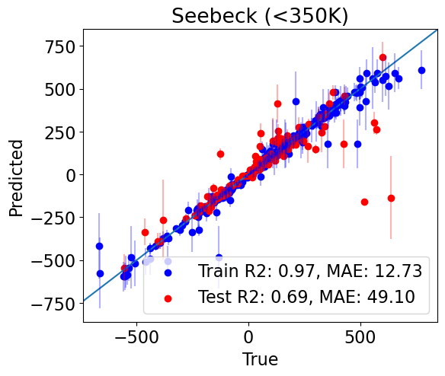
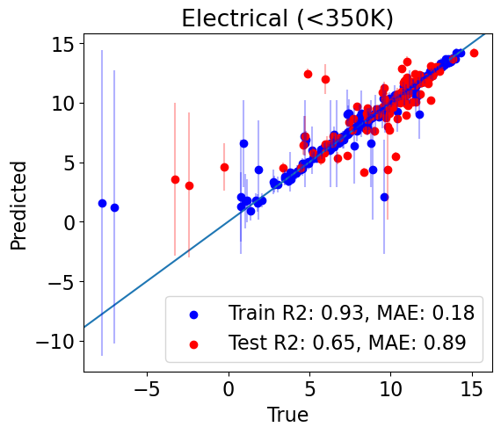
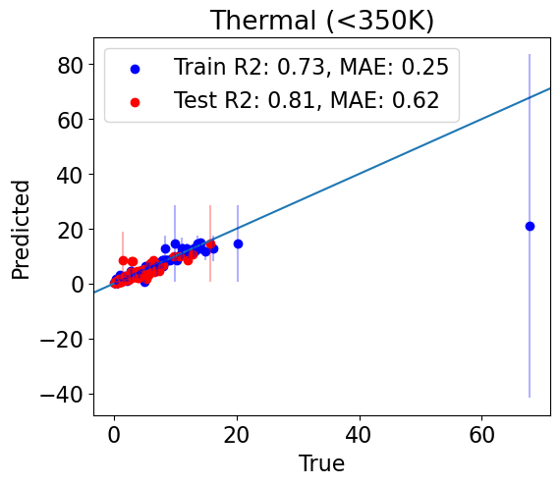
Model training
LiCoO2
TiS2

Slide 11
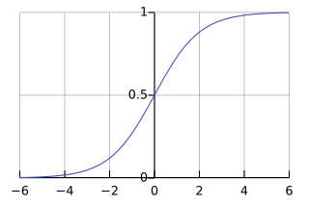
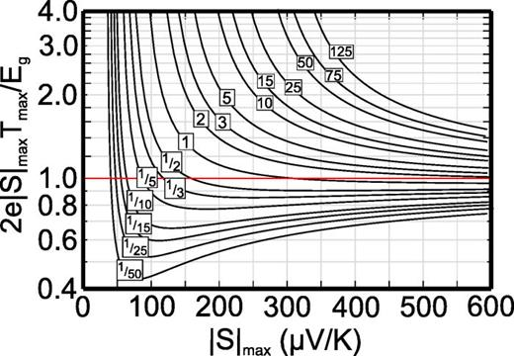
ZT-T curve fitting algorithm
Physics informed curve fitting using:
Melting point of the compounds (future)
Goldsmidt-Sharp limit ($E_{g}=2eS_{max}T_{max}$)
Z Gibbs et al, App Phys Lett, 2015, 10.1063/1.4905922

Slide 12
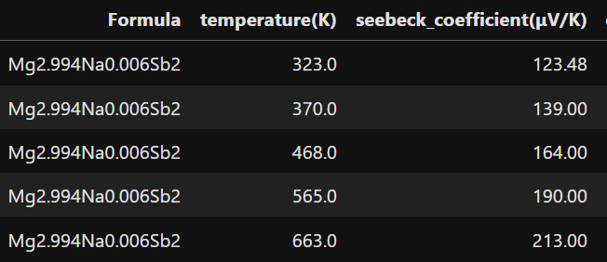
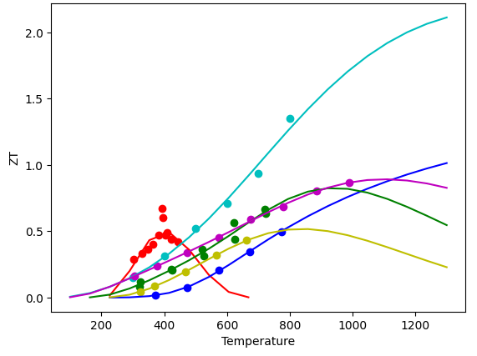
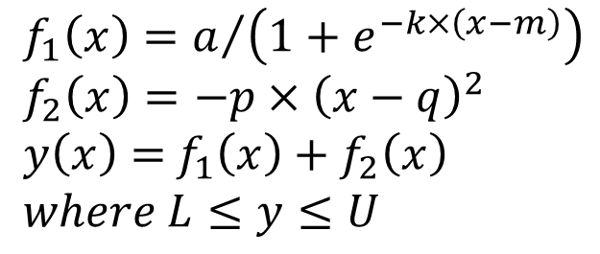
ZT-T curve fitting algorithm
$$f_{1}\left(x\right)=a/{\left(1+e^{−k×\left(x−m\right)}\right)}$$
$$f_{2}\left(x\right)=−p×{\left(x−q\right)}^{2}$$
$y\left(x\right)=$ $f_{1}\left(x\right)+f_{2}\left(x\right)$
$$where L≤y≤U$$
T_{max} with margin

Slide 13
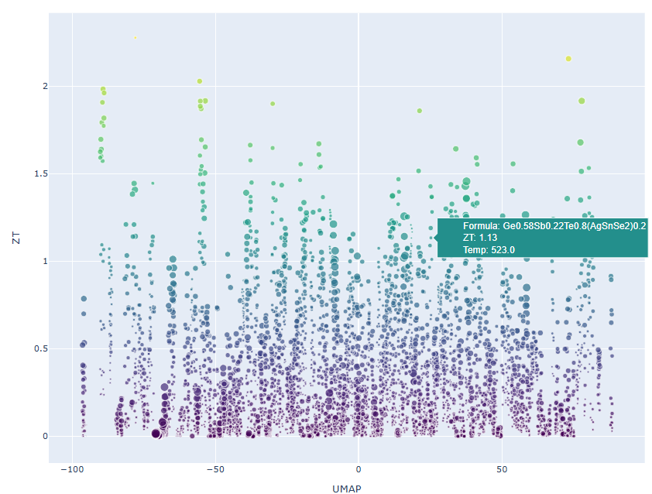
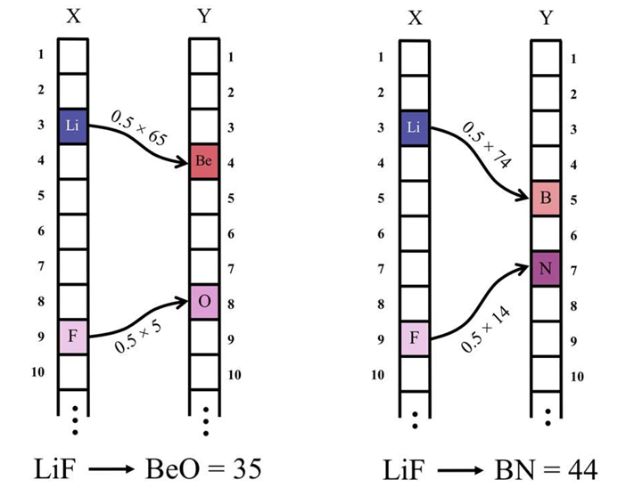
Visualization via Elemental Movers Distance (ElMD)
C Hargreaves et al, Chem Mater, 2020, 10.1021/acs.chemmater.0c03381

Slide 14
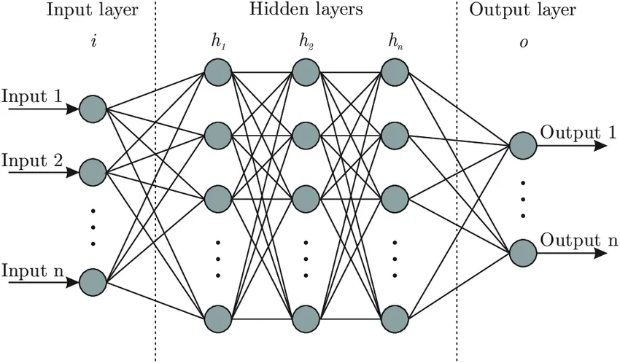
Active learning workflow
1. Dataset of TE materials
2. Multi-task ML model
3. Compute and extrapolate ZT-T curve
New experiments based on exploration and exploitation strategies
4. Sample/optimize chemical similarity and ZT at target T

Slide 15
Active learning demonstration
Initial model
Updated model
Experiments
Data for BiSb(Se0.92Br0.08)3 at 500 K and 800K are added to the train set

Slide 16
Contributions
ML property prediction for S, σ and κ
ZT-T curve fitting algorithm with informed physics
Visualization tool for chemical space
Workflow for sampling/optimization of TEs

Slide 17
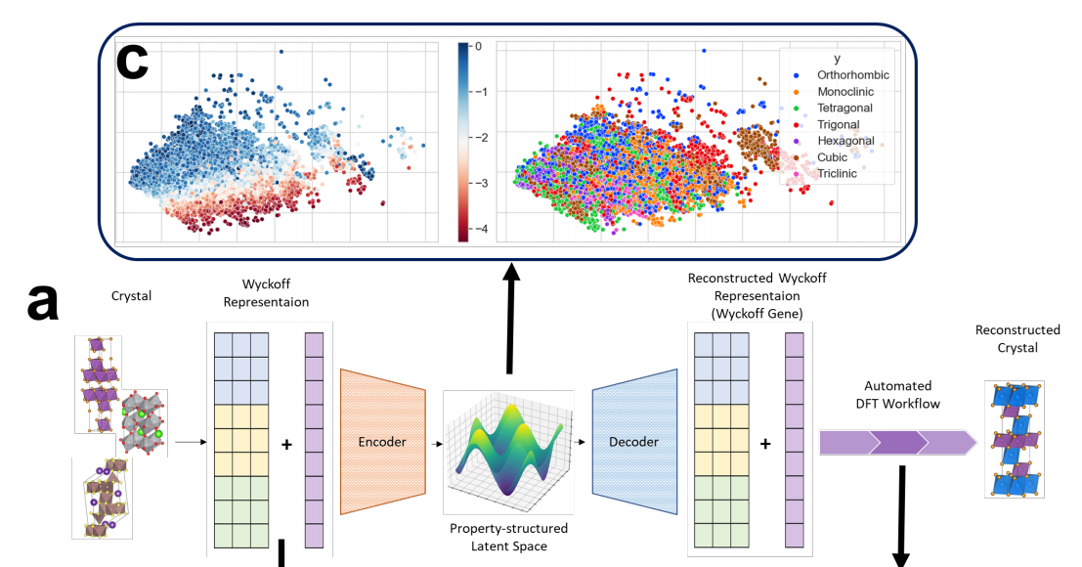
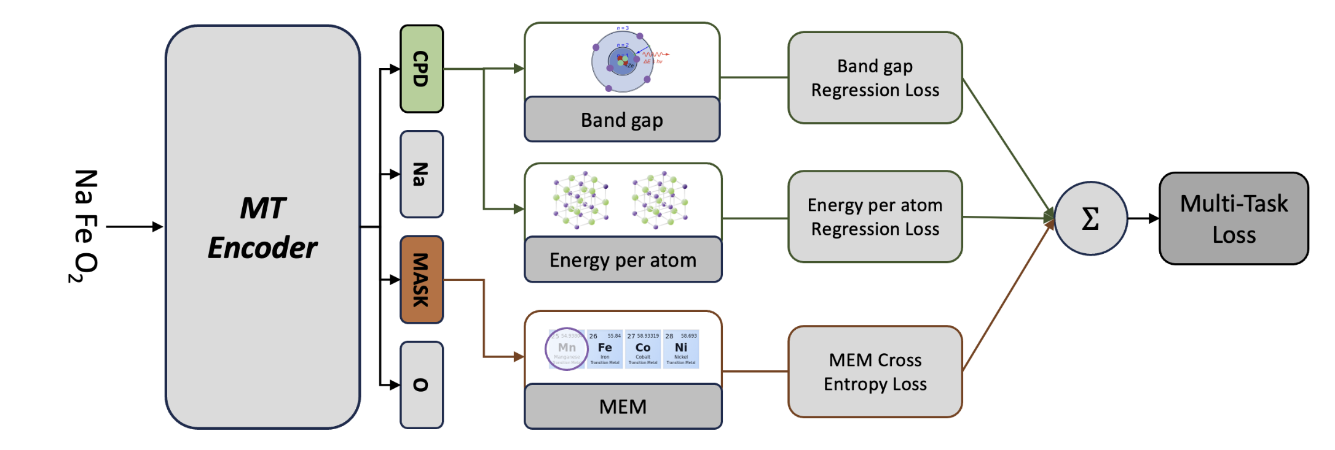
Future work
Prein et al, NeurIPS 2023 Workshop AI4Mat
Zhu et. al. Matter 7, 10, 3469-3488 (2024)

Slide 18
Thank you!

