Slide 1
LADM
Version December, 24th 2021

Slide 2
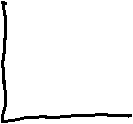






Slide 3

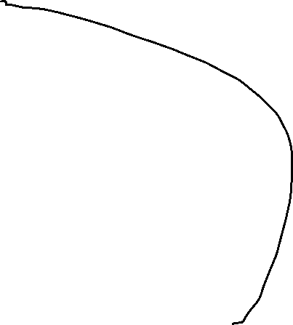


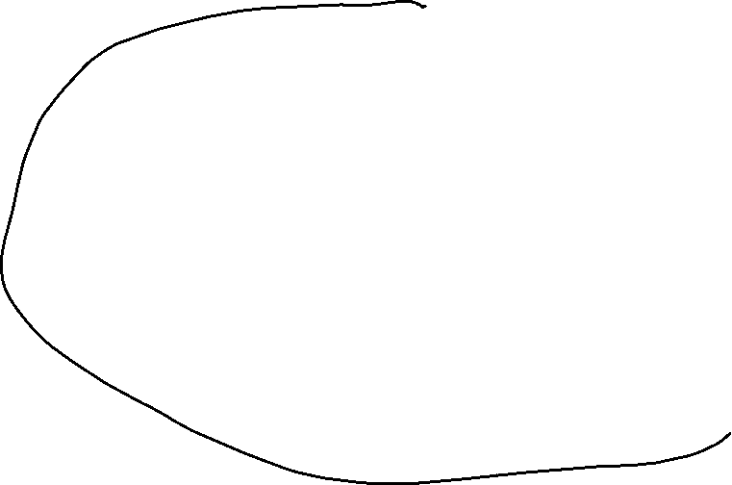
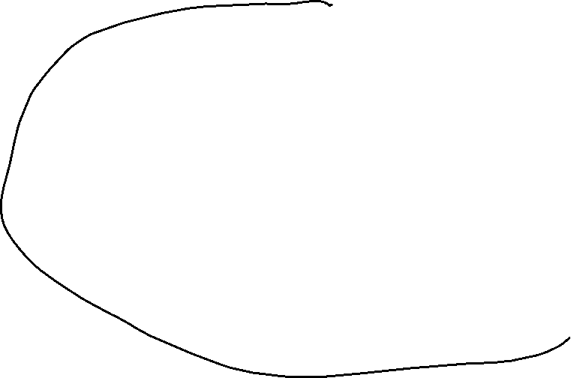
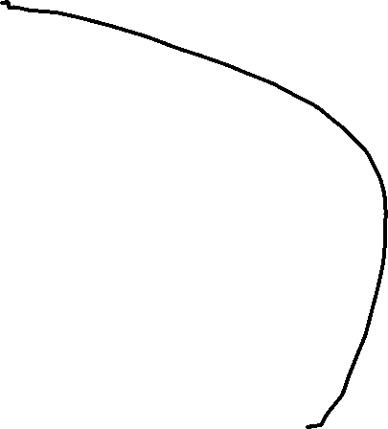
Welcome to the Municipality Waterriver
WR02
WR02
WR04
WR05
WR05
WR06
WR06
WR01
WR01
WR03
WR03
WR16
WR16
WR
15
WR
13
WR
15
WR
13
WR17
WR
14
WR17
WR
12
WR
14
WR
12
WR22
WR21
WR22
WR
11
WR21
WR
11
20
20
WR24
WR23
WR24
WR18
WR23
WR18
WR19
WR19
WR07
WR07
WR30
WR
09
WR30
WR
09
WR32
WR08
WR32
WR08
WR29
WR
10
WR29
WR
10
WR31
WR31
WR26
WR25
WR26
WR25
WR37
WR34
WR37
WR
28
WR34
WR27
WR
28
WR27
WR38
WR38
WR39
WR35
WR39
33
WR35
33
WR40
WR36
WR40
WR36

Slide 4
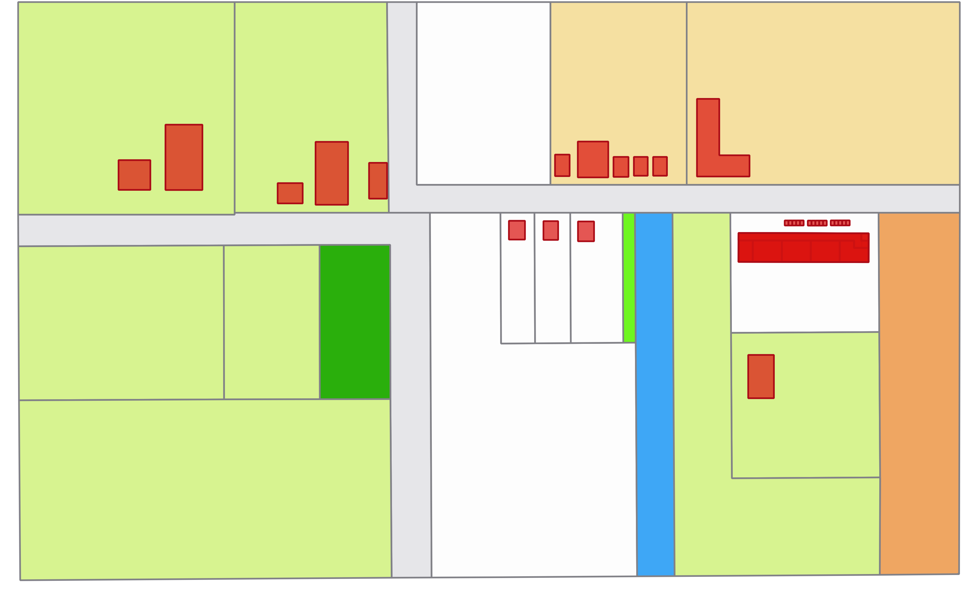
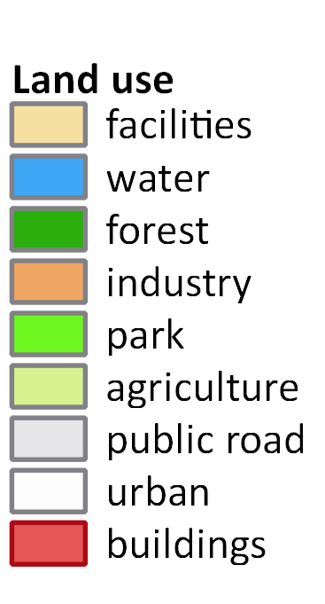
Welcome to the Municipality Waterriver

Slide 5
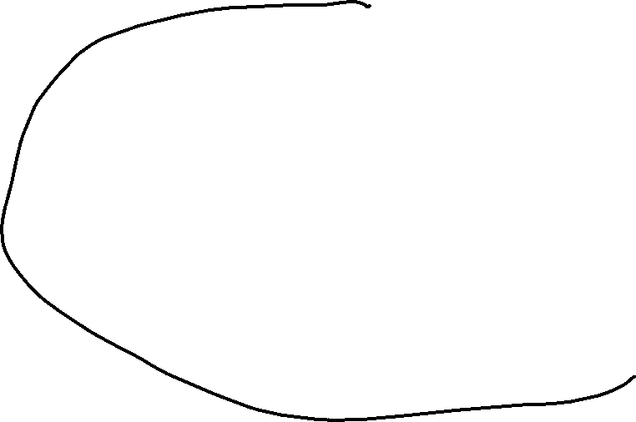
Cadastral Map Municipality Waterriver
WR04
WR03
WR01
WR02
WR05
WR06
WR02
WR02
WR04
WR05
WR05
WR06
WR06
WR01
WR01
WR03
WR03
WR16
WR07
WR16
WR
12
WR
13
WR
14
WR16
WR18
WR
19
WR11
WR
15
WR
13
WR
15
WR
13
WR17
WR
14
WR17
WR
12
WR
14
WR
12
WR22
WR08
WR21
WR22
WR09
WR
11
WR21
WR
11
20
20
WR24
WR
10
WR23
WR24
WR18
WR23
WR18
WR19
WR19
WR07
WR07
WR30
WR
09
WR30
WR
09
WR20
WR32
WR08
WR32
WR08
WR29
WR
17
WR
10
WR29
WR
10
WR31
WR31
WR21
WR15
WR26
WR25
WR26
WR25
WR37
WR34
WR37
WR
28
WR34
WR27
WR
28
WR27
WR38
WR38
WR22
WR39
WR35
WR39
33
WR35
33
WR40
WR36
WR40
WR36

Slide 6
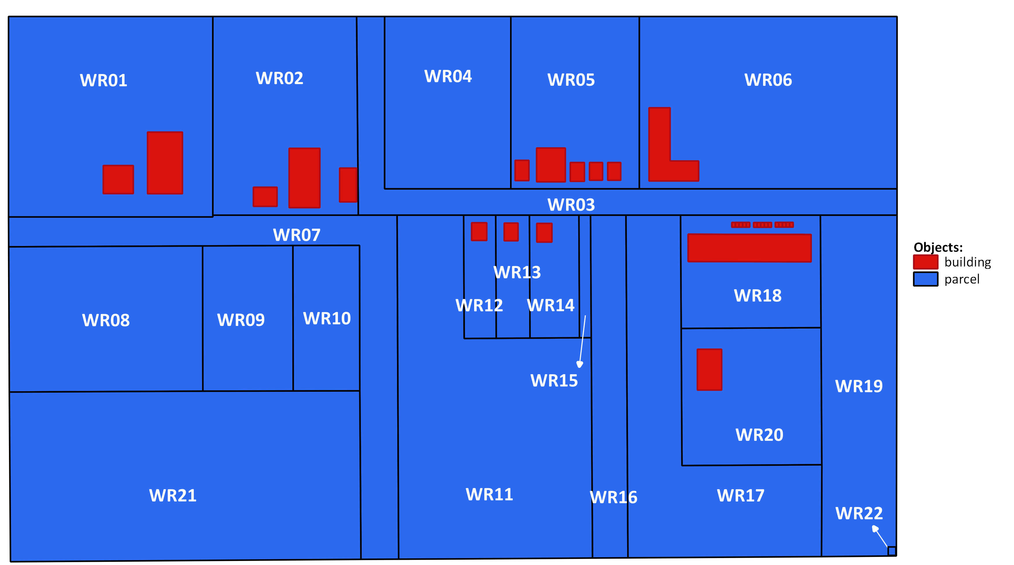
Cadastral Map Municipality Waterriver

Slide 7
Public Roads
WR04
WR03
WR01
WR02
WR05
WR06
WR02
WR02
WR04
WR05
WR05
WR06
WR06
WR01
WR01
WR03
WR03
WR16
WR07
WR16
WR
12
WR
13
WR
14
WR16
WR18
WR
19
WR11
WR
15
WR
13
WR
15
WR
13
WR17
WR
14
WR17
WR
12
WR
14
WR
12
WR22
WR08
WR21
WR22
WR09
WR
11
WR21
WR
11
20
20
WR24
WR
10
WR23
WR24
WR18
WR23
WR18
WR19
WR19
WR07
WR07
WR30
WR
09
WR30
WR
09
WR20
WR32
WR08
WR32
WR08
WR29
WR
17
WR
10
WR29
WR
10
WR31
WR31
WR21
WR15
WR26
WR25
WR26
WR25
WR37
WR34
WR37
WR
28
WR34
WR27
WR
28
WR27
WR38
WR38
WR22
WR39
WR35
WR39
33
WR35
33
WR40
WR36
WR40
WR36

Slide 8
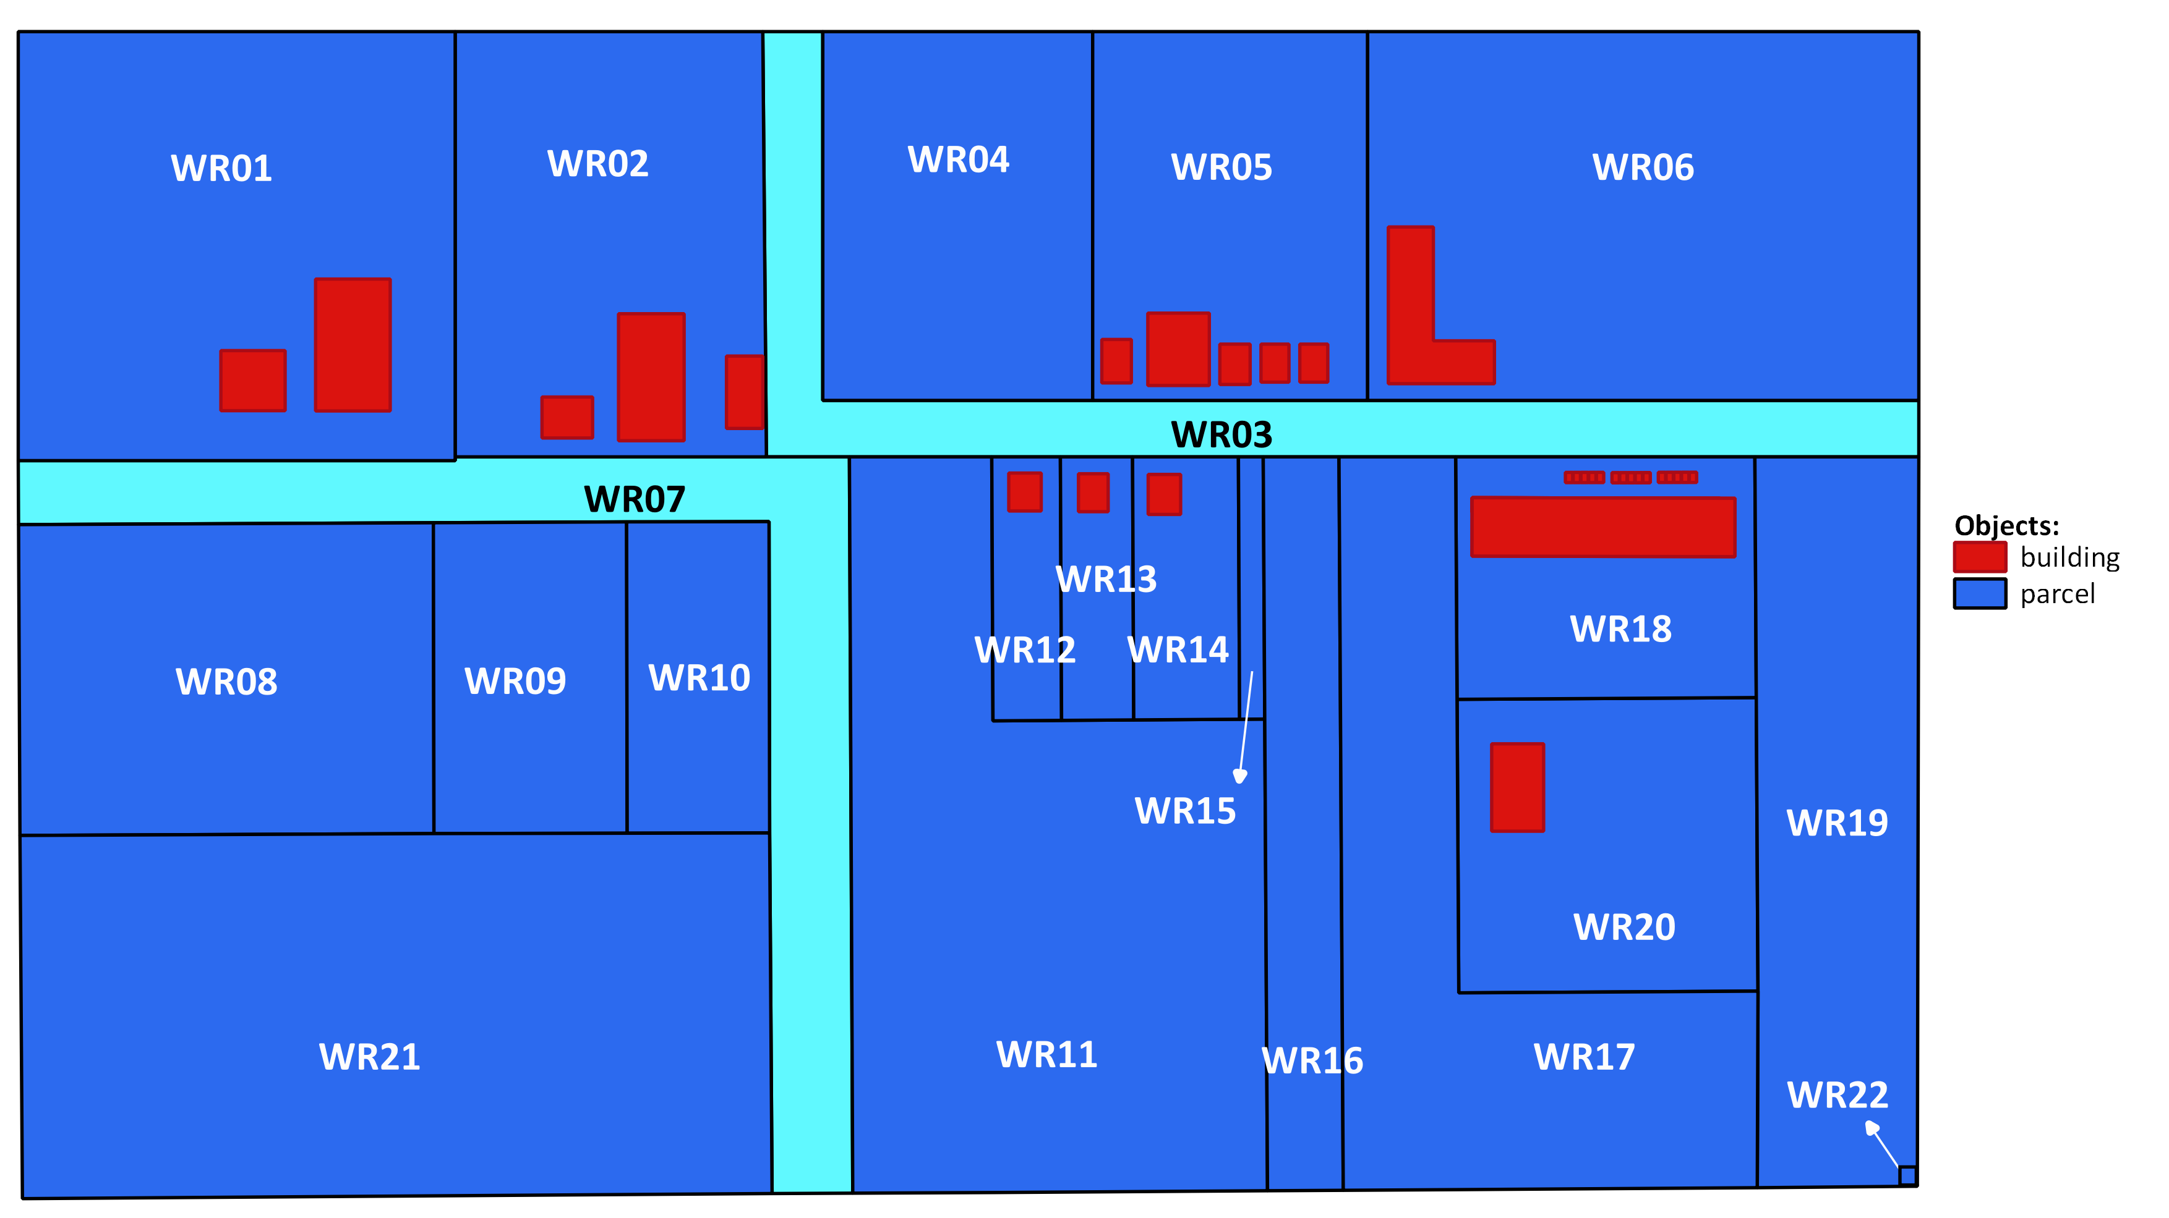
Public Roads

Slide 9
WR20 has no access to a public road
WR04
WR03
WR01
WR02
WR05
WR06
WR02
WR02
WR04
WR05
WR05
WR06
WR06
WR01
WR01
WR03
WR03
WR16
WR07
WR16
WR
12
WR
13
WR
14
WR16
WR18
WR
19
WR11
WR
15
WR
13
WR
15
WR
13
WR17
WR
14
WR17
WR
12
WR
14
WR
12
WR22
WR08
WR21
WR22
WR09
WR
11
WR21
WR
11
20
20
WR24
WR
10
WR23
WR24
WR18
WR23
WR18
WR19
WR19
WR07
WR07
WR30
WR
09
WR30
WR
09
WR20
WR32
WR08
WR32
WR08
WR29
WR
17
WR
10
WR29
WR
10
WR31
WR31
WR21
WR15
WR26
WR25
WR26
WR25
WR37
WR34
WR37
WR
28
WR34
WR27
WR
28
WR27
WR38
WR38
WR22
WR39
WR35
WR39
33
WR35
33
WR40
WR36
WR40
WR36

Slide 10
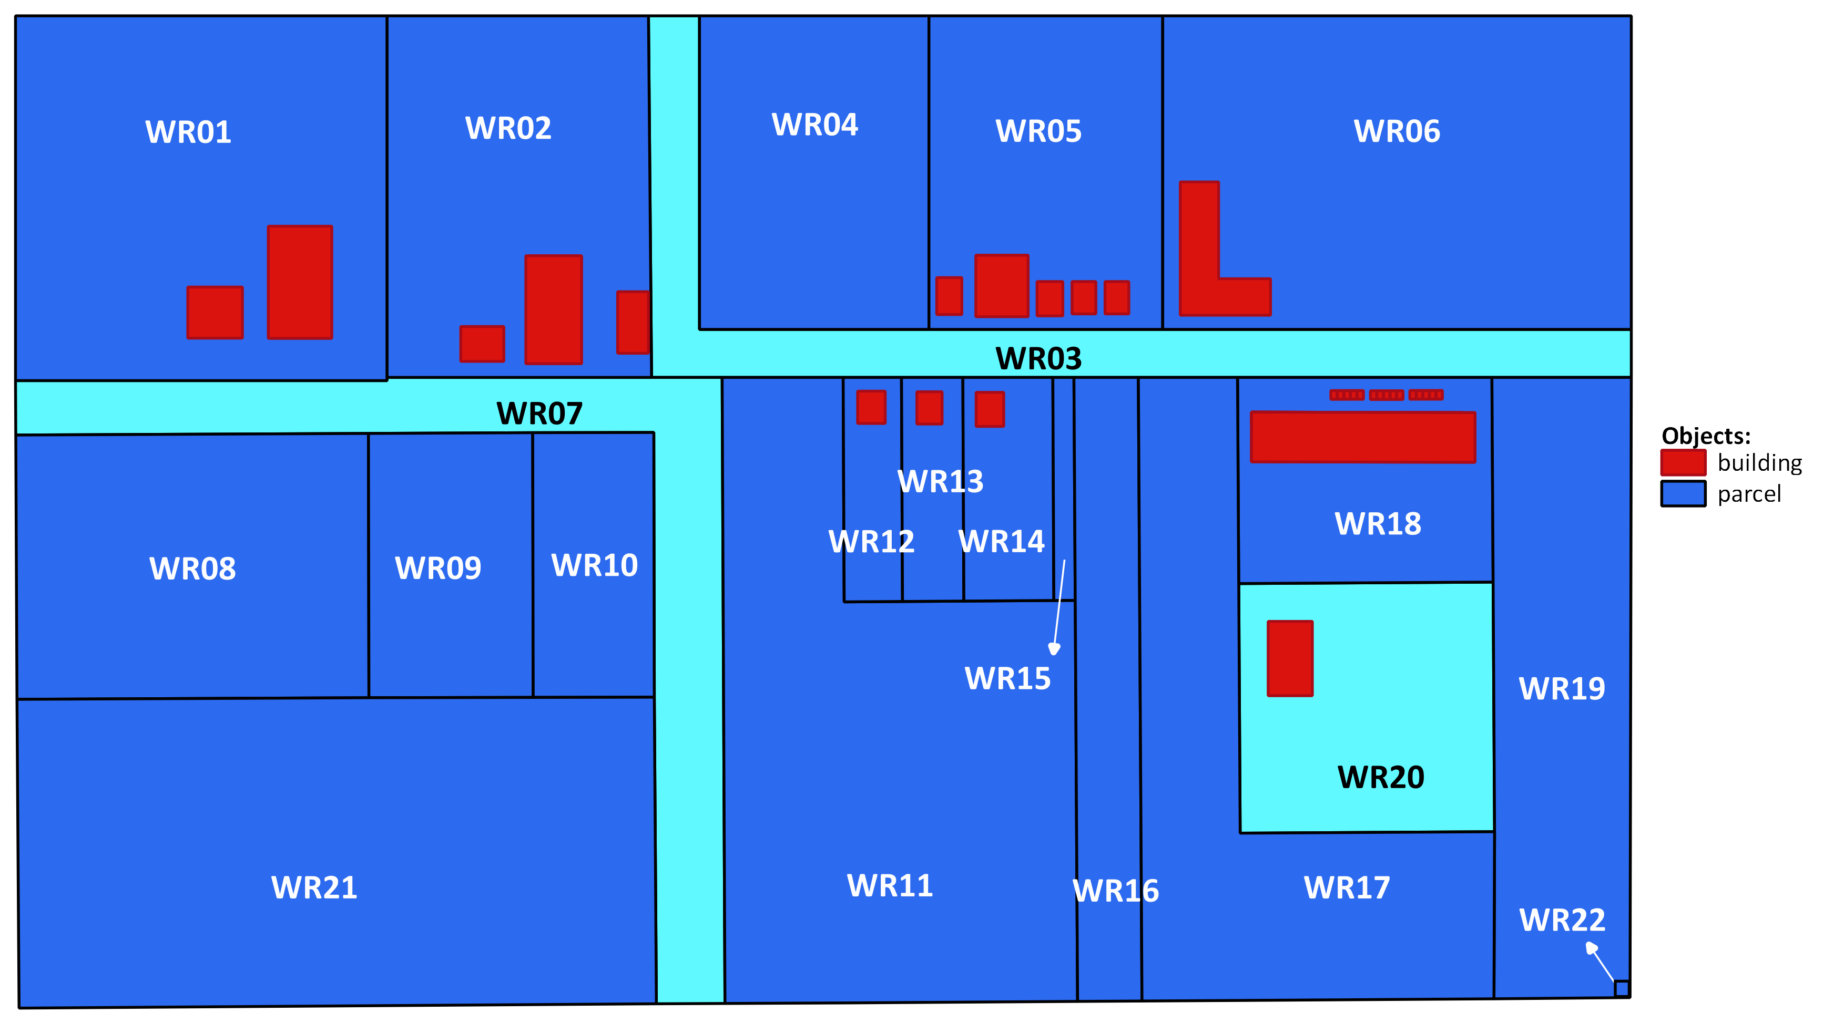
WR20 has no access to a public road

Slide 11
School
WR04
WR03
WR01
WR02
WR05
WR06
WR02
WR02
WR04
WR05
WR05
WR06
WR06
WR01
WR01
WR03
WR03
WR16
WR07
WR16
WR
12
WR
13
WR
14
WR16
WR18
WR
19
WR11
WR
15
WR
13
WR
15
WR
13
WR17
WR
14
WR17
WR
12
WR
14
WR
12
WR22
WR08
WR21
WR22
WR09
WR
11
WR21
WR
11
20
20
WR24
WR
10
WR23
WR24
WR18
WR23
WR18
WR19
WR19
WR07
WR07
WR30
WR
09
WR30
WR
09
WR20
WR32
WR08
WR32
WR08
WR29
WR
17
WR
10
WR29
WR
10
WR31
WR31
WR21
WR15
WR26
WR25
WR26
WR25
WR37
WR34
WR37
WR
28
WR34
WR27
WR
28
WR27
WR38
WR38
WR22
WR39
WR35
WR39
33
WR35
33
WR40
WR36
WR40
WR36

Slide 12
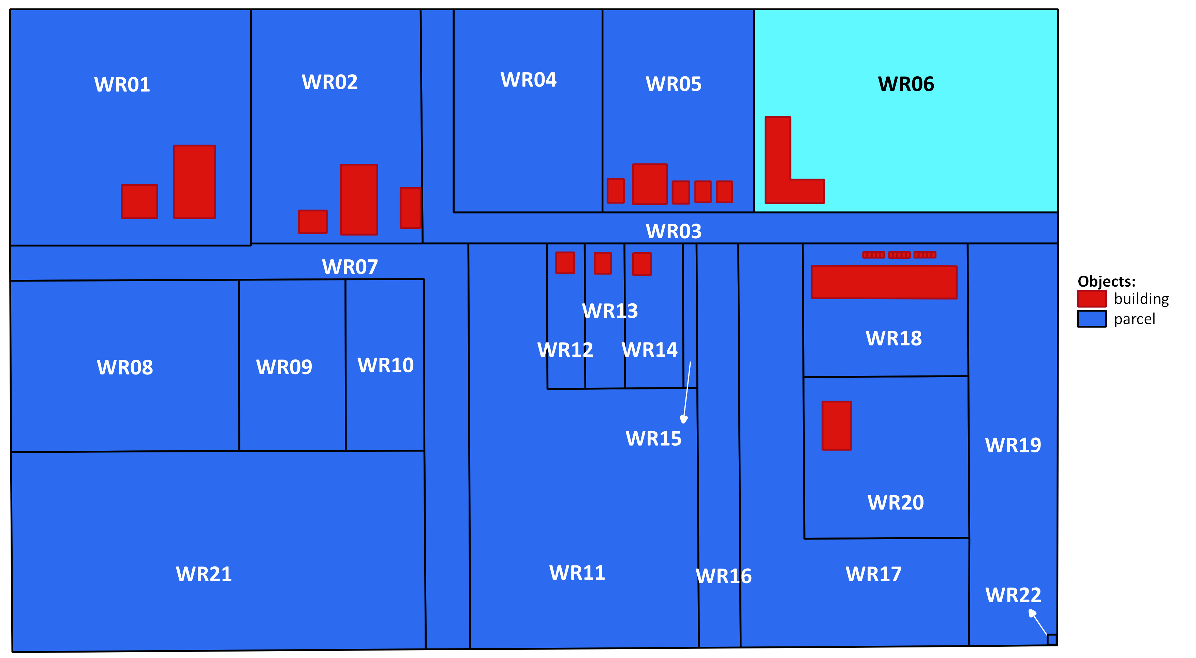
School

Slide 13
Municipal Offices and Services
WR04
WR03
WR01
WR02
WR05
WR06
WR02
WR02
WR04
WR05
WR05
WR06
WR06
WR01
WR01
WR03
WR03
WR16
WR07
WR16
WR
12
WR
13
WR
14
WR16
WR18
WR
19
WR11
WR
15
WR
13
WR
15
WR
13
WR17
WR
14
WR17
WR
12
WR
14
WR
12
WR22
WR08
WR21
WR22
WR09
WR
11
WR21
WR
11
20
20
WR24
WR
10
WR23
WR24
WR18
WR23
WR18
WR19
WR19
WR07
WR07
WR30
WR
09
WR30
WR
09
WR20
WR32
WR08
WR32
WR08
WR29
WR
17
WR
10
WR29
WR
10
WR31
WR31
WR21
WR15
WR26
WR25
WR26
WR25
WR37
WR34
WR37
WR
28
WR34
WR27
WR
28
WR27
WR38
WR38
WR22
WR39
WR35
WR39
33
WR35
33
WR40
WR36
WR40
WR36

Slide 14
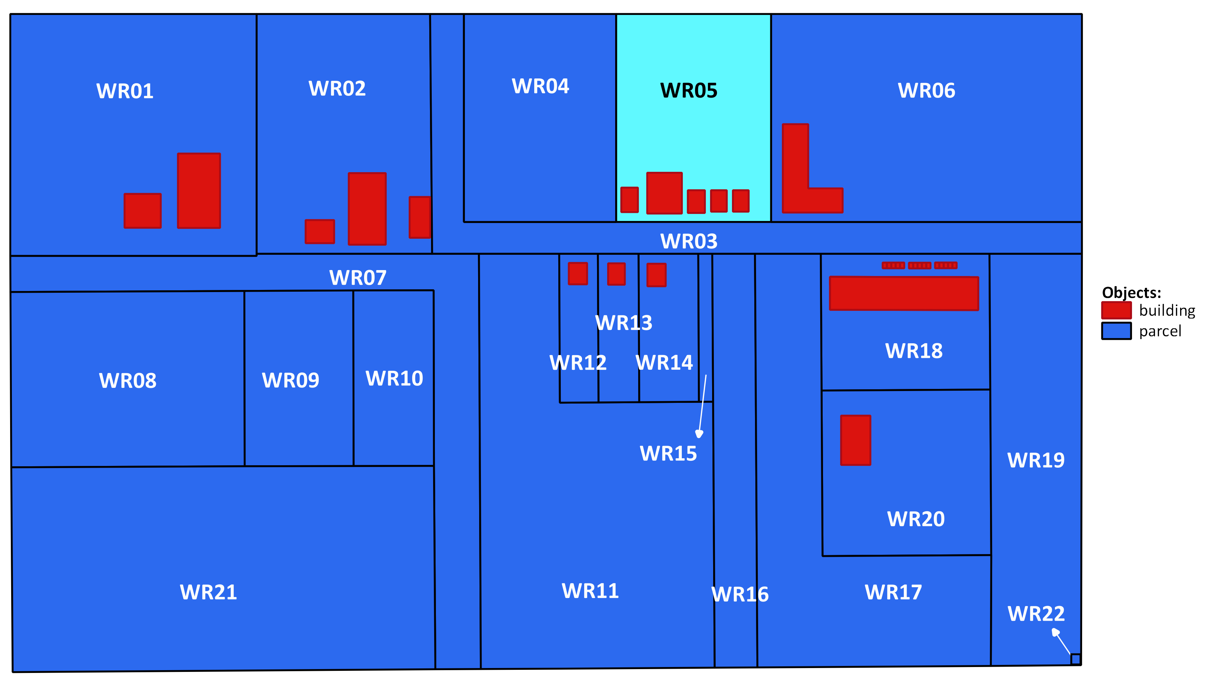
Municipal Offices and Services

Slide 15
Apartment
WR04
WR03
WR01
WR02
WR05
WR06
WR02
WR02
WR04
WR05
WR05
WR06
WR06
WR01
WR01
WR03
WR03
WR16
WR07
WR16
WR
12
WR
13
WR
14
WR16
WR18
WR
19
WR11
WR
15
WR
13
WR
15
WR
13
WR17
WR
14
WR17
WR
12
WR
14
WR
12
WR22
WR08
WR21
WR22
WR09
WR
11
WR21
WR
11
20
20
WR24
WR
10
WR23
WR24
WR18
WR23
WR18
WR19
WR19
WR07
WR07
WR30
WR
09
WR30
WR
09
WR20
WR32
WR08
WR32
WR08
WR29
WR
17
WR
10
WR29
WR
10
WR31
WR31
WR21
WR15
WR26
WR25
WR26
WR25
WR37
WR34
WR37
WR
28
WR34
WR27
WR
28
WR27
WR38
WR38
WR22
WR39
WR35
WR39
33
WR35
33
WR40
WR36
WR40
WR36

Slide 16
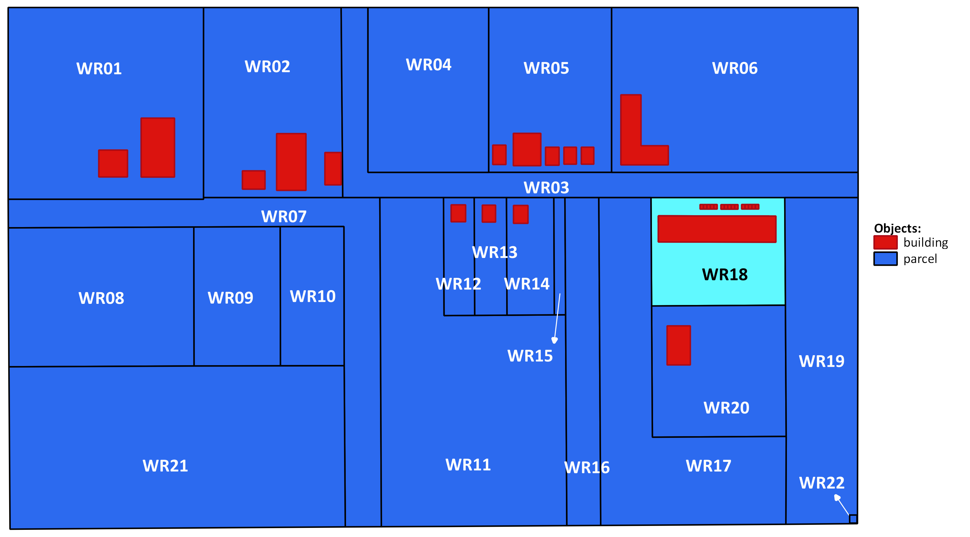
Apartment

Slide 17
WR22 is 1 sqm – electrical power distribution
WR04
WR03
WR01
WR02
WR05
WR06
WR02
WR02
WR04
WR05
WR05
WR06
WR06
WR01
WR01
WR03
WR03
WR16
WR07
WR16
WR
12
WR
13
WR
14
WR16
WR18
WR
19
WR11
WR
15
WR
13
WR
15
WR
13
WR17
WR
14
WR17
WR
12
WR
14
WR
12
WR22
WR08
WR21
WR22
WR09
WR
11
WR21
WR
11
20
20
WR24
WR
10
WR23
WR24
WR18
WR23
WR18
WR19
WR19
WR07
WR07
WR30
WR
09
WR30
WR
09
WR20
WR32
WR08
WR32
WR08
WR29
WR
17
WR
10
WR29
WR
10
WR31
WR31
WR21
WR15
WR26
WR25
WR26
WR25
WR37
WR34
WR37
WR
28
WR34
WR27
WR
28
WR27
WR38
WR38
WR22
WR39
WR35
WR39
33
WR35
33
WR40
WR36
WR40
WR36
WR
22

Slide 18
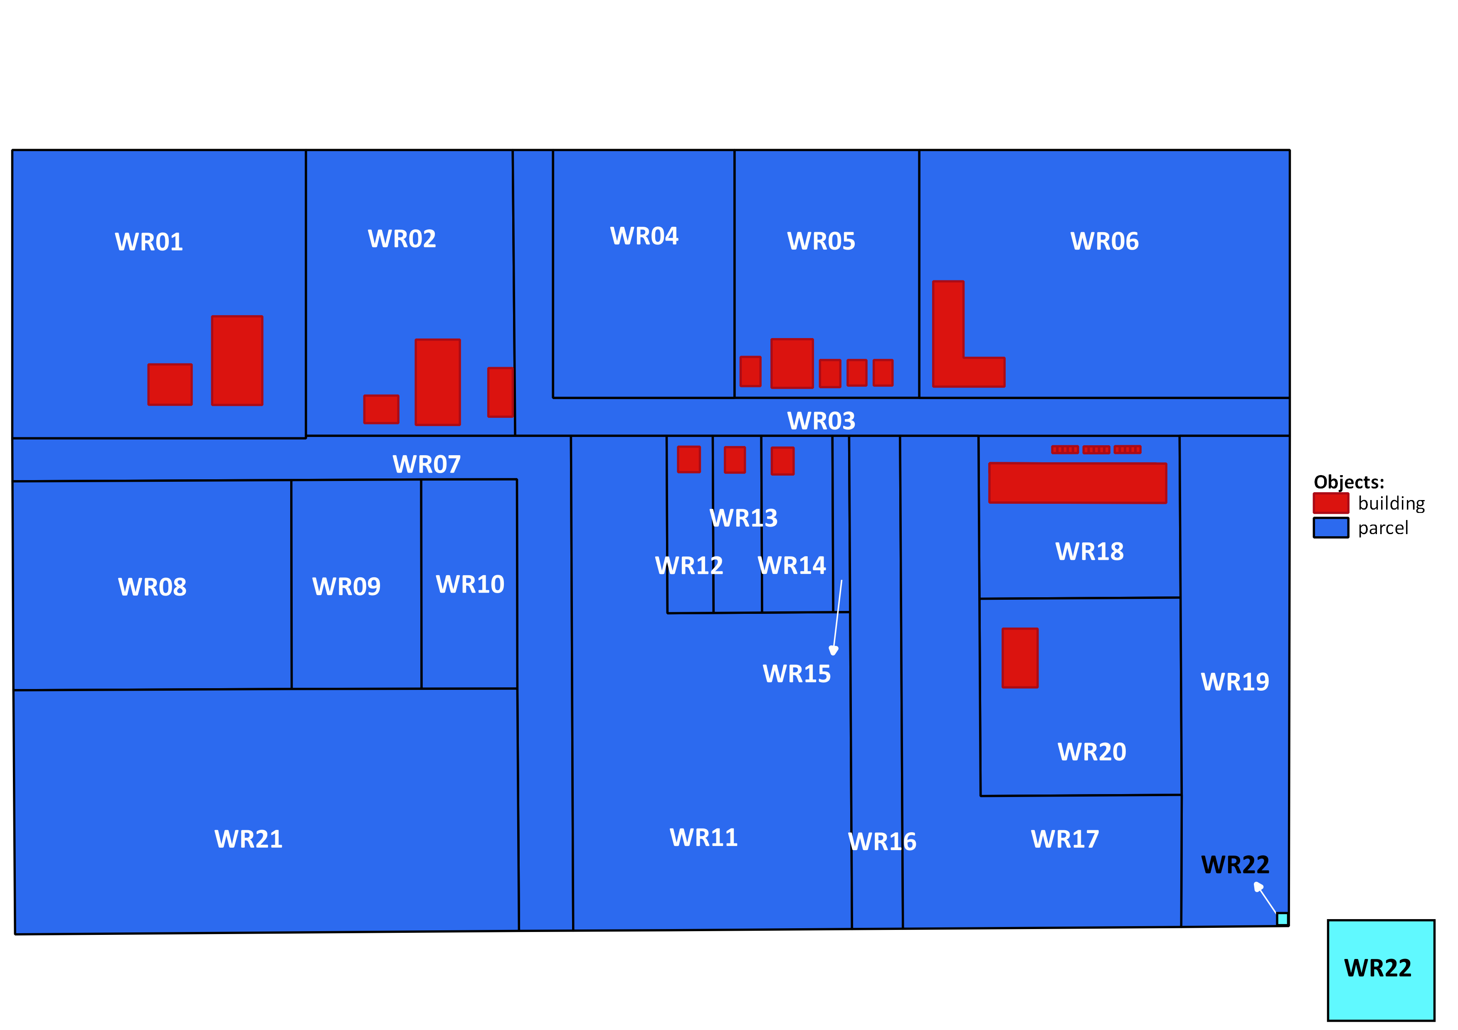
WR22 is 1 sqm – electrical power distribution

Slide 19
Carlos owns WR01
WR04
WR03
WR01
WR02
WR05
WR06
WR02
WR02
WR04
WR05
WR05
WR06
Ownership
WR06
WR01
WR01
Carlos
WR03
WR03
WR16
WR07
WR16
WR
12
WR
13
WR
14
WR16
WR18
WR
19
WR11
WR
15
WR
13
WR
15
WR
13
WR17
WR
14
WR17
WR
12
WR
14
WR
12
WR22
WR08
WR21
WR22
WR09
WR
11
WR21
WR
11
20
20
WR24
WR
10
WR23
WR24
WR18
WR23
WR18
WR19
WR19
WR07
WR07
WR30
WR
09
WR30
WR
09
WR20
WR32
WR08
WR32
WR08
WR29
WR
17
WR
10
WR29
WR
10
WR31
WR31
WR21
WR15
WR26
WR25
WR26
WR25
WR37
WR34
WR37
WR
28
WR34
WR27
WR
28
WR27
WR38
WR38
WR22
WR39
WR35
WR39
33
WR35
33
WR40
WR36
WR40
WR36

Slide 20
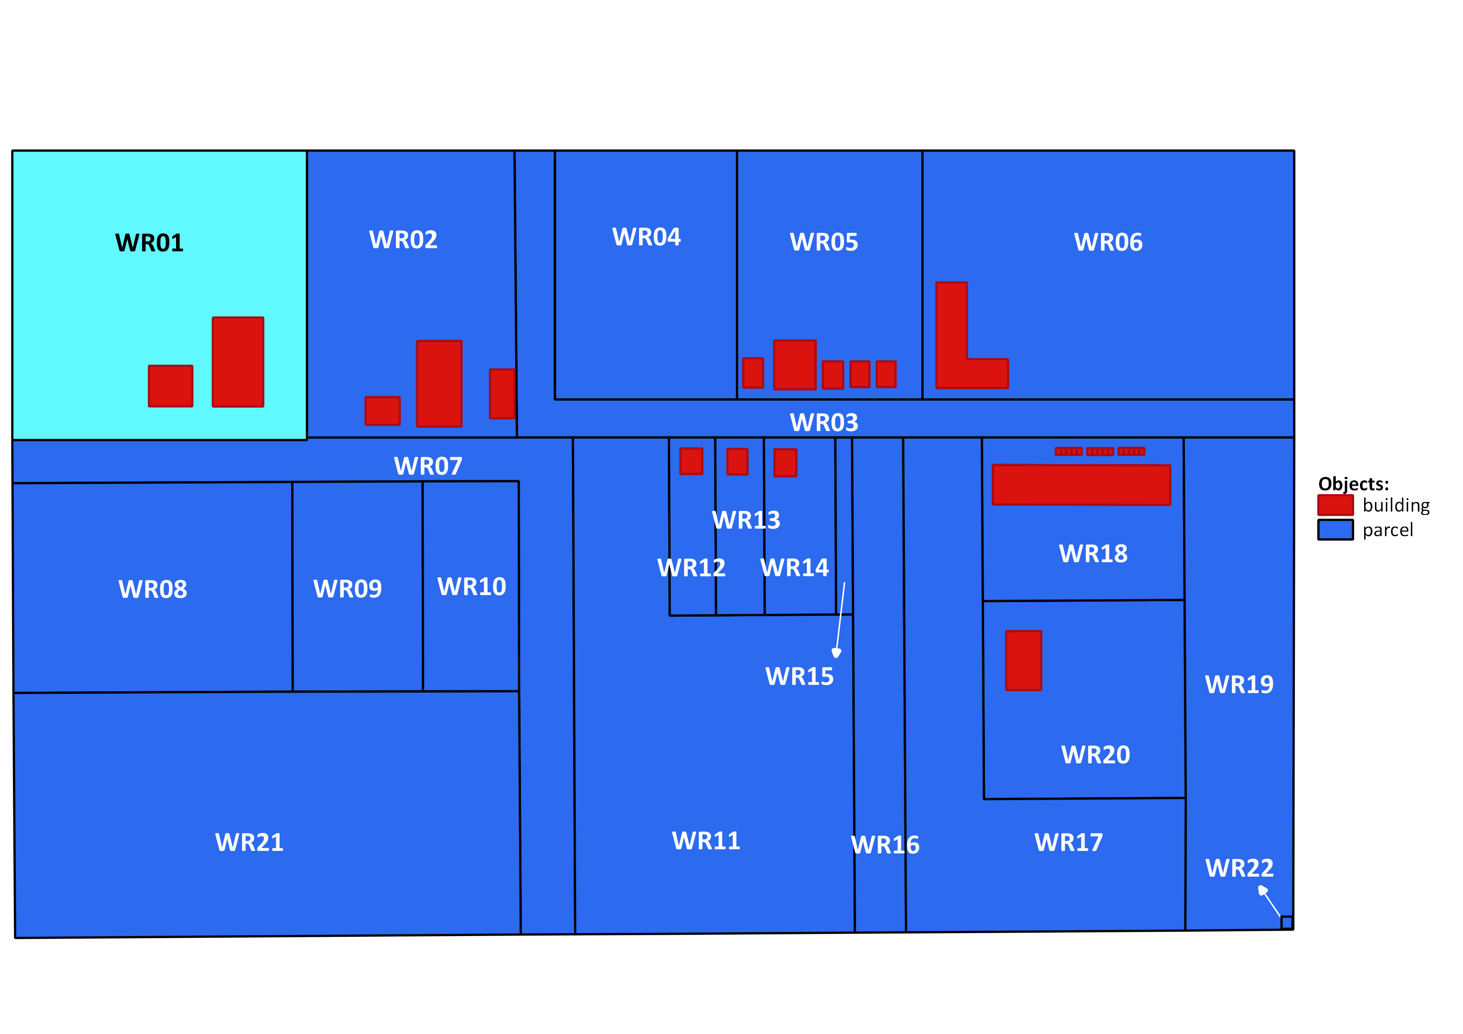
Carlos owns WR01
Ownership
Carlos

Slide 21
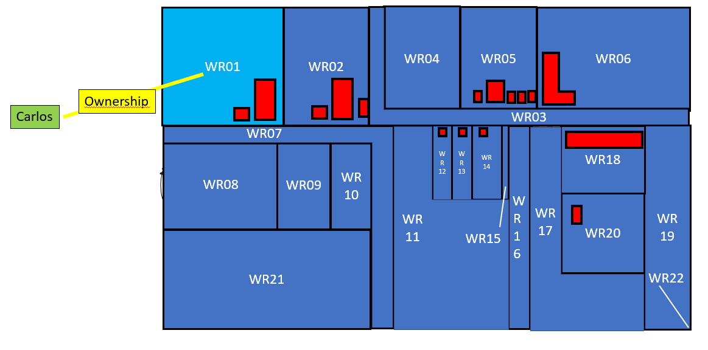
Carlos
Carlos P01
Ownership Right01
BAU01
WR01

Slide 22
Carlos
Ownership
Carlos

Slide 23
BAU01?
?
Carlos P01
Ownership Right01
BAU01
WR01

Slide 24
BAU01?
?

