Slide 1
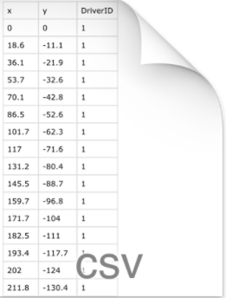
Feature Extractor
Data in form of csv files

