Slide 1
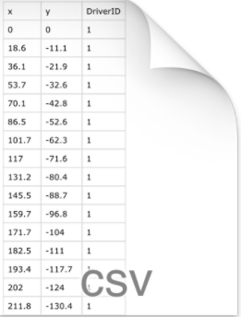
Data in form of csv files
Feature Extractor

