Slide 1

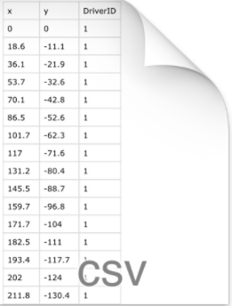
HDFS
Feature
Extractor
Feature extraction in Flink environment
Data in form of CSV files
Sample N x M feature matrix

