Slide 1

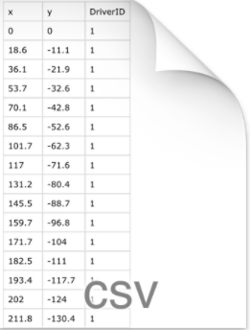
HDFS
Feature Extractor
Feature extraction in Flink
environment
Data in form of csv files
Sample x Dimension matrix

