Slide 1

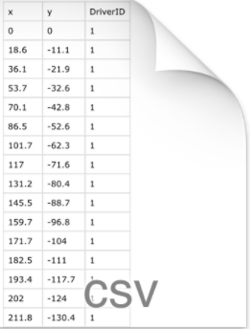
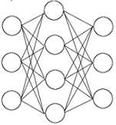
HDFS
Feature Extractor
Feature extraction in Flink
environment
Data in form of csv files
Auto-encoder
Sample x Dimension matrix
0.0021
0.0170
0.0019
.
.
Confidence Scores

