Slide 1
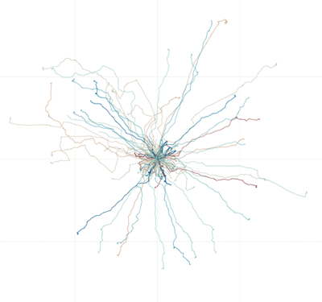


Unsupervised Anomaly Detection using H2O.ai
Peter Schrott, Julian Voelkel | Scalable Data Analysis and Data Mining

Slide 2
Agenda
Introduction
Problem Statement
Methodology
Experiments
Results
Conclusion
Notes:
Problem Statement -> Well defined target and scope
Methodology -> describe approach
Experiments
Results -> interpret, discuss, draw conclusions
Conclusion -> Relevance, importance, impact

Slide 3
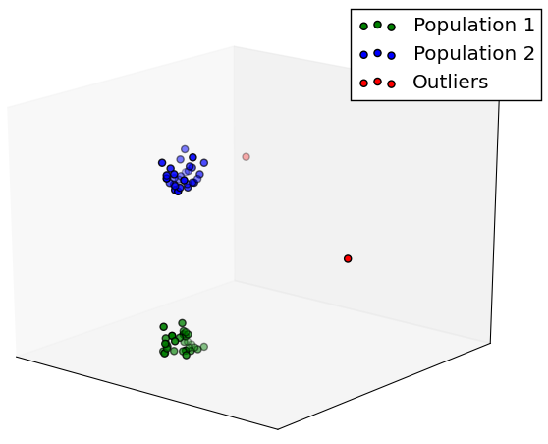
Anomaly Detection
Identify data points that do not fit the pattern of the data

Slide 4
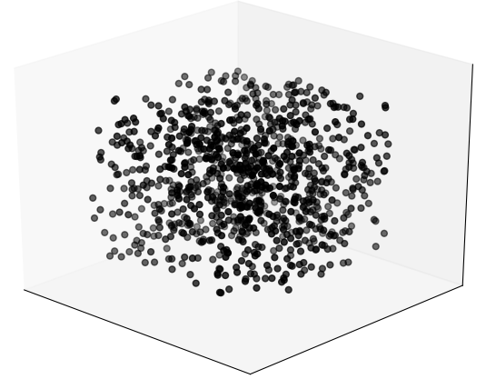
Unsupervised Anomaly Detection
“Anomaly detection is about finding what you don't know to look for.”
- Ted Duning¹
Fundamental assumption:
Amount of normal data points exceeds the amount of anomalous data points by far
¹ Practical Machine Learning: A new Look at Anomaly Detection
Notes:
We do not know the characteristics of the anomalies (unlike in classification for instance)

Slide 5
Problem Statement
Is a deep learning auto-encoder well suited for anomaly detection in an unlabeled dataset?

Slide 6
Problem Statement
?
?
?
Is a deep learning auto-encoder well suited for anomaly detection in an unlabeled dataset?

Slide 7
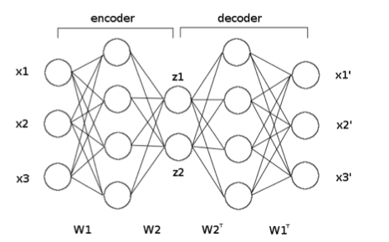
Foundations: Deep Learning Auto Encoder
Neural Net
Desired output = input
Auto-encoder learns a compressed representation of input
Most commonly used for dimensionality reduction purposes

Slide 8



Methodology
Feature Extractor
H₂O.ai auto-encoder
1
4
2
3
0.0021
0.0170
0.0019
.
.
Confidence Scores
Dataset
Sample x Dimension matrix

Slide 9
Experiments

Slide 10
Conclusion
Distortion of results by junk drives through:
Influencing the model
Distorting the probabilities
Direct influency on FPR and TPR -> AUC

