Slide 1
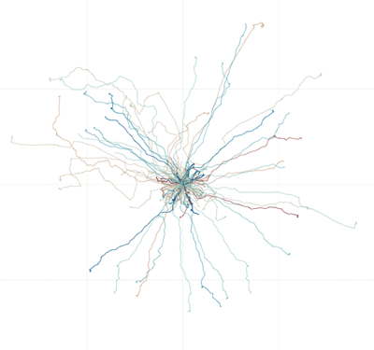


Unsupervised Anomaly Detection using H2O.ai
Peter Schrott, Julian Voelkel | Scalable Data Analysis and Data Mining

Slide 2
Agenda
Introduction
Problem Statement
Methodology
Experiments & Results
Conclusion
2
Notes:
Problem Statement -> Well defined target and scope
Methodology -> describe approach
Experiments
Results -> interpret, discuss, draw conclusions
Conclusion -> Relevance, importance, impact

Slide 3
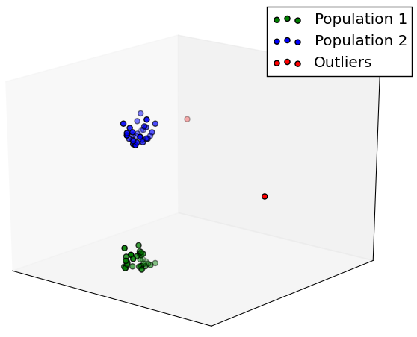
Anomaly Detection
Identify data points that do not fit the pattern of the data
3

Slide 4
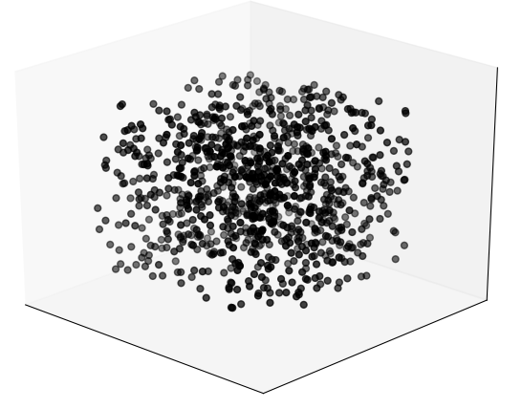
Unsupervised Anomaly Detection
“Anomaly detection is about finding what you don't know to look for.”
- Ted Duning¹
Fundamental assumption:
Amount of normal data points exceeds the amount of anomalous data points by far
4
¹ Practical Machine Learning: A new Look at Anomaly Detection
Notes:
We do not know the characteristics of the anomalies (unlike in classification for instance)

Slide 5
Problem Statement
Is a deep learning auto-encoder well suited for anomaly detection in an unlabeled dataset?
5

Slide 6
Problem Statement
?
?
?
Is a deep learning auto-encoder well suited for anomaly detection in an unlabeled dataset?
5

Slide 7
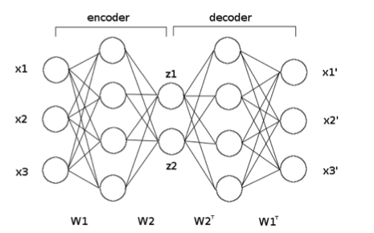
Foundations: Deep Learning Auto-Encoder
Neural Net
Desired output = input
Auto-encoder learns a compressed representation of input
Most commonly used for dimensionality reduction purposes
6

Slide 8

Dataset
Provided by Kaggle.com
5.92 GB
2736 Driver
200 Trips each
X- / Y-coordinates
Folder- / File- based structure
Anonymized by cropping & rotation
Trips start at (0,0)
Dataset
7

Slide 9



Methodology
Feature Extractor
H₂O.ai auto-encoder
1
4
2
3
0.0021
0.0170
0.0019
.
.
Confidence Scores
Dataset
Sample x Dimension matrix
8

Slide 10
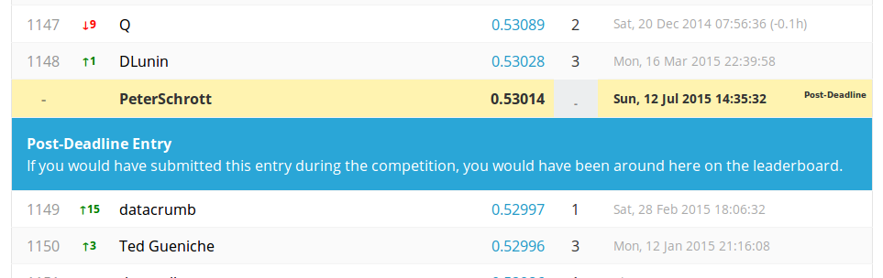
1st Experiment
One general model for all drivers
Normalization of resulting confidence scores
Sample x Dimension matrix
H₂O.ai auto-encoder
0.0021
0.0170
0.0019
.
.
Confidence Scores
0.53014
AUC value
9

Slide 11
Conclusions 1st Experiment
Generalization of model too high
Wide variance between drivers
Finding optimal parameters is tough
No labels, means no feedback
10

Slide 12
2nd Experiment
One single model for each driver
Normalization of resulting confidence scores
Sample x Dimension matrix
H₂O.ai auto-encoder
0.0021
0.0170
0.0019
.
.
Confidence Scores
0.61897
AUC value
11

Slide 13
Visual Exploration
Find 15 trips with highest reconstruction error
Visualize trips with matplot-lib
12

Slide 14
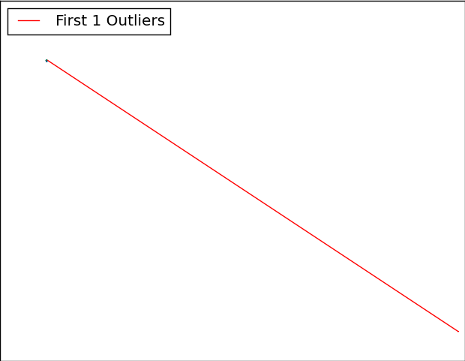
Visual Exploration
13

Slide 15
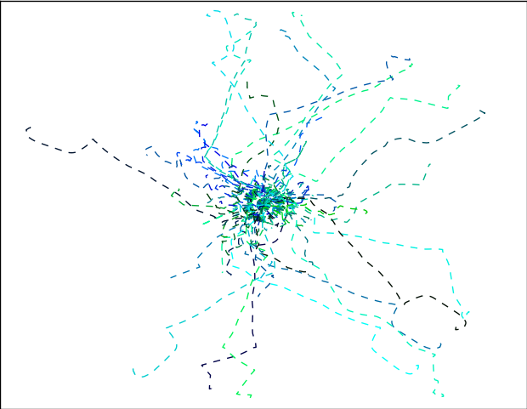
Visual Exploration
Dataset apparently still contains junk drives…
All trips of driver 1634
… that seem to be spoiling the model and / or predictions
All trips but trip #136
14

Slide 16
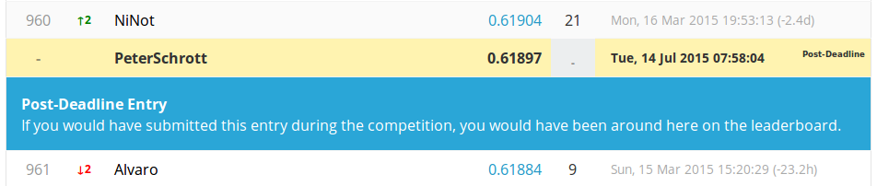
Conclusions 2nd Experiment
Noisy data seems to influence our model
Noise is recognized as outliers, but seems to distort the confidence scores and thus probabilities
15

Slide 17
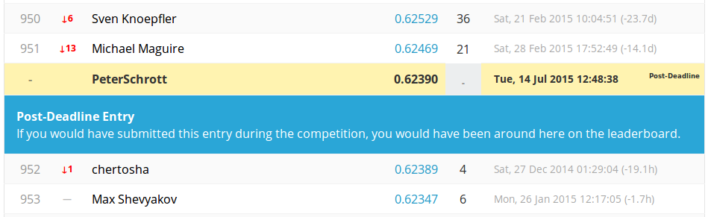
3rd Experiment
One single model for each driver
Normalization of resulting confidence scores
Discounting highest two confidence scores per driver
Sample x Dimension matrix
H₂O.ai auto-encoder
0.0021
0.0170
0.0019
.
.
Confidence Scores
0.62390
AUC value
952th out of 1,529
16

Slide 18
Conclusions 3rd Experiment
Better results after accounting for an arbitrary number of junk drives per driver
Noise is recognized as outliers, but seems to distort the confidence scores and thus probabilities
17

Slide 19
Conclusion
AUC score of 0.62390 far from reliable outlier detection
But still better than the 0.5 benchmark
Spend more time on cleaning the data
Recommendations for future work:
Use cleaner dataset
If possible with features already given
18

Slide 20
Thank you for your attention!
Peter Schrott, Julian Voelkel | Scalable Data Analysis and Data Mining

Slide 21
Were you surprised by any of your findings?
I was surprised at the number of junk runs there were. Some of the drivers had 30, 40 or more junk runs!
Scott Hartshorn (2nd place in the AXA Driver Telematics challenge on Kaggle.com)
20

