Slide 1



Market Basket Analysis & Recommender System
Gift-a-Lot Retail Store
Group V:
Anis Tmar (m20211157)
André Forte (m20210590)
Opeyemi Mary Akande (m20211320)
Rafael Nunes (m20210832)

Slide 2


OVERVIEW
OVERVIEW
Data Understanding
Market Basket Analysis
Implications and
Deployment
Business
Understanding
Data Preparation
Recommendation System

Slide 3


BUSINESS UNDERSTANDING
Business Goals
Data Mining Goals
Create a recommender system to assist consumers in making better decisions by proposing items they like and to enhance their shopping experience on the company's website.
Present a Market Basket Analysis and optimize a model that recommends customers who might buy a specific product and products that might be purchased together.

Slide 4


DATA UNDERSTANDING
Data Quality
Negative values for 'Quantity' and 'UnitPrice’
‘CustomerID’ and ‘Description’ registered missing and wrong values
We have:
25900 different transactions
4372 different customers
4070 different products

Slide 5
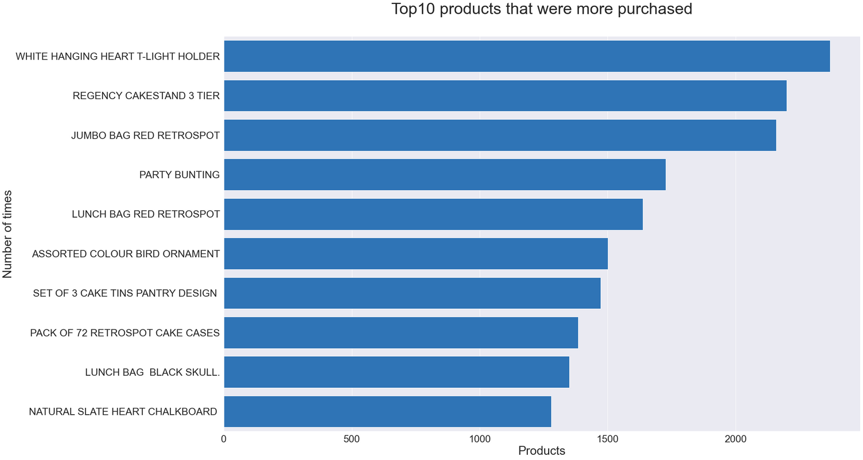
THE TOP 10 PRODUCTS
Top 3 Products:
White hanging heart t-light holder
Regency cakestand 3 tier
Jumbo bag red retrospot

Slide 6
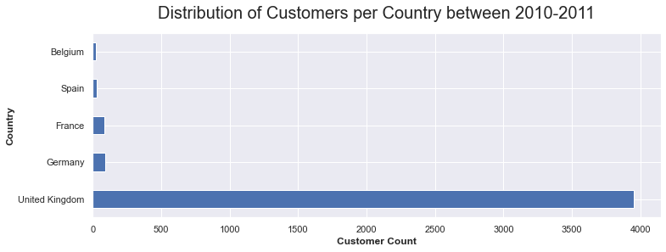
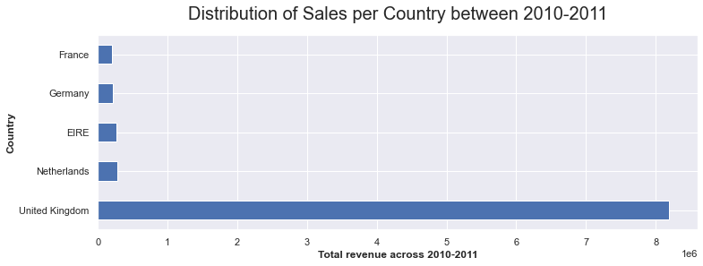
ANALYSING PER COUNTRY
United Kingdom
More customers
More Sales

Slide 7
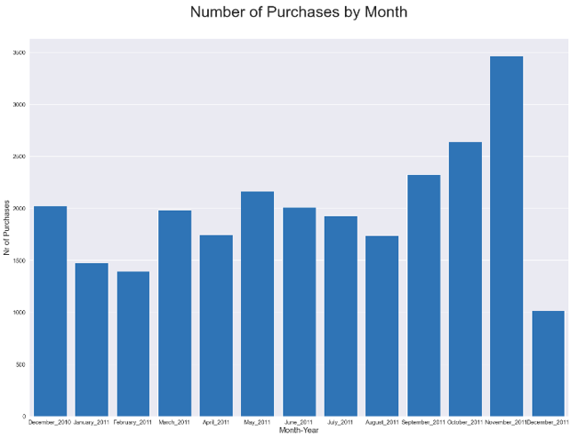

NUMBER OF PURCHASES BY MONTH
(2010-2011)
The best month was November 2011 (high number of different products sold)

Slide 8
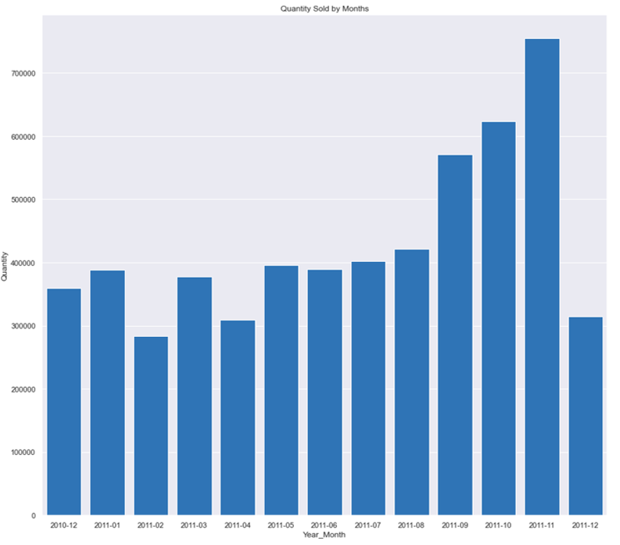
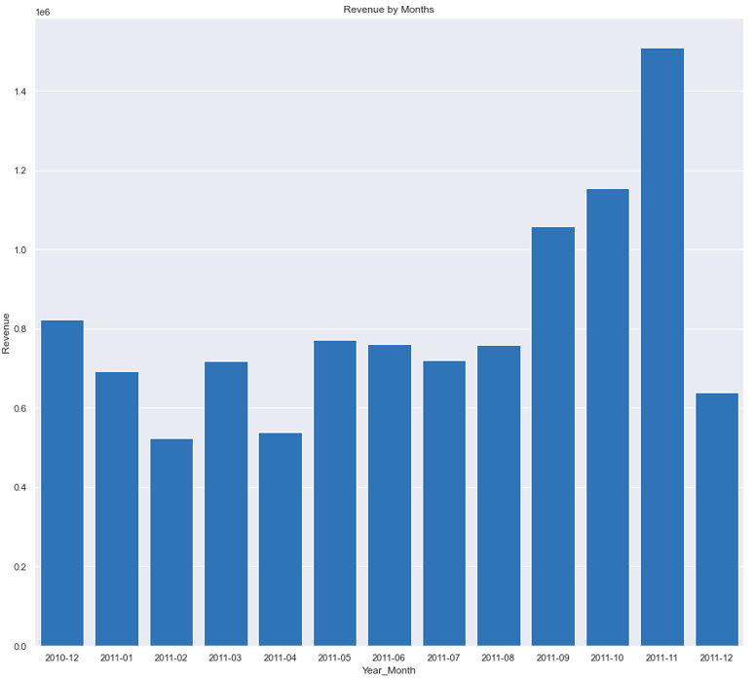
REVENUE AND QUANTITY BY MONTH
The best month was November 2011 (high number quantity sold and high of revenue)

Slide 9
DATA PREPARATION
Preparing the dataset for modeling
Outliers' removal (2.2% of the data)
Missing values' removal in “CustomerID”
The “StockCode” have values that could be interpreted as integers or strings (we added a prefix "SC")
Removed entries with wrong descriptions in lower case
In total 26.9% of the provided dataset were removed

Slide 10

MARKET BASKET ANALYSIS
Goal:
Define complementary and substitute products in past transactions
Analysis based on:
Algorithms:
All transactions
Apriori
per Quarter
JP Growth
UK vs worldwide

Slide 11
MARKET BASKET ANALYSIS
Evaluation Metrics
Complementary
Substitutes
Minimum Support = 2.5%
Minimum Support = 1%
Lift > 1
Lift < 1
Confidence > 70%

Slide 12
MARKET BASKET ANALYSIS
Results
Only complementary products considering all the transactions
Antecedents | Consequents
GREEN REGENCY TEACUP AND SAUCER | ROSES REGENCY TEACUP AND SAUCER
PINK REGENCY TEACUP AND SAUCER | GREEN REGENCY TEACUP AND SAUCER
GARDENERS KNEELING PAD CUP OF TEA | GARDENERS KNEELING PAD KEEP CALM
Top complementary products changed by quarter
Complementary products in UK are the same when we consider all the transactions
Substitute products when we analyse non-UK transactions
Table 1. Top Complementary Products when we consider all the transactions

Slide 13
RECOMMENDER SYSTEM
Goal:
Suggest items/individuals that could be interested in a specific product, based on interactions between products or individuals
Algorithm:
Evaluation Metrics:
LightFM
Precision @k
Train Test split:
AUC
Train (80%)
Test (20%)

Slide 14
RECOMMENDER SYSTEM
Results
Train
Test
AUC
0.96
0.88
Precision at k = 10
0.39
0.05

Slide 15

RECOMMENDER SYSTEM
Recommend products
Last Products Purchased
Recommendations

Slide 16
RECOMMENDER SYSTEM
Recommend Users
Users that could be interested in the product:
Product:
15945.0, 15940.0, 13672.0,
14393.0, 13270.0, 12875.0,
16257.0, 13841.0, 15562.0,
13188.0, 14373.0, 14946.0,
17024.0, 15374.0, 15423.0
LETTER "O" BLING KEY RING

Slide 17
RECOMMENDER SYSTEM
Products that could be bought together
Similar products:
1- RED HANGING HEART T-LIGHT HOLDER
2- TRIPLE HOOK ANTIQUE IVORY ROSE
3- SINGLE WIRE HOOK IVORY HEART
4- HEART OF WICKER SMALL
5- HEART OF WICKER LARGE
6- CANDLEHOLDER PINK HANGING HEART
7- PHOTO FRAME CORNICE
8- T-LIGHT HOLDER SWEETHEART HANGING
9- LOVE BUILDING BLOCK WORD
10- CREAM HEART CARD HOLDER
Product:
WHITE HANGING HEART T-LIGHT HOLDER

Slide 18
COLD START PROBLEMS
Solutions
Use of hybrid recommender systems
Use of customers' personal profile
The popular item technique
Problems
New or unpopular item
Addition of new users to the database

Slide 19

Business implication, Deployment and Limitations
Business implication
Deployment
Limitations
Cold start problem
Wrong reviews or Customers giving biased details about their personal information
Funding
Could drive promotional campaigns
Solve stocking problems
Improve sales
Generate more revenue
Embedded Web Application
Carrying out routine system update and maintenance

Slide 20



THANK YOU!
GROUP V

