Slide 1
Optimal Power Flow: Closing the Loop over Corrupted Data
André Teixeira, Henrik Sandberg, György Dán, and Karl H. Johansson
ACCESS Linnaeus Centre, KTH Royal Institute of Technology
American Control Conference
Montréal, June 28th, 2012

Slide 2
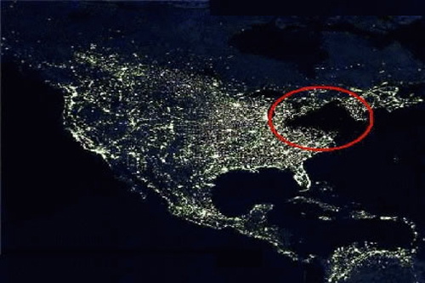
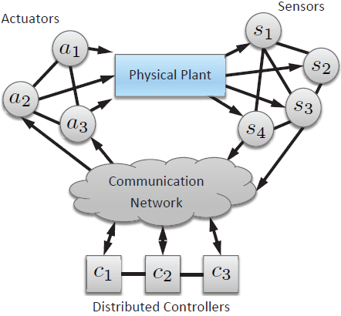
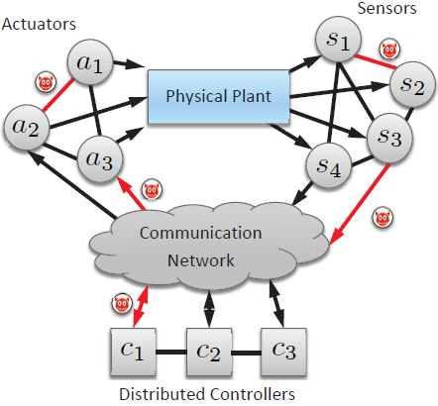
Motivation
Networked control systems are becoming more pervasive
Increasing use of ”open” networks and COTS
Infrastructures are becoming more vulnerable to cyber-threats!
Several attack points
Nature-driven events are known to have caused severe disruptions
A major concern is the possible impact of cyber threats on these systems

Slide 3
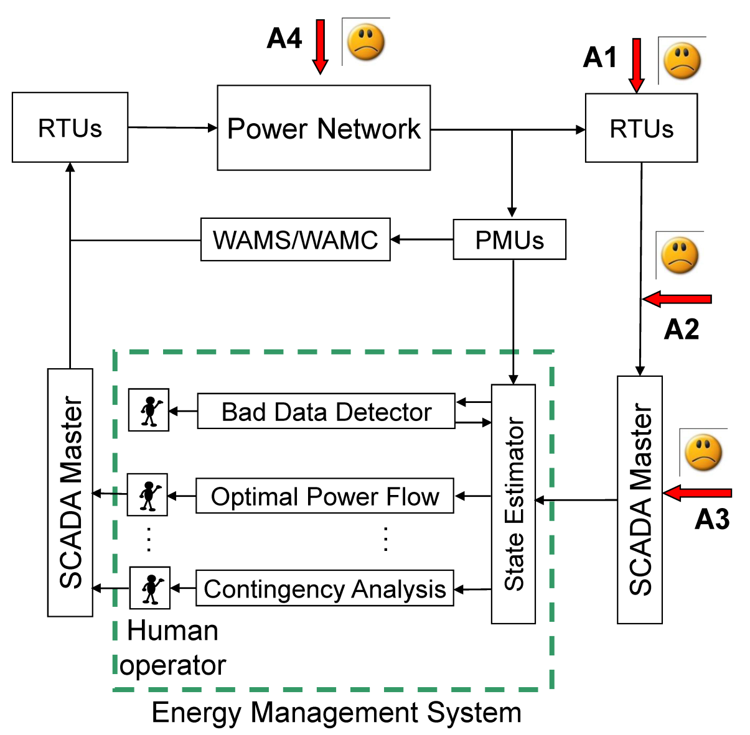
Power Transmission Networks
Previous work
Vulnerabilities of current SCADA/EMS systems to data attacks on measurements
Current work
Consequences on system operation: Optimal Power Flow
SCADA: Supervisory Control and Data Acquisition

Slide 4

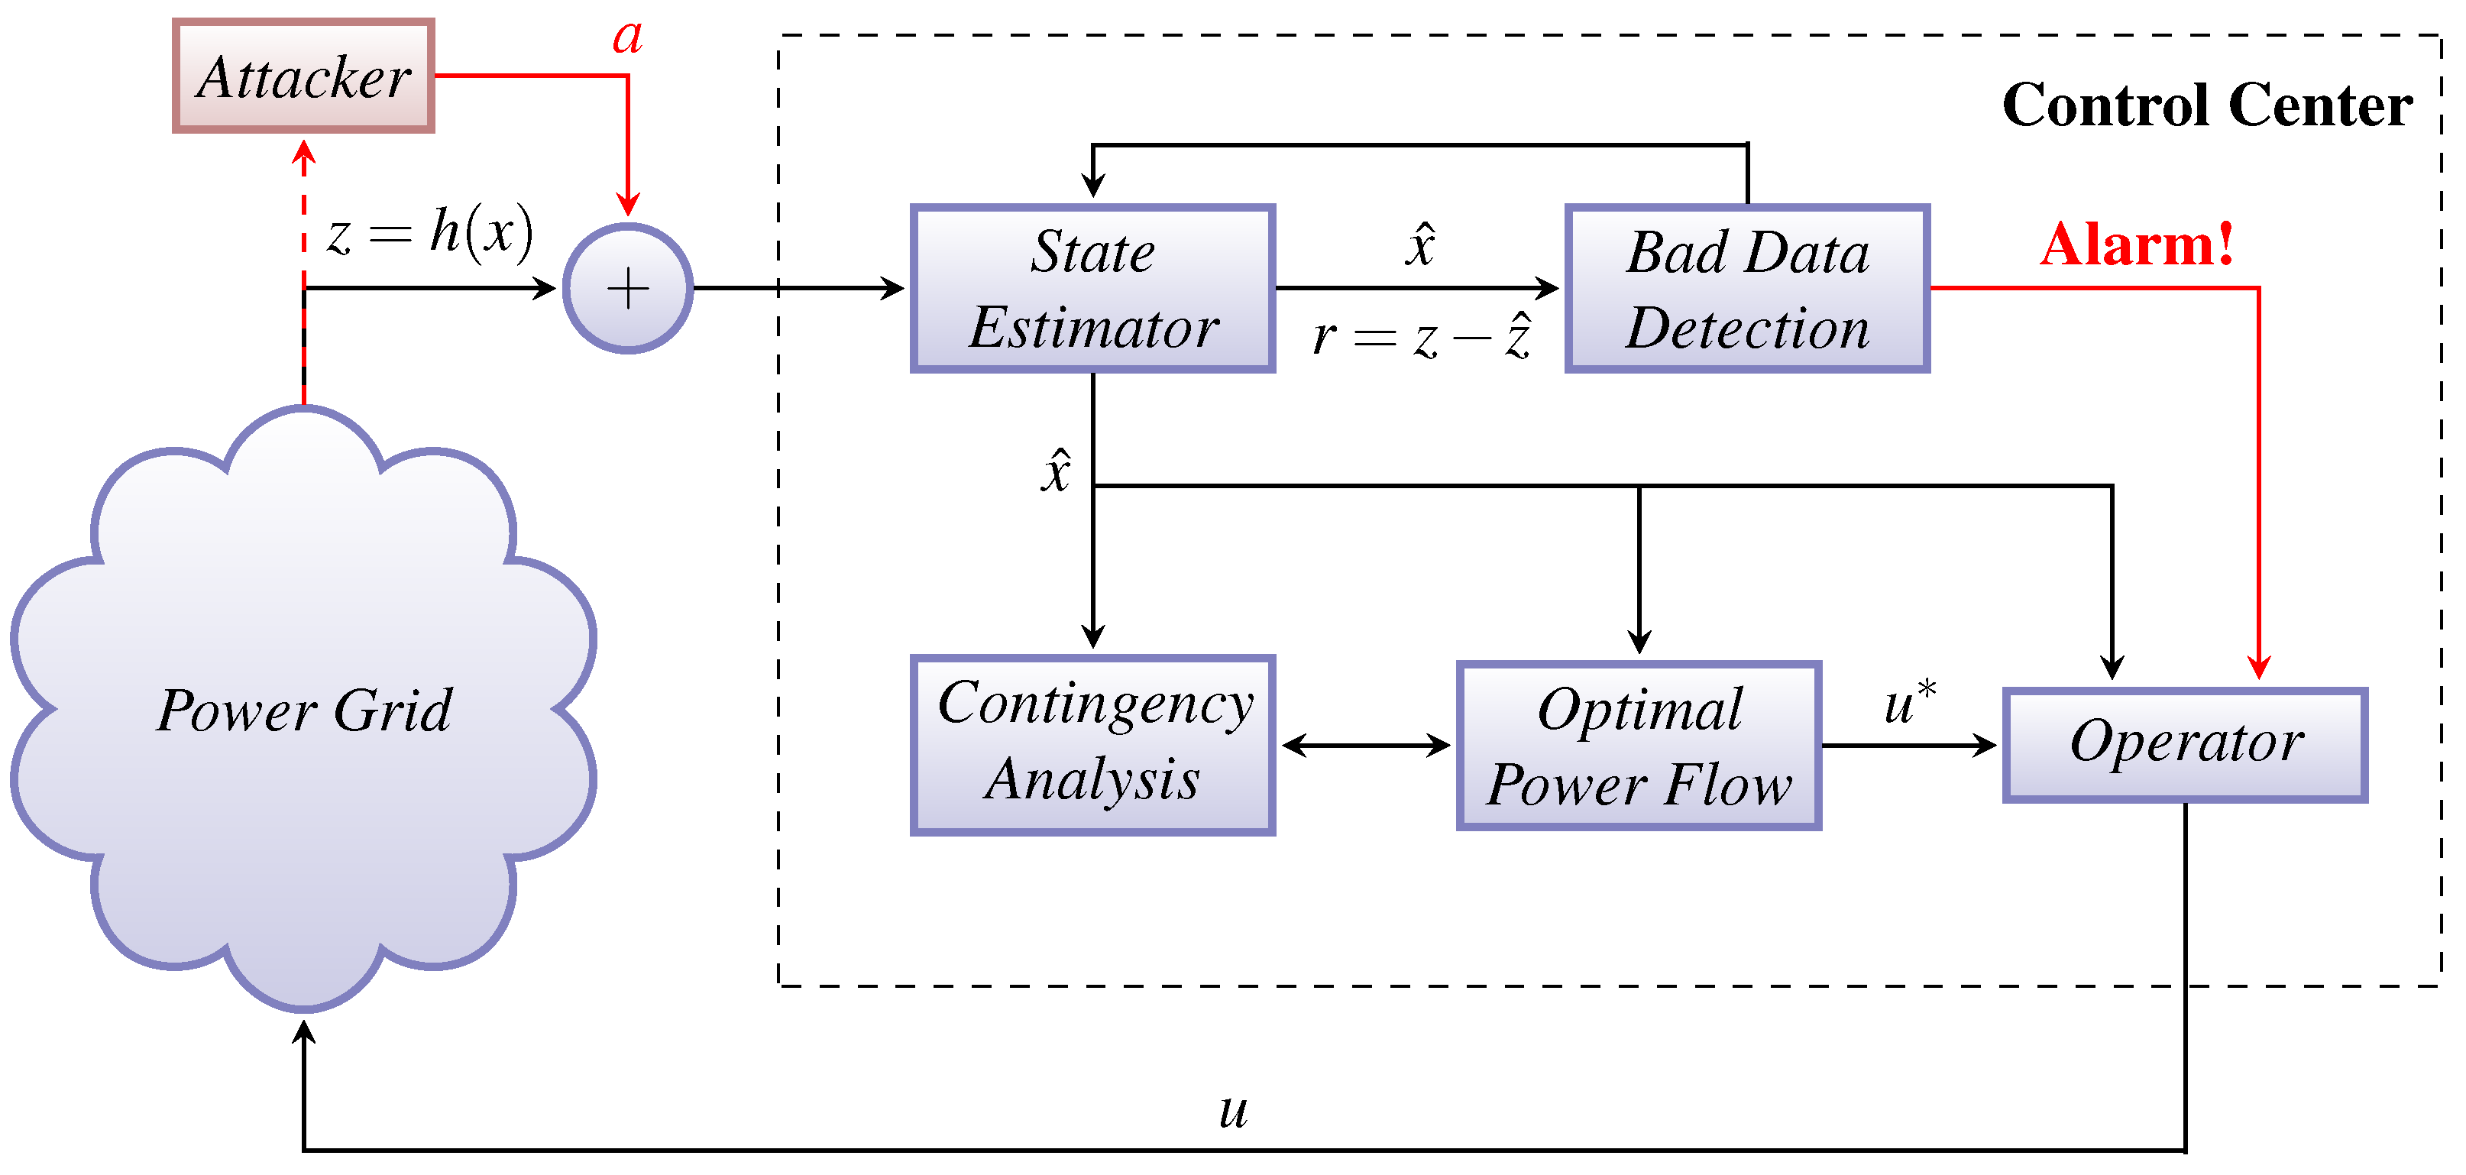


Cyber Security of State Estimator in Power Networks
State Estimator: estimates the state and unmeasured variables
Bad Data Detector: detects and removes corrupted measurements
Can data attacks affect the SE without being detected?
Yes! [Liu et al, 2009]

Slide 5
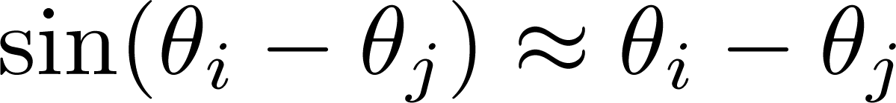
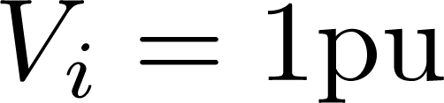
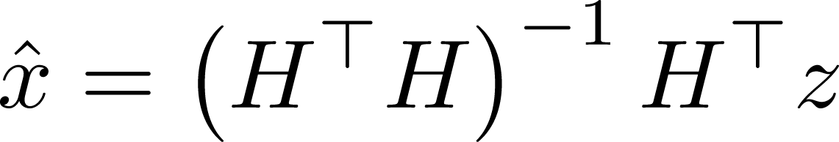
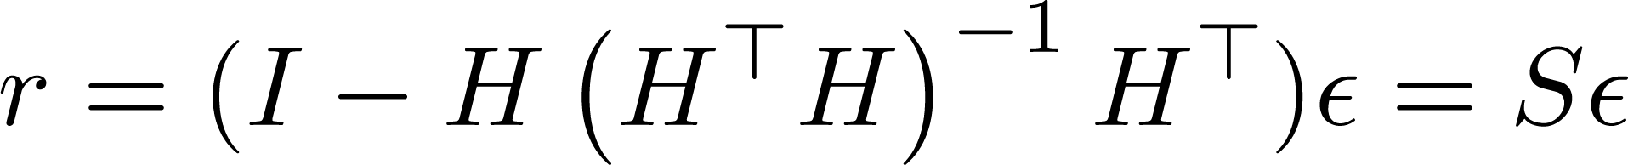
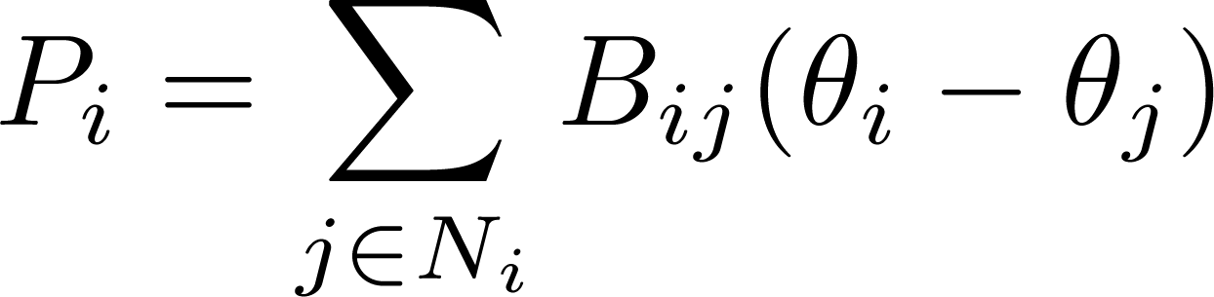
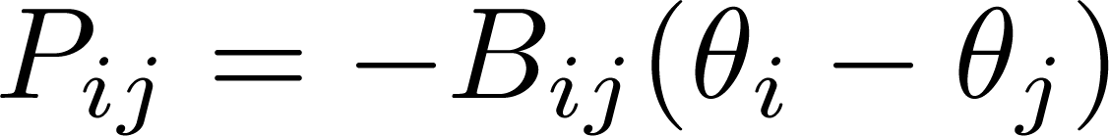
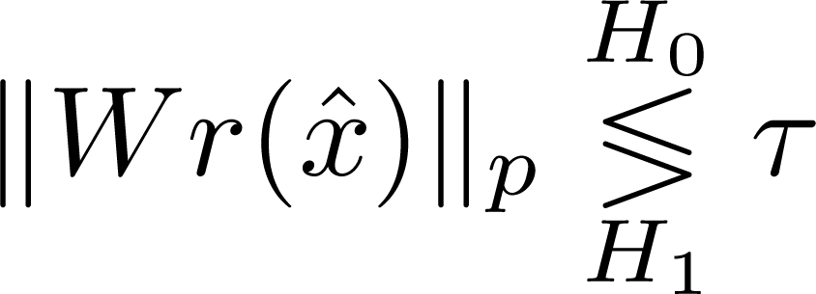
DC Network Model
Simplifications:
No resistances or shunt elements
Measurement model:
Linear Least Squares Estimator:
Measurement residual:
Bad Data Detector:
Only active power:
Similar to a DC resistive network

Slide 6
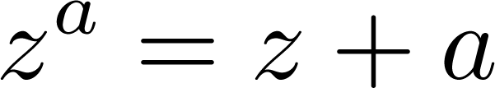



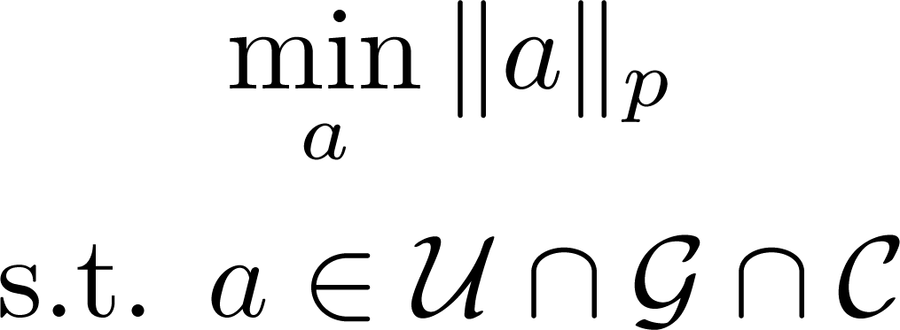
Attacker Model
Corrupted measurements:
Attacker’s objectives:
Attack is stealthy (undetectable)
Target measurements are corrupted
Least-effort attacks are more likely
Larger effort increased security
: set of stealthy attacks
: set of goals
: set of constraints
and are scenario specific
Minimum effort attacks:

Slide 7
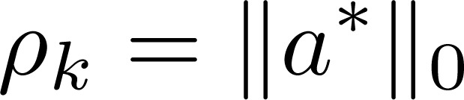
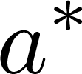
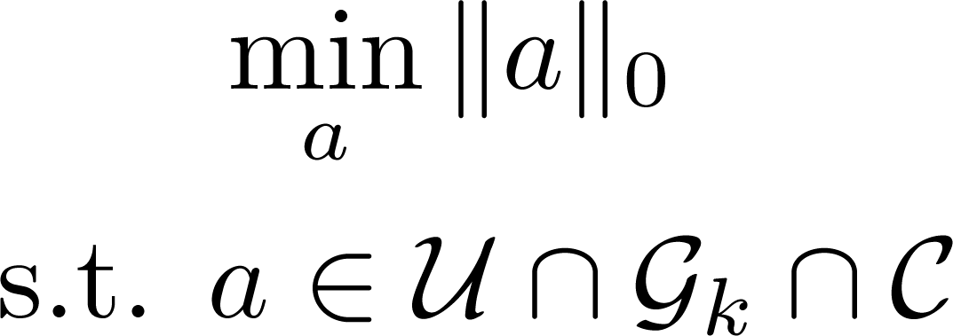
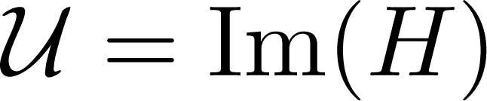

Security Metric for Stealthy Attacks
is the security metric for the k-th measurement
is the optimal solution of
Minimum number of attacked measurements so that
Attack is stealthy
Measurement is corrupted
[Sandberg et al, 2010]
[Sou et al, 2011]

Slide 8
Cyber Security of Optimal Power Flow in Power Networks
How do stealthy attacks affect the power system’s operation?
Related work: [Xie et al, 2010], [Yuan et al, 2011]
Optimal Power Flow
Computes generator setpoints minimizing operation costs
Ensures operation constraints

Slide 9


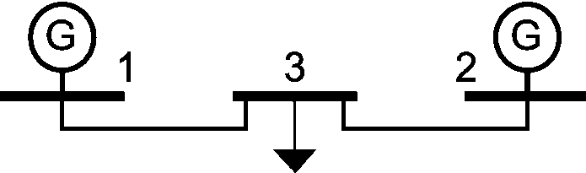
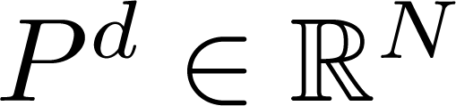
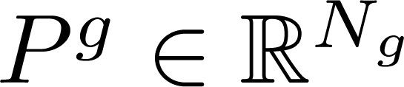
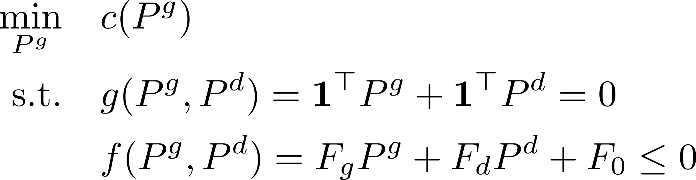

DC-Optimal Power Flow
$
$
$
$
DC-Optimal Power Flow considers the lossless DC model
power demand
power generation
Operation costs:
Generation costs
Transmission losses
Optimal power generation
However may not be measured

Slide 10
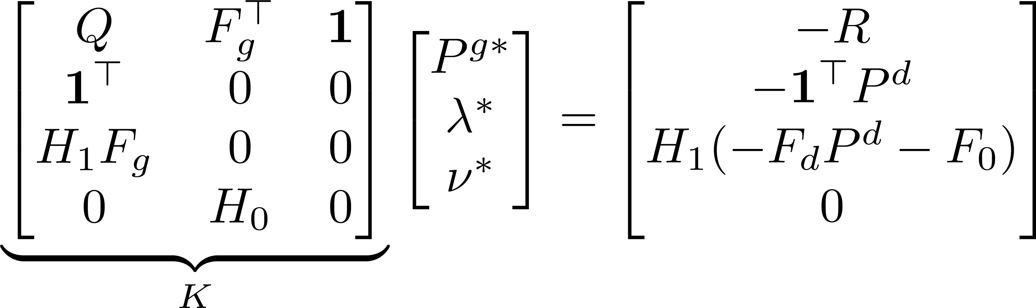
DC-Optimal Power Flow Nominal Operation
Lagrangian function:
At optimality, the KKT conditions hold:

Slide 11
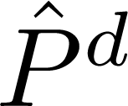
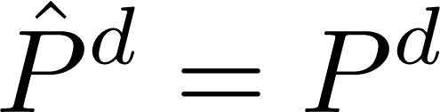
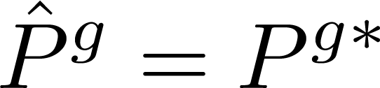
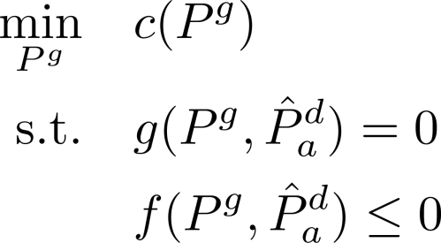
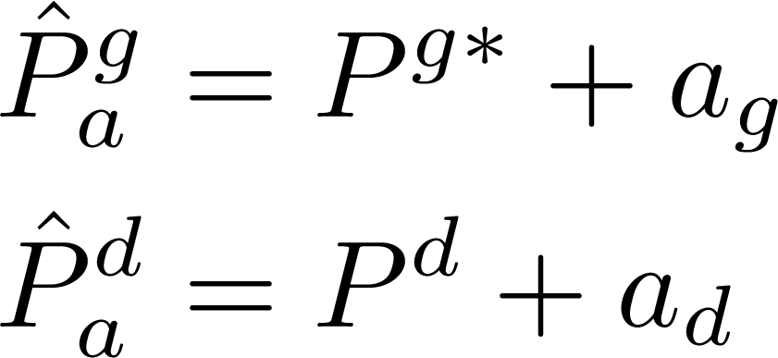
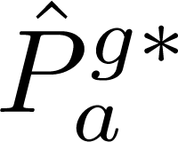
DC-Optimal Power Flow under attack
The estimate is given by the State Estimator
vulnerable to cyber attacks
Suppose the system is in optimality with and
Operation under Data Attacks
Proposed control action
Ficticious operating conditions
When would an operator apply the proposed control action?
What would be the resulting operating cost?

Slide 12
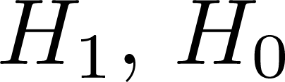
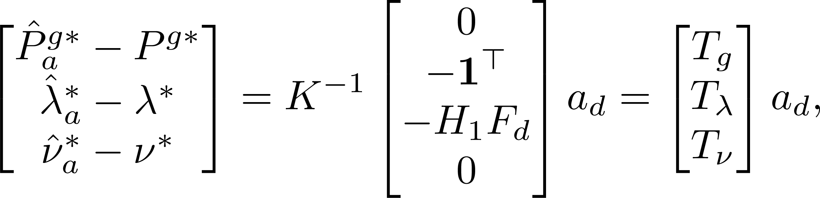

DC-Optimal Power Flow under attack
Assume the attack does not change the active constraints
thus are known
The proposed control action is given by
is an affine map w.r.t

Slide 13
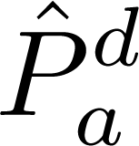
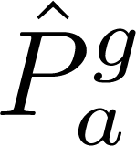


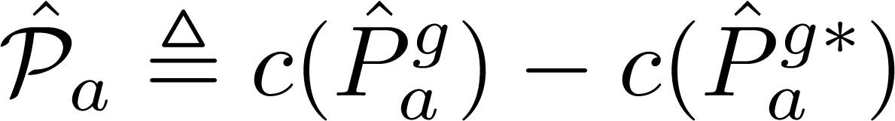
Estimated Re-Dispatch Profit
Proposed control action
Ficticious operating conditions
Consider the corrupted estimates and
: estimated operation cost
: estimated optimal operation cost given
: estimated re-dispatch profit
Large estimated profit may lead the operator to apply

Slide 14
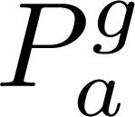
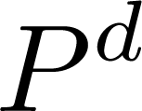
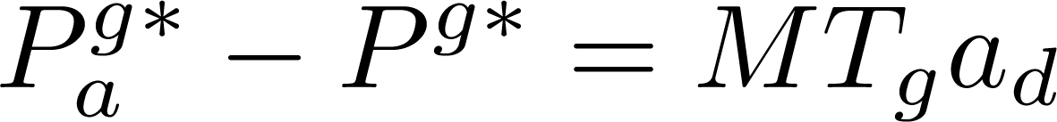

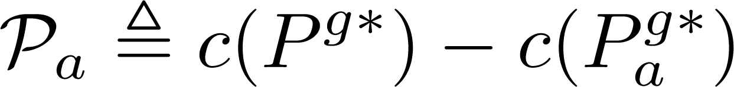

True Re-Dispatch Profit
Slack
generators
Proposed control action
True generation profile
Mismatches between and are compensated by slack generators
can be modeled as an affine map w.r.t :
: true operation cost after re-dispatch
: true re-dispatch profit
Large means more ”dangerous” attacks (larger impact)

Slide 15
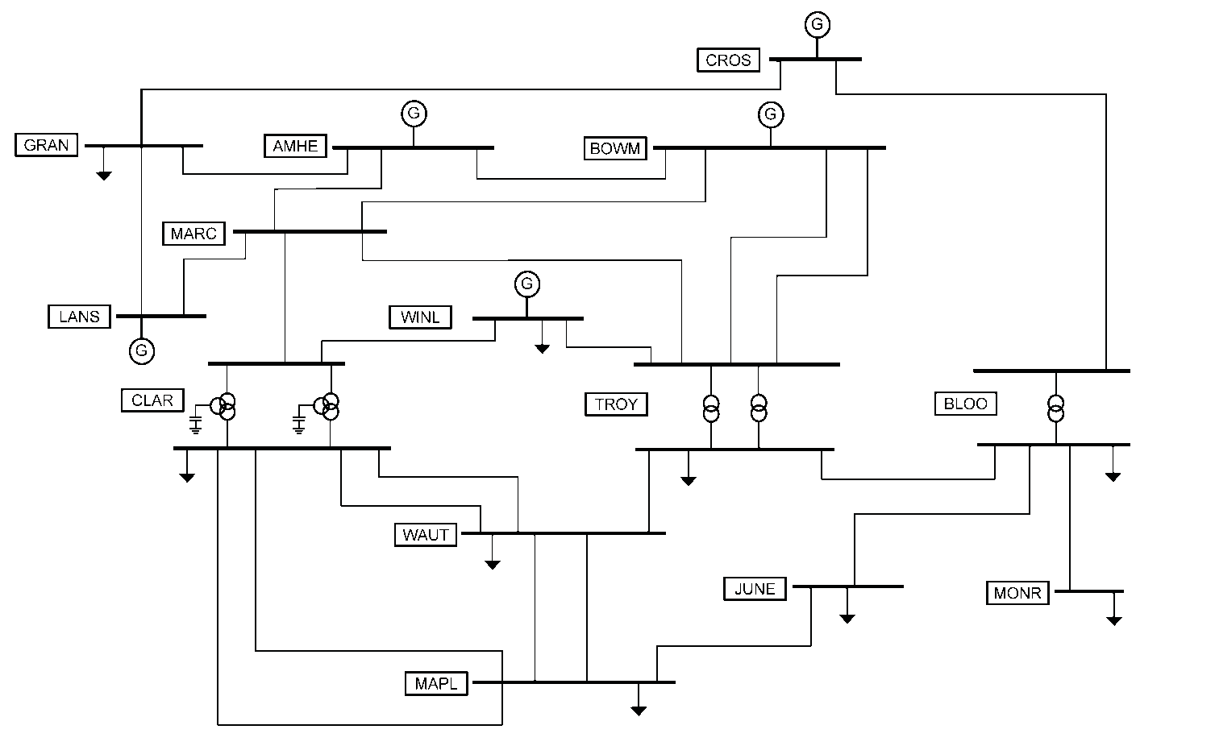

VIKING Benchmark: Impact of Data Attacks
Cost function corresponds to the total resistive losses
Sparse attacks are computed from the previous security metric
is computed for each sparse attack

Slide 16
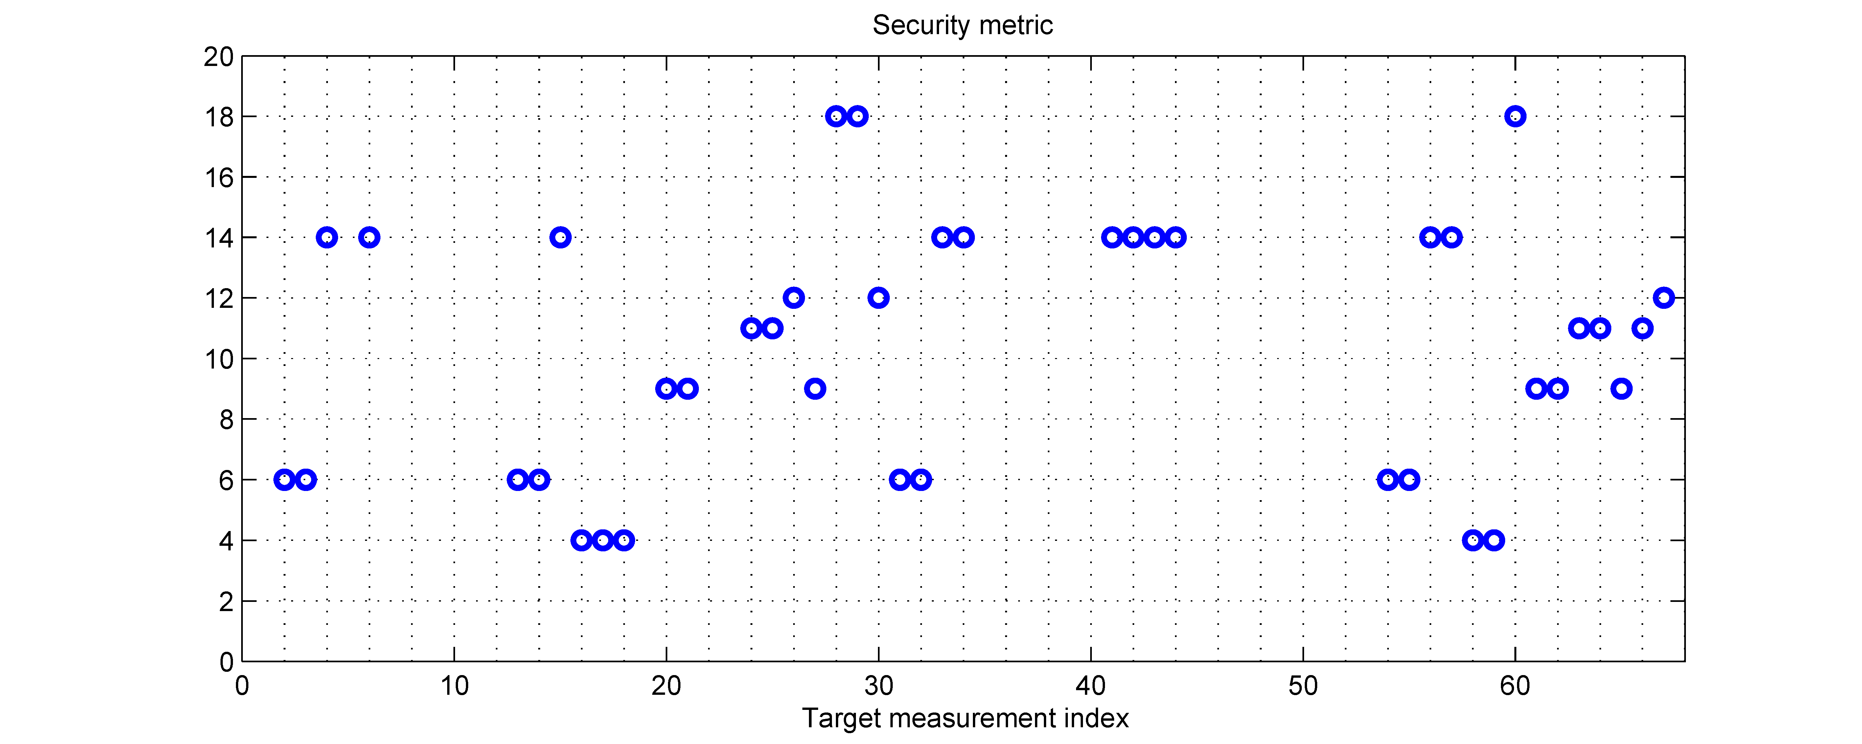


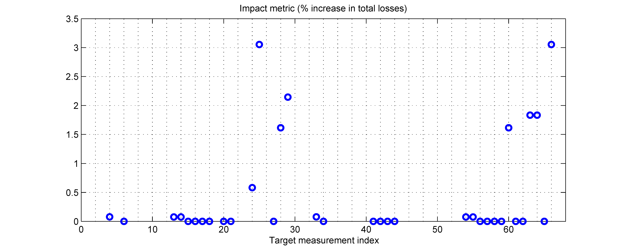
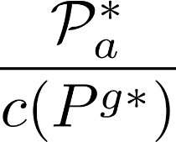

VIKING Benchmark: Impact of Data Attacks
Security metric
Are all the sparse attacks equally dangerous?
Target measurement index
Impact of Data Attacks
Most sparse attacks have low impact on operation cost
Target measurement index

Slide 17
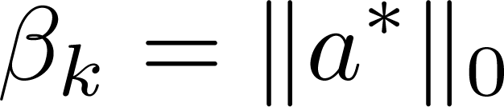
Impact-Aware Security Metric
is the impact-aware security metric for the k-th measurement
is the optimal solution of
Similar to the previous security metric
Sensitive to the choice of parameters

Slide 18
Summary
The effects of data attacks on the DC-OPF were analyzed and analytically characterized
The estimated and true profit were introduced
A novel impact-aware security metric was proposed
Thank you
Questions?

Slide 19
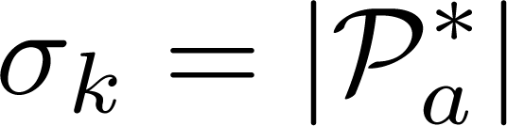

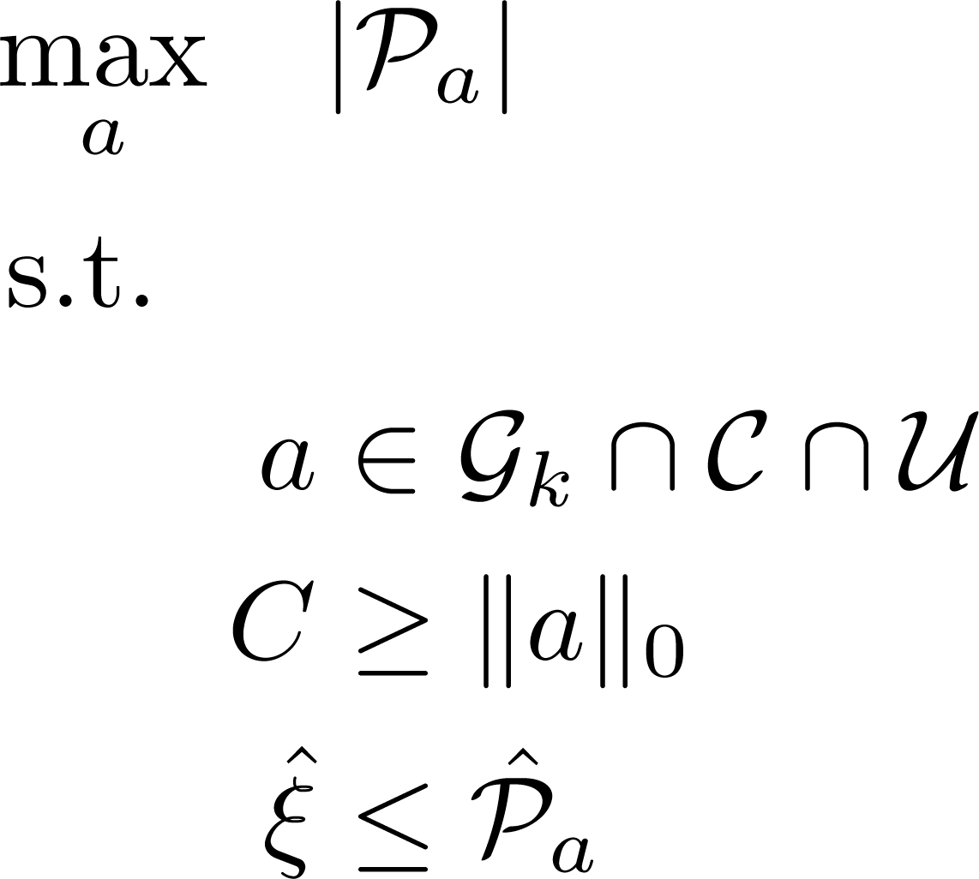
Impact-Aware Security Metric
is the impact-aware security metric for the k-th measurement (cf. )
is the optimal solution of
Maximum impact to the network operation cost so that
Attacks are stealthy with a given sparsity
Measurement is corrupted

