Slide 1




Revealing Stealthy Attacks in Control Systems
André Teixeira, Iman Shames, Henrik Sandberg, Karl H. Johansson
ACCESS Linnaeus Centre, KTH Royal Institute of Technology
50th Annual Allerton Conference, UIUC, IL, USA
October 4th 2012

Slide 2
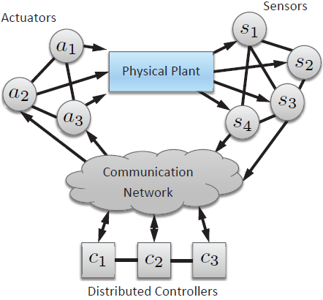
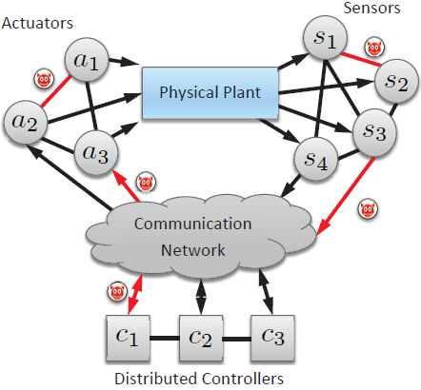
Motivation
Networked control systems are to a growing extent based on COTS
Leads to increasing vulnerability to cyber-threats with many potential points of attacks
Need for tools and strategies to understand and mitigate attacks in networked control systems
Related work: Basar, Sastry, Amin, Sinopoli, Bullo, Sundaram

Slide 3
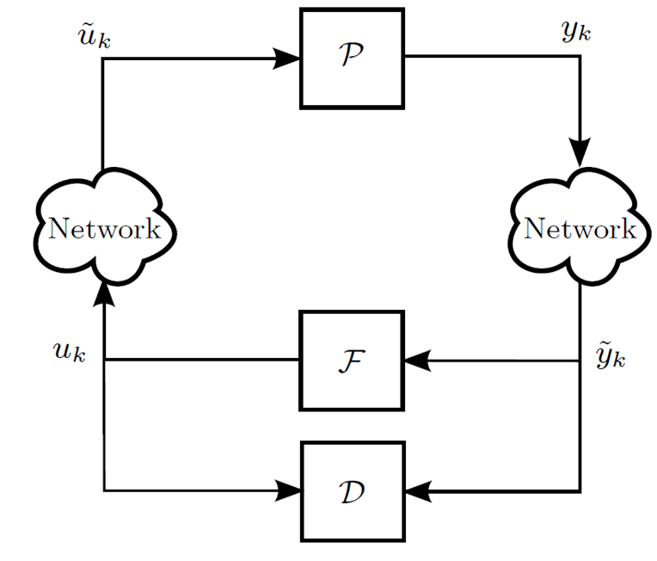
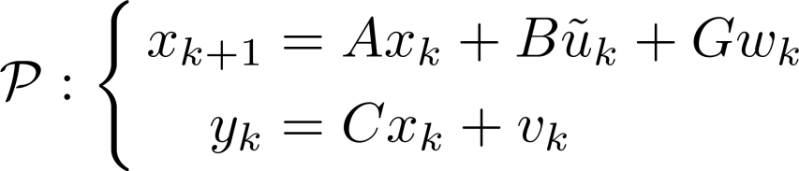
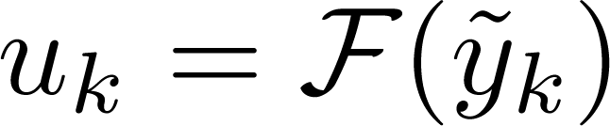

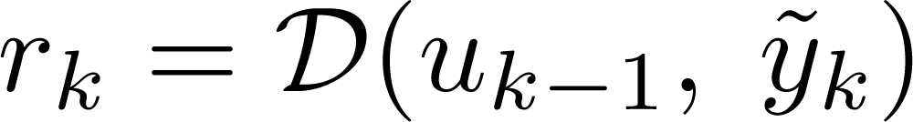

Networked Control System
[T, HiCoNS’12]
Physical Plant
LTI Feedback Controller
LTI Anomaly Detector
Alarm
Alarm triggered if

Slide 4
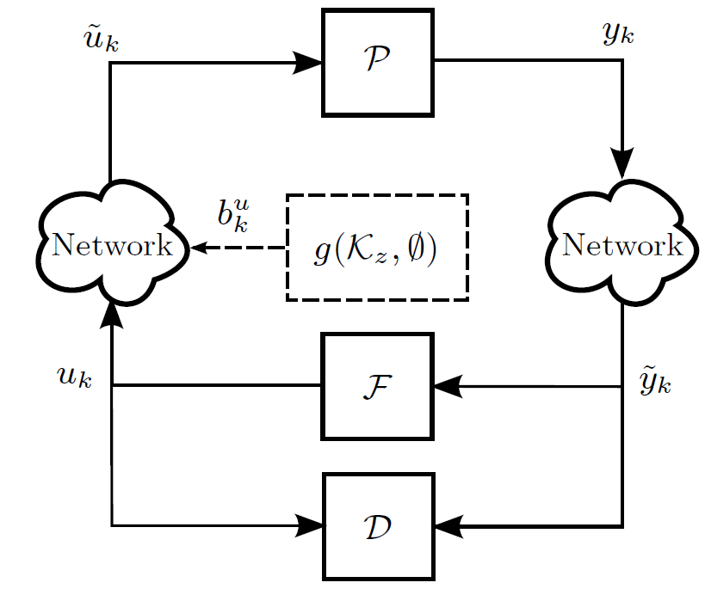
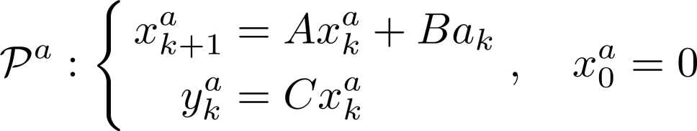


Zero-Dynamics Attack Model
[T, HiCoNS’12]
Physical Plant under attack
Attack policy
Computed using
Open-loop policy
Attack Goals and Constraints
Reach an unsafe state
Remain stealthy
Alarm

Slide 5
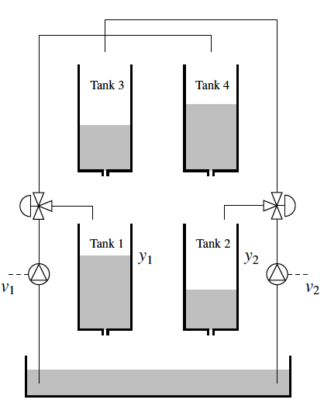
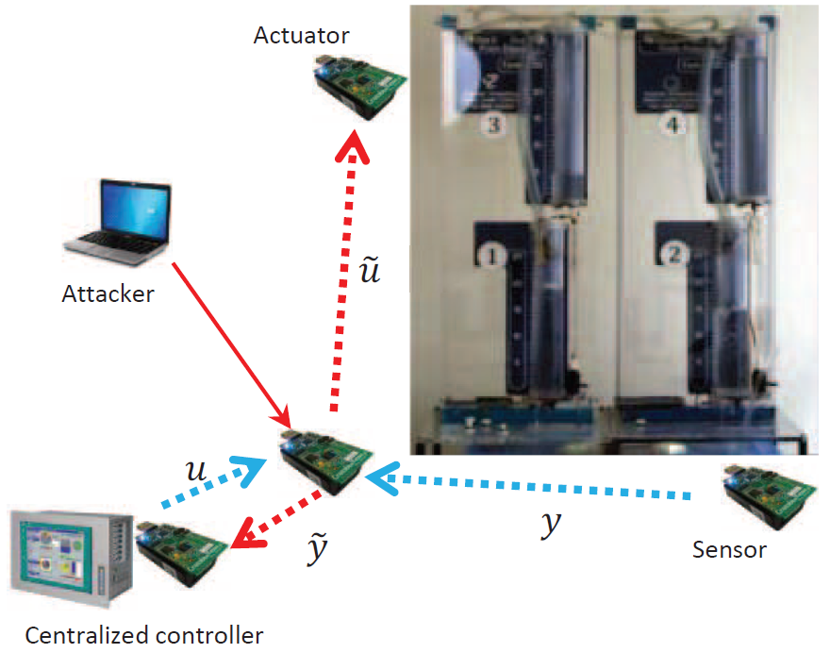
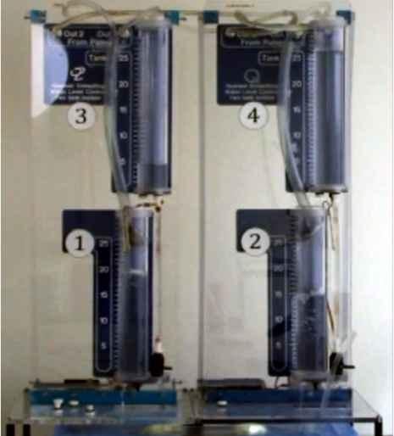

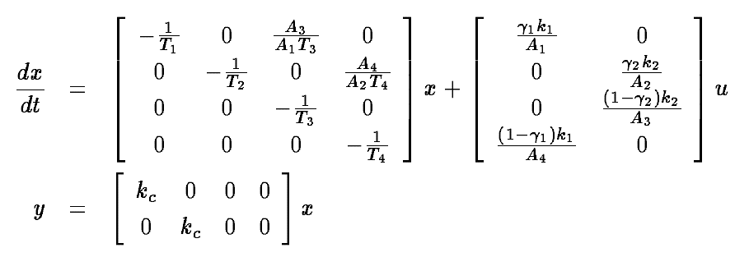
Testbed for Networked Control System Security
[T, HiCoNS’12]
Quadruple-tank process has an unstable zero if
[J, 2000]
Notes:
Mention why unstable zero is interesting

Slide 6
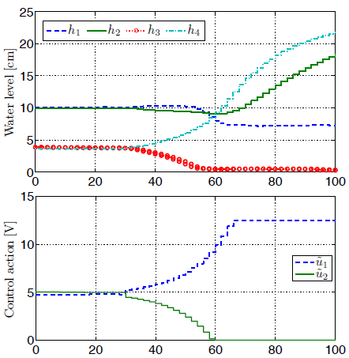
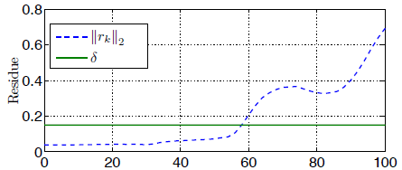
Experimental Result
Attack Goal: Empty tank 3
Zero-dynamics attack on both actuators
Tank 3 becomes empty
The attack is detected
[T, HiCoNS’12]
Notes:
Mention the interpretation of zero-dynamics
Related unstable zero to the exponential growing input

Slide 7
Experimental Result – Why?
Smooth increase
What causes it?
Does it compromise the attack’s stealthiness?
Abrupt increase
How can it be induced so that attacks are revealed?
Notes:
Mention it is an experimental result;
Briefly state the main conclusions (initial conditions and model change);

Slide 8
Outline
Revisit zero-dynamics
Output behavior with initial condition mismatch
Revealing zero-dynamics attacks

Slide 9
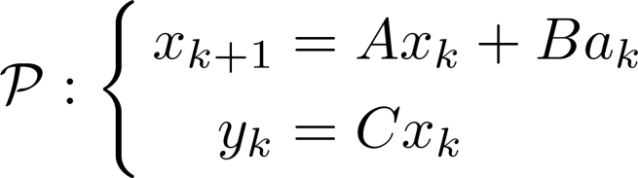


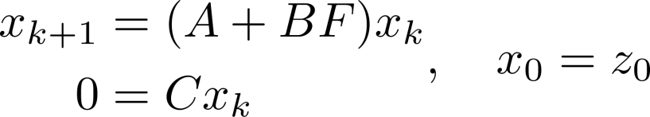
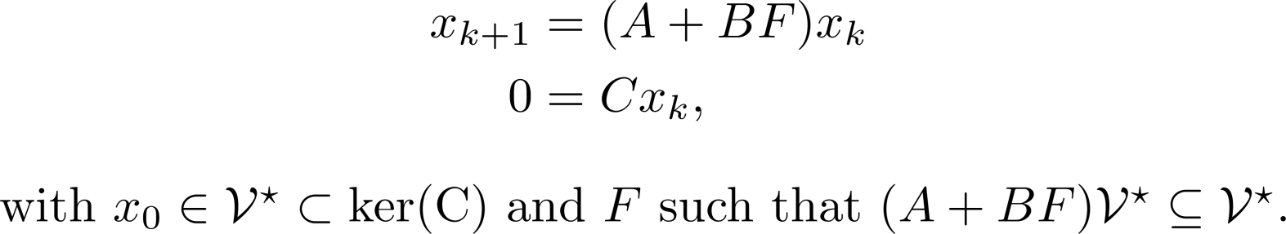
Zero-Dynamics
Physical plant
Output-zeroing problem:
Find and such that
Zero-Dynamics

Slide 10
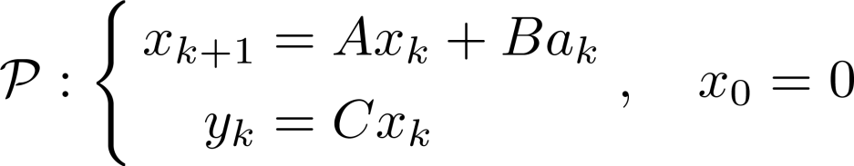
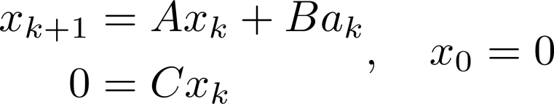
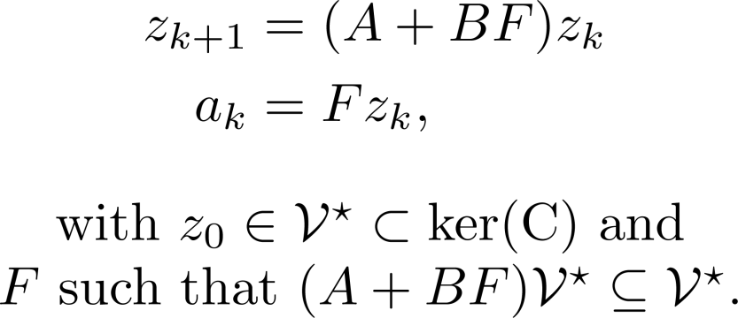
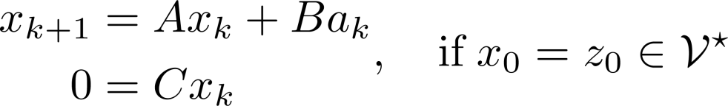

Zero-Dynamics Attack
Physical plant under attack
0-Stealthy attacks
Zero-dynamics attack policy
What happens when ?
Notes:
Say how the system can be decomposed in “attacked” and non-attacked components…

Slide 11
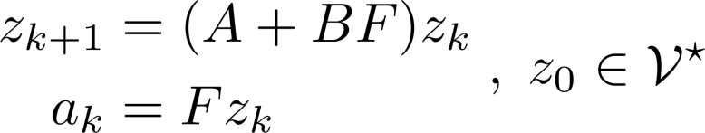
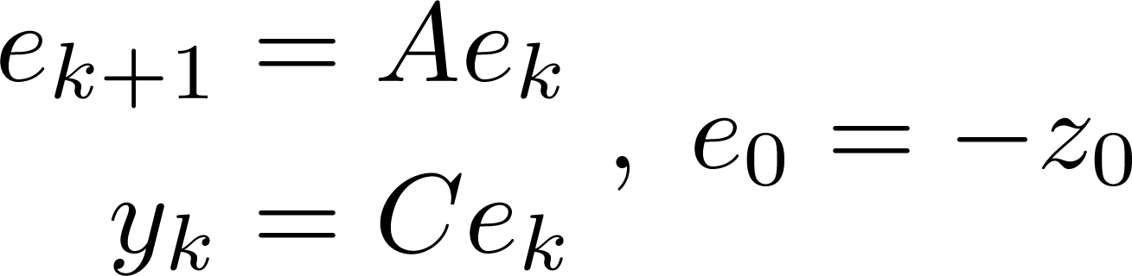



Initial Condition Mismatch
Theorem 1. The output produced by the zero dynamics attack
is described by
Attack is not 0-stealthy if belongs to the observable subspace of
If is stable:
the resulting output energy is finite;
the output can be made arbitrarily small by scaling down the initial condition
Notes:
Mention that it also applies to a stable closed-loop

Slide 12



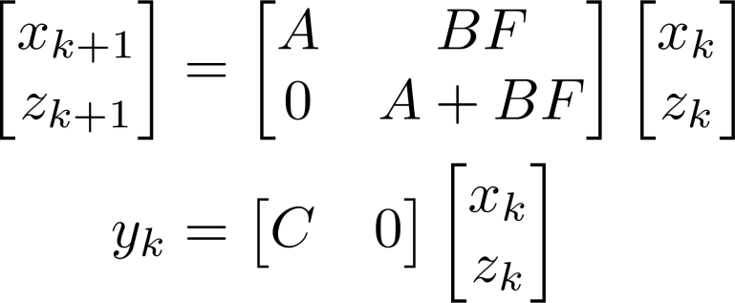
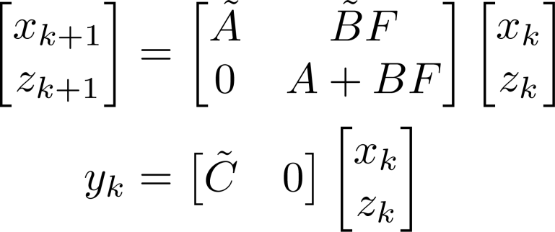

Revealing Zero-Dynamics Attacks
Definition: A zero-dynamics attack is revealed if
Proposed approach:
change the system dynamics from to
Zero-dynamics attacks are stealthy with respect to the system
for all
Every zero-dynamics attack is revealed if the system
is observable for all

Slide 13



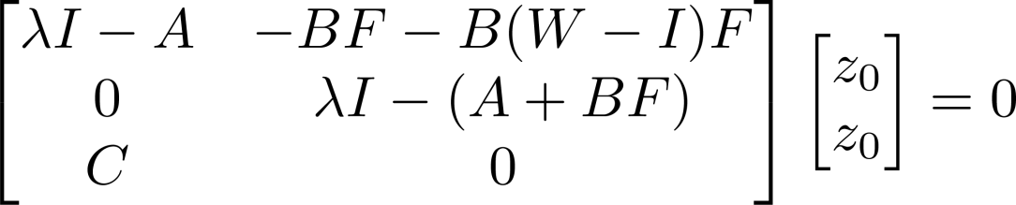





Modifying the input matrix B (1)
Consider
Observation: attacks remain stealthy w.r.t to if and only if the unobservable trajectories are not perturbed
Proof sketch: Check the conditions for which is unobservable i.e.,
, where
Revealing attacks: Choose such that
Theorem 2. All the zero-dynamics attacks associated with a given
remain stealthy with respect to if and only if

Slide 14



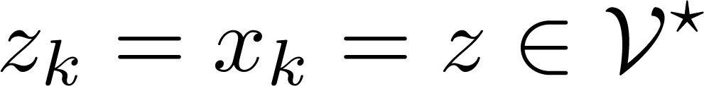

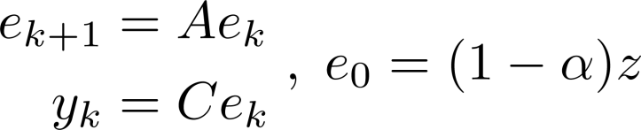

Modifying the input matrix B (2)
Simply changing to affects the system performance under no attack
Coordinated input scaling:
Similar to encryption
Theorem 3. Let and apply at time . The output trajectory is described by
Revealing attack: choose such that is “large” enough.
Does not affect the system dynamics

Slide 15

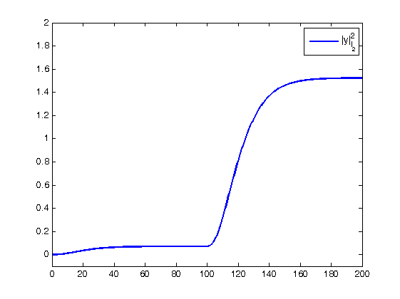



Example – modifying B
Solution to reveal attacks: input scaling
Example: choose
Attack begins at
Initial condition mismatch
Input scaling applied at
the attack is revealed
Stable results in finite output energy

Slide 16
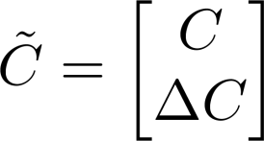







Modifying the output matrix C
Consider
Observation: attacks remain stealthy w.r.t to if and only if
and share common unobservable trajectories
Revealing attacks: add measurements so that becomes empty
system dynamics are not affected
Requires at most new measurements
Theorem 4. There exists a generating a stealthy attack to if and only if there exists a non-empty -invariant subspace that is contained in

Slide 17
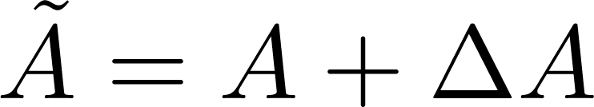

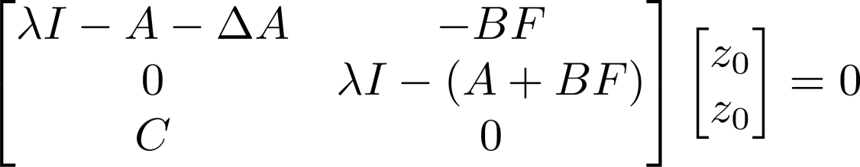





Modifying the system matrix A
Consider
Observation: attacks remain stealthy w.r.t to if and only if the unobservable trajectories are not perturbed (similar to )
Proof sketch: Check the conditions for which is unobservable i.e.,
, where
Revealing attacks: choose such that
Affects the system dynamics and may also require re-designing the controller
Theorem 5. All the zero-dynamics attacks associated with a given
remain stealthy with respect to if and only if

Slide 18
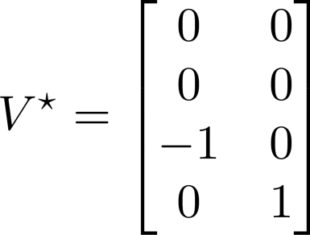

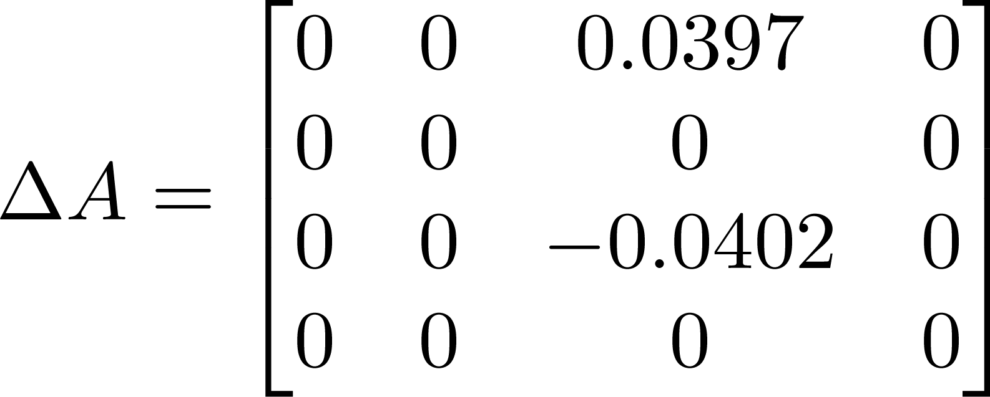
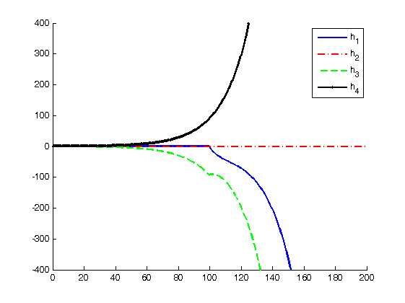
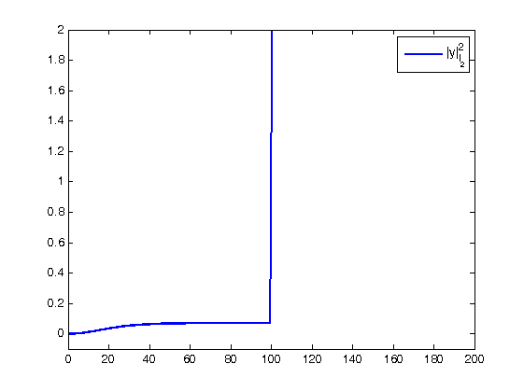
Example – modifying A
Solution to reveal attacks: such that
Example: connect tank 3 to tank 1:
Notes:
Comment on the initial condition effect.
Say that the attack starts at k=0.

Slide 19
Summary
Zero-dynamics attacks are robust to initial condition mismatch
Proposed methods to reveal attacks by
Changing C: Adding measurements
Changing A: Modifying the open-loop dynamics
Changing B: Cooperatively scaling the input signals
Adding measurements and scaling input signals does not affect the system performance

Slide 20
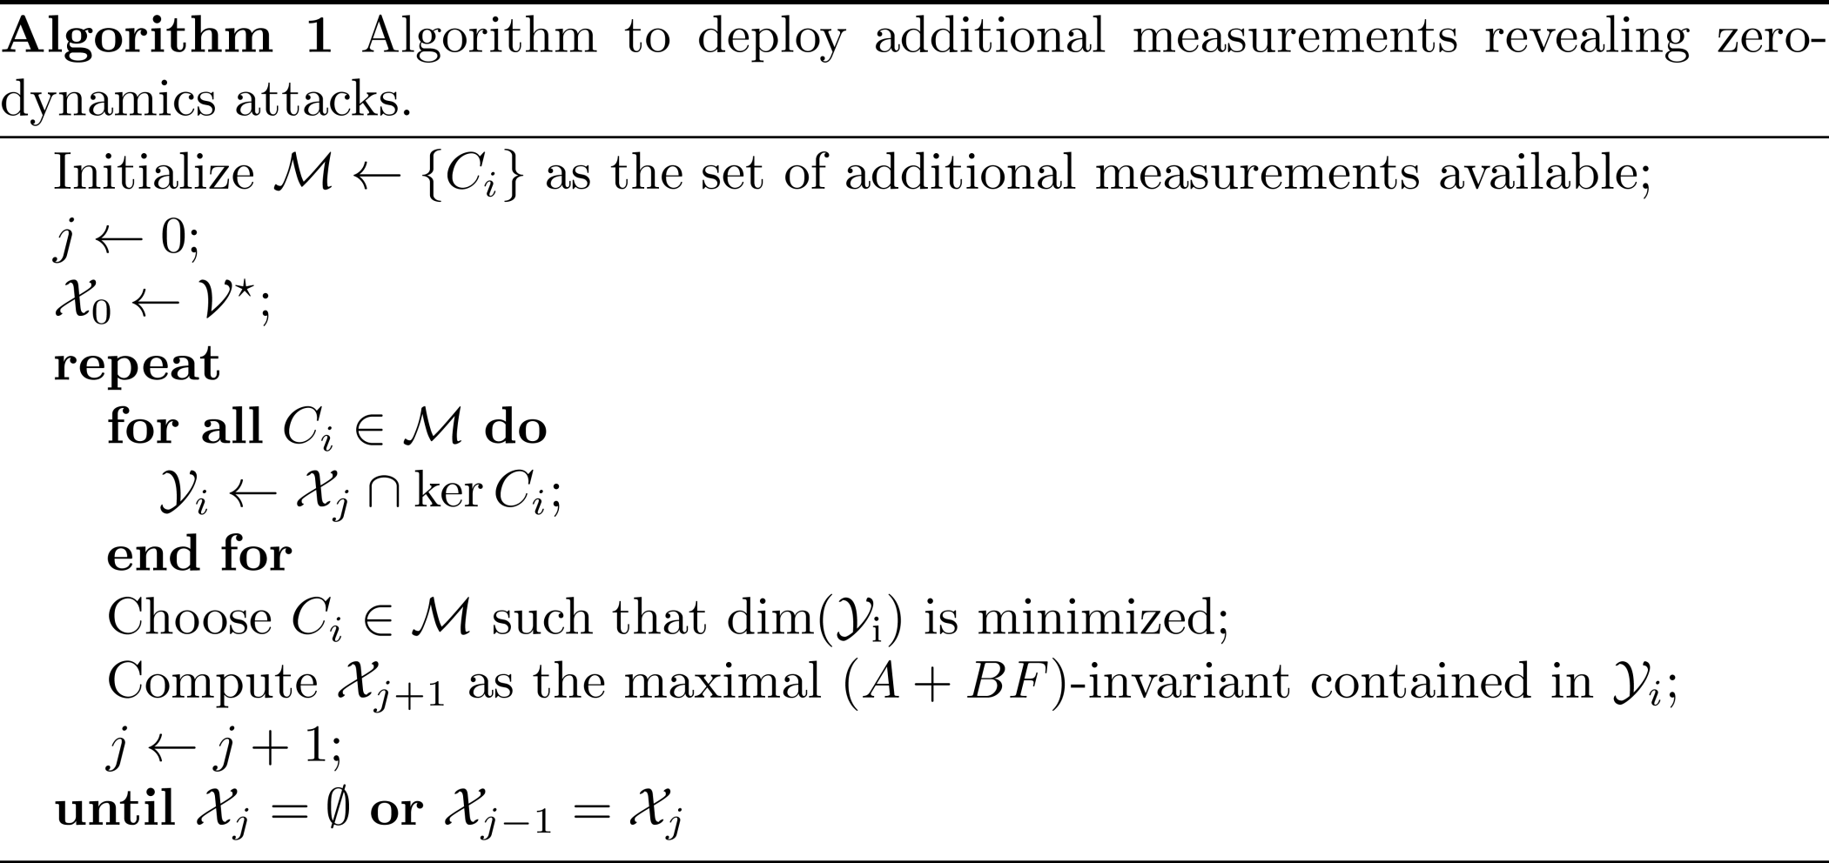
Modifying the output matrix C

Slide 21




Zero-Dynamics
Physical plant
Geometric Control framework
Controlled Invariant Subspace
Controlled Invariant Subspace contained in
Admits a maximum
Output-zeroing problem:
Find and such that
Zero-Dynamics

Slide 22
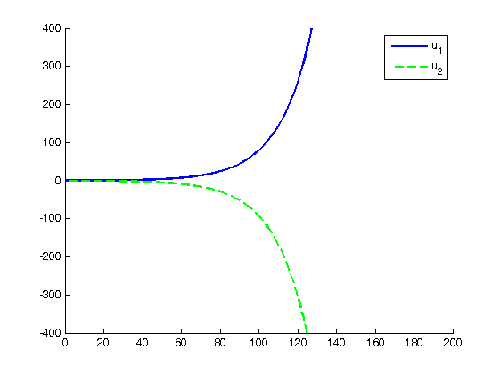
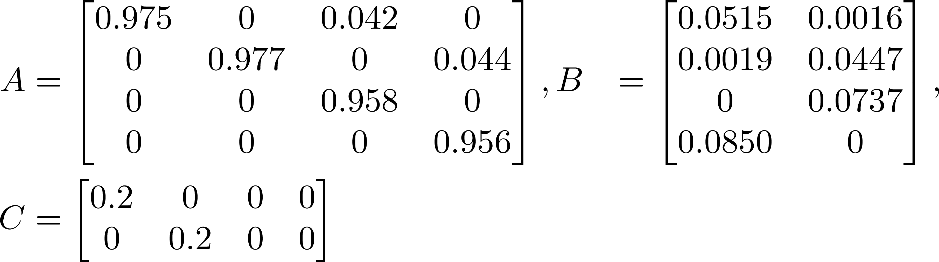
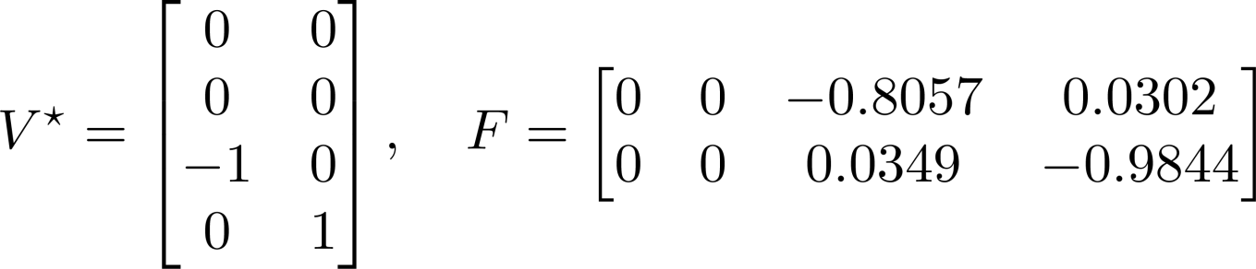
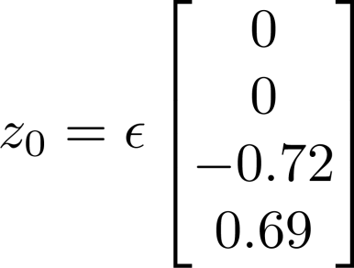
Example - QTP
Linearized and discretized model:
Zero-dynamics parameterized by
Unstable zero-dynamics excited at by
Notes:
Refer back to the example

