Slide 1


Typed Lua: An Optional Type System for Lua
Dyla 2014
André Murbach Maidl
Fabio Mascarenhas
Roberto Ierusalimschy

Slide 2
Dynamic typing versus Static typing
Dynamically typed languages
  (+) Allow quick development
  (+) Make code change easier
  (–) May hide bugs
Statically typed languages
  (+) Detect many bugs
  (+) Allow better program structure
  (–) Tie programmers to type abstractions

Slide 3
Typed Lua
An optional type system for Lua
  Allows static and dynamic typing in the same code
  Provides optional type annotations
  Uses local type inference
  Executes compile-time type checking
  Generates Lua code
  Does not influence run-time semantics because run-time checks are costly
  It is sound by design

Slide 4
Typed Lua
Complex enough to preserve some Lua idioms
New constructs to help structure Lua programs
  Interfaces
  Modules
  Classes
New keywords are not reserved words

Slide 5
Design a static type system for Lua is a challenge
Lua is a small scripting language
  First-class functions, tables, metatables, etc
The primary use of Lua is as an embedded PL
  Mechanisms versus policies
  Lua ecosystem versus different ideas
How programmers structure Lua programs?

Slide 6
We needed a guidance for designing Typed Lua
The semantics of Lua
A mostly automated survey of Lua idioms
  We run it using the LuaRocks repository
Both guide the design of Typed Lua

Slide 7
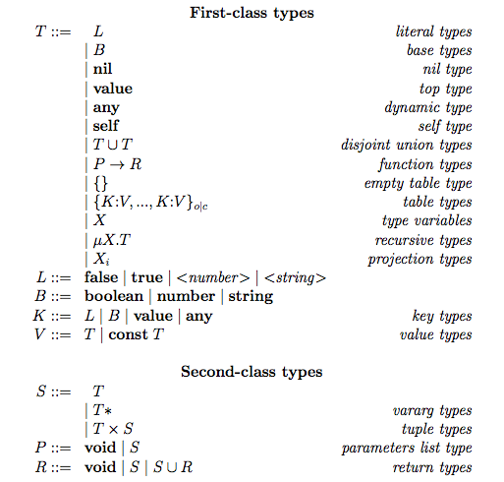
Abstract syntax of Typed Lua types

Slide 8
Type system
Structural type system
Types are ordered through subtyping
Dynamic typing through consistent-subtyping

Slide 9
Atomic types
1 local function fact (n:number):number
2 if n == 0 then
3 return 1
4 else
5 return n * fact(n - 1)
6 end
7 end
8 local x = 5
9 –- x : number
10 print(fact(x)) –- 120

Slide 10
The dynamic type
1 local function abs (n:number):number
2 if n < 0 then
3 return -n
4 else
5 return n
6 end
7 end
8 local function dist (x, y)
9 –- x : any – y : any : any ~ number
10 return abs(x – y)
11 end

Slide 11
Functions
1 local function multiple ()
2 return 2, “foo”
3 end
4 –- multiple : (value*) ->
5 -- (number, string, nil*)
6 local function sum (x:number, y:number)
7 return x + y
8 end
9 –- sum : (number, number, value*) ->
10 –- (number, nil*)
11 local x, y, z = multiple(), multiple()
12 –- x, y, z : number x number x string x nil*
13 print(sum(multiple(), multiple())) –- 4

Slide 12
Union types and optional values
1 local function message (name:string,
2 greeting:string?)
3 local greeting = greeting or “Hello”
4 –- greeting : string | nil or string : string
5 return greeting .. name
6 end
1 local function message (name:string,
2 greeting:string?)
3 greeting = greeting or “Hello”
4 –- greeting : string | nil or string : string
5 return greeting .. name
6 end

Slide 13
Union types and overloading on the input type
1 local function overload (s1:string,
2 s2:string|number)
3 if type(s2) == “string” then
4 –- s2 : string
5 return s1 .. s2
6 else
7 –- s2 : number
8 –- string.rep : (string, number, string?, value*) ->
9 –- (string, nil*)
10 return string.rep(s1, s2)
11 end
12 –- s2 : string | number
13 end

Slide 14
Union types and overloading on the return type
1 local function idiv (d1:number, d2:number):
2 (number, number) | (nil, string)
3 if d2 == 0 then
4 return nil, “division by zero”
5 else
6 local r = d1 % d2 –- r : number
7 local q = (d1 – r) / d2 –- q : number
8 return q, r
9 end
10 end

Slide 15
Union types and overloading on the return type
1 local q, r = idiv(n1, n2)
2 –- X : (number, number, nil*) | (nil, string, nil*)
3 –- q : X1 : number | nil
4 –- r : X2 : number | string
5 if q then
6 –- q : X1 : number
7 –- r : X2 : number
8 else
9 –- q : X1 : nil
10 –- r : X2 : string
11 end
12 –- X : (number, number, nil*) | (nil, string, nil*)

Slide 16
Thank you!
Questions?
For more information:
  https://github.com/andremm/typedlua
  amaidl@inf.puc-rio.br

