Slide 1


Typed Lua: An Optional Type System for Lua
Lua Workshop 2014
André Murbach Maidl
LabLua, PUC-Rio

Slide 2
Dynamic typing versus Static typing
Dynamically typed languages
  (+) Allow quick development
  (+) Make code change easier
  (–) May hide bugs
Statically typed languages
  (+) Detect many bugs
  (+) Allow better program structure
  (–) Tie programmers to type abstractions
02/27

Slide 3
Who never got a stack traceback?
lua: ./typedlua/tltype.lua:335:
attempt to index local 't' (a number value)
stack traceback:
./typedlua/tltype.lua:335: in function 'isUnionlist'
./typedlua/tltype.lua:751: in function
<./typedlua/tltype.lua:741>
(...tail calls...)
./typedlua/tlchecker.lua:491: in function 'check_return_type'
./typedlua/tlchecker.lua:531: in function 'check_function'
./typedlua/tlchecker.lua:1238: in function 'check_exp'
./typedlua/tlchecker.lua:483: in function 'check_explist'
./typedlua/tlchecker.lua:890: in function 'check_assignment'
./typedlua/tlchecker.lua:1263: in function 'check_stm'
./typedlua/tlchecker.lua:1331: in function 'typecheck'
./tlc:119: in main chunk
[C]: in ?
03/27

Slide 4



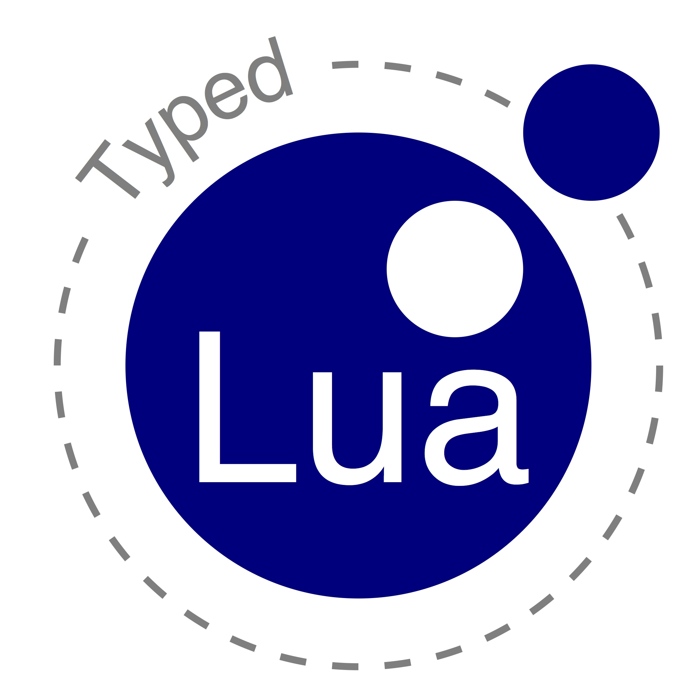

Why not combine both?
04/27

Slide 5
Typed Lua
An optional type system for Lua
  Allows static and dynamic typing in the same code
  Provides optional type annotations
  Uses local type inference
  Removes the type annotations
  Does not influence run-time semantics
  Unannotated Typed Lua code is Lua code
  Aims to be sound
  Rich enough to preserve some Lua idioms
05/27

Slide 6
Typing Lua is challenging
Lua is a small scripting language
  First-class functions, extensive use of associative arrays, dynamic overloading, etc
The primary use of Lua is as an embedded PL
  DIY module systems
  DIY object models
06/27

Slide 7
We needed guidance on the design
We surveyed 2598 files from 262 different projects that are on the LuaRocks repository
  Table initialization, indexing, and iteration
  Function declarations
  Dynamic overloading
  Object-Oriented programming
  Module definitions
07/27

Slide 8
Optional type annotations
type ← primarytype ['?']
primarytype ← literaltype | basetype
| nil | value | any | self | Name
| primarytype '|' primarytype
| functiontype
| tabletype
literaltype ← false | true | Number | String
basetype ← boolean | number | string
functiontype ← tupletype '->' rettype
tupletype ← '(' [typelist] ')'
typelist ← type { ',' type } ['*']
rettype ← type | unionlist ['?']
unionlist ← tupletype | unionlist '|' unionlist
tabletype ← '{' [tabletypebody] '}'
tabletypebody ← [keytype ':'] type | recordtype
recordtype ← recordfield { ',' recordfield } [',' type]
recordfield ← [const] literaltype ':' type
keytype ← basetype | value | any
08/27

Slide 9
A simple example
1 local function abs (n:number):number
2 if n < 0 then
3 return -n
4 else
5 return n
6 end
7 end
8
9 local function dist (x, y)
10 return abs(x – y)
11 end
09/27

Slide 10
A simple example
1 local function abs (n:number):number
2 if n < 0 then
3 return -n
4 else
5 return n
6 end
7 end
8
9 local function dist (x:any, y:any):number
10 return abs(x – y)
11 end
any – any : any ~ number
10/27

Slide 11
Optional parameters
1 local function message (name:string,
2 greeting:string?)
3
4 -- greeting : string | nil
5 greeting = greeting or “Hello”
6
7 -- greeting : string
8 return greeting .. name
9 end
t | nil or t : t
11/27

Slide 12
Union types on input parameters
1 local function overload (s1:string,
2 s2:string|number)
3 if type(s2) == “string” then
4 return s1 .. s2
5 else
6 return string.rep(s1, s2)
7 end
8 end
string.rep : (string, number, string?) -> (string)
string.rep : (string, number, string?, value*) ->
(string, nil*)
12/27

Slide 13
Union types on the return type
1 local q, r = idiv(a, b)
2 if q then
3 print(a == b * q + r)
4 else
5 print(“ERROR: “ .. r)
6 end
idiv : (number, number) ->
(number, number) | (nil, string)
X : (number, number) |
(nil, string)
q : X1 ≈ number | nil
r : X2 ≈ number | string
X : (number, number)
X1 ≈ number and X2 ≈ number
X : (nil, string)
X1 ≈ nil and X2 ≈ string
13/27

Slide 14
Table types as records
1 local person:{“firstname”:string,
2 “lastname”:string } =
3 { firstname = “Lou”,
4 lastname = “Reed” }
local interface Person
firstname:string
lastname:string
end
{ “firstname”:string, “lastname”:string }
14/27

Slide 15
Table types and interfaces
1 local interface Person
2 firstname:string
3 lastname:string
4 end
5
6 local function byebye (person:Person)
7 return "Goodbye " .. person.firstname ..
8 " " .. person.lastname
9 end
10
11 local user1 = { firstname = "Lou" }
12
13 local user2 = { lastname = "Reed",
14 firstname = "Lou" }
15
16 print(byebye(user1)) -- compile-time error
17 print(byebye(user2)) -- Goodbye, Lou Reed
15/27

Slide 16
Recursive types
1 local interface Element
2 info:number
3 next:Element?
4 end
5
6 local function insert (e:Element?,
7 v:number):Element
8 return { info = v, next = e }
9 end
16/27

Slide 17
Refinement of table types
1 local person = {}
2 person.firstname = “Lou”
3 person.lastname = “Reed”
1 local person = {}
2 person.firstname = “Lou”
3 person.lastname = “Reed”
1 local person = {}
2 person.firstname = “Lou”
3 person.lastname = “Reed”
1 local person = {}
2 person.firstname = “Lou”
3 person.lastname = “Reed”
person : {}
person : { “firstname” : string }
person : { “firstname” : string,
“lastname” : string }
17/27

Slide 18
Refinement of table types
1 local person = {}
2 local bogus = person
3 person.firstname = “Lou”
4 person.lastname = “Reed”
5 bogus.firstname = 1
person : {}
bogus : {}
person : { “firstname” : string }
person : { “firstname” : string,
“lastname” : string }
bogus : {}
18/27

Slide 19
Modules
1 local mymath = {}
2
3 local RADIANS_PER_DEGREE = 3.14 / 180.0
4
5 mymath.deg = function (x:number)
6 return x / RADIANS_PER_DEGREE
7 end
8
9 mymath.rad = function (x:number)
10 return x * RADIANS_PER_DEGREE
11 end
12
13 mymath.pow = function (x:number, y:number)
14 return x ^ y
15 end
16
17 return mymath
19/27

Slide 20
Modules
1 local m = require “mymath”
2 print(m.pow(2, 3)) -- 8
3 print(m.pow(2, “foo”)) -- compile-time error
m : {
“deg” : (number) -> (number),
“rad” : (number) -> (number),
“pow” : (number, number) -> (number)
}
20/27

Slide 21
Object-Oriented Programming
1 local Shape = { x = 0, y = 0 }
2
3 const function Shape:new (x:number,
4 y:number):self
5 local s = setmetatable({},
6 { __index = self })
7 s.x = x
8 s.y = y
9 return s
10 end
11
12 const function Shape:move (dx:number,
13 dy:number)
14 self.x = self.x + dx
15 self.y = self.y + dy
16 end
17
18 return Shape
21/27

Slide 22
Object-Oriented Programming
interface Shape
x, y:number
const new:(self, number, number) -> (self)
const move:(self, number, number) -> ()
end
1 local Shape = require “shape”
2 local shape1 = Shape:new(0, 5)
3 local shape2:Shape = Shape:new(10, 10)
22/27

Slide 23
Description files
1 userdata md5_context
2 __tostring : (self) -> (string)
3 clone : (self) -> (self)
4 digest : (self|string, value) -> (string)
5 new : () -> (self)
6 reset : (self) -> (self)
7 update : (self, string*) -> (self)
8 version : string
9 end
10
11 __tostring : (md5_context) -> (string)
12 clone : (md5_context) -> (md5_context)
13 digest : (md5_context|string, value) -> (string)
14 new : () -> (md5_context)
15 reset : (md5_context) -> (md5_context)
16 update : (md5_context, string*) -> (md5_context)
17 version : string
23/27

Slide 24
Description files
1 local m = require "md5"
2 local x = m.new()
3 local y = x:clone()
4 local z = m.clone("foo") -- compile-time error
5 print(x:digest() == m.digest(x))
24/27

Slide 25
Lua Standard Libraries
Could use only static types on 71%
Had to rely on the dynamic type on 29%
Could type most of its members
  string, math, bit32, io, and os
Polymorphism may help to type its members
  table
Could not type most of its members
  base, and coroutine
25/27

Slide 26
Limitations and Future Work
Polymorphic functions and tables
Operator overloading
Coroutines
Soundness proof
Lua 5.3
ZeroBrane Studio
26/27

Slide 27
Thank you!
Questions?
For more information:
  https://github.com/andremm/typedlua
  amaidl@inf.puc-rio.br
27/27

