Slide 1


Typed Lua: An Optional Type System for Lua
PhD thesis
André Murbach Maidl

Slide 2
Dynamic typing versus Static typing
Dynamically typed languages
  (+) Allow quick development
  (+) Make code change easier
  (–) May hide bugs
Statically typed languages
  (+) Detect many bugs
  (+) Allow better program structure
  (–) Force programmers to think about types

Slide 3
A stack traceback in Lua
lua: ./typedlua/tltype.lua:335:
attempt to index local 't' (a number value)
stack traceback:
./typedlua/tltype.lua:335: in function 'isUnionlist'
./typedlua/tltype.lua:751: in function
<./typedlua/tltype.lua:741>
(...tail calls...)
./typedlua/tlchecker.lua:491: in function 'check_return_type'
./typedlua/tlchecker.lua:531: in function 'check_function'
./typedlua/tlchecker.lua:1238: in function 'check_exp'
./typedlua/tlchecker.lua:483: in function 'check_explist'
./typedlua/tlchecker.lua:890: in function 'check_assignment'
./typedlua/tlchecker.lua:1263: in function 'check_stm'
./typedlua/tlchecker.lua:1331: in function 'typecheck'
./tlc:119: in main chunk
[C]: in ?

Slide 4



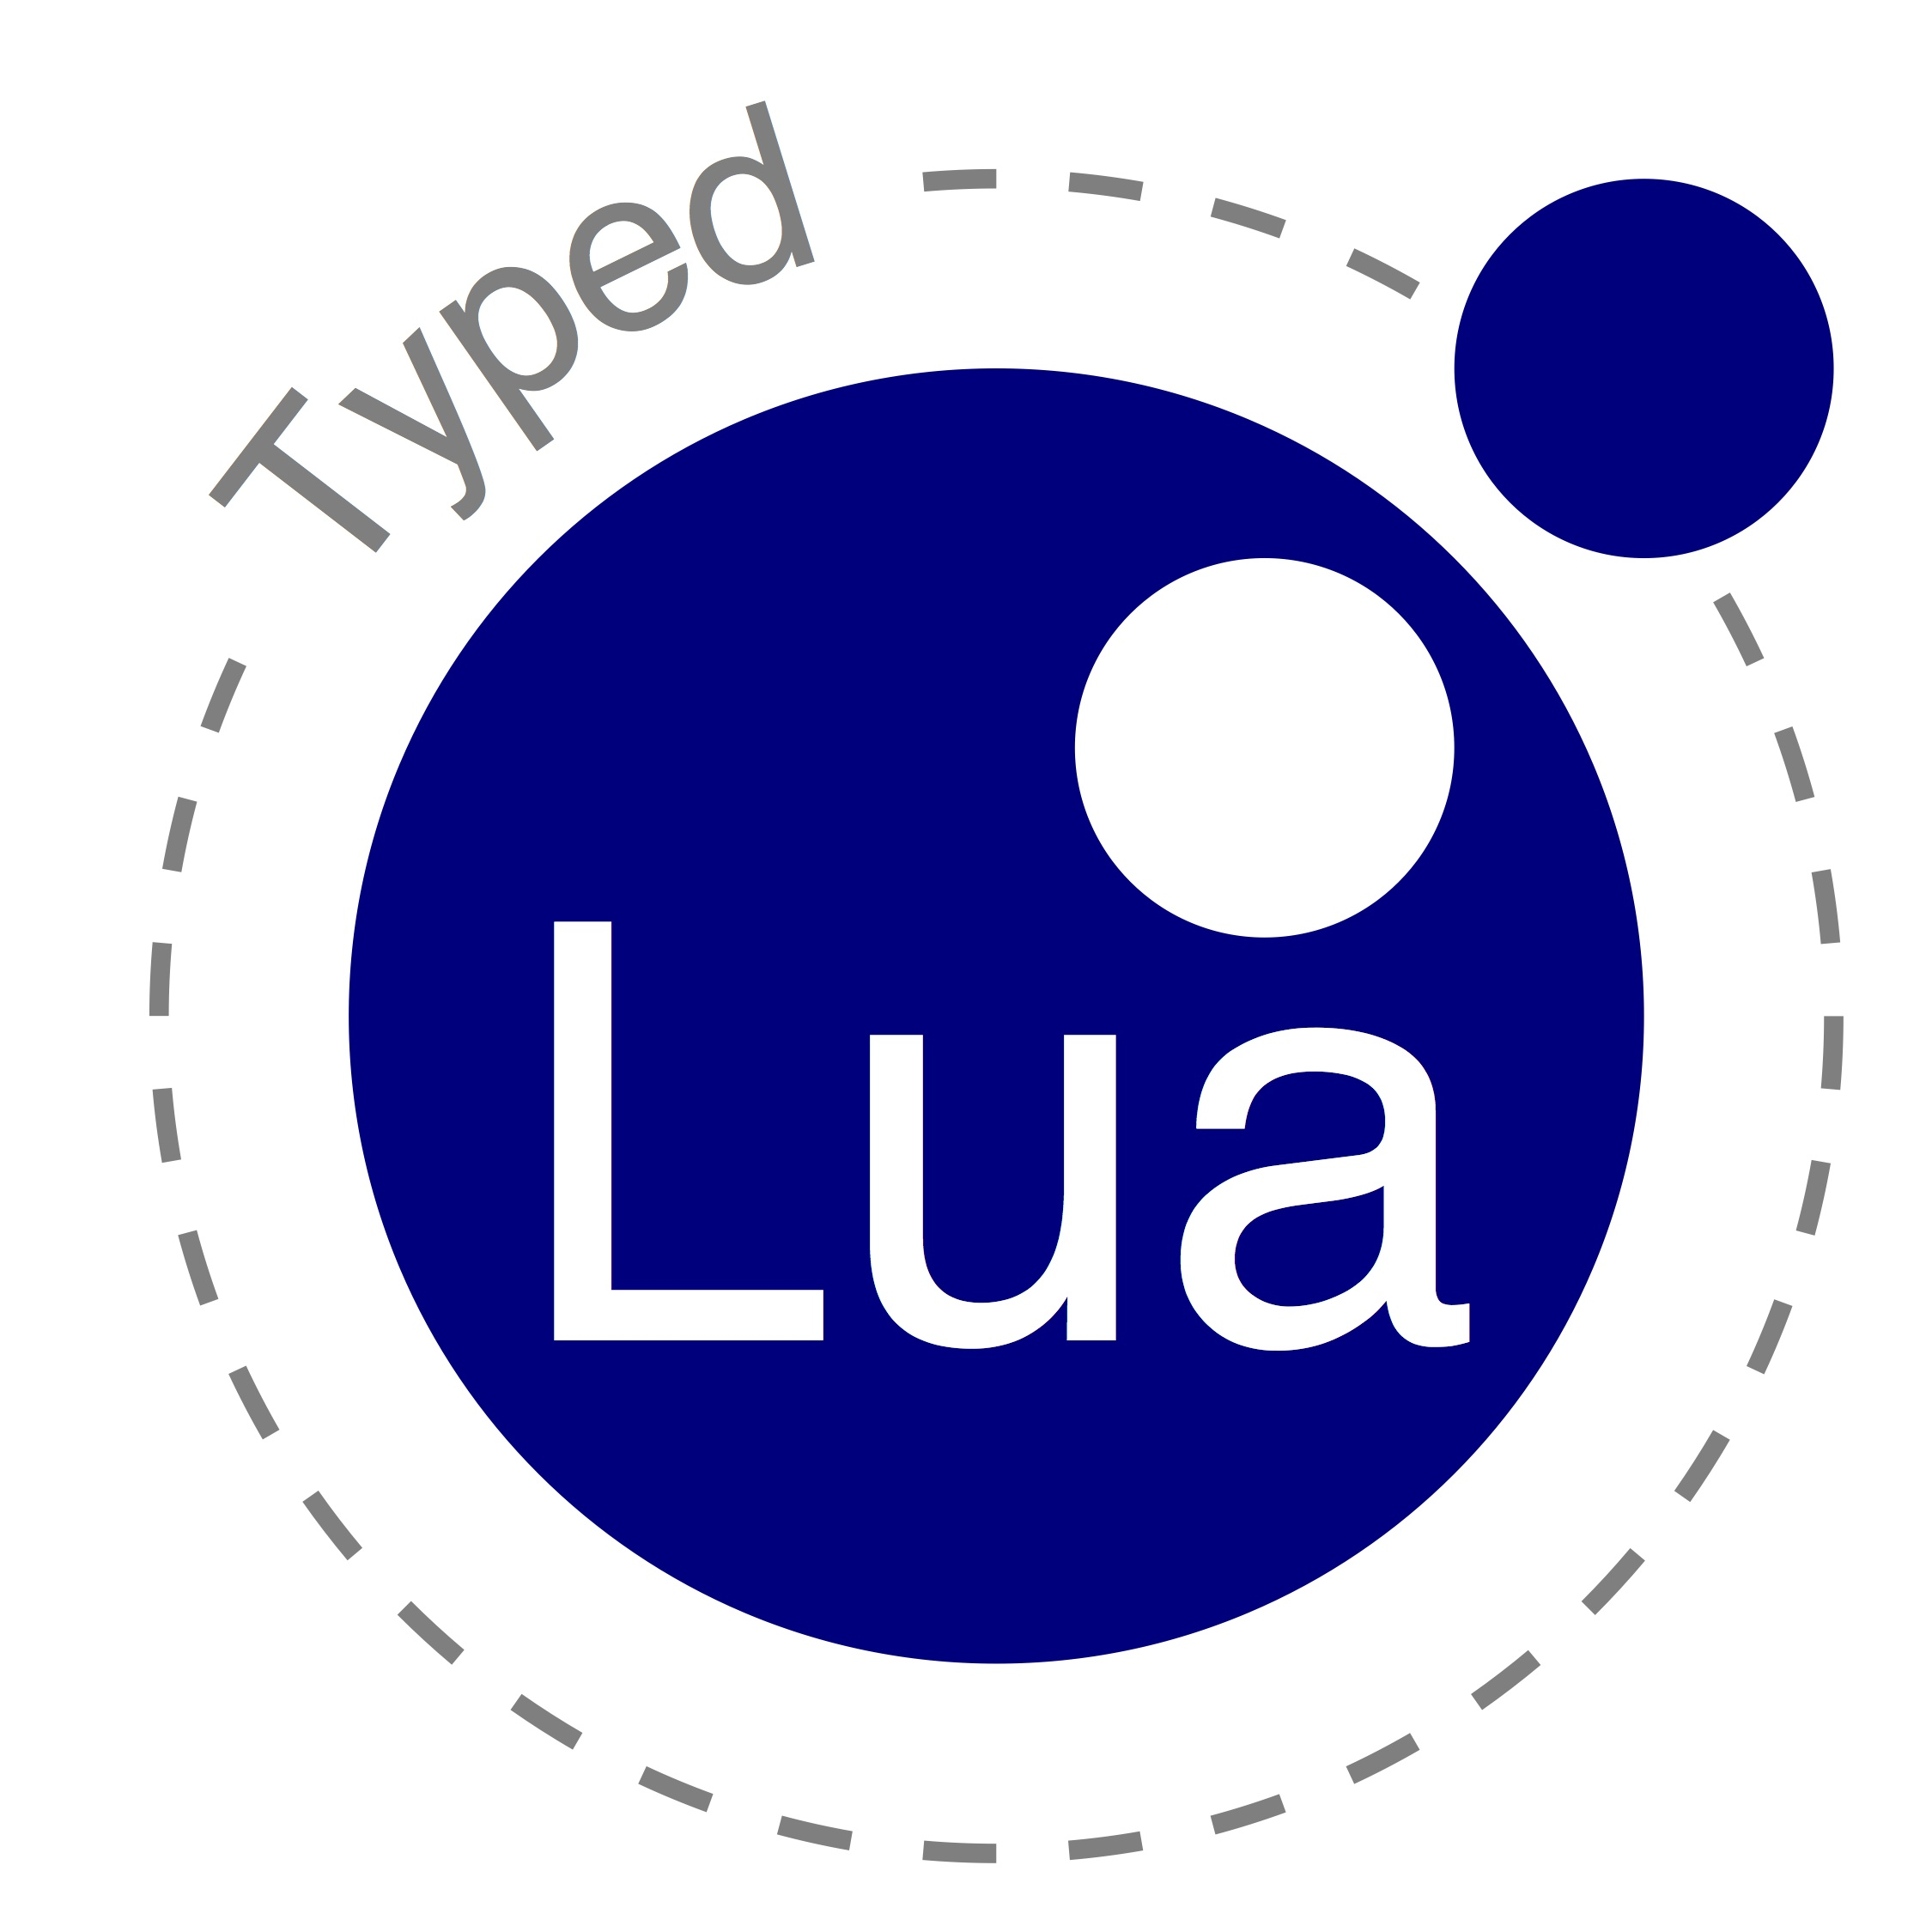


Why not combine both?

Slide 5
Optional type systems
Plug static typing into dynamically typed languages
  Optional type annotations
  Do not affect run-time semantics
Lack of formalization

Slide 6
Gradual typing
Adds a dynamic type (any) to statically typed languages
  Optional type annotations (gradual type systems)
  Consistency relation (t ~ any and any ~ t)
  Affects run-time semantics (run-time checks)
We can use it to formalize optional type systems
  Optional type systems = gradual type systems without run-time checks

Slide 7
Gradual typing and the dictionary
Gradual typing can also mean the incremental evolution of dynamically typed to statically typed code.

Slide 8
Typed Lua
An optional type system for Lua
  Allows static and dynamic typing in the same code
  Provides optional type annotations
  Uses local type inference
  Does not affect run-time semantics
  Accepts any Lua code as valid Typed Lua code
  Aims to be sound
  Preserves several Lua idioms

Slide 9
Typing Lua is challenging
Lua is a small scripting language
  First-class functions, extensive use of associative arrays, dynamic overloading, etc
The primary use of Lua is as an embedded PL
  DIY module systems
  DIY object models

Slide 10
We needed guidance on the design
We surveyed 2598 files from 262 different projects that are in the LuaRocks repository
  Table initialization, indexing, and iteration
  Function declarations
  Dynamic overloading
  Object-Oriented programming
  Module definitions

Slide 11
A simple example
1 local function abs (n:integer):integer
2 if n < 0 then
3 return -n
4 else
5 return n
6 end
7 end
8
9 local function dist (x, y)
10 return abs(x – y)
11 end

Slide 12
A simple example
1 local function abs (n:integer):integer
2 if n < 0 then
3 return -n
4 else
5 return n
6 end
7 end
8
9 local function dist (x:any, y:any):integer
10 return abs(x – y)
11 end
any – any : any ~ integer

Slide 13
Optional type annotations
type ← primarytype ['?']
primarytype ← literaltype | basetype
| nil | value | any | self | Name
| primarytype '|' primarytype
| functiontype
| tabletype
literaltype ← false | true | Int | Float | String
basetype ← boolean | integer | number | string
functiontype ← tupletype '->' rettype
tupletype ← '(' [typelist] ')'
typelist ← type { ',' type } ['*']
rettype ← type | uniontuple ['?']
uniontuple ← tupletype | uniontuple '|' uniontuple
tabletype ← '{' [tabletypebody] '}'
tabletypebody ← [keytype ':'] type | recordtype
keytype ← basetype | value
recordtype ← recordfield { ',' recordfield } [',' type]
recordfield ← [const] literaltype ':' type

Slide 14
Optional parameters
1 local function message (name:string,
2 greeting:string?)
3
4 -- greeting : string | nil
5 greeting = greeting or “Hello”
6
7 -- greeting : string
8 return greeting .. name
9 end
t | nil or t : t

Slide 15
Union types on input parameters
1 local function overload (s1:string,
2 s2:string|integer)
3 if type(s2) == “string” then
4 return s1 .. s2
5 else
6 return string.rep(s1, s2)
7 end
8 end
string.rep :(string, integer, string?) -> (string)
string.rep :(string, integer, string?, value*) ->
(string, nil*)

Slide 16
Union types on the return type
1 local q, r = idiv(a, b)
2 if q then
3 print(a == b * q + r)
4 else
5 print(“ERROR: “ .. r)
6 end
idiv:(integer, integer) ->
(integer, integer) | (nil, string)
x :(integer, integer)
|(nil, string)
q : π(x,1) ≈ integer | nil
r : π(x,2) ≈ integer | string
x :(integer, integer)
q : π(x,1) ≈ integer
r : π(x,2) ≈ integer
x :(nil, string)
q : π(x,1) ≈ nil
r : π(x,2) ≈ string

Slide 17
Table types as records
1 local person:{“firstname”:string,
2 “lastname”:string } =
3 { firstname = “Lou”,
4 lastname = “Reed” }
local interface Person
firstname:string
lastname:string
end
{ “firstname”:string, “lastname”:string }

Slide 18
Table types and interfaces
1 local interface Person
2 firstname:string
3 lastname:string
4 end
5
6 local function byebye (person:Person)
7 return "Goodbye " .. person.firstname ..
8 " " .. person.lastname
9 end
10
11 local user1 = { firstname = "Lou" }
12
13 local user2 = { lastname = "Reed",
14 firstname = "Lou" }
15
16 print(byebye(user1)) -- compile-time warning
17 print(byebye(user2)) -- Goodbye, Lou Reed

Slide 19
Recursive types
1 local interface Element
2 info:integer
3 next:Element?
4 end
5
6 local function insert (e:Element?,
7 v:integer):Element
8 return { info = v, next = e }
9 end

Slide 20
Refinement of table types
1 local person = {}
2 person.firstname = “Lou”
3 person.lastname = “Reed”
1 local person = {}
2 person.firstname = “Lou”
3 person.lastname = “Reed”
1 local person = {}
2 person.firstname = “Lou”
3 person.lastname = “Reed”
1 local person = {}
2 person.firstname = “Lou”
3 person.lastname = “Reed”
person : {}
person : { “firstname” : string }
person : { “firstname” : string,
“lastname” : string }

Slide 21
Refinement of table types
1 local person = {}
2 local bogus = person
3 person.firstname = “Lou”
4 person.lastname = “Reed”
5 bogus.firstname = true
person : {}
bogus : {}
person : { “firstname” : string }
person : { “firstname” : string,
“lastname” : string }
bogus : {}

Slide 22
Modules
1 local mymath = {}
2
3 local RADIANS_PER_DEGREE = 3.14 / 180.0
4
5 mymath.deg = function (x:number)
6 return x / RADIANS_PER_DEGREE
7 end
8
9 mymath.rad = function (x:number)
10 return x * RADIANS_PER_DEGREE
11 end
12
13 mymath.pow = function (x:number, y:number)
14 return x ^ y
15 end
16
17 return mymath

Slide 23
Modules
1 local m = require “mymath”
2 print(m.pow(2, 3)) -- 8
3 print(m.pow(2, “foo”)) -- compile-time warning
m : {
“deg” : (number) -> (number),
“rad” : (number) -> (number),
“pow” : (number, number) -> (number)
}

Slide 24
Object-Oriented Programming
1 local Shape = { x = 0.0, y = 0.0 }
2
3 const function Shape:new (x:number,
4 y:number):self
5 local s = setmetatable({},
6 { __index = self })
7 s.x = x
8 s.y = y
9 return s
10 end
11
12 const function Shape:move (dx:number,
13 dy:number)
14 self.x = self.x + dx
15 self.y = self.y + dy
16 end
17
18 return Shape

Slide 25
Object-Oriented Programming
interface Shape
x, y:number
const new:(self, number, number) -> (self)
const move:(self, number, number) -> ()
end
1 local Shape = require “shape”
2 local shape1 = Shape:new(0, 5)
3 local shape2:Shape = Shape:new(10, 10)

Slide 26
Description files
1 userdata md5_context
2 __tostring : (self) -> (string)
3 clone : (self) -> (self)
4 digest : (self, value) -> (string)
5 new : () -> (self)
6 reset : (self) -> (self)
7 update : (self, string*) -> (self)
8 version : string
9 end
10
11 __tostring : (md5_context) -> (string)
12 clone : (md5_context) -> (md5_context)
13 digest : (md5_context|string, value) -> (string)
14 new : () -> (md5_context)
15 reset : (md5_context) -> (md5_context)
16 update : (md5_context, string*) -> (md5_context)
17 version : string

Slide 27
Description files
1 local m = require "md5"
2 local x = m.new()
3 local y = x:clone()
4 local z = m.clone("foo") -- compile-time warning
5 print(x:digest() == m.digest(x))

Slide 28
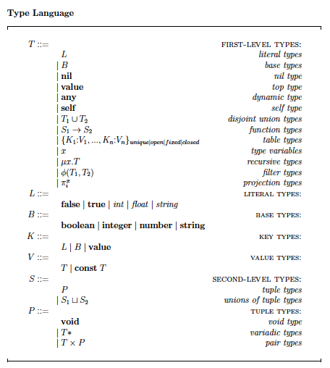
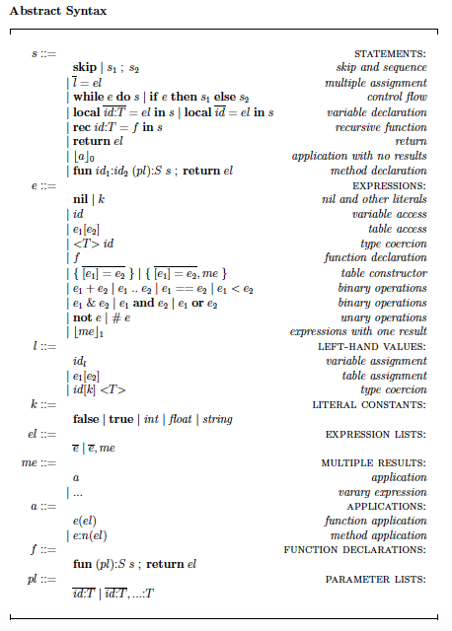
Type System

Slide 29
Evaluation

Slide 30
Lua Standard Library

Slide 31
Conclusions
Novel type system features
  type refinement, projections, and variadic types
Usability
  We could type 83% of 449 members from 29 modules
Limitations and future work
  intersection types, parametric polymorphism, and operator overloading
  soundness proof

Slide 32
Thank you!

