Slide 1
To type or not to type Lua
Lua Workshop 2017
Andre Murbach Maidl

Slide 2

Typed Lua

Slide 3
Optional type annotations
1 local function greet (greeting:string?)
2
3
4 greeting = greeting or "Hello"
5
6
7 return greeting .. " Lua Workshop 2017!"
8 end
9
10 print(greet("Good Afternoon")) -- ok
11 print(greet()) -- ok
12 print(greet({})) -- not ok

Slide 4
Local type inference
1 local function greet (greeting:string?):
2 string
3 -- greeting: string | nil
4 greeting = greeting or "Hello"
5
6 -- greeting: string
7 return greeting .. " Lua Workshop 2017!"
8 end
9
10 print(greet("Good Afternoon")) -- ok
11 print(greet()) -- ok
12 print(greet({})) -- not ok

Slide 5
Generated code
1 local function greet (greeting)
2 greeting = greeting or "Hello"
3 return greeting .. " Lua Workshop 2017!"
4 end
5 print(greet("Good Afternoon"))
6 print(greet())

Slide 6
Limitations on forward declarations
1 local is_even, is_odd
2 function is_even (n: integer):boolean -- err
3 if (n == 0) then
4 return true
5 else
6 return is_odd(n – 1) -- err
7 end
8 end
9 function is_odd (n: integer):boolean
10 if (n == 0) then
11 return false
12 else
13 return is_even(n - 1)
14 end
15 end
16 print(is_even(8))
17 print(is_odd(8))

Slide 7
Lua-like overloading
1 local function get_upload_server (
2 server: string | { "upload_server":string? }):
3 (string, string) | (nil, string)
4 if type(server) == "string" then
5 return server, "specific"
6 else
7 local server = server.upload_server
8 if server then
9 return server, "default"
10 else
11 return nil, "no upload server set"
12 end
13 end
14 end
15
16 local server, mod_or_err = get_upload_server({})
17 if not server then
18 print("ERROR: " .. mod_or_err)
19 else
20 print("using " .. mod_or_err .. " server " .. server)
21 end

Slide 8
Table is the only data structure
1 local array:{string} =
2 { "typedlua", "at", "lua", "workshop" }
3
4 local map:{string:integer} =
5 { moscow = 2014, san_francisco = 2017 }
6
7 local record:{"d":integer, "m":integer,
8 "y":integer} = { d = 10, m = 6, y = 2021 }
9
10 local record_with_array:{"z":integer,
11 string} =
12 { z = 2049, "K", "Joe" }
13
14 local va:string? = array[2]
15 local vm:integer? = map.san_francisco
16 local vr:integer = record.y

Slide 9
Nilable values (recalling Hugo’s talk)
1 function sum_list (xs:{integer}):integer
2 local sum = 0
3 for i = 1, #xs do
4 sum = sum + xs[i] --> integer | nil
5 end
6 return sum
7 end
8
9 print(sum_list({[1] = 1,[2] = 2,[4] = 3}))

Slide 10
Records and refinement of tables
1 local typealias Color =
2 { "r": number, "g": number, "b": number }
3
4 local typealias Circle =
5 { "x": number, "y": number,
6 "radius": number, "color": Color }
7
8 local gray:Color =
9 { r = 128, g = 128, b = 128, a = 255 }
10
11 local circle = {}
12 circle.x = 10
13 circle.y = 20
14 circle.radius = 5
15 circle.color = gray
16
17 -- circle has type Circle

Slide 11
Famous idiom, but polemic feature
1 local typealias T = {"i":integer, "s":string,
2 "f":(integer) -> (integer)}
3
4 local function get_s (t:T):string
5 t.y = 20.0 -- not ok
6 return t.s
7 end
8
9 local open = { i = 1 }
10 open.s = "foo"
11 open.f = function (x:integer):integer return x + 1 end
12 -- open: T
13
14 local closed1 = open -- closed1: T
15 closed1.x = 10.0 -- not ok
16 open.x = 10.0 -- ok
17 closed1.s = closed1.s:reverse()
18
19 print(string.format("%q", get_s(open))) -- prints "oof"
20
21 local closed2:T = open
22 closed2.y = 20.0 -- not ok
23 open.y = 20.0 -- ok

Slide 12
Defining modules
1 local mymath = {}
2
3 local RADIANS_PER_DEGREE = 3.14 / 180.0
4
5 function mymath.deg (r:number):number
6 return r / RADIANS_PER_DEGREE
7 end
8
9 function mymath.rad (d:number):number
10 return d * RADIANS_PER_DEGREE
11 end
12
13 mymath.pow = function (x:number,
14 y:number):number
15 return x ^ y
16 end
17
18 return mymath

Slide 13
Using modules
1 local mymath = require "mymath"
2 --[[
3 mymath:{
4 "deg":(number) -> (number),
5 "rad":(number) -> (number),
6 "pow":(number, number) -> (number)
7 }
8 ]]
9
10 print(mymath.deg(1)) -- 57.324840764331
11 print(mymath.rad(1)) -- 0.0174444444444
12 print(mymath.pow(2, "foo"))-- error

Slide 14
Typing external modules
1 draw : () -> ()
2 update : (number) -> ()
3
4 event : { "quit" : () -> () }
5
6 graphics : {
7 "circle" : (string, number, number, number) -> (),
8 "setColor" : (number, number, number, number?) -> (),
9 }
10
11 keyboard : { "isDown" : (string) -> (boolean) }
12
13 typealias flags = { "fullscreen":boolean,
14 "fullscreentype":string, "vsync":boolean,
15 "msaa":number, "resizeable":boolean,
16 "borderless":boolean, "centered":boolean,
17 "display":number, "minwidth":number,
18 "minheight":number, "highdpi":boolean,
19 "refreshrate":number, "x":number, "y":number }
20
21 window : { "getMode": () -> (number, number, flags),
22 "setTitle": (string) -> (),
23 }

Slide 15
Using external modules
1 local love = require "love"
2
3 typealias Color = {"r":number, "g":number, "b":number}
4 typealias Circle = {"x":number, "y":number,
5 "radius":number, "color":Color}
6
7 love.window.setTitle("Gray Moon")
8 local width, height = love.window.getMode()
9 local gray:Color = { r = 128, g = 128, b = 128 }
10 local circle:Circle = { x = width / 2, y = height / 2,
11 radius = 10, color = gray, }
12 function love.update (dt:number)
13 if love.keyboard.isDown("escape") then
14 love.event.quit()
15 end
16 end
17 function love.draw ()
18 love.graphics.setColor(circle.color.r,
19 circle.color.g, circle.color.b)
20 love.graphics.circle("fill", circle.x, circle.y,
21 circle.radius)
22 end

Slide 16
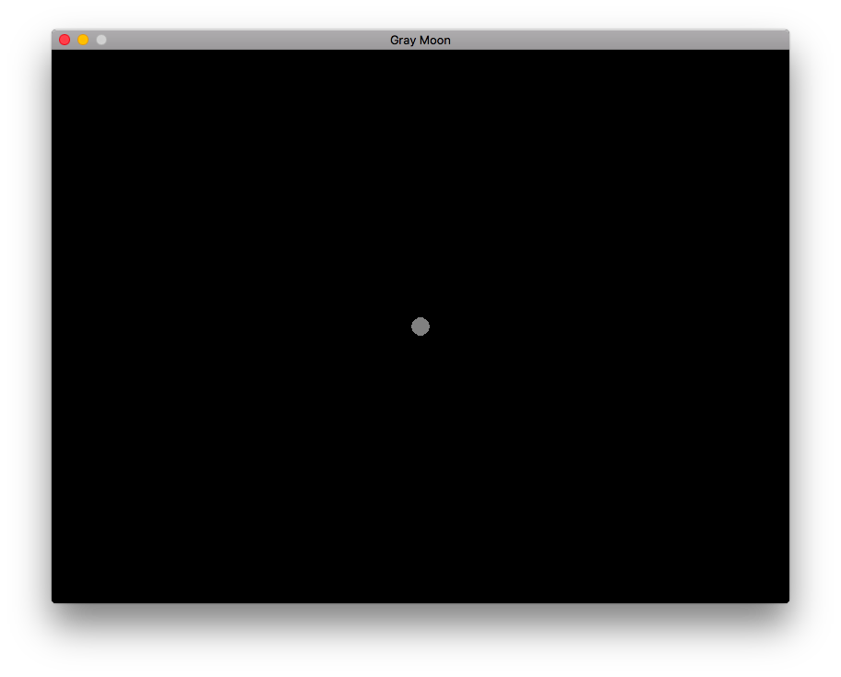

Slide 17
OO Support
1 class Circle
2 x: number
3 y: number
4 radius: number
5
6 constructor new (x:number, y:number, radius:number)
7 self.x = x
8 self.y = y
9 self.radius = radius
10 end
11
12 method move (x:number, y:number)
13 self.x = self.x + x
14 self.y = self.y + y
15 end
16
17 method getPosition ():(number, number)
18 return self.x, self.y
19 end
20 end

Slide 18
Using objects
1 require("circle")
2
3 local c1 = class(circle.Circle).new(10, 20, 5)
4 c1:move(50, 50)
5 print(c1:getPosition()) -- 60 70
6
7 local c2 = class(circle.Circle).new(100, 200, 10)
8 print(c2.radius) -- 10
9 c2.radius = 5
10 print(c2.radius) -- 5

Slide 19
Inheritance
21 class Color
22 r: number
23 g: number
24 b: number
25
26 constructor new (r: number, g: number, b:number)
27 self.r = r
28 self.g = g
29 self.b = b
30 end
31 end
32 class ColoredCircle extends Circle
33 color: Color
34
35 constructor new (x: number, y: number,
36 radius: number, color: Color)
37 super.new(x, y, radius)
38 self.color = color
39 end
40 method getColor ():(Color)
41 return self.color
42 end
43 end

Slide 20
Using inherited objects
1 require("circle")
2
3 local gray = class(circle.Color).new(128, 128, 128)
4 local cb = class(circle.ColoredCircle).new(10, 20, 5,
5 gray)
6
7 local c = cb:getColor()
8 print(cb.color.r, cb.color.g, cb.color.b)-- 128 128 128
9 c.r = 255
10 print(cb.color.r, cb.color.g, cb.color.b)-- 255 128 128
11
12 function cb:move (x:number, y:number)
13 print("exit")
14 os.exit(1)
15 end
16
17 cb:move(50, 50) -- exits here
18 os.exit(0)

Slide 21
Interfaces
1 local love = require "love"
2
3 interface Drawable
4 method draw: () => ()
5 end
6
...
38 class ColoredCircle extends Circle implements Drawable
...
49 method draw ()
50 love.graphics.setColor(self.color.r,
51 self.color.g, self.color.b)
52 love.graphics.circle("fill", self.x, self.y,
53 self.radius)
54 end
55 end

Slide 22
Back to the löve example
1 local love = require "love"
2 require "lua_logo.circle"
3
4 love.window.setTitle("Lua logo")
5 local width, height = love.window.getMode()
6
7 local blue = class(lua_logo.circle.Color).new(0, 0, 128)
8 local white = class(lua_logo.circle.Color).new(255, 255, 255)
9 local earth = class(lua_logo.circle.ColoredCircle).new(width / 2,
10 height / 2, 200, blue)
11 local hole = class(lua_logo.circle.ColoredCircle).new(width / 2 + 90,
12 height / 2 - 90, 60, white)
13 local moon = class(lua_logo.circle.ColoredCircle).new(width – 200,
14 90, 60, blue)
15
16 function love.update (dt:number)
17 if love.keyboard.isDown("escape") then
18 love.event.quit()
19 end
20 end
21
22 function love.draw ()
23 earth:draw()
24 hole:draw()
25 moon:draw()
26 end

Slide 23
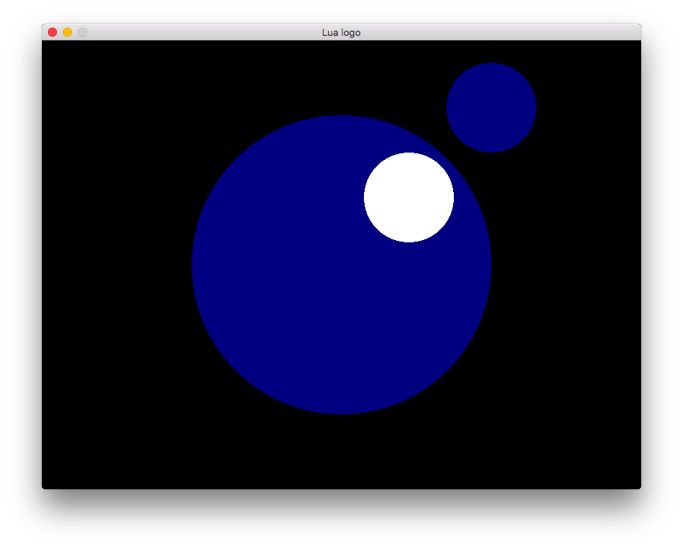

Slide 24
Nominal x Structural
1 class Nominal1
2 x: boolean
3 constructor new (x:boolean) self.x = x end
4 end
5 typedef Structural1 = { "x": boolean }
6
7 class Nominal2
8 x: boolean
9 constructor new (x:boolean) self.x = x end
10 end
11 typedef Structural2 = { "x": boolean }
12
13 local function get_x_n (n:Nominal2):boolean
14 return n.x
15 end
16 local function get_x_s (s:Structural2):boolean
17 return s.x
18 end
19
20 print(get_x_n(Nominal1.new(false))) -- not ok
21 print(get_x_s({ x = true })) -- ok

Slide 25
Generics
1 class Stack<T>
2 contents: {T}
3 constructor new ()
4 self.contents = {}
5 end
6 method push (x:T)
7 self.contents[#self.contents + 1] = x
8 end
9 method pop ():T?
10 local top = self.contents[#self.contents]
11 self.contents[#self.contents] = nil
12 return top
13 end
14 end
15 local stack1 = Stack.new<string>()
16 local stack2 = Stack.new<integer>()
17 stack1:push("Goodbye Lua Workshop")
18 stack2:push(2017)
19 print(tostring(stack1:pop())
20 .. " " ..
21 tostring(stack2:pop()))

Slide 26
IDE Support
Language Server Protocol
  A JSON-RPC API for integrating IDE features.
Typed Lua language server
  Implements the API with Typed Lua type checker.
  Adds error recovery to Typed Lua.
  Improves AST handling through Visitor Patterns.
Enabled features
  Find all references, renaming variables, goto definition, code completion, linting, etc.

Slide 27
Academic feeling
Typed Lua
  PhD Thesis
  https://github.com/andremm/typedlua
Typed Lua + OO Support
  GSoC 2016
  https://github.com/kevinclancy/typedlua
Typed Lua + IDE Support
  GSoC 2017
  https://gitlab.com/martanne/typedlua/tree/visitor

Slide 28


Lua community wants fast code
Typing Lua semantics is challenging.
  Coroutines, operator overloading, etc.
Typed Lua was not designed for optimizations.
  It is optionally typed instead of statically typed.
Titan goes for it and Typed Lua goes together.
  Not all Typed Lua, but the experiences we had.

Slide 29
Thank you!
Questions?
For more information:
  http://www.typedlua.org
  andremm@gmail.com

